Slide 1


Collecting Data
Jan Jansen, Chief Investigator
Claire Cochran, Senior Trial Manager
Health Services Research Unit, University of Aberdeen

Slide 2
Sources of Data

Slide 3
Trauma Team Leader
Research Nurses
Trauma Audit & Research Network

Slide 4
Trauma Team Leader
Research Nurses
Trauma Audit & Research Network

Slide 5
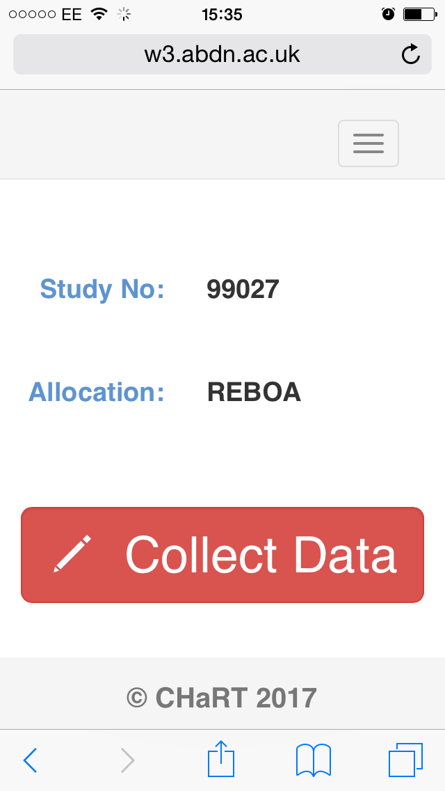

Slide 6
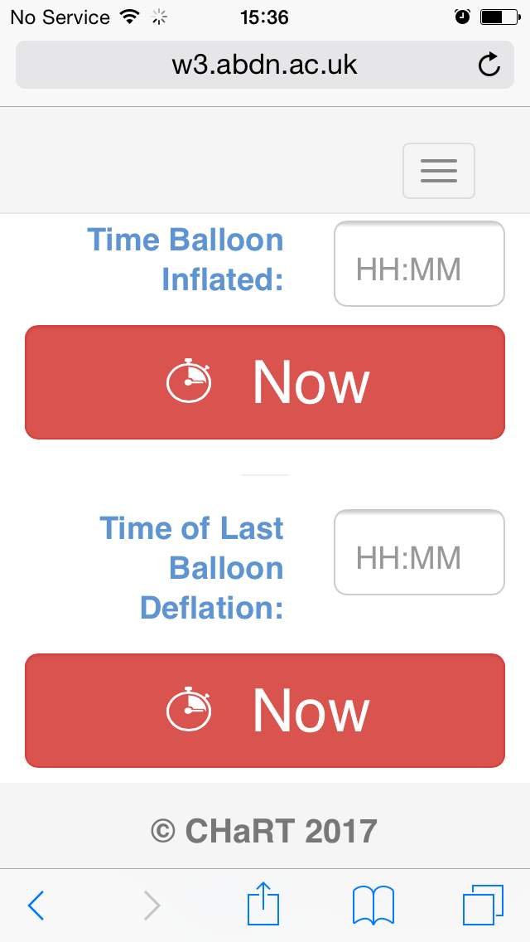

Slide 7
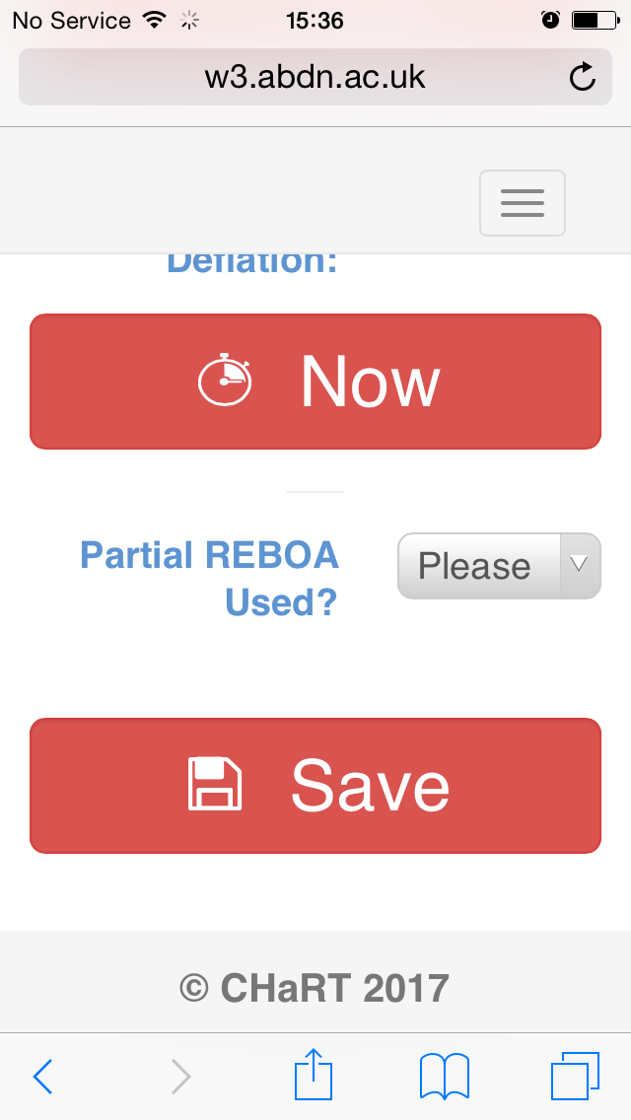

Slide 8
That’s it.

Slide 9
Cross-overs

Slide 10
Randomised to REBOA, but did not receive

Slide 12
Randomised to standard care, but received REBOA

Slide 13
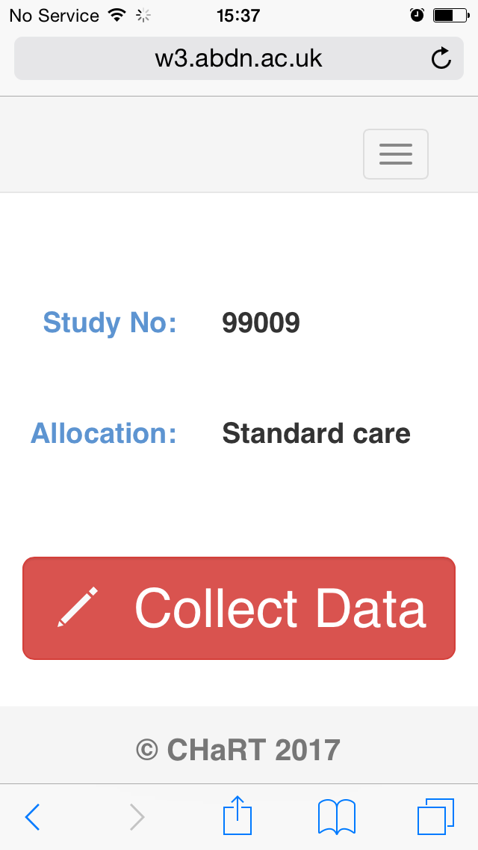

Slide 17
Trauma Team Leader
Research Nurses
Trauma Audit & Research Network

Slide 18

POA
REBOA Data
Study CRF
TARN
6 Months

Slide 19
TARN data
Collected as standard in the standard way
TARN Personnel just need to do their job!
Examples of what we are linking to:
  Injury details (inc mode, mechanism timings)
  Length of hospital stay
  Mortality
  PROMS (EQ5D 5L & GoS in hospital & @6mo post injury)

Slide 20

RN / CF Data Collection
REBOA
Data
Baseline
Baseline REBOA CRF
Complications / A/E’s
Adverse Events/ Complications CRF
SADE/ Death
SADE/ Death CRF
Change of Status
Change of Status Form

Slide 21

Examples of Baseline Data
(collected in Trauma, entered ASAP after)
  Personal details
  REBOA procedure details
      Access method
      Balloon Inflation/ deflation time
      Use of intermittent/ partial REBOA
  Organ support in first 24 hours
  Lab tests for first 24 hours
  Operations for entire hospital stay
  Physiology for first 24 hours

Slide 22
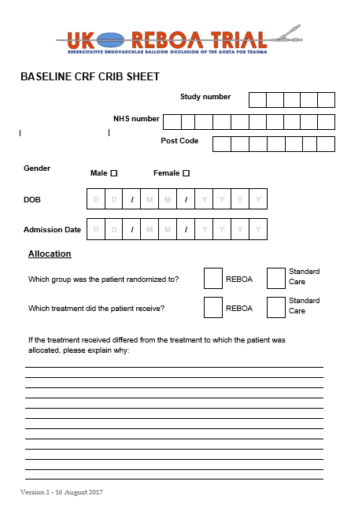

Slide 23
Follow Up Data Collection –
Concerned with AE /Complications
Captured on Adverse event /Complications CRF
Due to the nature of this study in this particular patient population Death & some Expected Complications/Adverse Events are listed in the protocol as outcomes because they are expected
This saves excessive over reporting of ‘serious events;
Examples:
  AE/ Complications that maybe related to standard treatment
  Adverse events that maybe expected as a result of using REBOA (ADE’s)

Slide 24
Serious Adverse Device Events
In REBOA, the only SAE’s are related to use of the REBOA device
Adverse device event that has resulted in any of the consequences characteristic of a serious adverse event
By default these SADE’s will only occur in patients who have received REBOA
SADE form doubles as a Death Report form!

Slide 25
In Summary
From intervention to Discharge
When?
What?
Where?
Adverse Event/ Complication
Pre-specified in protocol
Complications/ Adverse Events CRF
Death
Death/SADE Report Form
SADE
Death/SADE Report Form
Notes:
1- Where report non-specified non-serious AE?
2- As you said we can include some animations with the print screen from the website
3- Check with Marion/Jan if the period is correct

Slide 26
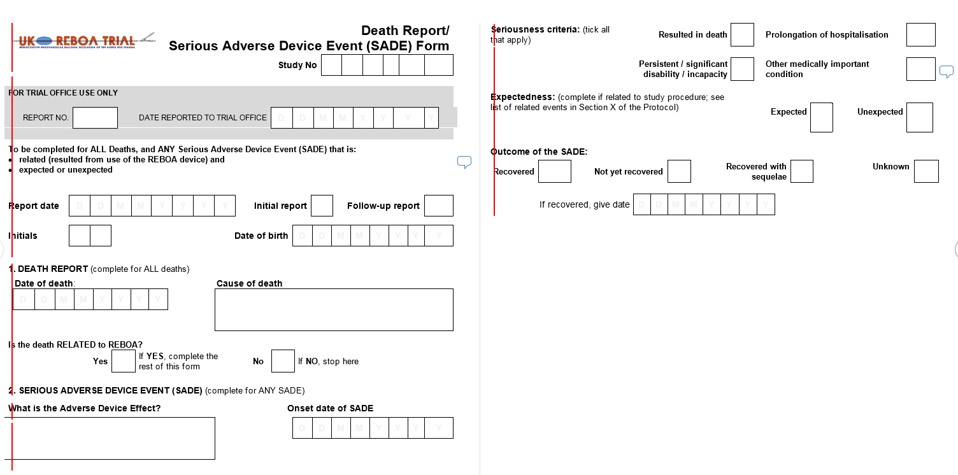

Slide 27
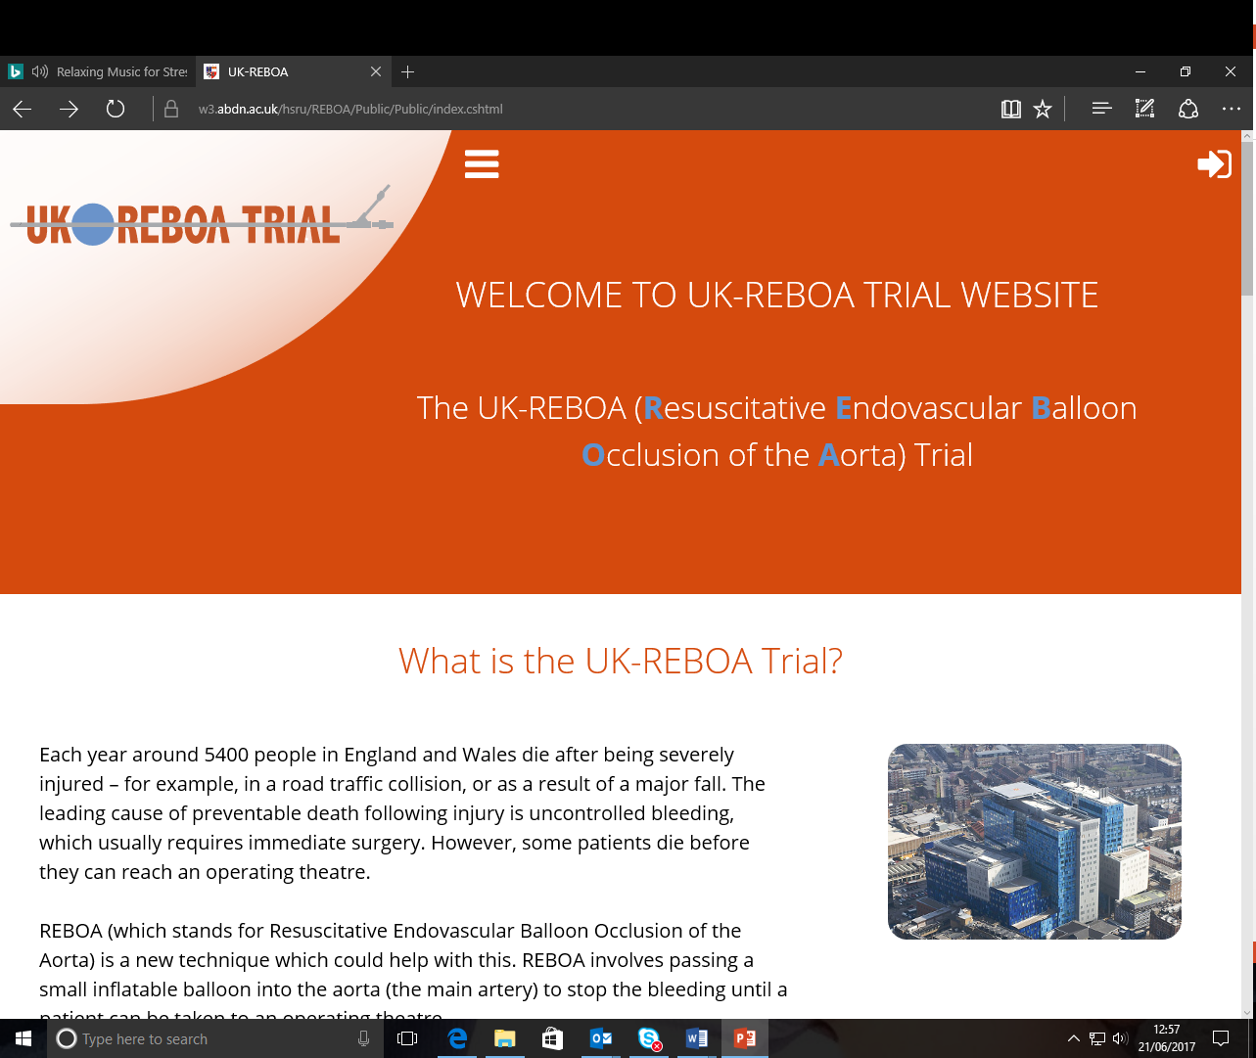
https://w3.abdn.ac.uk/hsru/REBOA/Public/Public/index.cshtml

Slide 28
Need help?
Phone us.

