Slide 1
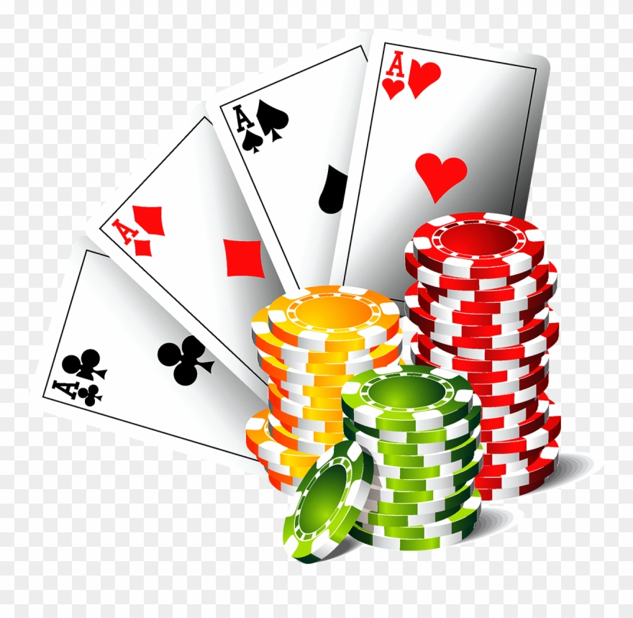
Dealer calls

Slide 2
Alerts and Approvals
Alerts and Approvals Dealers are required to inform and/or receive approval from the Floor Supervisor prior to engaging in various transactions.
An alert is when the Dealer announces a transaction prior to proceeding in a fashion that the Floor Person can hear it. A response is not required to proceed.
2. An approval is when the Dealer announces a transaction in a fashion the Floor Person can hear it and must receive a verbal approval prior to proceeding. Dealers are not permitted to turn their heads away from the table while performing this duty.

Slide 3
Alerts
 | Approvals:
 |  |  | all approvals should be prefaced with floor. Example: Floor color coming in
 | Color Coming In ($100 or more) Currency Change ($100 or more) Check Change ($100 or more)
 | card down
 | chip down
 | chip rolls in rack
 | paying black in purple when black or purple is not being played
 | black or purple action when they hadn't been playing that color the previous hand

Slide 4
Approval Examples
Floor Color Coming in
Shuffle check or rolling on pitch
Floor coloring up 200
Floor check or card down
Floor Check change coming in
Floor cheque change 100
Floor purple or black in action
Floor changing 100
Floor 4 black or purple going out

Slide 5
Alerts-must be yelled loudly for the floor to hear but no response is needed to proceed.
Cheque change coming in
Dealer cut
Cheque change 75
Coloring up dealer tokes
Color coming in
Shuffle or rolling, not pitch games
Coloring up 75
Double down face down
Splitting tens
Doubling down for less
Cheques play
Doubling down on a breaking hand
Changing $20

Slide 6
The End

