Slide 1

Planning a Smart Infrastructure for Intelligent Buildings
Carol Everett Oliver, RCDD, ESS, Siemon

Slide 2

Agenda
Elements of Infrastructure
Standards & Resources
Design Considerations
Remote Powering & Effects on Cabling
Different Cabling Layouts

Slide 3

Planning for Intelligent Buildings
Design 10-15 years out
  Allow for additional systems and cabling
  Plan for future builds
  Accommodate future applications
3
Notes:
Carol: Transition to space considerations:
You will also have to determine how to plan your telecommunications spaces.
While every building is different in terms of security, planning the spaces should always follow basic guidelines and best practices:
All spaces must meet applicable code and standards requirements.
The space should be protected from unauthorized or unnecessary access or damage. In this example, the ER is located in the center of the building away from exterior walls and spaces such as mailrooms.
To the best of your ability, different systems should be segmented within a space—different walls, different racks, etc.
Finally, when you design, you want design for the room that is needed in 10-15 years.
This planning should include leaving space for new racks, cabinets, and additional cabling.
It is also good to anticipate that you may eventually outgrow even that space and locate the room near other soft spaces such as meeting and storage rooms. This allows an organization to use the space up to the point that it is needed for expansion rather than simply leaving it empty within the ER or TR.
Heather: Move to the next slide.

Slide 4



Elements of the Communications Infrastructure
Topology
Coverage
Pathways and Spaces
Outlets
Cable
4
Notes:
Carol: Discuss the elements of the communications infrastructure:
Intelligent building systems may either share the collective set of cabling system components, cabling pathways, and related telecommunications spaces with a traditional voice/data ICT network or use separate dedicated networks operating in parallel.
Regardless of their makeup, intelligent buildings are share the same basic elements:
Topology
Spaces
Cabling
Cabling Pathways
TO/SO
Coverage Areas
In the next few slides, I will cover some of these items, and others will be covered by other speakers during this workshop.
Heather: Move to the next slide.

Slide 5





Intelligent Building Standards
ISO/IEC 11801
Information Technology—Generic Cabling for Customer Premises
(Part 1, General Requirements & Part 6, Distributed Building Systems)
ANSI/TIA 862-B
Structured Cabling Infrastructure Standard for Intelligent Building Systems
ANSI/BICSI 007-2017
Information Communication Technology Design and Implementation Practices for Intelligent Buildings and Premises
5
Notes:
Carol: Discuss how the BICSI 007 standard interacts with other standards:
These are three primary standards that will help you plan and design your infrastructure:
ISO/IEC 11801, Information Technology—Generic Cabling for Customer Premises
ANSI/TIA-862, Structured Cabling Infrastructure Standard for Intelligent Building Systems
ANSI/BICSI 007, Information Communication Technology Design and Implementation Practices for Intelligent Buildings and Premises
ANSI/BICSI 007 acts as a complement to the ISO and TIA standards, and it is the focus of this workshop.
[Note: A full list of standards and documents used to create this standard can be found in Section 3]
Heather: Move to the next slide.

Slide 6
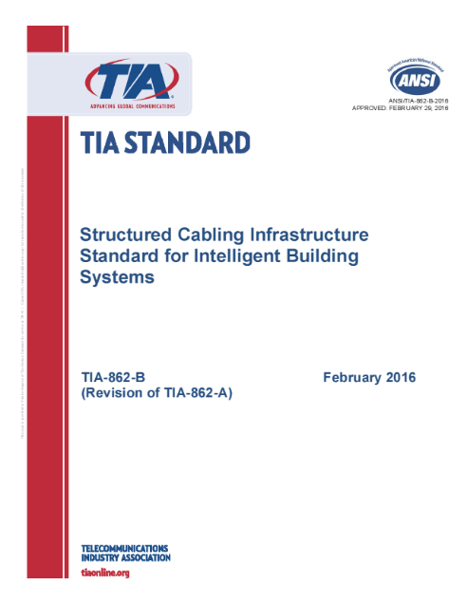
TIA-862-B-2016
Structured Cabling Infrastructure Standard for Intelligent Building Systems
  Change of title (was Building Automation Systems Cabling Standard)
General substitution of the term “intelligent building system” for the previous term “building automation system”
Addition of guidance for cabling for:
  Wireless systems
  Remote powering over balanced twisted-pair cabling
  Smart lighting

Slide 7
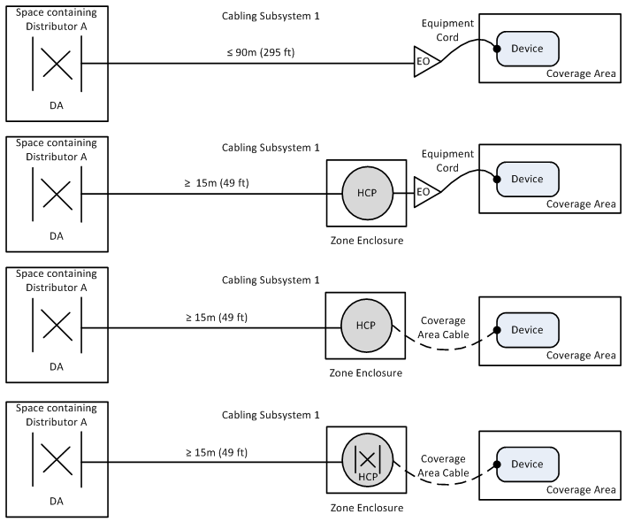
TIA-862-B Horizontal Topology
Standard
Zone Cabling
Notes:
Alternate topology options available in Annex

Slide 8
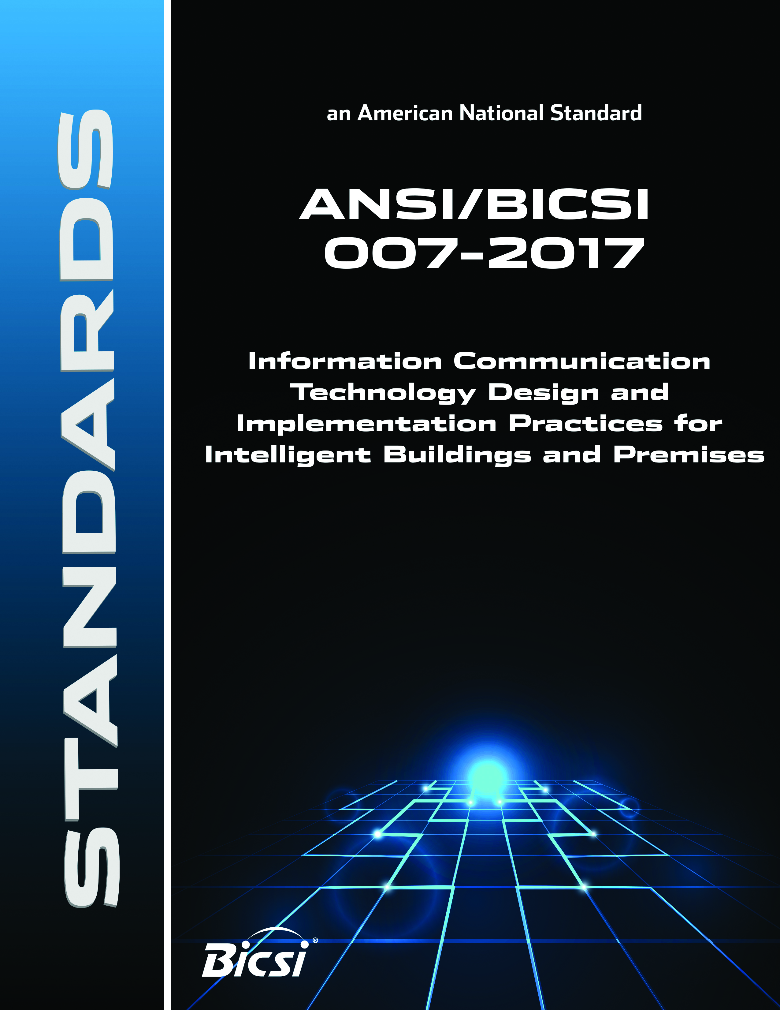
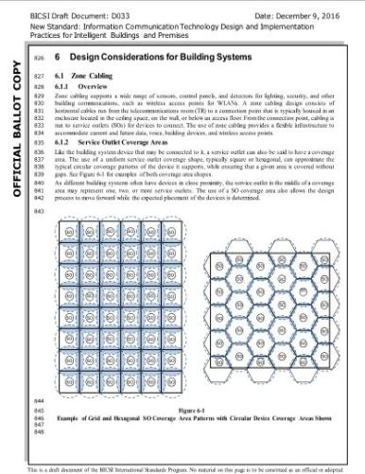
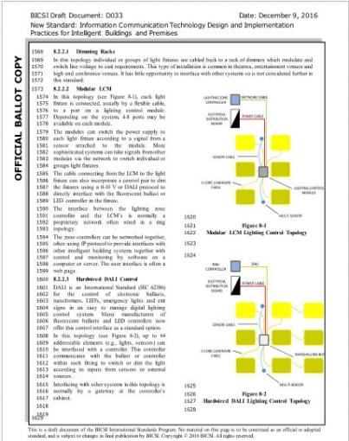
ANSI/BICSI 007-2017
Technology Design and Implementation Practices for Intelligent Buildings and Premises
Communications Infrastructure & Network Integration
Design Considerations (Power, Data, Zone Cabling)
Building Systems (Lighting, Digital Signage, Vertical Transportation, Sound Systems, ESS, etc.)
Building Monitoring Systems
Commissioning
Notes:
Intelligent Building from BICSI to help the ICT designer and installer plan and install these unique building systems
It contains layouts of unique systems such as LED lighting and even zone cabling.
Currently, these are the systems and chapters that are being addressed in the BICSI standard.
In addition sample matrixes will be provided to help the ICT professional map out which devices will interact with each other and how to integrate these into a converged network layout

Slide 9
ANSI/BICSI-007 Horizontal Cabling
Device
Device
Service Outlet
Device
Horizontal
Connection Point (HCP)
(Optional)
Device
Floor Distributor
(Horizontal Cross Connect)
Coverage Area Cable
Device
Coverage Area
Device
Device
Direct Connection Method
Non-structured Option
9
Notes:
Carol: Give a quick recap of SCS to establish what the foundation will be and to ensure that everyone is working from a common definition:
Although we won’t be teaching you how to design a conventional structured cabling system, it is important to ensure we that we define what “structured cabling” means in these standards and this workshop.
The term “structured cabling” is a term from the TIA standards. It specifies that a structured cabling channel must be terminated on both ends and that at the device termination side, the horizontal cable must be terminated into equipment outlet (or service outlet) and then connected with an equipment cord or patch cord.
This diagram also shows a non-structured option which is referred to as a direct connect method. We will be looking at this method in greater detail in a few slides.
Heather: Move to the next slide.

Slide 10
Example of a TR that Supports Multiple Systems
Wall-Mounted Systems
Wireless Device Systems
Future Racks and Systems
Specialty Systems
10
Notes:
Carol: Discuss the key features of this layout from the standard [Figure 5-4 in the standard]:
The systems are separated from one another and organized like with like.
Space is available for future growth.
Heather: Move to the next slide.

Slide 11
Example of a TR that Provides Restricted Access
Critical/Sensitive Information Systems
Restricted Access
11
Notes:
Carol: Discuss the key features of this layout from the standard [Figure 5-5 in the standard]:
Restricted area is given the same consideration as the non-critical:
They each have room for growth.
Each room has a separate electrical panel and conduit riser system.
Heather: Move to the next slide.

Slide 12
Quiz Question
What is Zone Cabling?

Slide 13
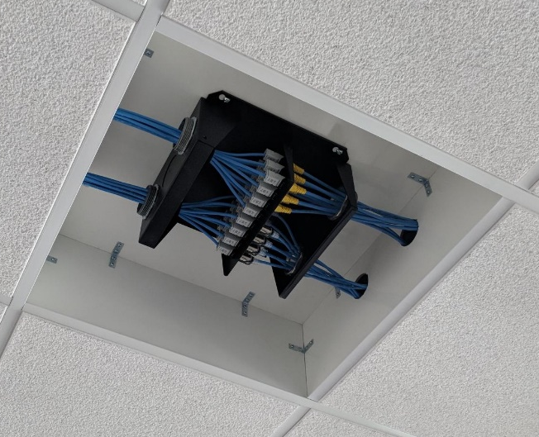
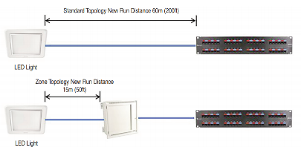
Zone Cabling Methodology
Zone cabling is a standards-based approach to support convergence of devices
  Consists of cables run from connections in the telecommunications room (TR) to outlets housed in a zone enclosure servicing coverage areas
  Shorter cables run from outlets in the zone enclosure directly to devices or to outlets servicing devices
25% spare port availability recommended for best ROI
Supports rapid reorganization and deployment of new devices and applications
  MAC work costs less, is faster and less disruptive
  Factory pre-terminated and tested trunking cables can
  be installed from the TR to the zone enclosure for quicker deployment
Notes:
Zone cabling is a highly flexible infrastructure that is ideally suited for the convergence of voice, data, wireless, and building device applications over one managed network. Furthermore, outlets serving voice/data, wireless, and building device connections can be conveniently combined within one HCP. Zone cabling solutions support rapid reorganization of work areas and equipment and simplify deployment of new devices and applications. With this type of infrastructure, moves, adds, and changes (MACs) are less costly, faster to implement, and less disruptive6 because changes are limited to the cabling segment between the EO/TO and HCP instead of the entire length of horizontal cabling.

Slide 14
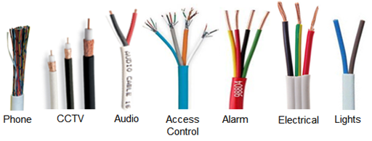

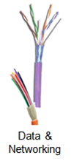
Cable Selection
Traditional Building
Employ a vast array of different protocols and cabling systems
Converged Building
Multiple building systems over a single IT cabling infrastructure (fiber and copper)
One cable type means:
  Rapid deployment
  Reduced labor costs
Notes:
Also, we will change the way we have to select different cabling for different applications. Eventually a converged building will mean that multiple building systems will be able to run over a single IT cabling infrastructure. This will mean rapid deployment and reduced labor costs.

Slide 15
Cabling for Intelligent Buildings
Copper
Fiber
Category 6_{A}/Class E_{A}
(Recommended)
Multimode (OM3, OM4, OM5)
Singlemode
15
Notes:
Carol: Discuss cabling considerations for intelligent buildings:
Selecting cable for an intelligent building will be based on several factors including: manufacturer’s requirements, signal type, distance and location, power requirements, and the how long the building will be occupied.
Depending on the requirements of your facility, you may choose to run copper or fiber, but in many cases, you will need to use a hybrid solution.
Copper: Where Category 6_{A}/Class E_{A} cabling is not the minimum performance required, Category 6_{A}/Class E_{A} or higher performing cabling is recommended. Even if it is not required, remember that you want to design for the future and that means designing for increased bandwidth requirements as well.
Fiber: OM3, OM$, and OM5 multimode fiber cable and all singlemode fiber are supported cable types for intelligent buildings.
Wireless: Wireless designs make up a significant portion of many intelligent building designs. Just remember: the wireless system has to be supported by copper and fiber cables.
Heather: Move to the next slide.

Slide 16
Recognized Copper Cable
Category 6
TIA TSB-184-A-2017
  Category 6A recommended
TIA-862-B-2016
  Category 6; category 6A recommended
ISO/IEC 11801-6 Ed1.0
  Class E_{A} or higher
BICSI 007-2017
  Category 6A/Class E_{A} or higher recommended
UTP
Shielded
Category 6A
Category 5e
Notes:
TIA TSB-162-A-2013
Category 6A

Slide 17
Quiz Question
What is an MPTL?
A: Modular Plug Terminated Link
Recognized by ANSI/TIA-568.2-D

Slide 18
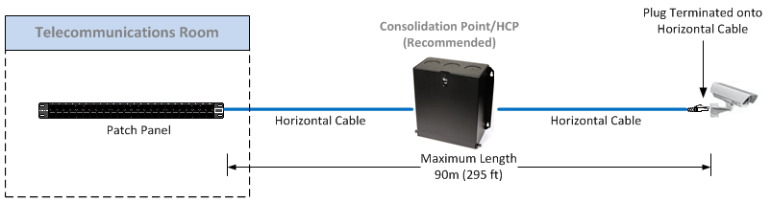
Modular Plug Terminated Link (MPTL)
Custom length, quick connections in the field for direction connection to devices
Improves performance and allows for more efficient power delivery by eliminating patch cords and outlets
Improves security for devices like surveillance cameras by eliminating exposed patch cords
Notes:
The MPTL is constructed by direct field termination of horizontal cabling at the device end with a modular plug - replacing the TO/SO and associated Work Area (WA) cord.
ANSI/TIA-568.2-D requires that horizontal cable be terminated onto a TO. In certain cases there may be a need to terminate horizontal cables directly to a plug.
ANSI/BICSI-007 recognizes the MPTL and refers to it as a direct connection method, with or without an HCP.
ANSI/TIA-862-B-2016 recognizes direct connections – should be limited to devices in fixed locations that are not expected to be replaced or required to be directly connected by the AHJ
Standard cabling environment does not always benefit or allow for the additional cost and flexibility provided by Telecommunications Outlets (TOs) or Equipment Outlets (EOs) due to many variables including device density and mounting environments. TIA has introduced in the pending TIA-568.2-D (Annex F) an alternate topology entitled the Modular Plug Terminated Link (MPTL) to address this environment.
In applications that extend outside traditional voice and data applications, there are circumstances that do not allow a jack to outlet scenario on the device end. BICSI 007 recognize these circumstances and allow for the horizontal cable to directly connect to a device. This method creates a modified permanent link.
The direct connect method can be used in the following scenarios:
In plenum spaces where an outlet or path cord are not rated plenum
When there is no room for a workstation outlet or patch cord
Where it is not safe or secure for an exposed outlet or patch cord
When the customer deems it is not aesthetically with the design of the facility
When the building system cable is enclosed in conduit and is directly attached to the building system equipment

Slide 19
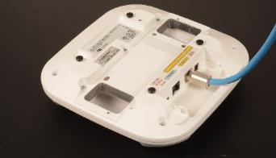
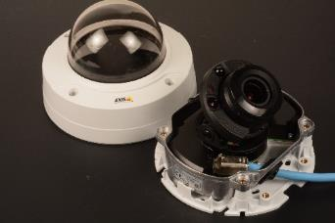
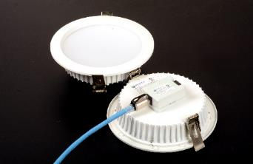
What are the market drivers?
IoT and Intelligent Buildings are driving the proliferation of IP-based and PoE-based devices in the walls and ceilings of modern buildings
LED lights, security cameras, wireless access points, digital displays, distributed antenna systems (DAS), building automation control devices and more can be directly connected using plug-terminated links rather than via boxes, outlets and patch cords
Wi-Fi
Security
LED Lights
Notes:
It is now the era of intelligent buildings – the Internet of Things – where virtually every device is connected to the network cabling infrastructure, allowing building systems to communicate via Internet Protocol, or IP, and many of these devices are being powered over the same cabling infrastructure using advanced Power over Ethernet technology.
Many of these IP-based and PoE-based devices, including lights, security cameras, wireless access points, digital displays, distributed antenna systems and building automation controls -- can be connected using plug-terminated links rather than connecting to the network via boxes, outlets and patch cords.
Z-PLUG terminated links are especially ideal for connecting to the latest 802.11ac Wi-Fi access points that require Category 6A cabling and higher levels of remote power delivery.
Not all devices need outlets and equipment cords
LED lights, cameras, access points, DAS, digital displays make more sense to be connected directly using plug terminated links rather than boxes, outlets and patch cords
Considerations
Low-profile designs for devices like cameras that have limited space

Slide 20
Quiz Question
What are the four IEEE PoE power levels (W)?
A: 15, 30, 60, 90

Slide 21

Existing IEEE PoE Applications
 | Minimum Power at PSE Output | Number of Pairs | Maximum Current Per PAIR
Power over Ethernet (Type 1) | 15.4 W | 2-pairs | 350 mA (.35 Amp)
Power over Ethernet Plus (Type 2) | 30.0 W | 2-pairs | 600 mA (.6 Amp)
4-pair PoE (Type 3) | 60.0 W | 4-pairs | 600 mA (.6 Amp)
4-pair PoE (Type 4) | 90.0 W | 4-pairs | 960 mA (.96 Amp)
Power over HDBase-T (POH) | 100.0 W | 4-pairs | 960 mA (.96 Amp)
Notes:
Four-pair powering is the key to delivering more power with greater efficiency because there are fewer losses.
IEEE 802.3 operating voltages are in the 48-55Vdc range.
Power over HDBaseT (POH) enables the transmission of DC power in conjunction with data signals over a single balanced twisted-pair cable to a distance of up to 100 meters/328 feet. The POH standard is based on Type 2 PoE, with the appropriate modifications to enable safe delivery of up to 100 watts (W) over the four-pairs of the cable, as necessary.
In a typical POH implementation, the power source equipment (PSE) is installed and powered by a 50- to 57-volt DC power supply, and all powered devices (PDs) then receive power directly over the HDBaseT link.
IEEE 802.3bt Type 3 and Type 4 is on track to publish in April 2017. DTE powering is intended to provide a 10BASE-T, 100BASE-TX, 1000BASE-T, 2.5GBASE-T, 5GBASE-T, or 10GBASE-T device with a single interface to both the data it requires and the power to process this data.

Slide 22
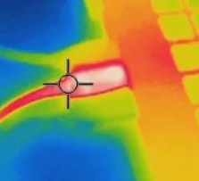
Implications of Remote Powering
Heat builds-up within cable bundles
Contact arcing occurs when un-mating pairs under load and may affect connecting hardware reliability

Slide 23
Quiz Question
What are the 3 temperature ratings for a Category cable?
Installation,
Storage,
Operating
Installation,
Storage,
Operating
General,
Riser,
Plenum
Max Cold,
Max Hot,
Ambient
30W
60W
90W
BICSI 2019©
23

Slide 24
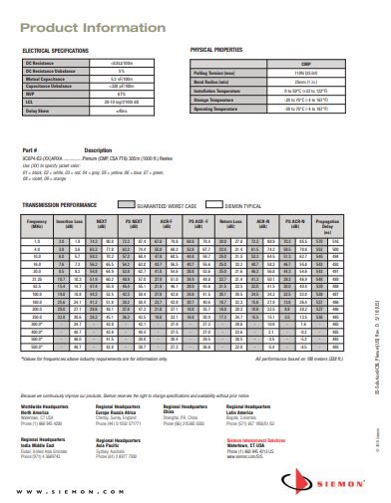
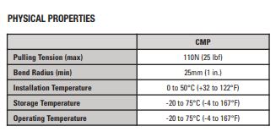
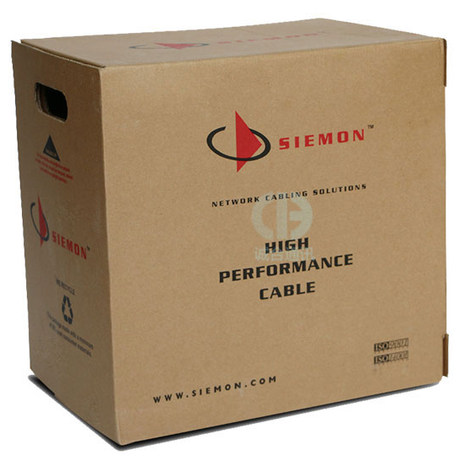
Temperature Ratings for Category Cable
Installation
Storage
Operating
Notes:
Standards bodies are providing guidelines. Recognizing cable rating of 60 degrees centigrade as a bench mark.
NEC (NFPA 70) is the benchmark for safe electrical design installation and inspection to protect people and property from electrical hazards.
Code – enforceable by AHJ (whoever that might be – building inspector, fire marshal, local or county agency – supersedes any standard) Code does not consider or care about cables’ ability to carry signals from one point to another. New sections in 310, 725 and 840 which in a nutshell state that cables have to be rated for 60 degree centigrade or properly marked and then requires compliance to a new ampicity table provide markings, and an ampacity table 725.144 and 840.166 were prompted by SAFETY concerns about the heating of communications cable carry power
725.144 – Ampacity table of each conductor (in Amps) in a 4-pair Class 2 or Class 3 data cables, based on copper conductors at ambient temperatures of 30 degrees C (86 degrees F) with all conductors in all cables carrying currents – 60°C (140°F); 75°C (167°F) and 90°C (194°F) rated cables
TIA also provides maximum current capacity guidelines to insure that the balanced twisted pair cable installations meet the installation requirements of ANSI/TIA-568-C.2 and requirements for pathways and spaces in ANSI/TIA-569-D will function properly for data and remote power delivery.
Focuses on de-rating of cable in a bundle and gives installation guidelines for bundles. Defines bundle sizes for Cat 5e, 6, 6a and 8 and includes cable with conductor size of 26 AWG.
Provides a table of maximum current per pair that the cable can support without exceeding the allow cable temperature rise. Cable bundle not to exceed 100 cables.
Specifies 15°C as the maximum allowed temperature rise above ambiant temperature of 45 degrees C given a cable temperature rating of 60 degrees C
Provides temperature rise for category cable versus the number of energized pairs in a 100 cable bundle
Guidelines for Supporting Power Delivery Over Balanced Twisted-Pair Cabling
Category 6A or higher performance 4-pair balanced twisted-pair cabling is recommended for new installations delivering remote power
Larger conductor sizes and shields reduce dc loop resistance and improve both energy consumption and heating
The maximum ambient temperature along the link (length of at least 1m) should be used as the basis for the calculation
The standard presumes a maximum ambient temperature of 45°C in conjunction with cabling with a maximum rating of 60°C, thus allowing a maximum temperature rise of 15 °C on any cable within the bundle due to dc powering

Slide 25
Quiz Question
What is the TIA specified operating temperature range for cabling?
A: -20°C to 60°C (-4°F to 140°F)

Slide 26
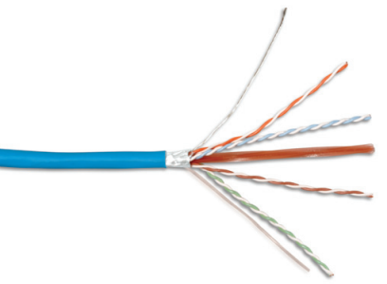
Shielded Cable Performs Higher
Typically qualified for higher temperature (75°C) operation
Reduced length de-rating
Superior heat dissipation supporting larger bundle sizes

Slide 27
Channel Length De-Rating
TIA, ISO/IEC Category 6A U/UTP
Subtract 18 m at 60°C/140°F
Insertion Length De-rating (m)
TIA, ISO/IEC Category 6A F/UTP
Subtract 7 m at 60°C/140°F
Notes:
As shown here, the length reduction for Category 6A F/UTP horizontal cable at 60ºC is 7 meters, which means reducing maximum link length from 90 meters to 83 meters. Furthermore, Category 6A F/UTP horizontal cable may be used to support remote powering currents up to 600mA applied to all four pairs up to 60ºC. Category 6A F/UTP cabling solutions require less than half the length de‑rating than Category 6A UTP cables at 60°C (140°F).
Note that the TIA profiles from 60ºC to 70ºC are extrapolated assuming that the de-rating coefficients do not change and are provided for reference only.

Slide 28
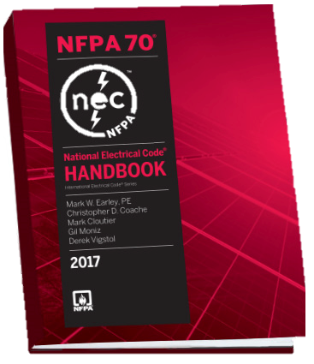
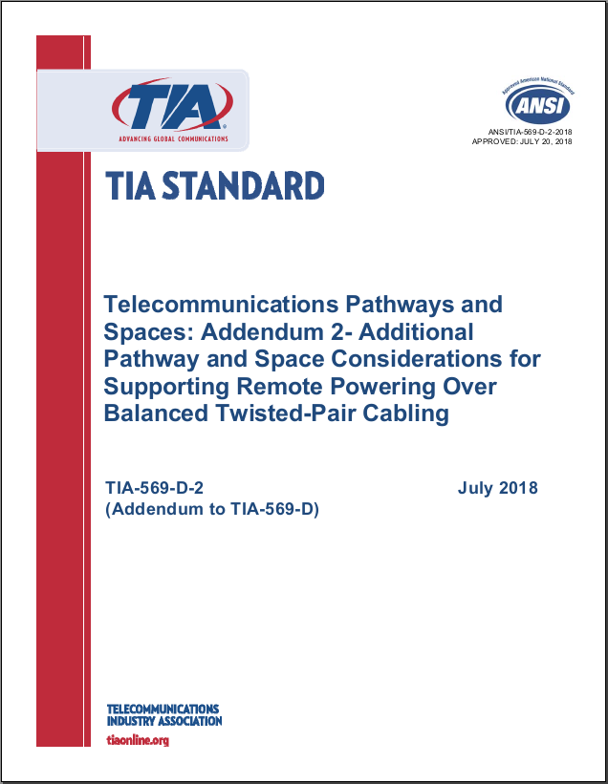
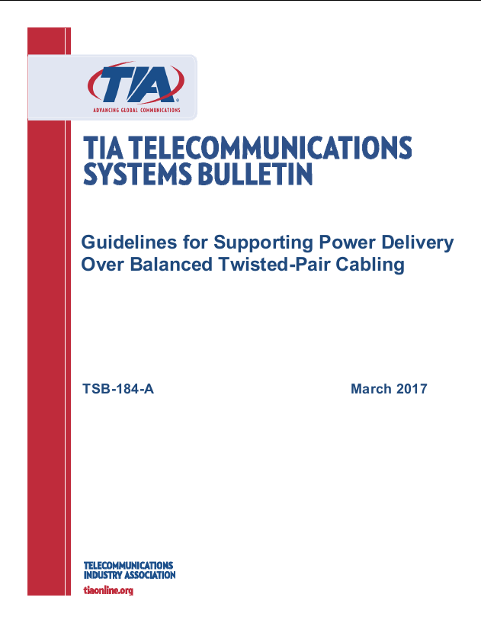
Resources for Cabling Heat Concerns
NFPA 70 (2017 NEC)
TIA TSB-184-A-2017
TIA-569-D-2-2018
Notes:
Standards bodies are providing guidelines. Recognizing cable rating of 60 degrees centigrade as a bench mark.
NEC (NFPA 70) is the benchmark for safe electrical design installation and inspection to protect people and property from electrical hazards.
Code – enforceable by AHJ (whoever that might be – building inspector, fire marshal, local or county agency – supersedes any standard) Code does not consider or care about cables’ ability to carry signals from one point to another. New sections in 310, 725 and 840 which in a nutshell state that cables have to be rated for 60 degree centigrade or properly marked and then requires compliance to a new ampicity table provide markings, and an ampacity table 725.144 and 840.166 were prompted by SAFETY concerns about the heating of communications cable carry power
725.144 – Ampacity table of each conductor (in Amps) in a 4-pair Class 2 or Class 3 data cables, based on copper conductors at ambient temperatures of 30 degrees C (86 degrees F) with all conductors in all cables carrying currents – 60°C (140°F); 75°C (167°F) and 90°C (194°F) rated cables
TIA also provides maximum current capacity guidelines to insure that the balanced twisted pair cable installations meet the installation requirements of ANSI/TIA-568-C.2 and requirements for pathways and spaces in ANSI/TIA-569-D will function properly for data and remote power delivery.
Focuses on de-rating of cable in a bundle and gives installation guidelines for bundles. Defines bundle sizes for Cat 5e, 6, 6a and 8 and includes cable with conductor size of 26 AWG.
Provides a table of maximum current per pair that the cable can support without exceeding the allow cable temperature rise. Cable bundle not to exceed 100 cables.
Specifies 15°C as the maximum allowed temperature rise above ambiant temperature of 45 degrees C given a cable temperature rating of 60 degrees C
Provides temperature rise for category cable versus the number of energized pairs in a 100 cable bundle
Guidelines for Supporting Power Delivery Over Balanced Twisted-Pair Cabling
Category 6A or higher performance 4-pair balanced twisted-pair cabling is recommended for new installations delivering remote power
Larger conductor sizes and shields reduce dc loop resistance and improve both energy consumption and heating
The maximum ambient temperature along the link (length of at least 1m) should be used as the basis for the calculation
The standard presumes a maximum ambient temperature of 45°C in conjunction with cabling with a maximum rating of 60°C, thus allowing a maximum temperature rise of 15 °C on any cable within the bundle due to dc powering

Slide 29
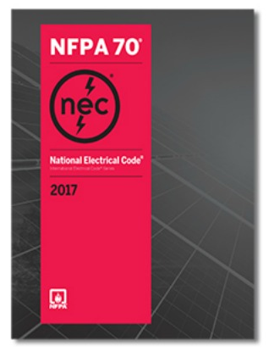
2017 NEC Code Revisions
Cable Ratings and Markings for Safety
Ampacity Table for Bundles
Part VI. Premises Powering of Communications Equipment over Communications Cables
840.160 Powering Circuits. Communications cables, in addi-
tion in carrying the communications circuit, shall also be permitted to carry circuits for powering communications equipment. Where the power supplied over a communications cable to communications equipment is greater than 60 watts, communication cables and the power circuit shall comply with 725.144 where communications cables are used in place of Class 2 and Class 3 cables.
Notes:
The rapid expansion and adoption of remote powering led to many contentious discussions within the National Fire Protection Agency in the development of the 2017 edition of the NFPA 70® National Electrical Code® (NEC). The end result was a new Article 840, Part VI requirement addressing premise powering of communications equipment over communications cable.
The text highlighted in red is important – this article only applies when the power supplied is greater than 60W, so let’s quickly review what this will apply to.

Slide 30
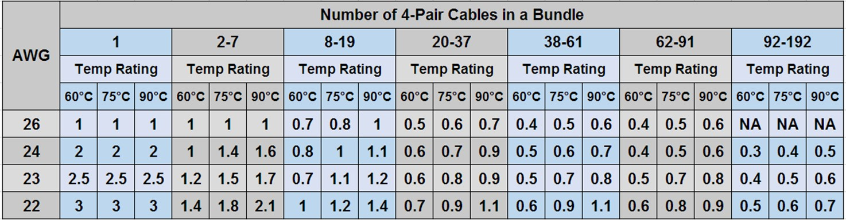
2017 NEC Table 725.144
Conductor gauge, bundle size and temperature rating are used to establish a safe power rating (Ampacity) for each conductor
Notes:
The maximum ampacity that may be carried by a cable conductor is determined by the conductor gage (AWG) size, number of 4-pair cables in a bundle, and the mechanical temperature rating of the cable as provided within Table 725.144 of the NEC as shown. A couple items to note:
This table is based on an ambient temperature of 30° C (86° F)
It is not specified whether this applies to free-air or conduit

Slide 31
Example: Can this cable support Type 4 PoE?
24 AWG category 5e cable
Bundle size of 75 cables
Mechanically rated to 60°C (Operating Temperature)
Notes:
So how does this table work? Let’s use an example. The maximum ampacity of one 24 AWG category 5e conductor, contained within a bundle of 62-91 cables and mechanically rated to 60° C, is 400 mA or 800 mA per pair. Since the pending IEEE P802.3bt Type 4 90W application is targeting an operating current of 960mA per pair, this example product and installation configuration would not be compliant to the NEC requirements for support of this application.

Slide 32
Alternatives
Use cables with a larger conductor or higher mechanical rating (Operating Temperature)
Reduce bundle size
Notes:
To overcome this restriction, the NEC provides a provision to use a limited power or LP-rated cable jacket to support increased ampacity. Another alternative allowed by the NEC is to use cables having larger diameter conductors and/or a higher temperature rating to reach the desired ampacity capability. In this example, the use of a 24 AWG cable with a 75° C mechanical rating or a 23 AWG cable with a 60° C mechanical rating would meet the requirements. Finally, if the bundle size was reduced to 61 or less, the initially specified category 5e cable would comply.
As a side note, a few of you might hopefully remember the general guideline that we included in our Cable Bundling Guidelines “When in doubt about cable mechanical or heat dissipation capability, installation environment, or remote powering application, a conservative practice is to limit maximum bundle size to 24 cables. With the exception of the few instances noted below, this easy to remember practice addresses the majority of media, environmental, and application scenarios.”
If we apply this practice to the NEC table, we can quickly see that ALL cable gauges and mechanical temperature ratings would readily support all known remote powered applications including Type 4 PoE and HDBASE-T.

Slide 33
TIA TSB-184-A
Guidelines for Supporting Power Delivery Over Balanced Twisted-Pair Cabling (March 2017)
The standard presumes a maximum ambient temperature of 45°C/113°F in conjunction with cabling with a maximum rating of 60°C/140°F, thus allowing a maximum temperature rise of 15°C/27°F on any cable within the bundle due to dc powering
60
50
40
Notes:
In order to minimize the impact on the physical and electrical performance of cabling, it is desirable to limit the temperature rise of cabling. This TSB recommends 15°C as the maximum temperature rise.
Discontinuities in environments such as penetrations through walls are expected to be less than 1m in length

Slide 34
Mitigation Recommendations
Use Category 6A or higher-performing 4-pair balanced twisted-pair cabling, or larger AWG or shielded cables
Reduce channel length, as necessary, to offset increased insertion loss
Reduce bundle size (24) and allow space between bundles
Notes:
Larger conductor sizes and shields reduce DC loop resistance and improve both energy consumption and heat dissipation
Selecting a larger conductor size, often associated with a higher-performance category of cabling, is one way to reduce dc loop resistance and improve power delivery efficiency and minimize heating.
Leaving cables unbundles facilitates better heat dissipation
One way to limit the temperature rise, due to conditions such as installation factors, possible high ambient temperature, the use of 26 AWG cords, and higher currents up to 1000 mA per pair with all four pairs energized, is to limit the number of cables per bundle to 24 in typical pathway installation conditions.

Slide 35
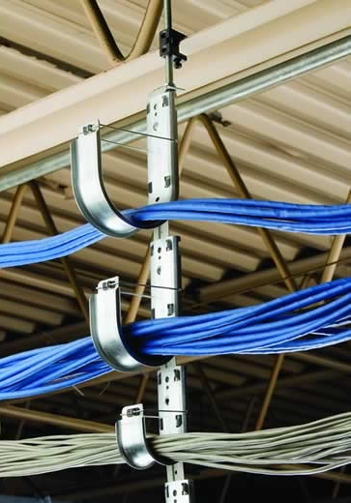
TIA-569-D-2-2018
Additional Pathway and Space Considerations for Supporting Remote Powering Over Balanced Twisted-Pair Cabling (July 2018)
Pathways differ in regard to geometry and contact area between cables, pathway, and air
Provides general guidance on heat dissipation of various pathways by bundle size

Slide 36
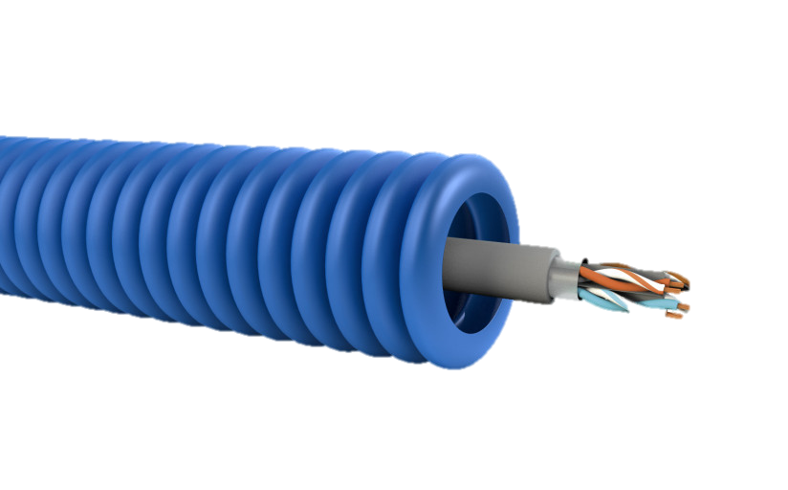
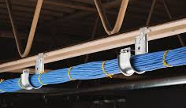
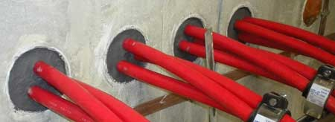
TIA-569-D-2-2018: J-hooks & Conduits
Pathway Type | Cable Routing | Cable Quantity
 |  | 1-37 | 38-61 | 62-91 | > 91
Non-continuous | Bundled | High | High | High | N/A
 | Unbundled | High | High | High | N/A
Conduit (Metallic & Non-metallic) | Bundled | Low | Low | Low | Low
 | Unbundled | Medium | Low | Low | Low
Sealed Conduit | Bundled | Low | Low | Low | Low
 | Unbundled | Low | Low | Low | Low
Notes:
– high is good. It’s the ability of the pathway to dissipate heat
Non-continuous: J-Hooks, catenary wire
Conduit: Conduit, surface raceway, duct

Slide 37
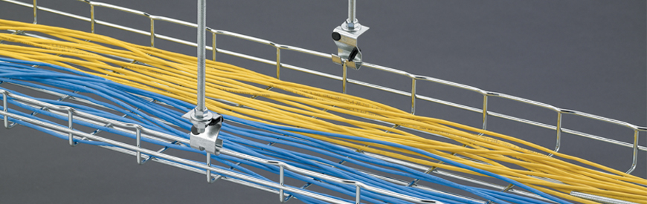
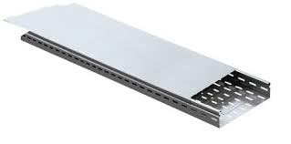
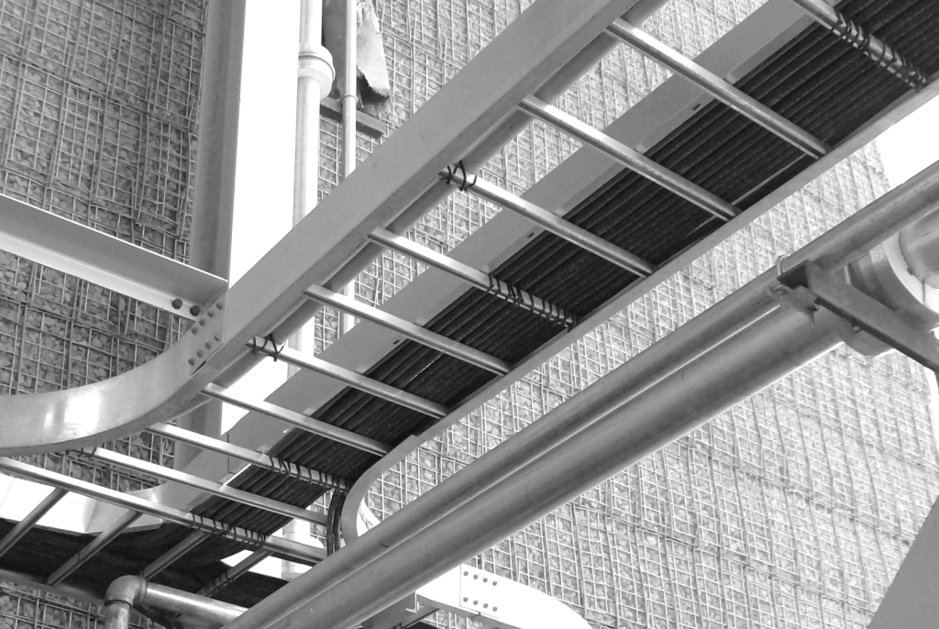
TIA-569-D-2-2018: Cable Tray
Tray Type | Fill Depth (in.)
 | 1 | 2 | ≥ 3
Wire Mesh/Ladder | High | High | High
Ventilated | High | Medium | Low
Unventilated | Medium | Medium | Low
Notes:
– high is good. It’s the ability of the pathway to dissipate heat
Non-continuous: J-Hooks, catenary wire
Conduit: Conduit, surface raceway, duct

Slide 38
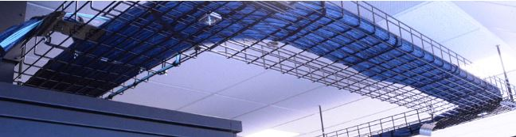
Additional Pathway Mitigation
Additional Pathway Mitigation
Use open wire tray or similar cable management that provides for largely unrestricted airflow around the installed cables
  Disperse cables evenly across the width of the tray
Mix unpowered cables with powered cables
Notes:
Example: (1) 91 cable bundle > (3) 37 cable bundles > 1” separation
Limit cables to 24 to reduce potential temperature rise caused by application, installation, component and environmental factors

Slide 39
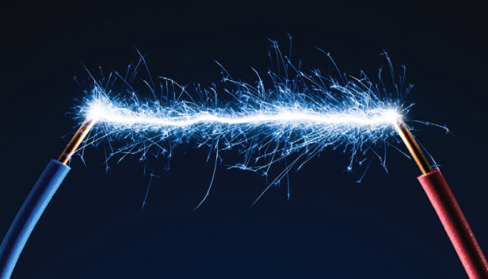
Potential for Arcing Under Load Conditions
Remote powering applications do not
apply DC power until a PD is sensed
by the PSE
Device disconnections can’t be
anticipated
“Un-mating pairs under load” produces an arc as the applied current transitions from flowing through conductive metal to air before becoming an open circuit
Arcing can result in corrosion and pitting damage on the
plated contact surface at the arcing location
Notes:
Telecommunications modular plug and jack contacts are carefully engineered and plated (typically with gold or palladium) to ensure a reliable, low resistance mating surface. Today’s remote powering applications offer some protection to these critical connection points by ensuring that dc power is not applied over the structured cabling plant until a remotely powered device (PD) is sensed by the power sourcing equipment (PSE). Unfortunately, unless the PD is shut off beforehand, the PSE will not discontinue power delivery if the modular plug-jack connection is disengaged. This condition, commonly referred to as, “unmating pairs under load”, produces an arc as the applied current transitions from flowing through conductive metal to air before becoming an open circuit. While the current level associated with this arc poses no risk to humans, arcing creates an electrical breakdown of gases in the surrounding environment that results in corrosion and pitting damage on the plated contact surface at the arcing location.

Slide 40
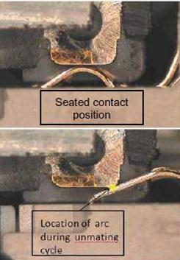
Ensuring Contact Integrity
Informative Annex B of TSB-184-A contains the following guidance:
  Connecting hardware having the required performance for mating and un-mating under the relevant levels of electrical power and load should be chosen
  IEC 60512-99-001 is referenced as a suitable test schedule
Notes:
While it’s important to remember that arcing and subsequent contact surface damage is unavoidable under certain mating and unmating conditions - contacts can be designed in such as way as to ensure that arcing will occur in the initial contact “wipe” area and not affect mating integrity in the final seated contact position, which is shown here.
Fortunately, there is a standard that was specifically developed to ensure reliable connections for remote powering applications deployed over balanced twisted‑pair cabling. IEC 60512-99-001 specifies the maximum allowable resistance change that mated connections can exhibit after being subjected to 100 insertion and removal cycles under a load condition of 55V dc and 600mA applied to each of the eight separate plug/outlet connections.
Test requirement: low level contact resistance not to exceed 20 milli-Ohms from initial readings.
To ensure reliable performance and contact integrity, Siemon recommends that only connecting hardware that is independently certified for compliance to IEC 60512‑99‑001 be used to support remote powering applications.
Annex B (Informative) – Unmating under load
B.1 Qualification of connecting hardware for mating and un-mating under load
Where it is not practicable to switch off the remote power before mating or un-mating (e.g. for power sources that do not have power management), connecting hardware having the required performance for mating and un-mating under the relevant levels of electrical power and load should be chosen. These requirements are not within the scope of the balanced connecting hardware standards (e.g. IEC 60603-7) referenced from ANSI/TIA-568-C.2 and equivalent standards, but may be assessed using additional test schedules. A test schedule for engaging and separating connectors under electrical load is described in IEC 60512-99-001.

Slide 41
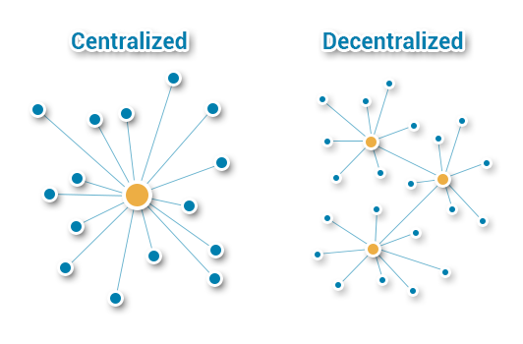
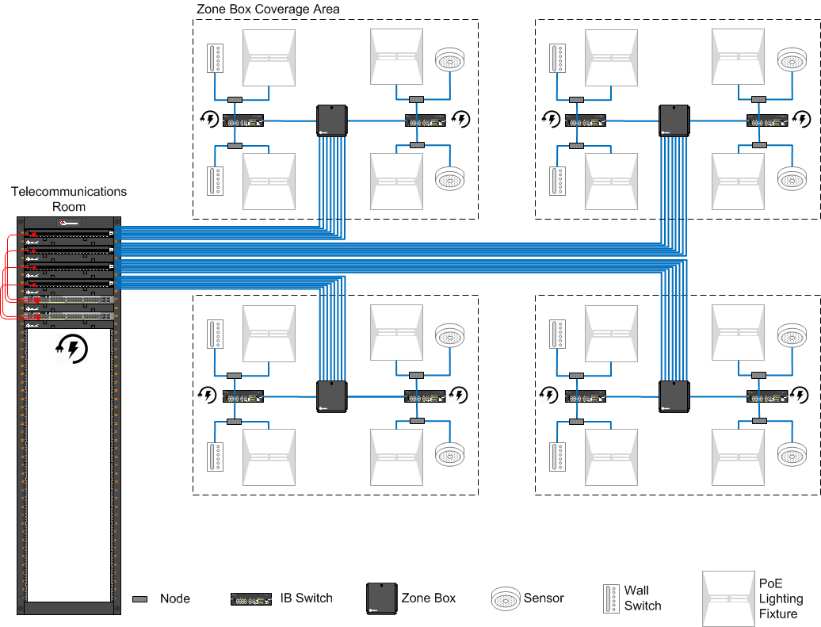
Cabling Layout Selection
Notes:
Planning an intelligent building infrastructure will change the way GCs, architects and buiding owners will plan a building because now it’s not just data, it’s power too.
Planning the infrastructure means getting educated on the codes and standards that are constantly being developed to address this. While every building is different in terms of security, planning the spaces should always follow basic guidelines and best practices:
Some of the infrastructure challenges will be the basic network design layout. Centralized versus de-centralized for the processing power. Everything is getting closer to the “edge” to eliminate latency. Also how are you going to design the horizontal cable – point to point or the use of zone cabling. I will discuss this in further detail.
Also, we are used to a data port being a data port and NOT application dependent. For now, the application will determine if there will be four-pair cable to the end device or whether you will still need to run an 18/2. This is determined by the device manufacturers. The cable type will be determined by the application as well – distance, bandwidth and remote power
I will get more into PoE but there are options to consider and some concerns to be realized.
Also – getting the data and power to the device may mean a plug on the end of a horizontal cable versus a patch cord and an outlet. I will talk about this, which has now been coined an MPTL – modular plug terminated link – otherwise a direct connection

Slide 42
Node Centric vs. Fixture Centric
Fixture Centric
One to One
More Powered Ports
More Costly
1:1
Node Centric
One to Many
Less Powered Ports
Less Expensive
1:N*
*Where N fixture(s) power requirements are less than the supplied PoE power
Notes:
Also, when employing devices, such as lighting, there are different methods depending on the application and device itself. For example, a fixture centric would be a one to one cable. Some devices employee a node where a category or network cable is connected to the node and then from there, depending on the requirements of the devices, several devices can be attached to the node. Note than when PoE is employed, the number of devices will rely on how much power will need to be supplied to each device.
Let’s take a look at some fixture and node centric layouts as well as centralized vs. decentralized

Slide 43
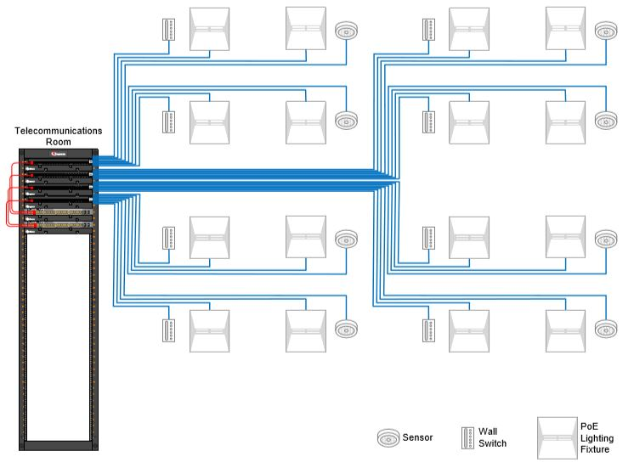
Example: Centralized Cabling – Fixture Centric
Notes:
Most lighting manufacturers have a node, or a SPICE point or a driver. The cable runs from the TR to the driver/controller/or node and from there the cabling, which in most cases is NOT a four pair but usually an 18/2 runs to the device and you can run more than one device daisy chained from the node.
Centralized Node Centric
Pros
Can employ structured cabling
Relatively easy administration
Minimal connections
Only requires centralized power in TR
Optimizes use of PoE power
Reduces cabling from nodes to fixtures
Supports all IB applications speeds
Cons
Limited flexibility to support MAC activity
High volume of cable
Additional connection point

Slide 44
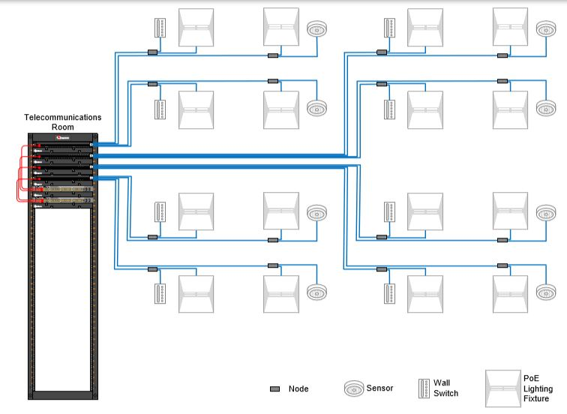
Example: Centralized Cabling – Node Centric
Notes:
Most lighting manufacturers have a node, or a SPICE point or a driver. The cable runs from the TR to the driver/controller/or node and from there the cabling, which in most cases is NOT a four pair but usually an 18/2 runs to the device and you can run more than one device daisy chained from the node.
Centralized Node Centric
Pros
Can employ structured cabling
Relatively easy administration
Minimal connections
Only requires centralized power in TR
Optimizes use of PoE power
Reduces cabling from nodes to fixtures
Supports all IB applications speeds
Cons
Limited flexibility to support MAC activity
High volume of cable
Additional connection point

Slide 45
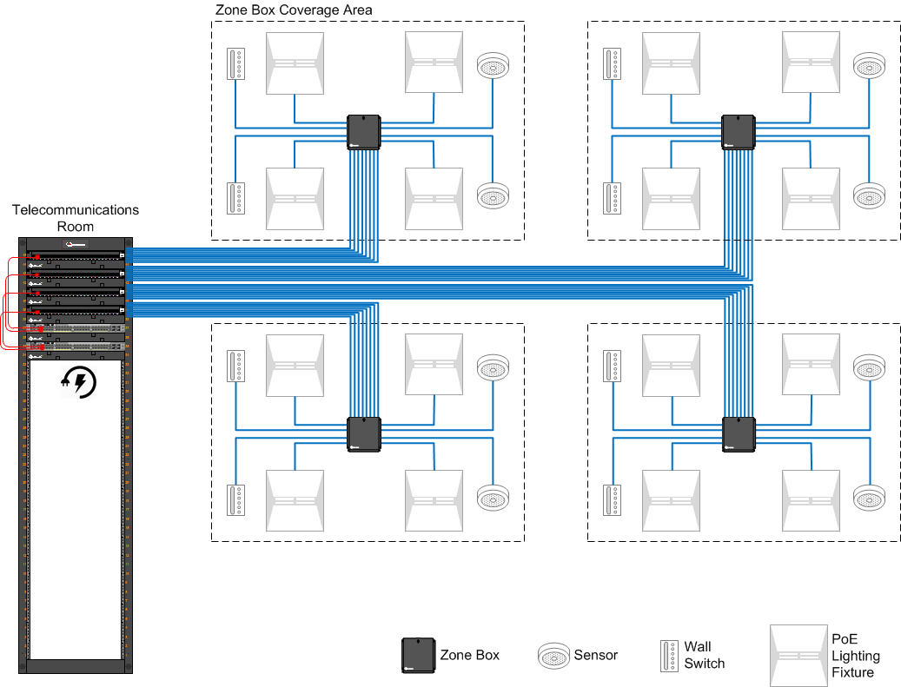
Example: Centralized Zone – Fixture Centric
Notes:
Centralized Zone - Fixture Centric
Pros
Employs structured cabling
Easily administered
Only requires centralized power in TR
Provides support of future IB applications
Supports all IB application speeds
Optimal support of MAC activity
Cons
High Day One cabling CAPEX
Additional connection point

Slide 46
Example: De-centralized – Zone Node Centric
Notes:
And, similar to the centralized version, this zone box scenario has the cable terminated to the zone box. No active equipment is housed in the zone box, so the switch would be located in the ceiling plenum space and then out to the node and then to the device.

Slide 47
Summary
Increasing numbers of IB applications will run over a low- voltage cabling platform
Know the resources, codes and standards to help you design your infrastructure
Zone cabling and modular plug terminations have a role
Remote powering places increased demands on network cabling systems
Design according to proper device coverage area

Slide 48

Thank You
Carol Everett Oliver, RCDD, ESS
Carol.Everett.oliver@gmail.com

