Slide 1


Planning a Building Infrastructure for PoE and LED Lighting
Carol Everett Oliver, RCDD, ESS
Principal, CEO Communications
BICSI Board of Directors

Slide 2
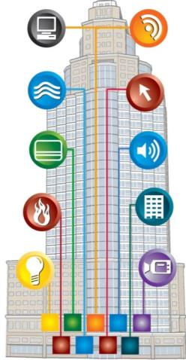
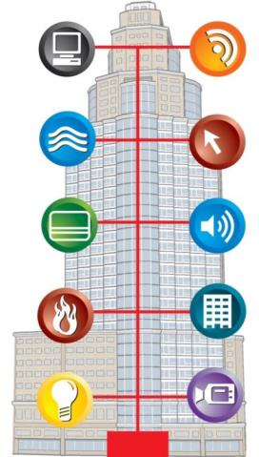
Intelligent Building Trend
Traditional Building
Multiple systems
Multiple proprietary cabling types
Multiple trades
Multiple AC outlets
Converged Building
Multiple building systems over a single IT cabling infrastructure
Power and control over the same infrastructure
Notes:
We know there is a revolution going on. A traditional has many systems in addition to data that are running on proprietary software and cabling types. Many different trades are involved such as MEPs and security integrators and installers. In the future we will see more and more of these applications with IP addresses and can co-exist on the same network and be cabled with structured cabling systems. Some of these systems include lighting, security, AV and event HVAC and fire alarm. However, it will take time as it is still a wild west out there and there are only a few early adopters that have taken a hold of this revolution and have realized significant savings in operating and capital expenditures.

Slide 3


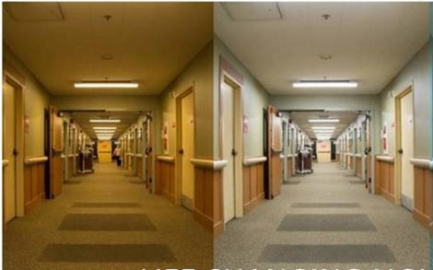
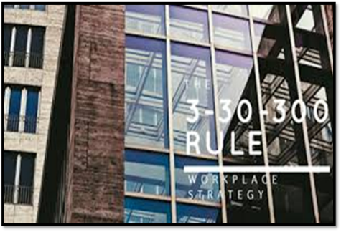
LED Lighting:
More benefits than just lighting
Financial Sense
Environmental Sense
Personnel Sense
Business Sense
CAPEX & OPEX Savings
Maximum Sustainability
Health and Wellness
Impacts all Cost Centers
Notes:
Today I am going to address changes in the infrastructure for intelligent buildings but will focus on LED lighting as that currently is a target for many low voltage and electrical engineers. And guess what – there are benefits for everyone and there are advantages for building owners to use low-voltage cabling but to employ both the low voltage and the electrical installers for lighting installations.
LED lighting may still be more costly to install than conventional lighting but in the long run it has proven to be more cost effective due to the energy savings. When areas are not in use the lighting is off which saves money. Programmable lighting can also adjust to daylight harvesting and occupancy.
Also, by being able to control the lighting it has been proven that it is better for people’s well-being and circadian rhythm. Controlled lighting Some people might light low lighting, some people may prefer cool versus warm lighting and all this can be controlled.
Facility managers focus on the 3-30-300 rule which is
$3 for utilities, $30 for rent and $300 for their employee costs (salaries, benefits, etc.). The focus on people is one of the reasons that the WELL Building Standard has been rolled out. While the costs can be significant, organizations that implement it understand the human impacts that it has. The resulting increased of better lighting has been shown to have positive effects on the health of employees, increasing mood and workplace satisfaction. Controlled LED lighting just makes sense

Slide 4
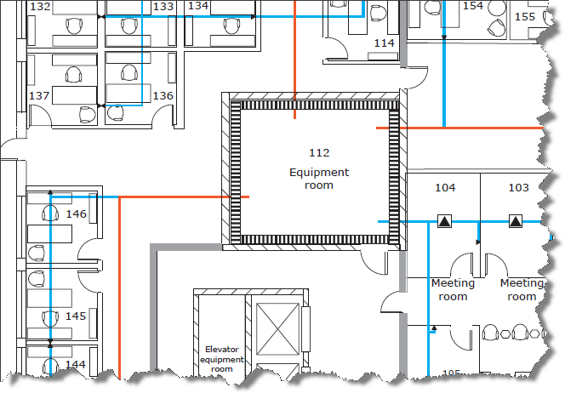
Agenda: Planning Your IP Infrastructure
Structured (IP) Cabling and Market Trends
Codes & Standards
Power (PoE) Options & Concerns
Cabling System Layouts for LED Lighting
Notes:
Planning an intelligent building infrastructure will change the way GCs, architects and building owners will plan a building because now it’s not just data, it’s power too.
Planning the infrastructure means getting educated on the codes and standards that are constantly being developed to address this. While every building is different in terms of security, planning the spaces should always follow basic guidelines and best practices:
Some of the infrastructure challenges will be the basic network design layout. Centralized versus de-centralized for the processing power. Everything is getting closer to the “edge” to eliminate latency. Also how are you going to design the horizontal cable – point to point or the use of zone cabling. I will discuss this in further detail.
Also, we are used to a data port being a data port and NOT application dependent. For now, the application will determine if there will be four-pair cable to the end device or whether you will still need to run an 18/2. This is determined by the device manufacturers. The cable type will be determined by the application as well – distance, bandwidth and remote power

Slide 5
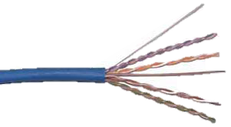
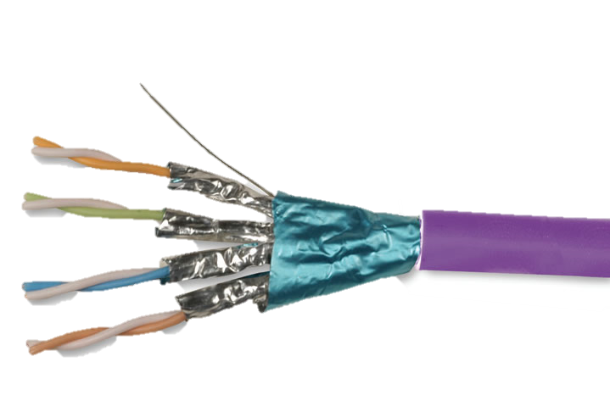
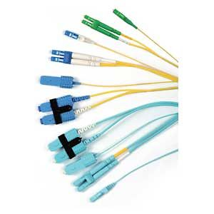
IP Cabling Selection
Copper and fiber cable types for bandwidth/resolution and distance for data and power
Notes:
Let’s look at the cabling selection for IP applications, such as PoE LED lighting

Slide 6
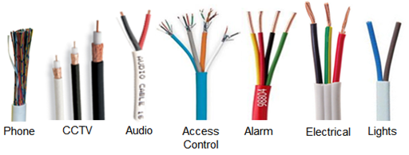

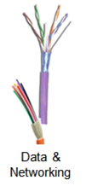
Trending – the Move to IP Cabling
Traditional Building
Employ a vast array of different protocols and cabling systems
Converged Building
Multiple building systems over a single IT cabling infrastructure (fiber and copper)
One cable type means:
  Rapid deployment
  Reduced labor costs
Notes:
We know there is a revolution going on. A traditional has many systems in addition to data that are running on proprietary software and cabling types. In the future we will see more and more of these applications with IP addresses and can co-exist on the same network and be cabled with structured cabling systems. Some of these systems include lighting, security, AV and event HVAC and fire alarm. However, it will take time as it is still a wild west out there and there are only a few early adopters that have taken a hold of this revolution and have realized significant savings in operating and capital expenditures.

Slide 7
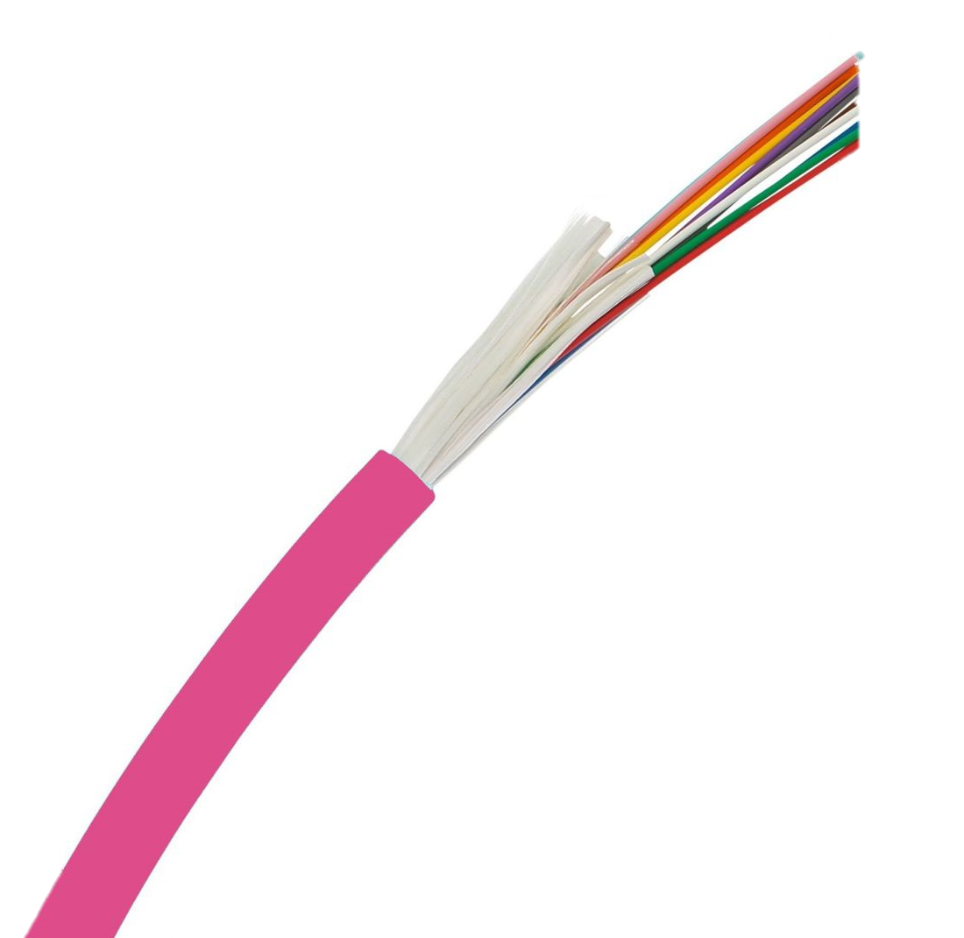



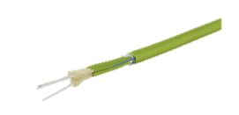
Recognized Horizontal Cables
The following types of horizontal cables are recognized in TIA Standards
  Four-pair 100Ω balanced twisted-pair
  Two-core (two strand) OM1, OM2, OM3, OM4 and OM5 multimode optical fiber
  Two-core OS1 & OS2 single mode optical fiber
Notes:
The IP cables are four pair balanced twisted pair and at least two strands of either multimode or singlemode fiber (one to transmit and one to receive)

Slide 8
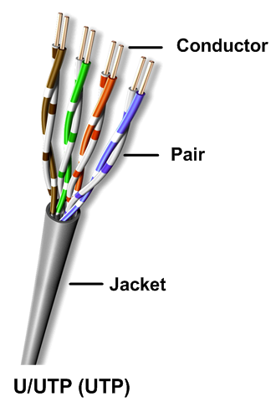
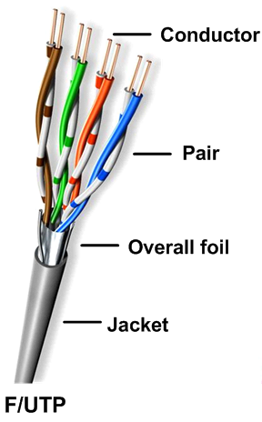
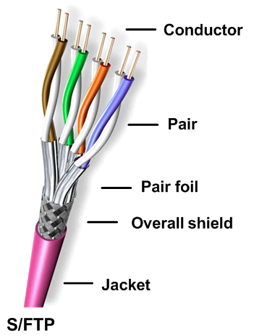
Balanced Twisted Pair Copper Cable Types
Category 3 (voice only), 5e, 6, 6A
Category 7, 7A, 8
Notes:
The lowest recognized cable is Category 3 which is only used for voice. Category 5e and 6 are the most installed base today. Category 5e, 6 and 6A are also available as shielded versions for better signal protection. Category 7 and 7A are recognized through international standards but are being deployed today, mainly in government installation because of the Tempest rating which is due to pair separation and isolation. Category 8 was recently ratified to run 2 Gigahertz but the distance is limited to 30 meters, so most likely will be for data centers).
Here you can see the difference between the type of unshielded and shielded constructions. The S/FTP is pairs with a metal shield and an overall shield. Shielded cables have a drain wire and It's important that the drain wire stays in contact with the conductive side of the shield. We are seeing more installations with shielded cable because of its better performance against noise.

Slide 9
Copper Performance Categories
Components (cable and connecting hardware) |  | Bandwidth (Characterization Frequency) | Maximum Recommended Application
ISO/IEC | ANSI/TIA
Category 3 | Category 3 | 16 MHz | 10BASE-T
Category 5 | Category 5e | 100 MHz | 100BASE-TX
Category 6 | Category 6 | 250 MHz | 1000BASE-T
Category 6_{A} | Category 6A | 500 MHz | 10GBASE-T
Category 7 | -- | 600 MHz | 10GBASE-T and cable sharing
Category 7_{A} | -- | 1000 MHz | Beyond 10GBASE-T, cable sharing and broadband video
Category 8.1 | Category 8 | 2 GHz | 25GBASE-T and 40GBASE-T
Category 8.2 | -- | 2 GHz | 25GBASE-T and 40GBASE-T
Performance designations are based on International Standard ISO/IEC 11801:2011 Ed. 2.2 and North American Standard ANSI/TIA-568.2-D. (ANSI/TIA-568-C.2-1)
Notes:
You can see that these class and category systems are defined by the applications and bandwidth. One thing to remember is that there are distance limitations for twisted pair cable which is 90 meters between the telecom room and the work area outlet for the permanent link and 100 meters for the channel which includes the patch cords. However, Category 8 is limited to 30 meters.

Slide 10
Optical Fiber Types
OM1, OM2
OM3, OM4
OS1a, OS2
Multimode
Singlemode
Notes:
There are a few different fiber optic cable types but their construction is very similar as a fiber optic cable core is glass and has a protective coating called cladding that guides the light through the core and then there is another hard plastic coating called Acrylate which protects the glass from physical damage and also helps the fiber to bend.
OM1, 2, 3 and 4 are Multimode cables where the light travels down the cable in many modes. These cables are mainly used for indoor premise application as it is limited in distance. OM1 and @ with a large core of 62.5 micron are rarely used for newer applications. OM3 and OM4 with a 50 micron core and with the use of laser-optimized transceiver technology is used for both backbone and horizontal applications.
Singlemode fiber is used as long haul fiber and also for high bandwidth. And due to the small core of 9 microns, the signal travels straight through the middle. This is why it can go further distance, in addition to higher power electronics. Because of the construction, singlemode fiber optic cable is actually less expensive than multimode. It’s the electronics that are expensive. So the network designer really has to take a look at the application and decide which cable is best. I see singlemode now being used for high bandwidth applications such as video and also for healthcare.

Slide 11
Features & Benefits
 | Copper | Fiber
Bandwidth | Category 6 – 250 MHz Category 6A – 500 MHz Category 7A – 1000 MHz | OM3 – up to 1500 MHz/km¹ OM4 – up to 3500 MHz/km¹ Singlemode - unlimited
Distance | 100 m (90m of horizontal cable; 10m of patch cables) | Multimode – Up to 2km² Singlemode - Up to 40km²
Applications | Data and PoE (Power over Ethernet) | Data only (Power can be achieved through a hybrid cable with media converters)
Termination | RJ45 field termination | Factory terminated (trunks) or Requires trained/skilled labor for field termination
Cost | $ - Most cost effective cable and connectivity | Multimode cable - $$$ Singlemode cable - $$ Electronics/Transceivers - $$$$
¹Minimum Overfilled Modal Bandwidth at 850nm wavelength
²Application and fiber type dependent
Notes:
Both copper and fiber have their place and their pros and cons. Cable selection will get down to bandwidth, distance, application requirements and of course cost!
Obviously copper bandwidth is less than fiber and distance is limited to a total of 100 meters, including the patch cables, but then copper is less expensive and easier to terminate. Copper can also transmit data and power (PoE) over the same 4-pair cable.
Fiber has its benefits but it is more costly to install and more difficult to terminate. Only data can be transmitted through fiber because glass is non conductive and can not be used for power. However, there are hybrid cables on the market that include a copper conductor running alongside a fiber cable within the same jacket that can transmit the power. But within this hybrid cable, the copper conductor can vary in diameter (or AWG size) depending on the distance and power draw as the power will drop the longer the cable. And there will need to be a media converter at the end of the cable to convert it to an Ethernet signal through the RJ-45 terminated cable or patch cord

Slide 12
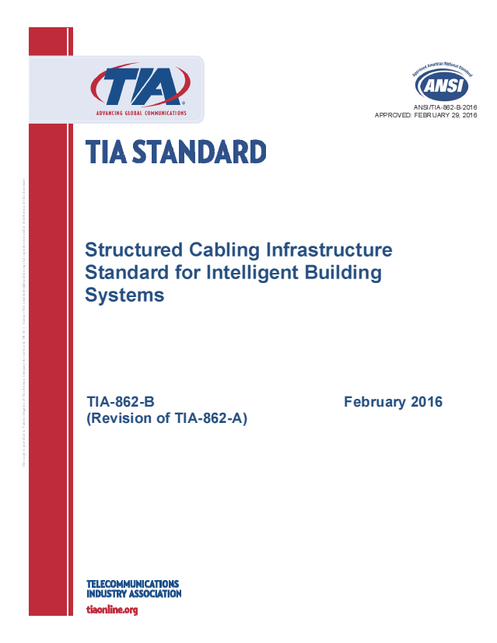
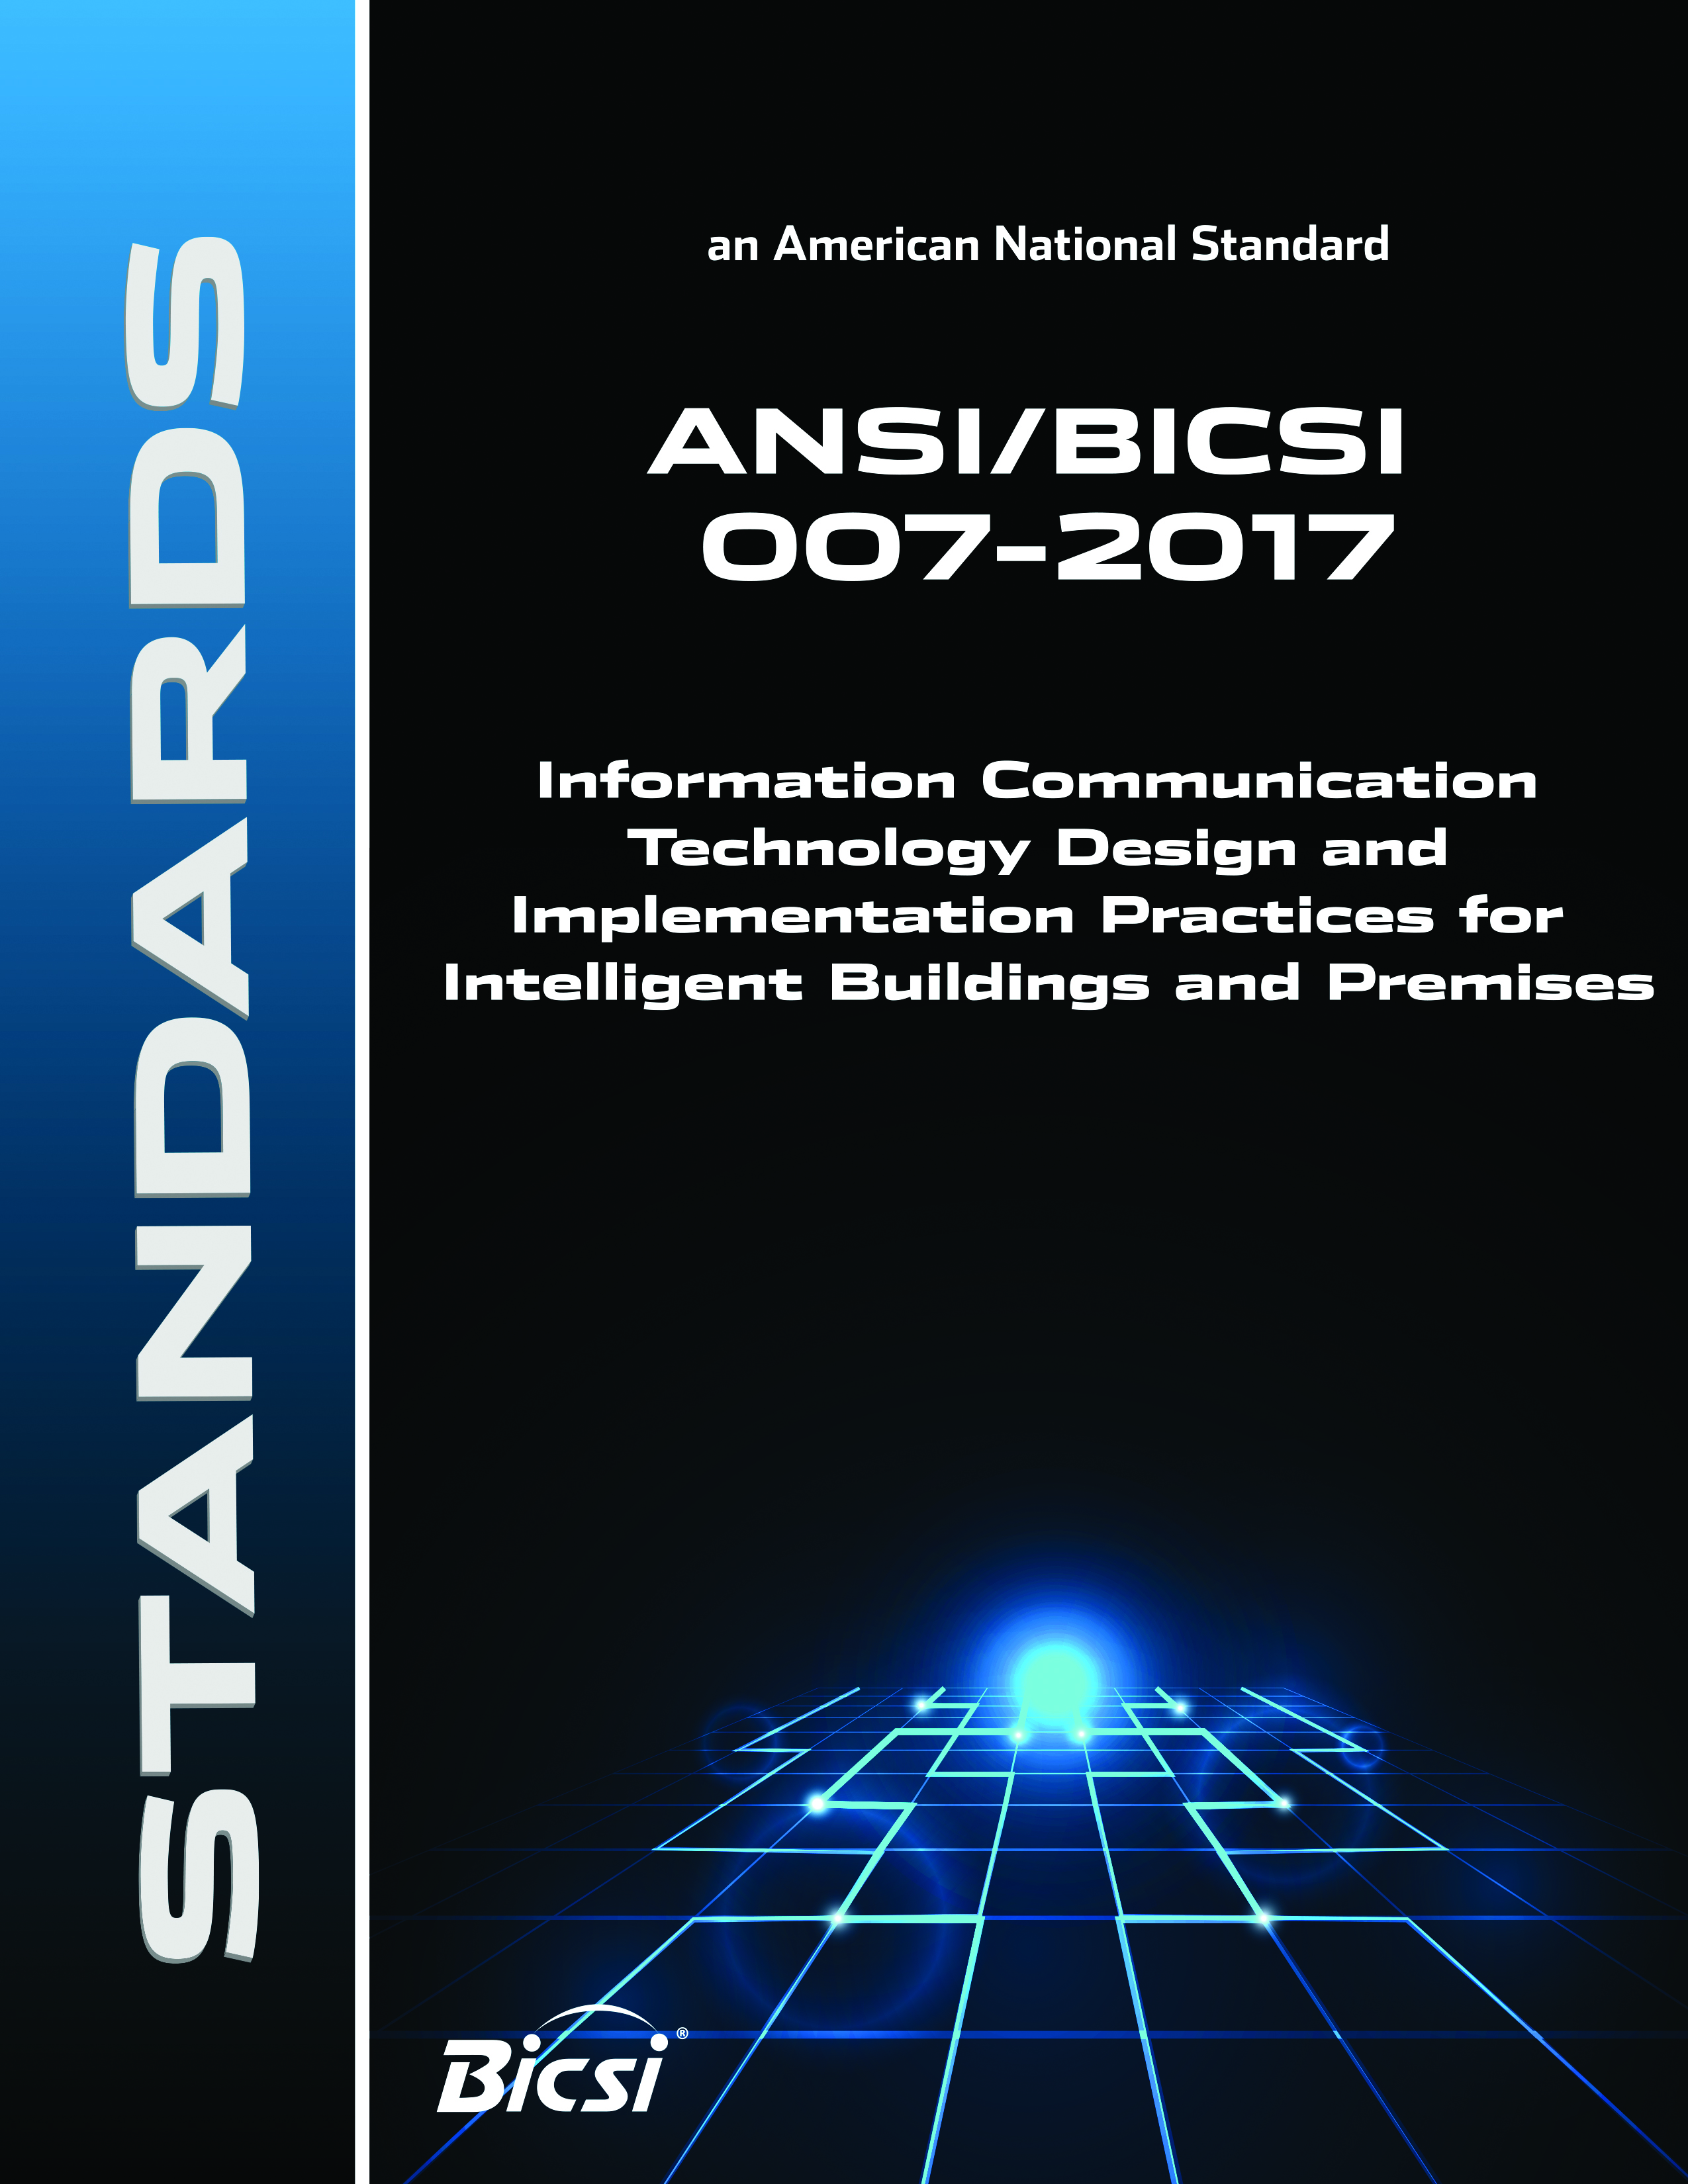
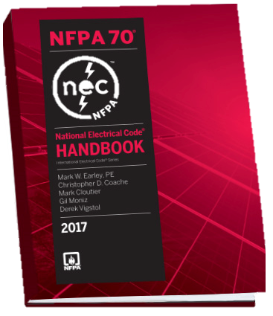
Codes and Standards
Resources to help with your infrastructure design
Notes:
Let’s look at some of the resources out there to help guide the design and installation.

Slide 13
Meeting Applicable Codes & Standards
ANSI/TIA-862-B “Structured Cabling Infrastructure Standard for Intelligent Building Systems”
ISO/IEC 11801 part 6 “Distributed Building Services”
ANSI/BICSI 007-2017, “Information Communication Technology Design and Implementation Practices for Intelligent Buildings and Premises”
NEC 2017 Code
Notes:
Standards are created for system reliability and interoperability and define applications and which media to use. The code is written for safety and safety trumps everything. Here are some codes and standards to adhere to – ANSI TIA 862B addresses a structured cabling layout for intelligent buildings and lists the recommended cable, connectivity, distances, telecom spaces, pathways and testing ISO/IEC is the European version.
BICSI has published a design and installation guide for cable designers and contractors that actually provides layouts for the different systems and applications.
And, of course, the NEC Code, which is updated every three years. The additions to the 2017 version is now addressing power over ethernet and cable bundles. Electrical contractors live and breathe the NEC Codes.

Slide 14
Copper Media Selection
Category 6
UTP
Shielded
TIA TSB-184-A-2017
  Category 6A recommended
TIA-862-B-2017
  Category 6; category 6A recommended
ISO/IEC 11801-6 Ed1.0
  Class E_{A} or higher
BICSI 007-2017
  Category 6A/Class E_{A} or higher recommended
Category 6A
Category 5e
Notes:
All industry standards documents are now recommending Category 6A as the preferred cable for all new installations especially for high bandwidth or high power applications

Slide 15
ANSI/TIA-862-B-2016
Structured Cabling Infrastructure Standard for Intelligent Building Systems
General substitution of the term “intelligent building system” for the previous term “building automation system”
Addition of guidance for cabling for:
  Wireless systems
  Remote powering over balanced twisted-pair cabling
  Smart lighting
Notes:
The TIA 862 B changed its name from the A version from Building Automation Systems to Intelligent Building – it’s not just the addition of applications, but it is also the relationship between applications and the advantages to having a converged network.
In addition to cabling there are sections that look at wireless systems, remote powering and smart DC lighting.

Slide 16
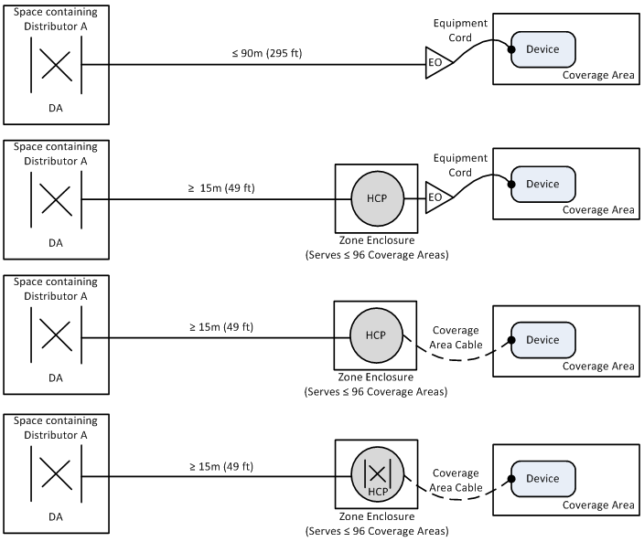
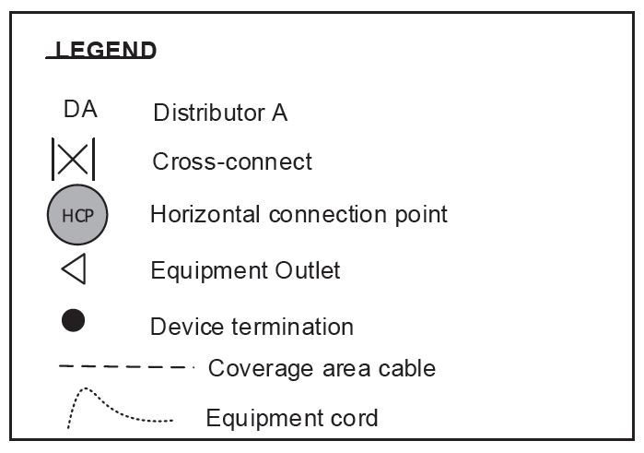
ANSI/TIA-862-B-2016 Horizontal Topology Options
Notes:
This schematic shows the different ways to cable the horizontal from the distributor to the device. Showing different ways to utilize the zone enclosure – as a midpoint for de-centralized cabling or as a cross connect to the active equipment or other controllers before directly attaching to the device. I will show examples later

Slide 17
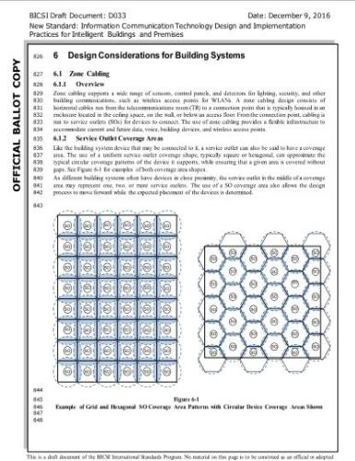
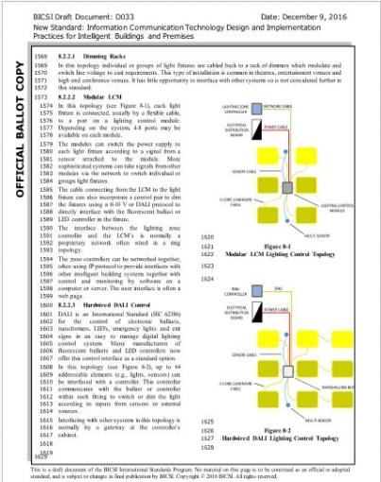
ANSI/BICSI-007-2017: ICT Design for Intelligent Buildings
Integrating Applications on ICT Network
Communications Infrastructure & Network Integration
Design Considerations (Power, Data, Zone Cabling)
Building Systems (Lighting, Digital Signage, Vertical Transportation, Sound Systems, ESS, etc.)
Building Monitoring Systems
Commissioning
Notes:
BICSI 007 – published in 2017 and currently being revised – is a compliment to the TIA standards but gets a little more granular
It contains layouts of unique systems such as LED lighting and even zone cabling.
Currently, these are the systems and chapters that are being addressed in the BICSI standard.
In addition sample matrixes are provided to help the ICT professional map out which devices will interact with each other and how to integrate these into a converged network layout

Slide 18
Designing a Telecom Room that Supports Multiple Systems
Wall-Mounted Systems
Wireless Device Systems
Future Racks and Systems
Core Network
Specialty Systems
Notes:
Adding more applications to the data network will mean that the Telecom room or IT closet as many refer to it will change to accommodate more devices. Here is an example as a single room layout.

Slide 19
Dual TRs that Provides Restricted Access to the Core Network
Critical/Sensitive Information Systems
Restricted Access
Notes:
The BICSI standard also provides a layout separating the core network from the ancillary systems. This is much more secure and provides restricted access to the core network for only approved IT managers or contractors to access.
Restricted area is given the same consideration as the non-critical:
They each have room for growth.
Each room has a separate electrical panel and conduit riser system.

Slide 20
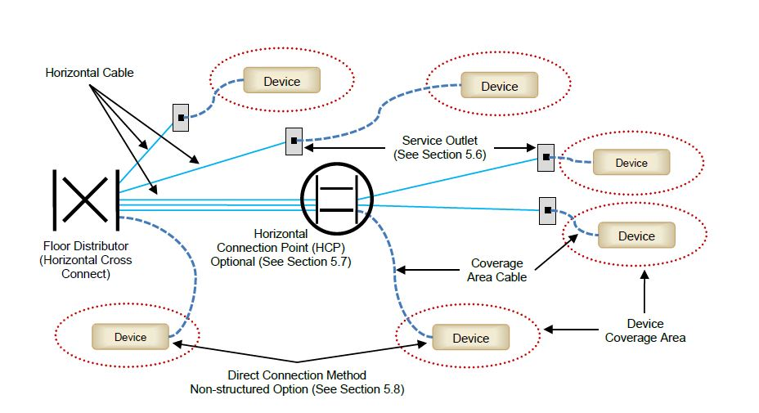
BICSI 007: Horizontal Cabling Elements
(Optional)
Non-structured option
Notes:
This diagram from the BICSI standard demonstrates similarities with TIA but also recognizes the direct connection method – basically putting a plug on the end of a horizontal cable which has been done by security integrators for years but has not followed structured cabling guidelines.
In applications that extend outside traditional voice and data applications, there are circumstances that do not allow a jack to outlet scenario on the device end. The standard recognizes these circumstances and allow for the horizontal cable to directly connect to a device.
And think about what it is being attached to now – security cameras, wireless access points and LED lighting.

Slide 21
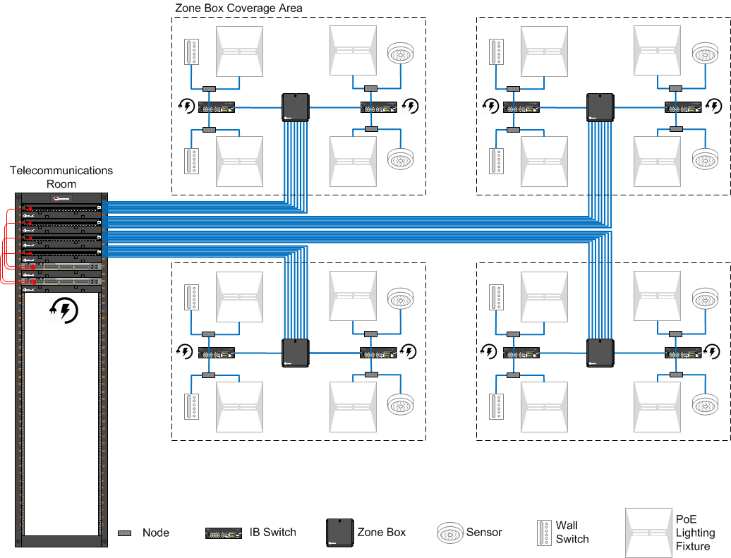

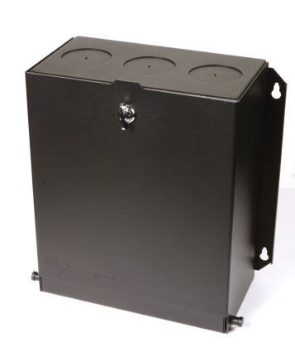
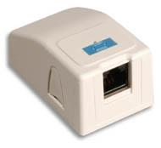
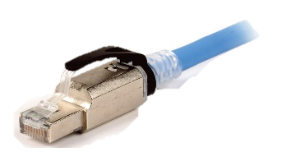
Modular Plug Terminated Link (MPTL)
(H)CP Housed in a
Zone Enclosure
Patch Panel in a TR
Outlet and Patch Cord
Direct Connection
100m
Total Copper Channel Distance
The MPTL is constructed by direct field termination of horizontal cabling at the device end with a modular plug - replacing the TO/SO and associated Work Area (WA) cord.
TIA-568.2-E requires that horizontal cable be terminated onto a TO. In certain cases there may be a need to terminate horizontal cables directly to a plug.
BICSI-007 recognizes the MPTL and refers to it as a direct connection method, with or without an HCP
Notes:
So this is a simplified layout from the telecom room to the device either using a workstation outlet or a direct connection. From the zone enclosure, you can either run a patch cord or a plug terminated horizontal cable.
Both BICSI and TIA recognize this termination style. TIA has introduced in the TIA-568.2-E an alternate topology entitled the Modular Plug Terminated Link (MPTL) to address this environment but recommends that you run the cable from a zone enclosure also known as a consolidation or a horizontal connection point. . BICSI 007 recognizes this either from a consolidation point or directly from the telecommunications room and refers to it as direct connect as we saw previously

Slide 22
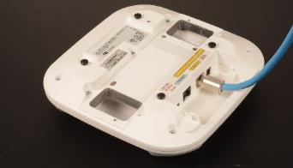
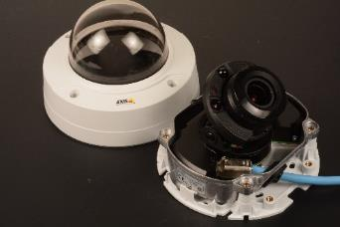
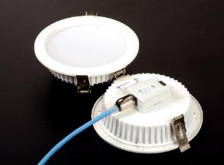
MPTL/Direct Connect Applications
IoT and Intelligent Buildings driving the proliferation of IP-based and PoE-based devices in the walls and ceilings of modern buildings
Wi-Fi
Security
LED Lights
Notes:
Here you can see the applications for the MPTL direct connection.

Slide 23
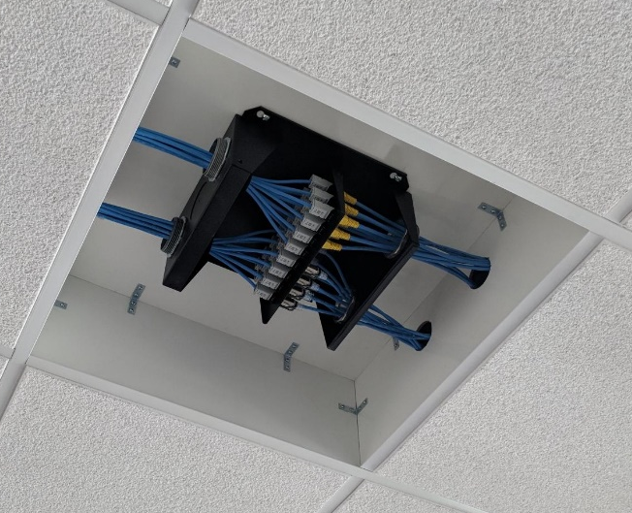
Zone Cabling/HCP (Horizontal Consolidation Point)
Zone cabling is a standards-based approach to support convergence of devices
  Consists of cables run from connections in the telecommunications room (TR) to outlets housed in a zone enclosure servicing coverage areas
  Shorter cables run from outlets in the zone enclosure directly to devices or to outlets servicing devices
25% spare port availability recommended for best ROI
Supports rapid reorganization and deployment of new devices and applications
  MAC work costs less, is faster and less disruptive
  Factory pre-terminated and tested trunking cables can
  be installed from the TR to the zone enclosure for quicker deployment
Notes:
Zone cabling, which has been great for open office architectures because it provides flexibility to have a patch panel in the ceiling and then easily have cables directly terminated into the zone box is now being deployed for intelligent building applications. This allows cable runs to the devices from the zone enclosure instead of having to add another run to the telecom room. This means that reorganization or deployment of new devices only need to run from that zone box out to the outlet or device. This makes it easier as the runs can be exactly measure and a plug can be attached at the end of the run.

Slide 24
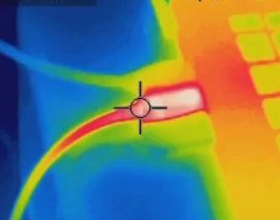
Power over Ethernet
Running parallel power over the data cabling
Notes:
Let’s look at PoE – the requirements and the challenges of running power over data cabling

Slide 25

Existing IEEE PoE Applications
 | Minimum Power at PSE Output | Number of Pairs | Maximum Current Per Pair (Per Conductor)
Power over Ethernet (Type 1) | 15.4 W | 2-pairs | 350 mA (.17 Amp)
Power over Ethernet Plus (Type 2) | 30.0 W | 2-pairs | 600 mA (.3 Amp)
4-pair PoE (Type 3) | 60.0 W | 4-pairs | 600 mA (.3 Amp)
4-pair PoE (Type 4) | 90.0 W | 4-pairs | 960 mA (.48 Amp)
Power over HDBase-T (POH) | 100.0 W | 4-pairs | 960 mA (.48 Amp)
Notes:
Here are the current standards and power for PoE
Type 1 & 2 PoE run over the two spare pairs. Type 3 & 4, which was ratified last year run simultaneously over the four-pair with the data. Note how many amps are allowed PER Pair and per conductor as this will become important when looking at the NEC code and the standards
Power over HDBaseT (POH) enables the transmission of DC power in conjunction with data signals over a single balanced twisted-pair cable to a distance of up to 100 meters/328 feet. The POH standard is based on Type 2 PoE, with the appropriate modifications to enable safe delivery of up to 100 watts (W) over the four-pairs of the cable, as necessary.
In a typical POH implementation, the power source equipment (PSE) is installed and powered by a 50- to 57-volt DC power supply, and all powered devices (PDs) then receive power directly over the HDBaseT link.
IEEE 802.3bt Type 3 and Type 4 is on track to publish in April 2017. DTE powering is intended to provide a 10BASE-T, 100BASE-TX, 1000BASE-T, 2.5GBASE-T, 5GBASE-T, or 10GBASE-T device with a single interface to both the data it requires and the power to process this data.

Slide 26
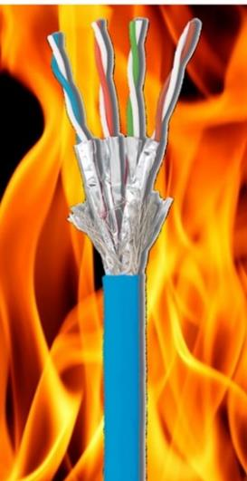
Temperature Rise Considerations
Temperature Rise Considerations
Heat builds up within cable bundles:
  Cabling insertion loss increases at temperatures above 20°C/68°F
  The temperature of any cable should not exceed the temperature rating for the cable
  Cables with higher temperature ratings are listed and marked accordingly
Contact arcing occurs when un-mating pairs under load and may affect connecting hardware reliability
Notes:
When twisted pair cabling is used to remotely power a device, the majority of the power entering the cable is successfully delivered to the device being powered; only a small percentage dissipated as heat in the cabling. This dissipation of power can cause the cabling to increase in temperature above the ambient temperature of the environment in which the cabling is installed. It is recommended to minimize cable temperature rise to reduce long term cable degradation, to minimize negative effect on transmission performance, to reduce the amount of heat added to the surrounding environment. This TSB describes methods to help manage temperature rise and keep cables below their maximum temperature ratings.

Slide 27
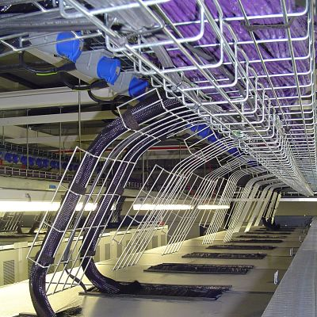
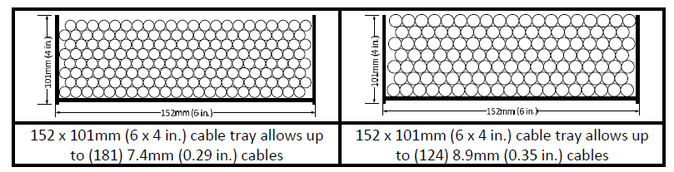
Pathway Capacity
Maximum pathway (cable tray/wireway)
capacity shall not exceed a calculated fill ratio
of 50% to a maximum of 150 mm (6 in)
inside depth.
But what happens when powered cables heat up in bundles?
Notes:
When cable are bundled, care has to be taken in making sure the heat within the cable is kept at a minimum. Cable tray fill ratio is 50%. Conduit is 40%. It will always look full and a lesser fill is recommended. But what happens when the cable pathways are full of powered cables in large bundles

Slide 28
Temperature Rise vs. Current in 100 Cable Bundle
Type 1
Type 2/3
Type 4
Notes:
You have to be concerned with the bundle size AND the cable type. You can see what happens to the cable and temperature rise between Category 5E, 6, 6A and shielded cable.
Here is a chart to show you the temperature rise of the different Category cables. The red arrow highlights the IEEE 802.3 Type 1 at 360 mA, 2 & 3 at 600 mA and type 4 at almost 1000 mA or 1Amp
You have to look at the maximum operating temperature of the cable, which is usually 60 ºC There is great concern for both data and power at these high temperatures which also leads to signal loss

Slide 29
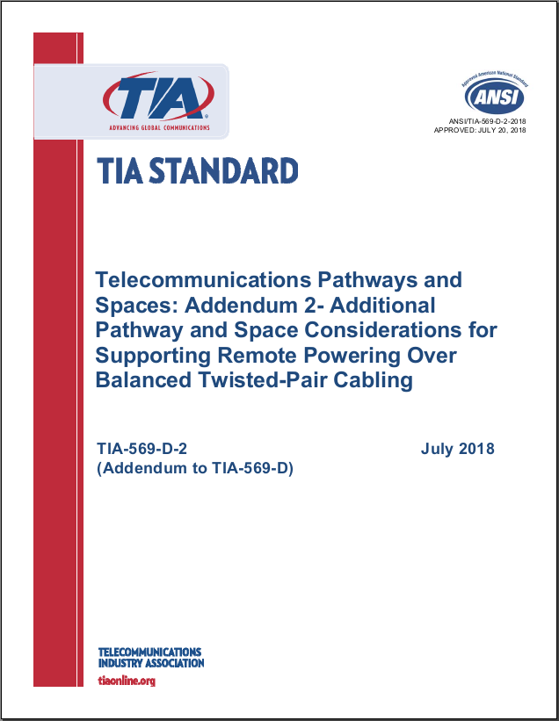
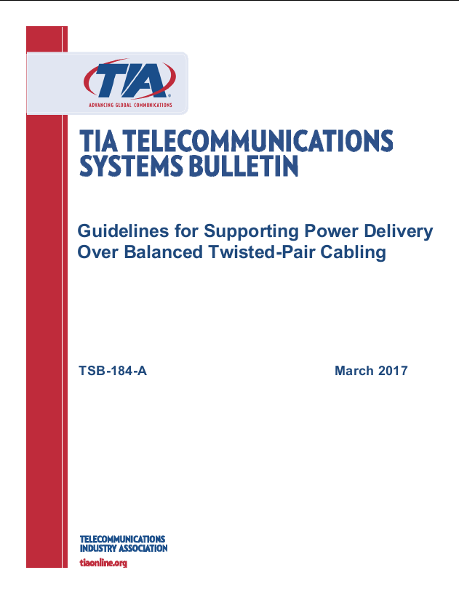
Resources for Cabling Heat Concerns
NFPA 70 (2017 NEC)
TIA TSB-184-A-2017
TIA-569-D-2-2018
Notes:
Standards bodies are providing guidelines for powered cables in bundles.
NEC (NFPA 70) is the benchmark for safe electrical design installation and inspection to protect people and property from electrical hazards.
725.144 – Ampacity table of each conductor (in Amps) in a 4-pair Class 2 or Class 3 data cables, based on copper conductors at ambient temperatures of 30 degrees C (86 degrees F) with all conductors in all cables carrying currents – 60°C (140°F); 75°C (167°F) and 90°C (194°F) rated cables
TIA also provides maximum current capacity guidelines to insure that the balanced twisted pair cable installations meet the installation requirements of
Defines bundle sizes for Cat 5e, 6, 6a and 8 and includes cable with conductor size of 26 AWG.
The standard presumes a maximum ambient temperature of 45°C in conjunction with cabling with a maximum rating of 60°C, thus allowing a maximum temperature rise of 15 °C on any cable within the bundle due to dc powering

Slide 30

2017 NEC Code Revisions
Cable Ratings and Markings for Safety
Ampacity Table for Bundles
Part VI. Premises Powering of Communications Equipment over Communications Cables
840.160 Powering Circuits. Communications cables, in addi-
tion in carrying the communications circuit, shall also be permitted to carry circuits for powering communications equipment. Where the power supplied over a communications cable to communications equipment is greater than 60 watts, communication cables and the power circuit shall comply with 725.144 where communications cables are used in place of Class 2 and Class 3 cables.
Notes:
The rapid expansion and adoption of remote powering led to many contentious discussions within the National Fire Protection Agency in the development of the 2017 edition of the NFPA 70® National Electrical Code® (NEC). The end result was a new Article 840, Part VI requirement addressing premise powering of communications equipment over communications cable.
The text highlighted in red is important – this article only applies when the power supplied is greater than 60W, so let’s quickly review what this will apply to.

Slide 31
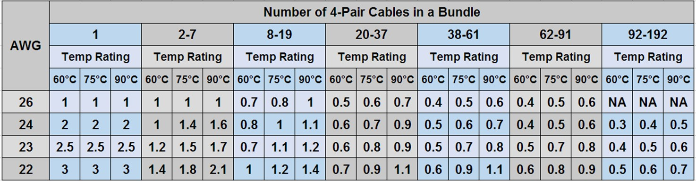
2017 NEC Table 725.144
Conductor gauge, bundle size and temperature rating are used to establish a safe power rating (Ampacity) for each conductor
Notes:
NEC provides an ampacity chart in section 725 as shown. The maximum ampacity that may be carried by a cable conductor is determined by the conductor gage (AWG) size, number of 4-pair cables in a bundle, and the mechanical temperature rating of the cable A couple items to note:
This table is based on an ambient temperature of 30° C (86° F)
It is not specified whether this applies to free-air or conduit

Slide 32
Example: Can this cable support Type 4 PoE?
24 AWG category 5e cable
Bundle size of 75 cables
Mechanically rated to 60°C (Operating Temperature)
Notes:
So how does this table work? Let’s use an example. The maximum ampacity of one 24 AWG category 5e conductor, contained within a bundle of 62-91 cables and mechanically rated to 60° C, is 400 mA or 800 mA per pair. Since Type 4 90W application targets an operating current of 960mA per pair, this example product and installation configuration would not be compliant to the NEC requirements for support of this application.

Slide 33
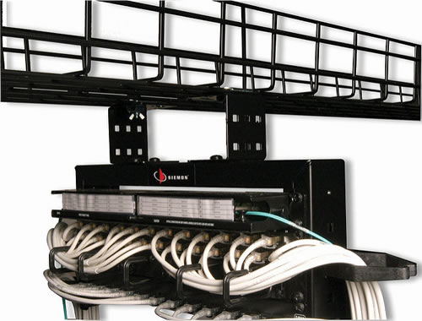
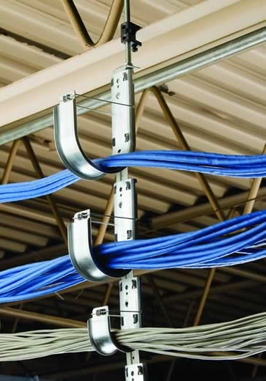
TIA-569-D-2-2018
Additional Pathway and Space Considerations for Supporting Remote Powering Over Balanced Twisted-Pair Cabling (July 2018)
Pathways differ in regard to geometry and contact area between cables, pathway, and air
Provides general guidance on heat dissipation of various pathways by bundle size
Notes:
TIA-569 addresses pathways and spaces. The newest revision of this standard looks at space considerations for pathways when running cable for data and power and provides general guidelines on heat disspation when the cable and bundles are affected. This standard addresses all the different types of pathways.

Slide 34
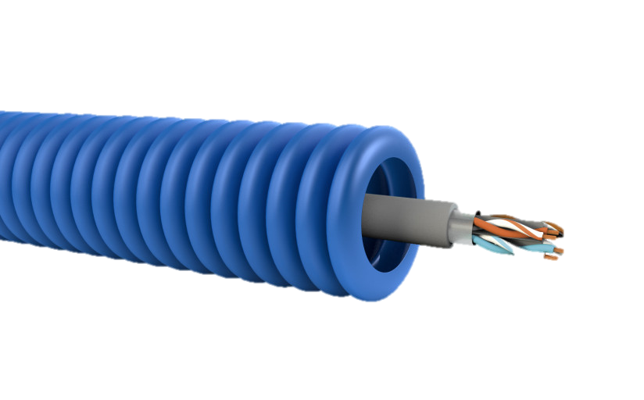
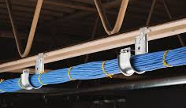
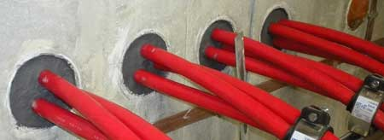
TIA-569-D-2-2018: J-hooks & Conduits
Pathway Type | Cable Routing | Cable Quantity
 |  | 1-37 | 38-61 | 62-91 | > 91
Non-continuous | Bundled | High | High | High | N/A
 | Unbundled | High | High | High | N/A
Conduit (Metallic & Non-metallic) | Bundled | Low | Low | Low | Low
 | Unbundled | Medium | Low | Low | Low
Sealed Conduit | Bundled | Low | Low | Low | Low
 | Unbundled | Low | Low | Low | Low
Notes:
This standard takes a look at the individual pathways and based on the bundle size it shows whether it is rated high, which is good, for heat dissipating. Here you can see that it is better to have the cable in an open j-hook versus a conduit.

Slide 35
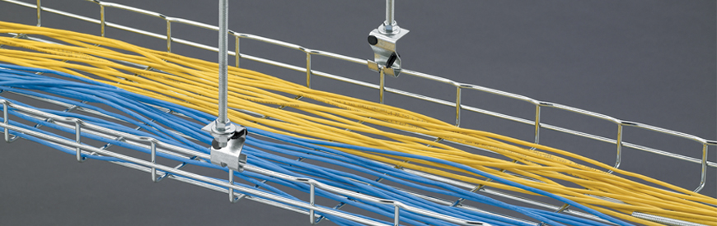
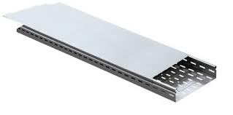
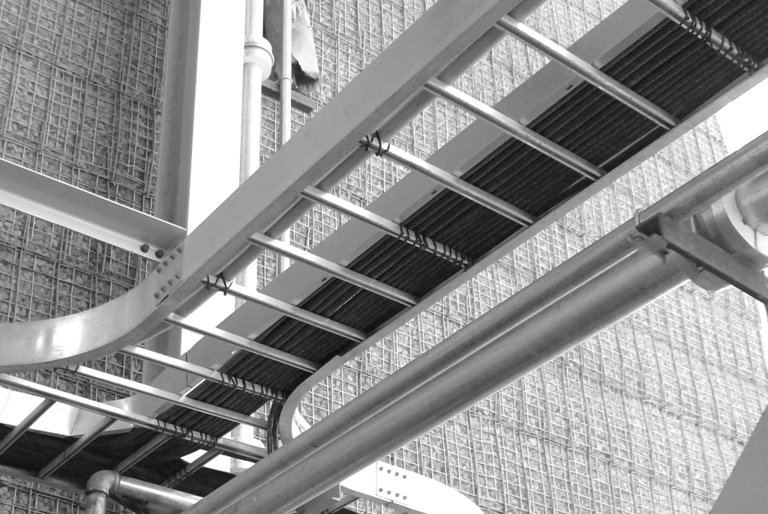
TIA-569-D-2-2018: Cable Tray
Tray Type | Fill Depth (in.)
 | 1 | 2 | ≥ 3
Wire Mesh/Ladder | High | High | High
Ventilated | High | Medium | Low
Unventilated | Medium | Medium | Low
Notes:
Let’s take a look at cable tray. There are different kinds of cable trays – wire mesh, ladder racking, ventilated and unventilated. high is good. It’s the ability of the pathway to dissipate heat

Slide 36
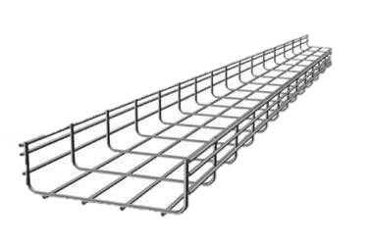
Mitigation Recommendations
Use Category 6A or higher-performing 4-pair twisted-pair cabling, or larger AWG or shielded cables
Reduce channel length, as necessary, to offset increased insertion loss
Use open wire tray or similar cable management that provides for largely unrestricted airflow around the installed cables
Mix unpowered cables with powered cables
Reduce bundle size (24) and allow space between bundles
Notes:
The standards also provides recommendations to mitigate the heat:
Use a higher performing cable or a shielded cable as they can operate at higher temperatures
Reduce (or derate) the length of the cable
Select the right pathway type – an open tray is the best to provide unrestricted airflow.
Mix powered cables with powered cables in the same pathway. Chances are that not ALL cables will be powered.
And reduce the bundle size to no more than 24 cables and spread the bundles out to allow airflow

Slide 37
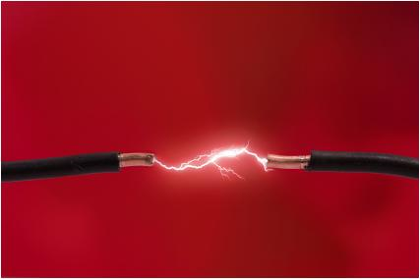
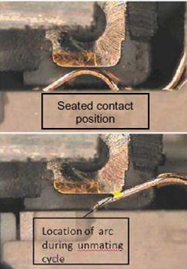
Potential for arcing under load conditions
“Unmating under load” produces an arc as the applied current transitions from flowing through conductive metal to air before becoming an open circuit
Remote powering applications offer some protection to these critical connection points by ensuring that dc power is not applied over the structured cabling plant until a PD is sensed by the PSE
Connecting hardware should be qualified for mating and un-mating under electrical power load. IEC 60512-99-001 is referenced as a suitable test schedule
Notes:
What about the effects of heat on the connector?
The modular plug and jack contacts are carefully engineered and plated (typically with gold or palladium) to ensure a reliable, low resistance mating surface. Today’s remote powering applications offer some protection to these critical connection points by ensuring that dc power is not applied over the structured cabling plant until a remotely powered device (PD) is sensed by the power sourcing equipment (PSE). Unfortunately, unless the PD is shut off beforehand, the PSE will not discontinue power delivery if the modular plug-jack connection is disengaged. This condition, commonly referred to as, “unmating under load”, produces an arc as the applied current transitions from flowing through conductive metal to air before becoming an open circuit. While the current level associated with this arc poses no risk to humans, arcing creates an electrical breakdown of gases in the surrounding environment that results in corrosion and pitting damage on the plated contact surface at the arcing location.

Slide 38
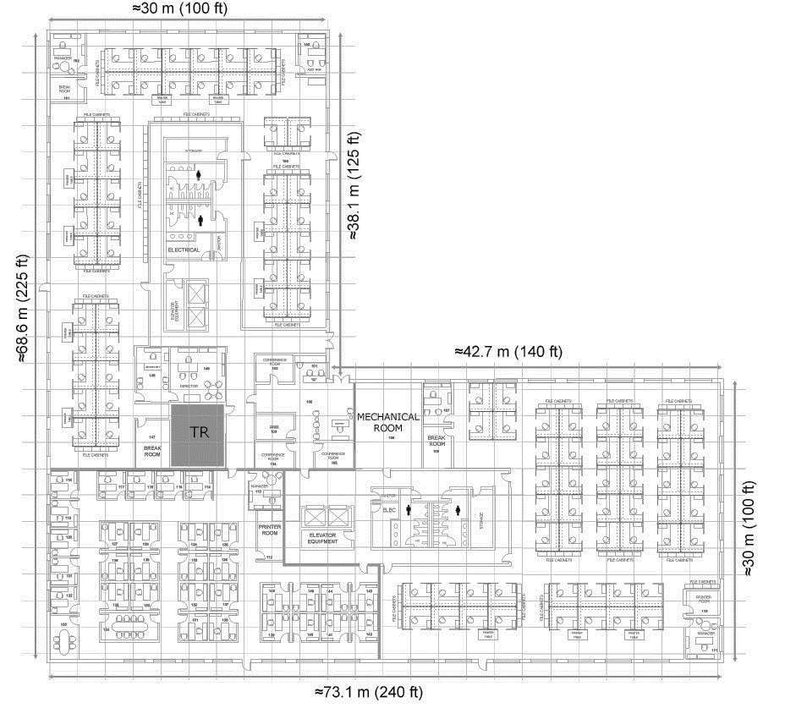
Cable Layout Options for LED Lighting
Different cable layouts
Notes:
There is not one vanilla solution that can apply to LED lighting and the cable layouts and I will show you some examples.

Slide 39

Cabling Layout Selection based on Active Equipment
Notes:
Some of the infrastructure challenges will be the basic network design layout. Centralized versus de-centralized for the processing power. Everything is getting closer to the “edge” to eliminate latency. Also how are you going to design the horizontal cable – point to point or the use of zone cabling. I will discuss this in further detail.
Also, we are used to a data port being a data port and NOT application dependent. For now, the application will determine if there will be four-pair cable to the end device or whether you will still need to run an 18/2. This is determined by the device manufacturers. The cable type will be determined by the application as well – distance, bandwidth and remote power

Slide 40
Node Centric vs. Fixture Centric
Fixture Centric
One to One
More Powered Ports
More Costly
1:1
Node Centric
One to Many
Less Powered Ports
Less Expensive
1:N*
*Where N fixture(s) power requirements are less than the supplied PoE power
Notes:
Also, when employing devices, such as lighting, there are different methods depending on the application and device itself. For example, a fixture centric would be a one to one cable. Some devices employee a node where a category or network cable is connected to the node and then from there, depending on the requirements of the devices, several devices can be attached to the node. Note than when PoE is employed, the number of devices will rely on how much power will need to be supplied to each device.
Let’s take a look at some fixture and node centric layouts as well as centralized vs. decentralized

Slide 41
Typical PoE LED Lighting System
User Interface
Remote Interface / Tech Support
Interactive Video Board
Control
Platform
Wireless
Router
Building System Dashboard
User Interface
Network
Linear Light Fixture
LED Light Fixture
PoE
Gateway/Node
Room Sensors
LED Light Fixture
LED Fixtures
(linked in serial)
Wall Interface
Sensor
Notes:
This is from the BICSI 007 standard which maps out a PoE-enabled lighting system. Some connectivity goes directly from the lighting and some go to a node. What is also important with this layout is to see that there are many controls – either software or hardware – that allows the lighting to be programmed and controlled.
I am going to show you examples of cabling options depending on whether the processing power (which is the switch) is centralized or de-centralized and whether the lights are node centric, which is a one to one ratio, or connected through a node, which then allows many lights to be connected in a row.

Slide 42

Example: Centralized Cabling – Fixture Centric
Notes:
Centralized cabling that is fixture centric means that the computing power for both data and power comes from the switch that is located in the Telecom Room. It’s a one-to-one or point-to-point ratio where the cable is terminated into a patch panel in the rack in the TR and then cabled out to each devices – whether be a light, or access point or sensor. In this case, an AC outlet is not needed at the device end, but because this is running over a Category cable, the 100 meter distance limitation applies

Slide 43

Example: Centralized Cabling – Zone Fixture Centric
Notes:
Here is thecentralized fixture centric layout but this examples shows the horizontal connection point, or a zone box between the TR and the fixtures. The zone boxes can be fully populated with the horizontal cable to the zone box, which contains a patch panel but no active equipment because at this point the power for both data and PoE is being drawn from the powered PoE switch in the telecom room. You can see that there is a lot of cable from the TR to the zone box. This scenario allows flexibility as more devices can be added later as needed and only cable from the zone box to the devices would be needed versus pulling a cable all the way from the TR to the device.

Slide 44

Example: Centralized Cabling – Node Centric
Notes:
Many lighting manufacturers have a node, or a SPICE point or a driver. The cable runs from the TR to the driver/controller/or node and from there the cabling, which in most cases is NOT a four pair but usually an 18/2 runs to the device and you can run more than one device daisy chained from the node.
Centralized Node Centric
Pros
Can employ structured cabling
Relatively easy administration
Minimal connections
Only requires centralized power in TR
Optimizes use of PoE power
Reduces cabling from nodes to fixtures
Supports all IB applications speeds
Cons
Limited flexibility to support MAC activity
High volume of cable
Additional connection point

Slide 45
Example: De-centralized – Zone Node Centric
Notes:
Decentralized means putting the computing power closer to the device itself. Here is a de-centralized and zone topology. The cabling runs from the TR to the zone box and is terminated there. Then it runs through the digital building switch (in this scenario an 8 port Cisco digital building switch is shown) and then from there to the node and then to several devices that can get daisy chained or point to point from the node.
The advantage of a zone cabling environment as I explained previously is that the cable can be terminated to the zone box and then horizontal cable OR a patch cord can run to the device or the node on an as needed basis. But one issue of being de centralized is that you will need AC power for the edge switches.

Slide 46

Key Takeaways:
Planning Your Infrastructure for Intelligent Buildings
Familiarize with the codes and standards
Power and data will co-exist, but can create cabling & pathway challenges
Zone cabling provides a flexible infrastructure
Direct connection (MPTL) now acceptable at the device end
Understand the requirements of the specific applications, requirements and locations before planning the cable infrastructure
Infrastructure needs to be incorporated at the beginning of the building planning stage
Notes:
In summary, we are really at the tip of the iceberg in realizing how much technology can save in costs in many ways and be more efficient in the longrun. But the infrastructure needs to be planned at the beginning of the planning stages with the architects, end users and GCs.
Realizing that power and data will co-exist on the same cable but also get educated on the bundle sizes and heat rise which will need to be carefully planned with proper pathway design.
Zone cabling will allow flexibility as you can add devices later and add the cable to the patch panel in the zone enclosure and also aid in cable management.
But most importantly is the education of all of this technology – talk to the manufacturers as each lighting manufacturer has their own unique operating system and layout – this is still non-standardized. But for the low voltage system designer and contractor, there are standards and codes to aid in the design and installation. Get familiar with these. Get educated and get a seat at the architects table from the onset.

Slide 47

Thank You
Carol Everett Oliver, RCDD, ESS
CEO Communications
Carol.Everett.oliver@gmail.com

