Slide 1
STRANGE BEDFELLOWS:
Electrical and Low-Voltage Contractors Working Together
Carol Everett Oliver, RCDD, ESS, DCDC
CEO Communications
BICSI President-Elect

Slide 2
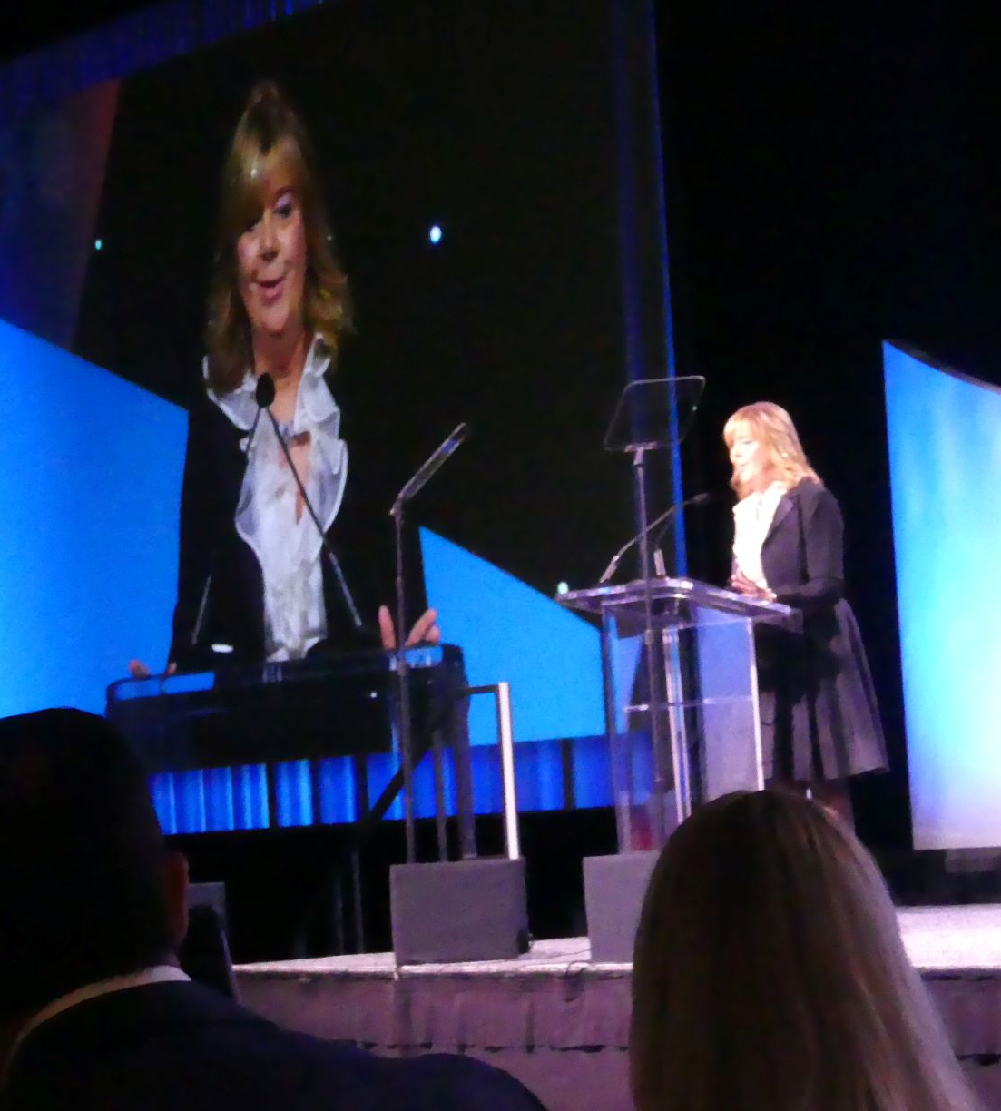
Speaker bio: Carol Everett oliver, rcdd, ess, dcdc
Work Experience
BICSI
Region Director (2012-2016)
Secretary (2016-2020)
President-Elect (2020-2022)
President (2022-2024)
Chair, Intelligent Building Standards
ICT Consulting
Technical Writer (ICT and Electrical)
Contractor Training
Technical Support
Presenter (BICSI, ASIS, IEC)
Notes:
Here’s a bit about me – 25 years in the industry – marketing, white papers, contractor training
Am also on the BICSI board .. Yada yada yada… first woman president of the association in 2022

Slide 3
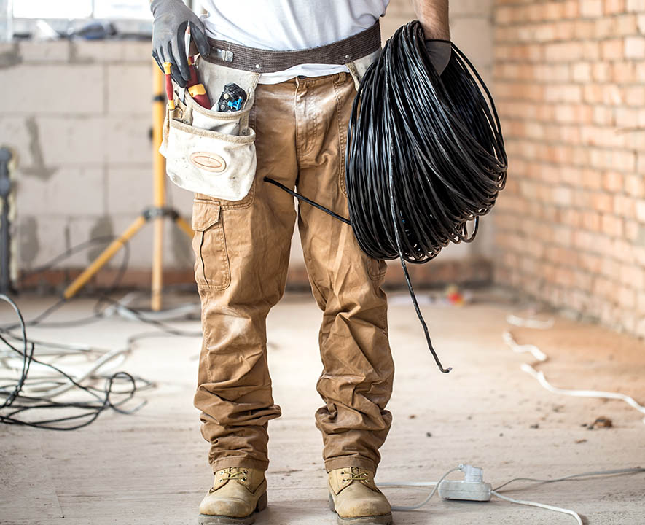
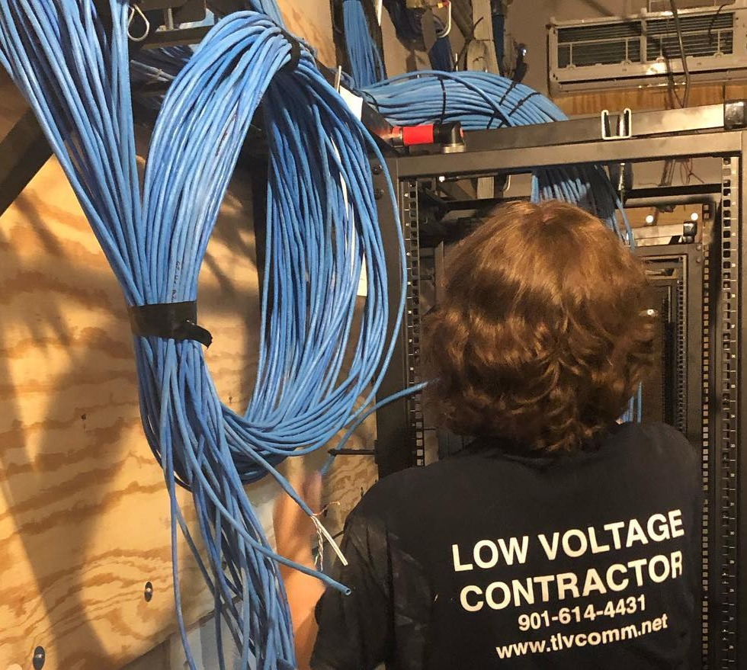
Electrical vs. low voltage - siMILAR, YET DIFFERENT
Electrical Contractors
Low-Voltage Contractors

Slide 4
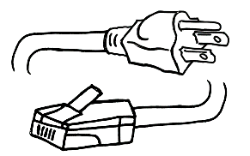
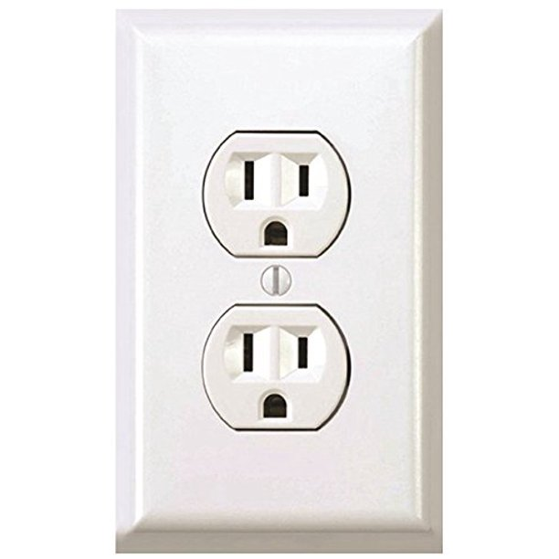
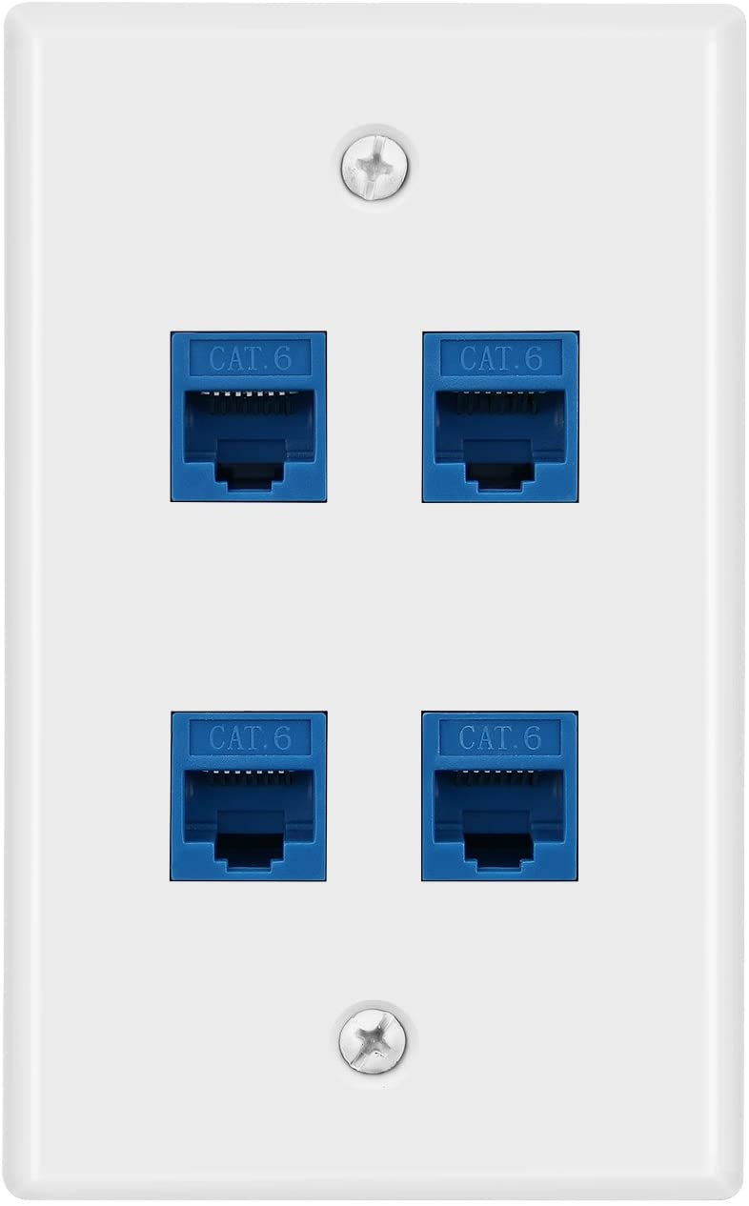
SIMILAR, Yet different
Electrical
Low-Voltage

Slide 5
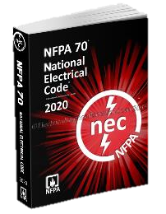
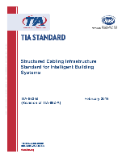
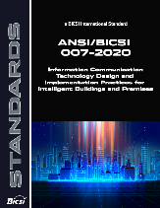
Playing by the rules and standards
Electrical Contractors
Low-Voltage Contractors
NECA
IEC
NEMA
NEC
UL
TIA
ISO
BICSI
NEC
UL
Standards are voluntary
Code is for safety and is mandatory by law!

Slide 6
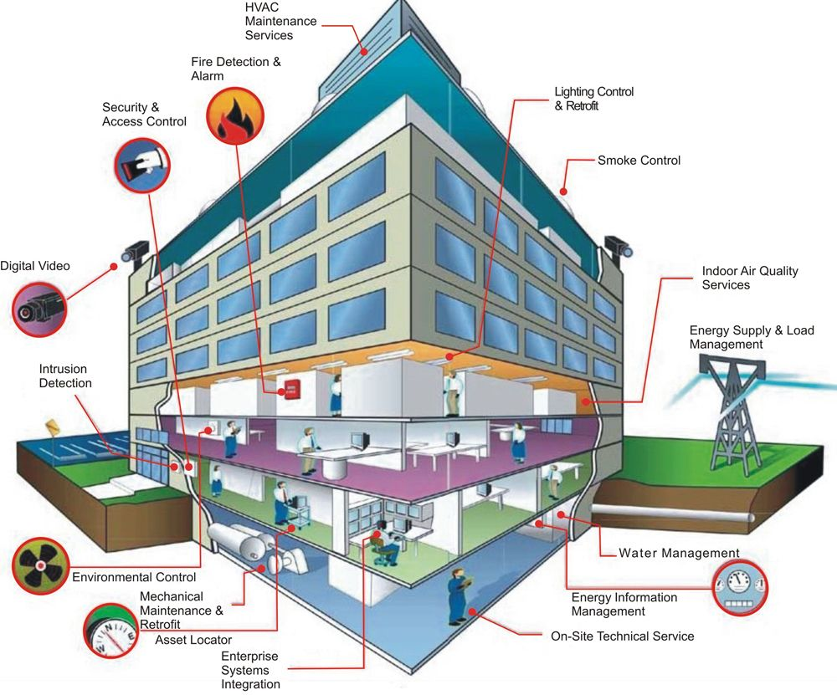
IP CONVERGENCE – Intelligent buildings
Multiple building systems integrated over a single IT cabling infrastructure
Data, control and power (PoE) over the same infrastructure
Remote monitoring

Slide 7
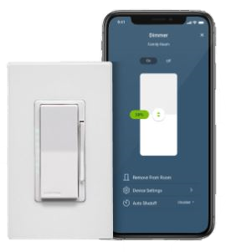
Post-COVID Changes
Development of touchless, voice-activated applications:
Lighting
HVAC
Security/Access Control
Sensors to count occupancy, control lighting, HVAC, etc.
Remote monitoring & control systems
Notes:
And look at what’s going on in today’s businesses and building operations. The Covid pandemic has made us all aware of a touch free environment. This means more sensors to control lighting, HVAC, security and access control. And with social distancing, there are sensors put into place that monitory occupancy counting. Also many electrical manufacturers, such as Leviton provide control of these systems through apps on a mobile device or through the internet.
And, just when open offices were starting to be the new norm, it’ back to closed cubicles and separation which minimizes collaboration.

Slide 8
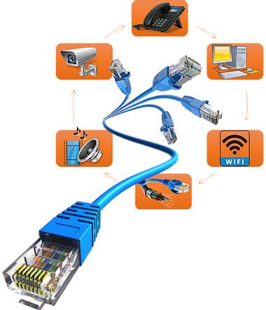
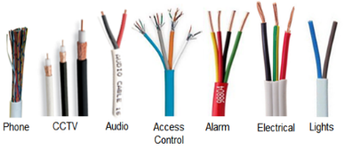
Trending – moving to ip cable
Traditional Building
Employ a vast array of different protocols and cabling systems
Converged Building
Multiple building systems over a single IT cabling infrastructure (fiber and copper)
Notes:
We also know that many of these systems have proprietary cabling. Moving to an IP or Ethernet based network will mean using fiber or copper cabling

Slide 9
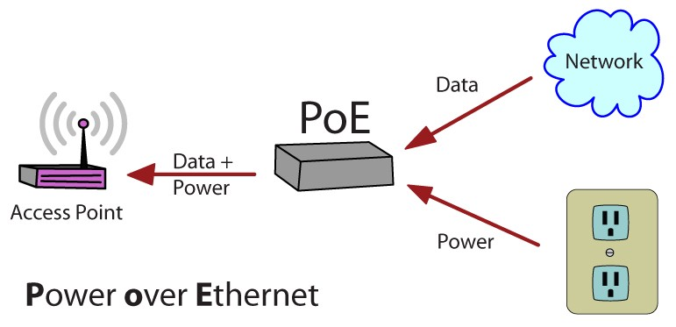
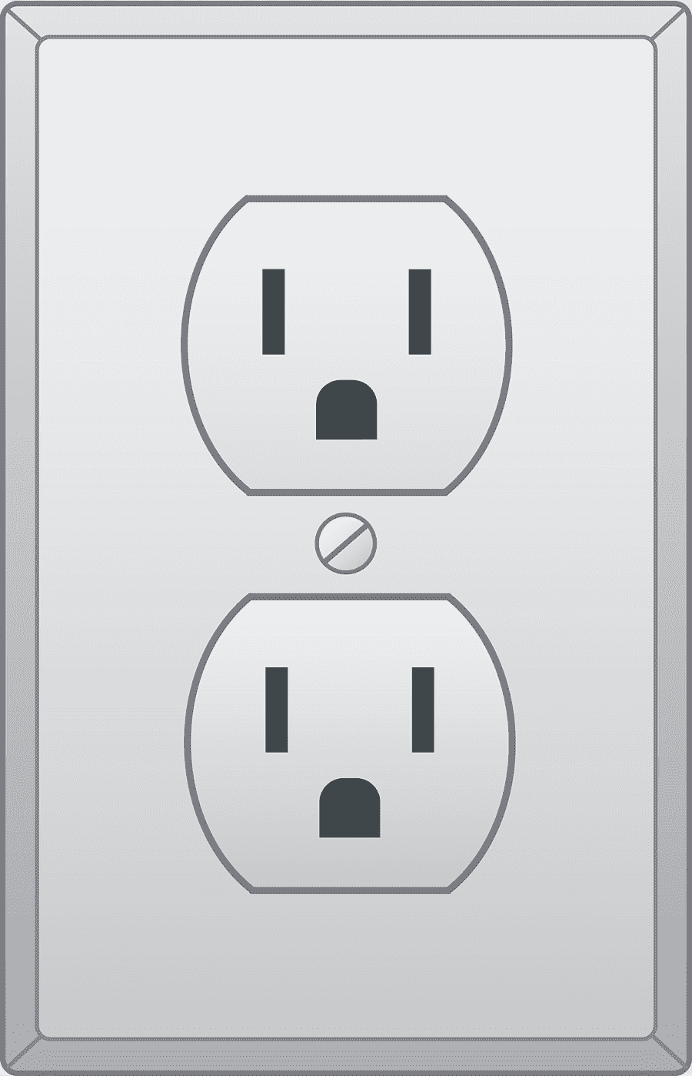
Let’s Talk POE
PD
(Powered Device)
PSE
(Power Source Equipment)
Switch

Slide 10
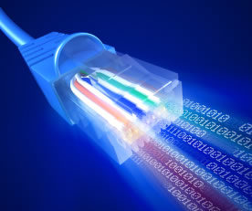
IEEE 802.3 poe standards
IEEE Standard | Year Ratified | Max. Power Per Port (PSE) | Power to Device (PD) | Maximum Current per Pair | Supported Applications
IEEE 802.3af (Type 1) 2-pr. | 2003 | 15.4 W | 12.95 W | 350 mA | Static surveillance cameras, VoIP phones, wireless access points, LED lights, sensors
IEEE 802.3at (Type 2) 2-pr. | 2009 | 30 W | 25.5 W | 600 mA | PTZ cameras, video IP phones, alarm systems,
IEEE 802.3bt (Type 3) 4-pr. | 2018 | 60 W | 51 W | 600 mA | Video conferencing, multi-radio wireless access points, A/V
IEEE 802.3bt (Type 4) 4-pr. | 2018 | 100 W | 71.3 W | 960 mA | Laptops, flat screens, digital signage, daisy-chained LED lighting, outdoor PoE network cameras

Slide 11
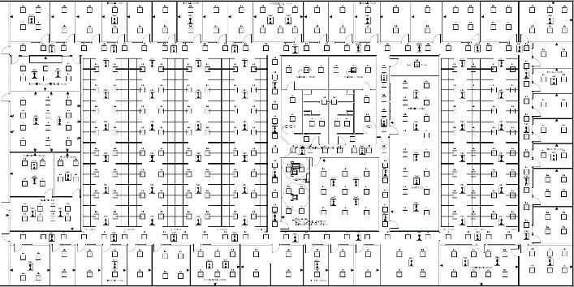
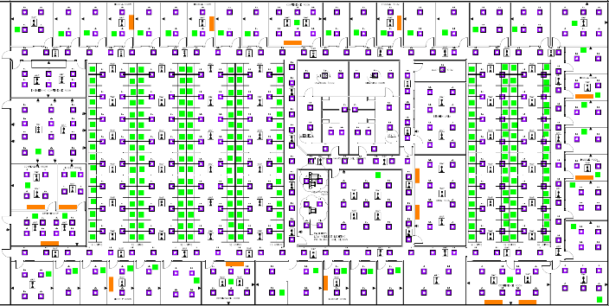
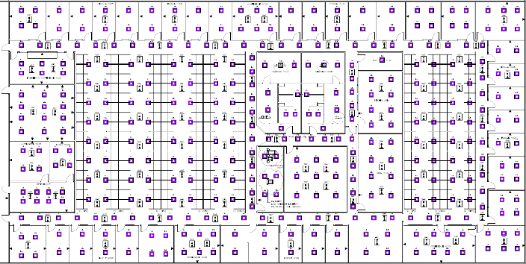
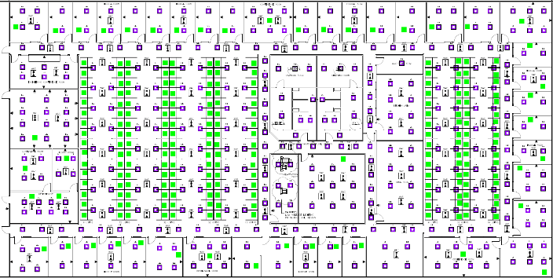
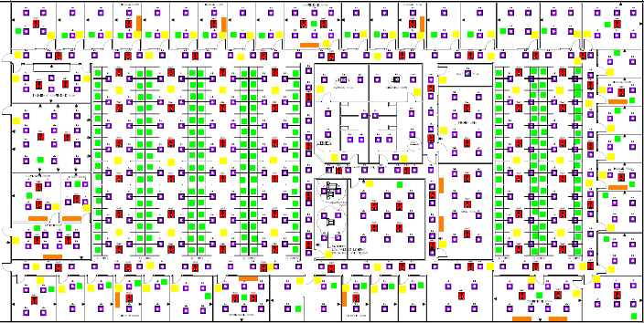
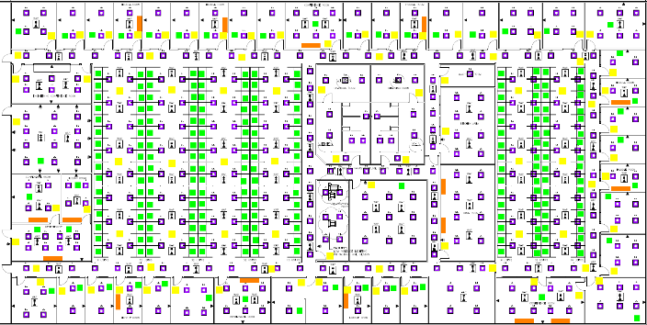
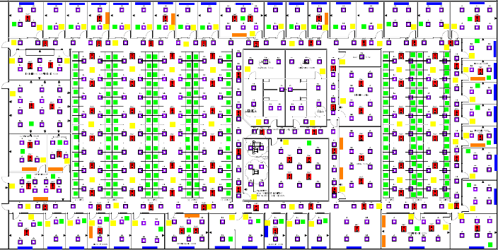
PoE – COMMERCIAL BUILDING APPLICATONS
25,000 SQ Feet
222’-10”
PoE Infrastructure
LED Lighting
389
Data/Telecom
470
Display Signage
15
112’-9”
Occupancy Sensors
89
WAP
102
Shade Control
40
Total
1093

Slide 12
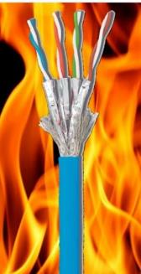
Poe cabling concerns
Cabling insertion loss increases at temperatures above 20°C/68°F
The temperature of any cable should not exceed the temperature rating for the cable
Powered cables should be in smaller bundles for better airflow
Cables with larger AWG have better heat dissipation

Slide 13
Planning the infrastructure for intelligent buildings
Understand the (data and power) requirements of the applications and locations of these devices
Infrastructure and electrical needs to be planned at the beginning of the building design stage
Power and data will co-exist, but can create cabling & pathway challenges
Electricians and low-voltage installers need to work together and become cross-trained.
Notes:
Its no longer all cable fits all applications. You actually have to know the device requirements and location of those devices.
Low voltage cabling used to be an afterthought but now this infrastructure planning needs to take place during the planning stages.
Power and data are co-exiting on the same cable and I can only see more and more devices using PoE technology, but this means there will be challenges to properly lay out the pathways and also the cabling choices.
No one is expected to memorize all of the codes and standards and education resources, such as the huge installation binders from BICSI, but as long as you are aware that these documents exist and where you can find this information
Lastly, not only are the applications being converged, so are the job responsibilities of both electrical and low-voltage designers and installers. Whereas in the past these trades were separate, as we move into the future, we will see more and more cross training going on between professions. I know that BICSI and IEC are working together to offer training to both professions which to me is long overdue that everyone work together as we are moving towards an integrated environment, especially with the awareness that COVID has brought which will change the way building applications will operate.

Slide 14
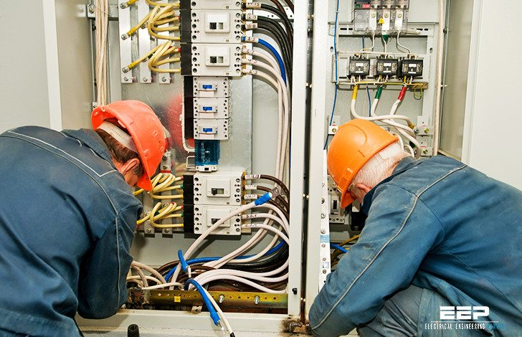
Working Together Creates Opportunities
Cross-training & education
Understanding the resources available (Standards, etc.)
Manufacturer training
Partnering
Trade shows & local events (in person and virtual

Slide 15
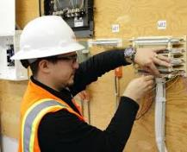
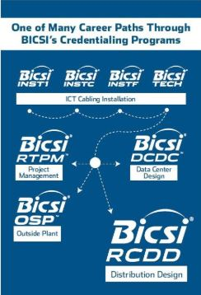
BICSI Credentialing Program
From Installation:
BICSI Installer 2, Copper® (INSTC®)
BICSI Installer 2, Optical Fiber® (INSTF®)
BICSI Installer 1 (INST1®)
BICSI Technician (TECH)
To System Design:
RCDD – Registered Communications Distribution Designer
DCDC – Data Center Design Consultant
RTPM – Registered Telecommunications Project Management
OSP – Outside Plant Designer
Notes:
BICSI also offers installation programs and credentials. I would highly recommend that the electricians take some of these courses or at least purchase the installation guide which covers both copper and fiber cabling installation as well as pathways and other critical elements.

Slide 16
Thank you
Carol Everett Oliver, RCDD, ESS
CEO Communications
ceo@ceocomm.com

