Slide 1


Free to be…you and me in ICT
Carol Everett Oliver, RCDD, ESS
ICT Consultant
BICSI Board of Directors
Notes:
Song will start

Slide 2

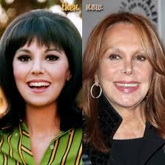
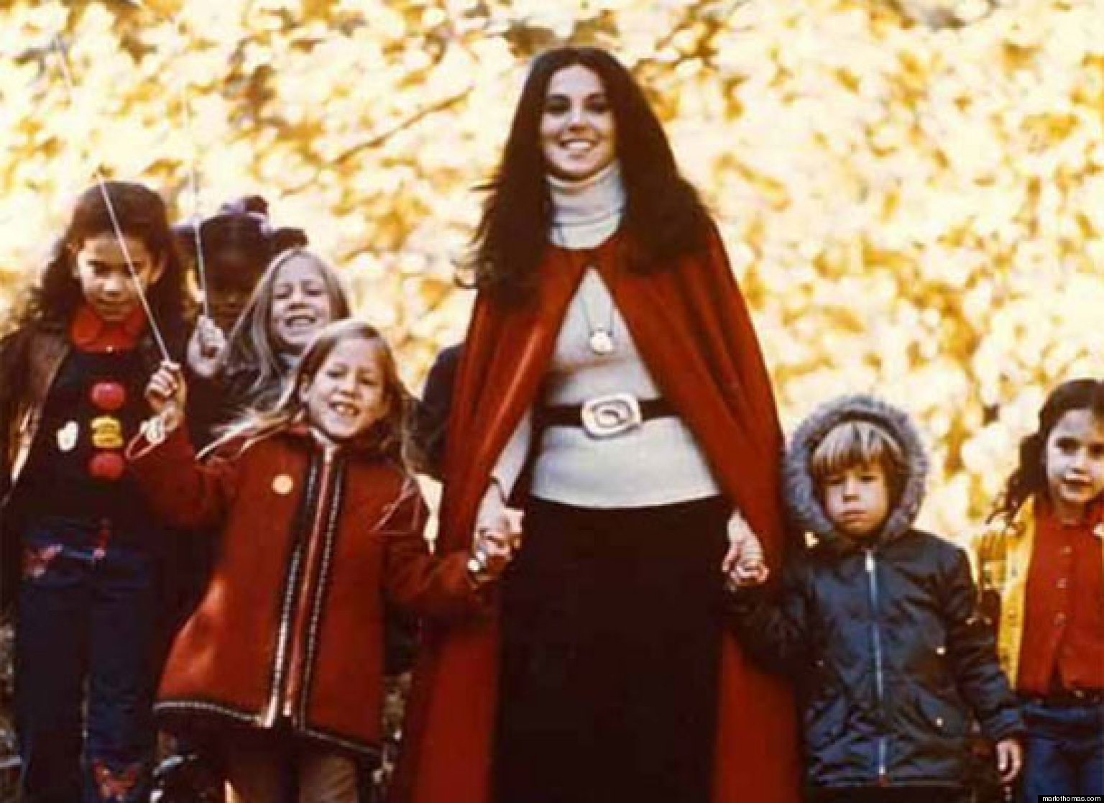
Free to be… you and me
Notes:
Hi I’m Carol Oliver and you were listening to the theme song by the New Seekers from a television show in the 1970’s called Free to be you and me.
CLICK
This show and an entire movement was created by Marlo Thomas, an actress who noticed that most children’s books pidgeon-holed girls and boys – such as girls could grow up to be nurses and boys to be doctors. She brought awareness that all girls and boys could choose any career and that it was even OK for boys to be stay at home daddies.
CLICK
I actually came across this CD when my kids were young in the late 80s and I wanted to instill in both my son and my daughter that the choices for their paths were totally open. My daughter is now a landscape architect and my son a jazz musician.
And so this is my theme for today’s webinar for the Women in BICSI.

Slide 3

Agenda
ICT Career Choices
Training and Education
Certifications/Credentialing
BICSI Volunteerism
Becoming a Mentor
Notes:
I’m going to take a look at career options in ICT for women. This includes understanding the available resources to you through BICSI. These resources include training and education, credentialing, volunteerism and mentoring. And, I am going to highlight some paths chosen by a few notable Women in BICSI.

Slide 4

Embrace Change
Notes:
One thing we know for sure is change is constant in our industry –technology changes quickly and so do opportunities and career choices. Learn to embrace change. Change may bring challenges, but challenges offer opportunities.
I should know from all the changes in my life - moving coast to coast, going through a divorce and the many job changes from being independent to working in the corporate world back to being independent again and being a very active member of the Women in BICSI and in other roles in the BICSI association.

Slide 5
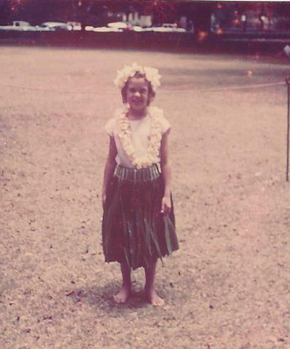
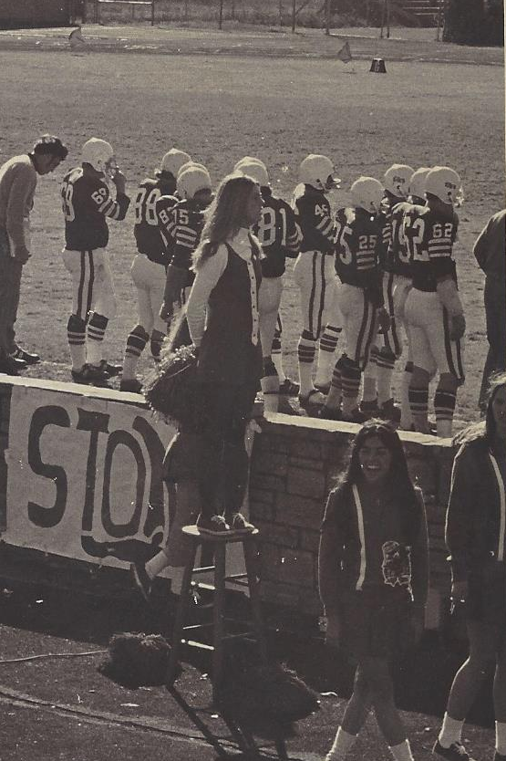
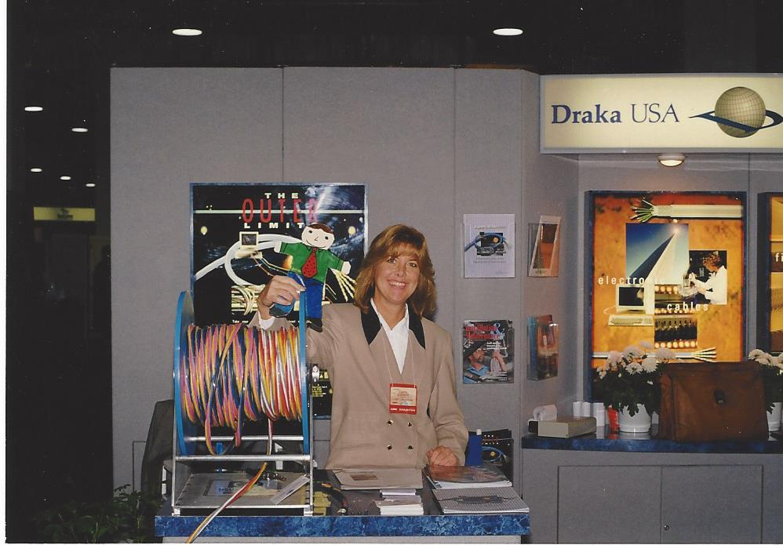
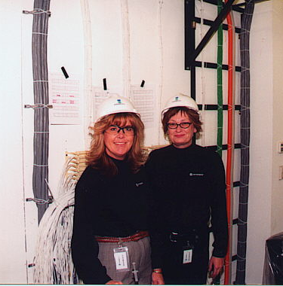
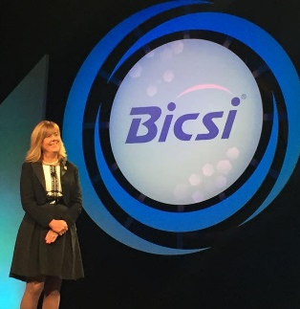
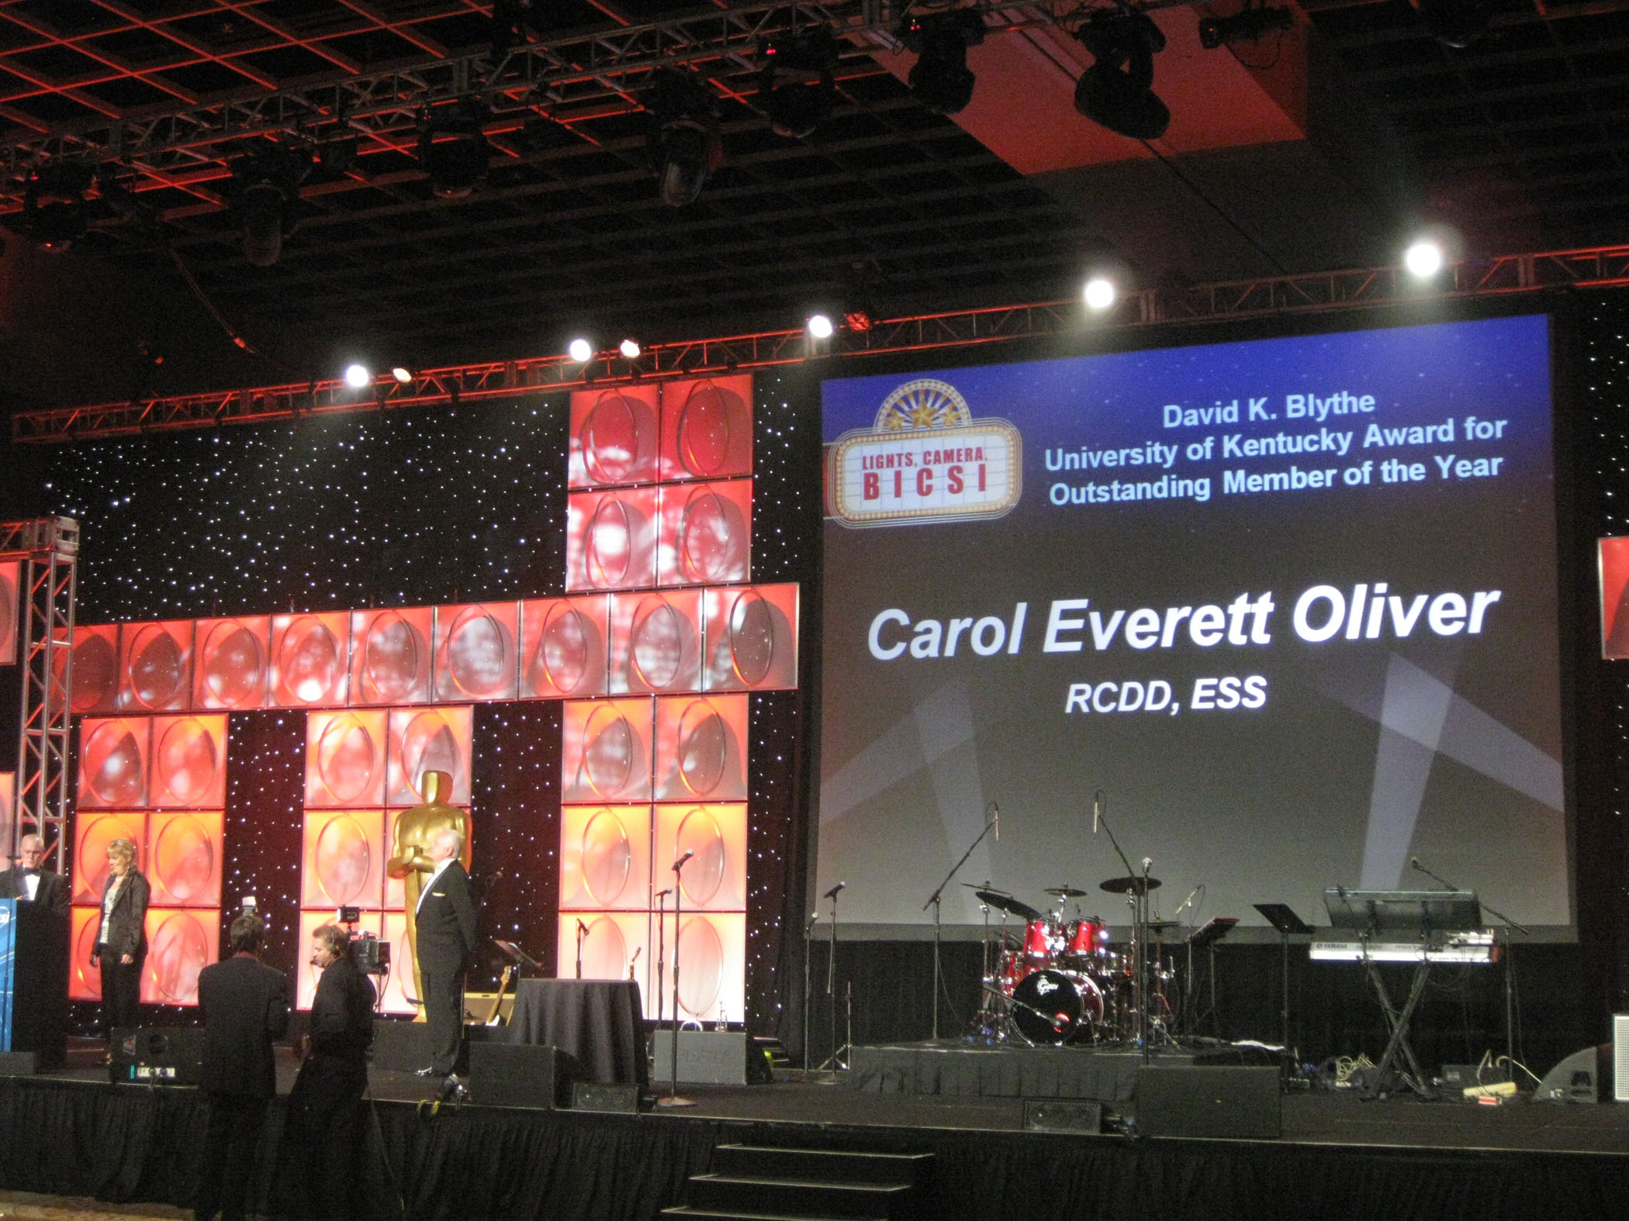
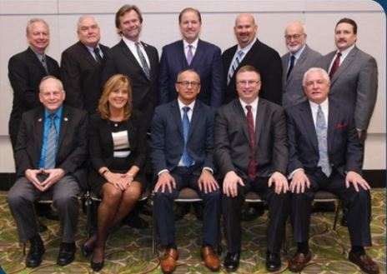
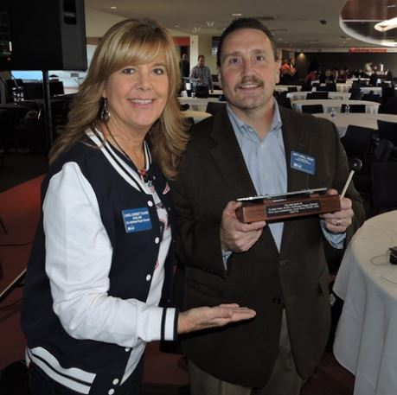
Carol Everett Oliver, RCDD, ESS
Notes:
When I was little, I grew up in Hawaii and dreamed of being a hula dancer
CLICK -- Of course that changed -- I moved to California to go to college where I studied marketing, even though I kept dancing as a cheerleader. After living on the West Coast, I moved to New England and worked for an advertising agency where my biggest client was a fiber optic cable manufacturer.
CLICK – I was coordinating their trade shows and I attended my first BICSI and even met my future husband there. I became really interested in this industry
CLICK – I visited many job sites and wrote installation articles for many different companies in ICT
CLICK – I went on to work directly for a couple of manufacturers and found myself presenting at Conferences which I thought I would never do as that was outside of my comfort zone
CLICK – I got more involved by joining committees and even won member of the year in 2010.
CLICK – After that I ran for the BICSI Board where I have served as Northeast Region Director and now secretary. I continue to serve on the board and on committees such as the standards committees and I am still a frequent presenter at industry events.
CLICK - I get a feeling of great pride in mentoring and passing the gavel on to the next generation. Here I am at the end of my term as Northeast Region director where Matt Odell, one of my best volunteers at the region events went on to take over the Region Director position.

Slide 6

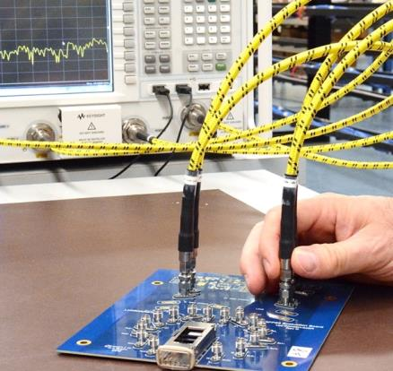
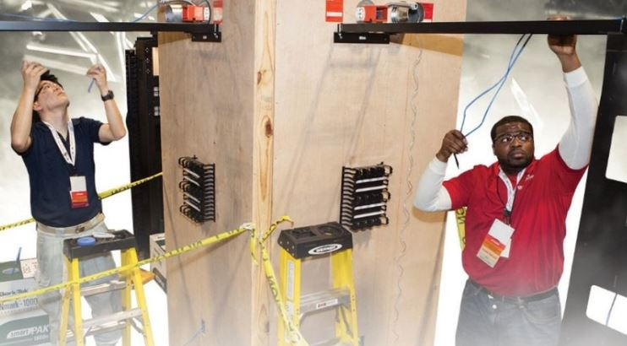
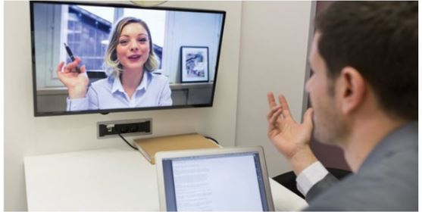
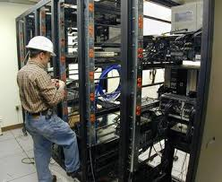
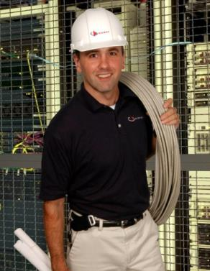

Career Choices
Notes:
There are many career choices in this industry. Whether you want to design, install, be a project manager OR maybe you want to be a trainer or technical writer or an engineer. There are so many possibilities in this industry and BICSI has many resources to help you decide.

Slide 7
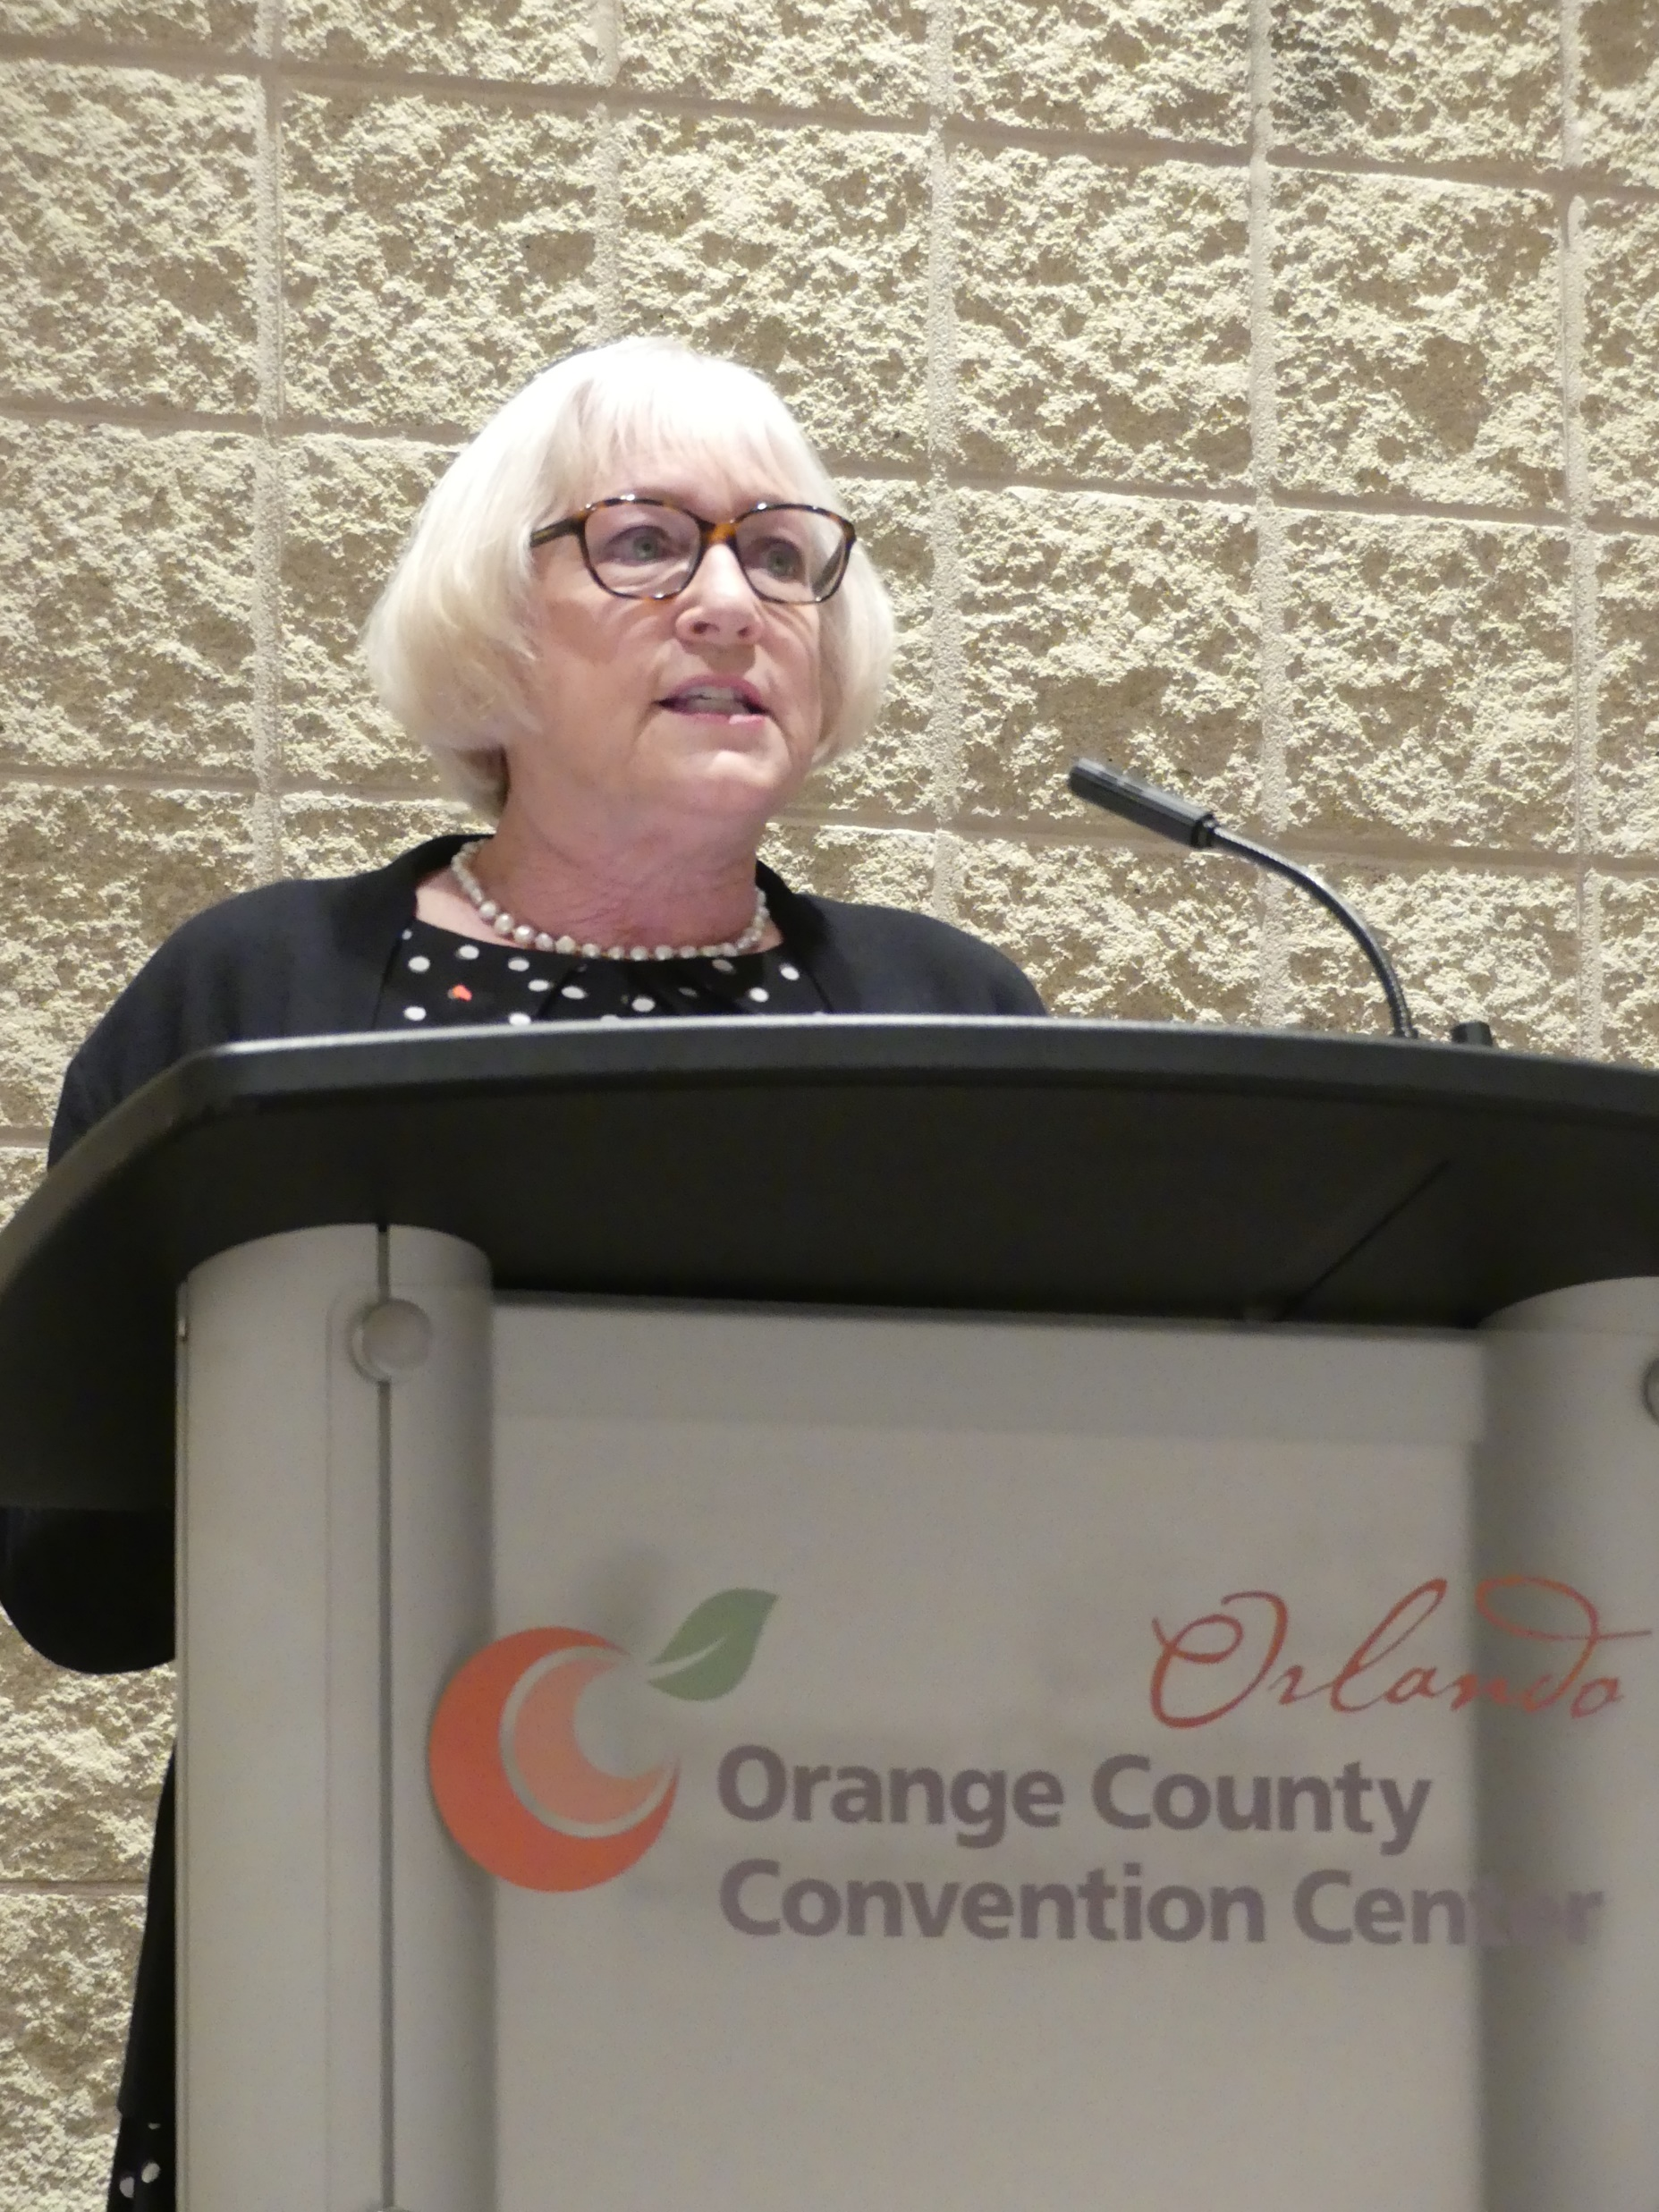
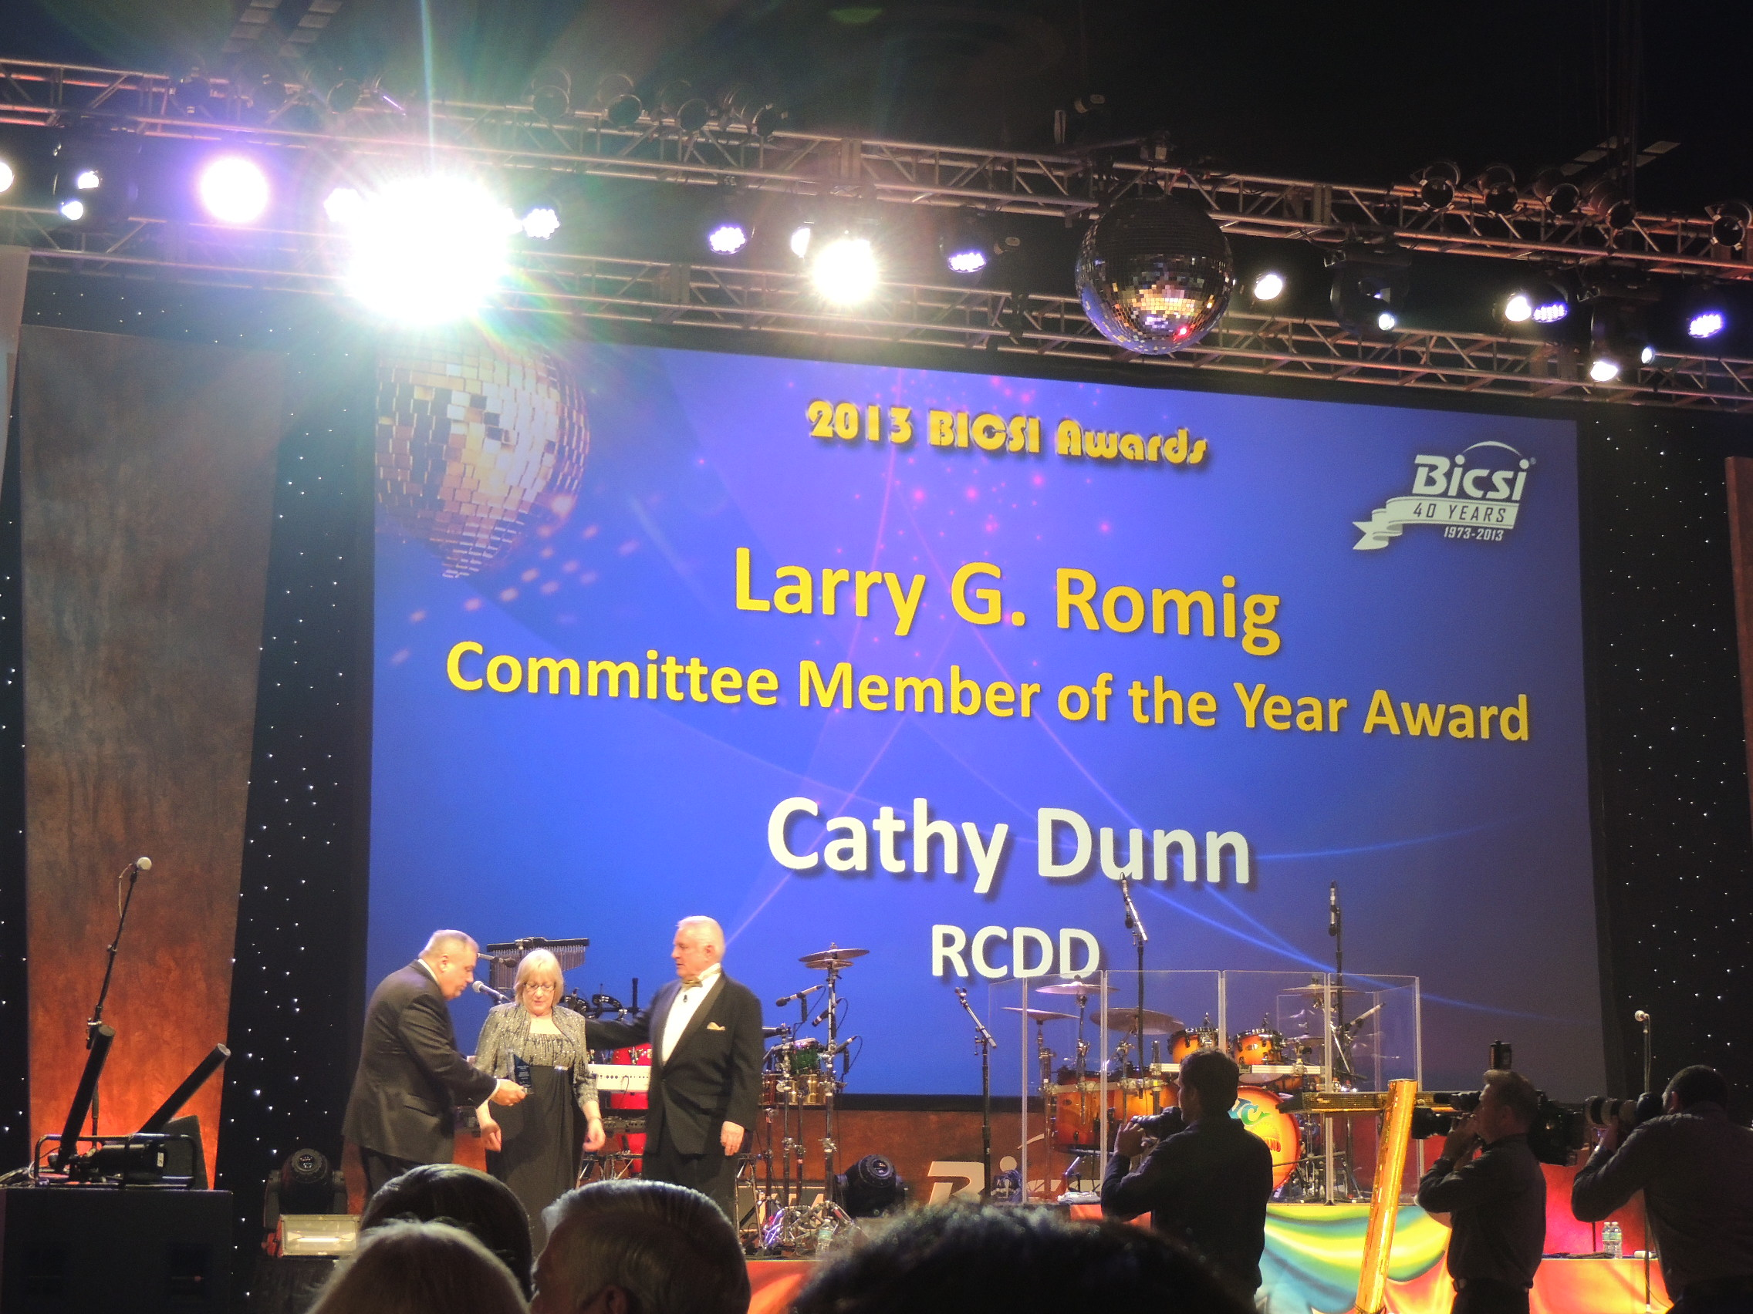
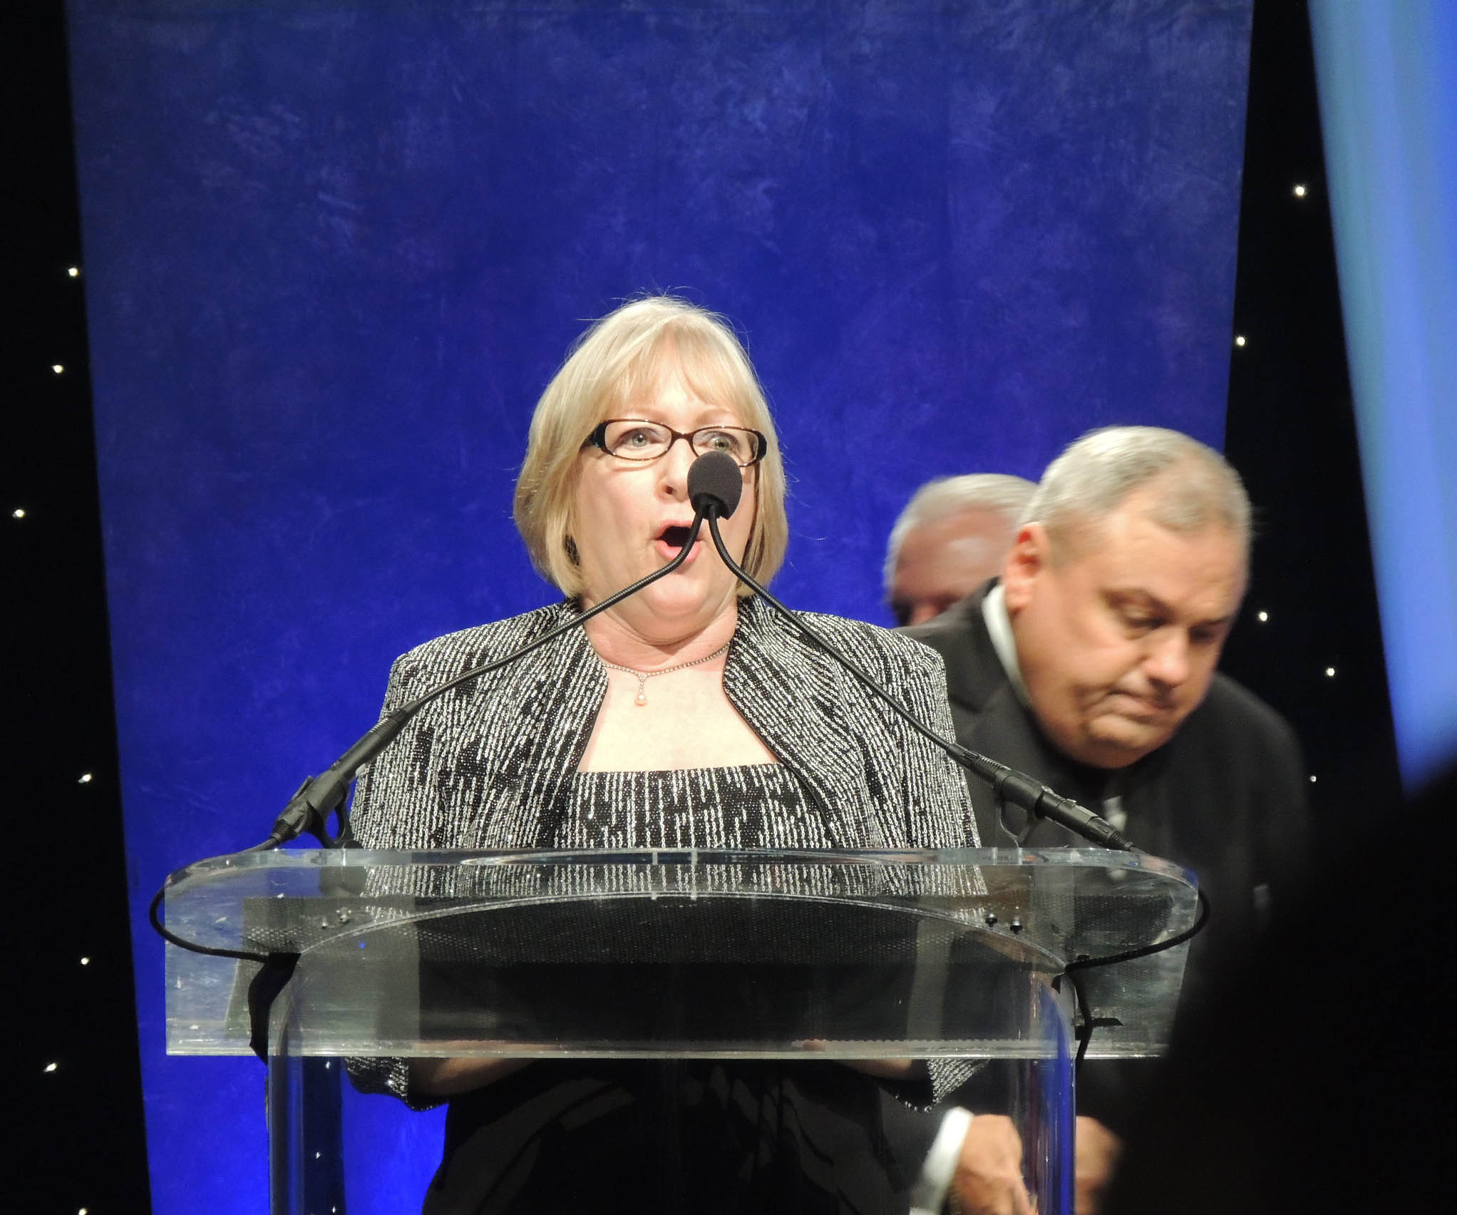
Cathy Dunn, RCDD
BICSI’s first Woman of the Year, Won Committee Member of the year; MOD Committee; Sales Representative – Cabling Skills Challenge
Notes:
Cathy Dunn, another founding member of the Women in BICSI has had many changes in her life – both professionally and personally.
Cathy Dunn had wanted to be either an architect or a doctor but ended up majoring in political science and went on to get her masters in American Government and her MBA.
Somehow she ended up in this industry through a temp job at Hubbell as an administrative assistant to the product managers. She kept asking questions on the products so that she could intelligently answer customer questions on the phone. She had a lot of on the job training and she ended up working as a sales representative for other companies in our industry. She eventually went on to get her RCDD.
Cathy believes in being involved in committees and she was on the Membership Outreach Development (also known as MOD) Committee for 15 years, five of which she served as chair. She also chaired two of MODs Subcommittees – the Speakers’ Bureau and Women In BICSI and has served on several BICSI Task Forces. She also won the prestigious Committee member of the year award and was the first to be awarded Woman of the year even after she retired. Retirement hasn’t slowed Cathy down as she continued to be the sponsorship sales representative for the Cabling Skills Challenge
Cathy is a breast cancer survivor and she is now enjoying the good life in her pool in Cape Coral, Florida. But she still keeps a pulse on the industry and you can probably catch up with her at the Winter Conference.

Slide 8


Training and Education
BICSI CONNECT Web-based training
BICSI Webinars Instructor-led courses online
On-Site Classes BICSI Training Delivery Specialists
Open Enrollment Courses
Authorized Training Facilities and Authorized Design Training Providers (ATF/ADTP) BICSI courses offered at approved locations by licensed instructors
Notes:
There are many forms of training and education.
Through BICSI’s own Learning Academy and through authorized training facilities, BICSI offers both in-person hands on training or online courses.
In addition there are many manuals and standards published by BICSI from which the courses are molded and are great references.
There’s also a boatload of webinars by BICSI and from corporate members of BICSI.

Slide 9
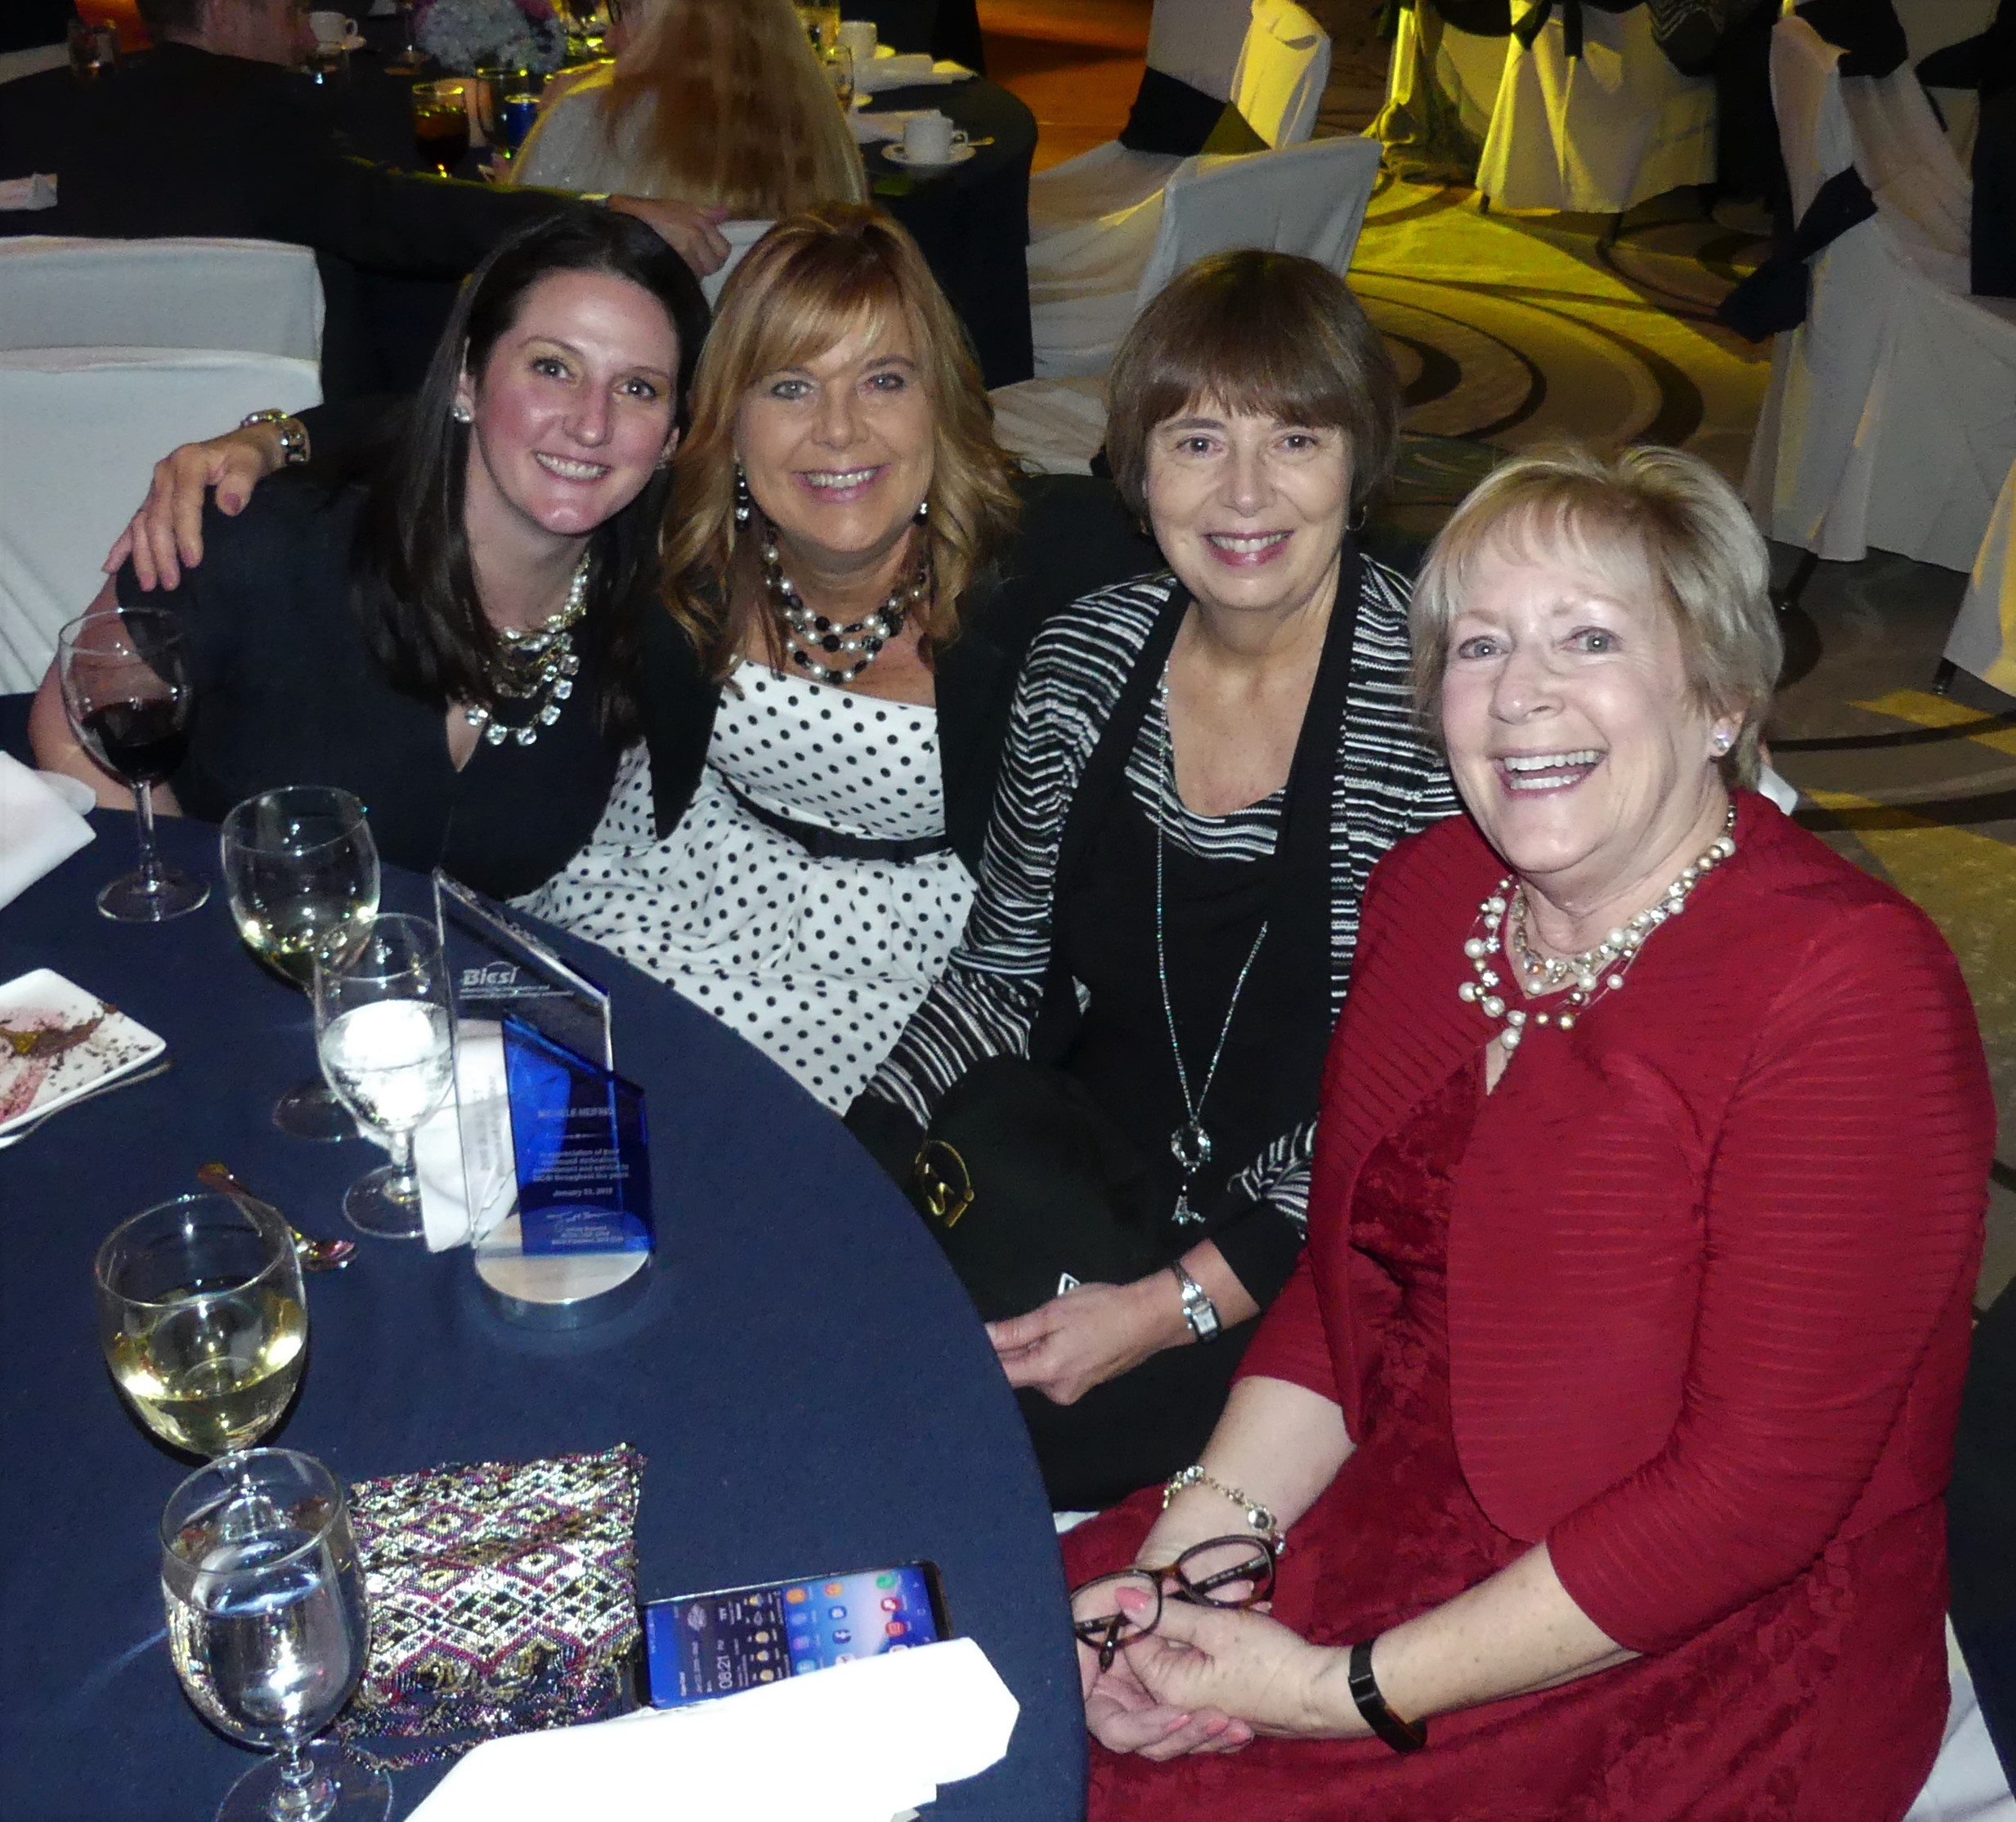
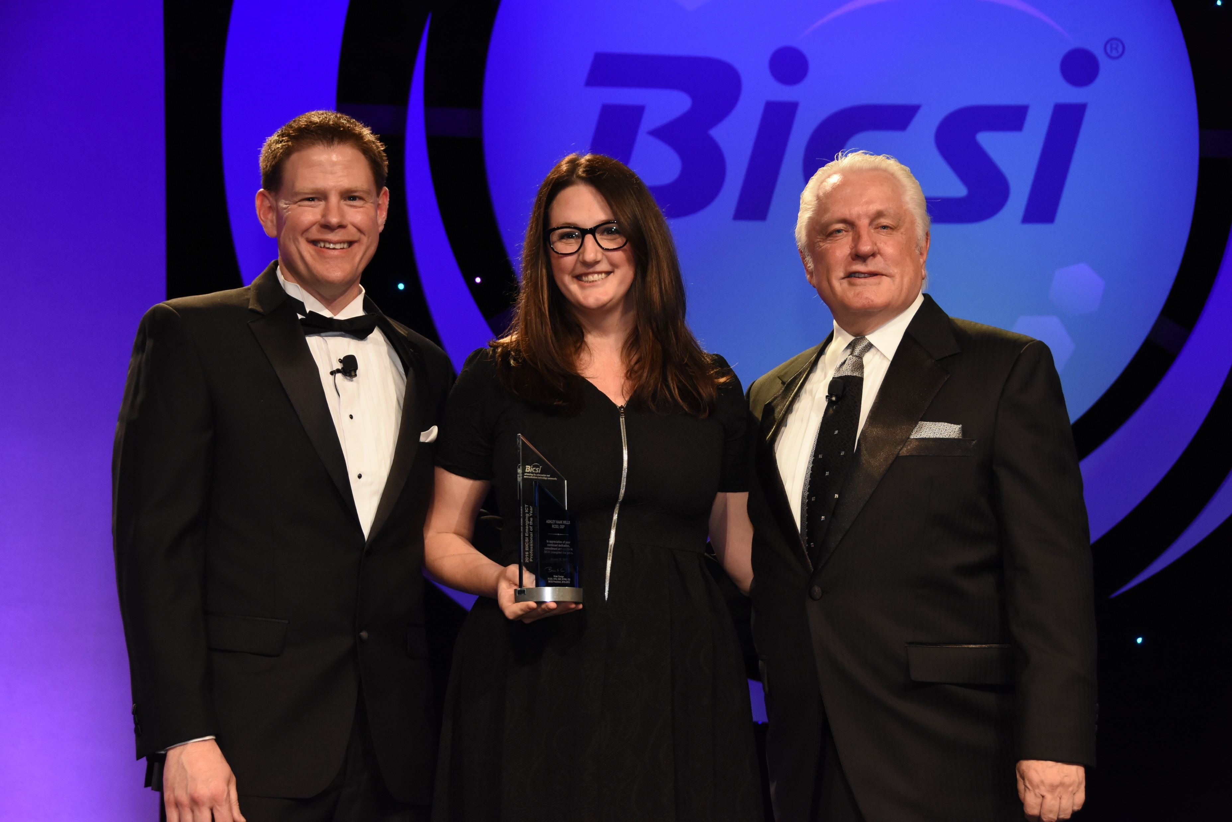
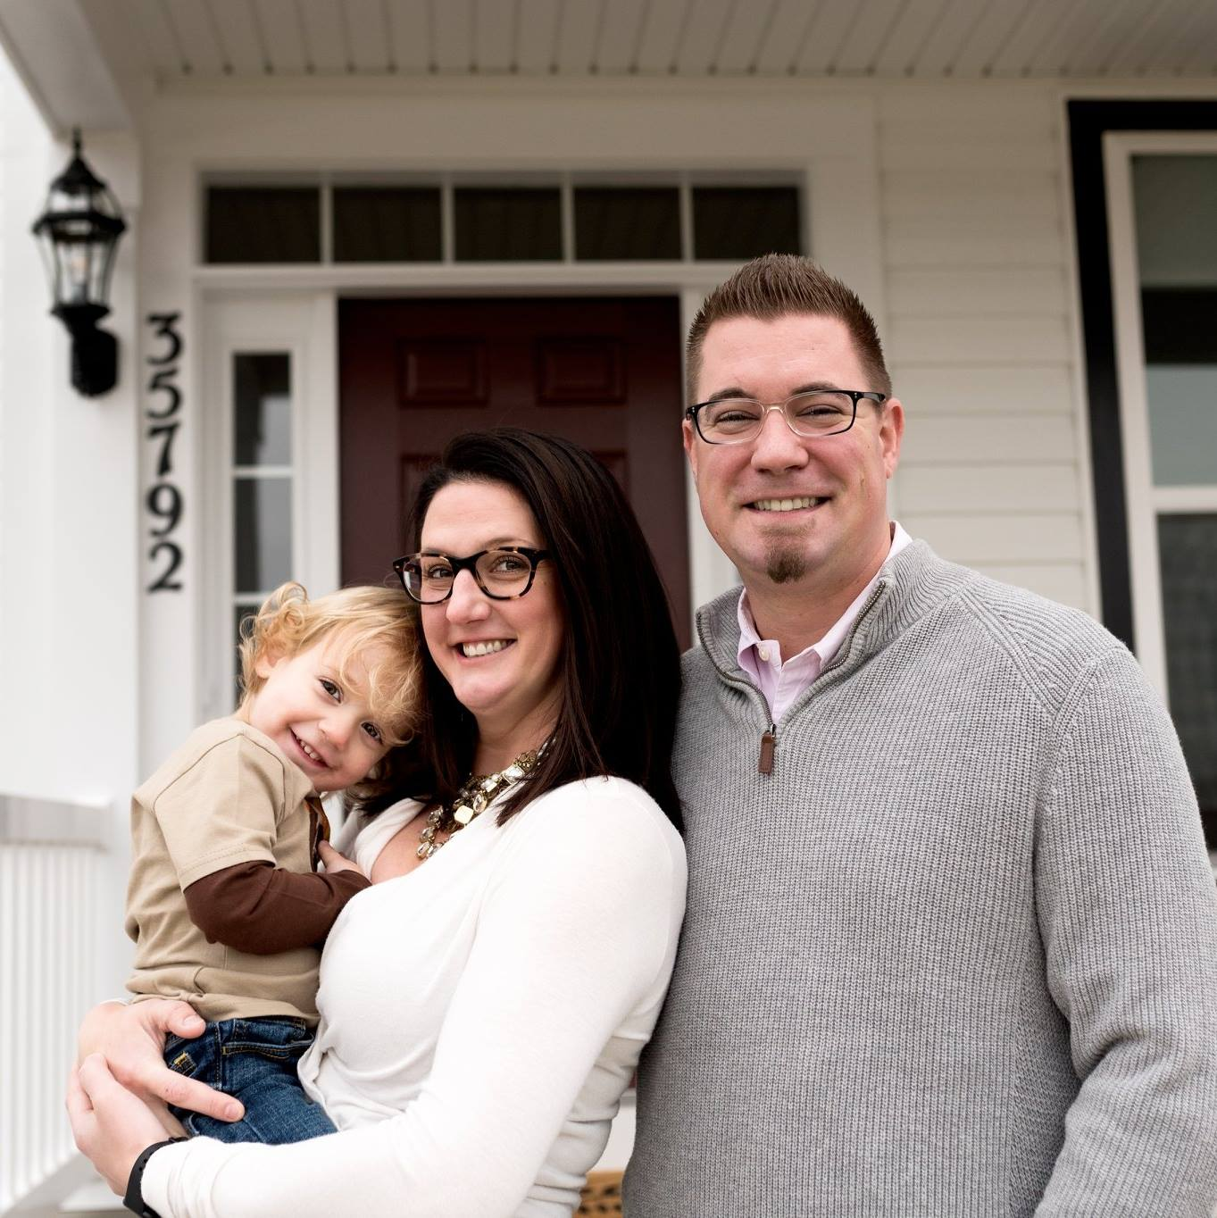
Ashley Wills, RCDD, DCDC, OSP
BICSI’s first Emerging Professional Recipient; MOD Committee Chair; Three-time credential holder; Mom
Notes:
Ashley Wills, who, in her young career, has already excelled in many forms of training and education. In fact, she says her drive for training is “out the wazoo,” and she has already earned her RCDD, DCDC and OSP credentials.
Would you believe that she wanted to be a doctor - specifically a anesthesiologist or an oral surgeon– and actually did a high school internship for an oral surgeon. But when she went on to college she acquired her B.S. in Family and Consumer Science with a Fashion Design focus and a minor in Business Administration. Go figure.
She ended up in the Metro DC area and took a job as an Inside Sales Rep with Anixter and was quickly promoted to working with contractors and integrators where she learned a lot on infrastructure design and then went on to earn her credentials.
I remember meeting Ashley at one of my BICSI Northeast Region Meetings and she was looking for ways to get involved in BICSI. We scooped her up! She joined the Technical Outreach subcommittee before joining the Emerging Professionals group and becoming chair. She then joined the MOD committee and became the chair last year.
She is currently an Account Manager for a large contractor company in Chantilly, VA. But you could call her the “Jill of all Trades” – from engineering to estimating to project management – mainly in data centers. Ashley was the first recipient of the BICSI Emerging Professional Award. She also balances her career with her busy personal life – she has an active 2-year old son and is currently pregnant with a baby girl due this Fall

Slide 10


Professional Credentialing Programs
Registered Communications Distribution Designer (RCDD®)
Registered Telecommunications Project Manager (RTPM)
Data Center Design Consultant (DCDC)
Outside Plant (OSP) Designer
BICSI Installer 1® (INST1®)
BICSI Installer 2, Copper® (INSTC®)
BICSI Installer 2, Optical Fiber® (INSTF®)
BICSI Technician® (TECH™)
bicsi.org\credentialing
Notes:
BICSI offers many credentials. Whether you choose to obtain your RCDD, or installer or even a specialized credential like OSP or DCDC, BICSI can put you on a customized educational track.
Credentialing 2020 was a BICSI Board Strategic Plan initiative that continues to modernize and advance BICSI’s credentialing programs.

Slide 11
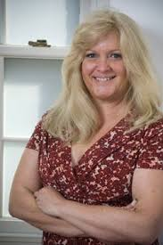
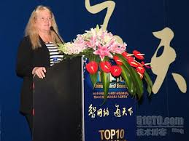
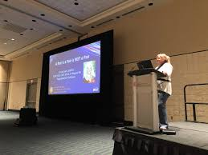
Carrie Goetz, RCDD, NTS
Degrees in Architecture and Computer Science; Global Technology Director; Data center guru; Frequent speaker; Holds 40 certifications
Notes:
Carrie Goetz believes in the strength of training and credentialing. Her education consisted of a lot of on the job training, but she also earned her RCDD and NTS through BICSI.
Would you believe that she originally had a full scholarship ride in college for dramatic arts? But, unfortunately, or fortunately for our industry, the college closed their drama program and so she changed her major and earned a degree in Architectural design. She ended up teaching that subject in college and also took up an interest in writing AUTOCAD programs so… back to school she went and earned a degree in computer science.
She realized she wasn’t afraid of computers and ended up putting together a networking program for the college campus and found herself getting involved in cabling – both in applications and hardware. From that point -- a network designer was born …and the rest is history!
She has worked for a cabling systems’ manufacturer but is now the Global Technology Director for Paige DataCom Solutions and a well-known speaker in this industry. In addition to the BICSI she holds over 40 certifications. If you run into her, ask her about them.

Slide 12

VOLUNTEER
Help Lead BICSI and the ICT Industry
MANY DIFFERENT VOLUNTEER OPPORTUNITIES ARE AVAILABLE
Join a BICSI Committee:
BICSI Cares
Education Advancement
Ethics
Exhibitor Liaison
Finance and Audit
Global Development
Membership Outreach & Development (MOD)
Nominating Committee
Program Coordination
Registrations & Credentials Supervision (RCSC)
Standards
Technical Information & Methods
(TI&M)
bicsi.org\volunteer
.bicsi.org/membership-global-community/membership/bicsi-committees
Notes:
Volunteering with BICSI is the most effective way to make sure your voice is heard within the organization. You should become part of a committee!
Every one of these committees serves different purposes. From BICSI cares, which raises money for local children’s charities to writing manuals in TI&M or standards in the standards committee, or being part of the exhibitor liaison committee for exhibitors, I am sure there is a committee that would interest you and would love to have you as a member.

Slide 13

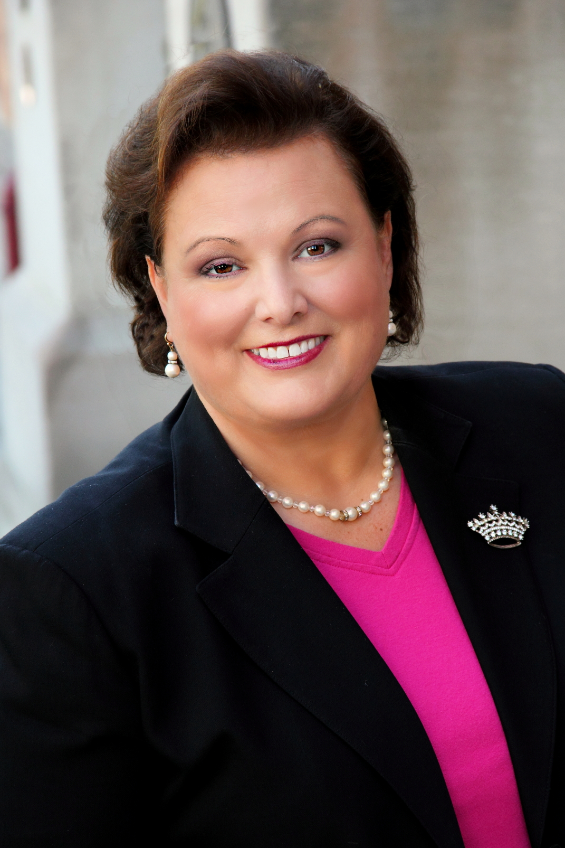
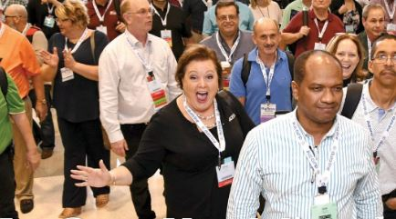
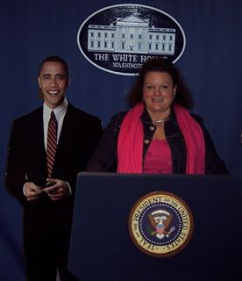

Denise Pappas
“Ms. Fabulous;” Stands out in a crowd; Executive Director for Technical Standards for Valcom and Exec. Dir. Of Keltron; Active BICSI Standards member and Vice chair
Notes:
Denise Pappas is a major contributor in committees – especially as a member in standards such as Intelligent buildings and healthcare and as vice chair to the wireless standard subcommittee. And she represents our industry in the National Fire Protection Association, which publishes the NEC Code.
Nicknamed “Ms Fabulous,” Denise admits when she was little she wanted to be a princess. But things changed when her father passed away when she was only 15. As one of eight children, she saw how hard her mom worked to provide for the family and she always encouraged Denise to shoot for the moon and even if she missed she would land amongst the stars!
Her college major was interpersonal and public communications – who could guess that.
She actually started early in the fire alarm industry with a telecom company and knew that she would be well positioned to converge two industry associations – NFPA and BICSI. She is the Executive Director of Technical Standards for Valcom and the Executive Director of Keltron (a fire alarm monitoring company).
Throughout her career, she has always had several mentors. And now she mentors others. One of the things she says she is best at, is being true to herself
CLICK She may not have become that princess, but she is certainly royal in our industry and has landed amongst the stars.

Slide 14

BICSI Events and
Women in BICSI are Global
Upcoming events taking place in:
Australia
Canada
Dubai
Guatemala
India
Las Vegas
London
Mexico
Oman
Peru
San Juan
Singapore
Tokyo
bicsi.org\conferences
Notes:
SPEAK SLOWLY!
BICSI Women are now being recognized around the world and have opportunities to attend both local, regional and international events. There are 15 global conferences.

Slide 15
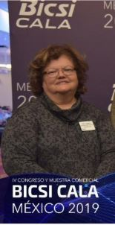

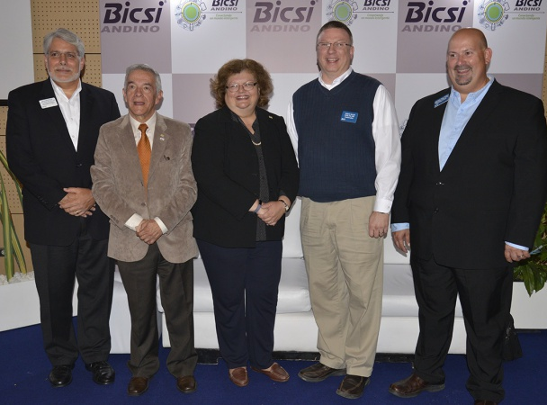
Betty Bezos, PE • PMP • RCDD, DCDC, OSP, ESS, NTS
CDCP-CDFOM-CTDC MSCE · MSEd
BICSI CALA District Chair; BICSI Committee leader and member; Business Owner; Consultant; Six Sigma Green Belt; International Presenter; Writer & editor; Industry Award Winner
Notes:
Betty Bezos is the BICSI Cala District Chair and has about every credential BICSI has offered and also holds other credentials. When she was young, she loved art and history but then fell in love with science and math and majored in civil engineering. She holds both a bachelors and a masters.
After graduation, she took a position with BellSouth in voice communications which morphed into Information Technology and is now known as ICT (Information Communications Technology). She has been a both a design engineer and project manager. When I asked her if there was one momentous event that molded her career she mentioned that it had to be receiving her first computer which was a UNIX based 256K RAM with a 10 megabit hard drive. Try and find one of those today!
Her training has been through the association and on the job and she VERY INVOLVED in BICSI Committees including Global, Standards, TI&M and Ethics where she is vice chair. She is an industry instructor, published author, and frequent presenter at many industry events. She was recognized as an RCDD Changemaker in 2009 and was awarded the BICSI Outstanding Member of the Year the same year
We hope to see more and more international women involved in BICSI. In fact there is a new open position on the board this year – for an EMEA Region director for Europe, Middle East and Africa.

Slide 16





Stay in the BICSI Social Media Loop
Join us on LinkedIn: linkedin.com/company/bicsi
Like us on Facebook: facebook.com/bicsi
Follow @BICSI on Twitter: twitter.com/bicsi
View videos on YouTube: youtube.com/user/BICSI2008
bicsi.org
Notes:
BICSI is very active on social media Make sure you join, friend, follow or like these social media sites to stay up to date and stay in touch with other members.

Slide 17
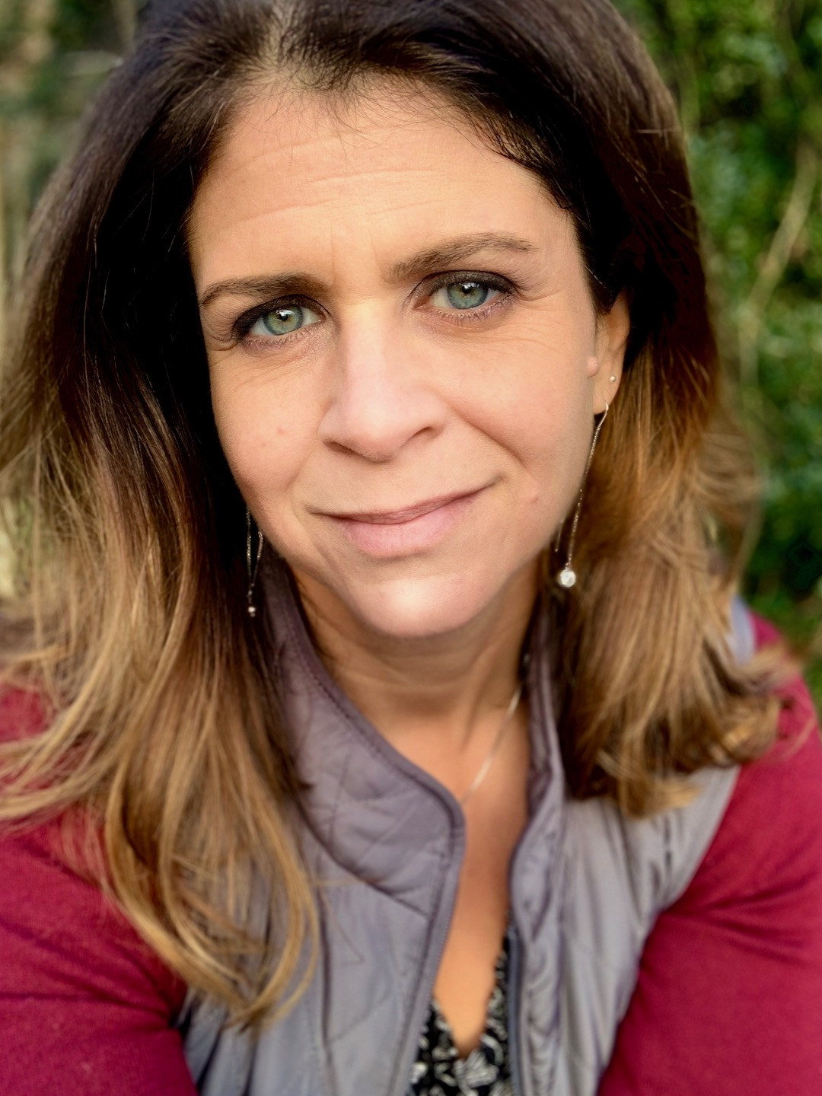
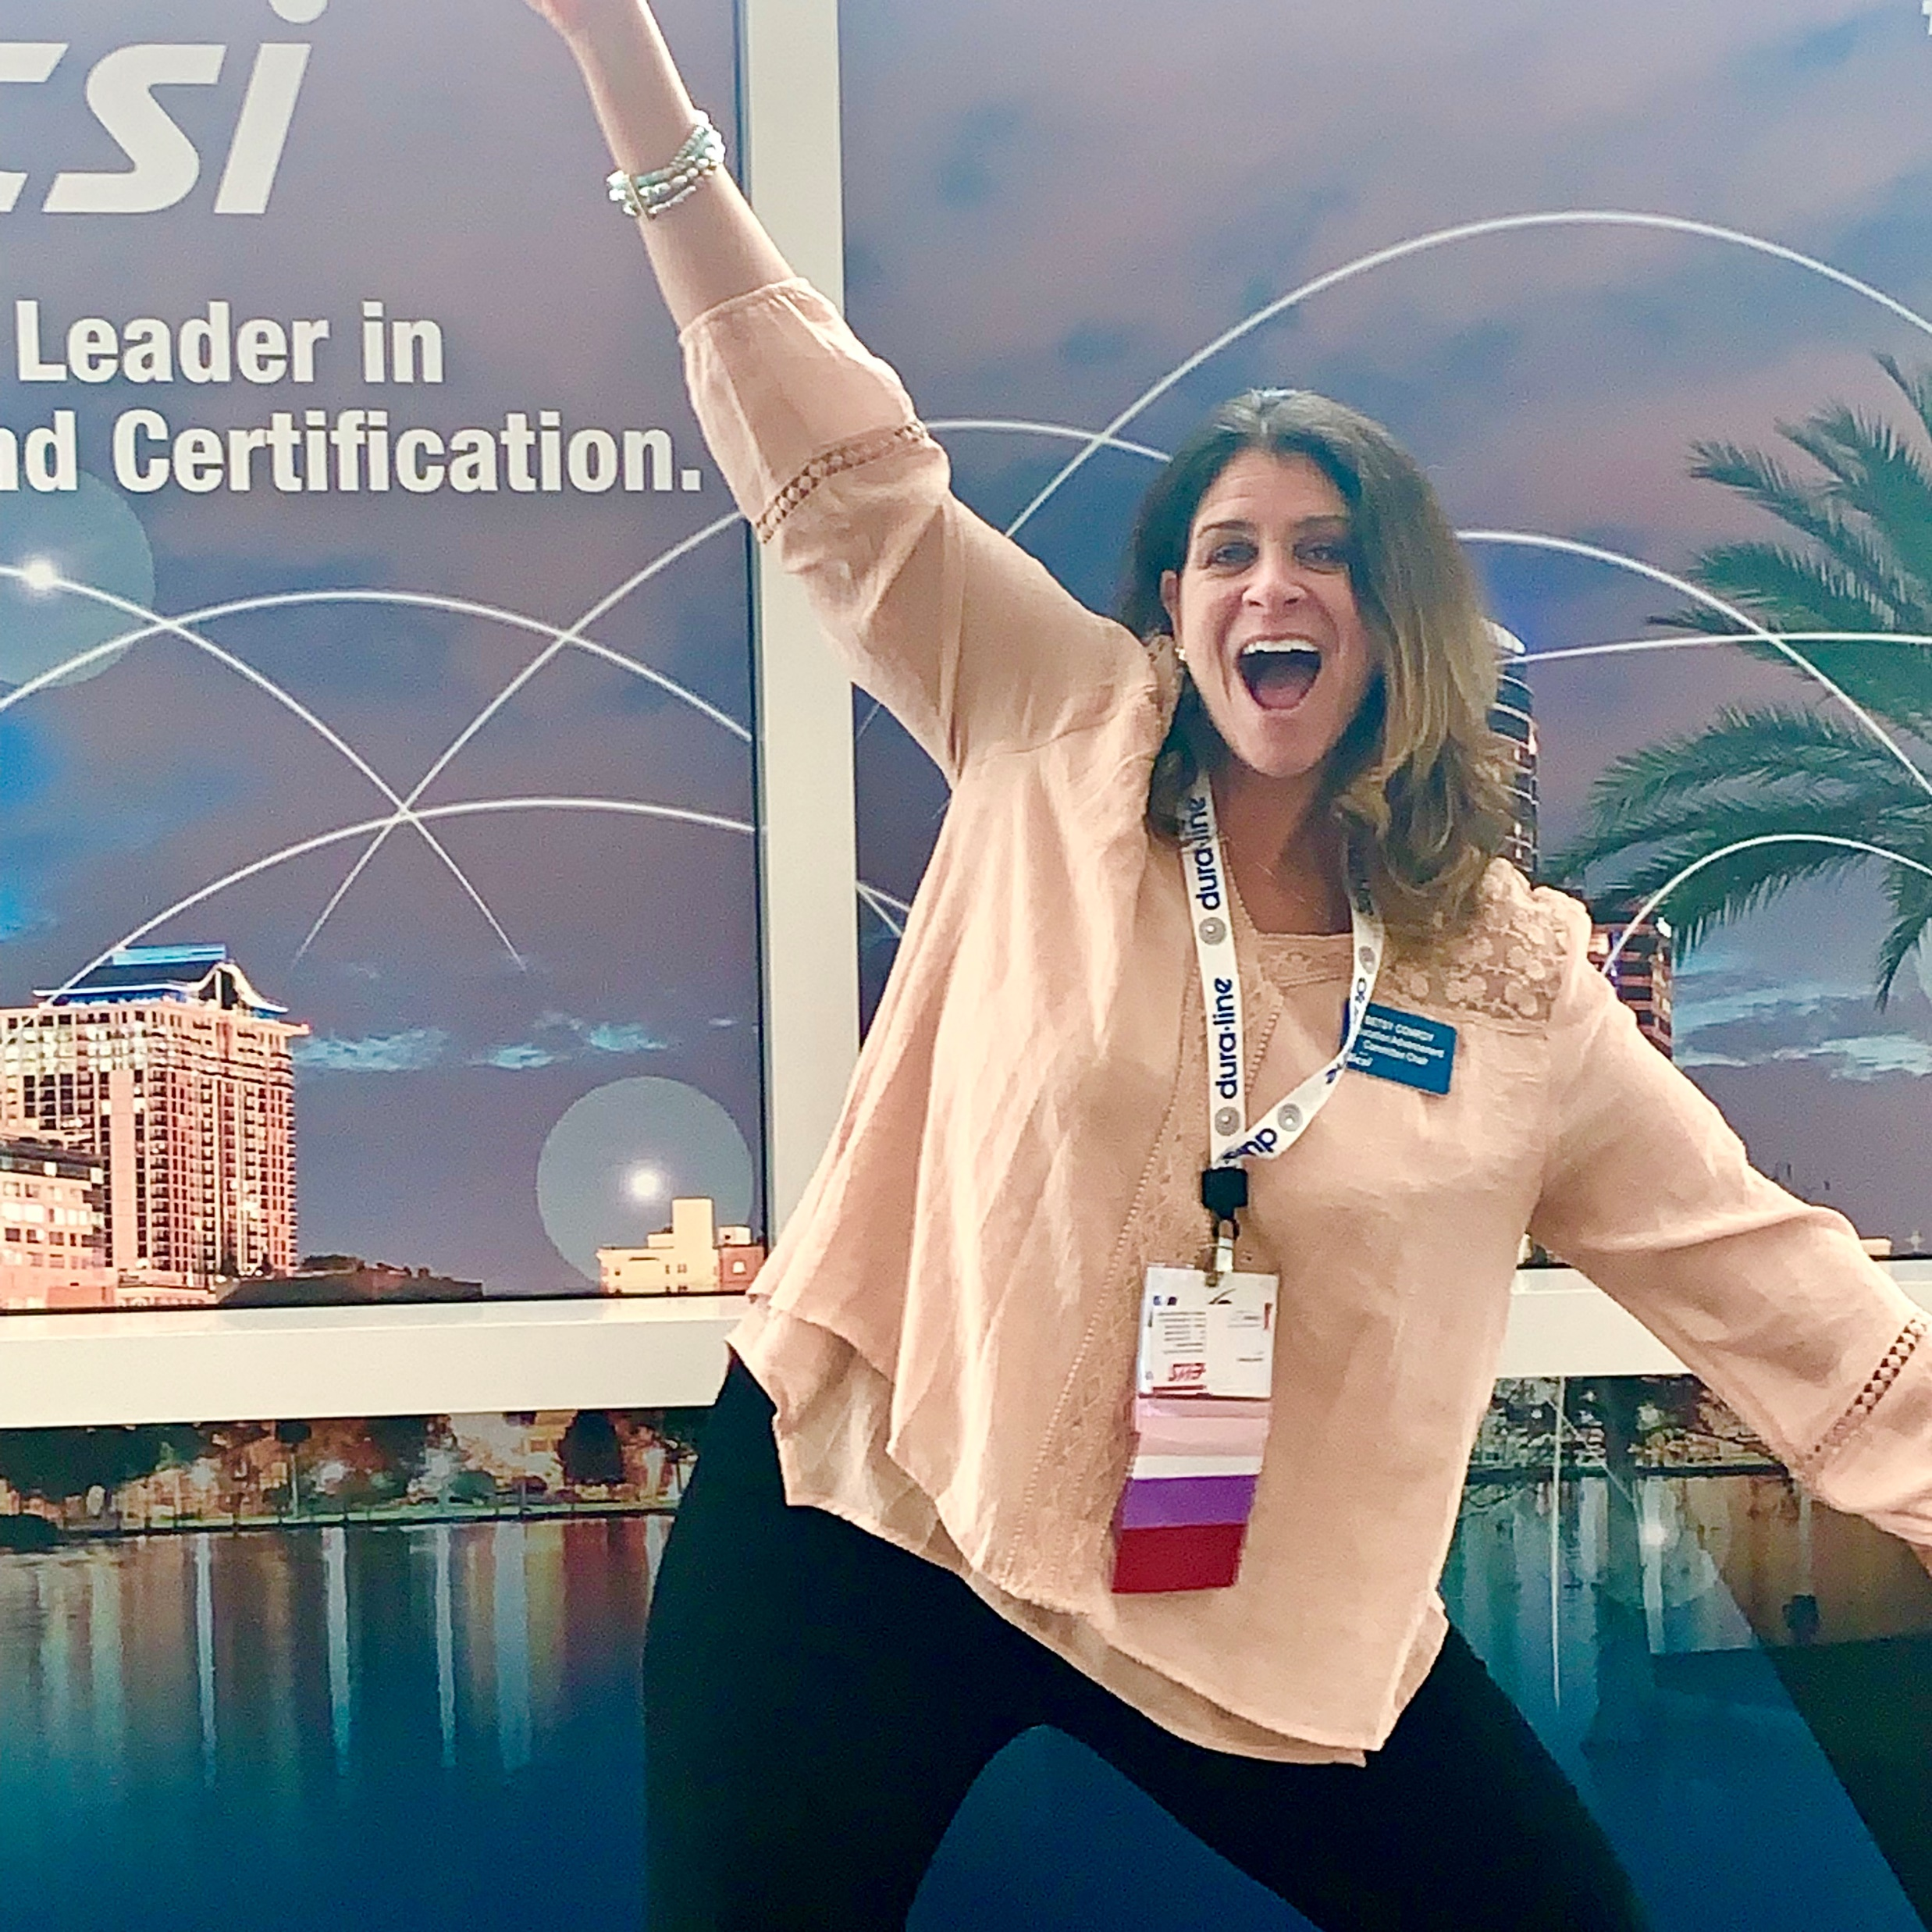
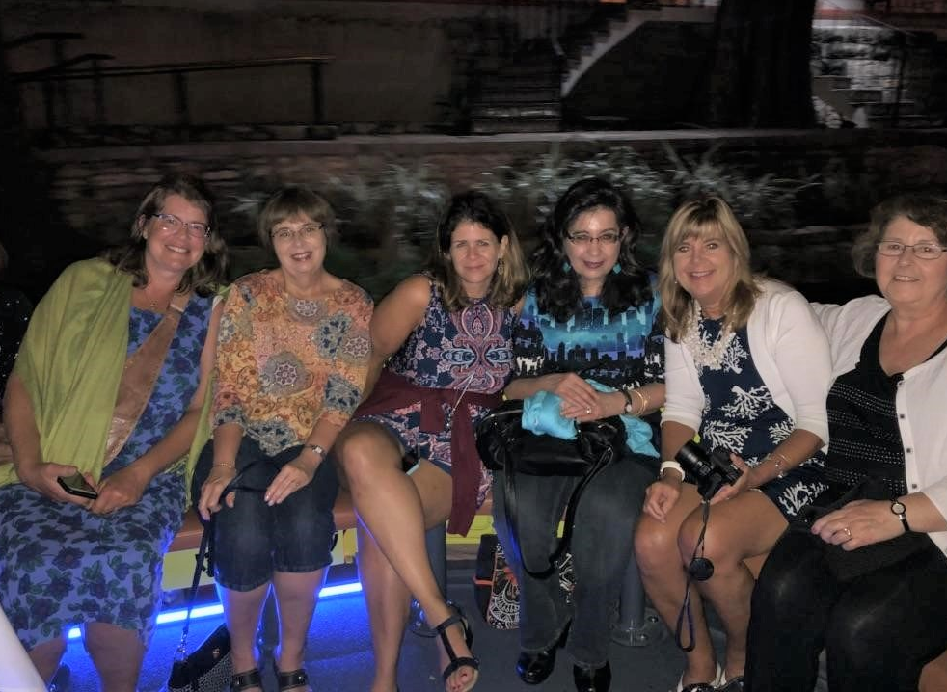
Betsy Conroy
Global Marketing Manager for Siemon; Chair of the EAC Committee; Former editor of BICSI News; Single mom; Friend
Notes:
Speaking of social media, my last personality is Betsy Conroy, who’s in marketing and we’ve had parallel paths. You probably read her article in the BICSI insider in which she discussed balancing her personal and professional life. She is a hard working single mom.
Her parents were an artist and an elementary school teacher, so she wanted to break the mold and make money and go into the business world. While studying economics in college, her journalism professor told her “Kid, you’re a writer.” Her first job was as a tech writer for Honeywell Fire Systems. But after her daughter was born, she went into freelance writing for many manufacturers in our industry; and was a frequent contributor to Cabling Installation & Maintenance magazine. She learned about ICT from many directions – from mentors, to traveling to job sites, to attending conferences and spending time with installers and technicians. She became the editor of BICSI News and turned it into a true magazine that eventually became ICT Today and is now it in good hands with the current editor, Alex Manning, another outstanding Woman in BICSI, who is pictured between Betsy and me at our social event last Fall.
She is now the Global Marketing Manager for Siemon, but she does freelance writing on the side. She joined the BICSI Education Advancement Committee (EAC) in 2009 where she was secretary, then vice chair and now as Chair. She is also a member of the Program Coordination Committee and attends the MOD committee meetings.
A turning point in Betsy’s BICSI involvement was that she was is one of the founding members of the Women in BICSI. She states that she knows that there is more for her out there in this amazing industry, and that her role will change again – but can say, with 100% certainty, that whatever it is, BICSI will continue to be a huge part of who she is

Slide 18

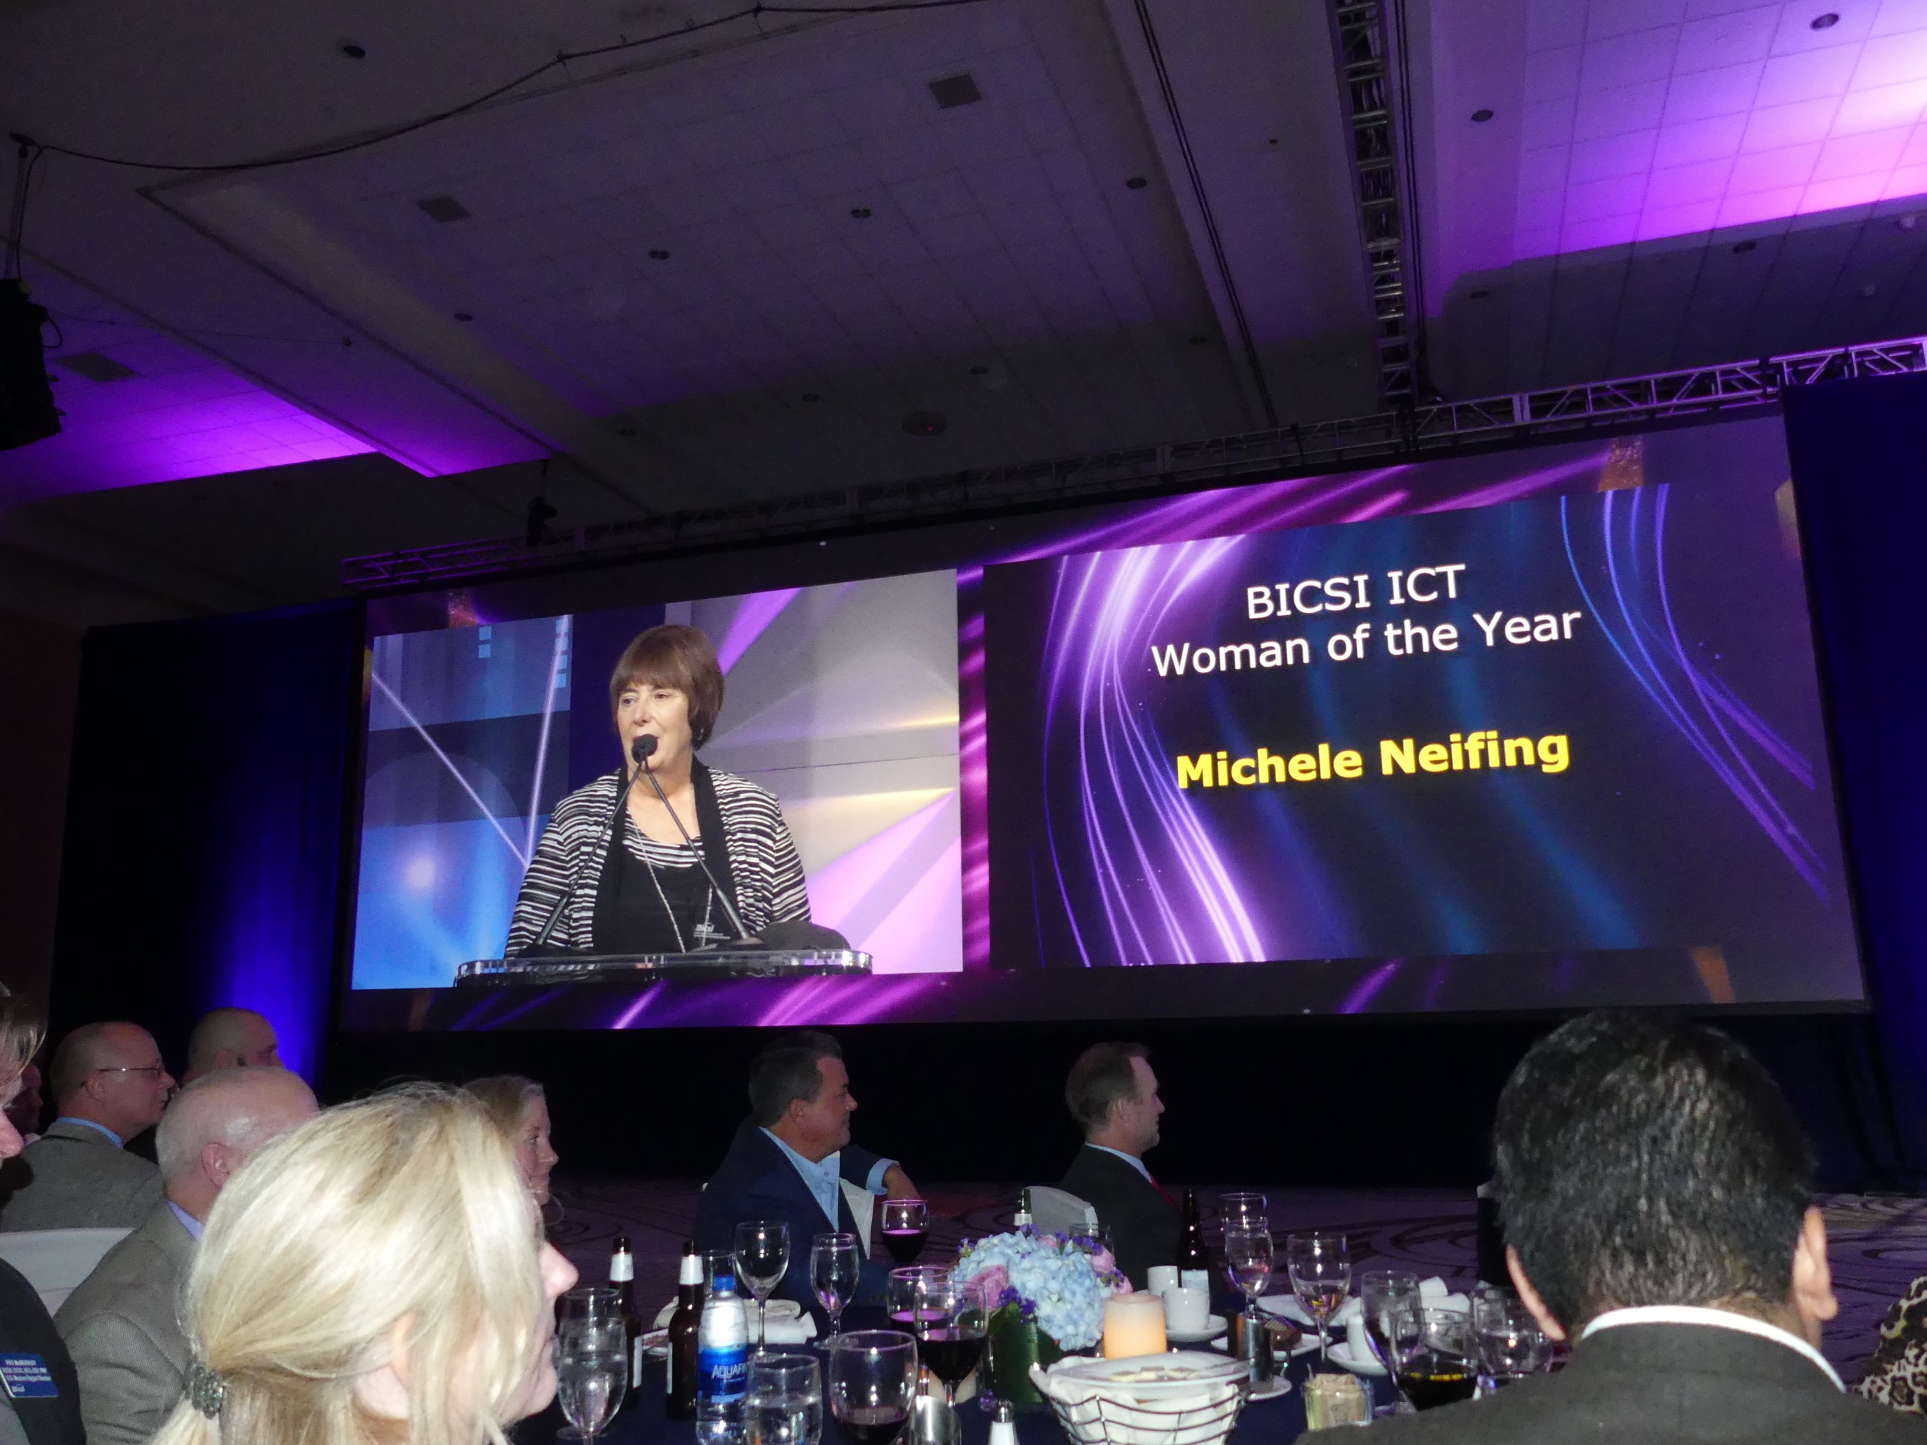

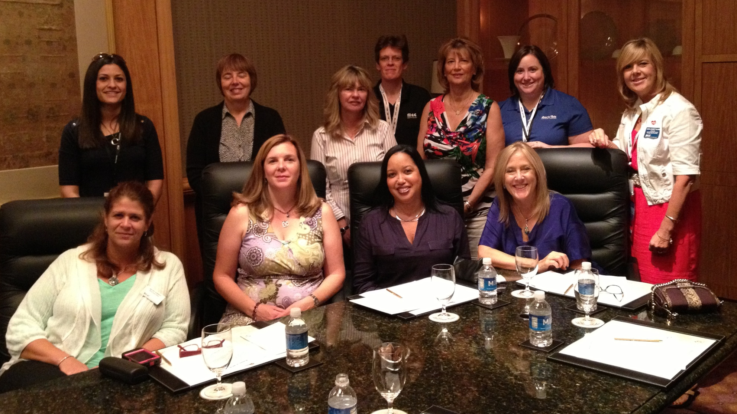
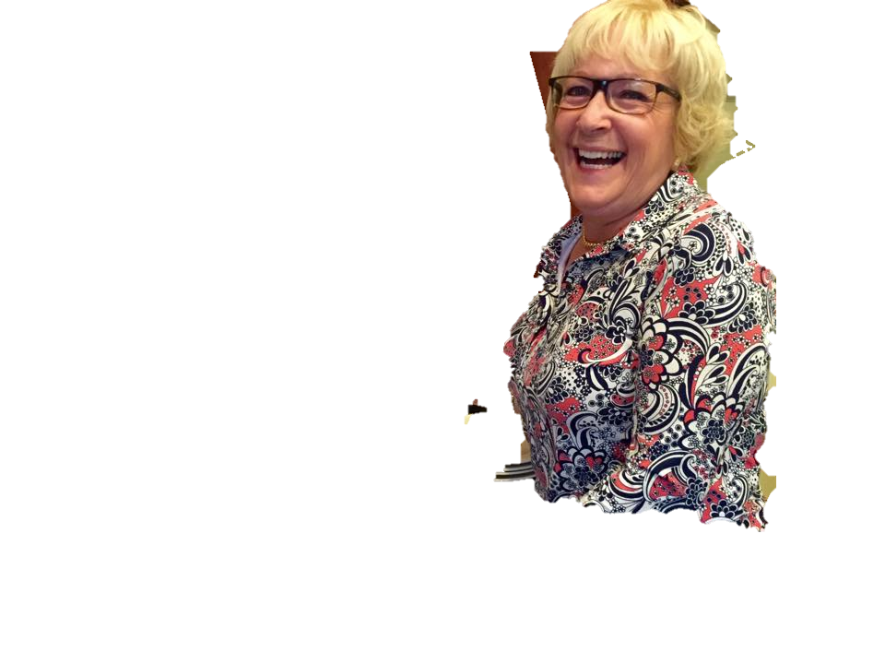
Join Women in BICSI
Visit bicsi.org/wib or email wib@bicsi.org to learn more.
NEEDED: Speakers for future BICSI Webinars and writers for BICSI Insider articles.
Contact: Women in BICSI Chair Michele Neifing at mneifing@ofsoptics.com.
Thank you
Women in
bicsi.org/wib
Notes:
If you haven’t joined the Women in BICSI already, I would recommend you do so as soon as this webinar is over. We have grown in five years from a five women who came together with a common bond to almost 200 members. We have an annual breakfast meeting at the BICSI Winter Conference and I hope to meet many of you there in 2020 where our next speaker is Betsy Conroy. And by the way, yes, men of BICSI are invited too.
CLICK
Michele Neifing, chair of the Women in BICSI Committee is always seeking volunteers for future Women in BICSI Webinars and also BICSI Insider articles. If you are interested in presenting a topic relevant to women in the ICT Industry or submitting a short article, please contact Michele at her email address shown here.
CLICK
Thank you for joining me today. I hope I have given you a lot to think about on the many choices that are available to you. The choice is yours. You just need to take that first step -- choose your own path and go for it!

