Slide 1
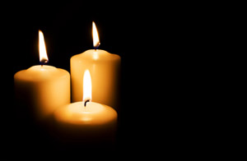


National Board for Certification of
Orthopaedic Technologist, Inc.
Remembers Those That Have
Gone Before Us
We Will Never Forget

Slide 2
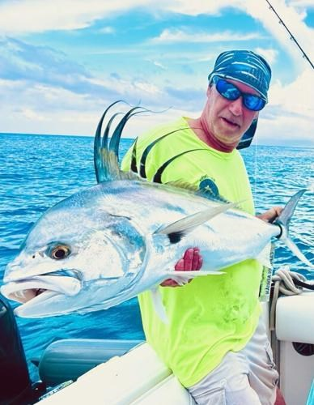
Michael J. Walton, OTC®, OT-SC™
May 23, 1963 ~ August 2, 2025
Dedicated OTC®, OT-SC™ From 2007 ~ 2023
https://www.legacy.com/us/obituaries/name/michael-walton-obituary?id=59147974

Slide 3
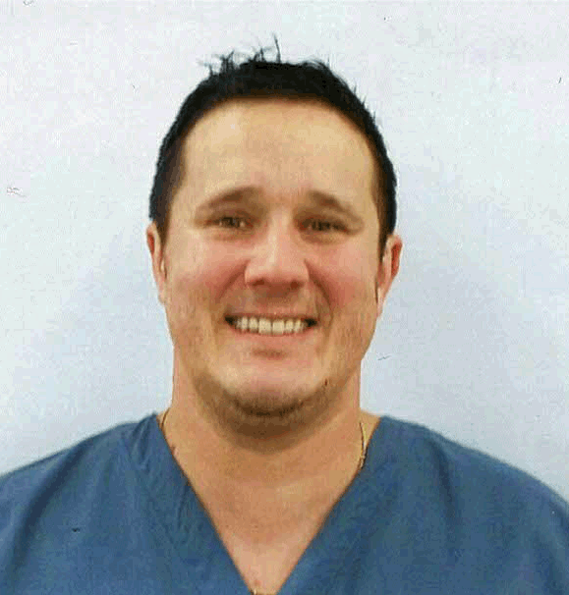
Daniel Allan Delnoce, OTC®, OT-SC™
December 29, 1976 ~ February 26, 2021
Dedicated OTC®, OT-SC™ From 2003 ~ 2021

Slide 4
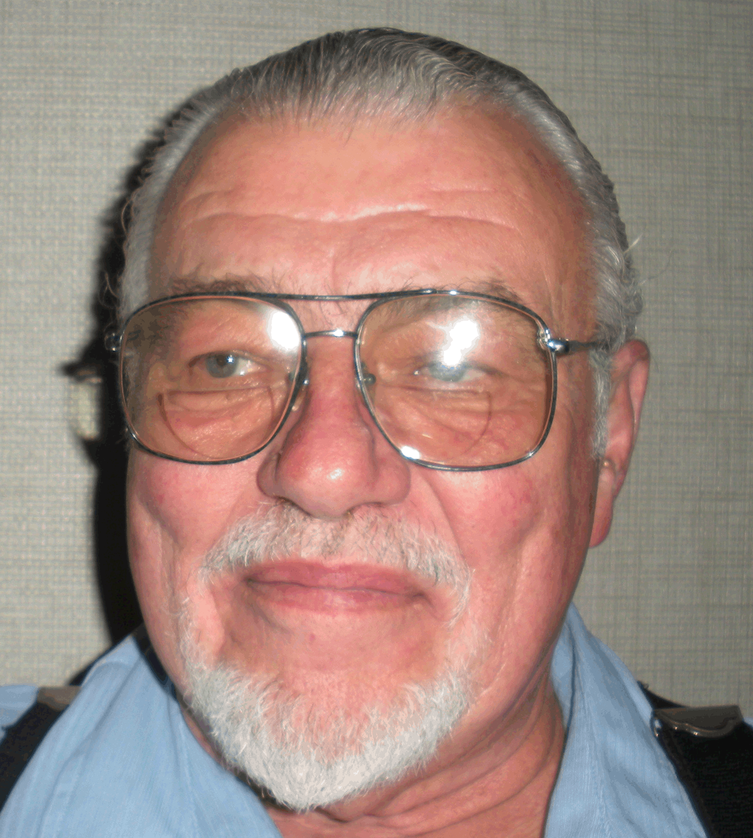
Donald Earl Griffin, OTC®
November 24, 1947 ~ June 20, 2019
Dedicated OTC® From 1989 ~ 2019

Slide 5
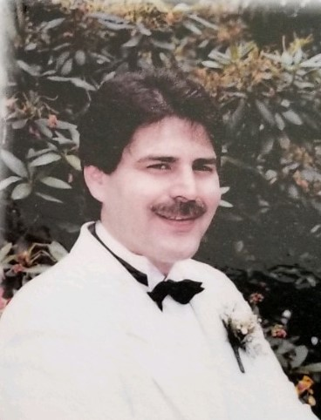
Michael A. Paley
June 30, 1951~ April 23, 2019
Dedicated OTC® From 1991 ~ 1997

Slide 6
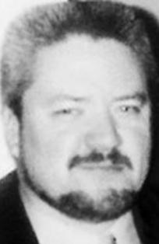
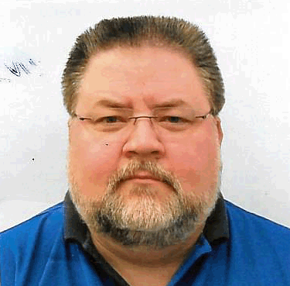
Scott G. Hutchins, OTC®
October 20, 1965 ~ January 4, 2017
Dedicated OTC® From 2002 ~ 2017
Dedicated member of the New England Society Of Orthopaedic Technologists.

Slide 7
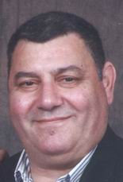
Gamal George Elias, OTC®
1958~ April 2, 2017
Dedicated OTC® From 1999~2017

Slide 8
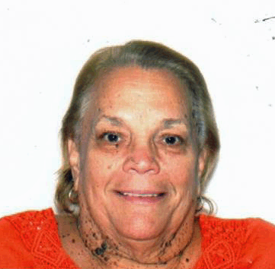
Sandra L. Smits, OTC®
September 8, 1951 ~ May 13, 2017
Dedicated OTC® From 1989 ~ 2017
Head OTC® at Moreno Valley County Hospital For 38 Years

Slide 9
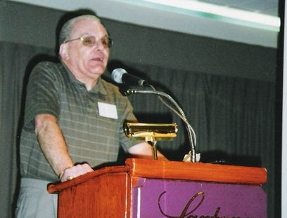
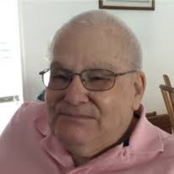
Sidney Rubinstein, OTC®
July 4, 1936 ~ August 28, 2017
Past President of NAOT
Past President of New England Society of Orthopaedic Technologists

Slide 10
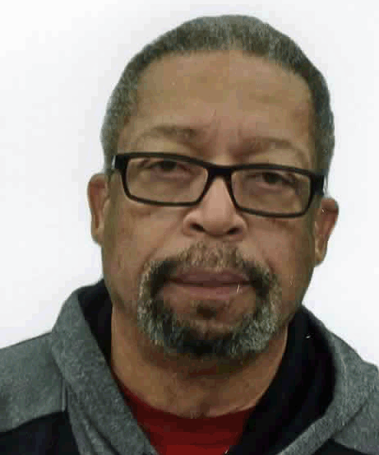

Michael J. Gill, Sr., OTC®, OT-SC$™$
November 25, 1950 ~ July 20, 2017
Dedicated OTC®, OT-SC™ From 1990~2017
Past NAOT President.
Instrumental in the development of the OT-SC Examination.
Dedicated Member & Officer of the Carolina’s Assoc.

Slide 11
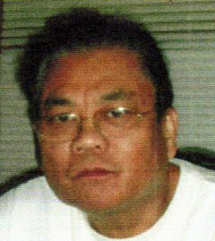

Ricardo Villar Esleta, OTC®
October 7, 1949 ~ November 8, 2017
Dedicated OTC$®$ from 1990 ~ 2016
A Graduate of Cook County Orthopaedic Technologist training program in Chicago, IL.
He continued his dedication to our profession with holding the OTC Certification until his retirement in 2016 and his longtime membership and participation in the Orthopaedic Technologist Association of Illinois.

Slide 12
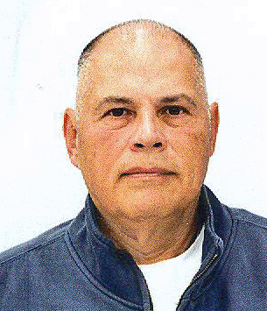
Quentin D. Simeone, OTC®
1951~ 2017
Dedicated OTC® 1993~2017
Active member for over 20 years in the Maryland Association of Orthopaedic Technologists (MAOT)

Slide 13

Wasyl Skomoroch, OTC®
1978-2016
Dedicated OTC® From 1989~ 1995

Slide 14
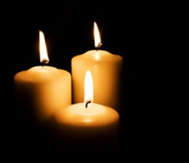
Terrence Kennon
1974-2015
First President of the Orthopaedic Technologist Association of Illinois

Slide 15
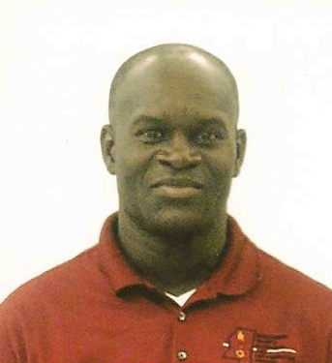
Hal Hart, OTC®
August 26, 1963 ~ February 27, 2015
Dedicated OTC® and Mentor
From 1999 ~ 2015

Slide 16
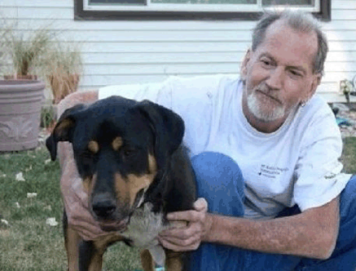
George Jones, OTC®
December 12, 1951 ~ April 6, 2015
Dedicated OTC® From 1989 ~2015
Past President of the Colorado Assoc. of Orthopaedic Technologists
Graduate from the Grossmont Orthopaedic Technologist Program

Slide 17
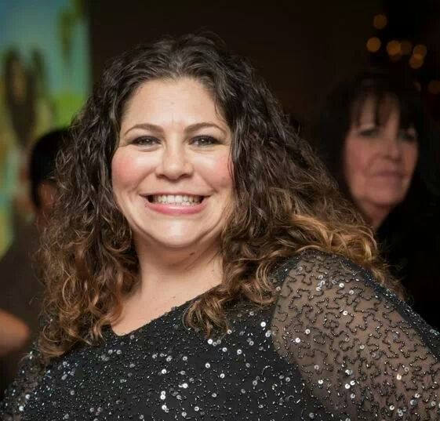
Cristina Segura, OTC®
September 18, 1975~ January 25, 2014
Dedicated OTC From 2007 ~ 2014

Slide 18
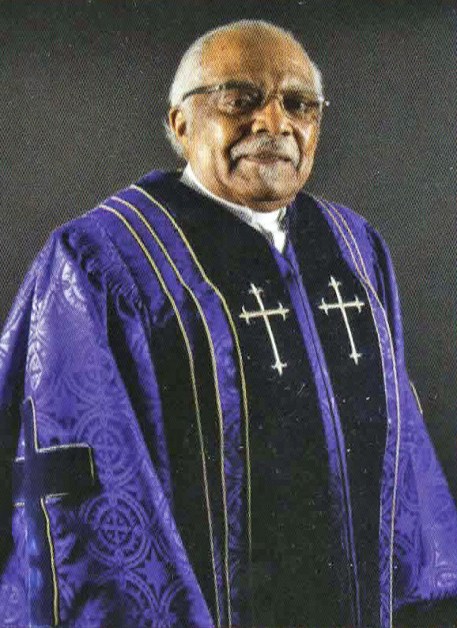
Rev. Dr. Pett Allen, Sr.
July 31, 1936 ~ December 24, 2014
Spiritual Leader and Constant supporter of NAOT and the Orthopaedic Technologist Profession

Slide 19
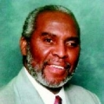
Dwellie Parris, Jr.
March 29, 1950~ January 11, 2013
Dedicated OTC® From 1995 ~ 2013

Slide 20
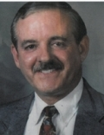
Thomas James Collins, OTC®
April 23, 1975~ May 21, 2012
Dedicated OTC® From 1987 ~ 2012

Slide 21
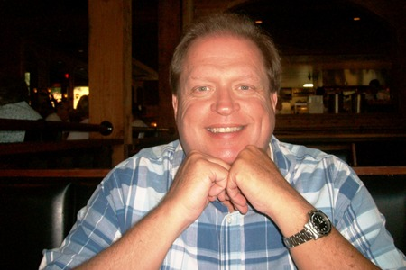
Richard Rubin
January 21, 2011
Executive Director
Maryland Association of Orthopaedic Technologists

Slide 22
Lloyd Selbourne Constable, OTC®
August 7, 2009
Dedicated OTC® From 1986 ~ 2009

Slide 23
Morgan Taylor, OTC®
December 17, 2009
Dedicated OTC® From 2002~ 2008

Slide 24
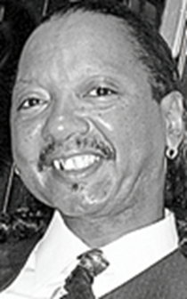
Rickey Merralle Henderson
March 10, 2007
Supportive Husband of Past President of NAOT Cindy Henderson

Slide 25
Fritz Gamble
February 21, 2006
One of Founding Fathers of the National Association of Orthopaedic Technologists and
One of the Original Vendor Representatives

Slide 26
Mark I. Jacobson, OTC®
April 21, 1954 ~ March 1, 2006
Dedicated OTC® From 1988 ~ 2006

Slide 27
Patrick McGuire, OTC®
March 10, 2005
Dedicated OTC® From 2001~ 2005

Slide 28
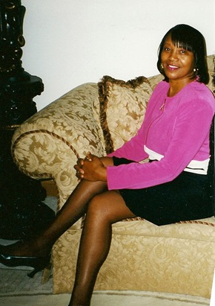
Doris Hardy, OTC®
September 23, 2004
Dedicated OTC® From 1982~ 2004
Clinical Instructor for Cook County Ortho Tech Program
Past Secretary of the Orthopaedic Technologist Association of Illinois
A Memorial Grant has been established by the NBCOT in her name.

Slide 29
Brandon E. Tripp, OTC®
Dedicated OTC® From 1999 ~ 2005

Slide 30
Gabriel Carranza, OTC®
Dedicated OTC® From 2001 ~ 2007

Slide 31
Garel Hardiman
First Vice-President of the Orthopaedic Technologist Association of Illinois
1975-1988

