Slide 1
Who's Who and What Did They Do?
The Austrian Economists
Paul F. Cwik, Ph.D.
University of Mount Olive
Fellow at the Mises Institute

Slide 2
The Founders of Austrian Economics
Menger
Böhm-Bawerk
Mises
Rothbard
Wieser
Hayek
Kirzner

Slide 3
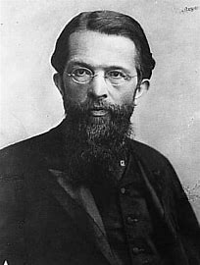
Carl Menger
(1840-1921)
Major Works:
Principles of Economics (1871/1950)
Investigations into the Method of the Social Sciences with Special Reference to Economics (1883/1963)
“On the Origins of Money” (1892)

Slide 4
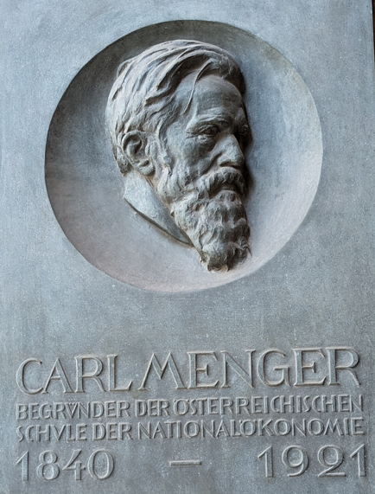
Carl Menger’s Life
Tutored the crown prince. (1876)
Appointed to the chair of Political Economy. (1878)
Retired in 1903.
Well known for having a very extensive library.
After he died (1921), his library became the core to Japan’s national library.
Today it is in the Library of Hitotsubashi University, Tokyo.

Slide 5
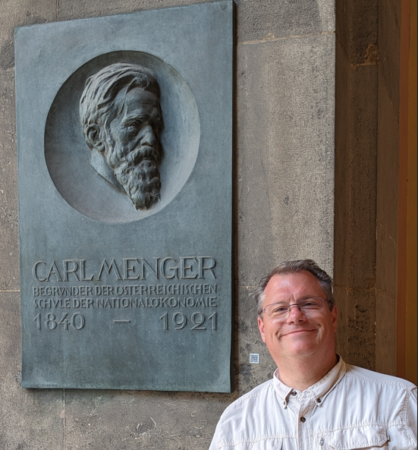
Menger’s Major Contributions
  the development of marginal analysis,
  his victory in the methödenstreit,
  the use of genetic-causal approach in explaining social relationships, and
  his demonstration that money’s origin is from the market, not the state.

Slide 6
The Second Generation
The second generation of Austrian economists consisted (primarily) of Eugen von Böhm-Bawerk and Friedrich von Wieser.
They never actually studied under Menger, but they did meet with him and exchanged ideas.
  They read Menger’s book in 1872 and became his greatest followers.
The three, Menger, Böhm-Bawerk and Wieser, were the core of the “Austrian School,” sometimes called the “Psychological School” or the “Subjectivist School.”

Slide 7
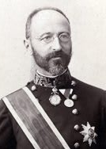
Eugen von Böhm-Bawerk
(1851-1914)
Major Works:
Capital and Interest: A Critical History of Economic Theory (1884/1890)
The Positive Theory of Capital (1888/1891)
“Karl Marx and the Close of his System” (1896)
Finance Minister: 1895, 1896-1897, & 1900-1904

Slide 8
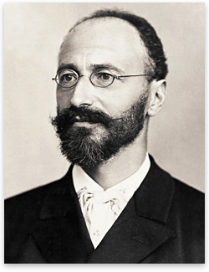
Eugen von Böhm-Bawerk
(1851-1914)
Böhm-Bawerk and Wieser were brother’s-in-law. (Böhm-Bawerk married Wieser’s sister.)
He attended the University of Vienna and passed his exams with distinction. Thereupon, he (and Wieser) went into the civil service.
He completed his Doctorate in Law in 1875 (24 years old) with a mark of distinction in the legal portion but earned only a mark of “able” for the economics section.
It’s reported that he once said that you should always keep a book at hand, especially if you are waiting for your wife. Why? Because you will get a lot of reading done! ☺

Slide 9
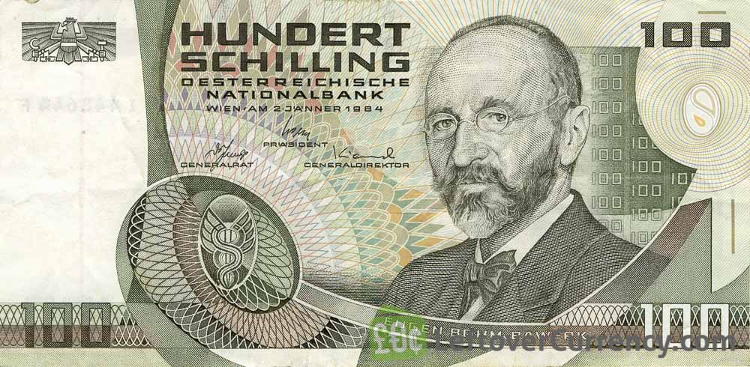
Eugen von Böhm-Bawerk
Böhm-Bawerk and Wieser held administrative jobs before landing traveling fellowships.
In 1876, they attended The University of Heidelberg with Professor Karl Knies (1821-1899). At this seminar Böhm-Bawerk presented his first paper on capital theory.
He was a professor at the University of Innsbruck (1881-1889).
After 1889, his scholarly career was intermittent because he kept switching between governmental appointments and the University of Vienna.

Slide 10
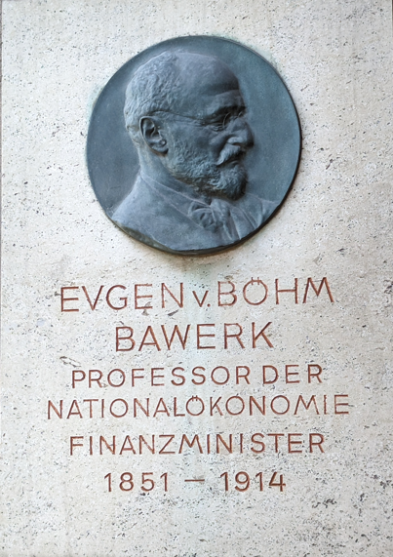
Eugen von Böhm-Bawerk
As Minister of Finance (1900-04), it’s reported that Böhm-Bawerk dominated the cabinet and was second in importance only the Prime Minister himself.
In 1904, he resigned his position as a protest.
  He thought that the military wanted too much and would break the budget.
  That cabinet collapsed.
Later in 1904, Böhm-Bawerk left government for academics.
  A personal chair was created for him at the University of Vienna.
  He turned down more lucrative offers outside of academia.
  At the university, he was Mises’ and Schumpeter’s teacher.
He held that chair until his death in 1914.

Slide 11
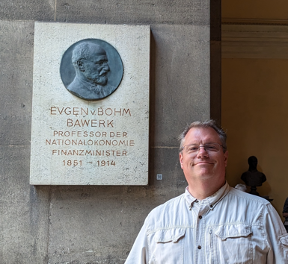
Contributions
Böhm-Bawerk systematized and clarified the underlying subjectivity of value and how it is at the margin all decisions are made.
  It was through this analysis that he attacked Marxism as being fundamentally flawed.
He has contributed in areas of the law and economics and even addresses the issue of intellectual property rights.
  He was against copyrights and patents.

Slide 12
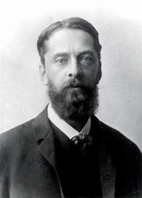
Friedrich von Wieser
(1851-1927)
Major Works:
On the Origin and the Main Laws of Economic Value (1884/Never translated into English)
Natural Value (1889/1893)
Social Economics (1914/1927)
The Law of Power (1926/the only English translation is in manuscript)

Slide 13
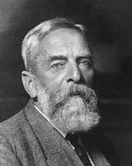
Friedrich von Wieser (1851-1926)
Wieser was the other half of the 2nd generation. He taught Hayek and Hans Mayer.
He is not as widely known by modern Austrian economists.
  Böhm-Bawerk was given a 46+ page chapter in Joseph Schumpeter’s Ten Great Economists, while Wieser was relegated to a three-page sketch in the appendix.
Wieser was the first to define cost as that of a foregone opportunity. I.e., Wieser created the concept of an opportunity cost.
  For a time, it was called “Wieser’s Law.”

Slide 14
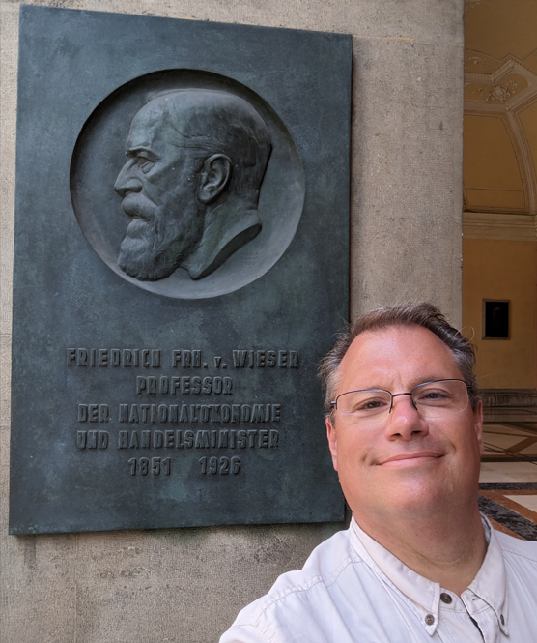
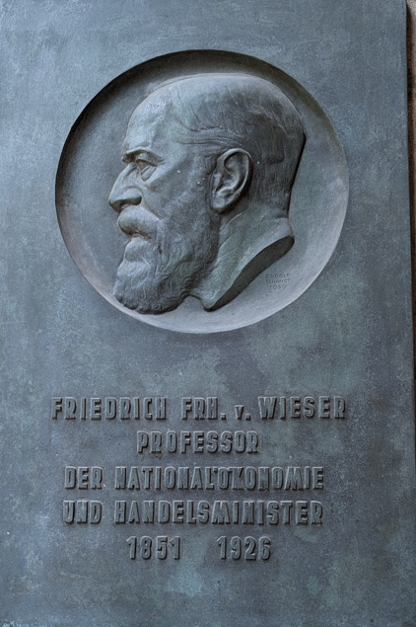
Friedrich von Wieser
Wieser came from a long line of Austrian civil servants. He went to the University of Vienna at the age of 17 and graduated with a law degree when he was 21.
Initially he wanted to go into history to study social phenomena. While studying sociology, he realized that he had to first clarify the economic relationship.
However, before he could explain economic relationships, he had to explain value theory.
  The elaboration of value theory is where he did most of his writing.
After graduating from U. of Vienna (1872), he and Böhm-Bawerk read Menger’s Principles of Economics.
It changed their lives.

Slide 15
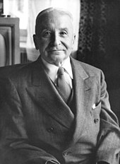
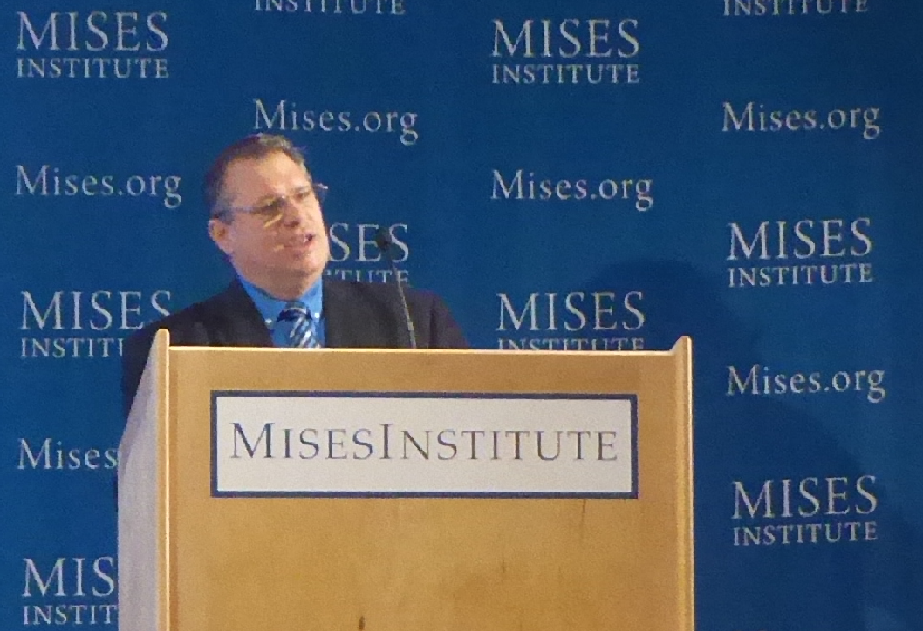
Ludwig von Mises
(1881-1973)
Major Works:
The Theory of Money and Credit (1912)
Socialism (1922)
Human Action (1949)
Theory and History (1957)

Slide 16
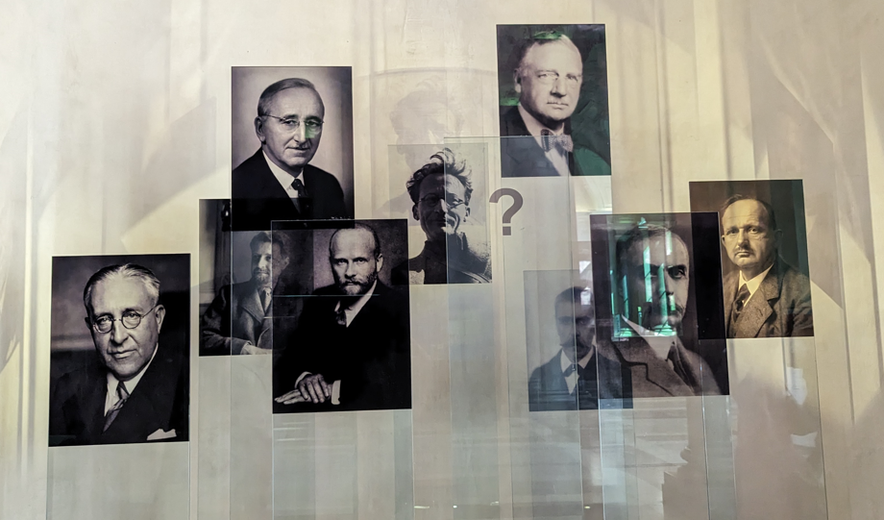
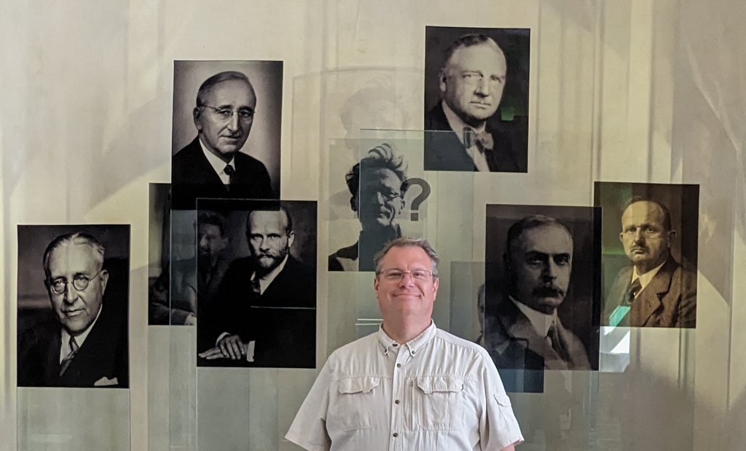
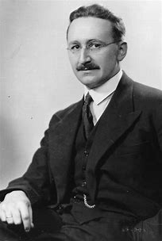
Friedrich von Hayek
(1899-1992)
Major Works:
Austrian Business Cycle Theory (1920s & ’30s)
The Road to Serfdom (1944)
“The Use of Knowledge in Society” (1945)
The Constitution of Liberty (1960)
Law, Legislation, and Liberty (1973, 1976, & 1979)
The Fatal Conceit: The Errors of Socialism (1988)

Slide 17
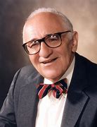
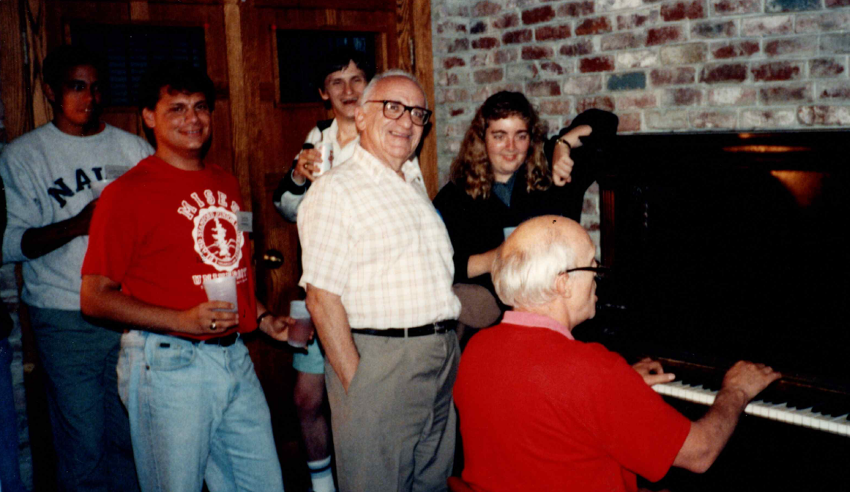
Murray N. Rothbard
(1926-1995)
Major Works:
Man, Economy, and State (1962)
America’s Great Depression (1963)
Conceived in Liberty 5 volumes (1975, 1975, 1976, 1979, & 2019)
The Ethics of Liberty (1982)
History of Economic Thought 2 volumes (1995)

Slide 18
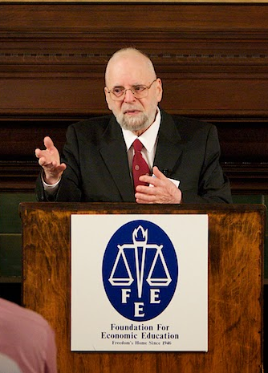
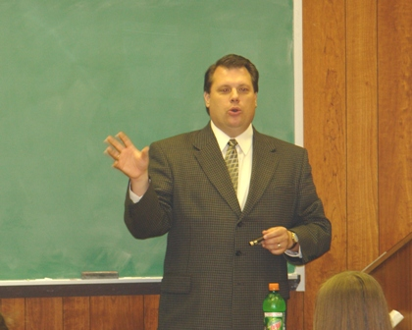
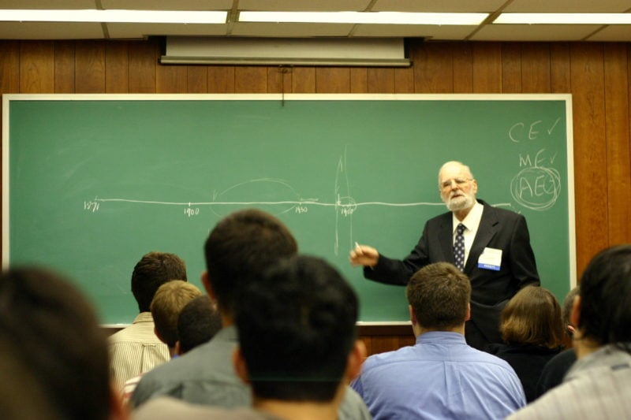
Israel M. Kirzner
(1930- )
Major Works:
The Economic Point of View (1960)
Market Theory and the Price System (1963)
An Essay on Capital (1966)
Competition and Entrepreneurship (1973)
Probably should have received the Nobel Prize

Slide 19






Who will be the next leader of Austrian Economics?
The reality is that there is NO central plan for freedom.
We are all leaders.
It is up to us to help and support each other.
This is the purpose of these Mises Meetups.

Slide 20
Thank You!!!
Paul F. Cwik
University of Mount Olive
PCwik@umo.edu

