Slide 1
Spring Creek Expansion update
Spring Creek Association Board Meeting
January 26, 2022

Slide 2
2021 SPRING CREEK EXPANSION TIMELINE
CONSTRUCTION
Construction began in Spring 2021
Lamoille Highway from Elko Summit to Palace Parkway
Designated routes in each tract to provide distribution service for commercial business, schools and residents on or directly adjacent to each route
OUTREACH
Commercial Business and Residential Outreach began in late 2020
Continuing outreach along designated routes as facilities are installed

Slide 3
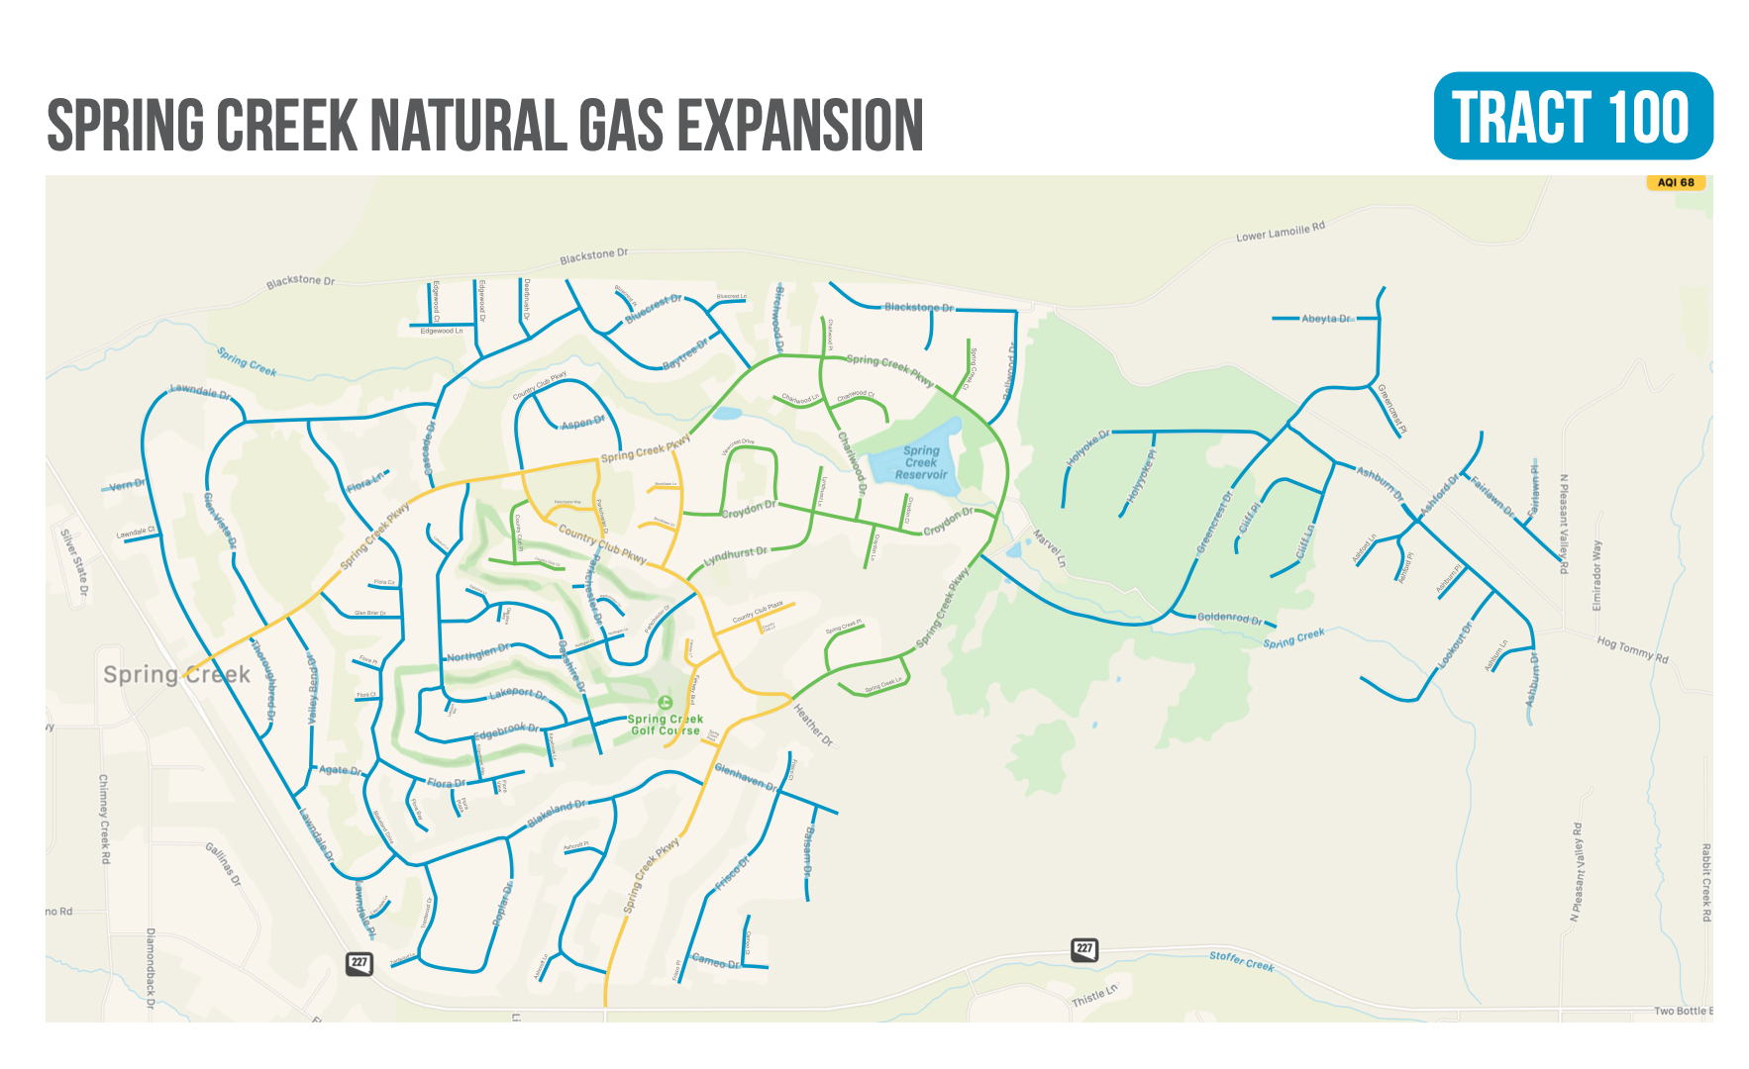

Slide 4
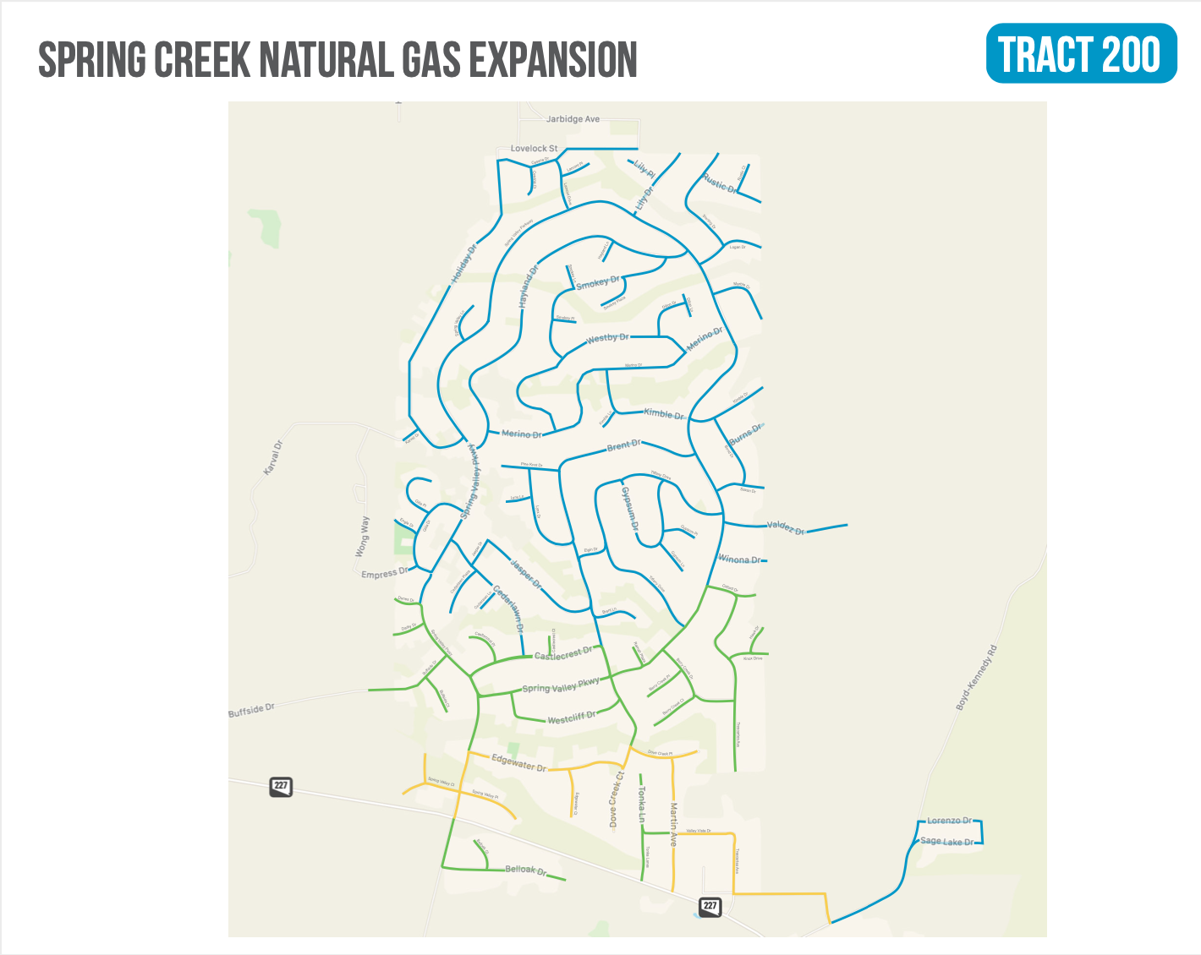

Slide 5
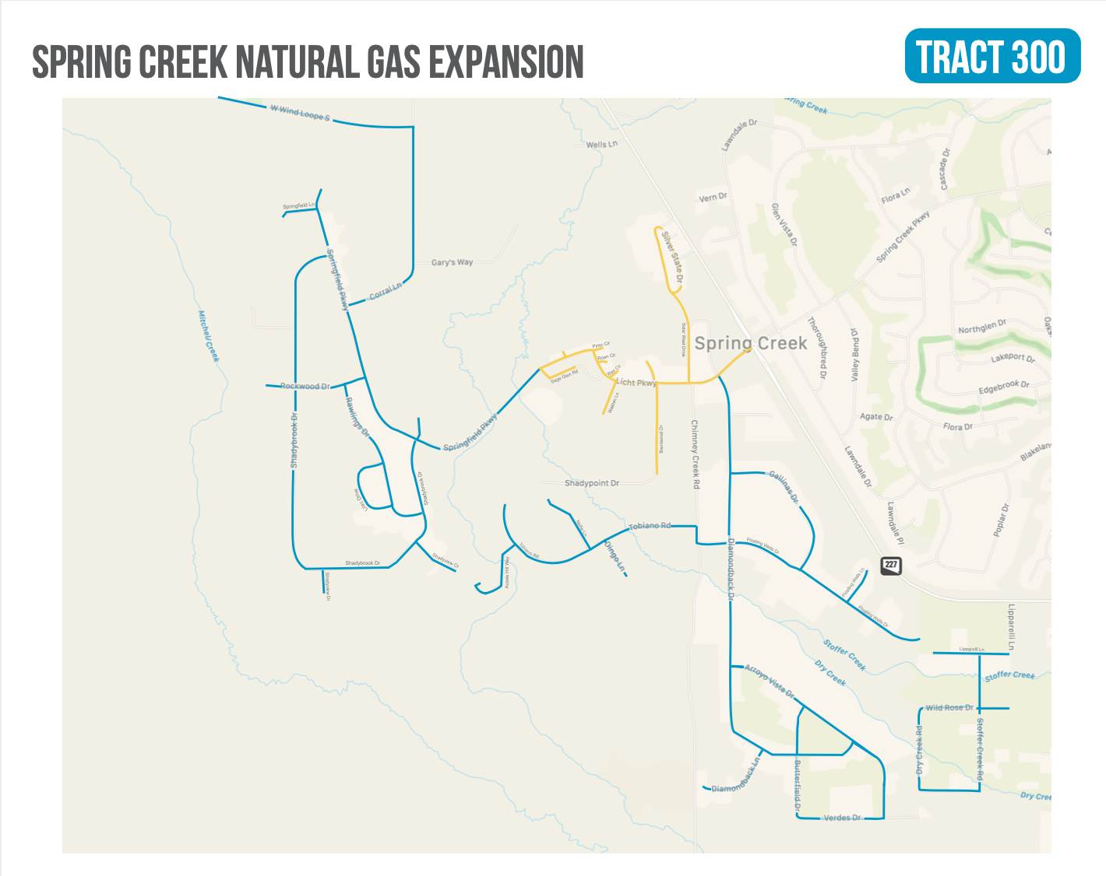

Slide 6
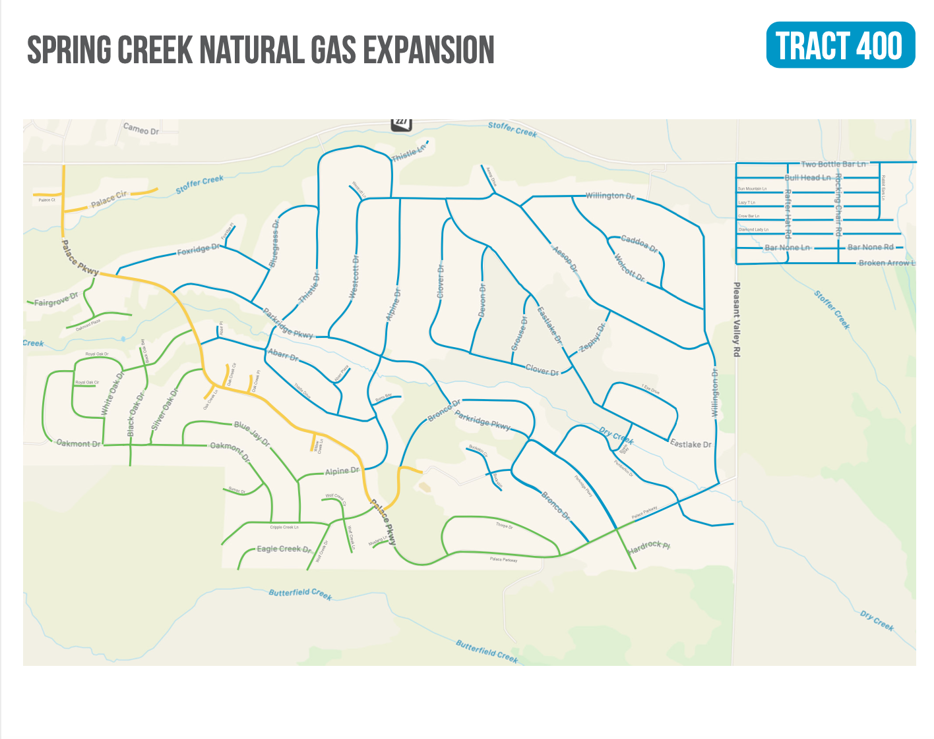

Slide 7
2022 SPRING CREEK EXPANSION OUTREACH DETAILS
Initial contact continues to be made through letters from the Company to residents who are along or directly adjacent to the designated 2022 construction routes
Company representatives will be visiting each Tract
Appointments can be made
Materials will be left if residents are not present
Residents are strongly encouraged to schedule pre-conversion inspections with the Company to provide more specific conversion-related information

Slide 8
2022 SPRING CREEK EXPANSION OUTREACH DETAILS
The expansion webpage, springcreekgas.com, contains information on all aspects of the expansion including contact information, project buildout maps and general conversion facts
Contact Information
springcreekoutreach@swgas.com
775-404-3349

Slide 9
Questions?

