Slide 1
Spring Creek Association Reservation System
How To Step by Step:

Slide 2
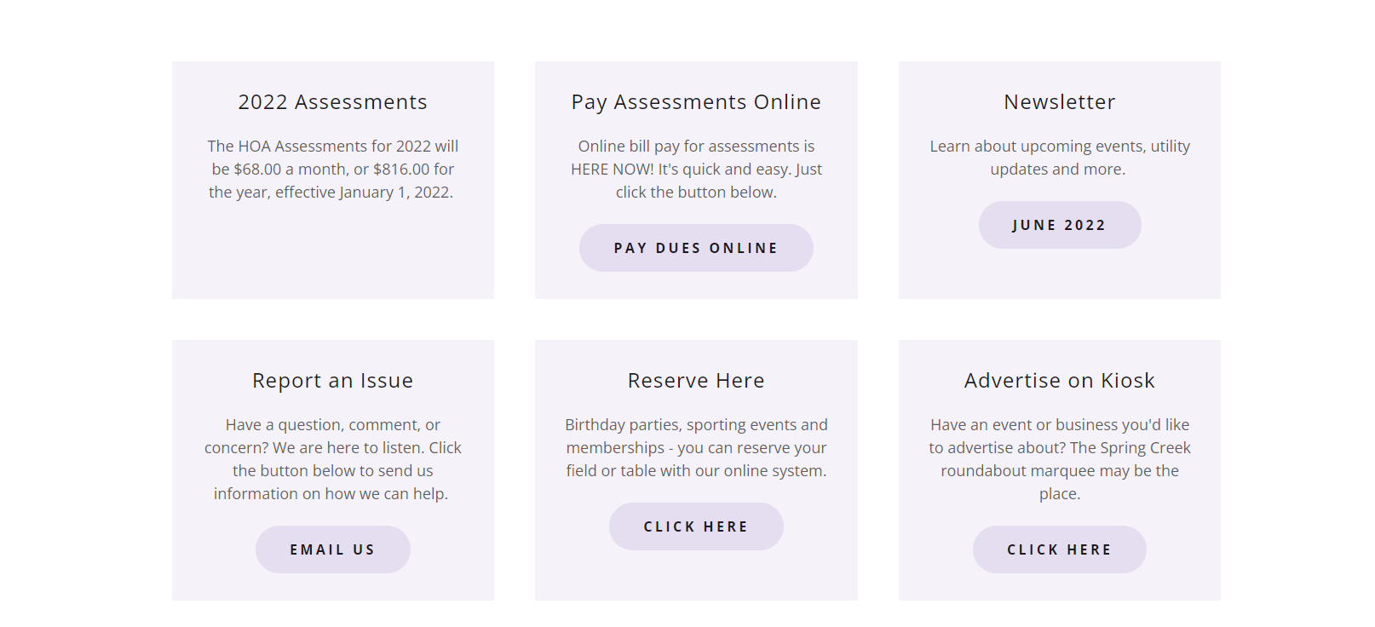
Step 1: Go to www.springcreeknv.org
Step 2: From Home Page scroll down to purple box labeled “Reserve Here” and click the “Click Here” button.

Slide 3
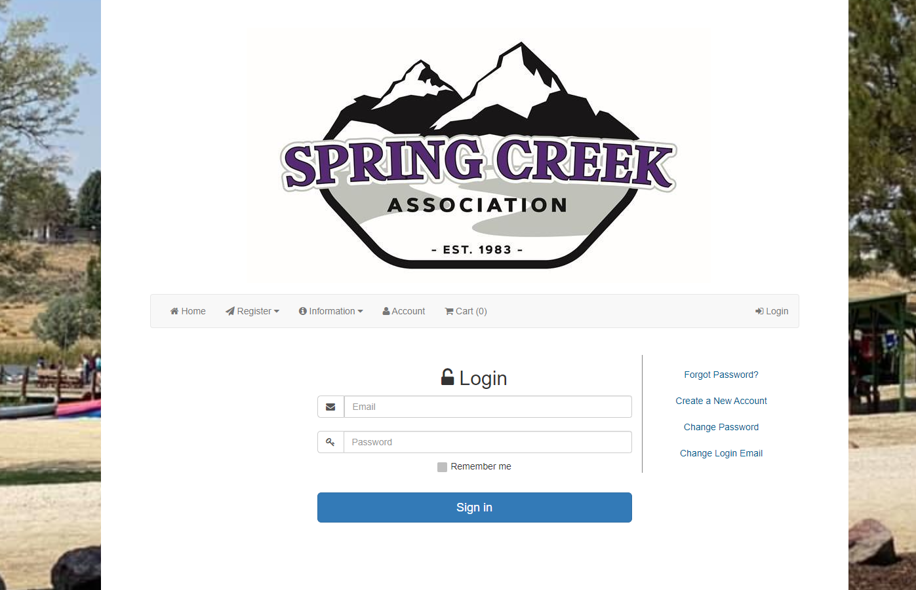
Step 1: You must create an account prior to reserving an amenity – From this screen you will click “Account”
Step 2: On next screen click “Create a New Account”

Slide 4
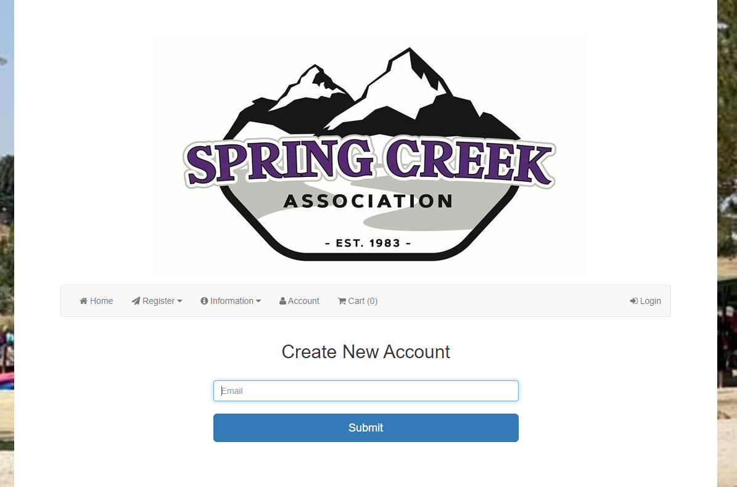
Step 3: Type in your email address

Slide 5
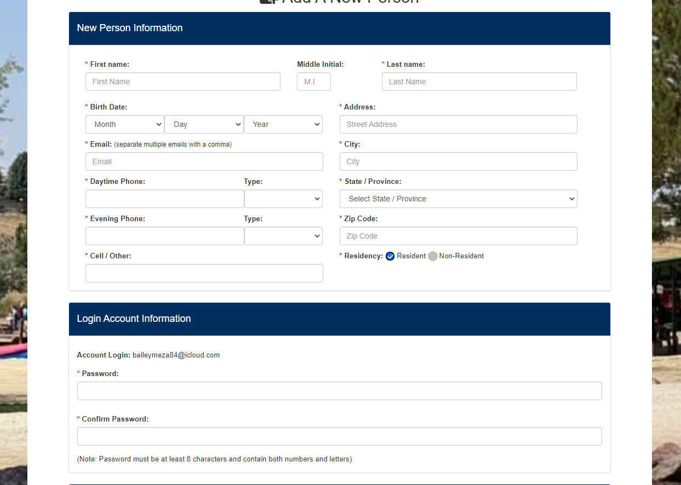
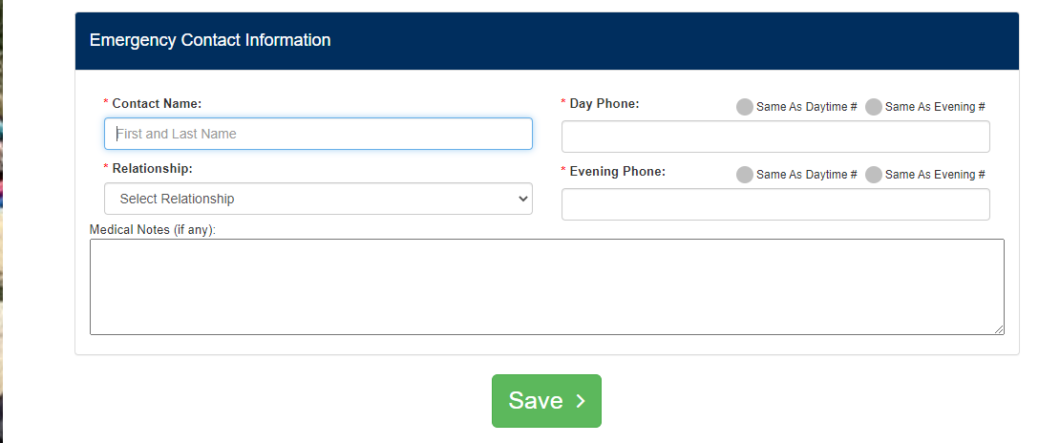
Step 4: Fill in your information under “New Person Information”
Step 5: Fill in “Login Account Information” – Create your password
*All asterisks must be filled in to proceed
Step 6: Spring Creek Residents MUST Click “resident”
Step 7: Fill in an Emergency Contact Information
Step 8: Click “Save”

Slide 6
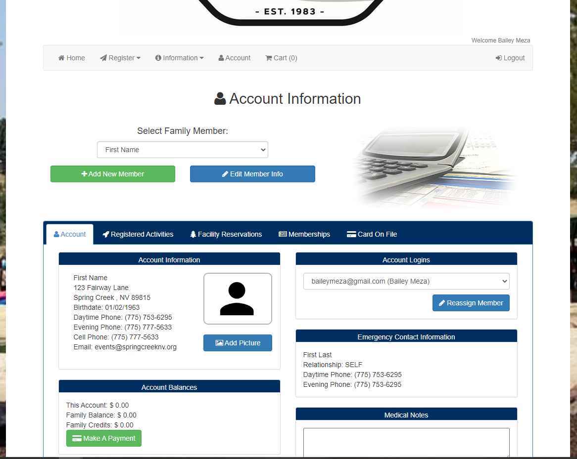
*On this page you can view your account, edit and or add other members of your family if wanted.
Step 9: Click “Home” button to be brought back to reservation home screen to reserve an amenity.

Slide 7
Follow these next steps to reserve an amenity

Slide 8
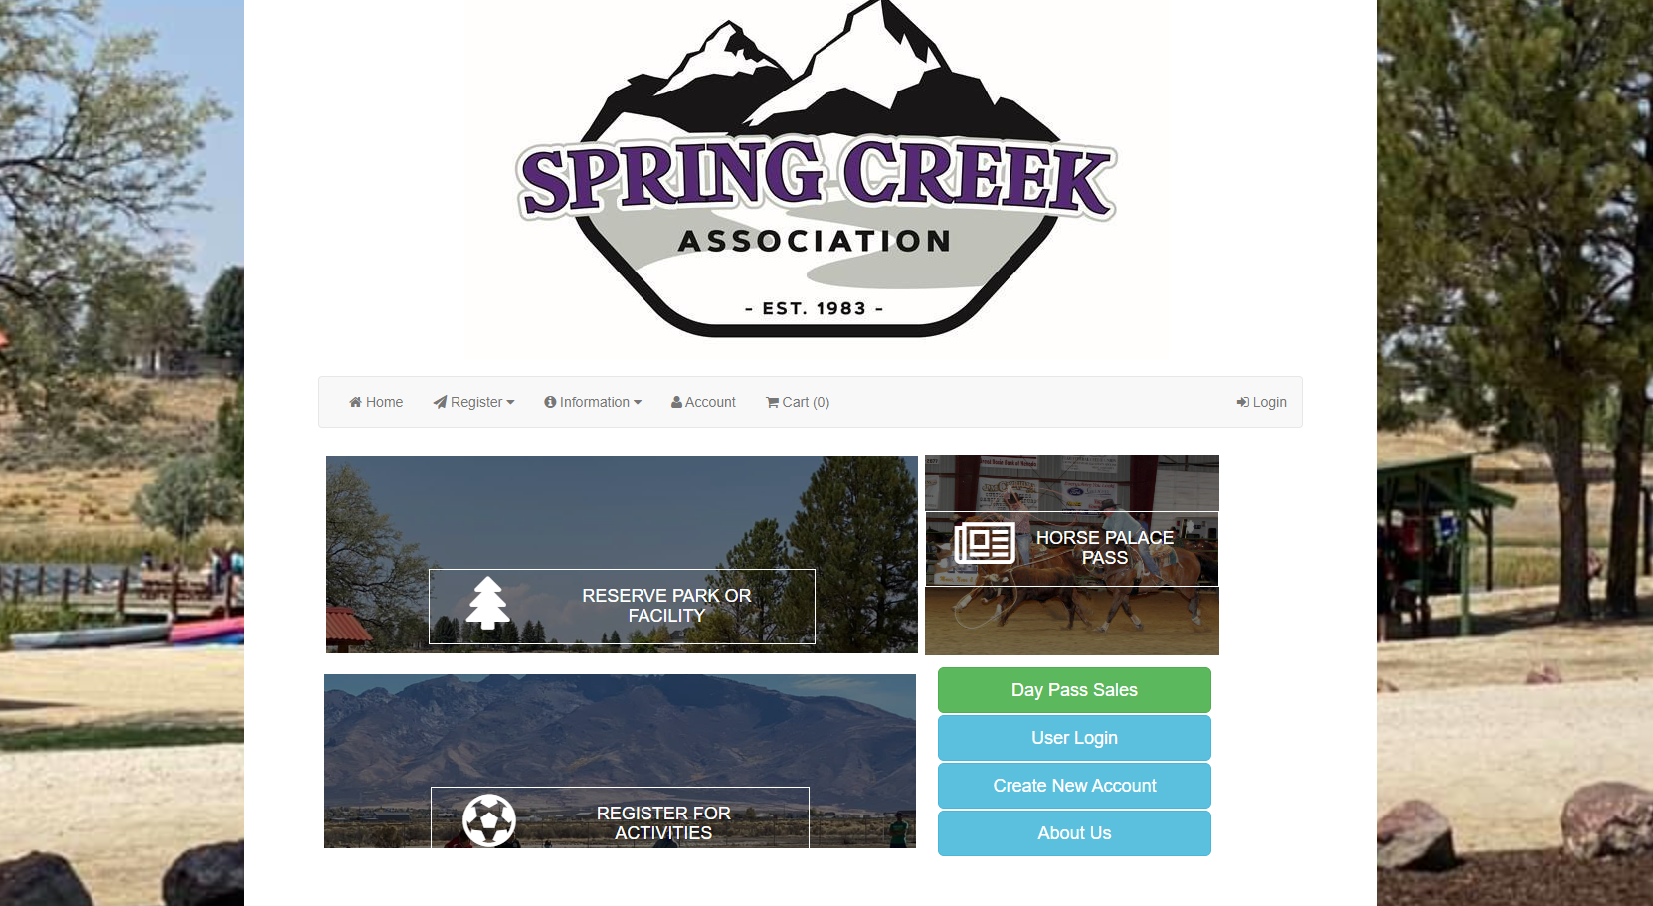
Step 1: From this screen you will click on “Reserve Park or Facility”

Slide 9
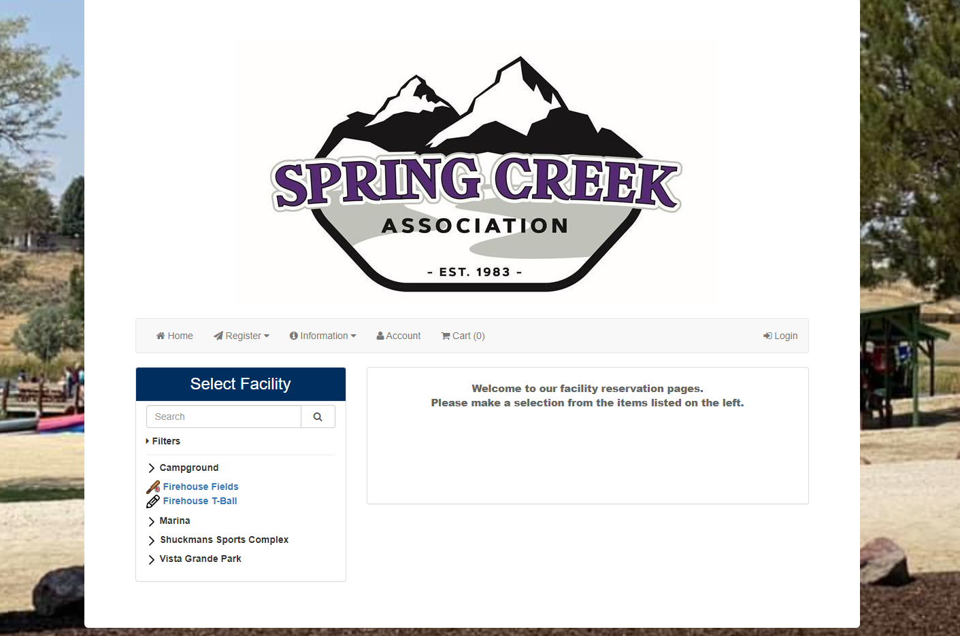
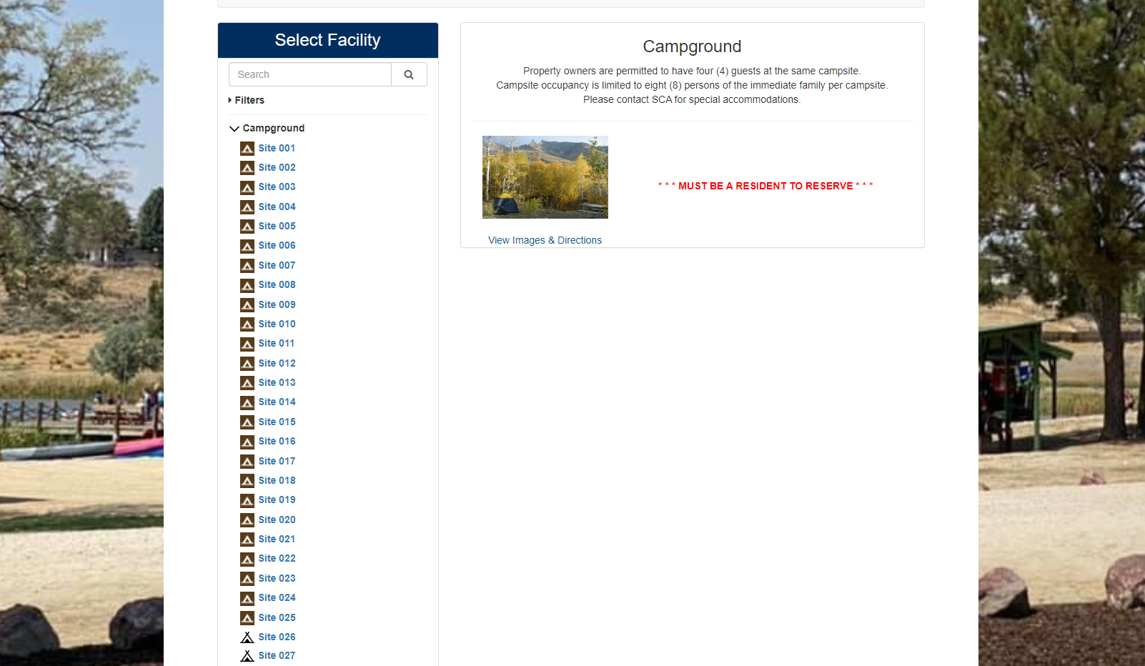
Step 2: Select the facility from the menu on the left-hand side of the screen
*Campground (example shown), Marina, and Vista Grande Park will have an additional items to chooses from (sites, tables, etc.) – if you are looking to reserve a field at The Sports Complex, please call The SCA Office at 753-6295 for availability.
Step 3: Choose your site, table, etc. from the additional item drop down.

Slide 10
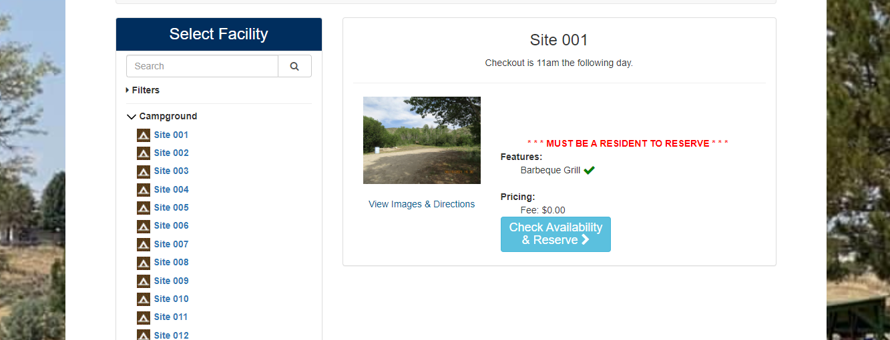
Step 4: Once you have chosen your amenity and additional item. (campground, site 001 – example shown)
Click “Check Availability & Reserve”

Slide 11
Step 5: Choose date that you are looking to reserve your site. If it is available, it will show green.
Step 6: Click a time slot – if you are looking to reserve a table at The Marina or Vista Grande Park” additional time slots will show.
Step 7: Click “Request a Reservation”

Slide 12
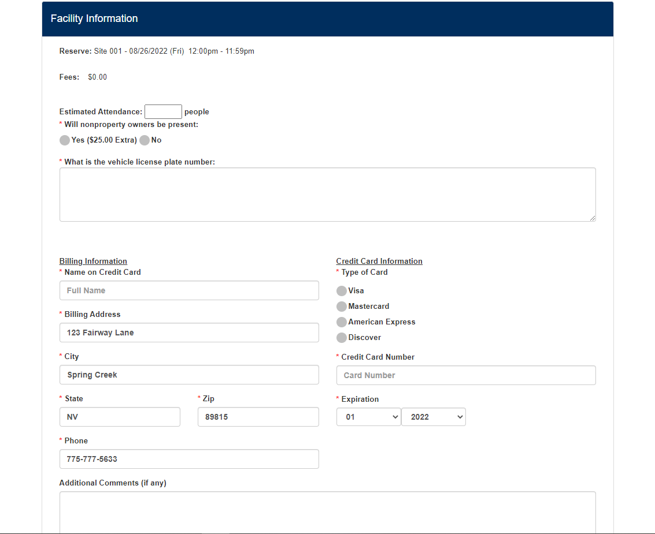
Step 8: Under “Personal Information” Select your name
Step 9: Fill out all the information under the “Facility Information” tab.

Slide 13
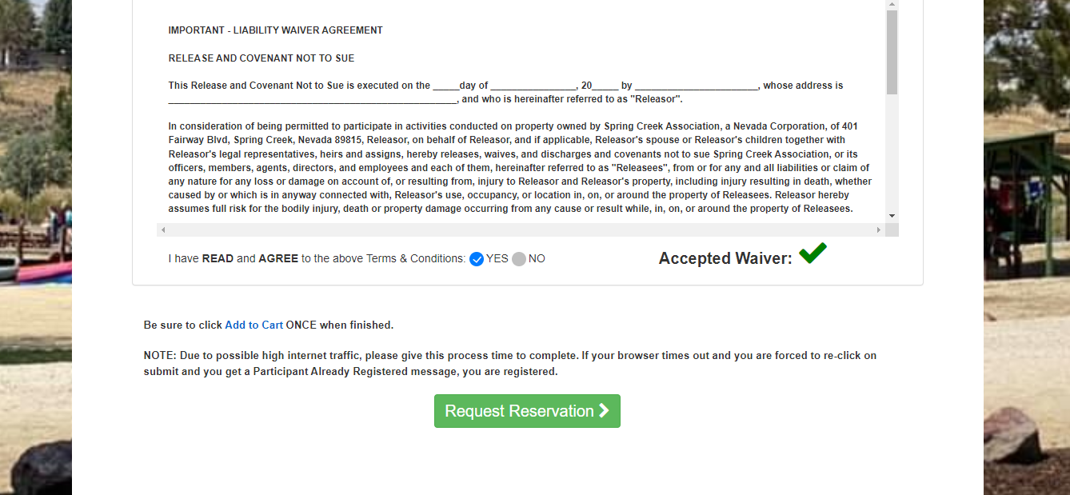
Step 9: Once you have READ and AGREED to the terms & conditions you must click “yes” that you agree.
*A green check mark will appear letting you know that it has been accepted.
Step 10: Once you have agreed to the terms and conditions & you will click “Request a Reservation”

Slide 14
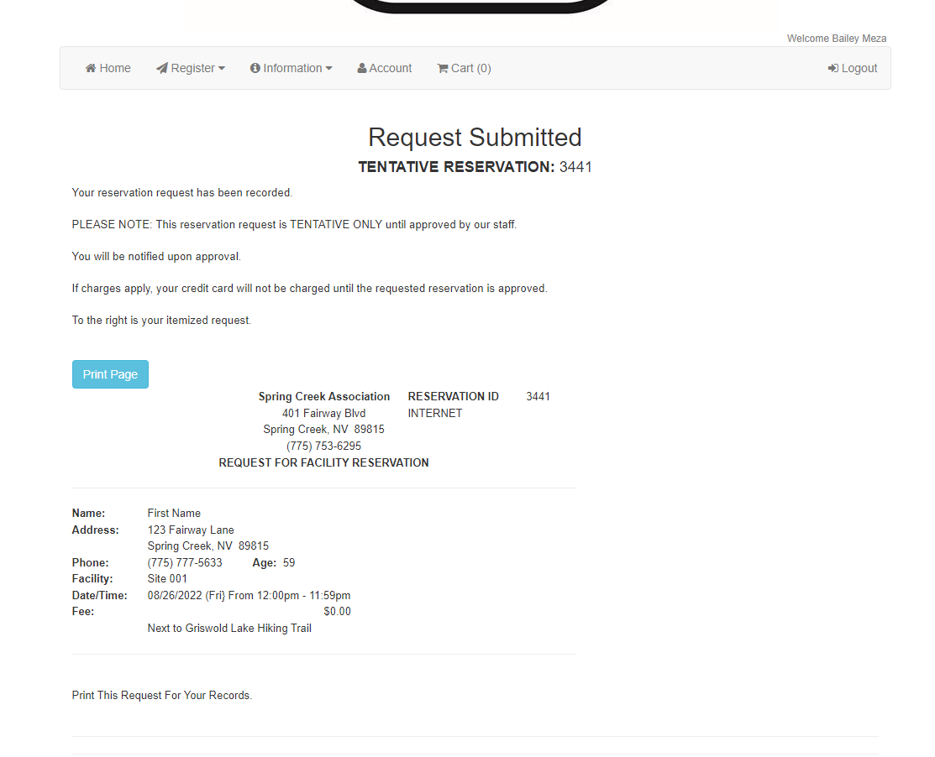
This page is your tentative reservation. Once approved on the SCA side you will be notified through e-mail.
If you have any further questions, please call the office at 775-753-6295. Or e-mail frontdesk@springcreeknv.org

