Slide 1

Camp Paque Troupe 2022-2023
“When the World turns its back on you, you turn your back on the world!
01
Launching of the Theme
The beginning of the journey.
02
$${Day}_{1}, {Day}_{2}, {Day}_{3 }$$
Throughout the camp.
03
The Last Day
The end!
Done by: Kelvin-Ray Ayoub

Slide 2




Launching of the Theme
When we first arrived we placed our bags and resources around the camping land. After a while we where called for an assembly where the launching of the theme "سافر بلبنان" took place between the scout cub leaders by a short movie. They clarified that they had discovered a new land which they called Lebanon and that we need to work as a team, with different characters, to build a successful country. We had a quest to find the place of a hidden egg by given hints. And their, our journey began.
Chef Leonard: “لبنان يا “قطعة سما

Slide 3





"بيت شباب"
$T_{1}$: Get to Know
We started our camp by a game around the village and we were asked to draw a map of it and answer some questions about its history, culture, and traditions. We had two hours to finish this mission and return back to our camping land.
SP Samer:” Ade mase7et bet shabeb?”
SP Charbel:” men wen badde jib mefteh el truck?”
بيت شباب

Slide 4



Getting Settled
CP Ralph:” Ma fi hada ghayre byeshteghel bhal patrouille”
After a while we sat for lunch, which was peas and rice, and we discussed the answers of the questions from the previous game to be able to determine the winner. Lion got tide up with Toro by 28 right answers however Lion’s map was better and lead them to be the winners of this game. After lunch we started settling and placing the tents as well as building our natural ovens.
Pret

Slide 5



Veille (1)
After a guard session with Act Christian, we were asked to start the preparation of the animating plan for tonight, yet it was not successful. After we ate dinner which was “Humus”, we presented what we prepared however the leaders weren’t satisfied. We ended our night with a small exercise with Chief Leonard and went to sleep to charge energy for the coming day.
SP Elio

Slide 6





Day #2
The other day we woke at 7:30, and we were called to an assembly to perform some morning exercises. CP Marc demonstrated some techniques for us to do. After a while we had a spiritual session with Act Christian. Later, breakfast was ready, so we sat down and ate “Chocolate Sandwiches”.
CP Marc

Slide 7






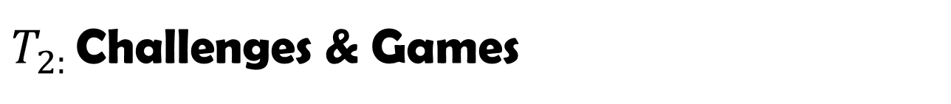
$T_{2: }$Challenges & Games
We had a game which requested solving codes that lead to places around the village where we find questions to solve. At the end of the game the scout leaders figured out that Lion had cheated and changed the order of the locations during the game which lead in giving them a zero. Toro were the winners of this game.
CP Ralph
CP Marc

Slide 8
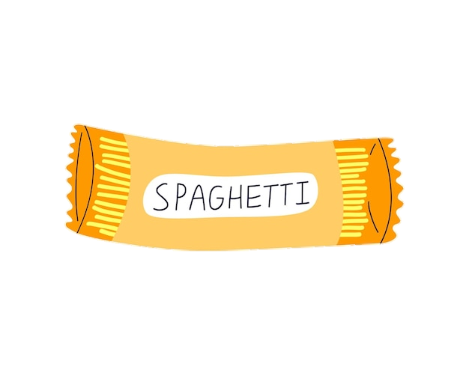

Cooking Lunch
After the game we had to prepare lunch. We were given a pot, water, spaghetti, oil, salt, and ketchup. With these resources we had to cook our lunch. The result wasn’t quite good. The pasta came out putty and was so bad. Consequently, we were given a bad remark on our cooking skills.
CP Kalsoust

Slide 9



Workshop (Districts)
After lunch, we were called to a workshop. We had 3 games to visit that would acquaint us on different scout districts. Lion and Renard were the winners of the three games.
Habib:"Haz99!”
Chef Leo: “Shou fi abel Hazmiye??”

Slide 10

Veille (2)
After collecting wood for the campfire we started preparing for the night under the theme “ Traditional Weddings”. We all agreed to work on the same movie but each group prepares a different idea. The preparation was great. After a while we were called for dinner which was “Mushroom Soup and Salad”. Afterwards we started our night and it was a success, the scout leaders were proud of our work. And at around 11:30pm we started going to our tents to sleep.
CP Ralph

Slide 11


Day #3
Here comes the final day, we started that day with a game called “Rovirina” and then we played “Rugby”. Subsequently we had a spiritual and deep session with Act Christian. Than breakfast followed, which was “Thyme Sandwiches”.
Act Johnny

Slide 12
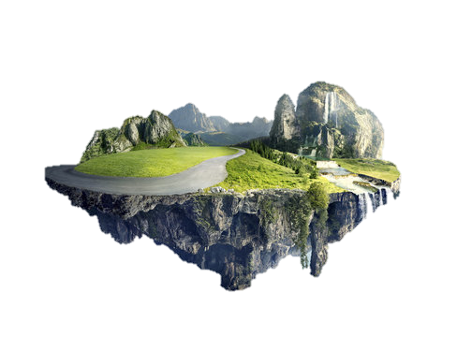

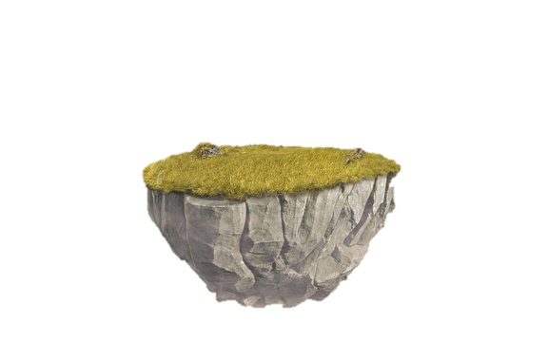




Risk & Packing
Before getting called for a game, Renard had guessed the location of the egg, which was in the first aid kit box, and won the whole camp, considering that Lion were so close as well. After announcing the winner we played a game of risk which contained a lot of challenges. Then we started packing our stuff and getting ready to leave.
CP Charbel

Slide 13
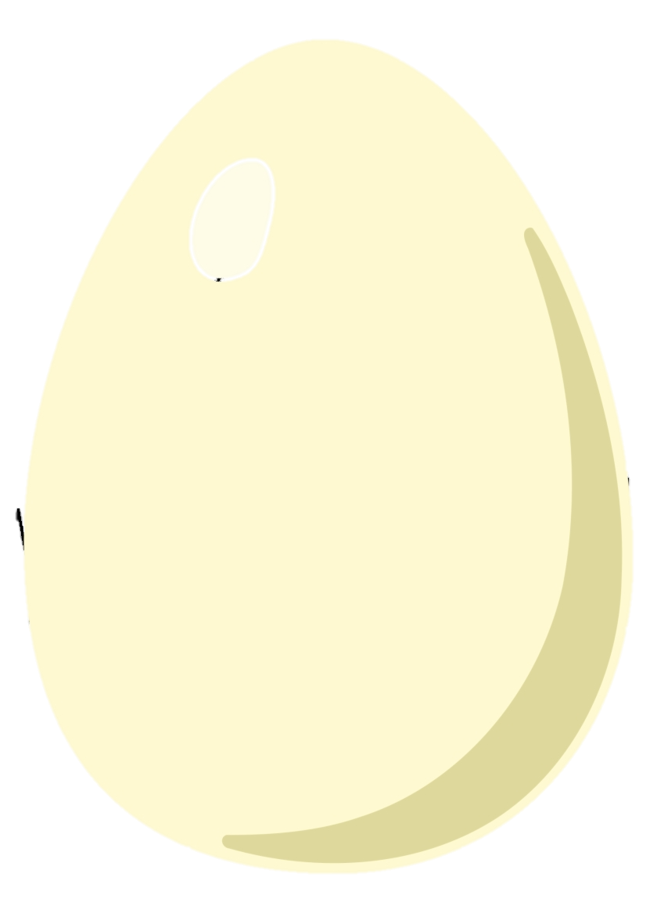
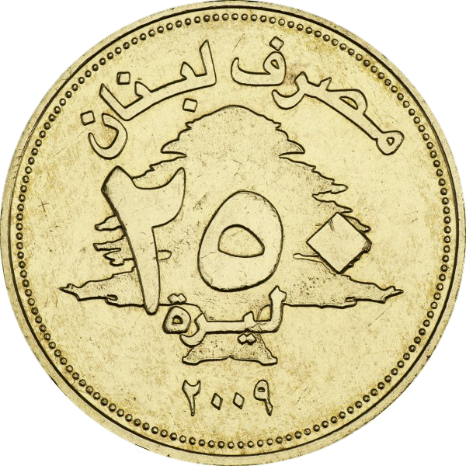
The End!
After two days of hard work our camp has unfortunately came to an end. After we returned to our main location in “Naccach”, we cracked eggs occasionally for Easter, and did a small workshop with 250 coins as a memory for the camp. And their we returned home, with memorable and valuable memories.
Act Goerge
SP Kelvin

Slide 14
Badge
Reporter

