Slide 1
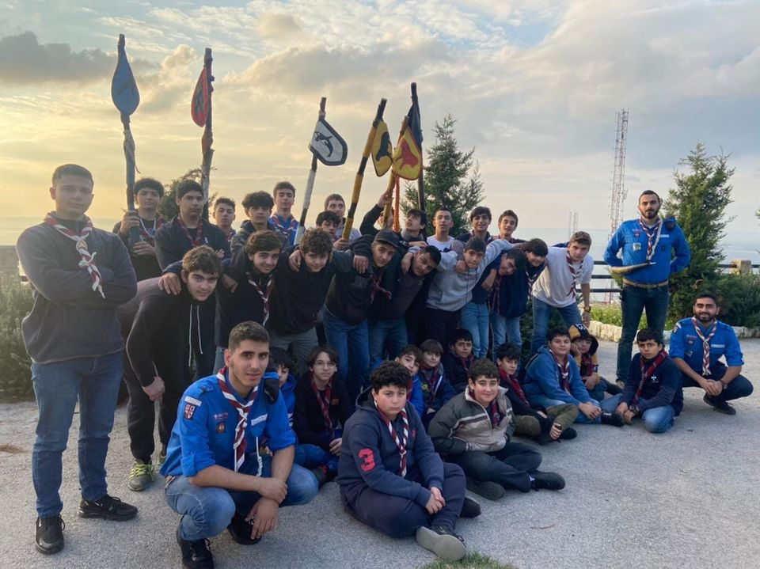
Camp Noel Troupe GSVN 2022
Presented by :
Ralph Al Alam

Slide 2
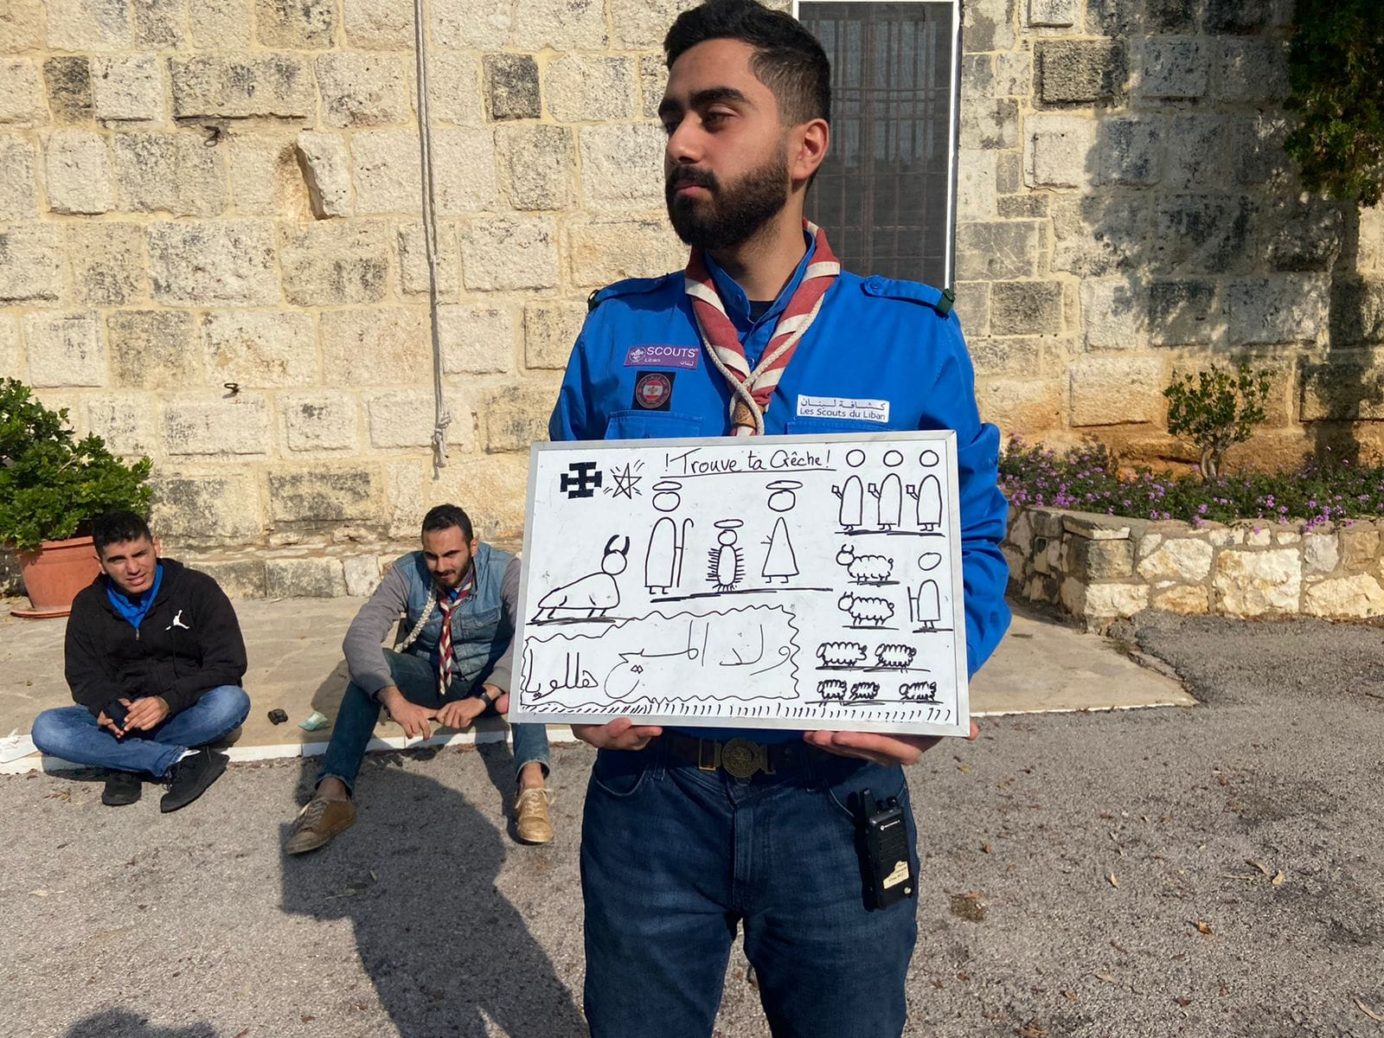
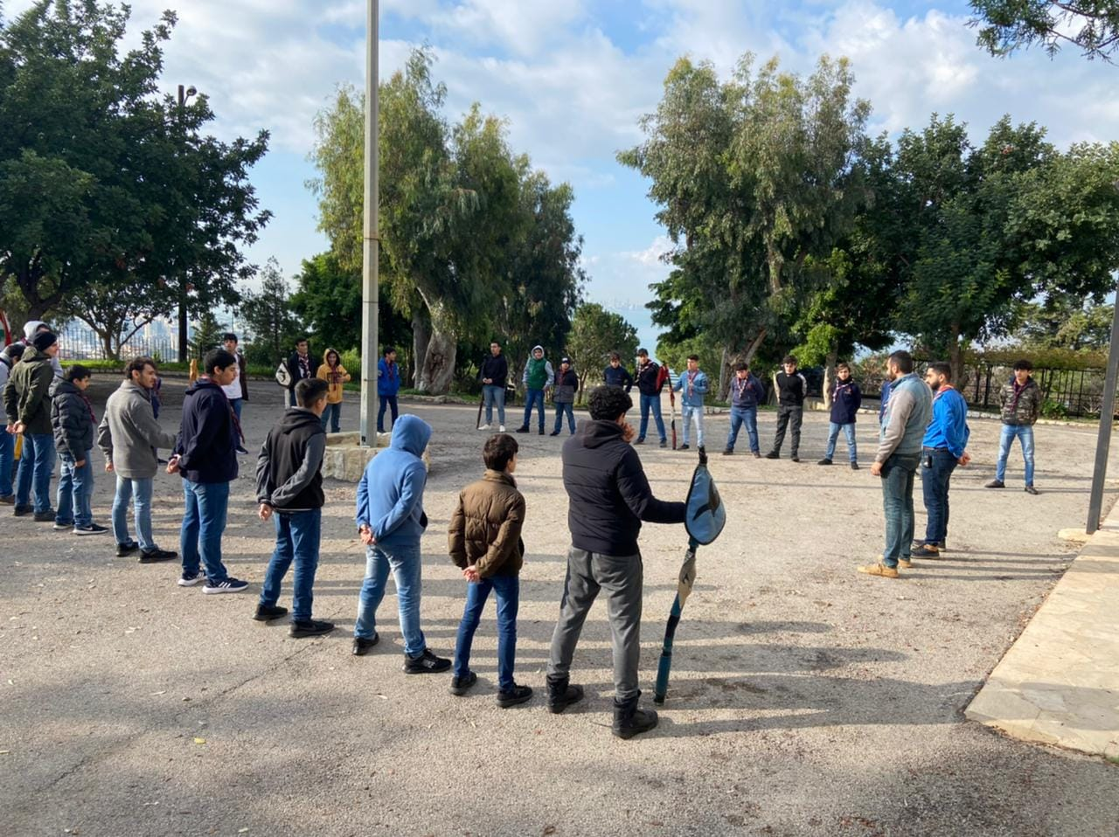
Lancement Du Thème :
As soon as we arrived , we did a quick “réunion” and then we started getting hints for what the theme may be (although we all should’ve read it from the flyer). As ACT Christian was making a Christmas scene about Jesus, CT Leonard was making a small drawing that we concluded the theme from, “Trouve Ta Crèche”.
After the introduction ended, the real camp started.

Slide 3
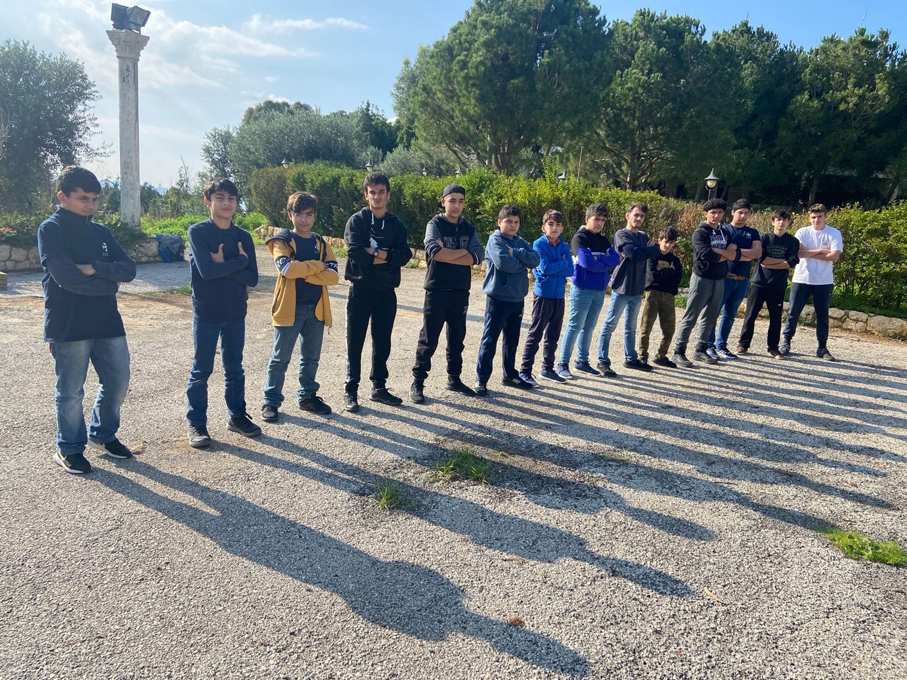
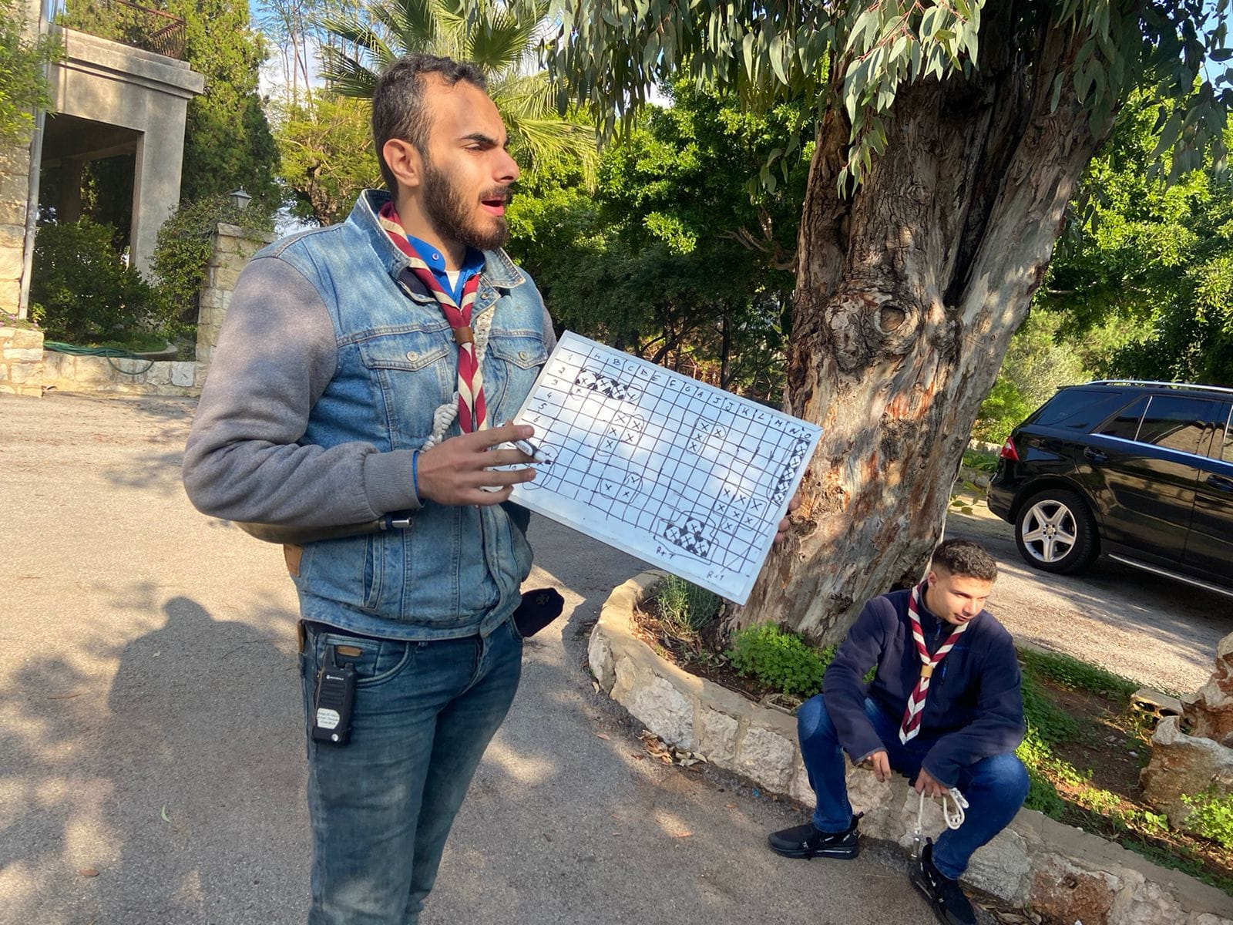
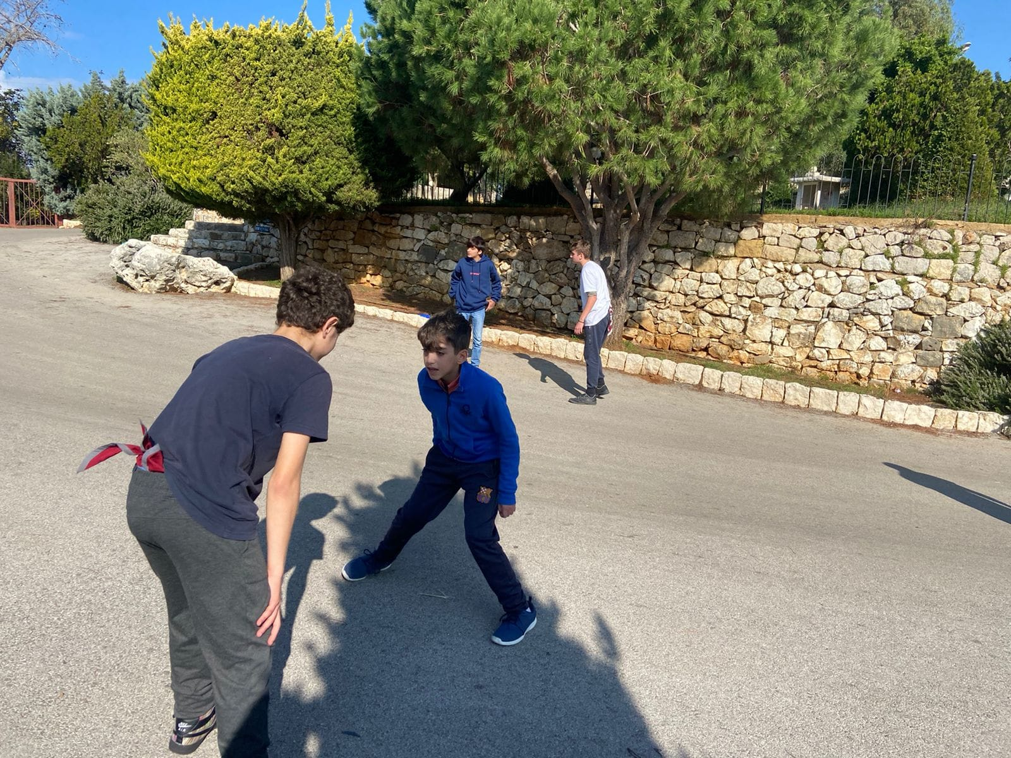
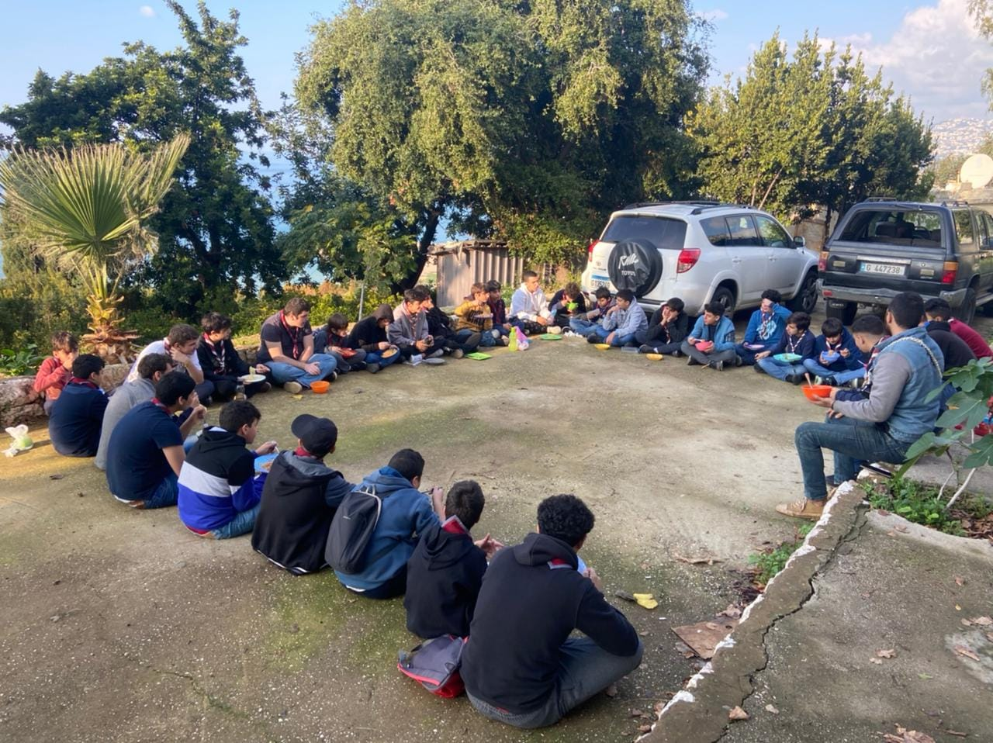
Day 1: T1: Scoutisme&Méthode
Starting with ACT Georges and ACT Johnny was a challenge, the game required speed and tactics, but at the end, no one was injured.
Then we went to learn about morse codes with CT Leonard and we played a very interessting game that was similar to battleship, it was tough to hit all the required zones but no work is hard enough for Troupe Orion.
Finishing with ACT Christian we endured a tiring Rugby match with some questions about St. Georges and general Scouting questions.
And finally, our favorite time has come. We ate pasta that was acceptable, but we all admire the hard work of our beloved Maitrise.

Slide 4
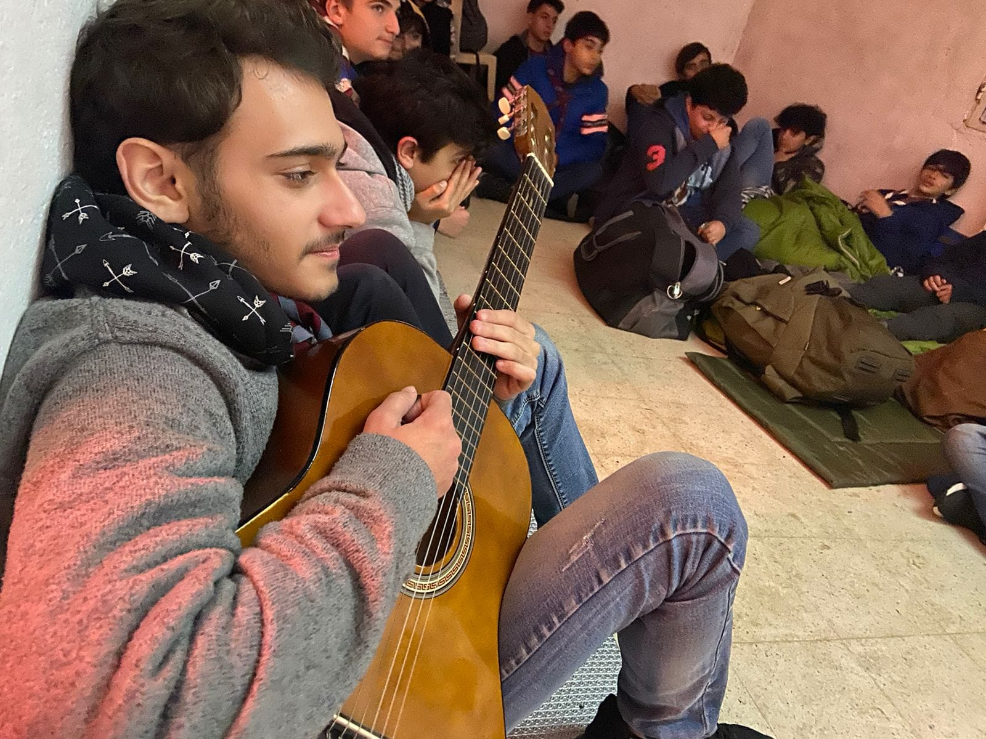
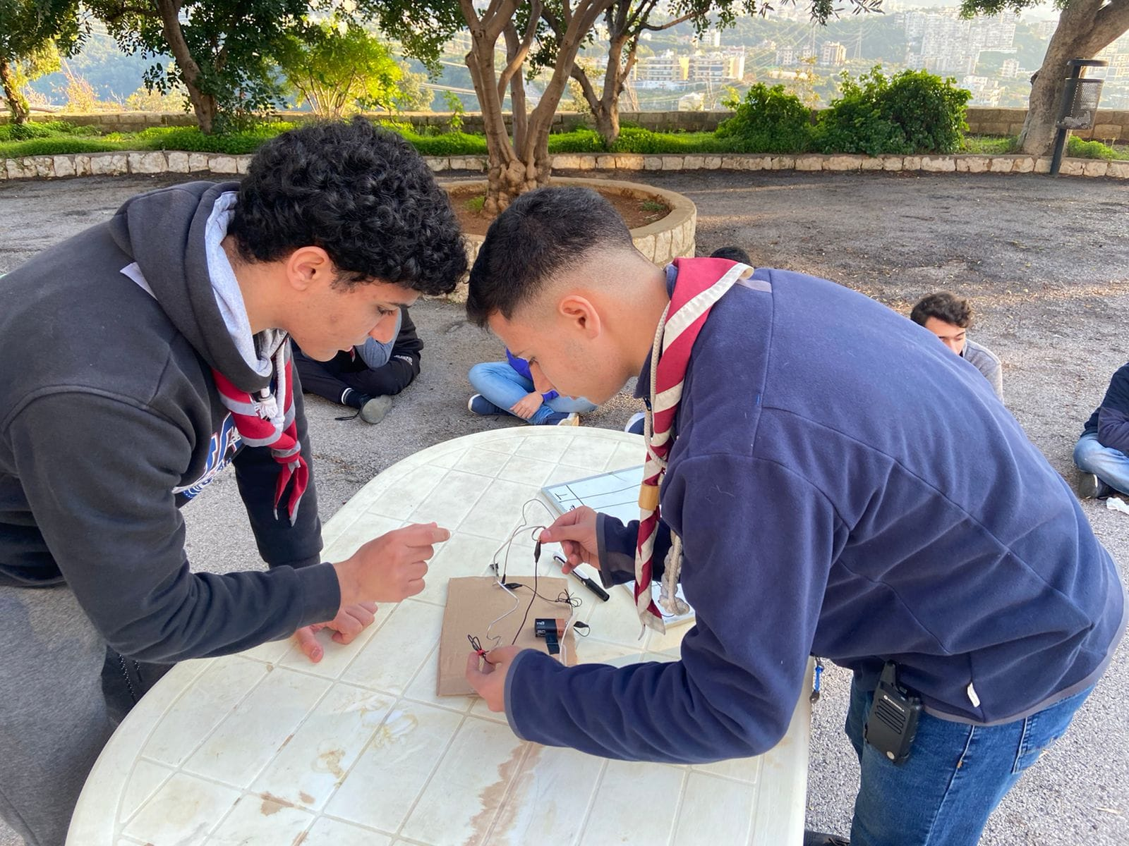
What a sweet break we had after our lunch. Soon after, we had an amazing session where everyone had fun and profited, it was about Badges. We went from having fun with technology, to learning about different types of trees, to learning about the human body. It’s just as beautiful as it seems.
After we finished this long journey, we headed to our base and we sat with our team to teach each other about the “ hymn of promise”and the “hymn of the patrols”. Teaching this to young children was hard but they ended up learning it.
Finishing our day, we had our lovely diner and soon after, an unforgettable spiritual night where we prepared new kids to their scouting promise.

Slide 5
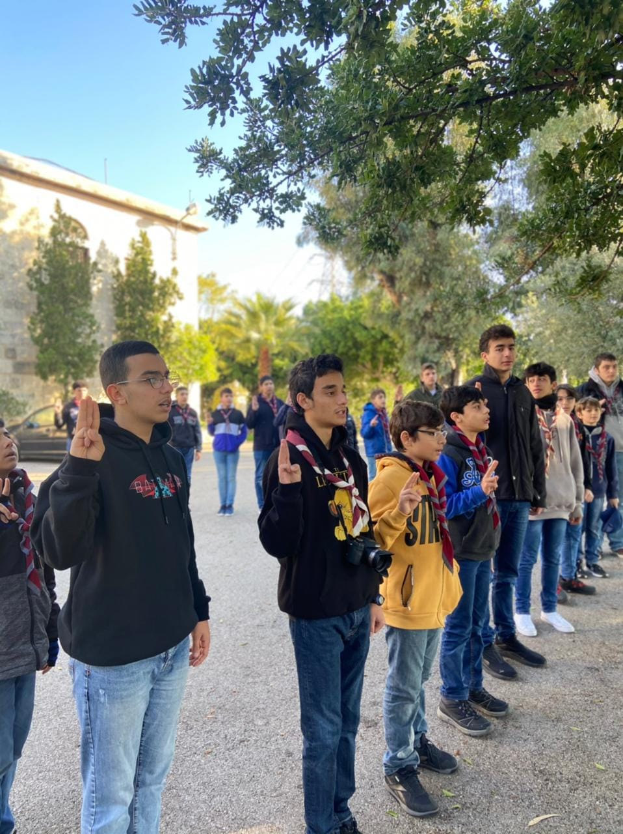
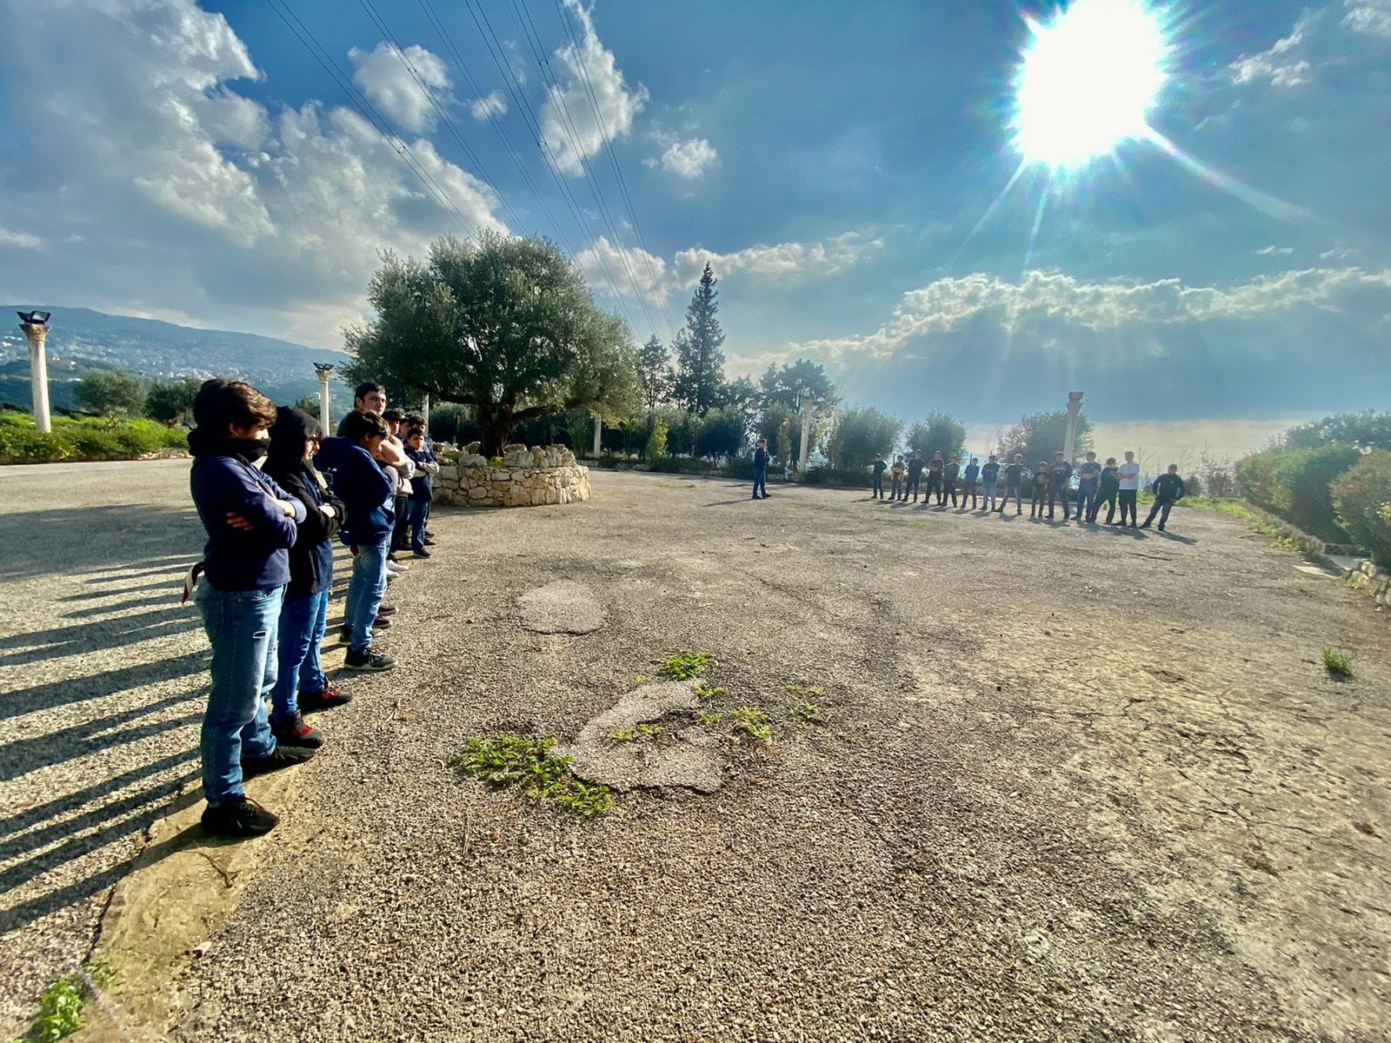
Day 2 :
No one can forget that sound when you’re waking up in a scout camp. It’s just unforgettable. So we got up and prepared ourselves for the biggest day of the camp, the day where “the fox patrol” went from being #1 to #5.
We started our day with a little morning exercise and headed to honor our Lebanese Flag by singing the National Hymn. Next up, we had a small spiritual reflexion with our beloved ACT Christian, and then our breakfast.

Slide 6
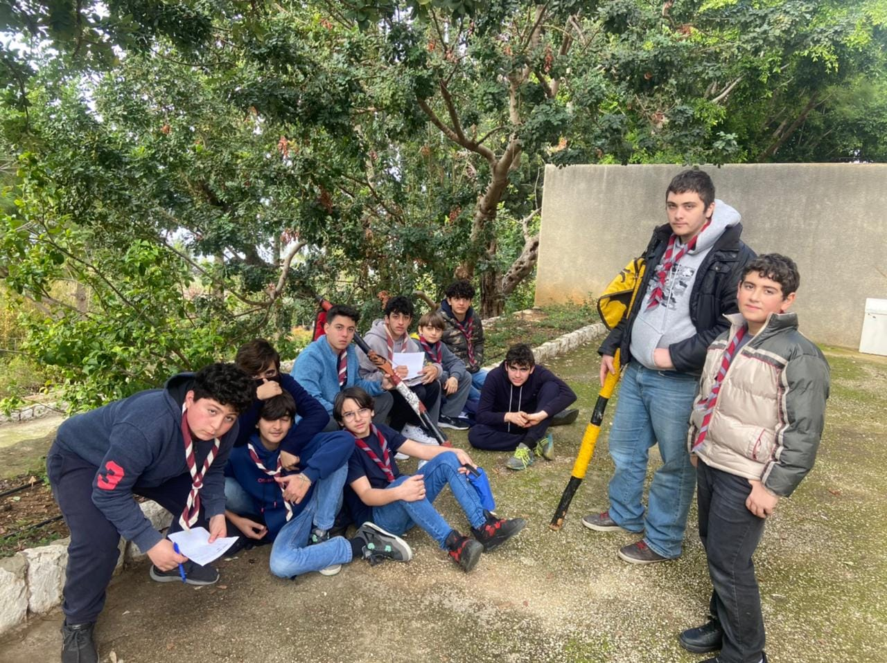
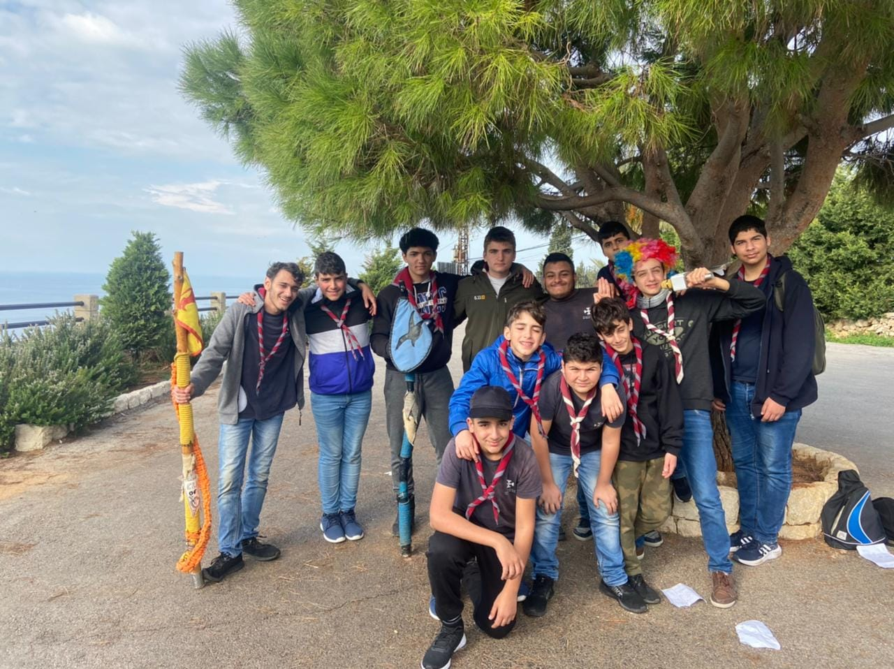
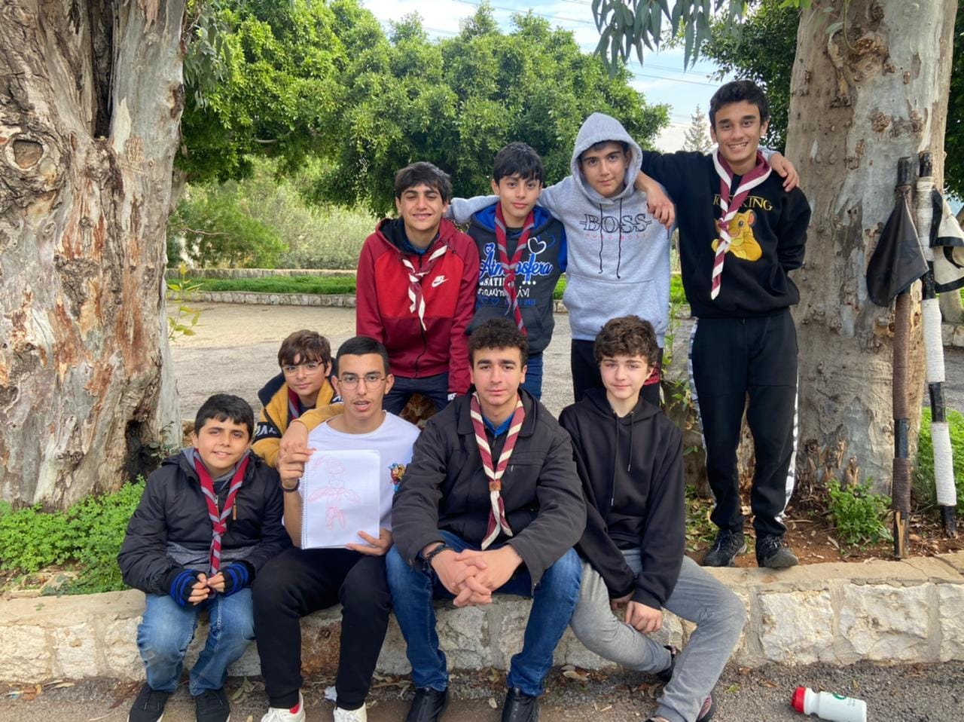
T2 : Jeux De Piste
The seriousness began, it was war, all versus all. We got separated and every 2 patrols stayed together, fighting and collecting as much points as they can.
Every Maitrise member had prepared a certain game. With ACT Christian we played Mafia, continued with CT Leonard to play singing games, and finishing with ACT Johnny and ACT Georges we did a parkour. And at the end of each game, we got questions that we will be answering later in the day.
We finished all the steps, gathering answers for the questions wasn’t easy, but we got a well deserved break after the games as well as a beautiful lunch.

Slide 7
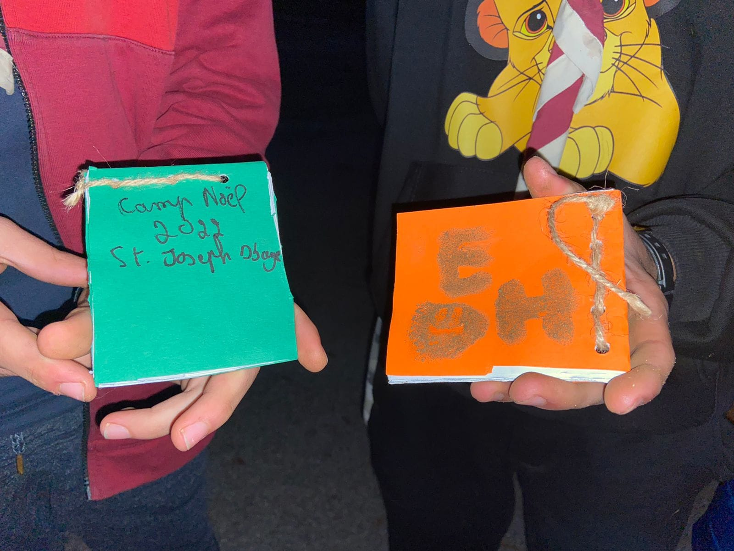
T3 : Carnet De Chants
After we finished our lunch and our break, we got to work again. But this time it was different. With the help of our Maitrise, we made ourselves a “ Carnet De Chants” which contains a big number of scouting songs , and it’s very helpful. Soon after, we got back to our base, and every member had to work on his progression ( Badges, 2nd classe, 1st classe) . In addition to that , we had to prepare for the upcoming “soirée”. Finally, we ate diner and prepared ourselves to perform “ The Talent Show “.

Slide 8
The Talent Show :
The show was a mix between war, songs, sketch, imitations, advertisement… It was just as beautiful as it seems. CG Paul also joined us and it was an honor to have him . We danced, sang and had fun all together . Personally, it was one of the nights that I will never forget.
After the show was over, we were all sweating, tired, and happy.
We learned that one man can’t make a whole show all by himself. It’s about the help and confidence that he puts in every single member to make of it a success.

Slide 9
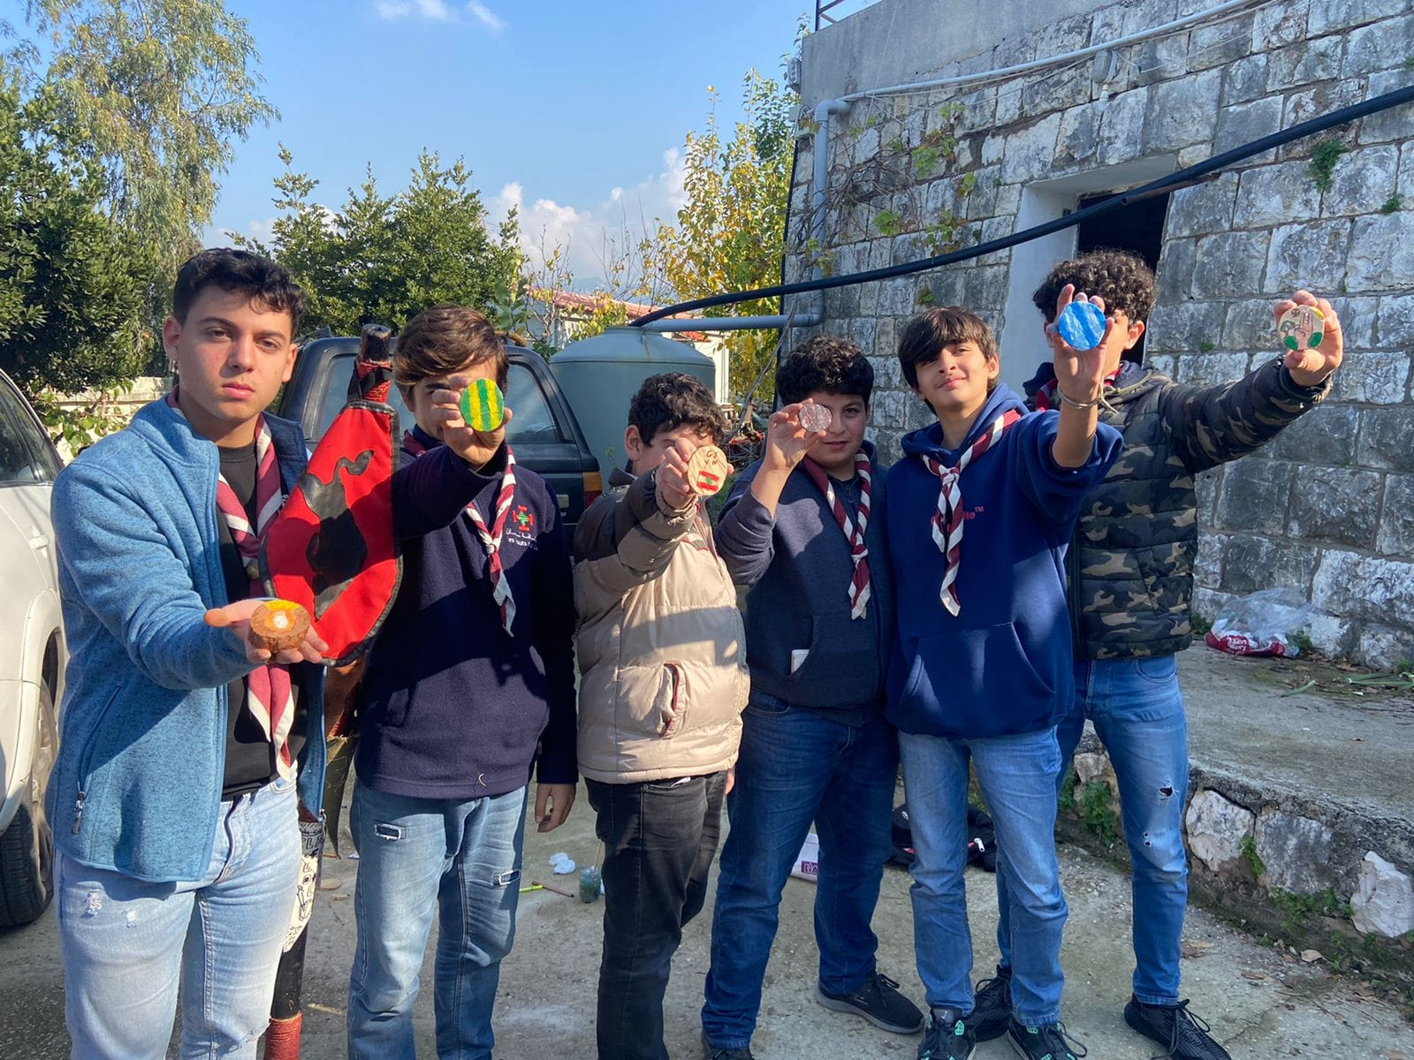
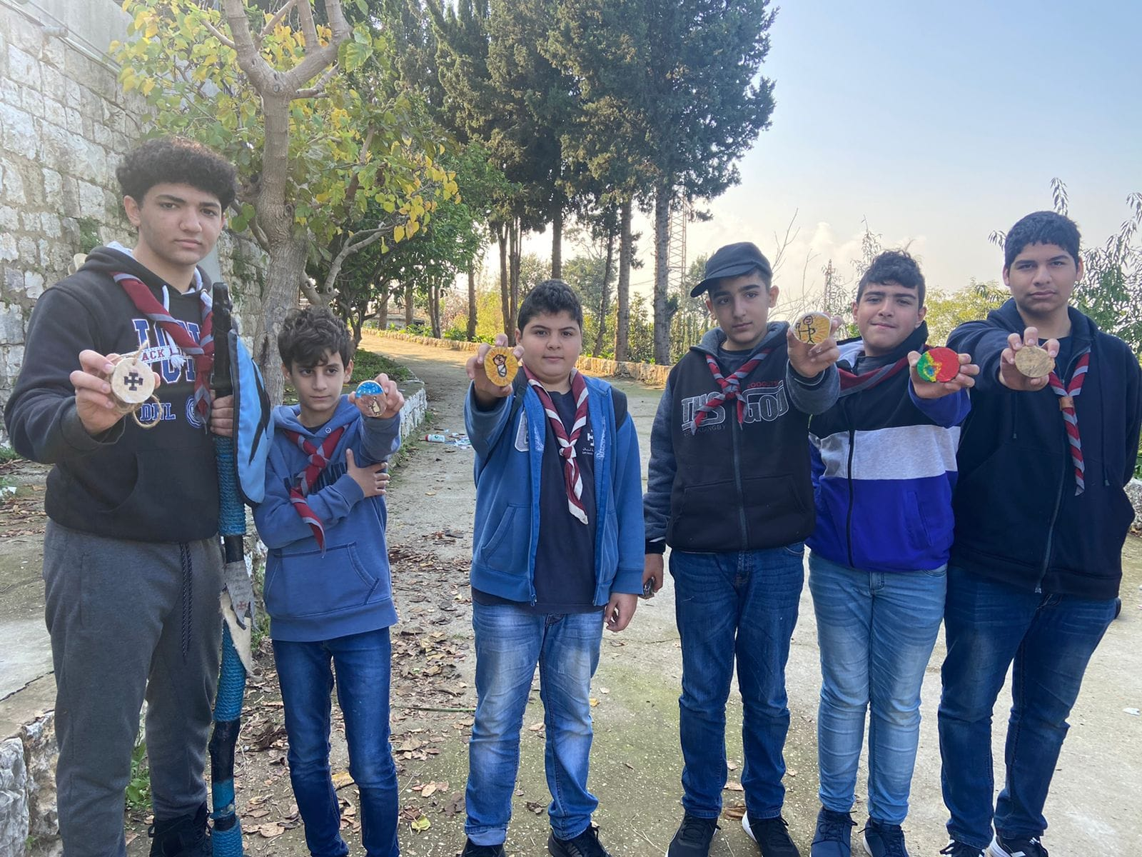
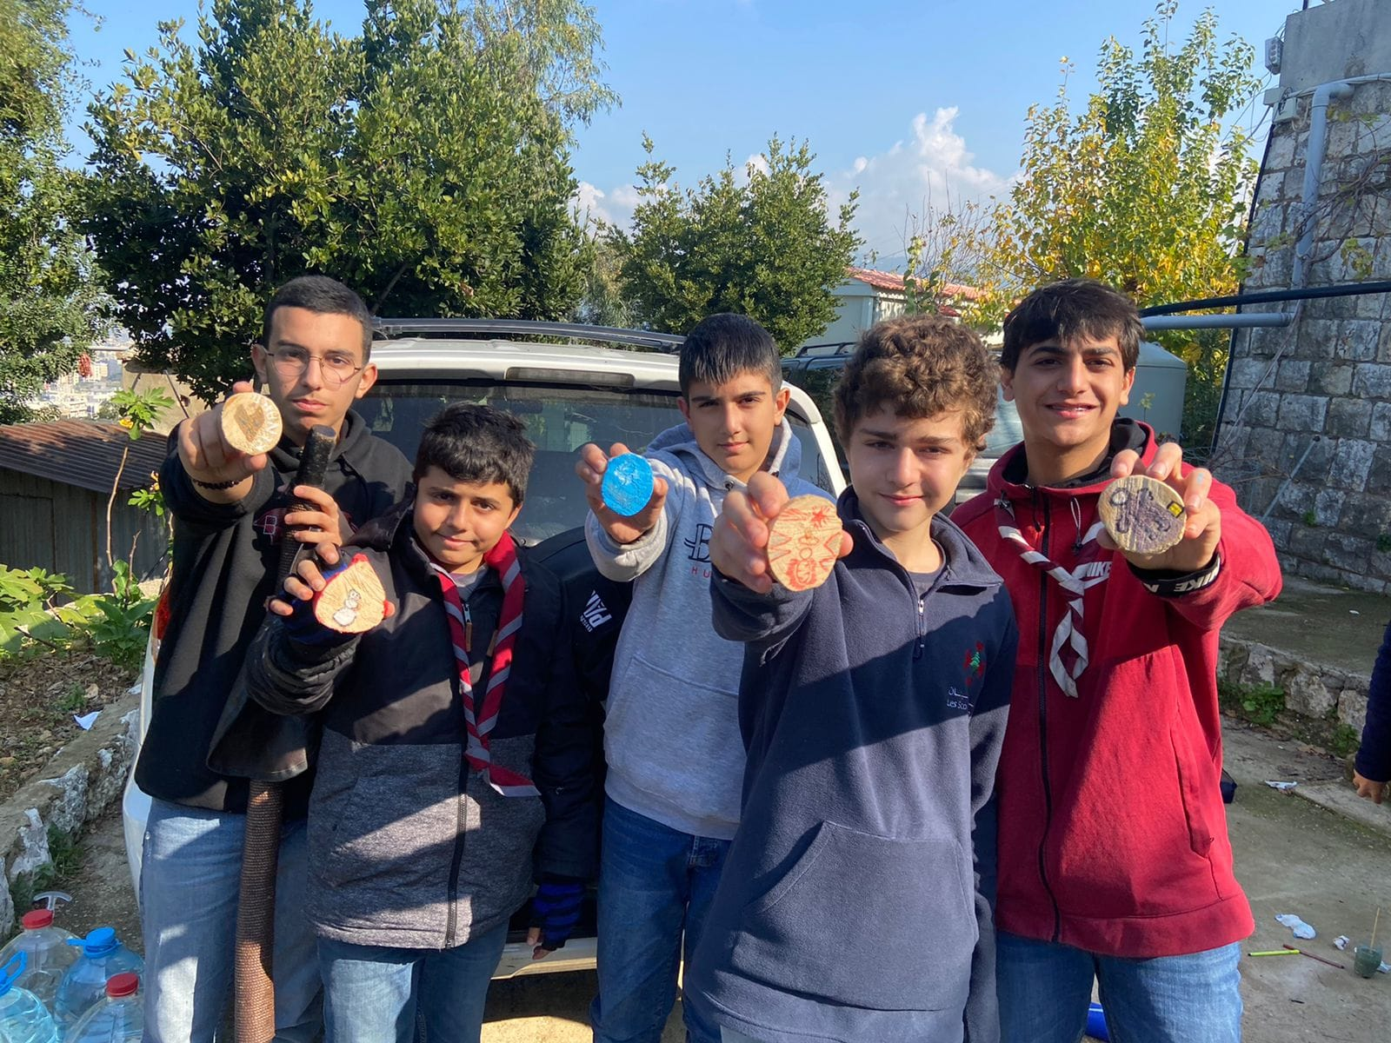
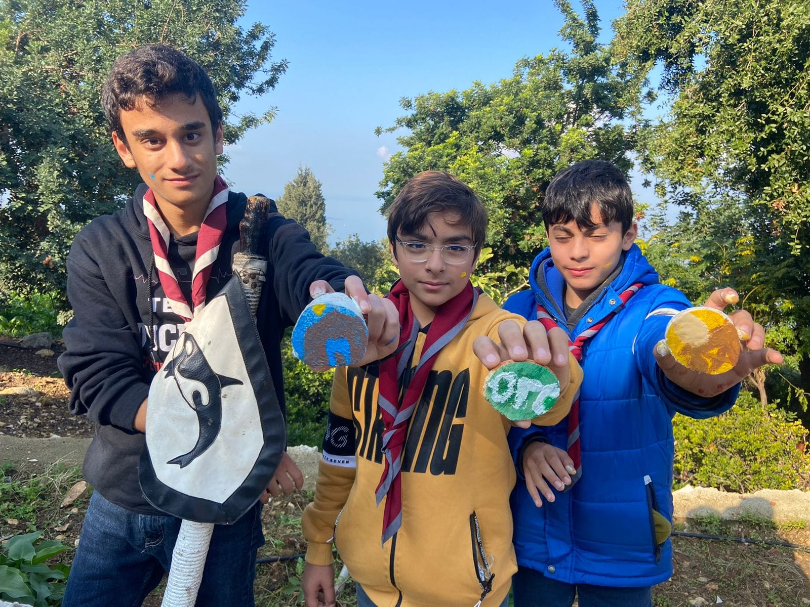
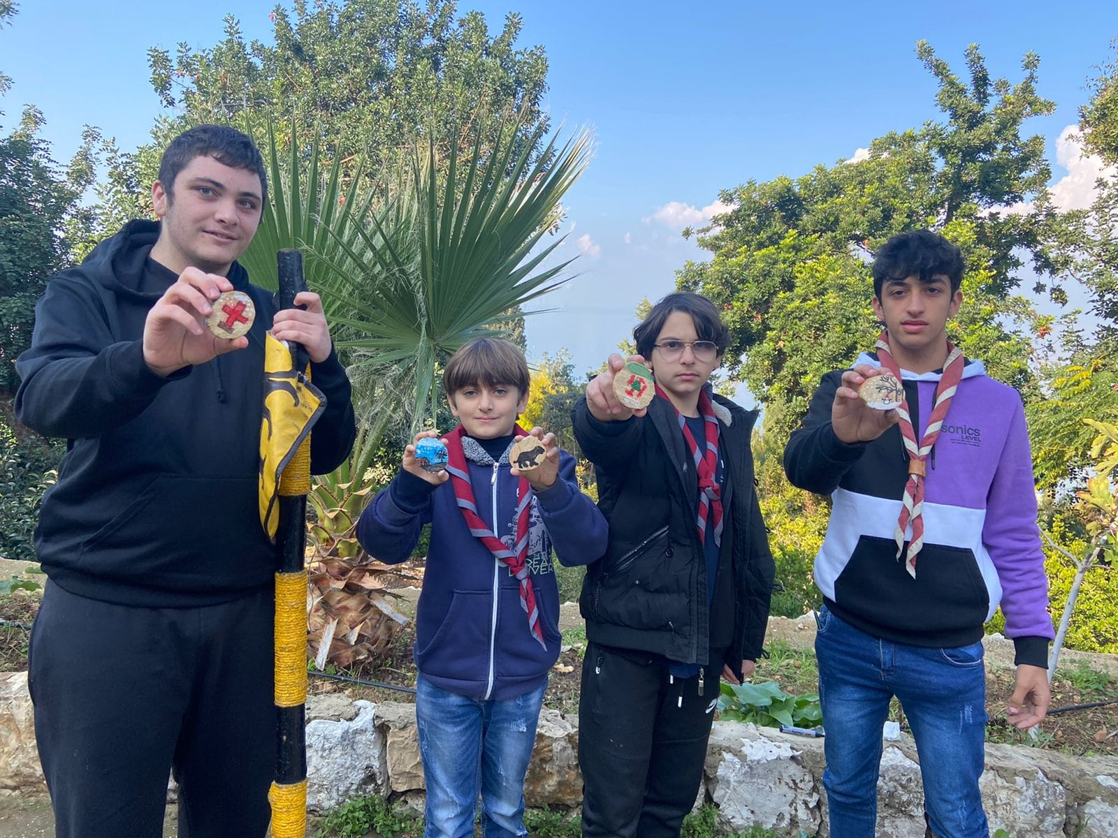
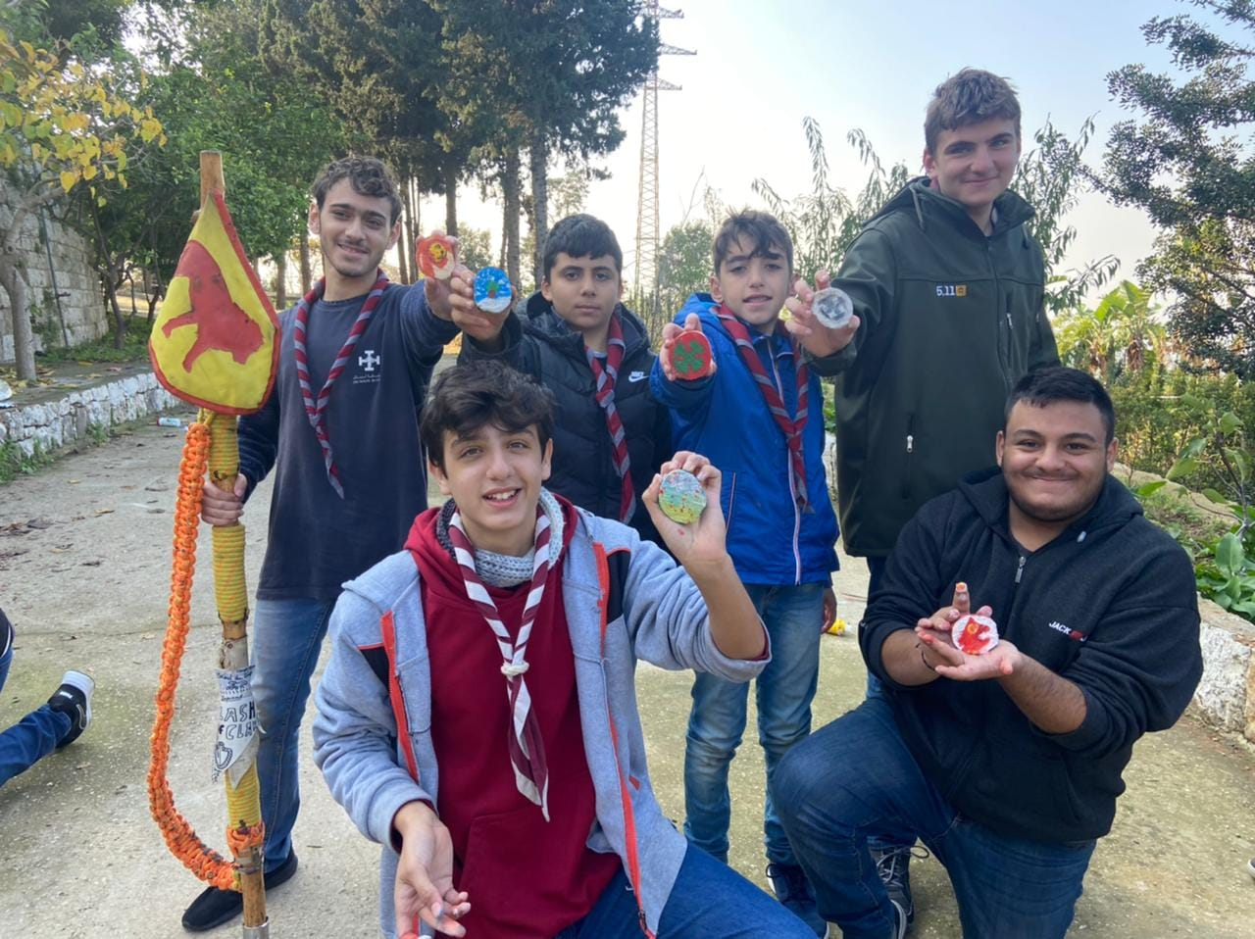
Day 3 :
The final day arrived. We woke up, and did the usual ( Honor the Lebanese Flag / morning sport/ spiritual reflection and after all that, breakfast).
We had a little “Atelier” where everyone designed a small piece of wood by his choice, it didn’t need to be related to scouts. And after we finished, we cleaned the whole place down and arranged our stuff, and went to sum up the camp with the big event that everyone awaited, “ Promesse”.

Slide 10
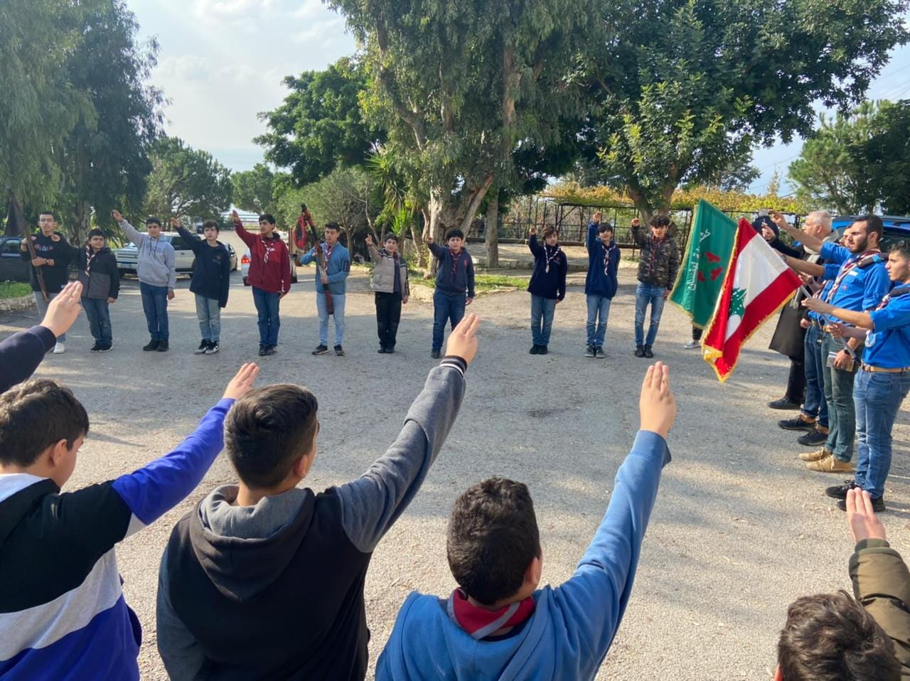
Promesse :
The new guys had their scout promise, a new phase of life started. Every CP&SP is proud of everyone that worked hard to achieve what they achieved. It was a long journey but a longer one awaits us. But for now, this beautiful camp comes to an end.

