Slide 1
Camp Patrouille Goeland
-Presented by charbel dahdouh

Slide 2
Imagine a weekend filled with excitement, learning, and adventure at Camp Patrouille 2023/2024 GOELAND, located in Saint Joseph Dbayeh. This camping program, happening on the 2nd and 3rd of December 2023, brings together 7 participants for a memorable experience. The theme for this camp is all about building "Confiance, Persévérance, Patience.

Slide 3
Day 1 - Saturday 3 December:
The day kicks off at 8:00 AM when everyone arrives and gets ready for a day full of activities. We start with a warm welcome, introducing the theme, and raising the camp flag. Then, it's time for T1, where we explore some cool chemistry experiments. After that, at 10:00 AM, T2 focuses on progression skills. A break for a delicious pasta lunch at 2:00 PM is followed by T3, a fun session on basic singing at 2:45 PM. We recharge with a snack at 5:00 PM, take a short rest, and then learn basic knots in T4 at 5:30 PM. The day continues with T5 at 7:15 PM, where we discover how to use our skills effectively. A yummy dinner of hummus and chay at 8:00 PM is followed by a night vigil at 8:45 PM, and we rest at 11:00 PM.

Slide 4
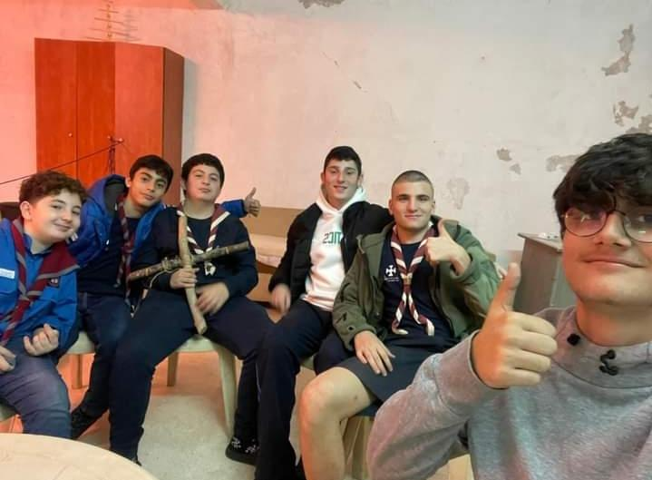

Slide 5
Day 2 - Sunday 4 December:
We wake up at 7:30 AM for morning sports and start the day with a reflection and flag-raising at 8:00 AM. Breakfast at 8:30 AM fuels us for the day ahead. At 9:00 AM, T5 brings a grand game, and then we dive into a workshop at 10:30 AM. T6 at 11:30 AM explores cultural games, and we take a break at 1:00 PM. Lunch of batata maslou2a and ketchup at 1:30 PM prepares us for T7 at 2:30 PM – learning how to pack our backpacks and getting ready for the Christmas camp. We pack up and clean at 4:30 PM, departing for the parish at 5:00 PM. The camp concludes with a closing ceremony at 5:30 PM.

Slide 6
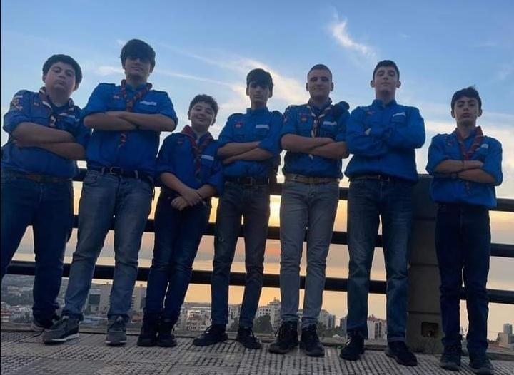

Slide 7
Camp Patrouille 2023/2024 GOELAND offers a fantastic opportunity for participants to have fun and learn valuable skills. The activities are designed to promote trust, perseverance, and patience while enjoying the great outdoors. As we wrap up our camping adventure, we take home not just memories but also a sense of accomplishment and a strengthened bond with our fellow campers.

Slide 8
