Slide 1
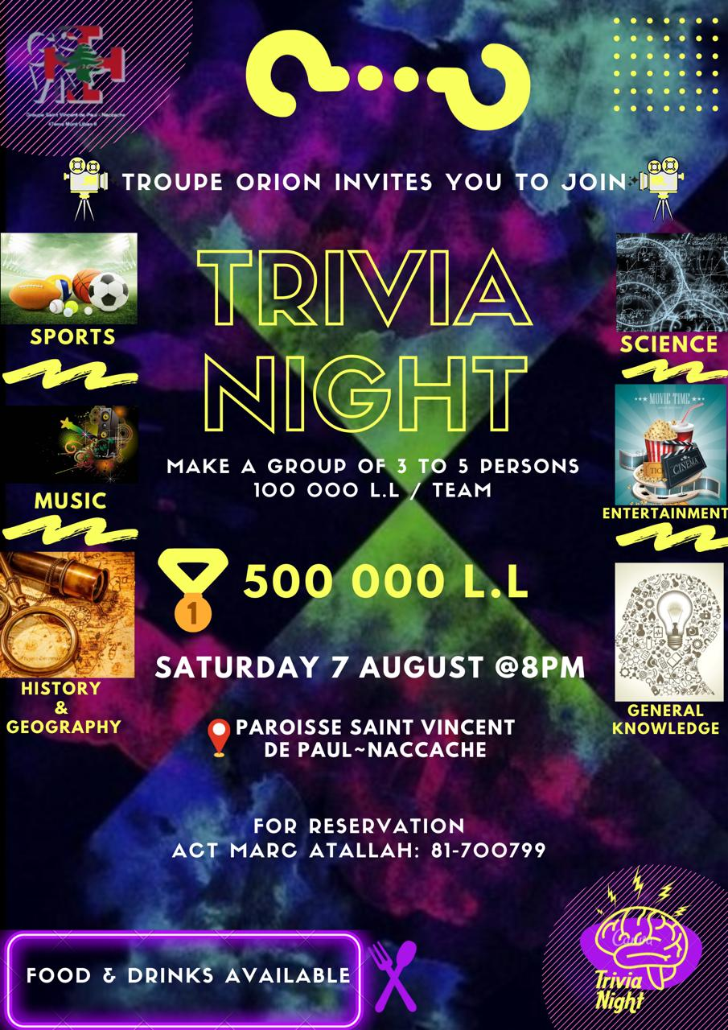

Slide 2
1
2
3
4
5
6
7
8
9
10
11
12
13
14
15
16
17
18
19
20

Slide 3
21
22
23
24
25
26
27
28
29
30
31
32
33
34
35
36
37
38
39
40

Slide 4
41
42
43
44
45
46
47
48
49
50
51
52
53
54
55
56
57
58
59
60

Slide 5
61
62
63
64
65
66
67
68
69
70
71

Slide 6
1
How many islands are in the Philippines in the latest research?
7641

Slide 7
2
What are the first 5 numbers after the comma in Pi?
14159

Slide 8
3
What was the name of the Greek Goddess of love?
Aphrodite

Slide 9
4
Which band of girls' singers had their first album name like the name of their band?
Spice girls

Slide 10
5
Which orchestral instrument can play the highest note?
Violin

Slide 11
6
What is the name of the song in the most liked video on tiktok
M to the B

Slide 12
7
Which one is above the other? Stratosphere or Troposphere?
Stratosphere

Slide 13
8
Who is the most followed singer on Instagram?
Ariana Grande

Slide 14
9
Kam notes de musique fi be kel gamme?
7

Slide 15
10
Chou esmo l abouna taba3 « zouwedit liom »
Omar el Hachem

Slide 16
11
Min el batrak yali seham bi este2lel Lebnen?
Elias el Howayek

Slide 17
12
What is the name of the singer who sang to his mother in a concert before his death?
Freddy Mercury

Slide 18
13
What is the chemical formula of nitric acid?
HNO3

Slide 19
14
What is the difference between astronaut and cosmonaut?
One is American and one is Russian

Slide 20
15
Which female artist had the most streams on Spotify in 2018?
Rihanna

Slide 21
16
What is the name of the sound theory in physics?
Acoustics

Slide 22
17
What is the name of the biggest organ in the body?
The skin

Slide 23
18
Which country’s flag does not have 4 points (corners)?
Nepal

Slide 24
19
What is the name of Mickey mouse’s dog?
Pluto

Slide 25
20
In which point on earth the closest human to you is in space?
Point nemo

Slide 26
21
Which muscle in the human body can produce the most force related to its’ size ?
The jaw

Slide 27
22
Which country has the most active volcanoes?
Indonesia

Slide 28
23
What is the hardest known substance on earth?
Diamond

Slide 29
24
Who is the composer of 4 seasons?
Antonio Vivaldi

Slide 30
25
What is the date of the united states’ independence?
4 July 1776

Slide 31
26
Where does the sound travel faster? In air or Water?
Water

Slide 32
27
Which war destroyed Pearl Harbor ?
World War 2

Slide 33
28
What is the oldest musical instrument in the world?
Flute

Slide 34
29
Chou houwe slogan cherkit tannourine? Bel 3arabe l na7awe
الأرز بيشرب تنورين

Slide 35
30
Where can you find the most iron in the human body?
Blood

Slide 36
31
Place those 4 liquids from higher density to lowest density:
Water, Olive Oil, Wine, Dish soap
Dish Soap>Water>Wine>Olive Oil

Slide 37
32
Which song is the most played on youtube of all time?
Shape of you

Slide 38
33
Who’s the famous deaf piano composer?
Beethoven

Slide 39
34
Which Asian country is the first in the world to use paper money?
China

Slide 40
35
What is the name of the biggest muscle in the body?
Gluteus maximus

Slide 41
36
What is the name of the smallest bone in the body?
Stapes

Slide 42
37
Kam cordes fi bel 3oud?
12

Slide 43
38
When did World War 2 ended?
1845

Slide 44
39
In Tennis, what piece of fruit is found at the top of men’s Wimbledon trophy?
Pineapple

Slide 45
40
In the Vikings, which son of Ragnar was the first to die?
Sigurd

Slide 46
41
In Bowling, what is the term given for three consecutive strikes?
A turkey

Slide 47
42
What did the Romans call Scotland?
Caledonia

Slide 48
43
In the action thriller Speed, why is Annie (Sandra Bullock)’s driver’s license suspended?
She was speeding

Slide 49
44
In 2016, who announced their retirement days after becoming F1 world champion?
Nico Rosberg

Slide 50
45
Which President has been given credit for abolishing slavery in the USA?
Abraham Lincoln

Slide 51
46
Which 1970 movie marked the feature debut of Arnold Schwarrzenegger?
Hercules in New York

Slide 52
47
How many players are there in a rugby team?
13

Slide 53
48
What was the name of Henry VIII’s first wife?
Catherine of Aragon

Slide 54
49
What is the biggest grossing animated film in movie history?
The Lion King

Slide 55
50
How many world titles has Phil Taylor won in darts?
16

Slide 56
Where does the Greek Goddess Peresphone spend half of the year when she is not with her methor
51
Underworld

Slide 57
52
How many Oscars has Meryl Streep won?
Three

Slide 58
53
What are the five colours of the Olympic rings?
Blue, Yellow, black, green and red

Slide 59
54
The main character in Toy Story was voiced by which actor?
Tom Hanks

Slide 60
55
Who is the first female Prime Minister of Australia?
Julia Gilliard

Slide 61
56
Which horse is the only three-time winner of the Grand National
Red Rum

Slide 62
57
Which movie was incorrectly announced as the winner of Best Picture at the 2017 Academy Awards, during the greatest Oscars flub of all time?
La La Land

Slide 63
58
Taj Mahal was constructed as a tomb of the wife of which Mughal Emperor?
Shah Jahan

Slide 64
59
Who won the FIFA Women’s World cup in 2019?
USA

Slide 65
60
What is the highest-grossing film of all time?
Avatar

Slide 66
61
According to Greek mythology, who is considered the Goddess of Agriculturen
Demeter

Slide 67
62
In Football, which team has won the Champions League the most?
Real Madrid

Slide 68
63
What is the highest-grossing R-rated movie of all time?
Joker

Slide 69
64
Which European is given the credit of reaching North America first?
Christopher Comlumbus

Slide 70
65
Who holds the women’s record for the 100m sprint?
Florence Griffith-Joyner

Slide 71
66
Who is the youngest President of the United States?
John Kennedy

Slide 72
67
In F.R.I.E.N.D.S :
Phoebe: Look, I had a hard life. My mother was killed by a drug dealer.
Monica: Phoebe, your mom killed herself
Phoebe: She …………………..(Fill the missing phrase)
Is a drug dealer

Slide 73
68
What is the highest-grossing Star Wars movie?
Star wars: The force Awakens

Slide 74
69
Which city name took the detective in money heist?
Lisbon

Slide 75
70
Which actor played the role of Robin hood in 1991?
Kevin Costner

Slide 76
71
What’s the name of the superhero who runs fast in DC?
The Flash

