Slide 1


Yooper Game Studios LLC : 08/17/2023

Slide 2
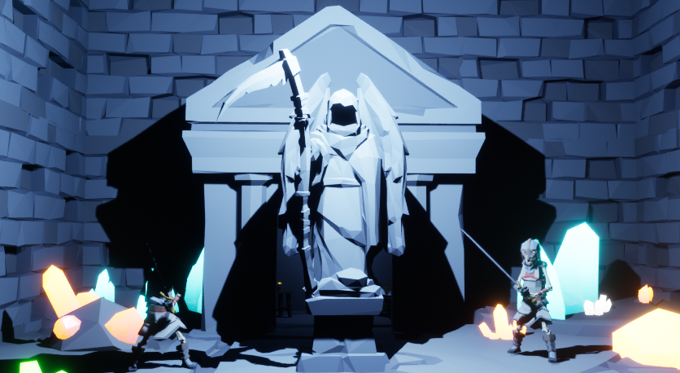
ESCAPE YOUR DESCENT

Slide 3

Hardcore Online RPG Looters
Problems:
Current matches take too long
Aesthetics try to be too “mature”
Need high-end PCs to run
Loss of progress can be too frustrating
Solutions:
Shorten gameplay loop, shorten the match time
Use friendly polygon art style to broaden appeal
Less demanding art style runs on low-end PCs
Allow players paths to retain progress

Slide 4
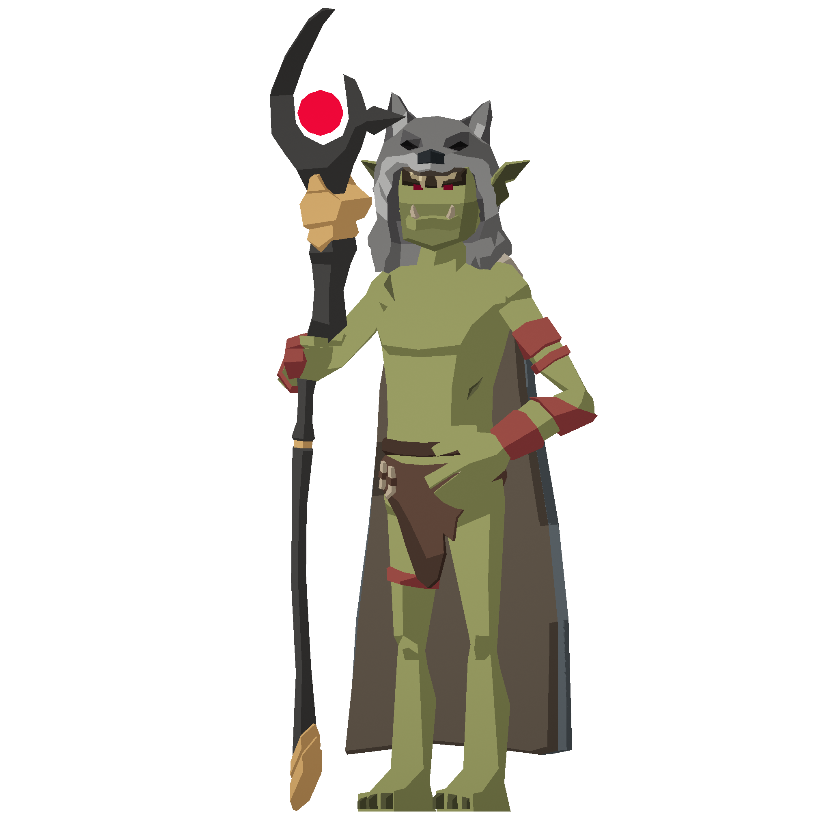
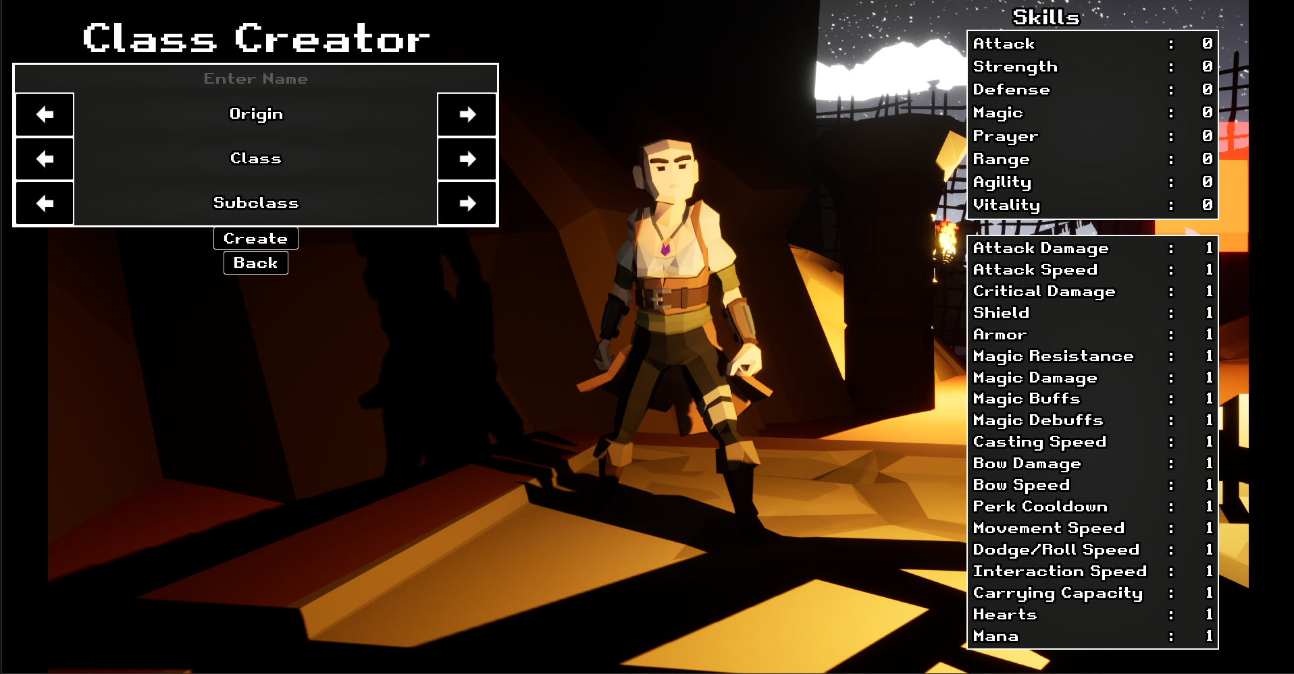
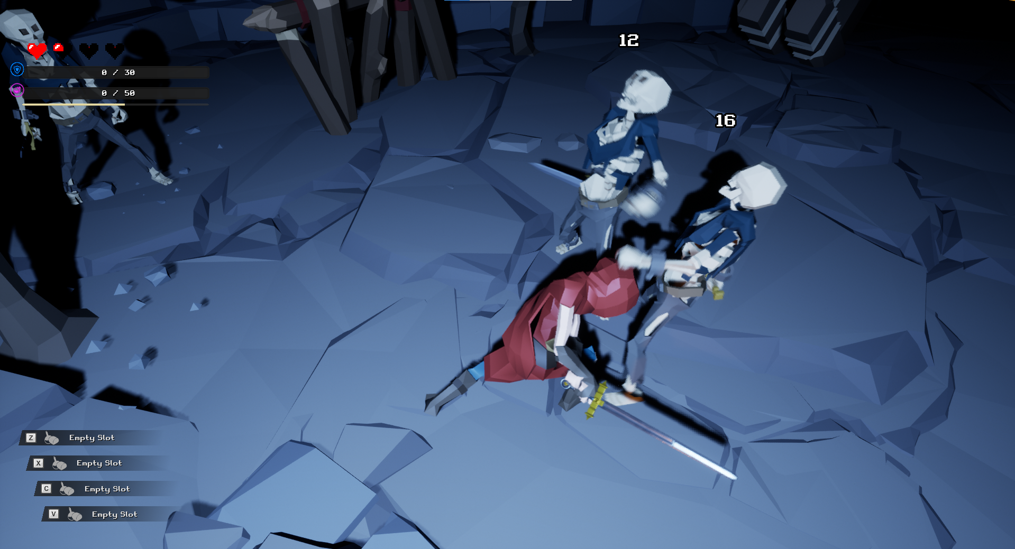
Dive into Quick and Unforgiving Battles for Survival
Choose your origin and class
Fight through escape room PvPvE dungeons
Dying loses all your hard-earned loot!
Quick and addicting 10–15-minute online matches
Party up with friends or go alone

Slide 5
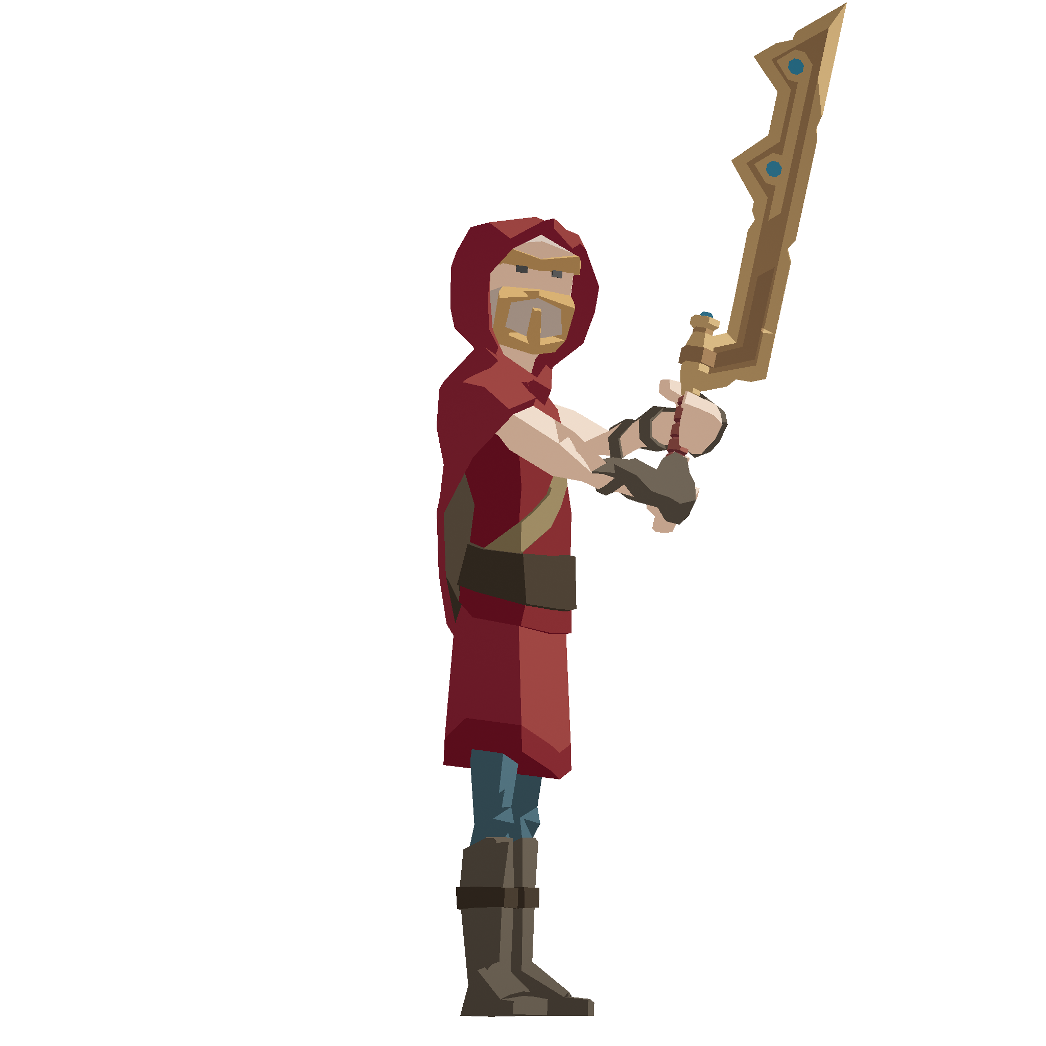
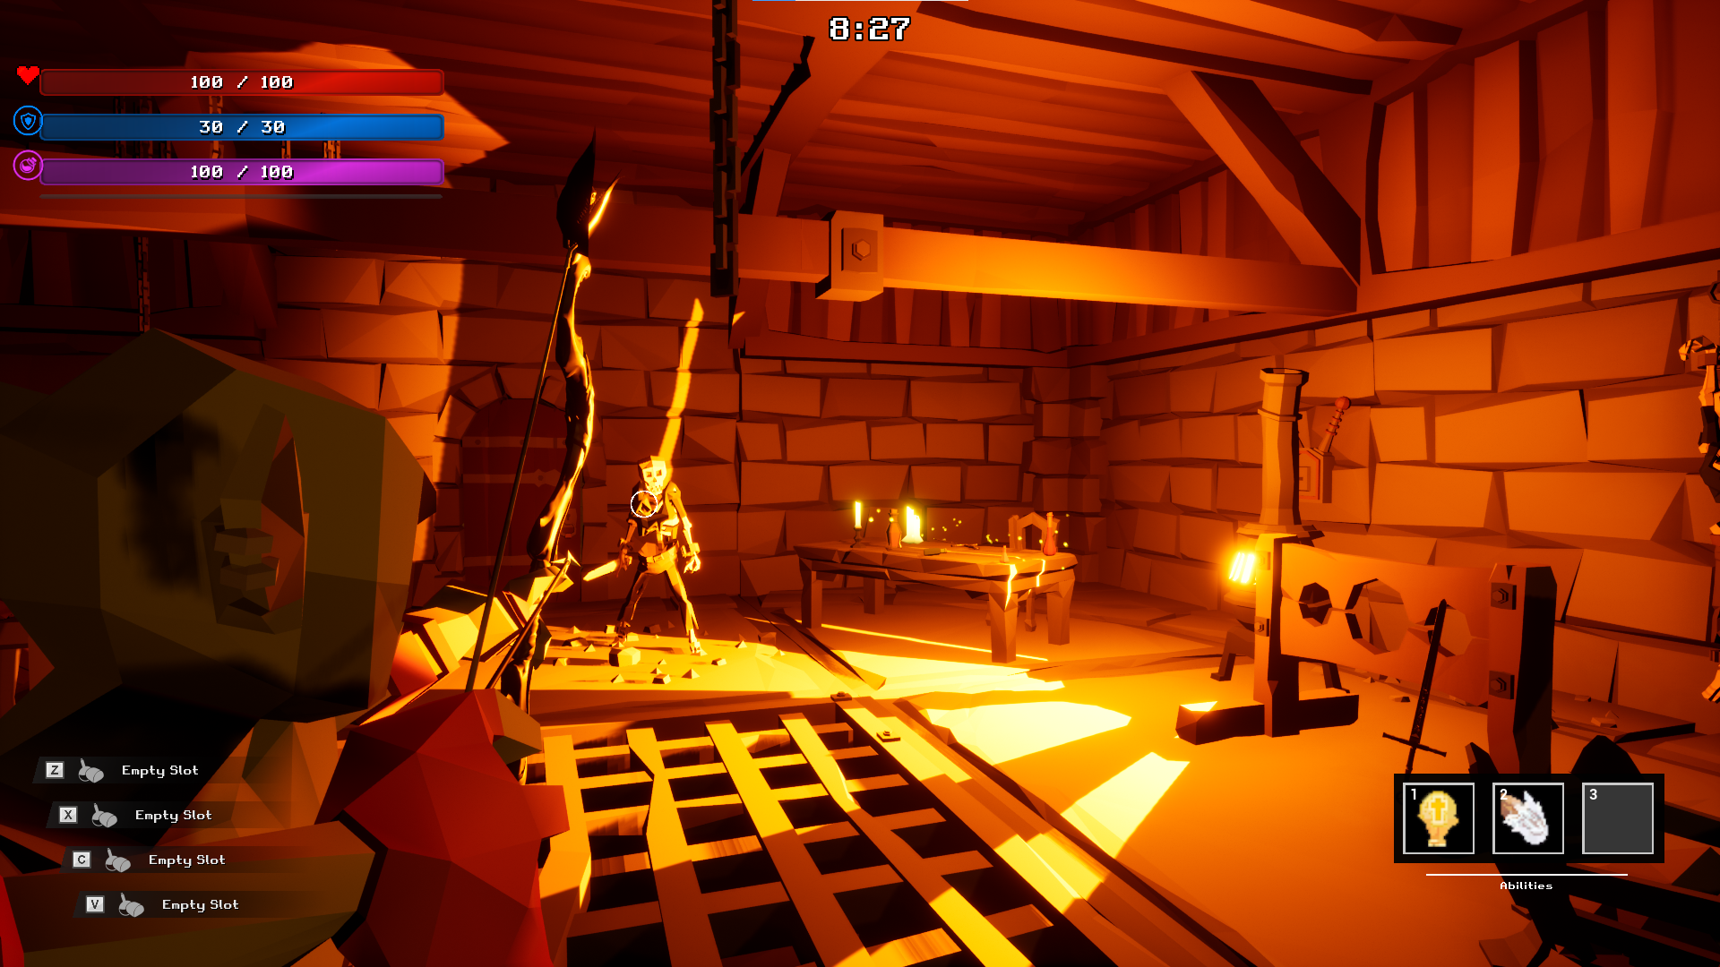
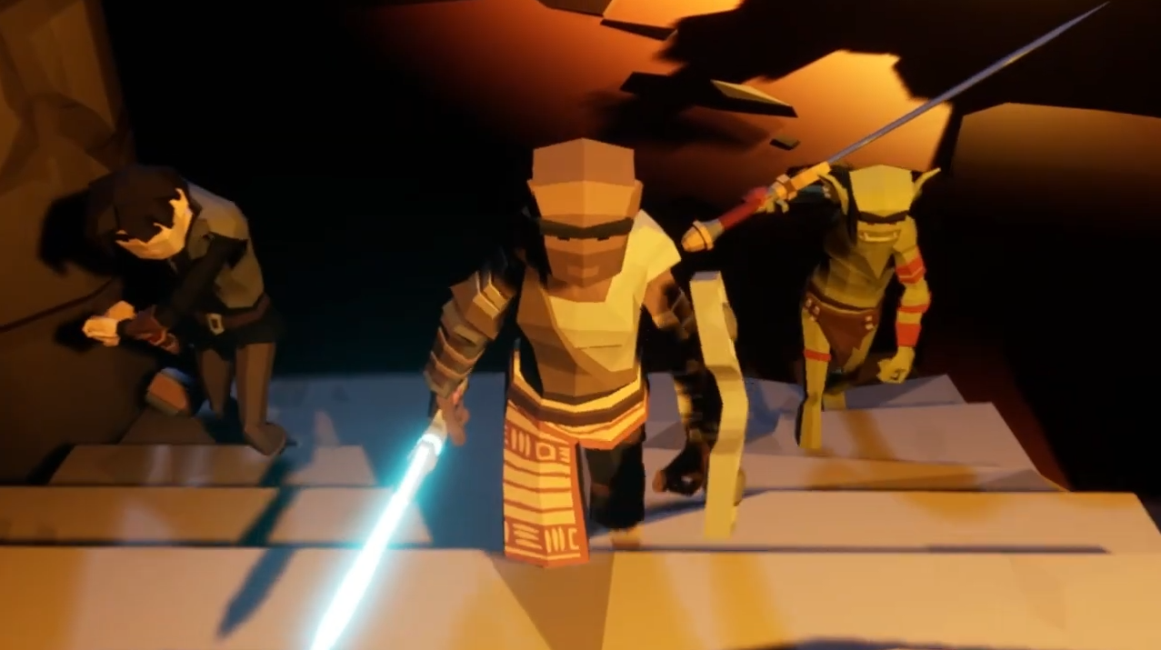
Made for All Players on Multiple Platforms
PC release targeted for ages 18-35
Console/Mobile release targeted for ages 12-18
Easy to learn keyboard, controller and touch controls
Deep class stat, ability, and perk customization
Working demos for PC and Android

Slide 6
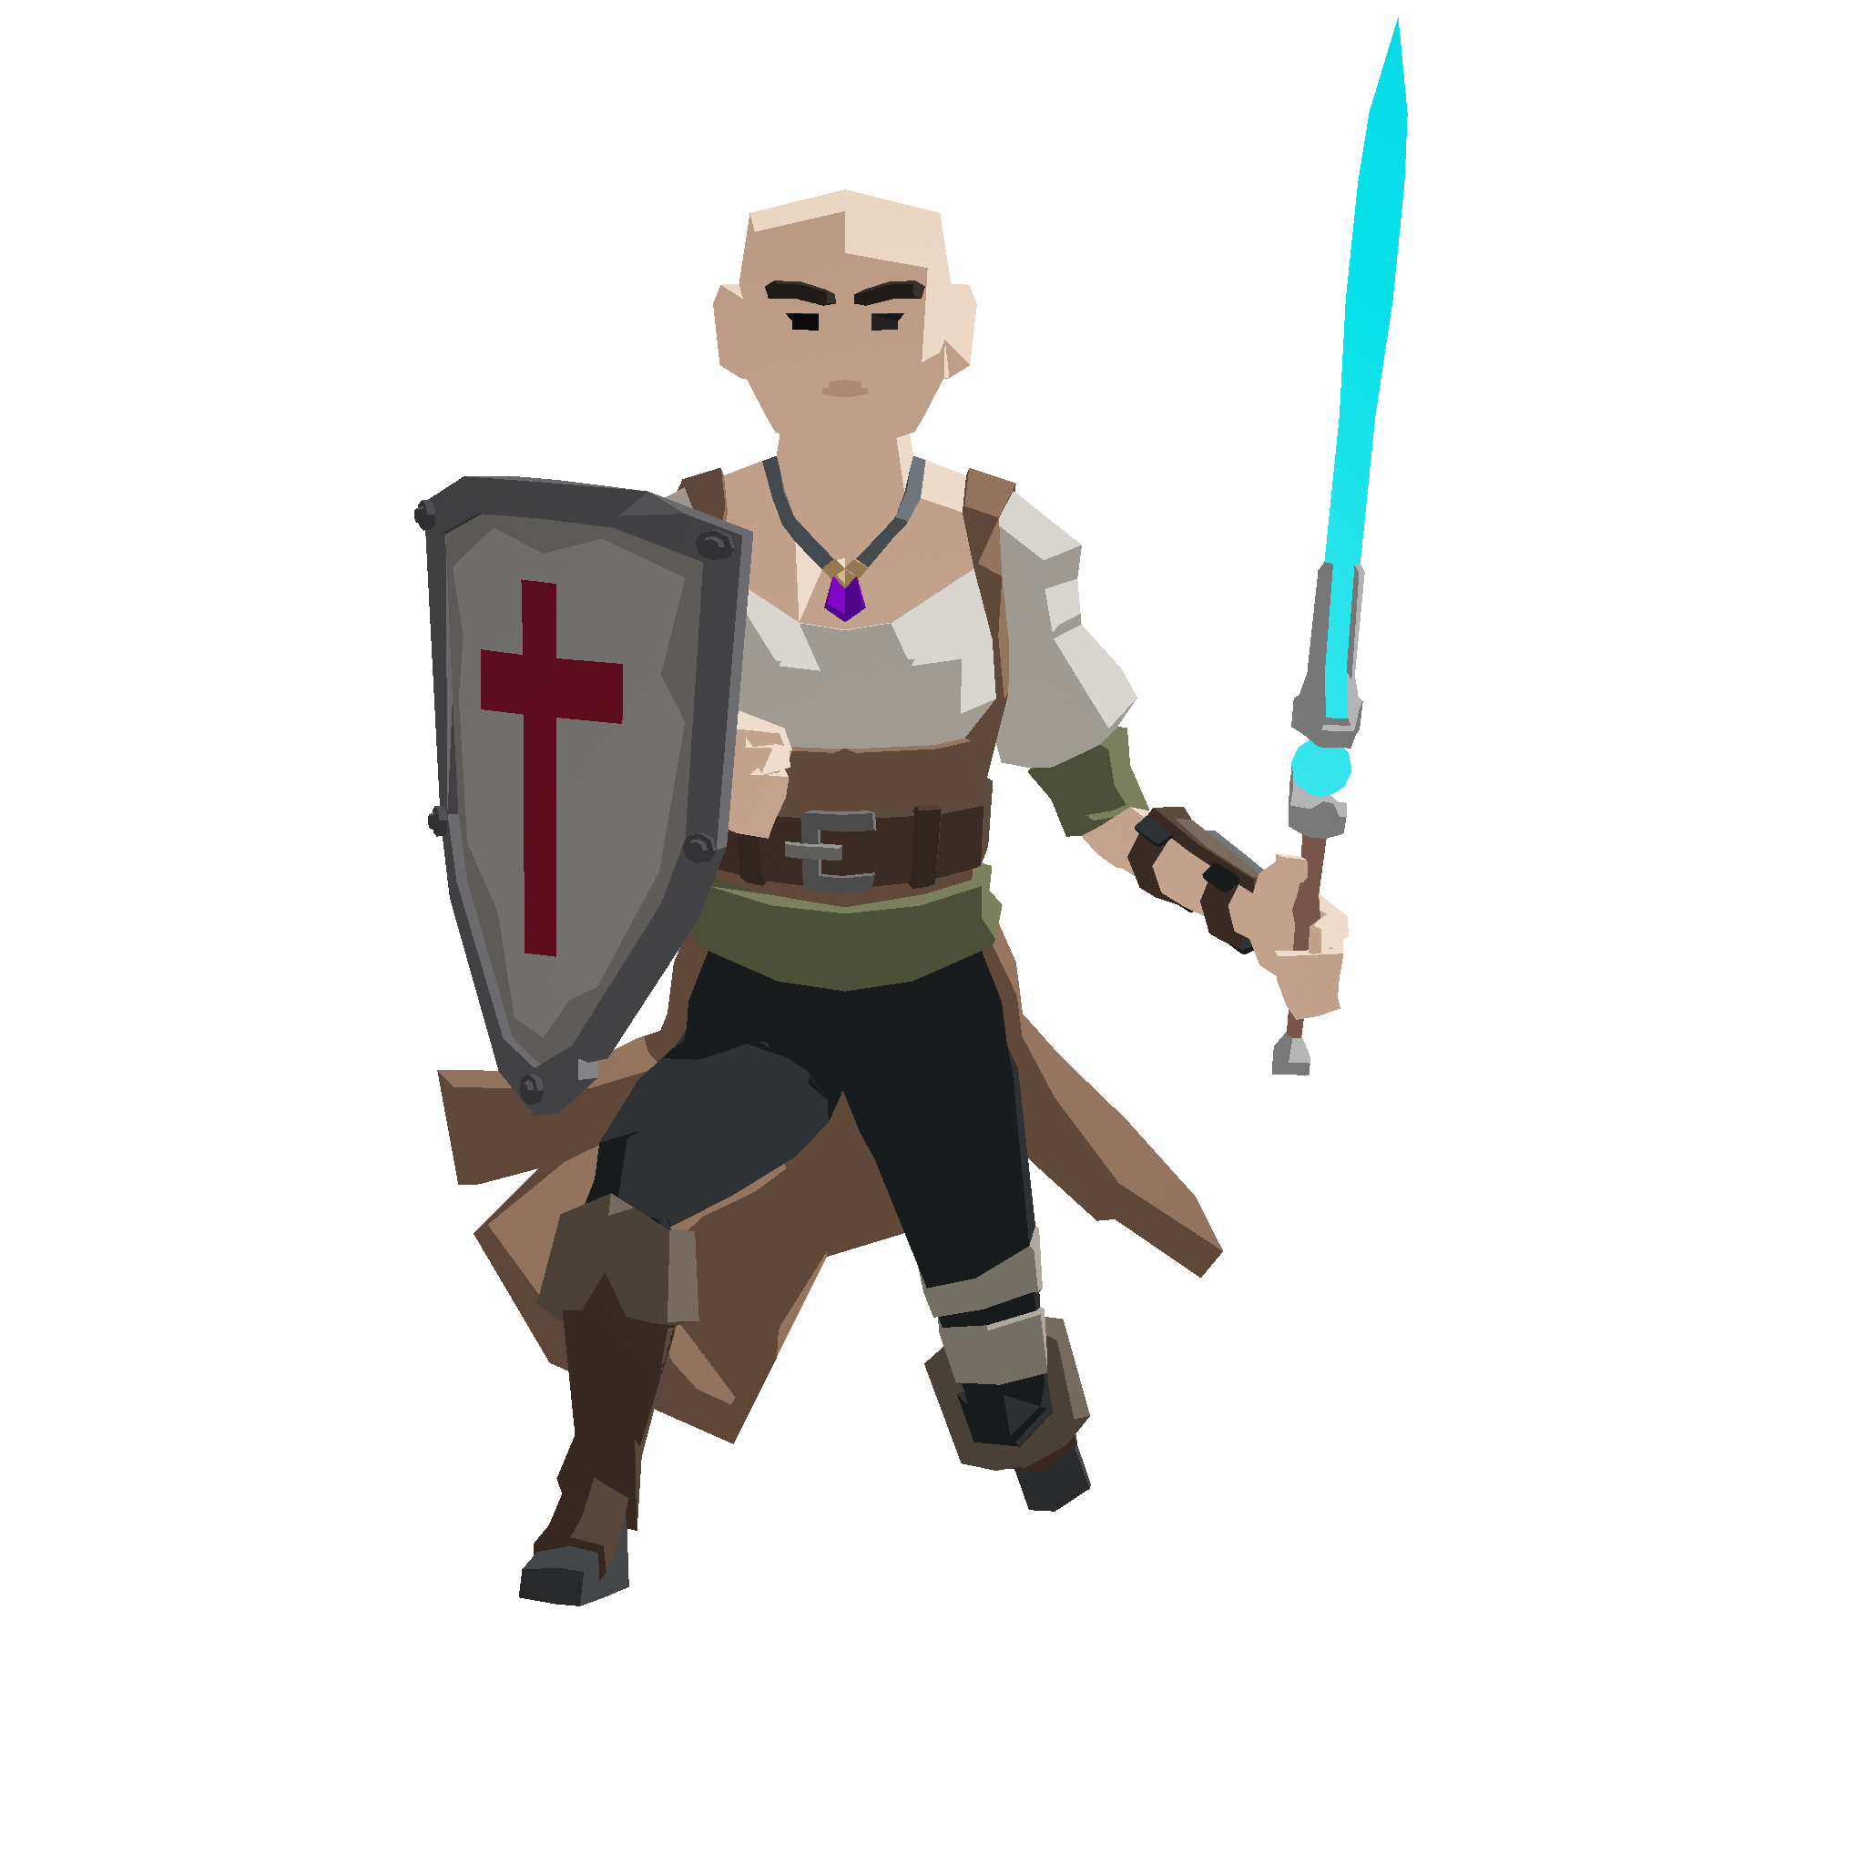
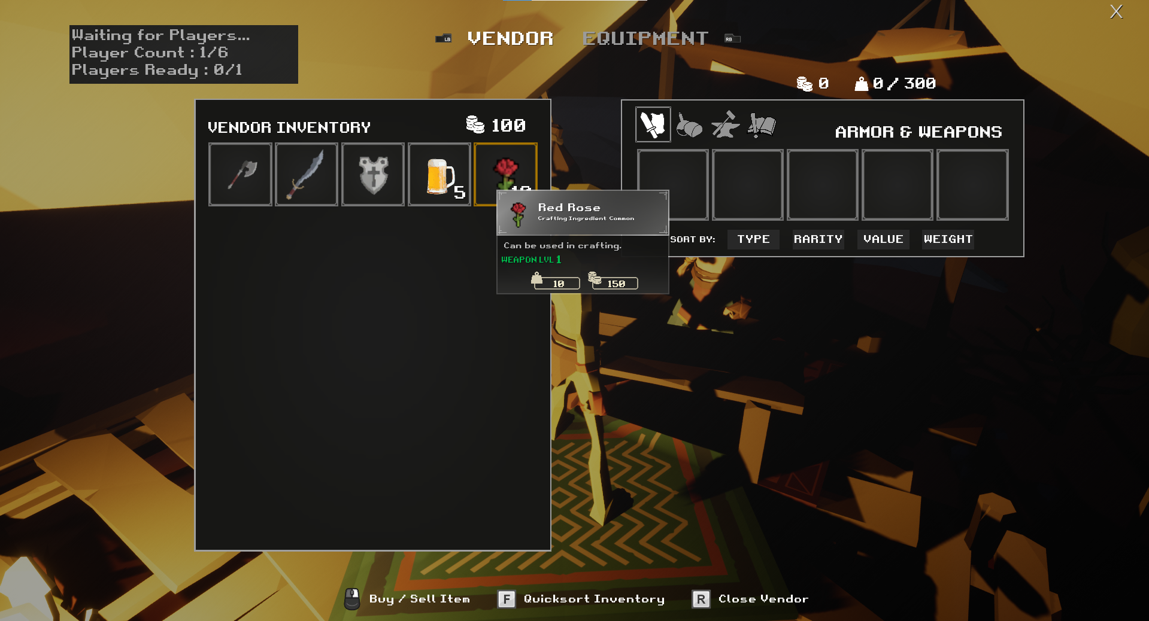
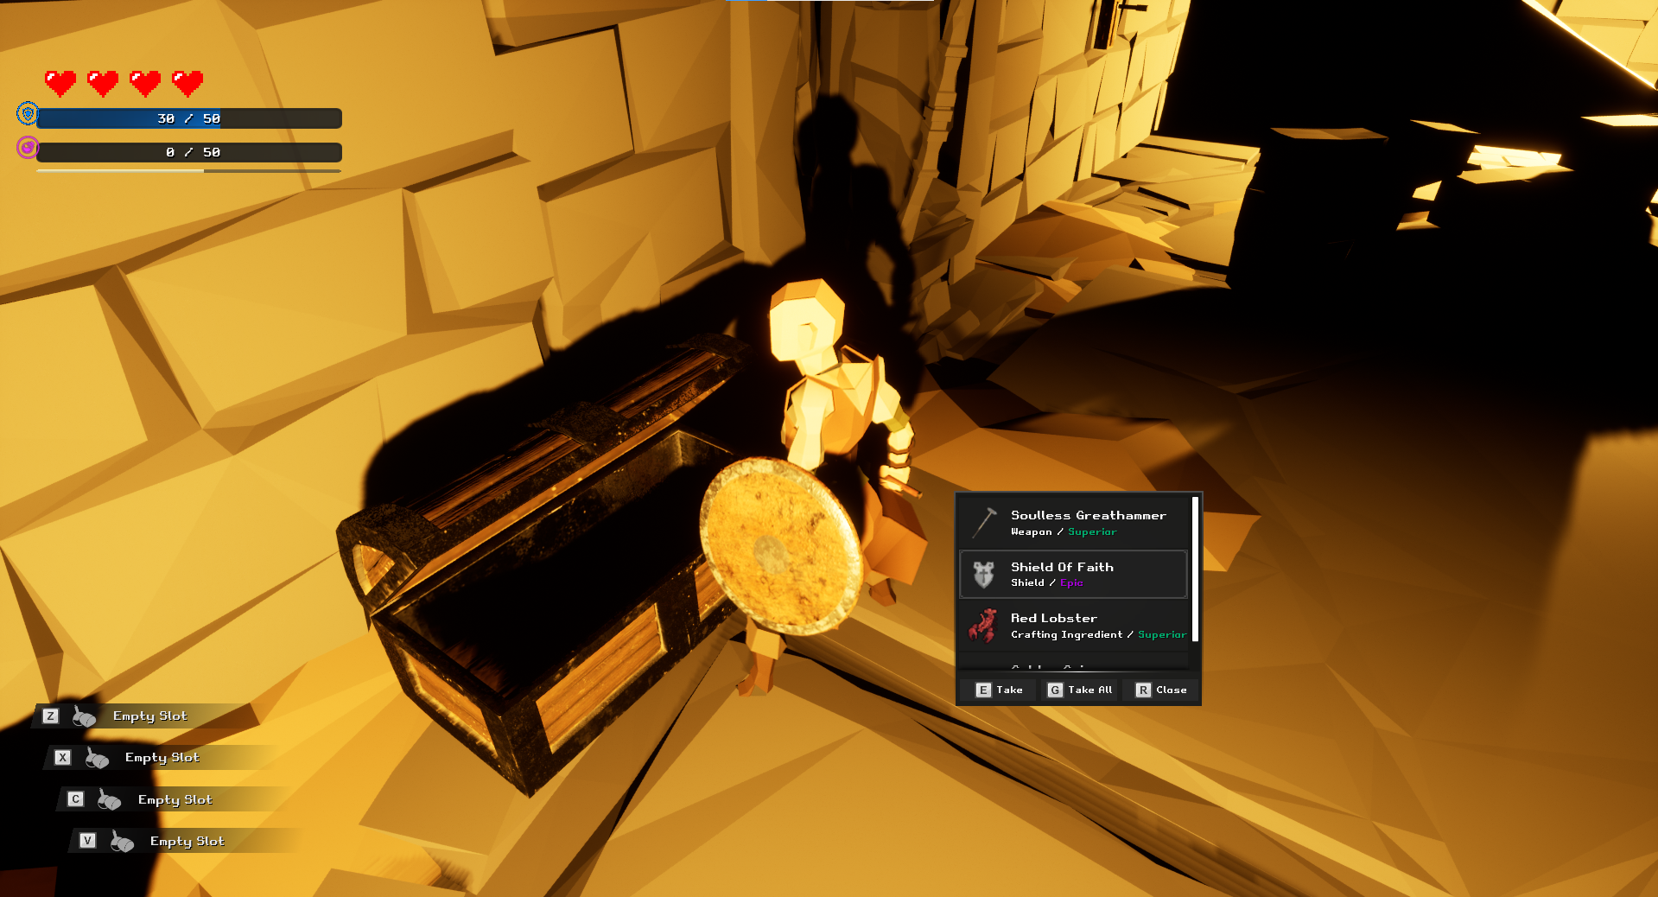
Season-based Monetization
Character stats/loot reset after each season
Pay for gold/gems to unlock starter loot each season
Gems are used to carry loot between seasons
Dungeon puzzles/boss change each season

Slide 7
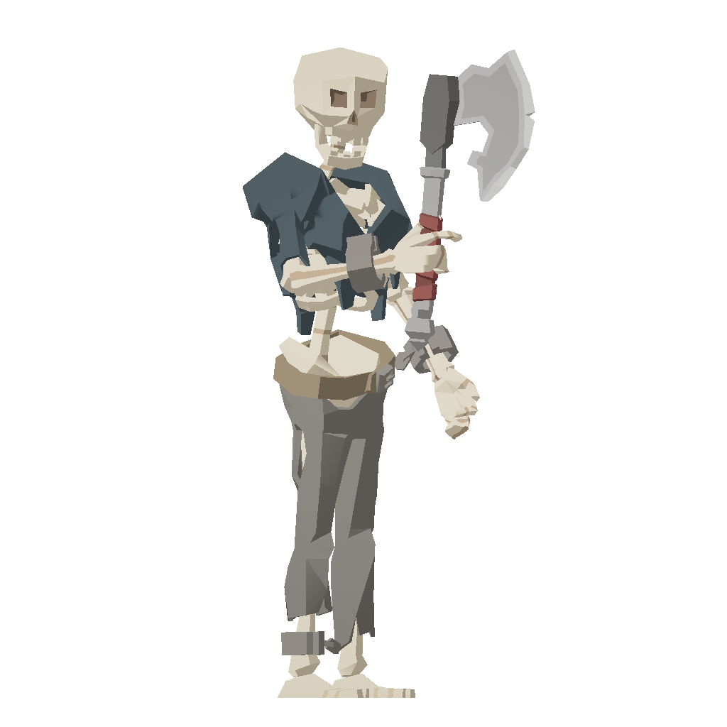
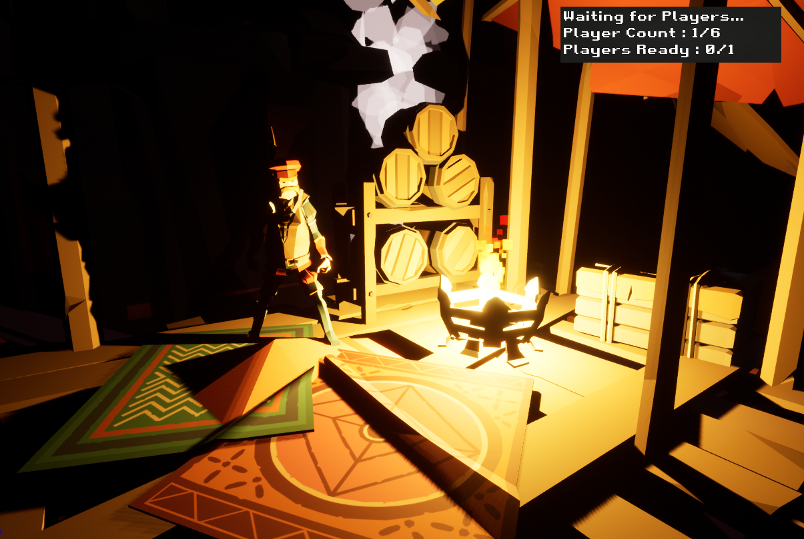
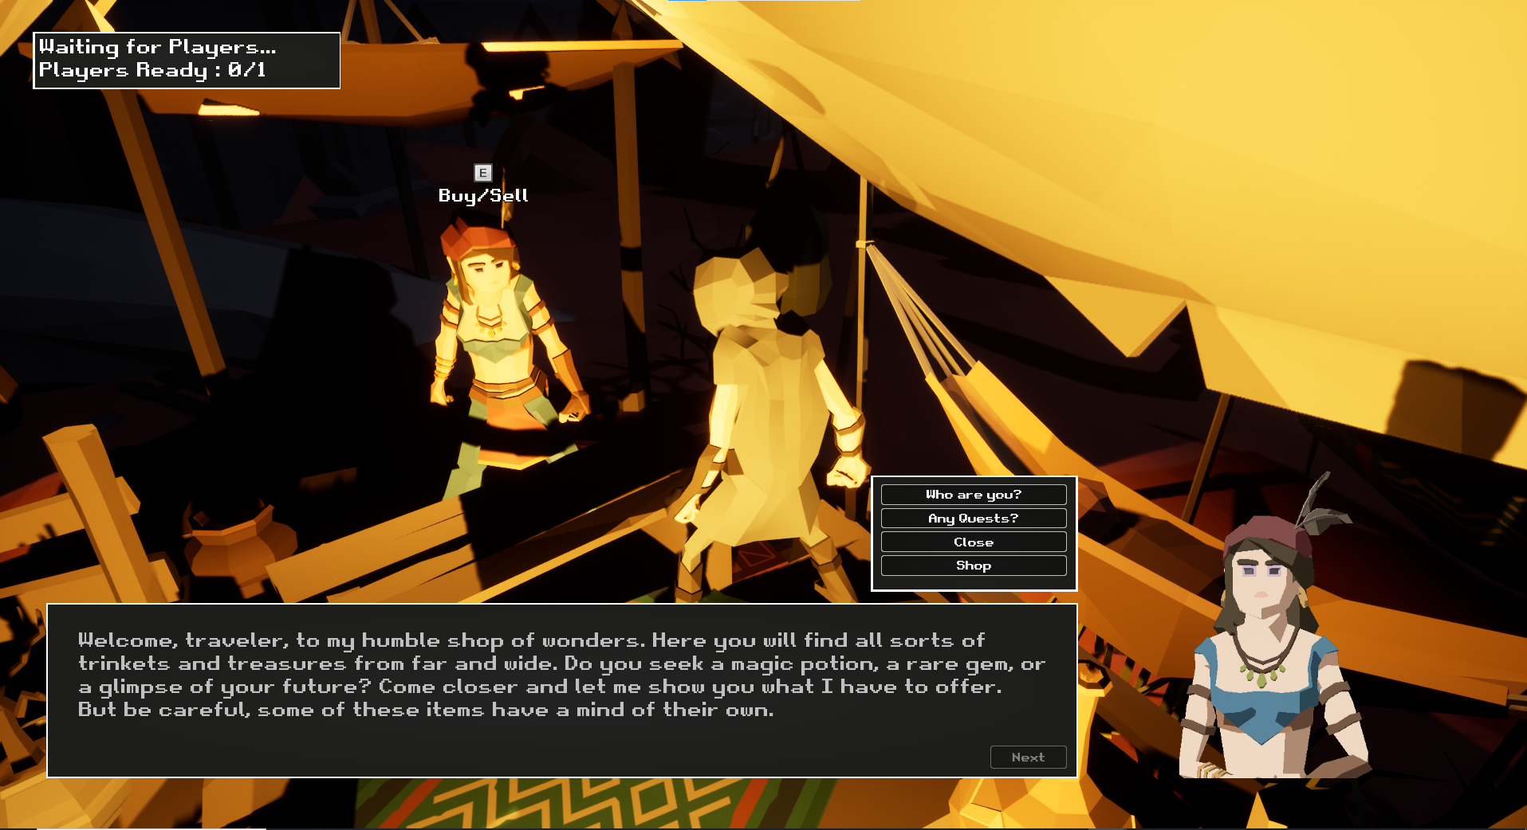
Full Hub World for Loot, Quests and Story
Gear up for the dungeon in the hub world
Talk to NPCs for story and quests
Shop with tailored vendors
Store items in the cloud for later descents

Slide 8

Trailer

Slide 9


Yooper Game Studios LLC
Newly founded
Currently seeking publisher to help with development funding and marketing the game
Located in the Midwest of the United States
CEO & Founder Matthew Spencer
Professional software engineer:
6+ years of software experience,
4+ years of Unreal Engine Experience
Currently the only studio developer, with friends volunteering to help community manage
2 Experienced UE4 Devs interested in joining if funding is available
External studios interested in aiding with additional 3D modeling, promotional material creation, and QA testing
Studio’s mission is to provide memorable gaming experiences to be enjoyed for years to come, meeting all players of all ages on the platform of their choice

Slide 10



User Engagement and Technologies
200+ players created accounts for the June 2023 playtest
Active Discord participation during June 2023 playtest
Uses the latest technology offered by UE5/Epic Online Services
Successfully leveraged PlayFab global dedicated server multiplayer back-end for June 2023 playtest

Slide 11
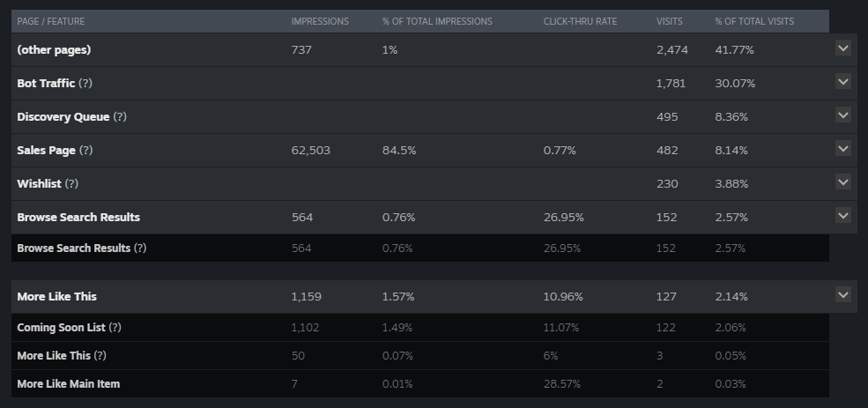
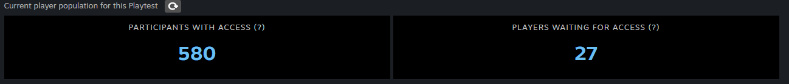
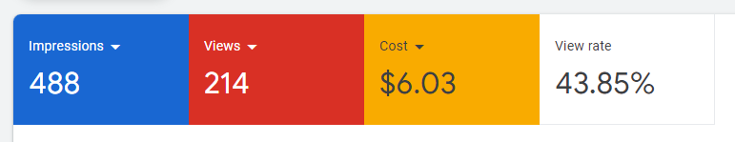
Marketing Overview
Very little money spent to-date for marketing (~$100)
4.6% CTR for overall Steam store presence
Since the Playtest page went live Apr. 25^{th:}
26.95% CTR through recommended store page search results
10.96% CTR “More Like This” store page results
^{3,310 Store Visits}
607 players requested playtest access
18.3% of everyone who visited the steam page requested access to playtest the game
634 wish-lists, 576 wishlist retention (17.4%)
^{90.9% wish-list retention rate}
Newly launched YouTube Google Ad campaign with a very small budget:
^{43.85% View Rate}
Ad contains the game trailer currently up on the Steam Page.
Targets Males ages 18-35 in the United States interested in online RPG, souls-like, and “hardcore” demographic game genres
At the time of writing, campaign is 2 days old

Slide 12
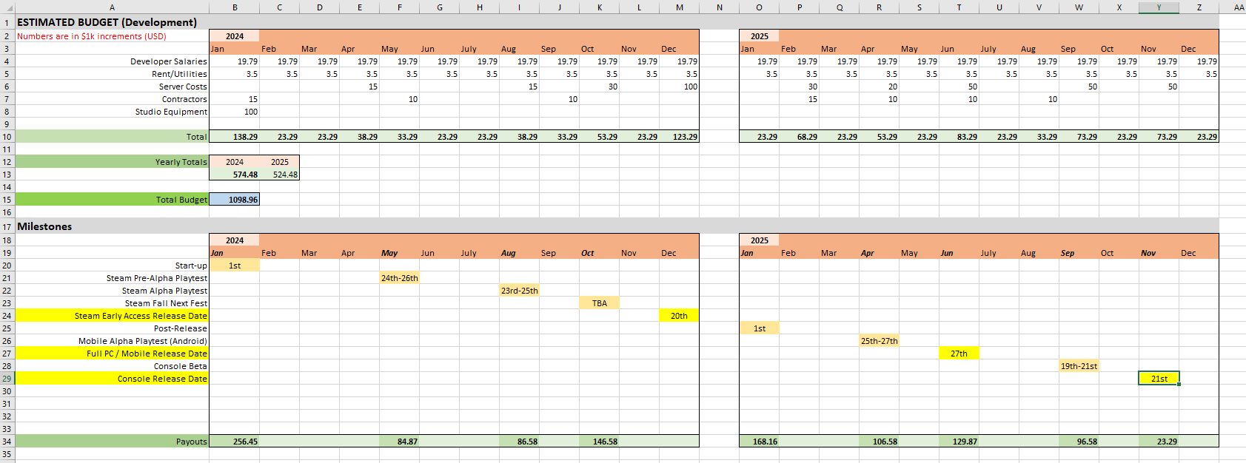
Estimated Development Budget and Timeline (~24 Months for PC/Mobile/Console)
Total Estimate
$1.205M

Slide 13
The Ask
Development funding for the Steam Early Access release
$19.99 sale price point
Players receive soundtrack and extra in-game bonuses
Development funding for the mobile/console release
Free-to-play with seasonal microtransactions described in the previous slide.
Premium edition for $19.99, includes early access in-game bonuses
Marketing help and funding
Set up campaigns based on the game’s Steam market information and current YouTube test demographic
CEO is open to be apart of community management, helping with campaigns

Slide 14
Contact / Demo
Email
mpspencer@yoopergamestudios.com
Steam
Exodus of Descent on Steam (steampowered.com)
Website
https://www.yoopergamestudios.com
Discord
https://discord.gg/exodusofdescent
Offline Demo:
https://yoopergamestudiosllc.itch.io/exodus-of-descent-playtest

