Slide 1
xxxxx
Committee Report
Name Date
Emergency Management and Communications Committee

Slide 3
App Analytics from the time the App went Live in December 2017
7,661 installs
Over 860 industry/agencies people have attended training

Slide 4
Total Pageviews (all pages): 150,718
Breakdown:
Latest CAER Messages: 115,113
Cleared Messages: 15,412
Connect with your City: 6,961
What is CAER Online?: 4,843
Preparedness: 3440
Get Involved: 1454
EHCMA Facebook: 1742
About EHCMA: 955
Contact EHCMA: 798

Slide 5
NEW USERS One Year May-May 1,400
ITC

Slide 6
Page views one year May-May 28,476

Slide 7
l

Slide 8
Enotify Yearly Data 2020
System Test – 14,651
Drill/Exercise – 1,241
Level 1/Courtesy – 3,488
A courtesy is a way to tell the community they may hear, see or smell something out of the ordinary.
145 Sites using Enotify

Slide 9
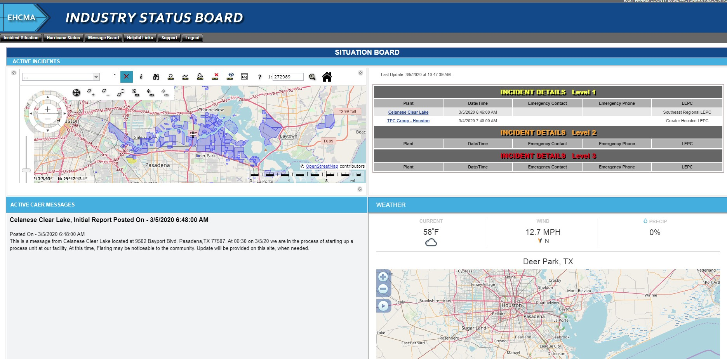
Industry Status board

Slide 10
Questions?
Jeff.Suggs@Kuraray.com

