Slide 1
Imagination Childcare Academy, Inc.
PARENT INFORMATIONAL MEETING
Notes:
Hello! I am Erin Medlar, the owner of Imagination Childcare Academy and I want to welcome you to our program! This presentation is designed to familiarize families with our policies and procedures. Included in this presentation is specific information about pick-up/ drop-off procedures, attendance expectations, remote learning, assessments and much more. After the presentation, if you still have questions or concerns please do not hesitate to call me (585-413-3948) or email me (emedlar@rochester.rr.com).

Slide 2
MISSION STATEMENT Committed to ensuring EVERY child thrives
OUR CORE VALUES
We believe that at the heart of each’s child’s success is a strong social emotional foundation.
We believe that all children can learn, and we will do whatever it takes to ensure every child’s success
We believe in celebrating each person’s unique gifts
We believe in being solution focused
We believe in being lifelong learners
We believe in building strong relationships with families
Notes:
At the heart of everything we do and every decision we make is our mission: We are committed to ensuring every child thrives! We understand that every child is unique and has different strengths and needs. We tailor our program to each child specifically to target those strengths and needs. Building relationships with our students and their families is our number one priority; it is those relationships that build the strong foundation for children’s future success.

Slide 3
Welcome to the Imagination Family
Notes:
That being said…welcome to the Imagination family! I always tell our families, “once your child enters our program, you will be a forever member of this family!” Over the years, we have had the privilege of serving hundreds of families and building strong relationships with all of them. We love it when we get pictures in the mail of past students or emails updating us on what the kiddos are up to. Each and every one of our families has a special place in our hearts.

Slide 4
Owner Background
Erin Medlar holds a Dual Master’s Degree of Science in Literacy/ Special Education from the University at Albany. She is certified in New York State to teach in the following areas: Elementary Education (1-6), Early Elementary Education (B-2), Special Education (1-6) and Literacy (B-6). Currently attending Brockport to attain my School Building/School District Leadership Certification.
She has over ten years of public and private school teaching experience, working with children from diverse backgrounds with a variety of needs.
Married and a mother of two boys, Erin understands the unique challenges that families face in today’s society.
Notes:
Prior to starting Imagination Childcare Academy, I was a teacher. That being said, I created this school to be an early childhood learning facility, not just a daycare. The foundational skills children learn at this age are essential to their success in later years. Though I miss teaching terribly, I love doing what I do. I am learning from my students, families and staff EVERY day. This September I will begin working towards attaining my school Building Leader/School District Leader certificate of advanced study from SUNY Brockport. This is a two year program, but all of my classes will be on-line and I will only need to meet in person on the weekends, so it will allow me to continue to do what I do here at Imaginations. I am looking forward to learning new skills to help me be the best administrator I can be.

Slide 5
History of Imagination Childcare Academy
Opened in 2012, four children (one was Erin’s)
Began partnership with Gates-Chili School District 2014-2015 school year, with one classroom.
Steady growth in enrollment every year, with a total of 208 children enrolled this 2020-2021 school year and this year we have 240 children enrolled.
Bought the property, including church May 2021.
Hoping to eventually become a fully inclusive facility that offers special education programming, Speech therapy, OT therapy and PT therapy.
Notes:
In 2012, we opened our facility. It was myself as the lead teacher/director and I had two part time assistants. We occupied one classroom in this entire building. We opened with three children enrolled….four if you count my son. I am forever grateful for those three original families who believed in me and took the leap to send their children to my program. As the years went by, we added more classrooms, hired more staff and welcomed more families. There was a need in this community for a program like ours and we are so happy that we were able to meet that need for our families. We now have over 200 children and are continuously growing. Currently, we are in the process of buying the entire property from the Roman Catholic Diocese, which includes the school, the church, the rectory next door and the adjacent property. Once I attain my administration certification, we can apply to become a private school and we can add special education services to our program. This will complete our ultimate goal of becoming a fully inclusive early childhood learning facility where all children’s needs can be met.

Slide 6
Our Programs
Gates-Chili Universal
Pre-kindergarten Program
Regulated: New York State Education Department
Parent Pay Programs
Licensed: Office of Children & Family Services
Junior PreK Littles (2 ½ -3 ½ years)
Junior PreK (3-4 years)
PreK (4-5 years)
School Age Program (K)
School-Age Program (Grades 1-6)
Before/After Wrap Around Program for UPK
Seven classrooms (18 children each)
9:30am-2:30pm, M-F
Paid by Gates-Chili School District
Notes:
We have two separate programs here at Imaginations. We have UPK classrooms that are paid for by Gates-Chili School District. That program runs Monday-Friday from 9:30am-2:30pm. That program is a lottery program and specifically for Gates-Chili residents. Our other program is paid for by parents and is flexible scheduling. On our parent pay side, we are open from 7am-6pm Monday through Friday and parents can choose whether they want their child to attend for the full day or just half a day. They can also choose how many days a week they would like their child to attend and which days they would like their child to attend. We have a private PreK program that is run similar to the UPK programs. The only difference is parents pay for that program. We also have three Junior PreK classrooms for children ages 2 ½ through 4. We have a school age before and after care program and we offer wrap around services for our UPK families who might need care before and after the UPK program.

Slide 7
Tuition is prorated for the school year, from September (including the first week of school) through June (last week of school). We do not provide tuition refunds for absences due to illness or any other reason, given that the centers’ operating expenses remain constant.
Tuition is due the week BEFORE care is provided. A $10 per day charge will be added to your account for each day that the payment is late. Please make sure to pay your tuition on time so that we can continue to operate a high quality program.
There is a payment box outside of my office window.

Slide 8
Parent Involvement
Open door policy
Email
Phone Calls
In-Person Conferences
Parent Communication Board
Newsletters
Parent Workshops
PTA
Volunteer In the Classroom
Notes:
We can’t do what we do here without the support from our families. I encourage parents to reach out if they have any questions or concerns. I always tell parents, I cannot be everywhere at all times and I count on them to be my eyes and ears. Please let me know if there is a problem and I will take care of it immediately. Our teachers work extremely hard to keep parents informed. They send emails, newsletters, post things on the parent board outside the classroom and have a class webpage that you will have access to in order to keep informed of the daily happenings in the classroom. We also have a PTA that meets three times a year to talk about how we can improve our policies and procedures. We send out surveys so that we can get input on ways to continuously strive towards best practice. We value your thoughts and ideas and encourage you to become involved.

Slide 9
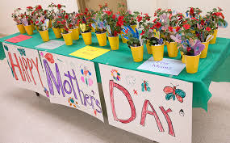
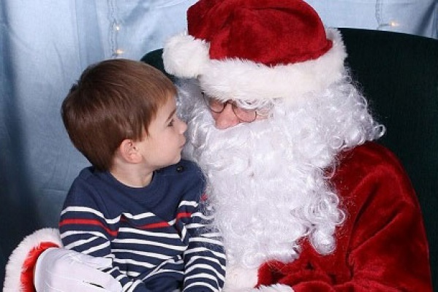
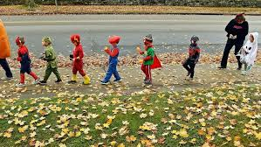
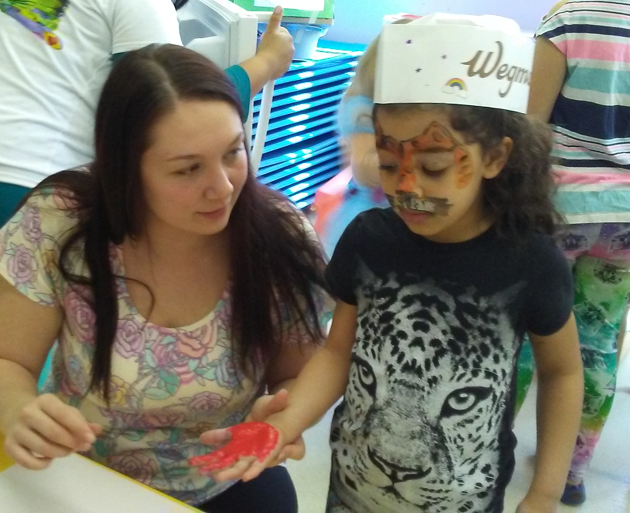
SPECIAL EVENTS
Notes:
0ur special events are what makes Imaginations so special. Our teachers go above and beyond to make these times ones that the children and families will never forget. We do a Halloween parade/party, Mother’s Day celebration, Father’s Day celebration, Supper with Santa, Imagination Day, Family Fun Night, etc. Unfortunately, due to the pandemic we were unable to do many of our special events last school year. I am hoping that by the spring of this year we will be able to resume with our special events. I will keep you posted.

Slide 10
Health and Wellness Policy
MISSION
Our children will learn how to make healthy choices about food and physical activity as part of their daily lives – building a foundation for a lifetime. Our staff model healthy eating and physical activity. We strive to work with our parents to promote healthy habits for life. To achieve these goals, Imagination Childcare Academy has adopted the following policies:
NUTRITION & PHYSICAL ACTIVITY EDUCATION
• Lesson plans include learning experiences about healthy eating at least once per month.
FOOD & BEVERAGE PRACTICES & BEHAVIORS
• All meals and snacks for children include a variety of fruits and vegetables, especially deeply colored ones.
• Safe, fresh drinking water is available and accessible for children to serve themselves at all times indoors and outdoors.
• Teachers avoid drinking sugar-sweetened beverages when caring for children.
• At meal time, at least one teacher sits with children at the table and eats the same meals and snacks.
• Teachers encourage children to serve themselves meals and snacks with supervision.
• Children have the opportunity to prepare the eating areas. They help set the table and clean up after the meal.
PHYSICAL ACTIVITY & SCREEN TIME
• Teachers interact with children and model fun ways to move and play in both structured and unstructured physical activities, using available open space and equipment.
• Teachers encourage families to limit screen time at home to no more than one to two hours daily.
OTHER ACTIVITIES
• Center staff is provided information on individual health assessments, or the center conducts a staff wellness assessment in order to increase staff awareness of personal health status.
• Center staff is provided resources related to nutrition and physical activity to encourage staff wellness.

Slide 11
Birthday Celebrations
Feel free to send in a HEALTHY, nut-free/peanut free treat for the class for your child’s birthday (see website for ideas).
No goody bags please

Slide 12
Weather and Emergency Closings
In the event of inclement weather or other emergency situation, every effort will be made to keep the center open. If the center must close, we will contact the following news agency: NEWS10 NBC
We follow Gates-Chili School District in inclement weather situations. If they are closed due to snow or impassable roads, we too are closed. We are not responsible for mistakes in the school closing announcements

Slide 13
Behavior Management Pyramid Model
A Social Emotional Framework
Build Relationships
Supportive, High-Quality Classrooms Environment
Teaching Expectations
Be Safe
Be Kind
Be Responsible
Focus on Teaching Skills
Problem Solving
Friendship
Recognizing Emotions
How to calm down
Intensive Intervention
Notes:
The pyramid model is the model that we use to approach behavior management. It guides our teaching and the way we interact with others. It begins with an effective workforce, a team that all share the same mission. All staff attend 18 hours of professional development to learn the Pyramid model strategies. Building nurturing and responsive relationships is the foundation for behavior management. First and foremost, children need to feel safe and loved. They need to know that the adults that are caring for them are listening and that their feelings are validated. In early childhood, the environment is the child’s first teacher. They are continuously learning about the world around them through exploration. Our teachers work tirelessly to create classrooms that encourage learning through play. We set children up for success by letting them know what the expectations are in every setting. We take them through the classroom and establish guidelines and routines. We use picture schedules and continuously review what will be coming next. We walk them around the building and model the expectations in every place. Daily we review these expectations in each setting. Throughout the year, beginning on the very first day, we start teaching children social emotional skills such as how to be a super friend, how to recognize their own emotions and the emotions of others, how to react to those emotions, how to calm down when upset, and how to problem solve. We teach the children how to use these skills independently. Finally, for children who continue to struggle with challenging behaviors we have a Behavioral Support Team that meets to come up with ideas of how to help that child be successful (maybe special seating, a fidget toy, a social story, a 5 min break card, etc.). We involve the parents in the process to make sure that we are coming up with the best possible plan for that child to find success.

Slide 14
Positive Behavior Supports
Our School Rules
Be Safe
Be Kind
Be Responsible
Incentives
BEE Coupons
Friday Buzz
Positive Specific Praise
Notes:
We believe that positive behavior support is essential to behavior management. We teach our children the school rules: Be Safe, Be Kind, and Be Responsible. Then we teach them what that looks like in every setting (classroom, bathroom, gym, playground, parking lot, etc.) Then, when we see children doing these things, we specifically praise them, telling them what we see and praising them for that behavior. We give “BEE” coupons for children we see following our school rules (walking quietly in the hall, cleaning up toys, raising hand at morning meeting, helping a friend, etc). Every Friday, “Buzz,” our school mascot, goes to each classroom and chooses one BEE coupon out of the bee hive, and that child gets to choose from the toy chest. The children LOVE Fridays ☺

Slide 15
Assessments
1. Benchmark Assessments
2. Work Sampling System
3. Brigance
4. Observations & Anecdotal Notes
5. Ages & Stages (Parents complete)
-Research Based Developmental Screening Tool
Ages & Stages (Communication, Gross Motor, Fine Motor, Problem Solving, Personal-Social)
Ages & Stages SE (Social Emotional)
We use these tools, along with our own screening to help us understand each child’s unique strengths and needs and to help us guide our instruction
Notes:
We use various assessments throughout the year to help us learn each child’s unique strengths and needs and to design individual learning plans for each child. Our benchmark assessments are done three times per year. These assessments are focused on academic skills (counting, writing name, scissor cutting, letter and number recognition, etc.). We use the work sampling system to help ensure that every child is developing in each area. We complete that screening tool three times per year as well. It helps us focus on all developmental areas to ensure that each child is developing as he/she should. Throughout the day teachers are observing children as they interact with each other and as they complete assignments. They use these observations to help guide their decisions for planning instruction. Another assessment tool that we use is called Ages & Stages. This is an assessment tool that parents complete. It breaks down all developmental areas and asks parents to check whether or not they observe their child doing specific things. Often children act quite differently in school then they do at home. This tool helps us bridge that gap and really get to know each child! We will be sending this screening tool home to you to fill out and bring back on the first day of school.

Slide 16
Pick Up and Drop Off Procedures
To create a safe and manageable way for children to arrive and leave our program, we will be implementing the following protocol:
ALL ADULTS ARE REQUIRED TO WEAR MASKS AT ALL TIMES!!!
Only one parent/caretaker of each child will be allowed to escort the child to his/her classroom door. The teacher will greet each child at the door and conduct a daily health check (temperature check, symptoms check and ask Covid 19 screening questions).
We are asking that parents DO NOT enter the classroom. Instead, please stand at the classroom door and wait for your child’s teacher to greet you. This will help limit the amount of exposure in the classroom. Make sure to keep a six foot distance from others at all times (this includes while waiting in line to pick up/drop off your child).
Again, please adhere to 6 feet physical distancing when picking up and dropping off your child. Make sure there is only one family in the lobby area at a time and one person standing in the classroom door at a time.
PLEASE REMEMBER….THIS IS NOT A TIME TO TALK WITH THE TEACHER as their focus needs to be on the children at all times. Teachers will communicate with families via, phone, email, or you can call to make an appointment with the teacher when they are not responsible for directly supervising the children.
Notes:
Please take a moment to read the above pick-up and drop-off procedures! We are requiring parents to wear masks at all times when they are in the building. We are asking that only one parent/caregiver brings the child into school and picks up the child from school each day. Please adhere to the 6 foot distance rule when in the building. Thankyou in advance for complying with these new safety rules.

Slide 17
All doors are locked with coded entry
Please DO NOT give the code out to anyone, including your children
Do NOT leave cars running in the parking lot
DO NOT leave any child in an unattended car
Drive SLOWLY in the parking lot
Hold your child’s hand at all times when in the parking lot
Do NOT prop the door open for any one. If they are supposed to be in the building they will know the code. If they are not, they will need to buzz in and someone from the office will take care if it.
Make sure your child wears SNEAKERS every day
Notes:
Please make sure to abide by the above safety rules. They are for your child’s protection!

Slide 18
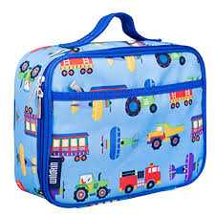
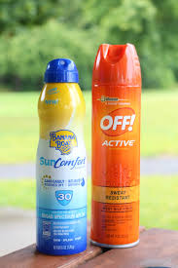
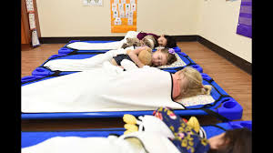
What to Bring on the First Day
Lunch (peanut/nut free), if not ordering from the School Nutrition Program
2. Water Bottle
3. At least two extra sets of clothes, including underwear and socks
4. Bug spray & Sunscreen
5. Blanket and crib sheet for nap
6. Family Photo
Notes:
We ask that families only bring in the above items and please keep all toys at home. Don’t worry…we have plenty here ☺

Slide 19
Covid Procedures
1. Enhanced health screenings and temperature checks upon arrival.
2.. Stricter child exclusions for signs of illness: Refer to Emergency Health Policy.
3. Limitation of family members in the building: Rest assured, you will always have access to your children, but in an effort to reduce the number of people coming into the building we have amended our drop off/pick up policy, see below. Please note, if you do enter the building, you will be required to follow our health screening procedures, must wear a mask and follow physical distancing guidelines.
4. Elimination of non-essential visitors into our building.
5. Personal Items from Home:
Because we are limiting the cross contamination of bodily fluids, even more stringently at this time, staff members will provide you a list of mandatory supplies for your child. These supplies must be maintained on a daily basis in order for your child to attend the program. (for example: indoor shoes in all classrooms, extra bibs for the infant/toddlers).
Children may bring a lightweight blanket, sheet for their cot, and small stuffed animal.
Other items from home will NOT be permitted without director approval.
6. Amplifying Our Daily Cleaning Efforts: While this is part of our normal routine, there will be additional efforts made to disinfect the classrooms, gross motor spaces and high traffic areas, paying special attention to doorknobs, phones, tables, chairs, keyboards, handrails, gates etc. We will be disinfecting with a higher concentrated bleach/water as recommended by the CDC. In addition to classroom cleaning, all staff members will be assigned various areas of the building for frequent disinfecting.
7. All adults are required to wear masks whenever they are in the classrooms and/or interacting with the children.
Notes:
We have remained open through this entire pandemic and continue to follow these guidelines. Please read this slide carefully and be sure to abide by these procedures at all times.

Slide 20
Health Policy
If my child(ren) or any person within my household show any of the following symptoms, I agree to keep them home for 48 hours or until the child is fever free, without fever reducing medication.
Fever over 100.0
Excessive dry cough
Shortness of breath
Lethargic, overly tired, unusually calm or quiet
Mild respiratory illness/ issues
Diarrhea and/or vomiting
If my child experiences any of the above symptoms during childcare, I understand that either myself, or a person I have designated as an emergency pick up, will arrive within one hour.
Administration may request a physician’s note to return to care.
I agree to inform the program if my child, or any family member, has tests positive for COVID-19 so that the program can take necessary mandated steps. Your child’s identity remains confidential.
Notes:
If you believe your child may be sick and/or is displaying ANY of the above symptoms, please keep your child home until your child is symptom free for at least 48 hours. I know that we all have to work and we have things to do, but the responsibility to keep everyone healthy is all of ours and can only be done with everyone working together. Please be courteous of others and do send your child to school if he/she is not feeling well.

Slide 21
Nut Free/Peanut Free Facility
In order to limit exposure to allergens we:
Frequent handwashing
A list of children with allergies posted in each classroom, so that all staff are aware.
We have emergency plans on file for each child with an allergy.
We have a All staff are trained to use epi-pens.
We have are a strict nut free/peanut free zone.
Notes:
We have several children here with SEVERE food allergies that could cause them to go into anaphylactic shock (stop breathing). We ask that before brining any food into our facility you make sure it is nut free and peanut free. I know this is another thing we all have to do, but taking that extra two minutes to read the package could make the difference between life or death.

Slide 22
Every month we send home order sheets. Please take a moment to look through them and see if there are any books you might want to purchase. There are many benefits to this program:
Get wonderful books in the hands of children for a low cost.
Every dollar parents spend goes towards money that we can use on books here at school.
They also make GREAT birthday and Christmas presents (if it is a present, please let me know ahead of time, so I don’t ruin the surprise!)
Notes:
We participate in Scholastic Book club. For every dollar you spend we get money to spend on books to build our classroom libraries and to purchase other classroom supplies. Also, it’s a great way to get books into your child’s hands!

Slide 23
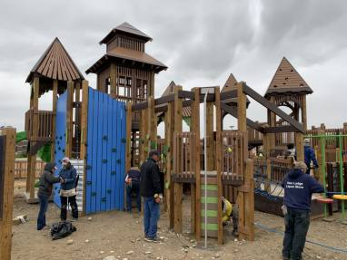
Community Build Playground Project
Working with Play by Design, company out of Ithaca, NY
Tear down existing playground and rebuild a new, ADA compliant playground, where all children will have access to the equipment.
Build with Community volunteers and grant funding
Anyone interest on being on the committee please let Erin know ASAP via email.
Design Day October 14, 2021
8am-12pm each classroom meets with designer to help with the design
6pm-7pm Design Reveal

Slide 24
Next Steps
Paperwork-Please complete forms immediately (OCFS requirements)
September 8th is Open House. You can come anytime between 9am-4pm to drop your child’s belongings off, see your child’s classroom and meet the teacher.
Complete Ages & Stages and Ages & Stages SE and return to classroom teacher on first day.
Notes:
Once you get your packets in the mail, please complete them and bring them into school on your child’s first day. Also, the week of September 8th we will be closed. However, we are allowing families to sign up for a time to come in with your child to see the classroom, meet your child’s teacher and drop your child’s belongings off. Just give us a call and we will set that up with you. We can’t wait to get to know you and get this school year started ☺

