Slide 1
Welcome
Latinx SOWK Alumni
December 10, 2020
On the chat:
Please state your name, grad year, & where you are joining us from today
Notes:
Welcome/Individual shout out

Slide 2
Agenda
Welcome
History, Mission, Vision
Committees
How to get involved

Slide 3
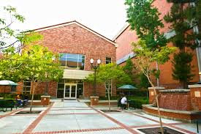
USC Suzanne Dworak-Peck
School of Social Work
Welcome
Amanda Decker
Notes:
Amanda K. Decker
Senior Development Officer, Constituent Relations and Advancement Operations
Office of Advancement

Slide 4
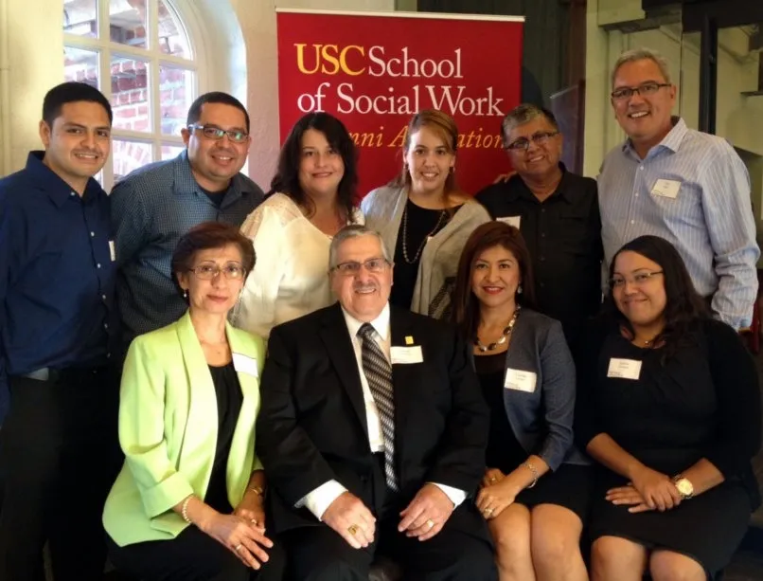
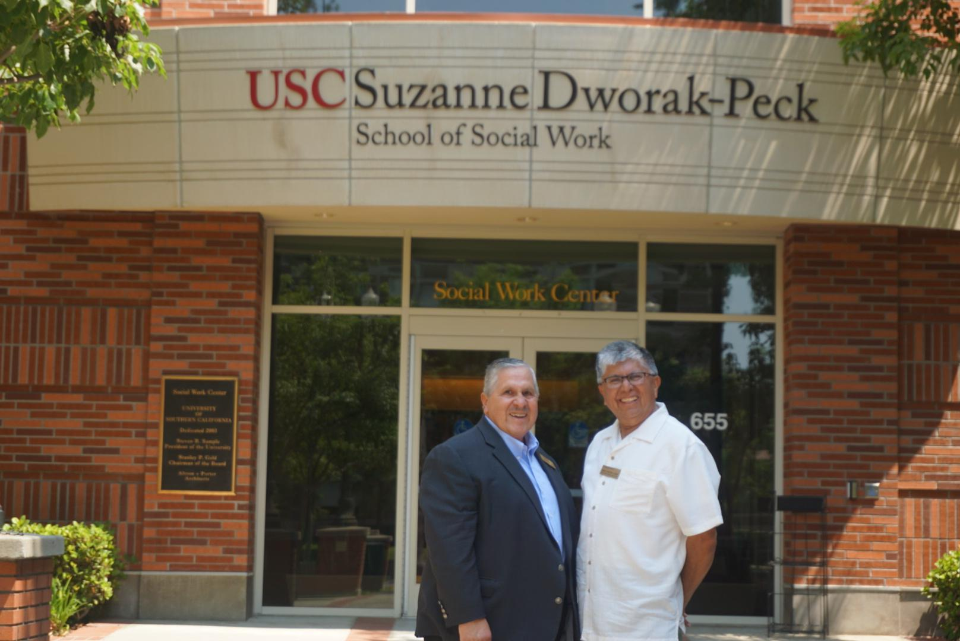
Established in 1999
The Latino Alumni Advisory (LAAB), formerly known as the Latino Alumni Community Advisory Committee (LACAC) was created to advise the USC School of Social Work on issues pertaining to Latino’s within the school’s curriculum, its students, and faculty.
Notes:
MIKE FOSTER

Slide 5
The Five Pillars of LAAB
Committees
Letisia Alvarado
Co-Chair
Elizabeth Ramos
Co-Chair
Alumni
Relations
Community
Engagement
Student
and
Family
Engagement
USC Suzanne Dworak-Peck School of Social Work Engagement
Fundraising
Bill Mejia
&
Sandra Salcedo
Stephen
Ceasar
&
Mirian Juarez
Hector Ibarra
Mike Foster
&
Dr. Estela Andujo
Laura Velez-Garcia

Slide 6
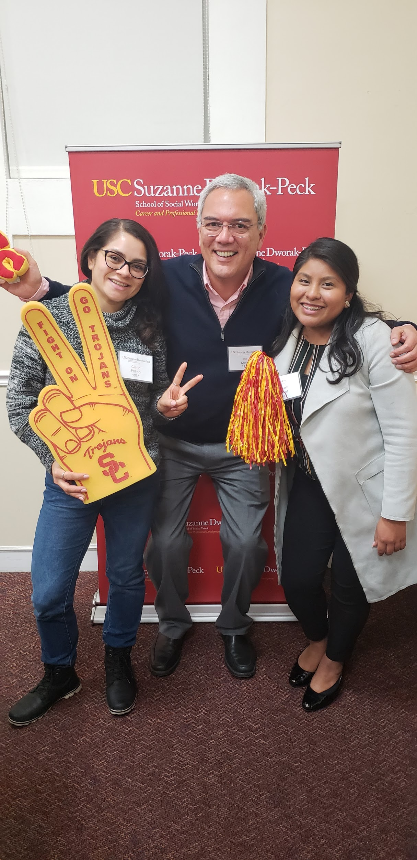
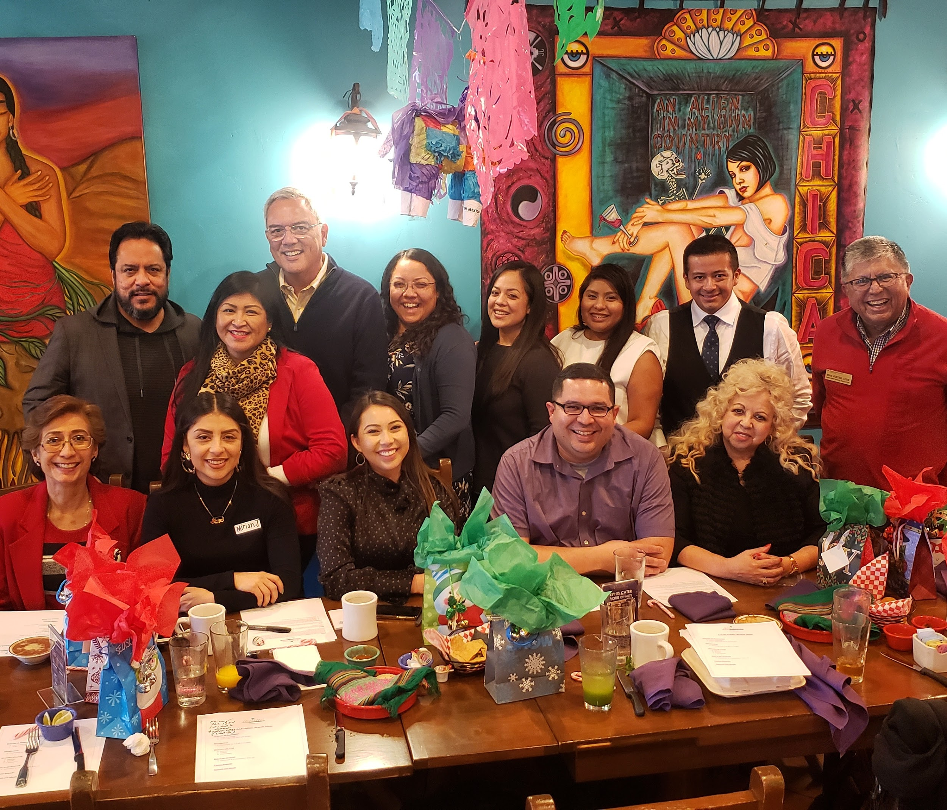
Alumni Relations
Support our Latino Alumni network and recruit new members
Co-chairs: Sandra Salcedo and Bill Mejia
Alumni Panel with LSWC
Alumni Mixers
Virtual Events: COVID-19
Social Workers in the
Front Lines
Notes:
SANDRA & BILL

Slide 7
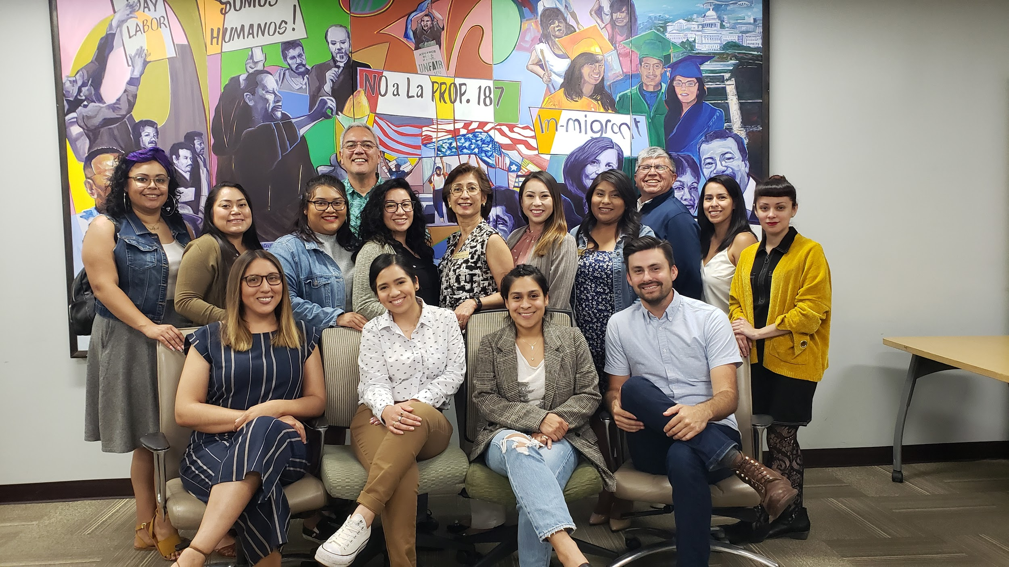
Community Engagement
Advocate for the Latino Community and build relationships with community agencies.
Co-Chairs: Stephen Ceasar & Mirian Juarez
Anti-Racism Social Work Guide
Diversity Course Redesign Ad Hoc Committee
Notes:
Elizabeth share link to the Anti-Racist Social Work Guide in the chat box
tinyurl.com/antiracistsw

Slide 8
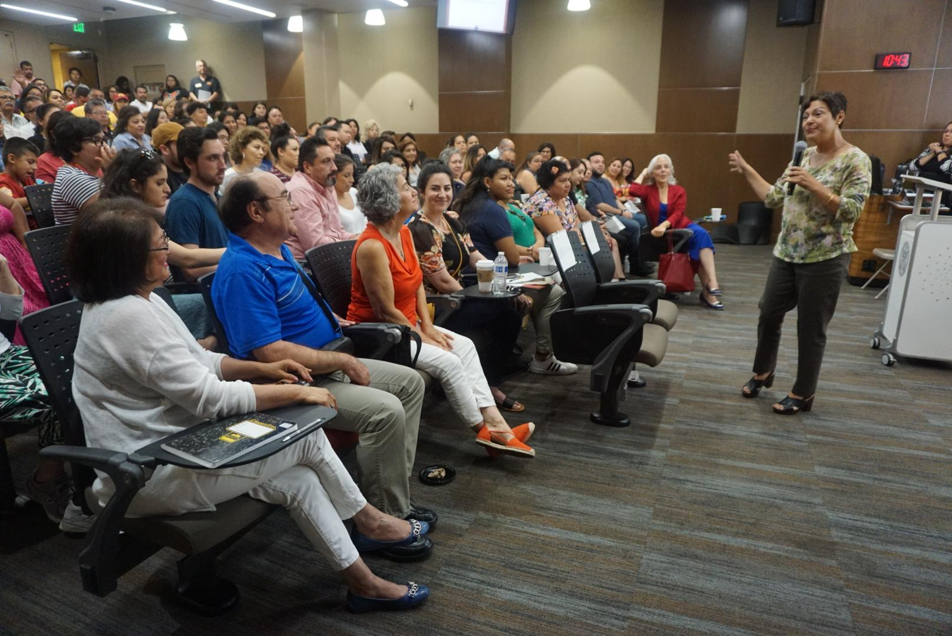
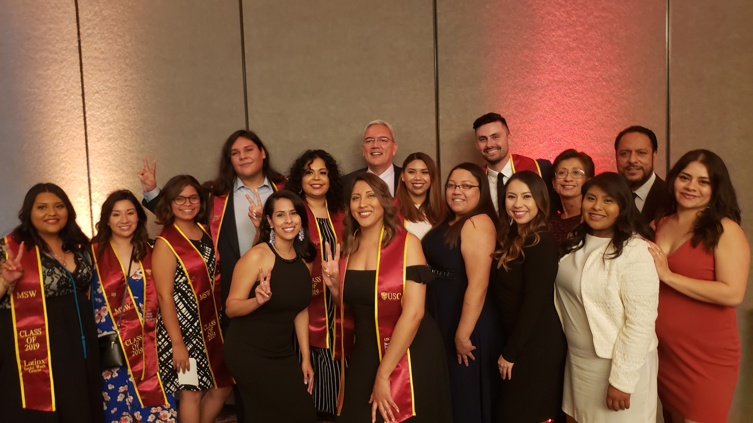
Student and Family Engagement
Support current MSW Latino students and their families
Co-Chair: Hector Ibarra
Annual Latino Family Orientation
Support Latinx SOWK Caucus
Notes:
HECTOR

Slide 9
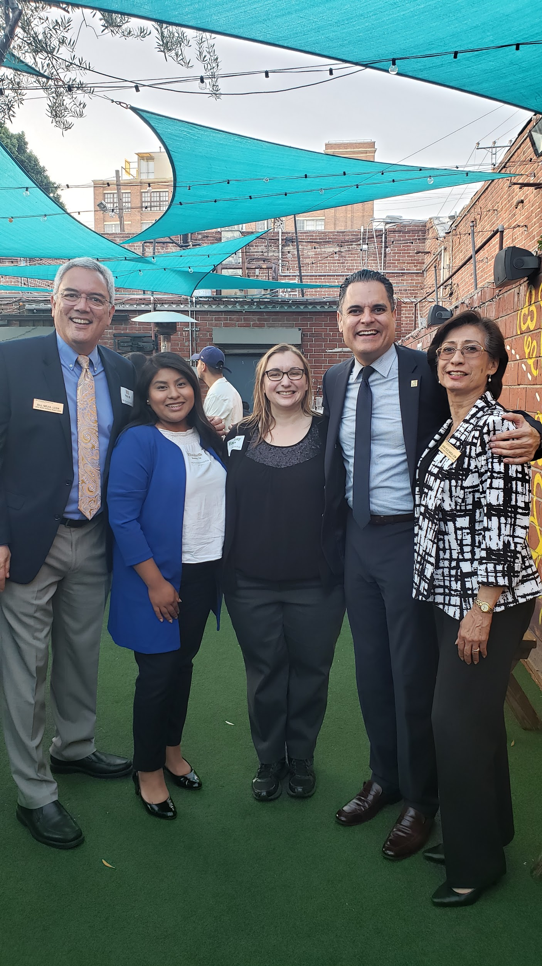
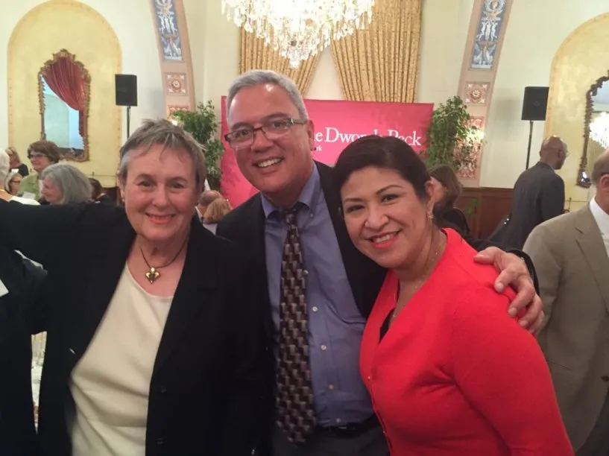
USC Suzanne Dworak-Peck School of Social Work Engagement
Develop a working relationship with Latino Faculty and School Leadership
Co-chairs: Mike Foster and Estela Andujo
Notes:
MIKE and ESTELA
https://dworakpeck.usc.edu/about-us/dean-sarah-gehlert

Slide 10
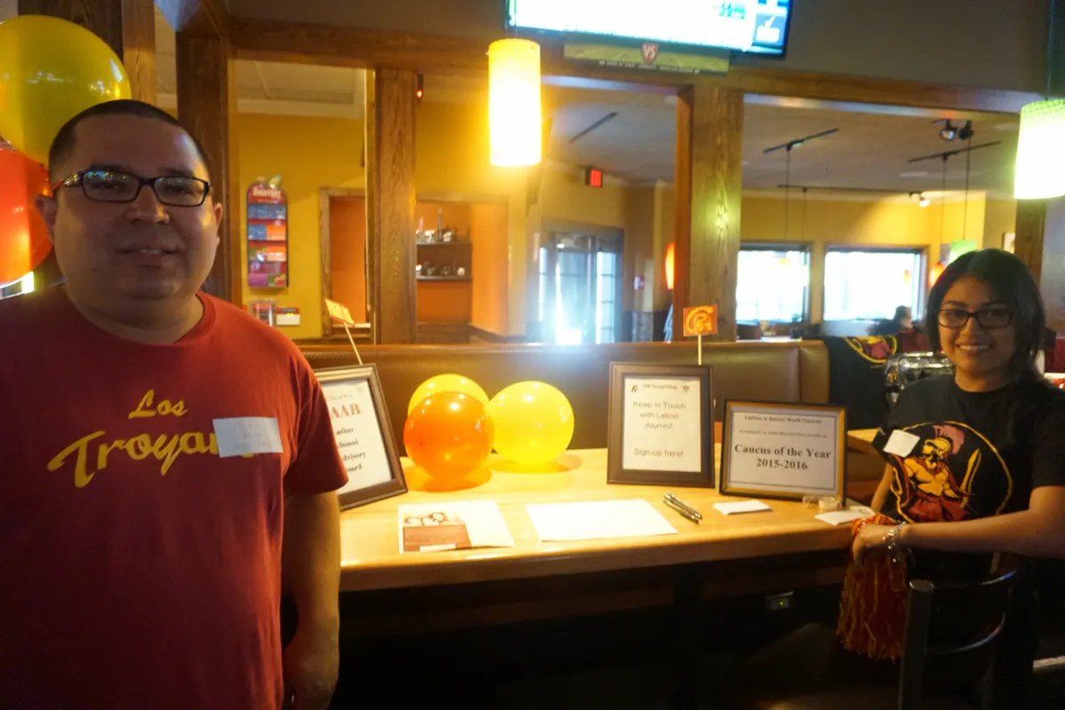
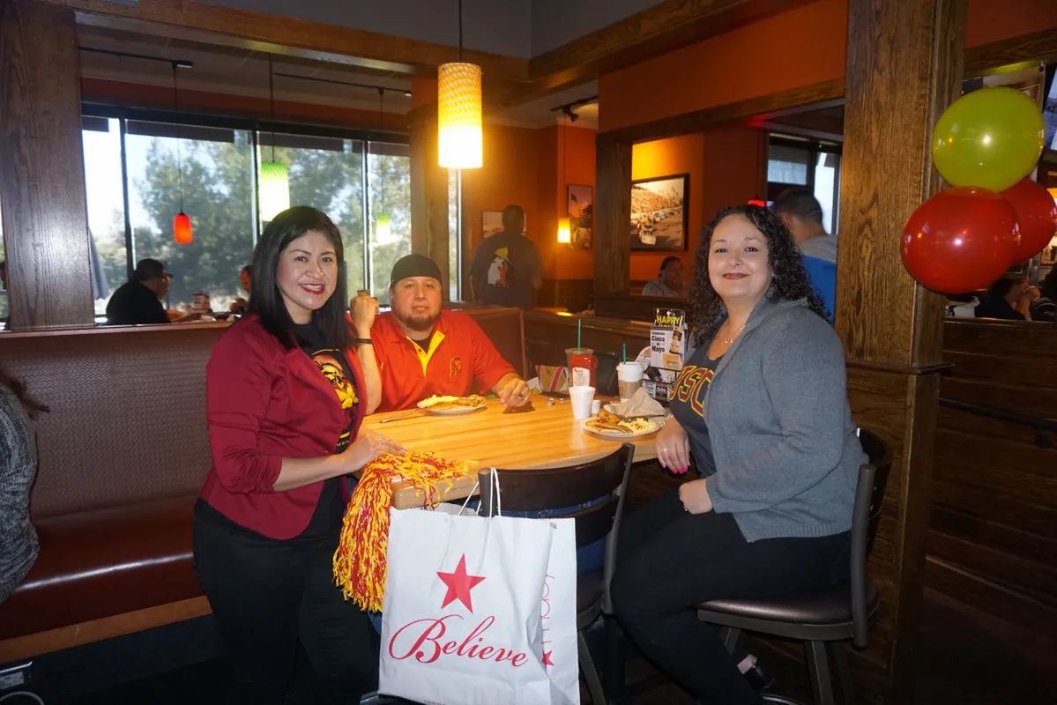
Fundraising
Raise funds for LAAB Operating Budget
Co-Chairs: Laura Velez-Garcia
Applebee’s Montebello Fundraiser (2016)
Notes:
LAURA

Slide 11
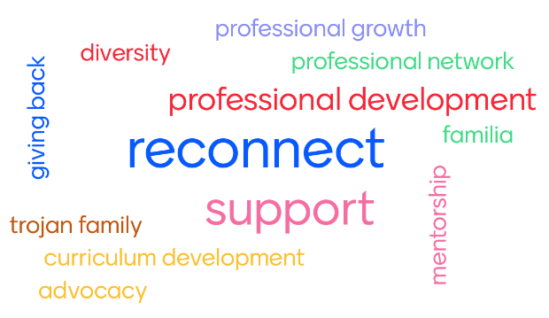
Benefits of Joining LAAB
Notes:
Professional Network/Support
Mentorship
Supporting Latinx Social Work Caucus
Advocacy (outside of our professional job)
Professional growth
Reconnecting with our Trojan Family
Advising the School of Social Work (curriculum development)
MSW Diversity Redesign Ad Hoc Committee
Give back to the community

Slide 12
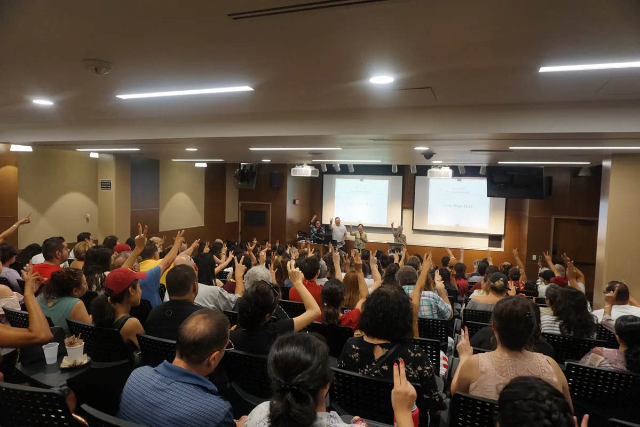
FIGHT ON! LET’S GET TO KNOW EACH OTHER!
Notes:
Chatter Fall Question: Walking down memory lane – favorite USC Memory? your favorite professor/course? What interested you from LAAB today?
Option 1: Interact with folks directly/more intimate (call on people)
Option 2: Breakout Room - each LAAB member will ask the questions above

Slide 14
Facebook/USCSWLAAB
@USCSWLAAB
Email: laabusc@gmail.com

Slide 15
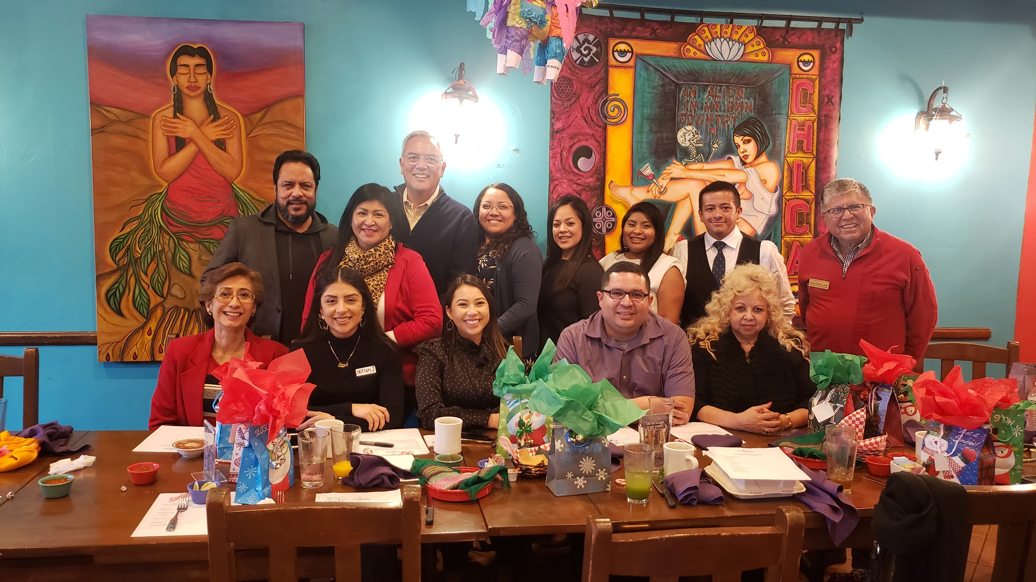
Thank you for joining us!
Happy Holidays
Notes:
Happy Holidays

