Slide 1



Alpha Phi Omega
United Arab Emirates Alumni Association 96
SERVICE RENDERED
FOR THE MONTH OF
AUGUST
DY 2025-2027

Slide 2
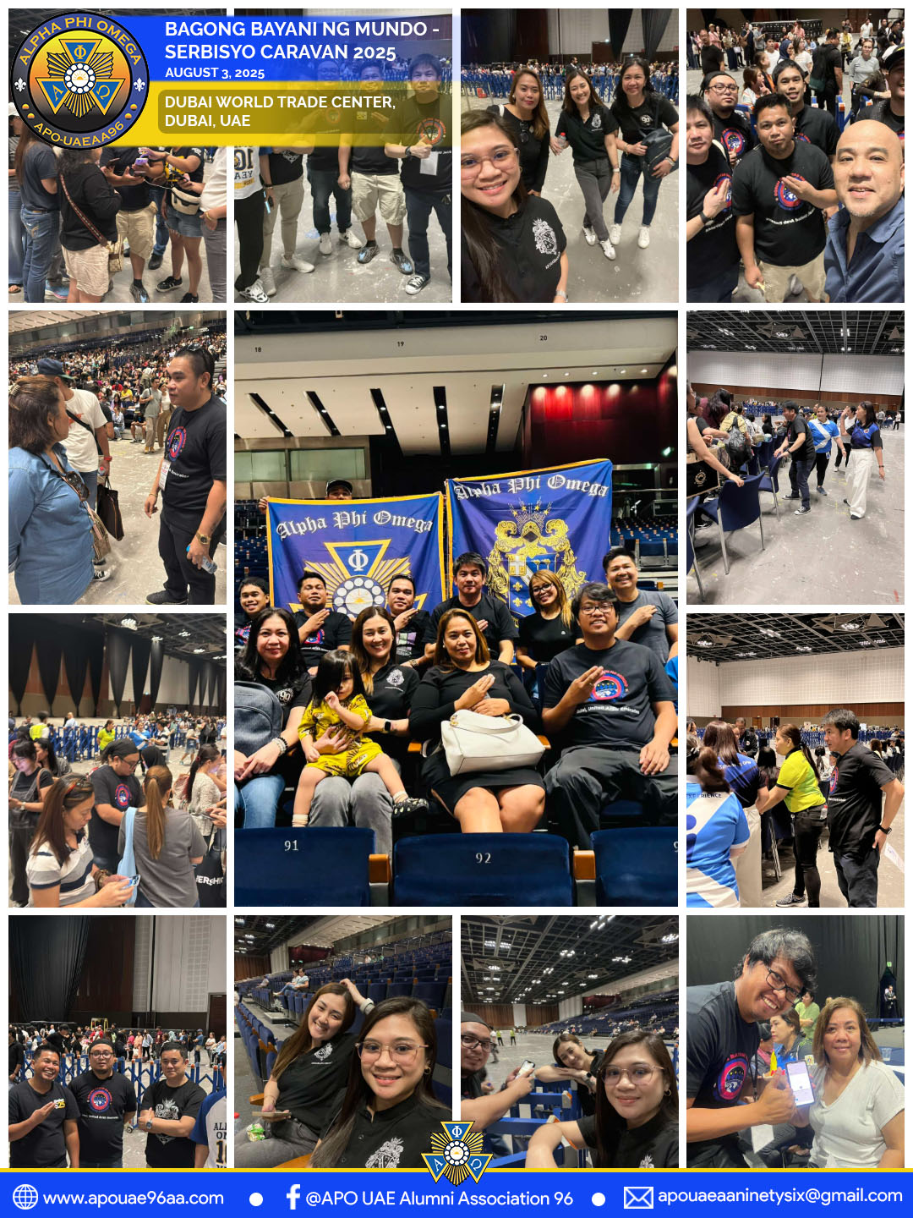


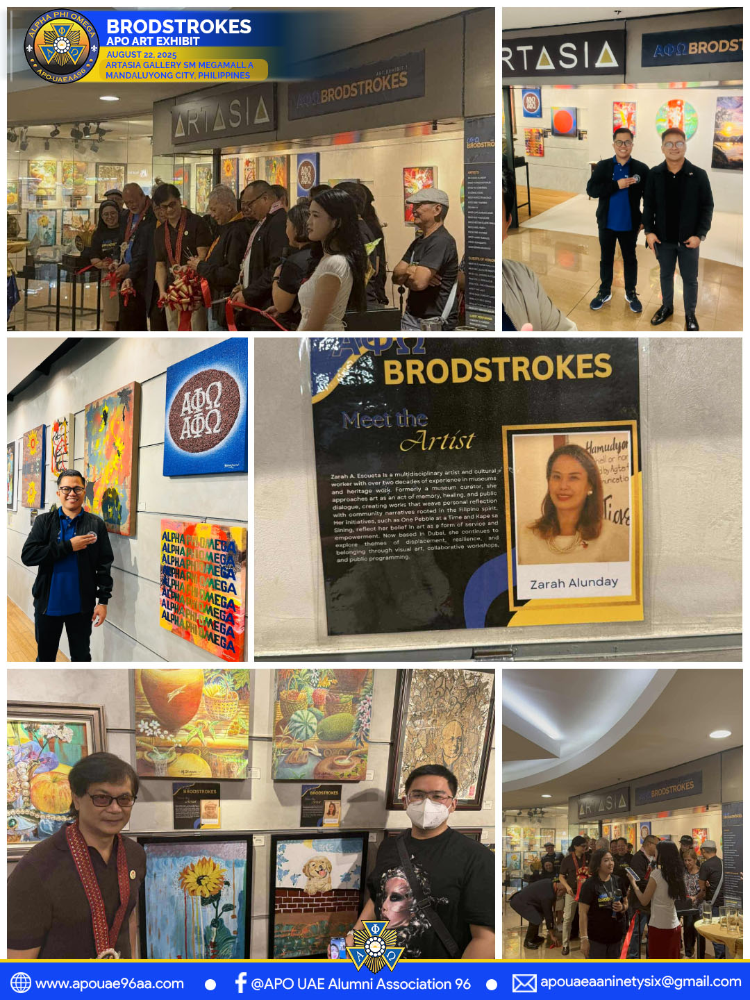
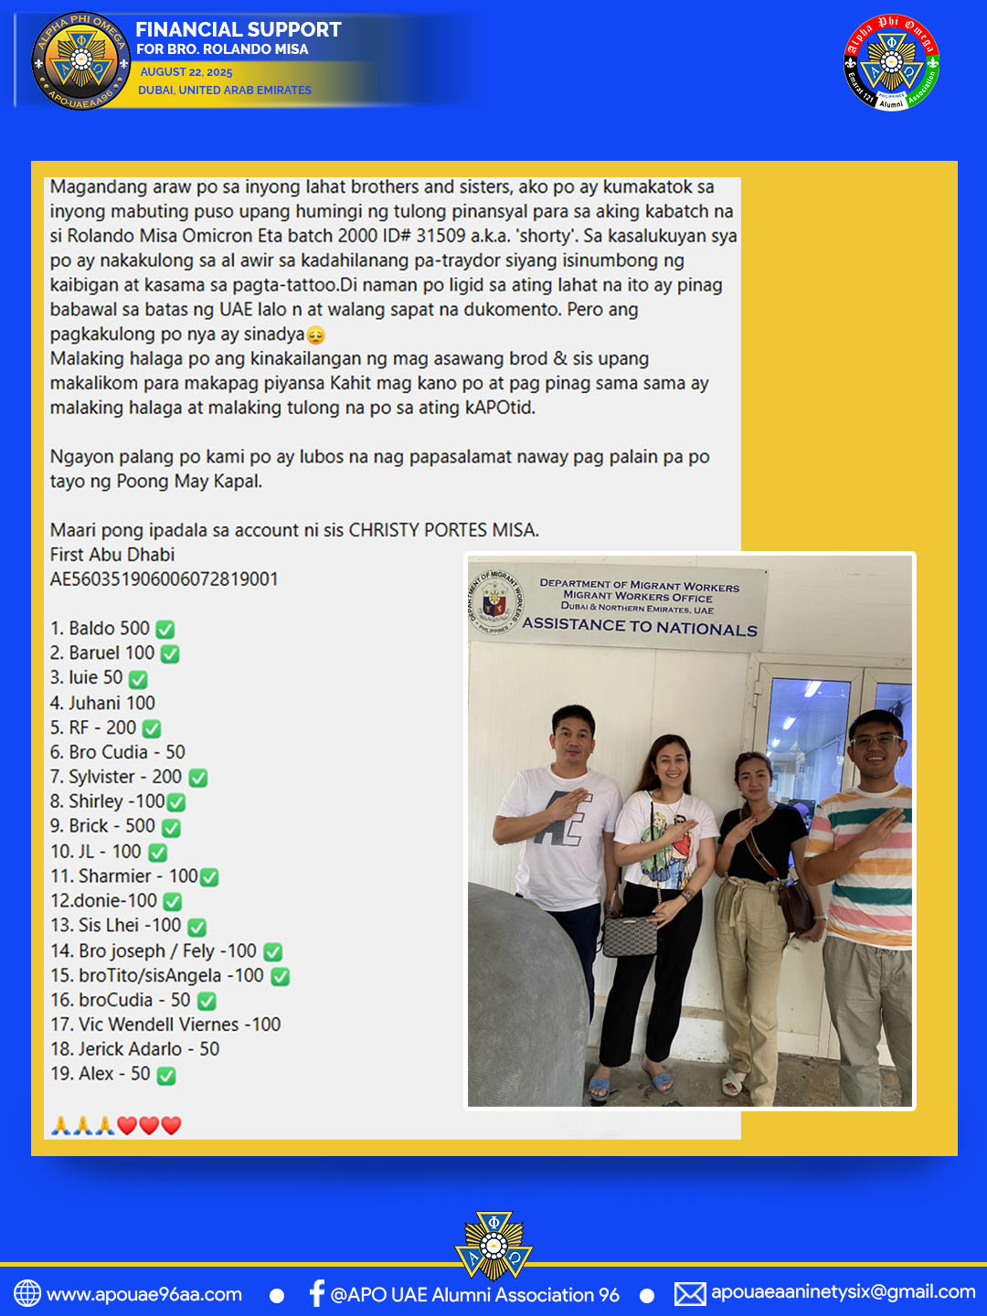
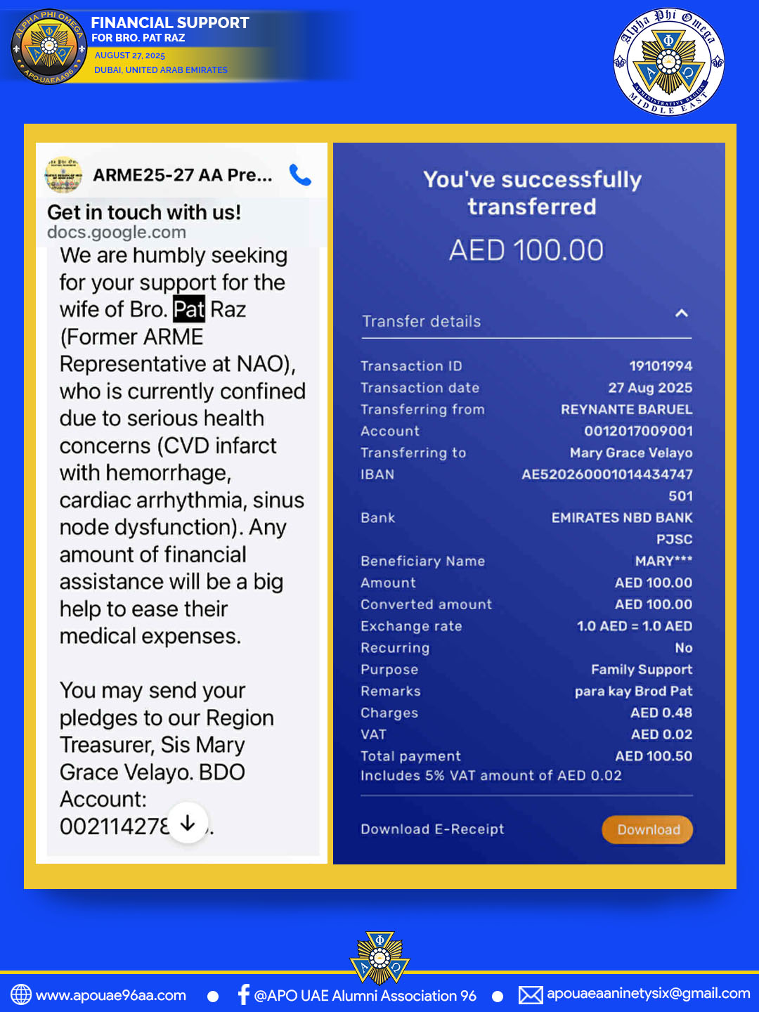
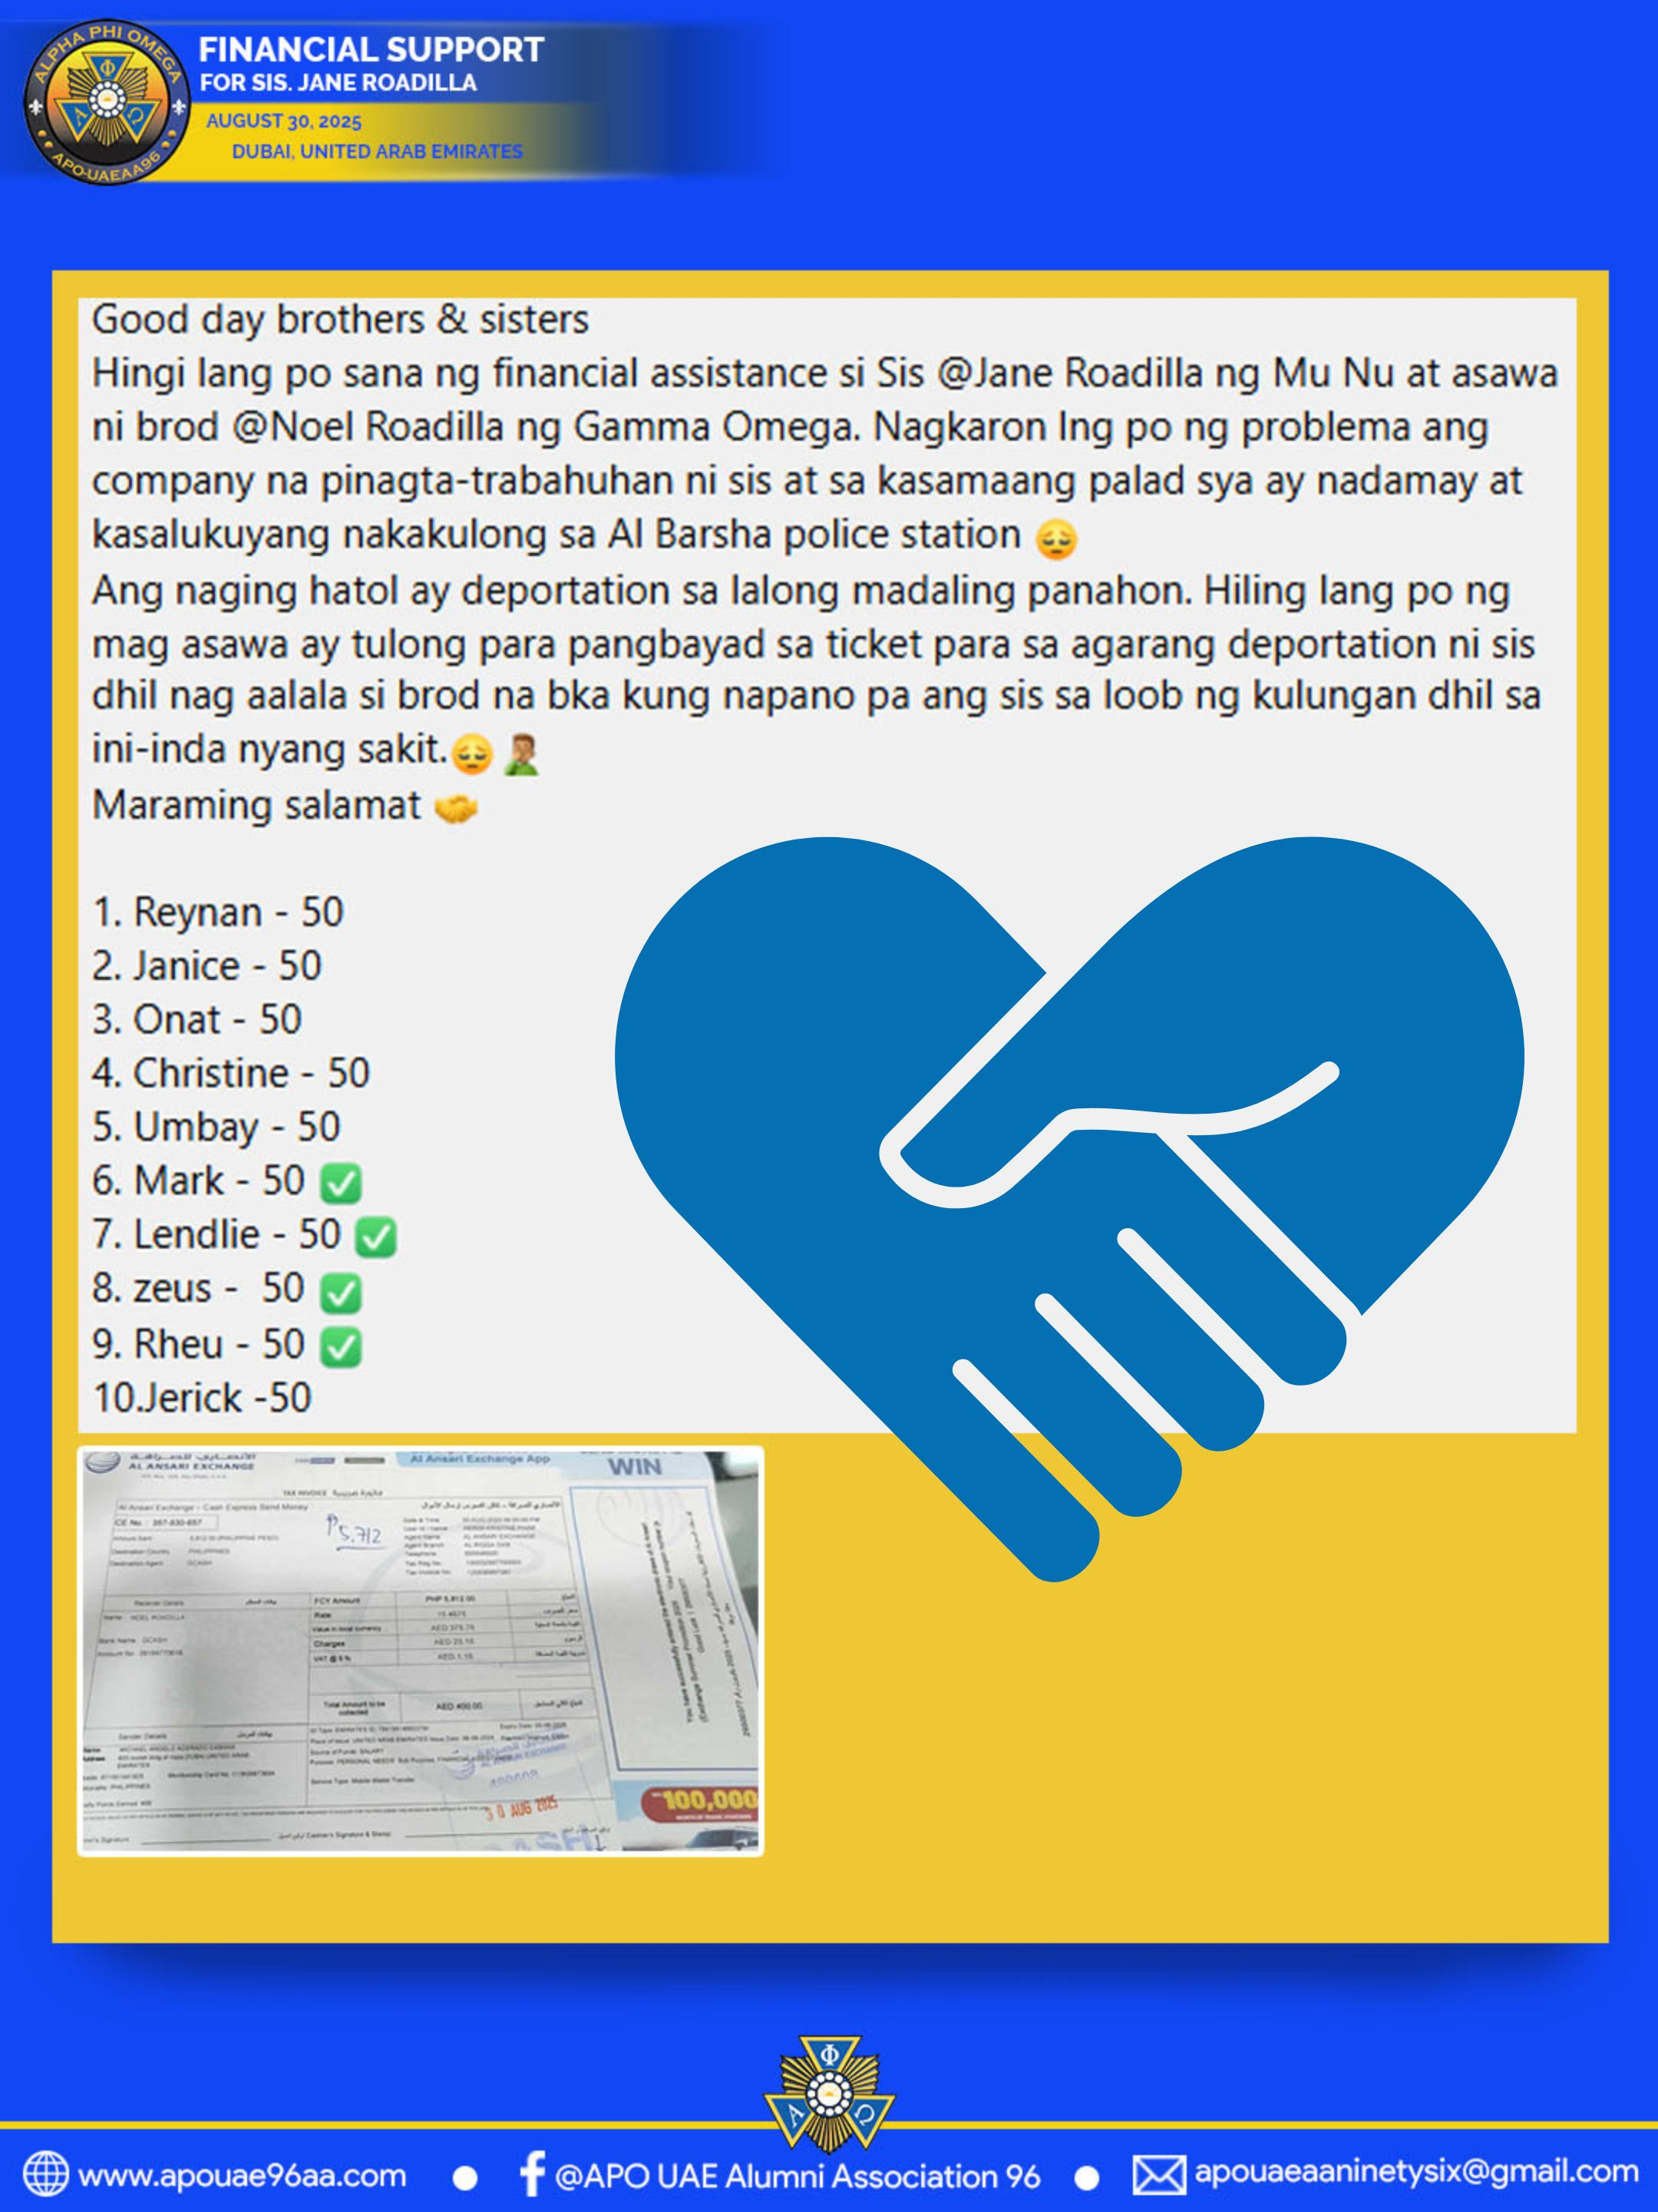

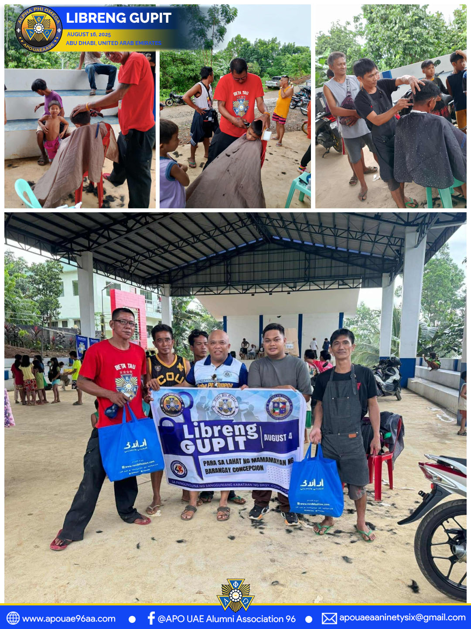

SERVICES

Slide 3
ARME ID RUN
August 1, 2025 - Dubai, United Arab Emirates
APOUAEAA96 took part in the ARME ID Run, an initiative aimed at streamlining the process and providing members with faster access to NAO for ID renewal. The activity strengthened organizational identity, ensured proper recognition of APO alumni, and reinforced unity among members across the region. During the event, a total of 55 IDs were renewed—54 Alumni ID renewals and 1 Life ID renewal—with a total amount collected of PHP 44,675.

Slide 4
BAGONG BAYANI NG MUNDO - SERBISYO CARAVAN 2025
August 3, 2025 - DWTC Dubai UAE
This event was conducted to provide various government services to Filipino OFWs in the UAE. The initiative was organized by the Filipino Social Club (FILSOC). As a member organization, APOUAEAA96 took part by serving as crowd marshals. Our participation helped ensure the smooth flow and success of the event.

Slide 5
MEGA SERVICE - BICOL ADMINISTRATIVE REGION
August 3, 2025 - San Agustin, Canaman Camarines Sur, Philippines
APOUAEAA96 extended financial support to the Mega Service activity in the Bicol Administrative Region Section 2 - Camarines Sur Gamma Nu Chapter.
The program offered various services such as medical consultation with free medicine, dental extraction, libreng gupit, libreng ukay, school supply distribution, barangay justice orientation seminar, free pap smear and HIV testing, bloodletting drive, and a feeding program with 700 beneficiaries.
Through this initiative, APOUAEAA96 donated ₱10,100 (CE No. 720-845-325).
This contribution helped bring essential services and assistance to the local community.

Slide 6
LIBRENG GUPIT
August 4, 2025 - Brgy. Concepcion, Mindoro, Phil;ippines
APOUAEAA96 supports the Service Initiative providing free haircuts for young students and adults in the community of Brgy. Concepcion, Mindoro, Philippines. (Reference No. to be provided)

Slide 7
WATER STATION - FREE TUBIG
August 16, 2025 - Lianga, Surigao Del Norte, Philippines
The APOUAEAA96 Water Station proudly supports the Lianga Half Marathon 2025 by providing free drinking water to all participants. Runners can stay refreshed and hydrated as they push toward the finish line. We are committed to promoting health, endurance, and community spirit through this small but essential gesture. Stop by, grab a cup, and keep moving forward! Reference No. 0031 230 207238 August 1, 2025

Slide 8
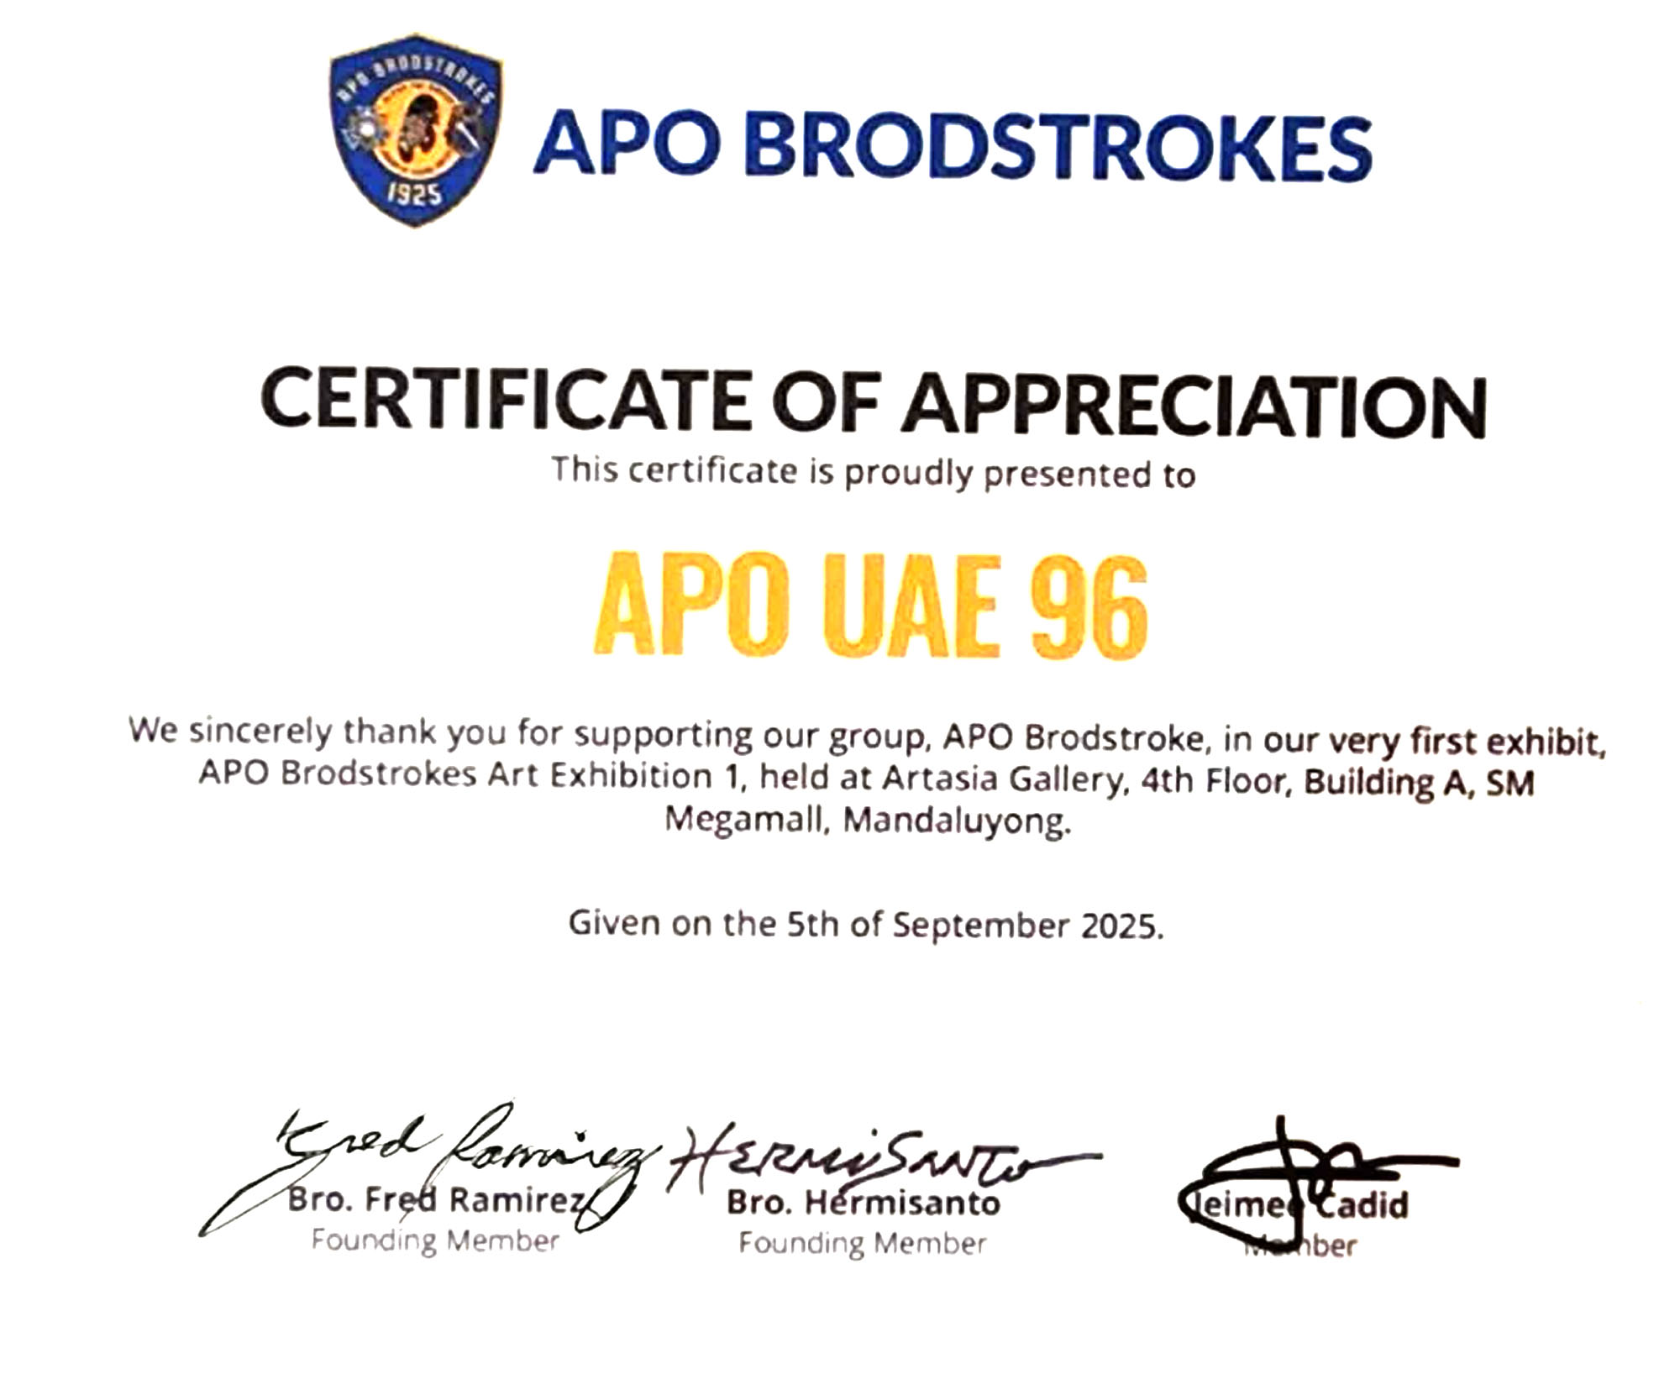
BRODSTROKES - ART EXHIBIT
August 22, 2025 - Artasia Gallery SM Megamall A, Mandaluyong City, Philippines
APOUAEAA96 proudly supports the Brodstroke Art Exhibit through Sis. Zarah Alunday, NAO Chairperson on Culture in the Arts. This exhibit highlights the creative talents of our APO brothers and sisters, showcasing their unique artworks. It’s a celebration of artistry, culture, and the boundless creativity within our APO community.

Slide 9
FINANCIAL SUPPORT FOR BRO. ROLANDO MISA
August 22, 2025 - Dubai, United Arab Emirates
APOUAEAA96, together with brothers and sisters from APO Emarat 121 AA and APO ADAA, took the initiative to provide financial assistance to Bro. Rolando "Shorty" Misa. This support helped him secure bail and demonstrated the spirit of solidarity and brotherhood within the APO community. It is a testament to our commitment to helping members in times of need.

Slide 10
FINANCIAL SUPPORT FOR BRO. PAT RAZ
August 27, 2025 - Dubai, United Arab Emirates
APOUAEAA96 extended financial assistance to Bro. Pat Raz, Past Regional Director of ARME, as part of its continuing commitment to support and provide aid to our fellow brothers in need. This initiative reflects the spirit of solidarity and compassion that our association upholds in living out the principles of Leadership, Friendship, and Service. (Tansaction ID : 19101994)

Slide 11
FINANCIAL SUPPORT FOR SIS. JANE RODILLA
August 30, 2025 - Dubai, United Arab Emirates
APOUAEAA96 extended financial assistance to Sis. Jane Rodilla of Mu Nu Chapter to support her repatriation, following her detention due to issues with her employer. The association continued its assistance even after her repatriation, exemplifying our commitment to the principles of Leadership, Friendship, and Service by providing care and support to our sisters in need. (CE No. 357-530-657)

Slide 12
FUNDRAISING PROJECT - 100 YEARS TSHIRT
August 16, 2025 - Dubai, United Arab Emirates
APOUAEAA96 launched the APO 100 Years T-Shirt as a fundraising project in celebration of the Centennial Anniversary of Alpha Phi Omega. The initiative not only served as a commemorative keepsake for members and supporters but also generated funds to sustain the association’s service projects and activities, embodying the spirit of unity, pride, and commitment to Leadership, Friendship, and Service.

Slide 13
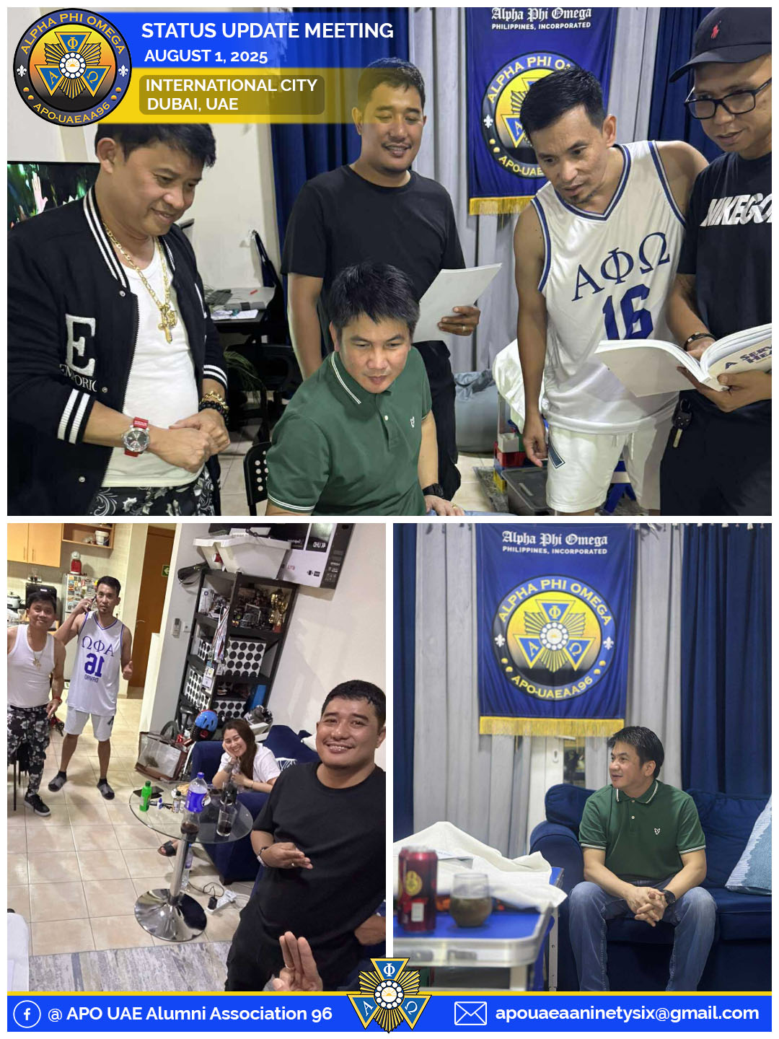
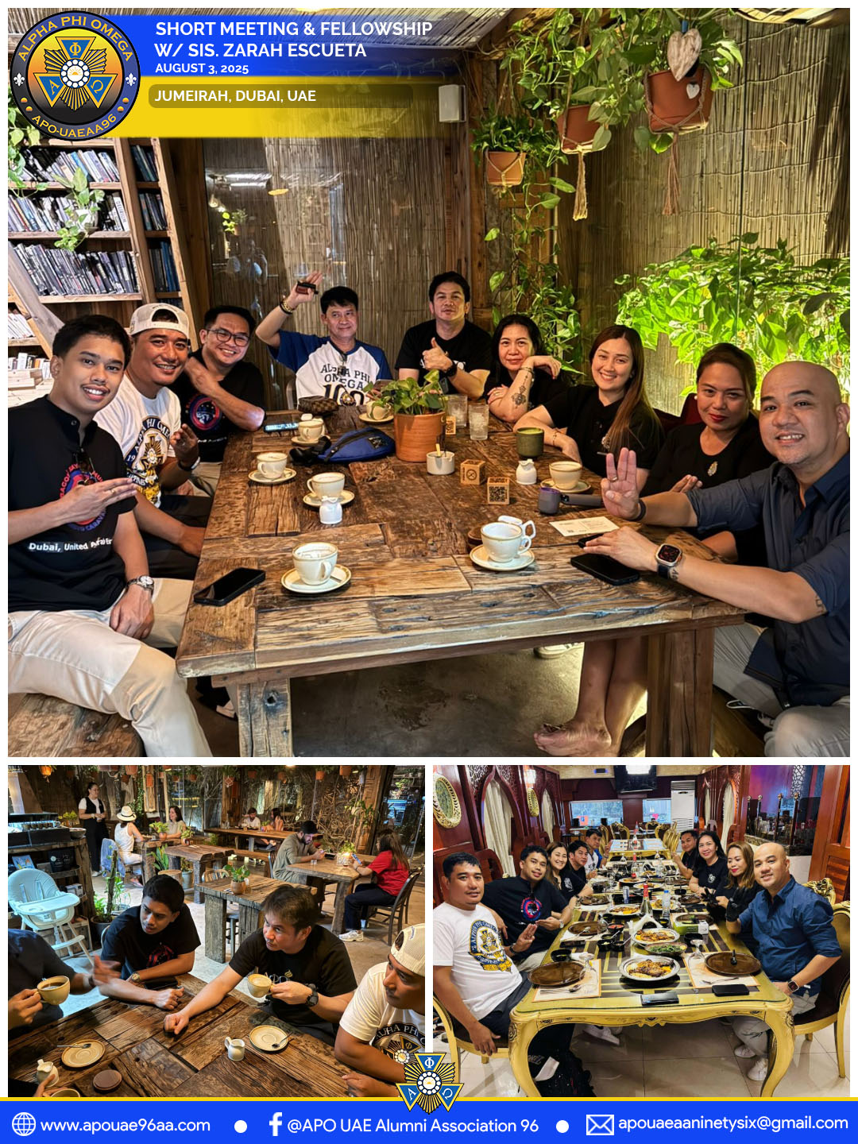
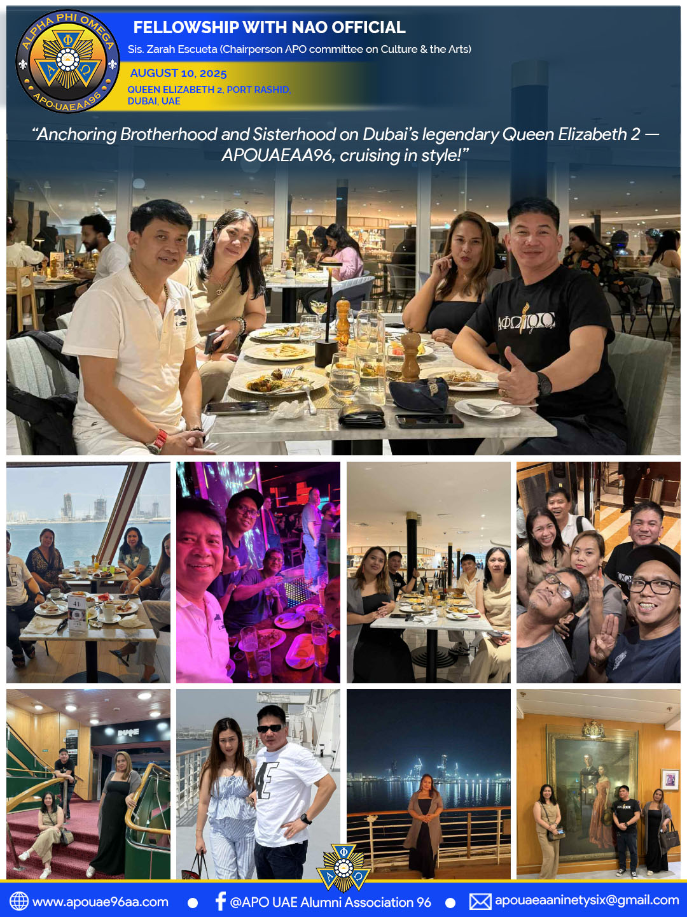
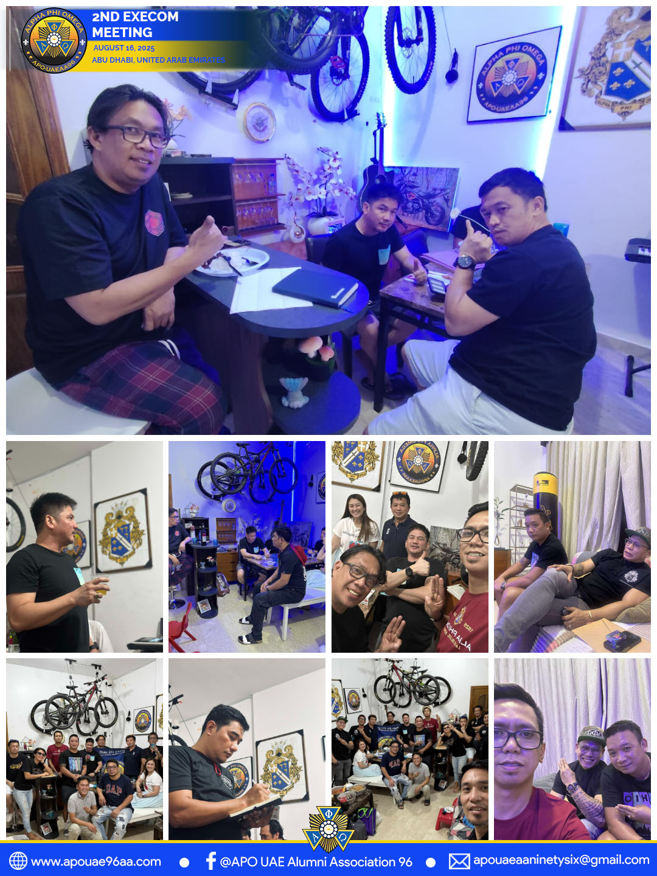
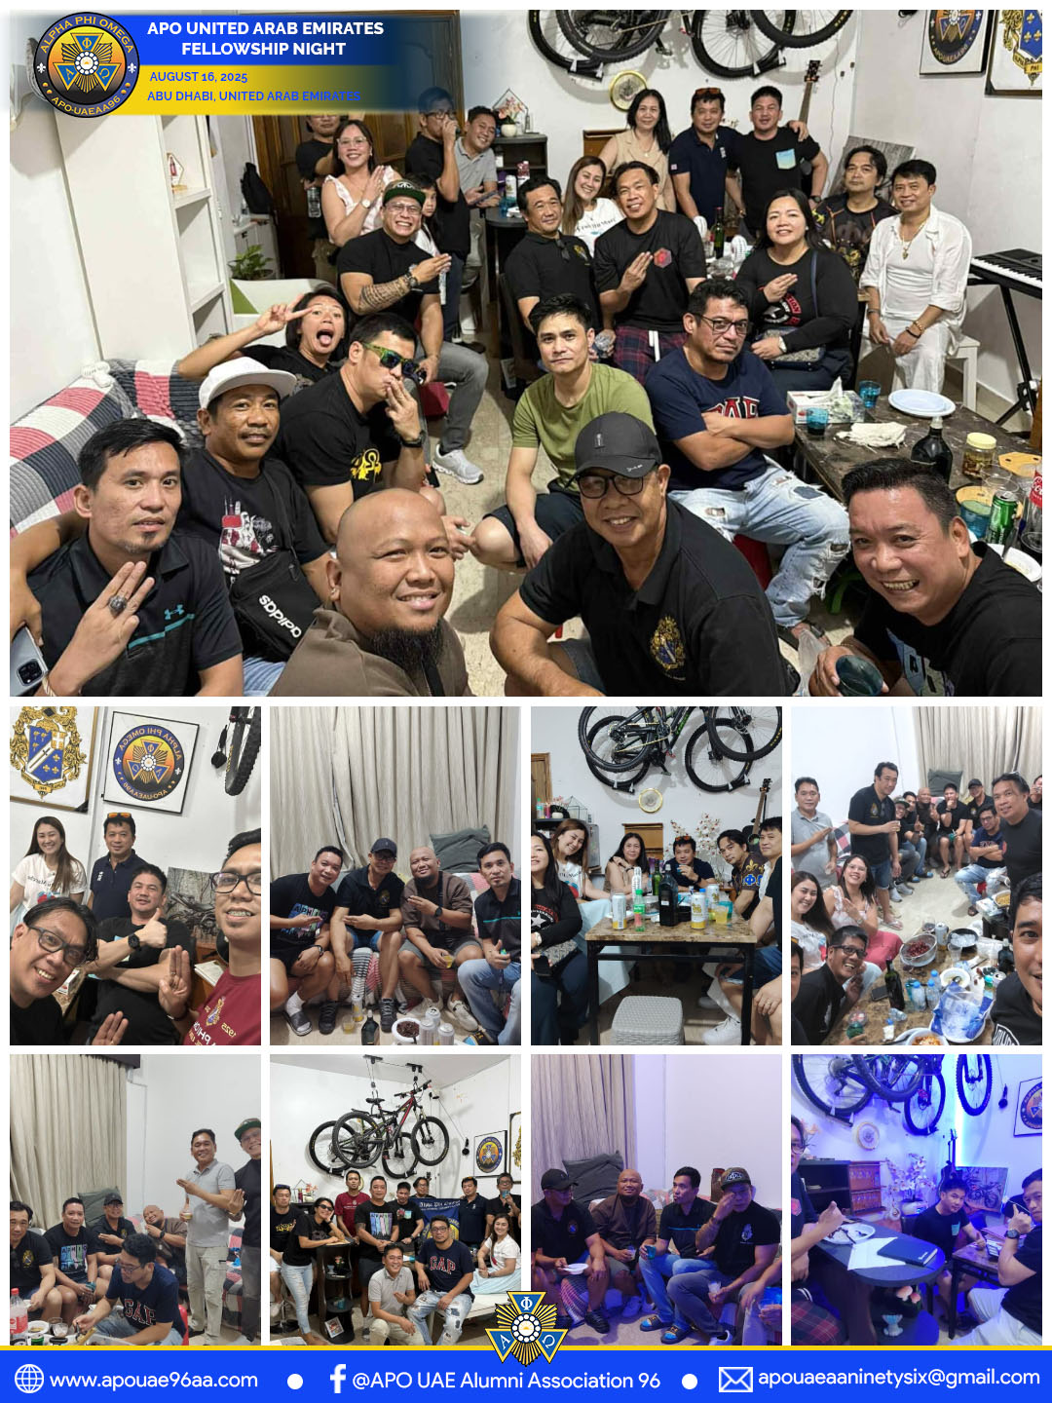

ACTIVITIES

Slide 14
APOUAEAA96 WEBSITE DEVELOPMENT
August 1, 2025 - Dubai, United Arab Emirates
APOUAEAA96 initiated the development of its official website to enhance communication, provide accessible information to members and the public, and showcase the association’s programs, activities, and accomplishments. The website serves as a platform to strengthen connectivity, transparency, and engagement within the APO community.

Slide 15
STATUS UPDATE MEETING
August 1, 2025 - International City, Dubai, United Arab Emirates
The APOUAEAA96 Execom Members held a status update meeting.The agenda focused on the launching of the APOUAEAA96 Website.Members also discussed the preparation for upcoming services.This meeting ensured alignment and progress on the organization’s priorities.

Slide 16
SHORT MEETING & FELLOWSHIP W/ SIS ZARAH ALUNDAY
August 3, 2025 - Jumeira, Dubai, United Arab Emirates
After the service activity, APOUAEAA96 members gathered for a short meeting to discuss its success.
The meeting highlighted the teamwork and commitment of the members.
We also enjoyed a fellowship with Sis. Zarah Alunday, NAO Chairperson on Culture and the Arts.
This gathering strengthened camaraderie and inspired us for future endeavors.

Slide 17
FELLOWSHIP AT QUEEN ELIZABETH HOTEL
August 10, 2025 - Queen Elizabeth 2, Dubai, United Arab Emirates
APOUAEAA96 held a fellowship gathering with NAO Chairperson Sis. Zarah Alunday, Chairperson on Culture and the Arts. The activity served as an opportunity to strengthen camaraderie, exchange insights, and foster deeper collaboration in promoting the values of Leadership, Friendship, and Service.

Slide 18
2ND EXECOM MEETING
August 16, 2025 - Abu Dhabi, United Arab Emirates
APOUAEAA96 successfully conducted its 2nd Executive Committee Meeting to discuss ongoing projects, upcoming activities, and organizational matters. The meeting provided a venue for collective decision-making, ensuring alignment with the association’s goals and continued commitment to Leadership, Friendship, and Service.

Slide 19
FELLOWSHIP NIGHT WITH APO EMARAT 121 AA & APO ADAA
August 16, 2025 - Abu Dhabi, United Arab Emirates
APOUAEAA96 joined a fellowship with members of APO Emarat 121 and APO ADAA to strengthen brotherhood and sisterhood among alumni associations in the UAE. The gathering fostered closer ties, promoted collaboration, and reinforced the shared commitment to uphold the values of Leadership, Friendship, and Service.

