Slide 1

Profile -2024

Slide 2

2
What we do at APL
Overview
Africa Privacy and Legal stands as the premier choice for entities seeking top-tier legal support for fintech and broader Technology, Media, and Telecommunications (TMT) ventures across Africa. Based in Kenya, we provide exceptional legal services with a profound understanding of the regulatory landscapes unique to the continent. Our team combines extensive market experience with specialized knowledge, making us the ideal partner for your African market expansion.
We offer clients a full-service fintech and TMT law solution across Africa, delivering both local and cross-border support. Our unparalleled legal, strategic, and technical counsel is backed by a team of experienced specialists who are adept at advising both bank and non-bank fintech companies on the regulatory impacts of their products and services in Kenya and other African markets.
Our Expertise
As a boutique firm, we excel in guiding new market entrants through product launches, regulatory engagement, and market strategies with a level of attention and customization that larger firms cannot match. We provide precise, actionable advice to ensure your products meet all regulatory requirements and market expectations. Our expertise extends to various legal domains, including mergers and acquisitions (M&A), private equity, employment law, corporate law, and contract management, all within the fintech and TMT sectors.

Slide 3

Our Exceptional experts
Our exceptional team of experts is at the forefront of our success. With a strong focus on the TMT, Fintech and payments industry, our consultants have earned global recognition for their exceptional legal services. They have consistently demonstrated their expertise, earning praise for their proactive approach, unmatched technical knowledge, and unwavering support from our clients.
Notably, they have been ranked as recommended individuals in Chambers Global Fintech for the years 2020, 2021, 2022, 2023, and 2024. Additionally, their excellence has been acknowledged in the Legal 500. Chambers has commended their responsiveness, describing them as "very responsive, vibrant, and knowledgeable."
When you choose our team, you're partnering with industry leaders who are dedicated to providing you with the highest level of legal expertise and service in the industry.

Slide 4

Our Commitment to you
Africa Privacy and Legal is proud to be a part of the growth and development of businesses across the African continent. Our services are not just about legal advice; they are about fostering innovation, facilitating growth, and ensuring that businesses in the TMT sector can thrive in an ever-changing landscape.
Your Trusted Partner
When you choose Africa Privacy and Legal, you are choosing a trusted partner committed to your success. We are here to help you navigate the legal and regulatory challenges of the Telecommunications, Intellectual Property, Technology, Fintech and Payments industries, providing tailored solutions that empower your business to reach new heights.
Thank you for considering Africa Privacy and Legal as your partner. We look forward to the opportunity to work with you and help you achieve your goals in the dynamic world of TMT.

Slide 5

Our Services
  Regulatory Compliance and Advisory
  In-depth analysis and strategic guidance on regulatory implications for fintech and TMT products and services across Africa.
  Comprehensive advice on financial regulations, corporate law, and governance to ensure your operations comply with both local and international standards.
  Market Entry and Product Launch
  Full support for multinational companies launching new products in African markets, from initial market research and regulatory approval to strategic planning and execution.
  Corporate and Commercial Law
  Expertise in corporate structuring, mergers and acquisitions (M&A), and private equity transactions.
  Robust advisory on corporate governance and compliance, helping your business thrive.
  Proficient in drafting and negotiating customer-facing contracts and technology procurement agreements.

Slide 6

Technology and IP Commercialization
Specialized legal expertise in the commercialization of technology and intellectual property (IP), protecting your innovations and maximizing their value.
Data Protection
Expert advice on data protection and privacy laws across Africa, ensuring compliance with local and international standards.
Development and implementation of data protection strategies to safeguard your business and customer information.
Support in drafting and negotiating data protection contracts.
Defense against data protection claims and strategies to protect your data integrity.
Finance and Banking
Specialized counsel in finance and banking, competition law, and tax and exchange control.
Tailored solutions to support your financial operations and strategic initiatives.

Slide 7
Fintech Solutions
Comprehensive support for fintech companies, including navigating regulatory requirements in various African markets.
Expert advice on developing and launching fintech products and services, ensuring full compliance with local regulations.
Strategic guidance on partnerships, mergers, and acquisitions within the fintech sector.
Legal support for innovative financial technologies, including blockchain, digital payments, and online lending platforms.

Slide 8

Why Choose Us?
Boutique Focus on Fintech and TMT
As a boutique firm, we provide a high level of specialized attention and personalized service that larger firms cannot match. Our deep focus on fintech and TMT ensures that you receive expert, tailored advice for your specific needs.
Proven Track Record
Our team has successfully guided many clients through the complexities of African markets, delivering tangible outcomes and added value.
Deep Local Expertise
We have a profound understanding of local regulatory environments and strong relationships with local regulatory bodies, ensuring seamless compliance and strategic advantage.

Slide 9
Why Choose Us?
Specialized Knowledge
Our expertise spans fintech, TMT, and related legal areas, providing comprehensive and precise legal solutions tailored to your business needs.
Client-Centric Approach
We prioritize understanding and aligning with your business goals, offering proactive communication and service delivery.
Strategic Insight
Our market knowledge and regulatory expertise provide you with the strategic insight necessary to make informed decisions and achieve successful market entry and growth.

Slide 10
Why Choose Us?
Comprehensive Legal Support
From regulatory compliance to commercial law and data protection, we offer a full suite of legal services to support your business at every stage of its African journey.
Technological Integration
We leverage advanced technology to enhance service delivery, improve efficiency, and ensure compliance, providing you with a competitive edge.

Slide 11

PROPOSAL
Our Team
Partners

Slide 12
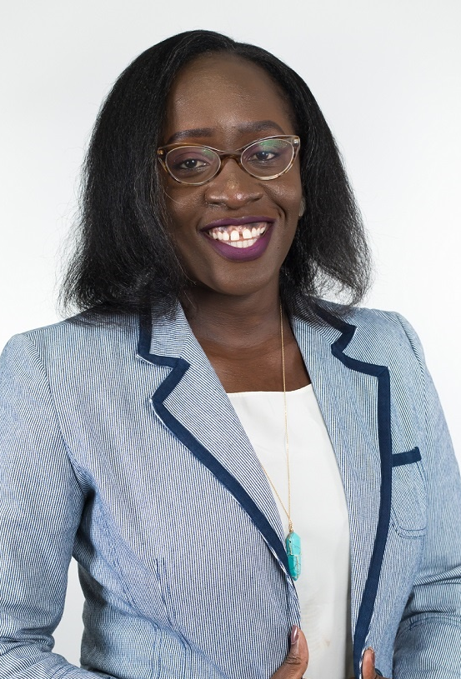
Janet Othero
Email: otherojanet@africaprivacyandlegal.com otherojanet@outlook.com
Tel: +254 722 540 039 https://www.linkedin.com/in/janet-othero-cipm-86b63730 https://chambers.com/lawyer/janet-othero-fintech-49:25722804
Janet is a Kenyan qualified lawyer that offers a vibrant, sound, and commercial- focused approach to the TMT practice. She has been highly involved in high-value complex project developments and has a strong foothold in all the attendant issues such as compliance, tax, and regulatory compliance.
Janet’s expertise in fintech, reg tech, cyber resilience advisory, and data privacy governance has seen her engage with entities ranging from government bodies, and financial institutions to start-ups.
Janet is one of the few privacy practitioners in Kenya trained and certified in GDPR with a CIPM qualification from IAPP. She is also a certified Data Protection Officer. She has been listed in Chambers Global Fintech Legal 2022, 2023 and 2024 edition and previously in the Legal 500, 2020 edition as a rising star in Banking, Finance, and Capital Markets.
The chambers rankings have consistently praised Janet noting that “Janet Othero is a well-respected partner in the telecommunications, media and technology department. She has expertise in FinTech, regtech, cyber resilience advisory, and data privacy governance.”

Slide 13
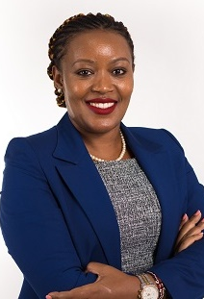
Catherine Kariuki-Mulika
E-mail: kariukiw@africaprivacyandlegal.com
Tel: +254 704 623 975 https://www.linkedin.com/in/catherine-kariuki-mulika-91b63730 https://chambers.com/lawyer/catherine-kariuki-fintech-49:26106616 https://en.wikipedia.org/wiki/Catherine_Kariuki_Mulika
Catherine demonstrates expertise, efficiency, and commercial awareness in dealing with all legal matters pertaining to technology, media, and the telecommunication industry.
She provides advisory services on commercial law, fintech, and mobile payments, data protection, cyber security support in digital forensics work, privacy, consumer protection, data protection and intellectual property. She works with several domestic and multi-national companies towards regulatory compliance and business processes, and strategy support.
Catherine is a Kenyan qualified lawyer, trained Accountant, a certified Data Protection Officer as well as an accredited Mediator with CIARB. Catherine is listed in the Chambers Global Fintech Legal 2020, 2021, 2022, 2023 and 2024 editions as a leading individual in fintech, and was praised in the feedback by clients as “very knowledgeable and commercially minded – she can see things from our perspective and has a good personality.”

Slide 14

14
Client
Testimonials
We have a history of satisfied clients who can attest to our exceptional service and successful outcomes.
We have received numerous client testimonials and are proud to be recognized and lauded by Chambers Global FinTech, where our partners have consistently achieved high rankings for their outstanding work in the industry.
At Africa Privacy and Legal, we are committed to being your trusted legal partner as you expand your fintech and TMT operations across Africa. Our goal is to empower you with the legal expertise and strategic insights needed to thrive in this dynamic and evolving market. Let us help you turn your African ambitions into reality.

Slide 15
15
Relevant
Experience sheet of our Partners
Our Partners pride themselves in their extensive expertise and proven track record in providing comprehensive legal support across a range of sectors, with a particular focus on TMT, fintech, data protection, and regulatory compliance.
They have successfully advised clients on complex legal issues, ensuring compliance with both local and international regulations. Below are some of the significant engagements we have handled, demonstrating our capability to deliver exceptional legal services.

Slide 16
16
Relevant
Experience
Advised a major mobile network operator in Kenya on the continuous adoption of technology in its fintech digital offerings. Our support includes data protection and privacy, regulatory compliance, consumer protection, intellectual property rights, and contract due diligence.
Provided a leading multinational alcohol beverage supplier with advice on their data protection and privacy compliance program, focusing on the implications of data protection regulations on their regional operations in Kenya and Uganda.
Assisted a tier-one, NSE-listed regional financial institution in incorporating its bank and fintech subsidiary. We provide continuous multi-jurisdictional legal support on regulatory compliance, intellectual property, regional fintech partnerships, and general corporate commercial support.

Slide 17
17
Relevant
Experience
Negotiated, drafted, and reviewed a core banking software agreement for a tier-one bank, ensuring all regulatory and operational requirements were met.
Drafted and reviewed contracts for an NSE-listed integrated property and financial solutions provider's innovative digital product. This involved advisory on obligations arising from aggregation and integration of third-party platforms, banking regulatory obligations, data protection, privacy, consumer protection, intellectual property rights, cybersecurity, data ownership, and contract due diligence.
Provided legal advice to a prominent digital lender operating in Kenya on licensing of payment solution providers, partnership options, regulatory approvals for innovative products, legal implications of non-compliance, and compliance obligations.

Slide 18
18
Relevant
Experience
Advised an on-demand float for remittance and payment company on the regulatory framework governing payment service solutions, digital lending, microfinance, and financial institution regulations.
Supported a venture-capital-backed fintech in launching new offerings in Kenya by advising on the regulatory framework for setting up payment service solutions and international money remittance.
Assisted a digital lender with practical advice on preparing for imminent regulation, engaging with regulators for clarifications, and preparing their application for a license to operate as a Digital Credit Provider. We also advised on data privacy issues.

Slide 19
19
Relevant
Experience
Provided practical advice to an international fintech company on how emerging regulations by the Central Bank of Kenya would affect their operations, preparing for regulation, and engaging with regulators.
Reviewed master templates for software and hardware license agreements, as well as annual maintenance agreements for a tier-two bank, ensuring compliance in contracting processes with vendors and third parties.
Advised the Kenyan Ministry of Information, Communication, and Telecommunications on onboarding innovators and related intellectual property issues for a government initiative.

Slide 20
20
Relevant
Experience
Trained a pan-African bank's group legal team on the local legal and regulatory framework for financial technology legislation, cybersecurity, and data protection, highlighting the impact on their organizational processes.
Assisted an ag-tech farming ecosystem in its expansion in Kenya and securing financing from a Mauritian-based financier by structuring the deal using local legislation and lending practices.
Provided data protection compliance support for a tech company’s operations in Kenya and Uganda, including documentation review, data privacy impact assessment, gap analysis, compliance framework development, and training programs.

Slide 21
21
Relevant
Experience
Advised a global taxi-hailing app service provider on Data Protection Regulations, registration with the Office of the Data Protection Commissioner, and aligning policies, user terms and conditions, and processes with data protection regulations.
Trained a global energy company on the implications of the Computer Misuse and Cyber Crimes Act and the Data Protection Act on their organizational operations.
Provided training on data privacy and protection laws at the African Corporate and Government Counsel Forum's annual meet-up.

Slide 22
22
Relevant
Experience
Advised a national airline on data protection compliance to understand the implications of regulations on their offerings in Europe and regionally, including drafting their privacy policy, privacy notice, and data protection clauses.
Assisted a specialty chemical company with overall compliance with the Kenyan Data Protection Act.
Advised an eyewear company on compliance with the Kenyan Data Protection Act.
Advised a major telecommunications company on compliance and risks arising from local data protection laws compared to GDPR.

Slide 23
23
Relevant
Experience
Coordinated a training program on agri-technology entrepreneurship in Africa for a German development agency, targeting entrepreneurs in the ag-tech space.
Developed tools and templates for SMEs in Kenya in collaboration with a German development agency to facilitate compliance and awareness of data protection laws.
Supported a short-stay company with regulatory issues related to their platform operation in Kenya.

Slide 24
24
Relevant
Experience
Represented and defended data protection complaints and facilitated regulatory data audits for clients.
Supported the fintech arm of a pan-African bank by drafting comprehensive ICT contracting templates to ensure regulatory compliance and facilitate secure collaborations.
Assisted a multinational company in its compliance efforts with the Kenyan Data Protection Act, including registration as a controller and processor and addressing data protection risks with comparative analysis to GDPR.

Slide 25
25
Relevant
Experience
Provided legal expertise to an IT company specializing in data centers on IT and labor law-related concerns, drafting various templates, and offering comprehensive advisory services.
Advised a member organization of leading digital-first loan providers in Kenya on legislative review and drafting of regulatory provisions affecting licensing of digital lenders.
Reviewed and advised on the customer onboarding process, terms and conditions, and data processing rights for an asset financing platform, ensuring compliance with consumer protection laws and data protection regulations.

Slide 26
26
Relevant
Experience
Reviewed the local asset transfer agreement for a global technology company, ensuring compliance with relevant employment, data protection, competition, and business laws.
Trained the management and board of a major bank on the local legal and regulatory framework for cybersecurity and data protection and its impact on their organizational processes.
Conducted a legal compliance audit for a financial institution to ensure compliance with cyber-risk regulatory obligations and outsourcing guidelines.
Audited ICT contracts for a financial services holding company, drafted amendments to ensure compliance, and advised on GDPR compliance and data ownership.

Slide 27

Contact us
Africa Privacy and Legal LLP
P.O.Box 52623-00100
Nairobi
ACK Gardenhouse, 1st Ngong Avenue
www.africaprivacyandlegal.com
apl@africaprivacyandlegal.com
+254751183224

