Slide 1
GRAMMAR GIGGLES
From
Poorf That Blog
Created by Kathy Sieckman, PP, PLS, ACP
DCLP meeting; August 4, 2021
Notes:
I’m calling this presentation GRAMMAR GIGGLES because the slides in this show come from the Proof That Blog created by Kathy Sieckman, PP, PLS, ACP—who is an amazing NALS member from Arizona. I encourage each of you to google Proof That Blog and stay up-to-date with her postings. (By the way, you don’t need to mute your microphones today, because I want your feedback.)
I’ve tried to categorize the images somewhat—for example: menus, outdoor signs, weather, etc.
All of them contain some kind of grammar mistake. Some are more obvious than others. Many are not spelling errors as much as proofreading errors.
I warn you though—that some may be obscene or at least distasteful. But I hope you are NOT offended by any of these images.

Slide 2
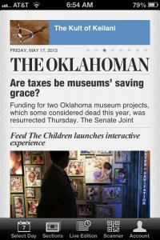
Notes:
I’m going to start with newspaper articles. There’s something wrong with this title. I’m not sure what it should be. But maybe “Are taxes GOING TO be museums’ saving grace?”

Slide 3
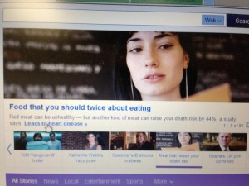
Notes:
This title needs something also. If you read it fast, you won’t notice the word that’s missing. But if you read it slowly, you realize that the word THINK should follow the word SHOULD.

Slide 4
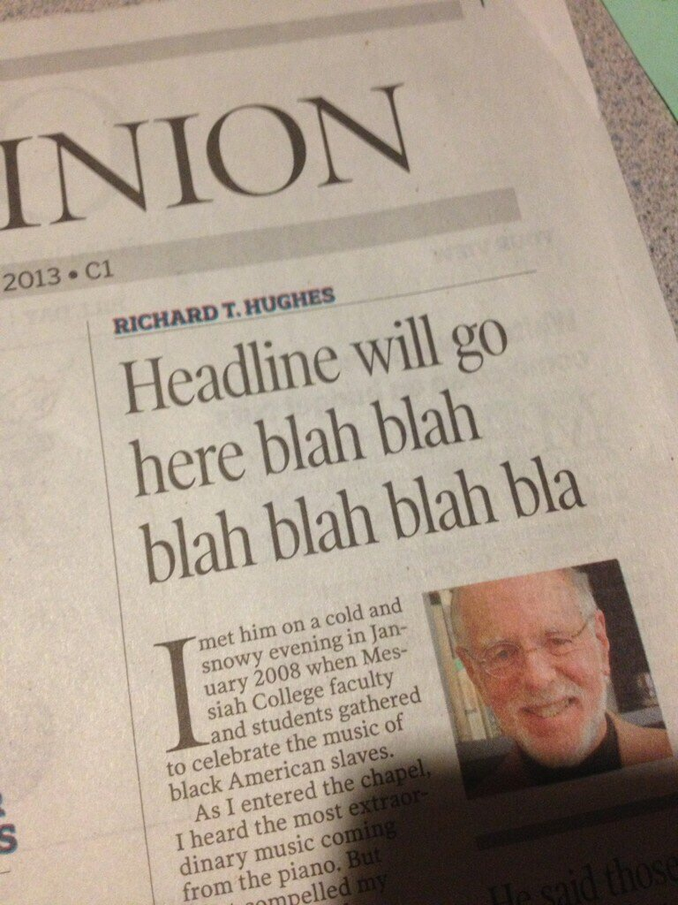
Notes:
Did you ever do this—just put in BLAH, BLAH, BLAH—to fill up space—thinking that you’d go back later and fix it?

Slide 5
Notes:
This is a headline from a newspaper. Is it clear to you WHO was arrested?
The girl,
The booze,
Or the officer?

Slide 6
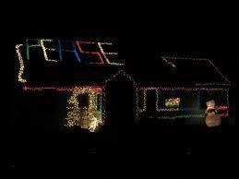
Notes:
If you’re going to use Christmas lights to spell out a HUGE word on your roof—check the spelling first.

Slide 7
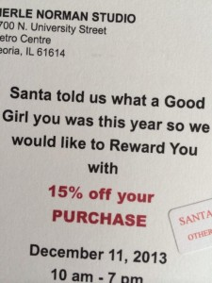
Notes:
Here’s another Christmas item. I think Santa might give you a lump of coal for grammar as bad as this!

Slide 8
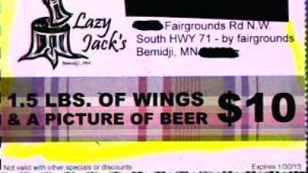
Notes:
This is an ad for wings and beer. A lot of wings—and a PHOTO? Of beer.

Slide 9
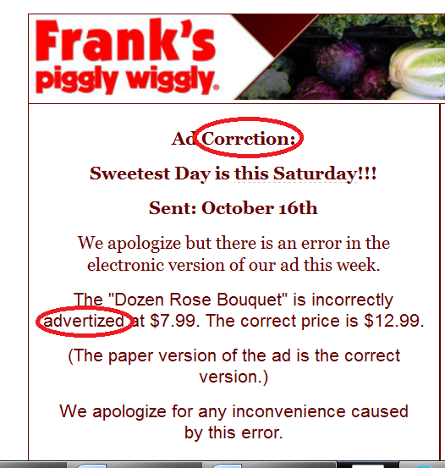
Notes:
Here the paper is trying to publish a correction. But still has some problems. I think they need to publish a correction to their correction.

Slide 10
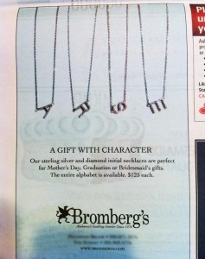
Notes:
This ad looks pretty good. The third line says: The entire alphabet is available.
So why did they choose A-R-S-E?

Slide 11
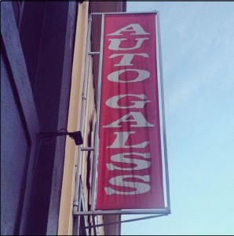
Notes:
The next images are outdoor signs. Outdoor—for all to see—and hard to correct!
Is this a business for Auto Glass or Auto Galss? And what ARE Auto Galss?

Slide 12
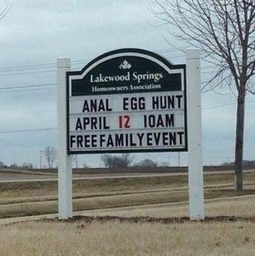
Notes:
This Easter egg hunt doesn’t appear to be for the family.
Obviously, they meant ANNUAL—not anal.

Slide 13
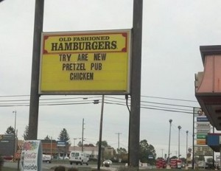
Notes:
Someone needs to go back to primary school to learn the difference between A-R-E (a verb) and O-U-R (a possessive word).

Slide 14
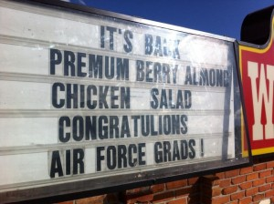
Notes:
A big word that’s hard to spell!

Slide 15
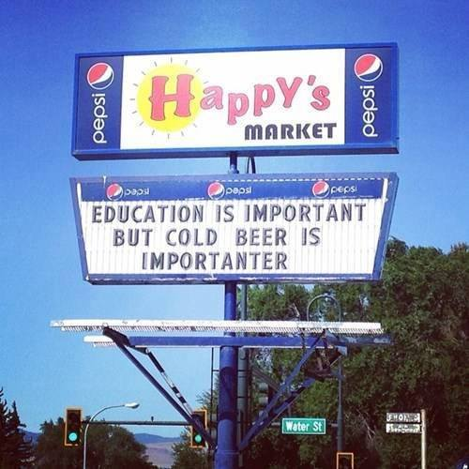
Notes:
I’m speechless at this one. I don’t know what to say!
Answer this: Who would put that on a sign?!

Slide 16
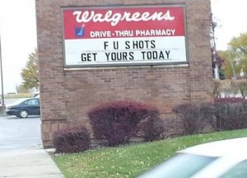
Notes:
I didn’t know you could get those kinds of shots.

Slide 17
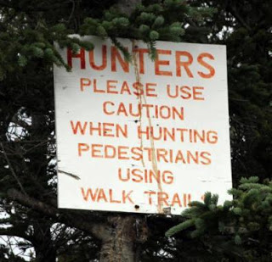
Notes:
I think this needs punctuation. And maybe a few more words so that it’s clearer.

Slide 18
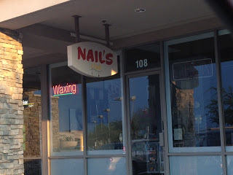
Notes:
Is NAIL the owner’s name? If it is, then this is correct.
But I don’t think that’s the case.
It’s an odd sign. But I don’t think it should have the apostrophe.

Slide 19
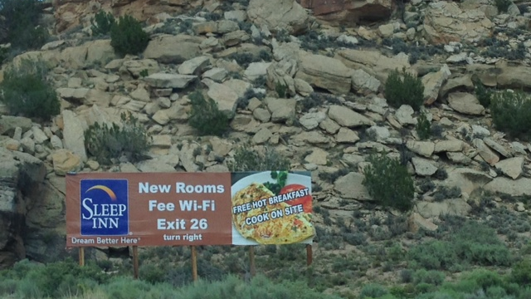
Notes:
What is FEE WI-FI?
And secondly, COOK ON SITE sounds like you do your own cooking.

Slide 20
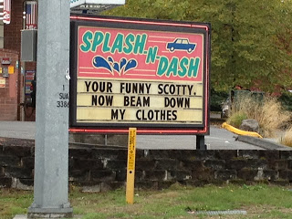
Notes:
This is maybe my favorite. Someone has a sense of humor.
But he/she can’t tell the difference between YOUR and YOU’RE (a contraction).

Slide 21
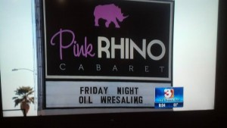
Notes:
What is “Oil Wresaling”? Maybe it’s a phonetic spelling and the signmaker pronounces the word “res-a-ling.” Do they mean WRESTLING?

Slide 22
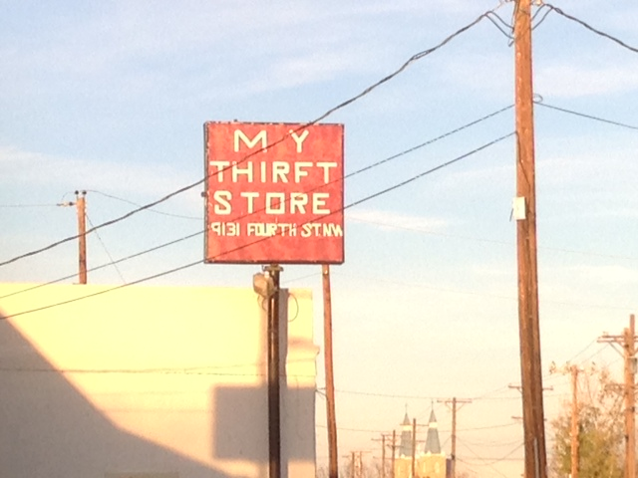
Notes:
This looks like an amateur made this, not a professional signmaker. But it still wouldn’t be easy to correct.

Slide 23
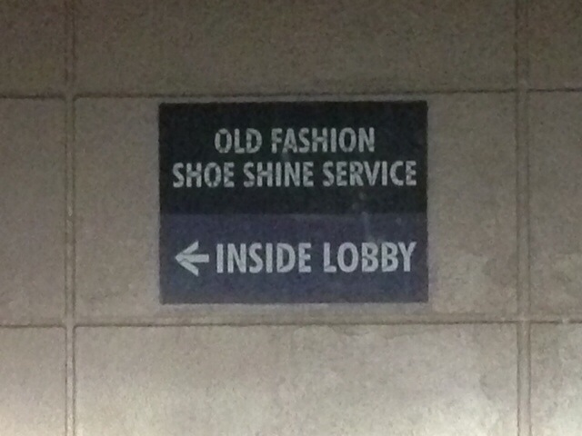
Notes:
What’s wrong with this? (Add –ED to Fashion)

Slide 24
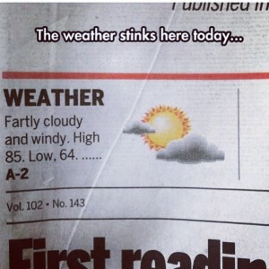
Notes:
I like the line that someone has put at the top: The weather STINKS here today.

Slide 25
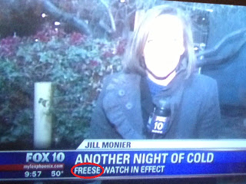
Notes:
This looks like a photo of a TV screen—with a misspelling.

Slide 26
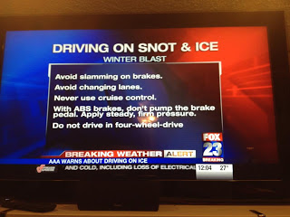
Notes:
Another weather-related notice.
Be especially careful when driving on SNOT and ice.
This is another good example of making sure you proofread your titles.

Slide 27
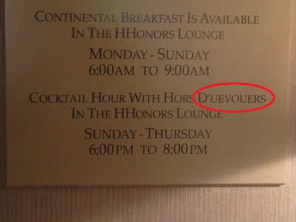
Notes:
The spelling mistake is circled in red on this slide. I realize French words might be hard to spell, but maybe just writing “Appetizers” would be easier.
By the way, the correct spelling is D’OEVRES.

Slide 28
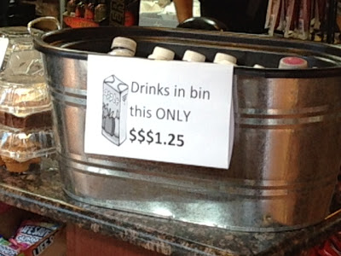
Notes:
I had to read this several times to figure out that the word THIS is in the wrong place.
It should say “Drinks in this bin only $1.25.
But there’s another problem. Do they mean ONLY this bin? Or only $1.25?

Slide 29
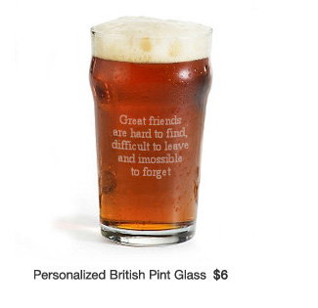
Notes:
It’s hard to honor a friend when you use bad spelling.

Slide 30
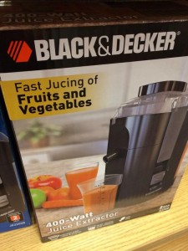
Notes:
Someone got a new juicer for Christmas! But does it also JUKE fruits and vegetables?

Slide 31
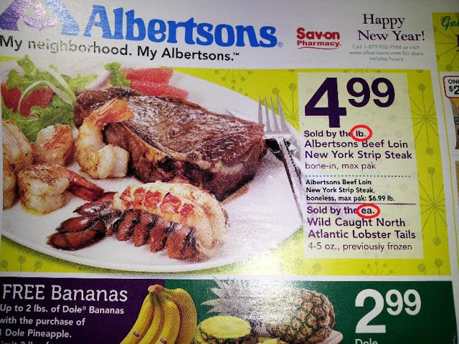
Notes:
You an see the red circles in this ad.
First “Sold by the lb.” POUND should be spelled out.
Next, “By the ea.” doesn’t make sense and I don’t know how to fix it.
They wanted to advertise BOTH for the same price of $4.99, but I think there would’ve been a better way to do it.

Slide 32
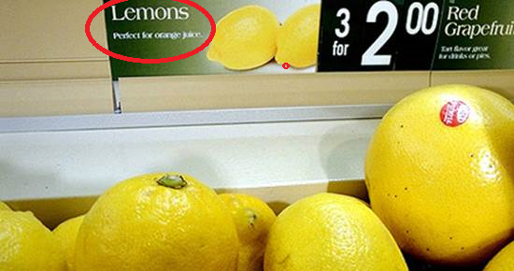
Notes:
I didn’t know you could make ORANGE juice out of lemons.

Slide 33
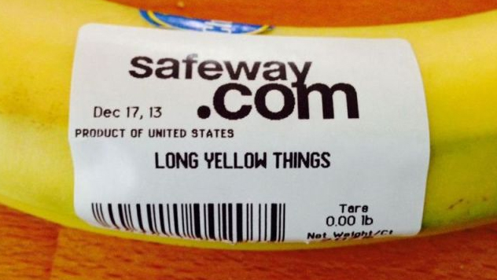
Notes:
What do you think these “long yellow things” are?

Slide 34
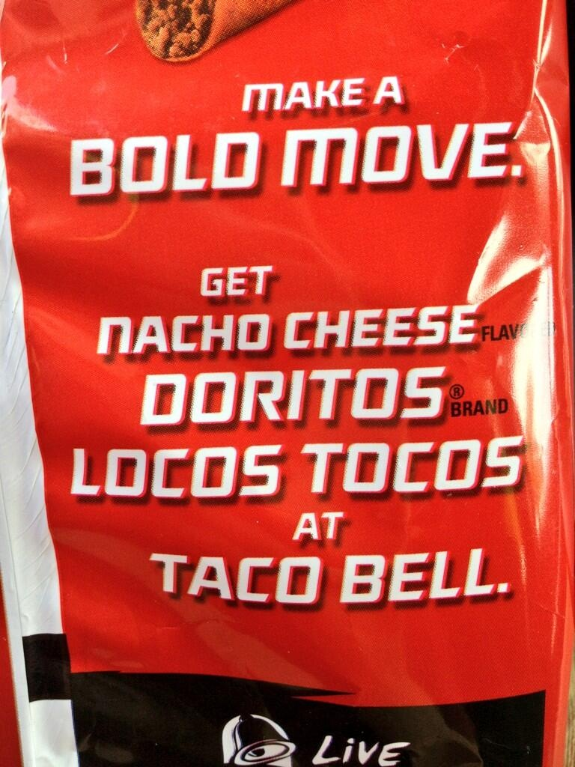
Notes:
What are Locos Tocos?

Slide 35
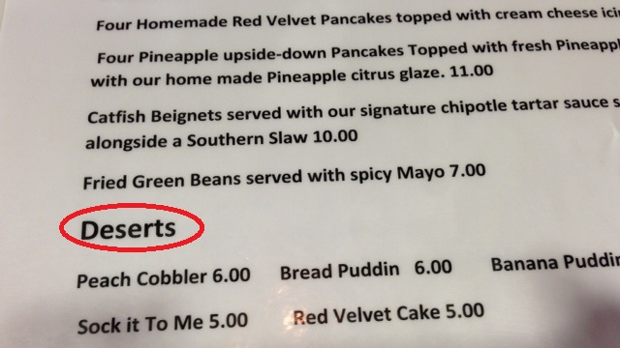
Notes:
This is a menu—with several obvious mistakes.
First: Desserts is circled.
Second: Bread Puddin needs a G at the end.
Third: Words are capitalized anywhere and everywhere.

Slide 36
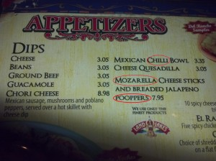
Notes:
This is another menu.
The worst one is “breaded jalapeno poopers.”
Look at the description of Chori Cheese Dip on the left. I’d have to ask the waiter what “served OVER a hot skillet” means.

Slide 37
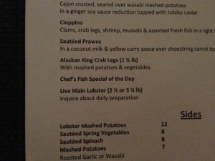
Notes:
Is this lobster from the state of Maine? If so, it needs an E at the end.
Or maybe it lives on Main Street—in which case, it’s OK.

Slide 38
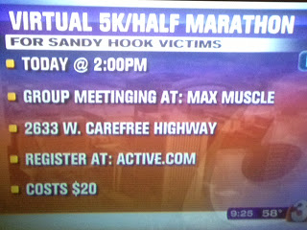
Notes:
Here’s a challenge for you. How many mistakes can you find? I found at least eight. I’ll give you a few moments.
Don’t use @ sign.
2:00 should be written without the colon and zeroes.
There should be a space before PM.
PM should be P.M.
Meetinging has too many letters.
No colon after at (Max Muscle)
No colon after at (Active.com)
Costs should be singular.
And I think you could put a colon after Cost: $20.

Slide 39
We all know that of all the writing you do, one of the most important is your résumé. It is a potential employer’s first impression of you and if there are errors, that isn’t a very good impression. I found this article at http://www.resumark.com/blog/andrew/top-15-of-the-most-hilarious-spelling-mistakes-on-resumes-and-cover-letters/ with some interesting résumé and cover letter errors.
20. “I have a known track record and excellent experience with accurancy and fixing erors”
19. “Strong Work Ethic, Attention to Detail, Team Player, Attention to Detail”
18. “My experience include filing, billing, printing and coping”
17. “Demonstrated ability in multi-tasting.”
16. “My work ethics are impeachable.”
15. “I have nervous of steel.”
14. “I consistently tanked as top sales producer for new accounts.”
13. “I am a perfectionist and rarely if if ever forget details.”
12. “Dear Sir or Madman,”
11. “I can type without looking at thekeyboard.”
10. “Instrumental in ruining entire operation for a Midwest chain store.”
9. “I am anxious to use my exiting skills”
8. “Speak English and Spinach”
7. “I am a Notary Republic”
Notes:
(Read from slide)

Slide 40
6. “I attended collage courses for minor public relations”
5. “Following is a grief overview of my skills.”
4. “I’m attacking my resume for you to review.”
3. “I am experienced in all faucets of accounting.”
2. “Hope to hear from you, shorty.”
And the most embarrassing one to finish off our list:
“Directed $25 million anal shipping and receiving operations.”
Notes:
(Continue reading from slide)

Slide 41
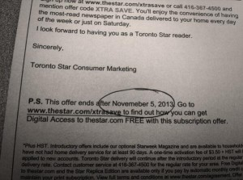
Notes:
Obviously, the circled word is misspelled. It has an extra E.

Slide 42
Notes:
This is a case no not knowing the difference between EXCEPT and ACCEPT.

Slide 43
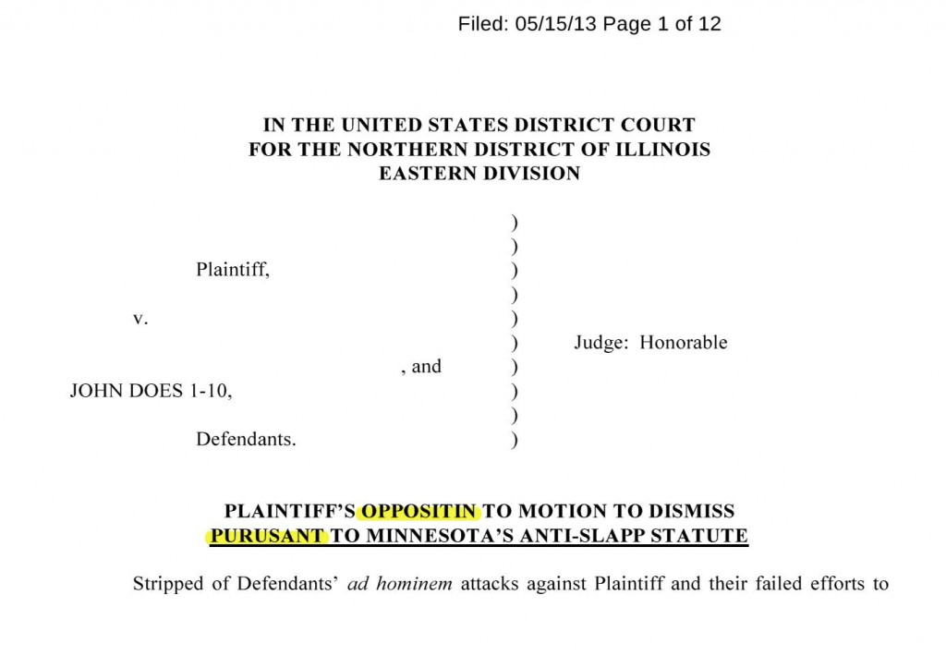
Notes:
One of the first rules of proofreading is CHECK THE TITLES.

Slide 44
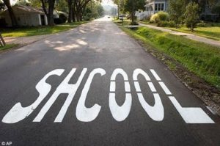
Notes:
Talk about an outdoor sign that’s embarrassing! AND hard to correct~
Would you send your child to THIS school?

Slide 45
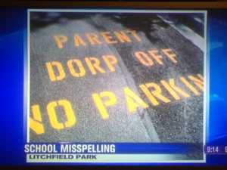
Notes:
This is another school driveway sign.
This is the Parent DORP OFF zone.

Slide 46
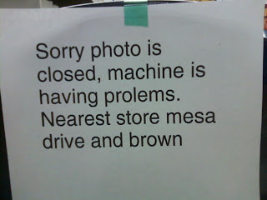
Notes:
This is another challenge for you. I found 11 errors—and there are only 14 words in this notice. I’ll give you a few moments to see how many mistakes you can find.
Period after SORRY.
New sentence; capitalize PHOTO.
There’s a word missing between PHOTO and IS.
Period after CLOSED.
New sentence; capitalize MACHINE.
PROBLEMS is misspelled.
Some words are missing between STORE and MESA (maybe IS AT?)
Capitalize MESA.
Capitalize DRIVE.
Capitalize BROWN.
Period after BROWN.

Slide 47
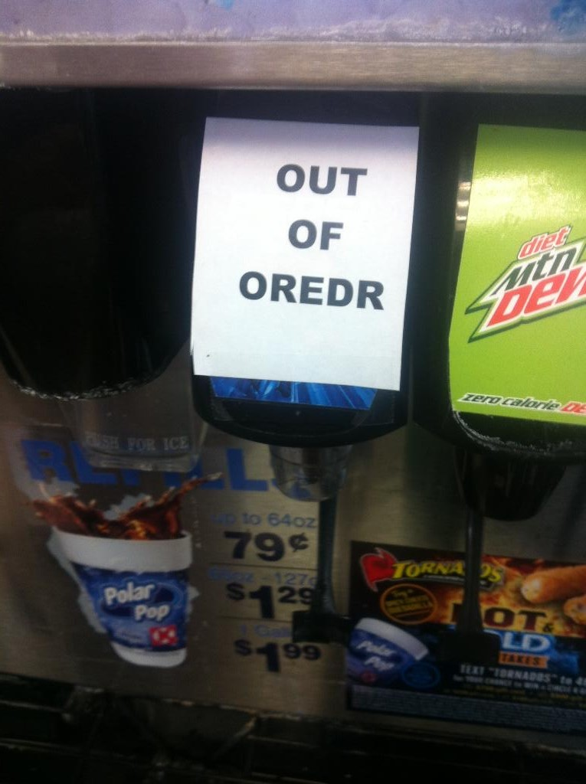
Notes:
Something is definitely out of order.

Slide 48
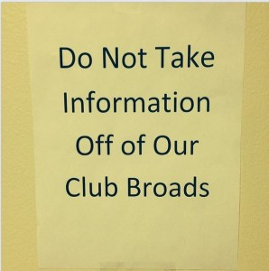
Notes:
First: Is it really necessary to capitalize EVERY word?
Second: What are CLUB BROADS?
Third: Do we really want to know?

Slide 49
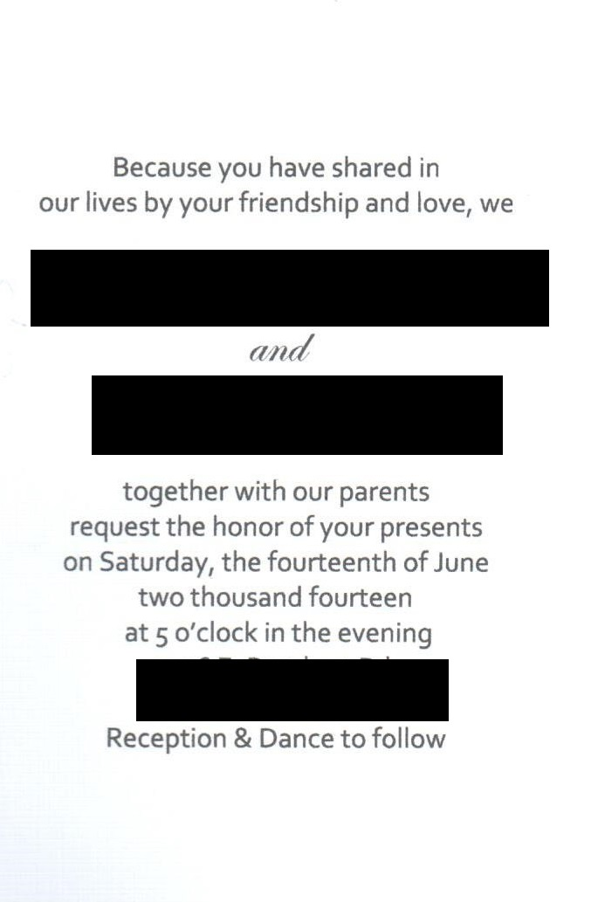
Notes:
This is a wedding invitation with the names redacted, for obvious reasons.
(Read from slide)
In other words, “Don’t bother to come; just send PRESENTS.”

Slide 50
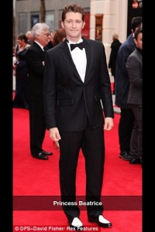
Notes:
I like his black and white shoes.
But I don’t believe this person’s name is Princess Beatrice.

Slide 51
Notes:
Read down to the line at the bottom.
PURCHASE is spelled wrong.

Slide 52
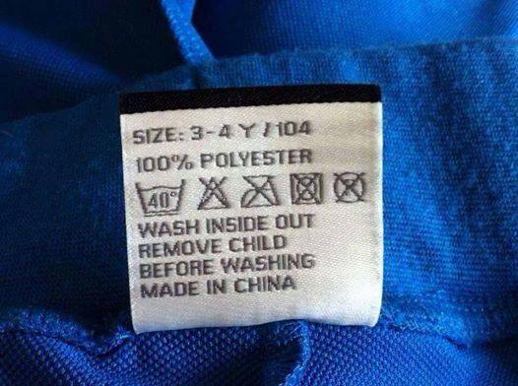
Notes:
(Read from slide)
That’s a good idea: REMOVE CHILD BEFORE WASHING.

Slide 53
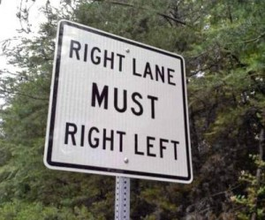
Notes:
If you saw this traffic sign, would you know what to do?

Slide 54
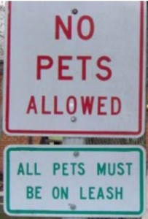
Notes:
How can it be both ways?

Slide 55
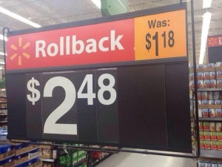
Notes:
This is a Rollback sign at a Walmart. But it’s confusing because it looks like the price has been reduced from $1.18 to $2.48.

Slide 56
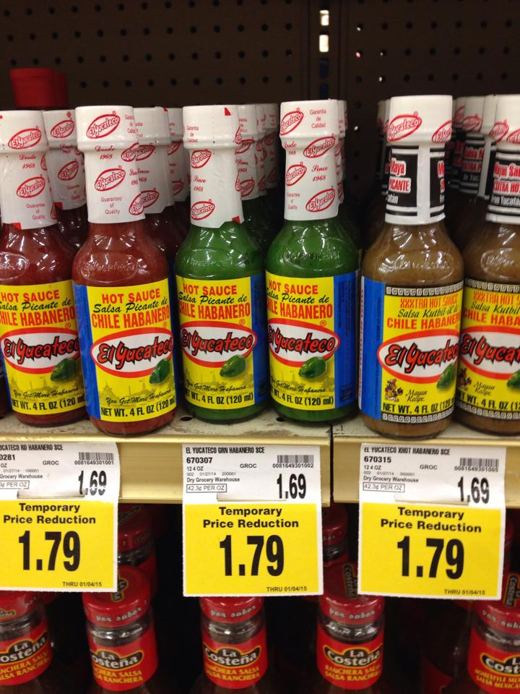
Notes:
This might take a moment to realize the problem. But it’s like the Walmart Rollback sign. The price here was reduced from $1.69 to $1.79.

Slide 57
Notes:
You’ve won the spelling bee and received this trophy. Notice it says Spelling at the top and it’s an image of a bee.
But it says: CON-GRADUAL-TIONS.
Really?

Slide 58
Notes:
This is an apostrophe in the wrong place. It’s not ONE teacher on strike. So TEACHERS should be plural.
The rule is make the word plural, and then make it possessive.
So the word should be TEACHERS followed by an apostrophe.

Slide 59
Notes:
I called this screen “Apostrophes Run Rampant.”
First, THE MENS RACK might be the name of the store, or a rack inside the store.
But either way, there should be an apostrophe before the S in MENS. Again, the rule is make the word plural (MEN) then make it possessive (MEN’S).
Farther down, TIES, BELTS, and SOCKS are NOT possessive. They’re plural.
So there should NOT be an apostrophe in any of them.

Slide 60
Notes:
Should we tell Big G that the sign on his trailer is incorrect?

Slide 61
Notes:
Angel has a plumbing business and he has a van. But PLUMING is spelled wrong.
Just because the B is silent, that doesn’t mean that you an leave it out!

Slide 62
Notes:
Quick! Please! Someone close the door on that Starbucks van!

Slide 63
Notes:
This is a sign on a bus in New York advertising McDonalds. Oh, my!

Slide 64
Notes:
“Don’t touch yourself.”
So, is this saying that you should “Ask the Staff” to touch you?

Slide 65
Notes:
What is that word supposed to be?
Maybe TYPOGRAPHY.
But what a big mistake to make on such a HUGE screen.

Slide 66
Notes:
There are multiple problems with this sign.
Someone is trying to be overly polite. There are two PLEASES and a SORRY.
Take the D off USED.
Period after DOOR.
Omit the second PLEASE.
Period after INCONVENIENCE.

Slide 67
Notes:
CONSULTANT is spelled wrong. The L and T are turned around.

Slide 68
Notes:
This is a want ad.
What’s a “PASTE ENVIRONMENT”?
They mean “fast paced.”

Slide 69
Notes:
(Read from slide)
ORIGINAL SNOT required.

Slide 70
Notes:
YOUR is misspelled. It should be the contraction YOU’RE.

Slide 71
Notes:
Here’s another correction.
(Read from slide.)
At least, they got it right this time.
“The Sentinel regrets the error.”
And The Sentinal hopes that it will NOT be sued for this mistake.

Slide 72
Notes:
Remember: Every day is National Grammar Day!

Slide 73
Lucy and Desi Arnez
https://youtu.be/MAL9VD6Lz9Y
Notes:
I want to show you a YouTube clip from an old I Love Lucy episode. Lucy and Ricky are expecting their first child and Lucy is concerned about her husband’s knowledge of the English language.

