Slide 1
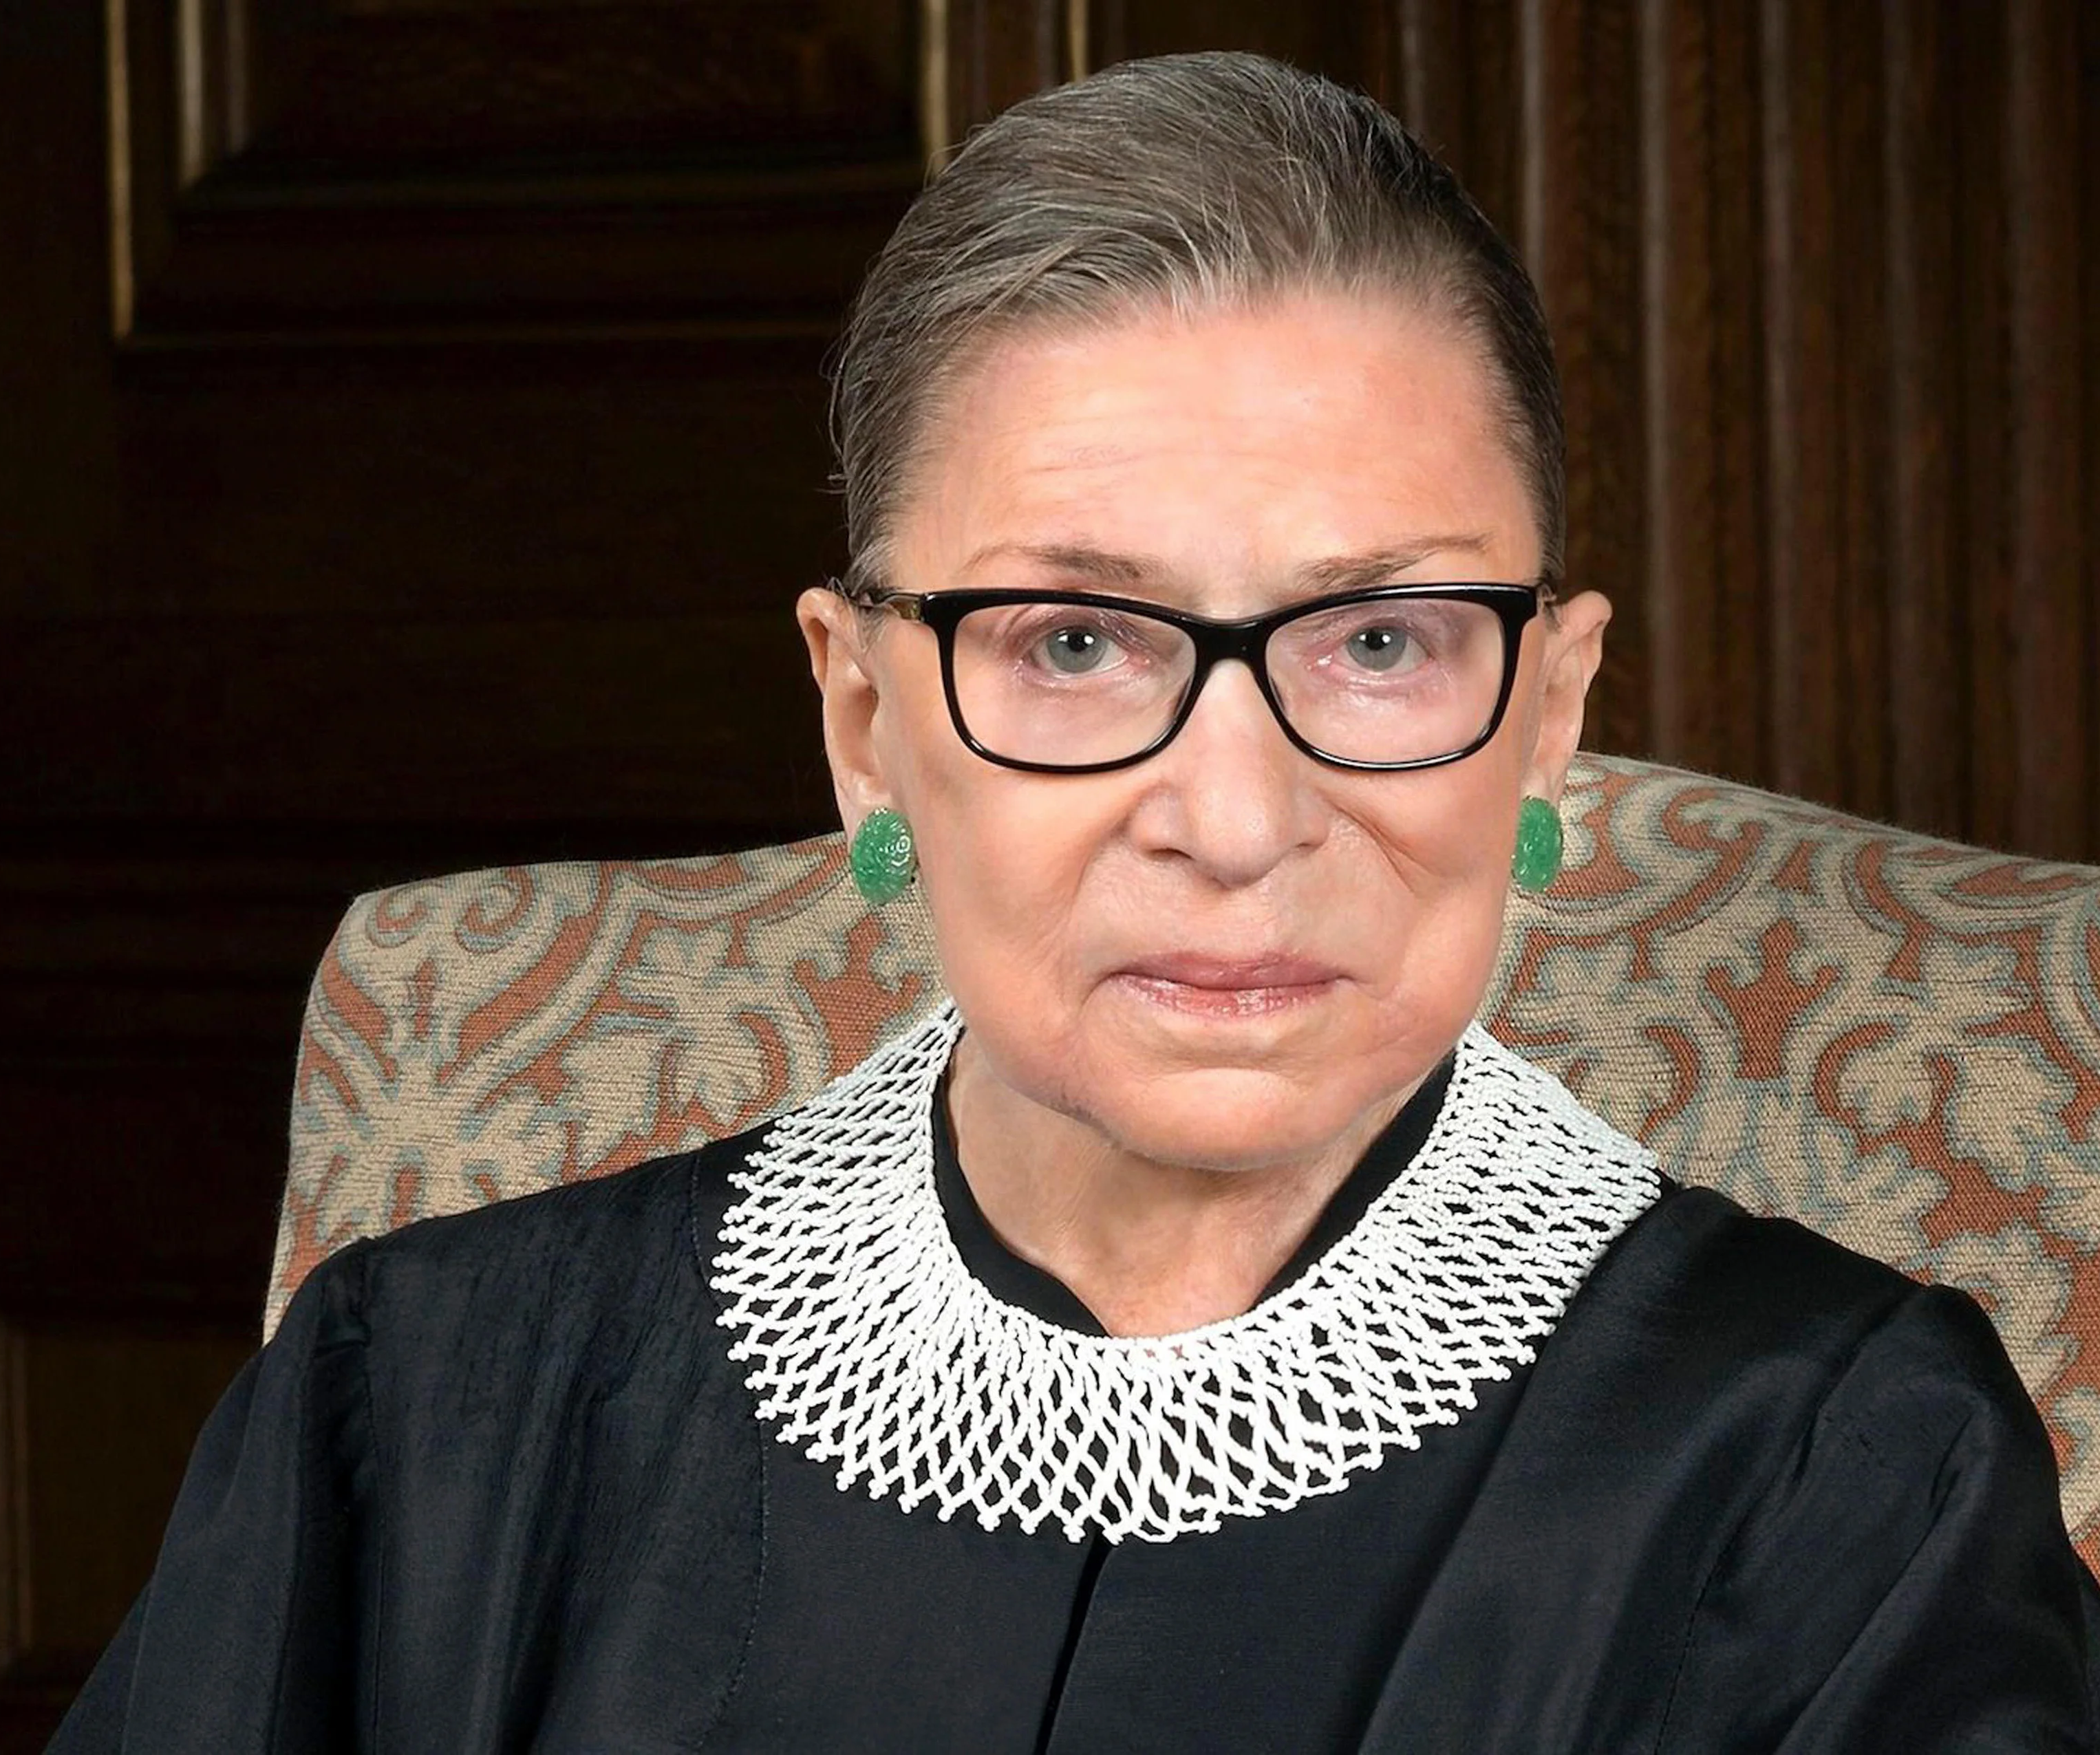
Life & Legacy of the Notorious (Justice) Ruth Bader Ginsburg
Chandeni Sendall, WCBA President 2020-2022

Slide 2
Background
Born in 1933 to a working-class family in Brooklyn, New York
Early life shaped by her mother’s advice, “Always be prepared to be self-standing, to fend for yourself.”
Justice Ginsburg attended college at Cornell University on a full scholarship and graduated first in her class
In 1956, she entered Harvard Law School as one of only eight women in a class of 500

Slide 3
Background
First female member of the Harvard Law Review, and was selected to serve on the Columbia Law Review after transferring
  Justice Ginsburg was a new mother while attending law school
Even though Ginsburg graduated first in her class, it was difficult for her to find work as a lawyer
  After being rejected from all 12 law firms at which she interviewed, she clerked with a judge at the U.S. District Court for the Southern District of New York for two years
An assistant professor at Rutgers School of Law in 1963

Slide 4
Work as an Attorney
In the 1970s:
  Ginsburg was promoted to full professor
  Joined the faculty at Columbia Law School
  Gave birth to her second child, and
  Co-founded the ACLU Women’s Rights Project
Ginsburg involvement in ACLU:
  Argued six landmark Supreme Court cases demonstrating the negative impact gender discrimination has on both women and men.
  She won five of the six cases she argued, all of which were critical in expanding the scope of civil rights protections under the Fourteenth Amendment.
Reputation of being a defender of individual rights with a special concern for oppressed, marginalized, and underserved groups

Slide 5
Time on the Bench
President Jimmy Carter appointed Justice Ginsburg to the U.S. Court of Appeals for the District of Columbia in 1980
She served on the appellate court for thirteen years
  Reputation of maintaining positive relationships with both the liberal and conservative judges she worked alongside
In 1993, Bill Clinton nominated her to the Supreme Court. She was confirmed by a Senate vote of 96-3

Slide 6
Time on the Bench
In her 27 years on the Supreme Court, Justice Ginsburg was a powerful voice.
  She was known for authoring forceful dissents, which she would occasionally read from the bench for maximum impact.
  After Justice John Paul Stevens retired in 2010, she became the de facto leader of the court’s four-justice liberal bloc.
  Reputation among other Justices for her good character and work ethic
Justice Ginsburg voted consistently to defend abortion rights, legalize gay marriage, uphold the Affordable Care Act, and otherwise advance the rights of marginalized people and groups.
  In 1999, she won the American Bar Association's Thurgood Marshall Award for her contributions to gender equality and civil rights.

Slide 7
Inspiring Marriage Quotes - RBG
"In the course of a marriage, one accommodates the other.”
"If you have a caring life partner, you help the other person when that person needs it. I had a life partner who thought my work was as important as his, and I think that made all the difference for me.”
"In every good marriage, it helps sometimes to be a little deaf.”

Slide 8
Inspiring Quotes - RBG
"Real change, enduring change, happens one step at a time.”
"So often in life, things that you regard as an impediment turn out to be great, good fortune.“
“Fight for the things that you care about, but do it in a way that will lead others to join you.“
"You can't have it all, all at once.“
"I'm a very strong believer in listening and learning from others.”
"If you want to be a true professional, do something outside yourself.”
"Don't be distracted by emotions like anger, envy, resentment. These just zap energy and waste time.“
Reading is the key that opens doors to many good things in life. Reading shaped my dreams, and more reading helped me make my dreams come true.”
"You can disagree without being disagreeable.“
"Women belong in all places where decisions are being made.”

