Slide 1

Let’s reveal motivational gems hidden in your class!
Notes:
Feeling burned out? I found that my feelings of burnout came from trying to teach apathetic kids. My students just did not seem to care about what I was teaching. After an evaluation I thought could have gone better and a not-so-nice staff training ice-breaker game, I realized that my students had also been dealing with a lot of negativity. Don’t do this, don’t do that, your score is too low, you’re not trying hard enough, blah blah blah, negative vibes from all around. I didn’t want my class to be another negative environment for my kids.

Slide 2
Social-Emotional Inclusion → Setting up a Team
The Science of teamwork & Securing the Microsystem
Collaboration leads to more successful outcomes > Allow students to share input and ideas about the environment and its expectations.
Kids need to feel like they are part of the class society and believe there are acceptable, attainable expectations (humans seek social connection and social reward; fear does not promote connection)
The Hidden Gem: ReWording Classroom Rules into Expectations or Affirmations
> Use positive language and avoid the anxiety of ridicule or unacceptance
> Cover multiple behaviors and prevent emotional dysregulation
Benefits: A learning environment that feels safe and supportive, increases participation and motivation.
Notes:
As ScienceDirect states, A microsystem is a setting with particular physical characteristics, resources, patterns of activities, roles, and interpersonal relations experienced by the developing person. The key words there are ‘experience’ and ‘roles’, specifically how a student perceives their role within the microsystem. People mature as they are allowed increased control over their participation in the microsystem, and students are no different. You cannot control the home-life of students, but you can make your class an environment that feels validating and stable to help them reduce emotional reactivity. By using simple SEL-like strategies, you can encourage students to collaborate as a class team and increase their likelihood of participating in your class. By allowing students to be a part of establishing the rules and using words like ‘we’, you share some of the control of the environment and inspire compliance. A class that is not struggling with disruptive behaviors will be less stressful on you and the students!

Slide 3
Hidden Gem: ReWording the Rules & Affirmations
Rule
No Talking.
No Bullying.
No Playing.
Behavior Expectation
We will be respectful by speaking one at a time.
We will treat the people and tools in this classroom with respect and kindness.
We will use our time wisely.
Scenario: Student is playing with his pencil instead of staying on task.
Teacher Response 1: I appreciate those that are using our time wisely.
Scenario: Student is talking while the teacher is giving instructions.
Teacher Response 2: It makes me feel confident in our work when I see you trying so hard to pay attention and get ready for our task.
Positive Language inspires cooperation and creates a safe environment.
Notes:
Why use collaborative language? When you feel like you’re on a team, you don’t want to let them down. When you feel alone, you don’t care about others as easily.
Why use affirmations? When you hear someone receive praise, you want some too and will try to copy the behavior that received it. It’s better to reward those making good choices than make those making bad choices feel publicly punished or embarrassed. Notice how I put “teacher response 1”. We all know there’s always that one kid that needs closer and more frequent encouragement to stay on the right path. Just remember to breathe between responses. No one appreciates being called out or shamed in front of others, so try to stay positive with responses like these or “I’m sorry class, we need to pause for just a moment while one of our classmates remembers how to respect the time we have together.” If someone is disrespectful or becomes dysregulated, a location should be selected for cool down before clear explanation of what was witnessed, the root cause identified, consequences discussed, and a positive solution to move forward is shared. Escalating isn’t worth the effort and disrupts the respectful environment you’re going for. The location selected should offer some privacy and time for you to cool down as well as for the student to work through their emotions. Having the step outside an open door, where they are separate but still visible may be an option, or if you could have a corner reserved with a comfortable chair facing away from the focus of the class. Sometimes we all need a little space to calm down and reflect.

Slide 4
Motivation - Going Beyond the Prize Box
The Science of how the brain learns -
Learning for Extrinsic Reward vs Learning for Intrinsic Confidence
Hidden Opportunity: Daily Mini Assessments & Pre/Post Test Data Utilization
Benefits of this Gem:
Boosting Student Confidence through Participation Grading
Gathering Data for Intervention Prior to Testing
Connecting Daily Lessons to Support Coherence
Building Student Confidence through Growth Reports
Notes:
The NGSS Frameworks are grounded in students making sense of things and solving problems together, and that core idea can be applied to the entire science class environment but it requires becoming a guide and supporter as opposed to a sage on the stage. Just as the rules can be developed as a team, lesson progression is also best achieved through teamwork between teacher and students. Assessments often get a bad rap because of the stress they cause, seemingly useless data, and performance stigma attached to them. Poor test scores year after year despite every effort are a big source of burnout for teachers. Let’s look at how we can turn that around!

Slide 5
“The use of test scores to index educational success or failure is almost never questioned.” – Scholarly Journal
Performance assessment and education reform
Haertel, Edward H. Phi Delta Kappan; Bloomington Vol. 80, Iss. 9, (May 1999): 662-666.
Scores aren’t questioned by students either, and often tests become a source of stress and anxiety at school.
What if you could turn all that around by adding more assessments? Sounds crazy, right?!
Notes:
Many states in our fair land are well below the national average for science scores. Science needs support like never before because more and more careers depend on it! If the same attitudes and stigmas around standardized testing remain, we cannot possibly expect improvements. Most would argue that more testing would be a bad idea, but I believe they’re just doing it wrong.

Slide 6

Hidden Gem: On-Going Assessment & Feedback (Formative Assessments the easy way)
DQs to Give you the Scoop
Don’t let the connections kids are making melt away!
Support retention by using Daily Questions to link your lessons. *Storyline Maintenance*
Personal Reference type questions encourage reflection and communication of opinions.
Simple Level 1 & 2 DOK questions provide practice for the students and insights for you.
By using “Participation” Grading, students build confidence as they see effort pay off daily.
Improved student participation efforts help reduce your feelings of burnout!
Notes:
Using a daily assessment may make you cringe at first, but I promise you that it is a hidden gem just wanting to shine in your classroom. I call them Daily participation grades but you can classify them however you want. These grades, especially those for labs, were the direct source of confidence boosting strategies in my class. If you share your input and someone slams a 50% on it, you feel rotten and unlikely to participate again or expect anything different when you do. If you try your hardest on a test and still only make a 70, you do not feel successful and will think yourself incapable. If you make an 85 just for sharing your thoughts, you feel that effort was valued and rewarding. If you see that you started with a 30 on a test and increased your score over 100% to a 70, you feel like you are very capable and could do even better next time. Where we go wrong with assessments is when we make it all about the score instead of the person earning the score. Students do not care that participation grades are weighted very low, which allows the teacher to fluff them up to build motivation. Students only care that they are consistently getting those scores they have always been told are the goal, As and Bs and 100s. So, adding daily assessments as confidence-boosting participation grades will increase student motivation and students will want to put in effort for you! The data you’ll gather is also a hidden gem as it helps to direct your remediation efforts later, allowing you to target certain groups of students.

Slide 7
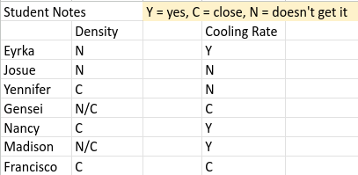
Example
Class on Monday > Starting a 5E Unit on Weather
Warm-up Question: What is your favorite type of weather? *personal experience, any answer OK*
Class Task: Engage video displays how weather can affect daily activities and poses questions for students to consider.
Class on Tuesday > Continuing Weather
*Warm- up Question: How does weather affect our daily lives? Give at least 2 examples. *personal experience, any answer OK but better if it refers to some part of yesterday’s discussion*
Class Task: Explore to investigate important processes involved in weather, such as condensation. Demonstrate process.
Class on Wednesday > Continuing Processes in Weather
*Warm-up Question: What happens to water vapor in the air when it hits a cold surface?
*recall from lesson, the more descriptive the better the grade; begin data collection* →
Class Task: Explore to collect data about temperature, dew point, the relationship between condensation/precipitation.
Hidden Gems:
Day 1 = Personal connection story opportunities, SEL hook, Participation grade #1 100%, boost
Day 2 = Assessment of effort/retention of D1, Practice for higher DOK level 2s later, Participation #2
grade 70-100% depending on completion and accuracy, confidence boost.
Day 3 = Assessment of understanding & need for remediation, Practice of DOK 2 and for DOK level
3&4s later, Participation grade #3 70-100% depending on completion and accuracy,
confidence boost. Students that receive positive feedback will participate with more effort!
Notes:
I am an advocate for slower pacing in planning. Trying to cram all aspects of the 5E into a lesson or always having an anticipatory set, , and … for every class is just too much in one period. However, using a DQ formative assessment can be passed for an anticipatory set, and will do you far more good than coming up with a new hook that may distract students from the progress you’re trying to make. Pacing your lesson to slowly increase the depth of knowledge practices and boost their confidence along the way means that they will be ready for extended thinking and capable of remembering and applying the content you’ve taught.

Slide 8
Effort - Using INCUP & Scaffolding to Encourage
The Science of Learning by Doing
Driving Factors behind Effort: Interest, Novelty, Curiosity, Urgency, Passion
Hidden Opportunity: Organizing a Unit of Instruction Using the 5E for 3D
The Engage - how to build interest and curiosity > “Have you ever…?”, “Can we find anything…”
The Explore - how to maintain engagement and encourage novelty > “What are you finding?”
The Explain - how to encourage the urgency to discover and understand > “How do we…?”
The Extend - how to encourage practice through play and communication > “Can you demonstrate?”
The Elaborate/Evaluate - how to use and share data > “How can you apply what you’ve learned?”
Benefits of this Gem: Higher participation rates, deeper understanding, increased performance scores, easily include all the Science & Engineering Practices and Cross-Cutting Concepts into unit storylines.
Notes:
Quote bybee
Again, pacing is crucial and should not be rushed. Trying to use all 5Es in one lesson will cause diminishing of each of the Es and students will not have time to retain and reflect on their learning. An Engage can take up an entire class by itself as a hook that spirals and lasts through the entire unit. An Explore can take 2 to 3 classes to really draw students in and motivate them to want the knowledge you are about to guide them through. An Explain should last as many classes as it takes for students to become comfortable with the content information and link it to their experiences. I’ll use a quote from a very good movie to emphasize the importance of planned pacing, “Practice does not make perfect. Practice makes permanent!” We don’t want students to just drill and memorize facts that they will find uninteresting and flush by the next unit. We want students to be interested in the facts, explore their curiosities within the content, and develop deeper understanding that lasts.

Slide 9
Gems that Never Hide!
Strategy: The 5E for 3D > At every ‘E’ lies an opportunity
Engage = Students should be asking questions and engaging in argument based on initial evidence, aka personal experience. *Patterns, Scale, Structure*
Explore = Students should be carrying out investigations, interpreting data, using computations, and debating regularly.
*Cause & Effect, Stability & Change, Function, Quantity & Proportion*
Explain = Students should continue all of the above adding constructing explanations and communicating information.
*Systems & Models, Energy & Matter, and all other CCCs*
Extend/Elaborate = Students should do all of the above adding designing solutions and easily prep for assessment.*
Best Practice Strategy: Socratic Guiding
Give away as little direct information as possible → Answer questions with more questions!
Allow students to discover the answer by providing guide rails and sign posts.
“What made you draw that conclusion?” “Can you share your train of thought with me?” “What would happen if you {made this change}?” “What result do you think will occur in this situation? Why?” “How could you show that in real time?”
Notes:
Planning a piece of an E into every lesson is not the most effective way to reach students, but it is possible to fit in the 3Ds into each lesson. Practices that engage students as they explore like investigating and engineering, Cross-cutting concepts like patterns, cause and effect, and models, and disciplinary core ideas that focus on the content and assessing learning are much easier to use in small increments and spiral through each class regardless of the E you are on. Socratically guiding students is a great strategy for bringing them into deeper participation and inspiring their need for the knowledge you have to teach. Instead of asking only content questions to students, you pull the content discoveries from them; you give them insights into the knowledge to inspire them to want to know more. Ask them what they observe, what they experience, ask them to make connections. So much more learning opportunity lies within asking than just regurgitating facts. Sometimes it’s ok to let students ask you those slightly off topic questions to draw their interest out and increase their faith in you as their guide. If you’re studying planets and they ask how a space suit works, tell them then ask them why those features may be important going into different planetary environments. If you don’t know why a space suit works, find out together with a little research then ask them to hypothesize how scientists knew they would need those features having never been to space for trial and error tests. Use as much relevance and rigor and student authenticity as you can to maintain the hook you set into play in the beginning. Add details to the storyline that students help you conceive to make them feel included and important. Learning happens through doing and discussing, not just memorizing.

Slide 10
Choosing the Right Class Task to Light a Fire instead of Burning You Out!
Weather & Climate
Patterns, Cause & Effect, Technology
Analyzing & Interpreting Data, Argument from Evidence, Communicating Information
3-ESS2-1. Represent data in tables and graphical displays to describe typical weather conditions expected during a particular season.
3-ESS2-2. Obtain and combine information to describe climates in different regions of the world.
W.3.8 Recall information from experiences or gather information from print and digital sources; take brief notes on sources and sort evidence into provided categories. (3-ESS2-2)
MP.2 Reason abstractly and quantitatively. (3-ESS2-1),(3-ESS2-2),(3-ESS3-1)
Travel Agent Challenge: Students must navigate latitude maps and use weather patterns to identify the ideal vacation location! https://forms.gle/Dw5tdwRQGCni91AM7
Weather Man Challenge: Students must explore the weather patterns of Spain and design a forecast for at least 1 week in one season. https://docs.google.com/presentation/d/1lhs_JQgzLasTbcVxYsmVOq8i1NAt5FeblJZz32xb-vg/edit?usp=sharing
Writing: Students must write a Response to a Bad Review to defend their Vacation selection & Letter to the Editor to support their work and argue for its publication.
Notes:
The teacher is a guide on the side, not so much a sage on the stage, in the most successful classrooms. Standing in front of students the entire time or going over worksheet after worksheet as instruction puts a lot of stress on the teacher to maintain momentum for learning. Choosing the right types of activities will help you create a class in which the students pull most of the weight instead of you. Using the 5E methodology and performance tasks in which students must use what they have discovered or learned to be successful require the effort to come from the students more than the teacher. Pacing classes to allow students the time they need to practice and see the value of their effort is essential. These tasks are all examples of designs in which students must actively manipulate information to be successful but there is a personalized factor that makes the task more fun. These would be part of the Explain or Elaborate segments of the 5E. Burnout may come from trying to plan for these types of activities, so I have a pre-screener guide to help you identify the good, better, and best options for you and your students as a freebie today.
Matching up standards to assessment tasks is an entirely separate though not unrelated presentation though! If you are interested in a more in-depth look at design, please pick up one of my cards at the end of the presentation.

Slide 11
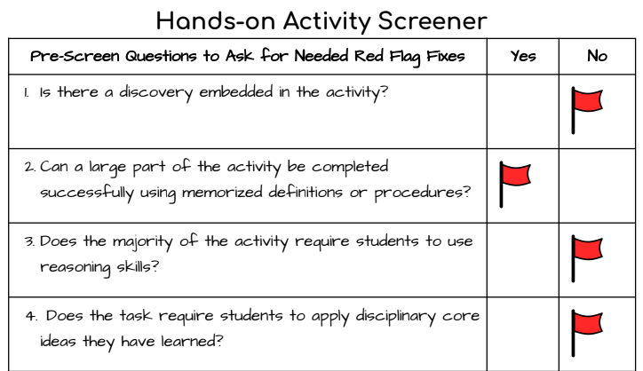
Don’t let the “teacher’s manual” burn you - Just screen it!
Notes:
The NSTA also has a pre-screener on their website, but mine is geared towards upper elementary and middle school grade levels. When using curriculum suggestions or searching Teachers-Pay-Teachers for resources, use a pre-screener to ensure the activity will be worth your effort and the students’ time. When creating or screening activities keep in mind the goal of discovery and application. If students are told what to do step by step and word for word, they are not discovering connections or applying knowledge and the practice will not stick. Let’s take a look an an example activity for animal classification to demonstrate.

Slide 12


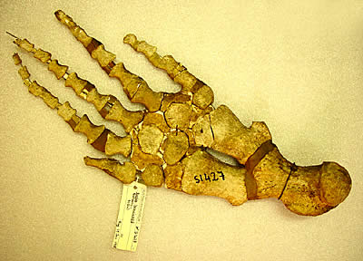

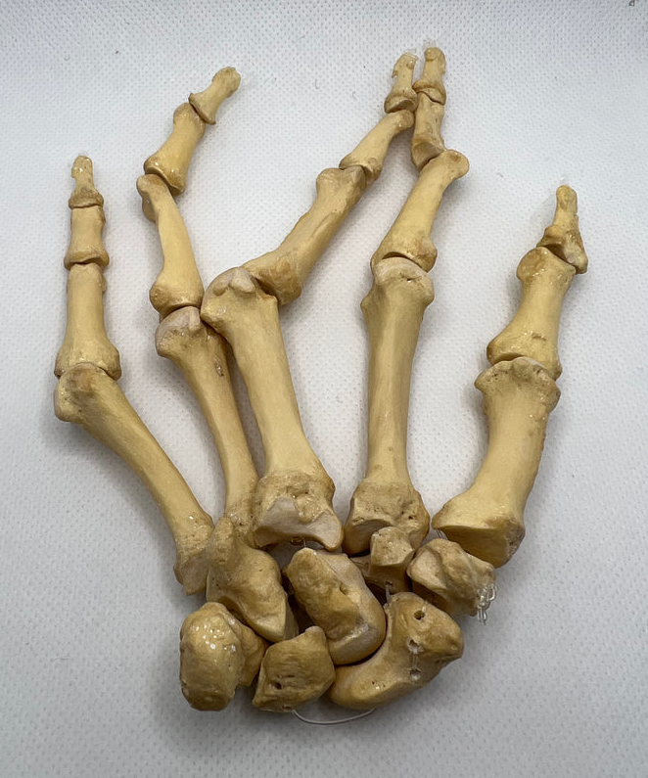
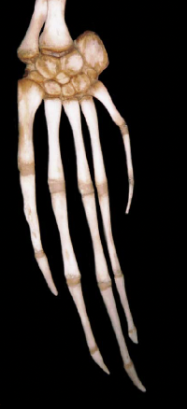

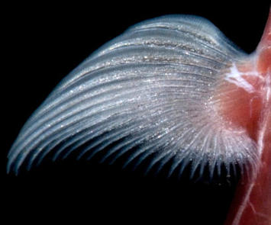
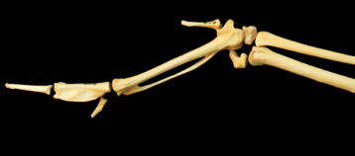
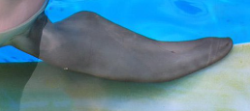
Find the Matching Limbs!
A
2
B
1
3
4
C
D
5
E
Notes:
Not all hands-on activities need to be complicated or require extra materials. This is an example of an Engage for a unit on animal classification. Let’s screen it - does it require you to make a discovery or observation? Does it require reasoning? Is the activity teacher directed or student-centered? Is the activity straightforward but provides opportunities for discussion? Are there multiple approaches to answering? SO, What makes this activity engaging? You had to DO something active and had to use your brain actively to do it - you couldn’t do it by memorization of vocabulary terms - you didn’t even need vocabulary to do it! In this activity you didn’t have to actually put your hands-on something to feel like you were actively doing it. There are many angles from which to approach a hands-on activity but only 2 purposes: engaging the brain to naturally learn and deepen understanding. The majority of tasks should include some form of ‘doing’, an action to spur the need or desire for learning. The more involved students feel, the more they participate and put forth effort for you and the less burned out you feel. I have used this strategy to redesign an old favorite you may have seen before, the Candy Rock Cycle. I have provided it as another hard copy freebie for you at the end of the presentation.

Slide 13
Recap
Takeaway Freebies
Strategy 1: Reword classroom rules and use affirmative language.
Strategy 2: Use formative assessment data to drive instructional motivation and increase participation.
Strategy 3: Incorporate INCUP inspiration by using the 5E methodology and 3D learning.
Guide to Rewording Rules to inspire Teamwork
5E/3D Task Screener (inspired by the NGSS Task PreScreener)
Sample: A H.O.T. ReDesign of the Starburst Rock Cycle Activity
Notes:
I hope I have given you some ideas today to help you find some relief to those burned-out feelings. You are welcome to come up for the hard copies and discuss any further consulting you may be interested in. I want to say a huge thank you to you all for choosing to spend some of your valuable time with me today. I truly appreciate it and wish you all the best! Thank you!

