Slide 1
Hands-On Tasks:
From Good Idea to
Good Execution
How to get the most out of hands-on experiences so that it is worth your time!
Notes:
Many teachers have grown to dislike hands-on activities because they take extra time to organize, require additional materials that may not be supplied by the school, and often end with the students having fun but seeming to learn little they can apply to tests later. After over a decade of practice, it is my belief that the last of those reasons comes from simple design flaws. To get the most out of the time and effort you put in, your students need to put in a lot of effort too.

Slide 2
The goal is not to get them to memorize facts.
The goal is to teach them to use their brain!
Neuromyth: “Individuals learn better when they receive information in their preferred learning style (auditory, visual, kinesthetic…).”
Apart from those programs that specifically target a number of learning disabilities, educational programs (especially curriculums) offered to schools today rarely have scientific research to support them. -ISTF
Better Strategy: Promote learning through guided inquiry, reasoning, and the application of what has been learned in relevant contexts. This will incorporate all learning styles to promote meaningful, lasting, & transferable learning!
The brain learns by DOING! The brain learns through DISCUSSING!
Notes:
“One of the keys to self-regulated learning is the knowledge of good metacognitive strategies that promote meaningful, lasting, and transferable learning. Indeed, research shows that this is one of the factors with the greatest impact on student performance and, consequently, on their motivation and autonomy.” So what are those metacognitive strategies and how do you make sure they are in your hands-on tasks? They are techniques that help students become aware of their thinking process. If you don’t allow students to develop their thinking process because you are giving them hands-on tasks that are too directed or too simple, you are missing the goal.

Slide 3
How can you use what you have to create better opportunities for students to learn by doing?
Start with rearranging some things in the lesson plan!
Vocabulary should NOT come first. Students do not need to know the words to experience the concept or process.
Front-loading decreases the motivation to learn. It is OK for them to call rotation spinning until they discover the need to label it for clarification from revolution.
Probing for specific information they do not yet have makes them less confident in their participation because they are confused about the expectations of what they are supposed to already know.
Experiences should come first. Vocabulary should help label those experiences. Probes for understanding should come after they have experienced understanding.
Notes:
To develop the thinking process skills in students, they must become less dependent on you for that thinking. They must become confident in their ability to figure things out. Organizing your lesson will help students discover more, which means it will be more valuable to them. Giving the majority of the information up-front means they did not have to work for it, and the less effort they have to put forth means the less interest they will have and the less confident they will be in using the information.

Slide 4
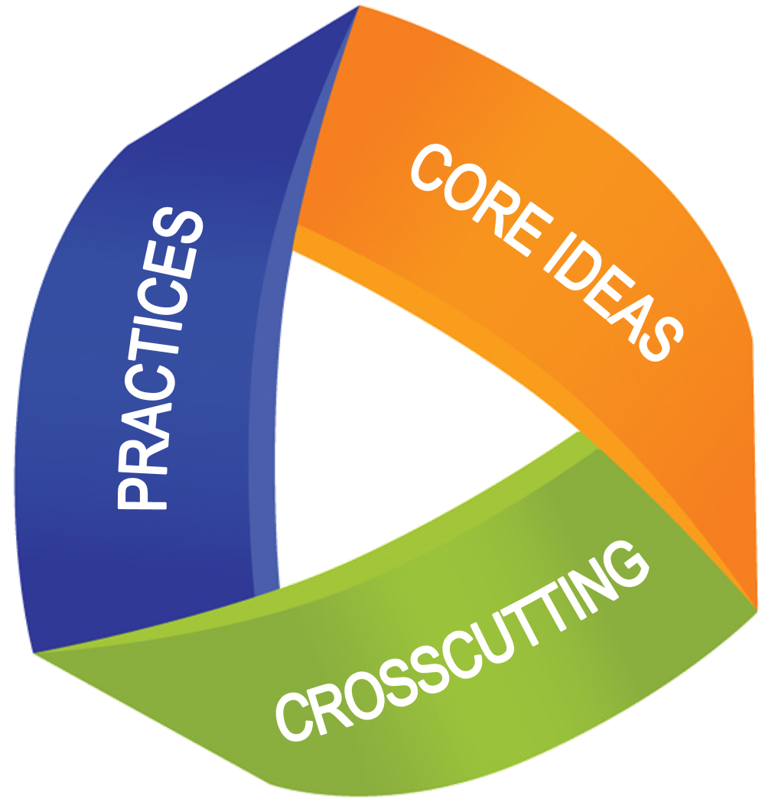
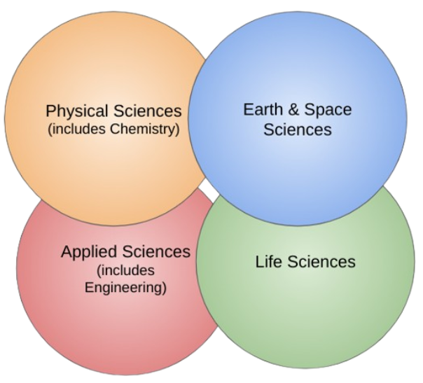
The Elements of 3 Dimensional Learning
Practices are the “behaviors that scientists engage in as they investigate and build models and theories about the natural world and the key set of engineering practices that engineers use as they design and build models and systems”. Examples include formulating questions to investigate, designing ways to solve a problem, and identifying relevance.
Cross-Cutting Concepts are “a way of linking the different domains of science” using ideas that can be identified and used regardless of topic. Examples include pattern recognition, cause and effect, structure and function, stability and change.
Core Ideas are “to focus science curriculum, instruction and assessments on the most important aspects of science”. Examples include organizing concepts, investigating ideas, relating experiences, and increasing understanding of the domains.
Notes:
The elements of 3 dimensional learning are supposed to work in tandem with each other and the science domain skills they intend to strengthen. Notice how the first two are more about behaviors to be developed. If the teacher remains a sage on the stage, constantly regurgitating facts and directing students as opposed to coaching them, all the effort is being placed on the teacher instead of the student that needs it to develop as a learner. A sage on the stage wants students to memorize then somehow magically be able to apply the knowledge. A guide on the side wants students to have experiences that build their knowledge.

Slide 5
What is the most productive lesson plan outline & Where should hands-on tasks fit in?
Engage with a visual and discussion of personal experience and personal observations.
Explore observations and create new experiences relevant to the content to be taught. **Hands-on tasks**
Clarify new connections that were made and relate them to the content; start labeling them as needed with vocabulary. **Hands-on tasks**
Probe for understanding with experiments and arguments. Use small groups and data. **Hands-on tasks**
Practice through experience. Practice through discussing. Practice through creating, explaining, modeling, and analyzing. Remediate if necessary based on collected data. **Hands-on tasks**
Assess for understanding through traditional and elaborative methods. **Hands-on tasks**
Notes:
In each of these areas, elements of 3 dimensional learning can easily be implemented. Engaging students involves inquiry, exploring involves identifying ideas and relevance, experimentation involves applying concepts and procedures, and assessment involves design and application of skills gained. You don’t necessarily need to have you hands in something to experience the idea behind it either. Manipulating materials, reviewing information for flaws, and sorting images can all be tasks that demand action from the student.

Slide 6
Hands-On Tasks are for Experience & Making Connections…but the student must be involved directly, not indirectly following along.
Students need clear parameters, not only step-by-step instructions.
Students need to prove what they have learned, not just prove they can follow along.
Students need to discover and teachers need to clarify and support.
Instead of “do this first”, try asking “what do you think we need to do first”.
Instead of “this is the correct way”, try asking “which of these is correct”.
Guide and supervise students!
Notes:
One of the main flaws in hands-on tasks that make activities stressful on teachers and unproductive for students is how they are planned and executed. Learning happens through trial and error experiences. If the teacher prevents any errors from happening and only provides one try, then students will learn to lean on the teacher’s knowledge instead of developing their own. Just as Ms Frizzle says, you have to get messy and make mistakes!

Slide 7
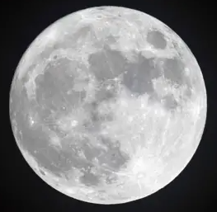
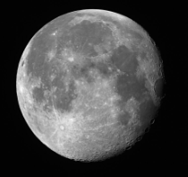
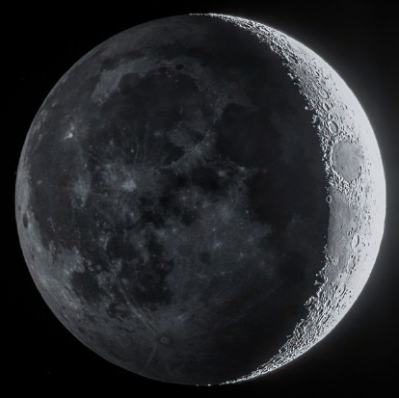
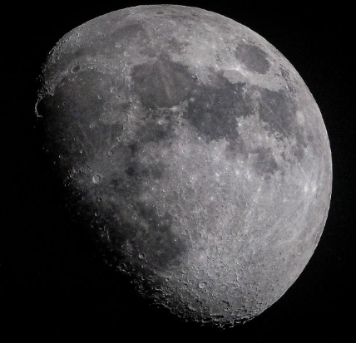
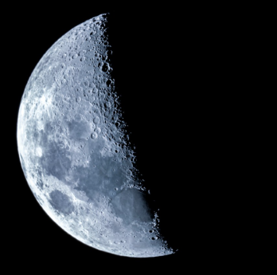

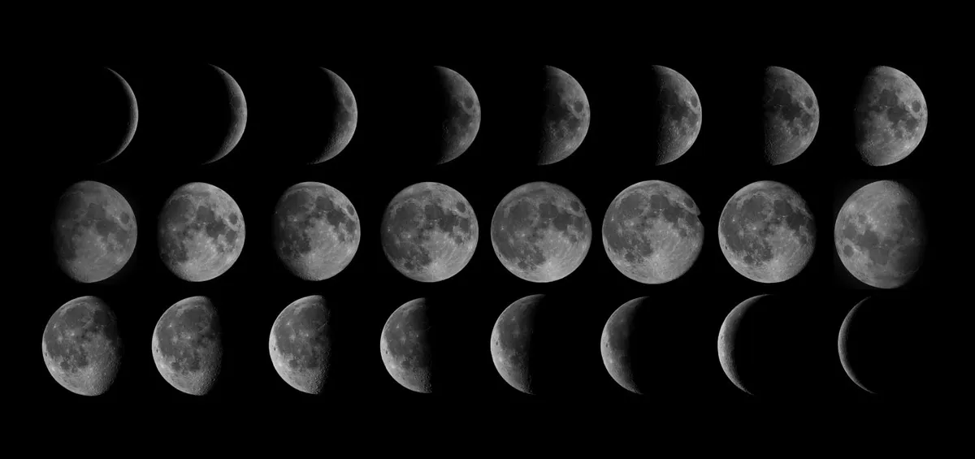
Notice anything about the Moon in its different phases?
Sources: BBC, Forbes, & Space.com
Notes:
Let’s do a little hands-on engagement activity and see where it goes! Look at these images of the moon in all its different phases. Other than the changes in where the light is on the moon, what else do you notice about the moon? To preserve our time together, I will tell you that I am looking for one key observation. Can anyone tell me what it is by examining these images?
(Yes, in each image you can see the same craters. What does that mean? Yes, we are always seeing the exact same side of the moon!)

Slide 8
Which case demonstrates the movement the Moon must have to match always keeping the same side visible?
Case 1:
A student representing Earth sits in a chair capable of spinning (rotation).
A student representing the Moon moves around the Earth (revolves) while keeping their eyes fixed on one place in the room.
*Demonstrate and discuss observations.*
Case 2:
A student representing Earth sits in a chair capable of spinning (rotation).
A student representing the Moon moves around the Earth (revolves) while keeping their eyes fixed on the Earth.
*Demonstrate and discuss observations.*
Possible lessons to follow: What does this tell us about the Moon’s rotational speed compared to Earth? What could be responsible for the different amounts of light visible on the moon? What effects might this gravitational relationship have on the Earth’s water? Could this same case be true for all the natural satellites in our SS?
Notes:
Let’s see if we can work out what must be happening for us to always see the same side of the moon. Here are 2 cases we will demonstrate to try to prove the observation we have made. Do I have a volunteer to be the Earth? In this model we won’t focus so much on the actual speeds of spinning but more on the simplified movements, so Earth will rotate slowly to allow the Moon to keep up. Do I have a volunteer to be the Moon? Ok, to clarify the case parameters - the Earth will keep its eyes on the Moon and the Moon will keep its eyes on the presentation screen. Ok, here we go my celestial objects! What did we notice? Was the Earth able to see both sides of the Moon aka our volunteer’s face as well as the back of their head? (YES) Alright, let’s try case #2. If my volunteers would remain, we will only make one change to our demonstration: this time the 2 will maintain eye contact with each other. Alright, take 2! What did we notice this time? Was the Earth able to see both sides of the Moon? (NO) So, which of these cases best matches the observations we made using actual images of the moon? (Correct, case # 2!) I round of applause for our celestial volunteers! Now what could we do with this hands-on task?

Slide 9
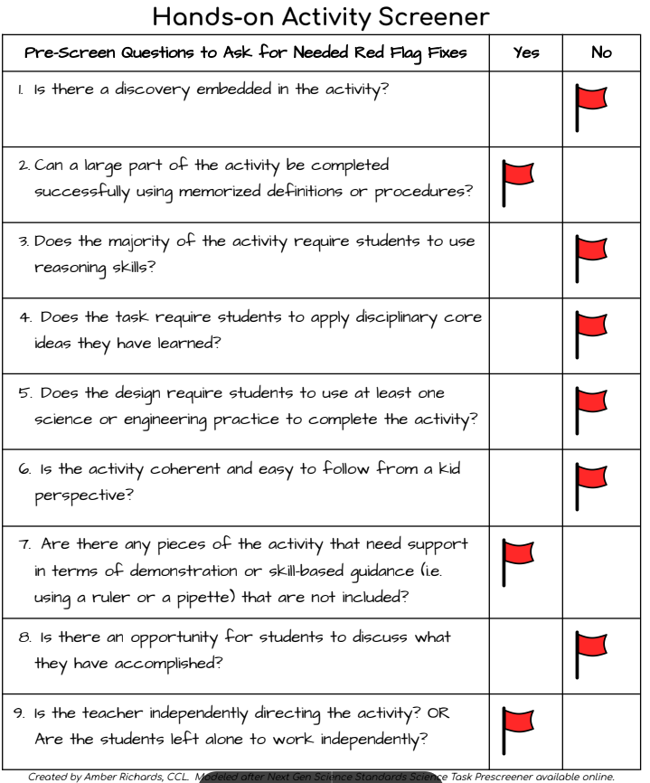
Screening & Upgrading Hands-On Tasks
Example for teaching Taste:
Online sources says to set up taste jars. Label each one > salty, sweet, bitter, sour.
Does that require any thinking practice for the kids? Does it ask them to examine their experience?
Upgrade Example:
Taste test without smell! Use suckers and have students try to identify the flavor by taste alone. Poll answers then reveal → smell is an important part of taste. Then offer each category of taste with a known experienced example and ask them to try to identify it by smell before tasting it to prove their accuracy.
Notes:
I developed this activity screener to help identify flaws that may be hindering effectiveness of a suggested or found activity. I based it off of one the NGSS has available, but my targets were lower grade levels and the types of activities many teachers find on Teachers Pay Teachers or within their required curriculum resources. Here is a simple example I found for young students learning about the senses.

Slide 10
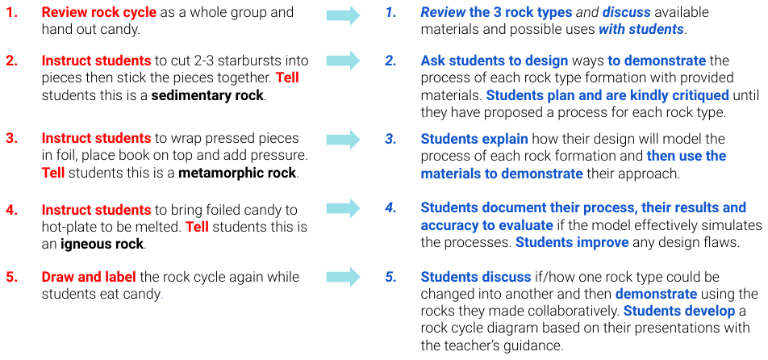
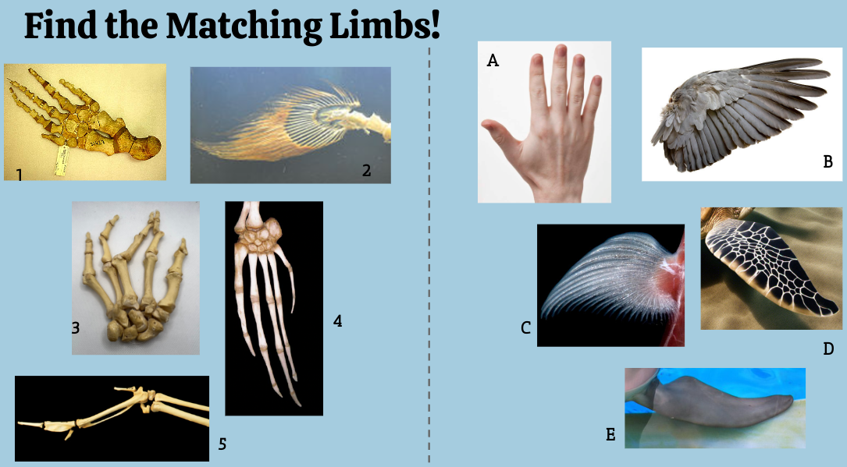
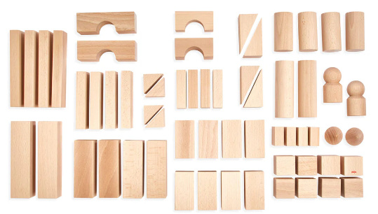
Upgrade the Starburst Rock Cycle
Role Play: Travel Agent
You have been hired as a brand new travel agent! Your job is to help people plan the perfect vacation. You'll need to prove you know about climates around the world to be successful. Your boss has set up this challenge to test your knowledge! Choose a client then help guide them to where they want to vacation. Good Luck!
Prep. for Classification
Design to discover Force & Motion
Notes:
Here are few examples of hands-on tasks, beginning with a old favorite I have seen many times. Other oldies you may need to upgrade a little > hard candy weathering and erosion, oreo phases of the moon, and magnetic scavenger hunts. Not all hands-on tasks have to be about proving the student knows something. Many can be about discovering and making observations to apply later.

Slide 11
Takeaways
Freebies
The 3Ds can be easily incorporated into hands-on tasks.
Hands-on tasks can be part of any phase of your lesson.
The teacher must be the Guide-on-the-Side instead of the Sage-on-the-Stage to promote deeper learning.
Using an activity screener can help increase the effectiveness of your chosen hands-on activities and prevent pointless stress or waste of materials, but don’t forget to include clear parameters.
The Activity Pre-Screener for grades 3-8
The Upgraded Rock Cycle Candy task
A guide to identifying where the 3Ds can fit in

