Slide 1
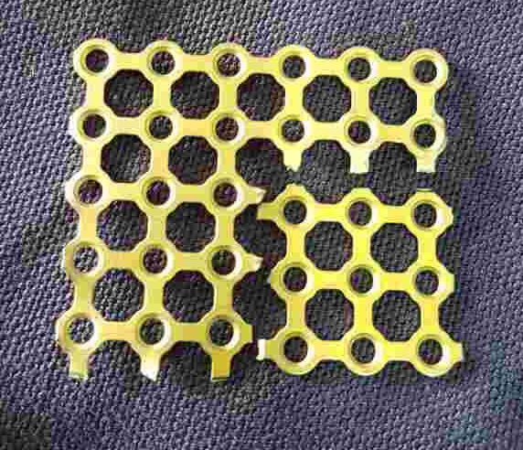
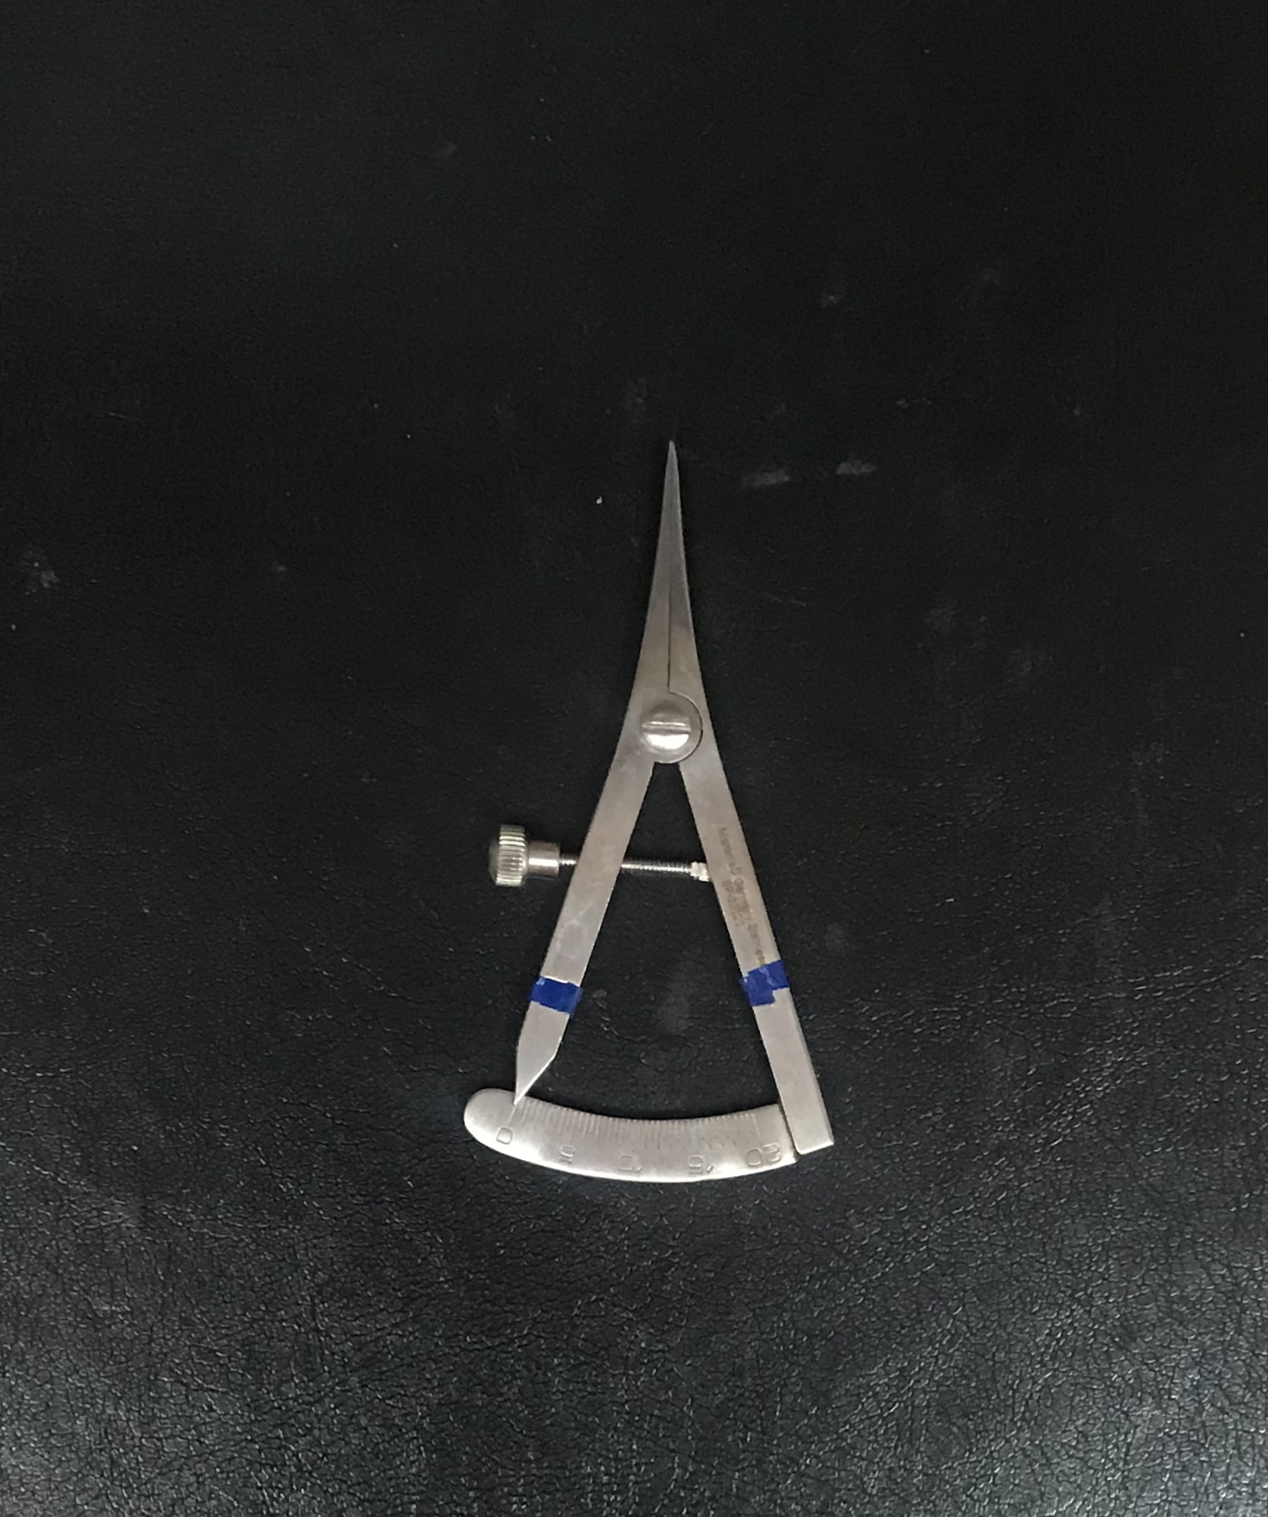
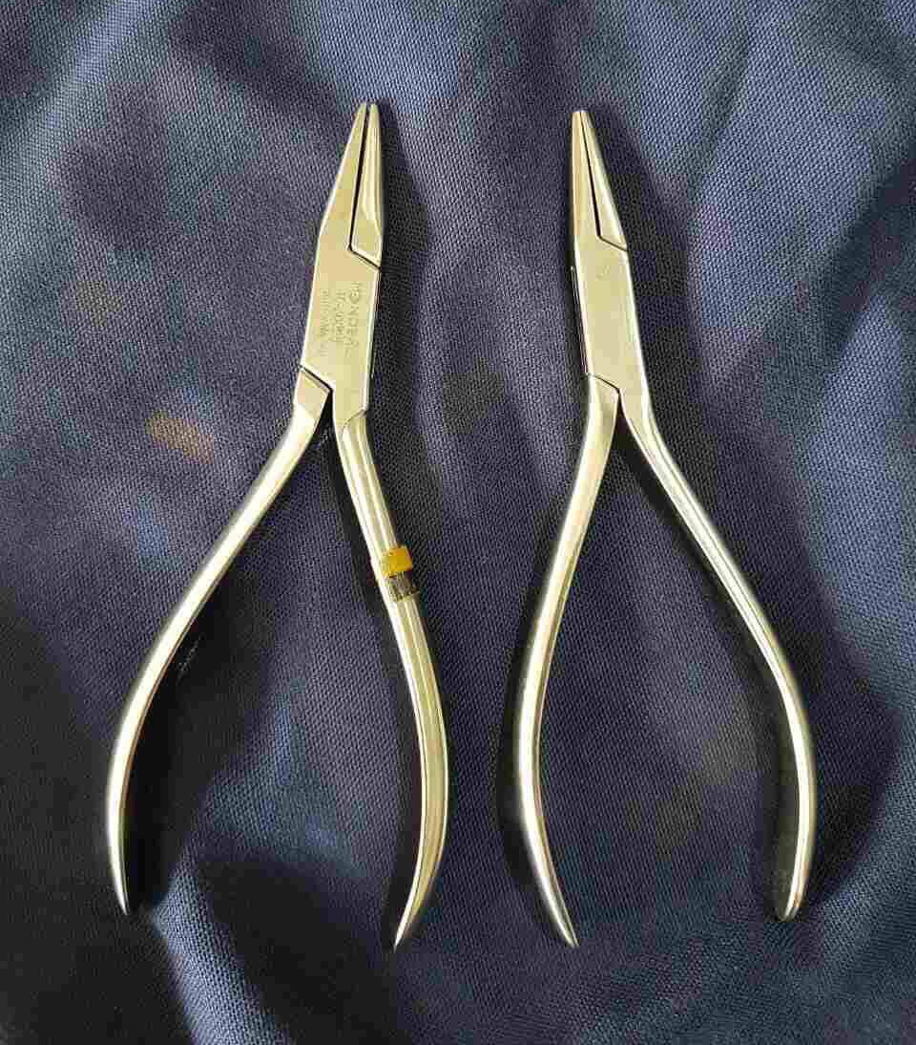
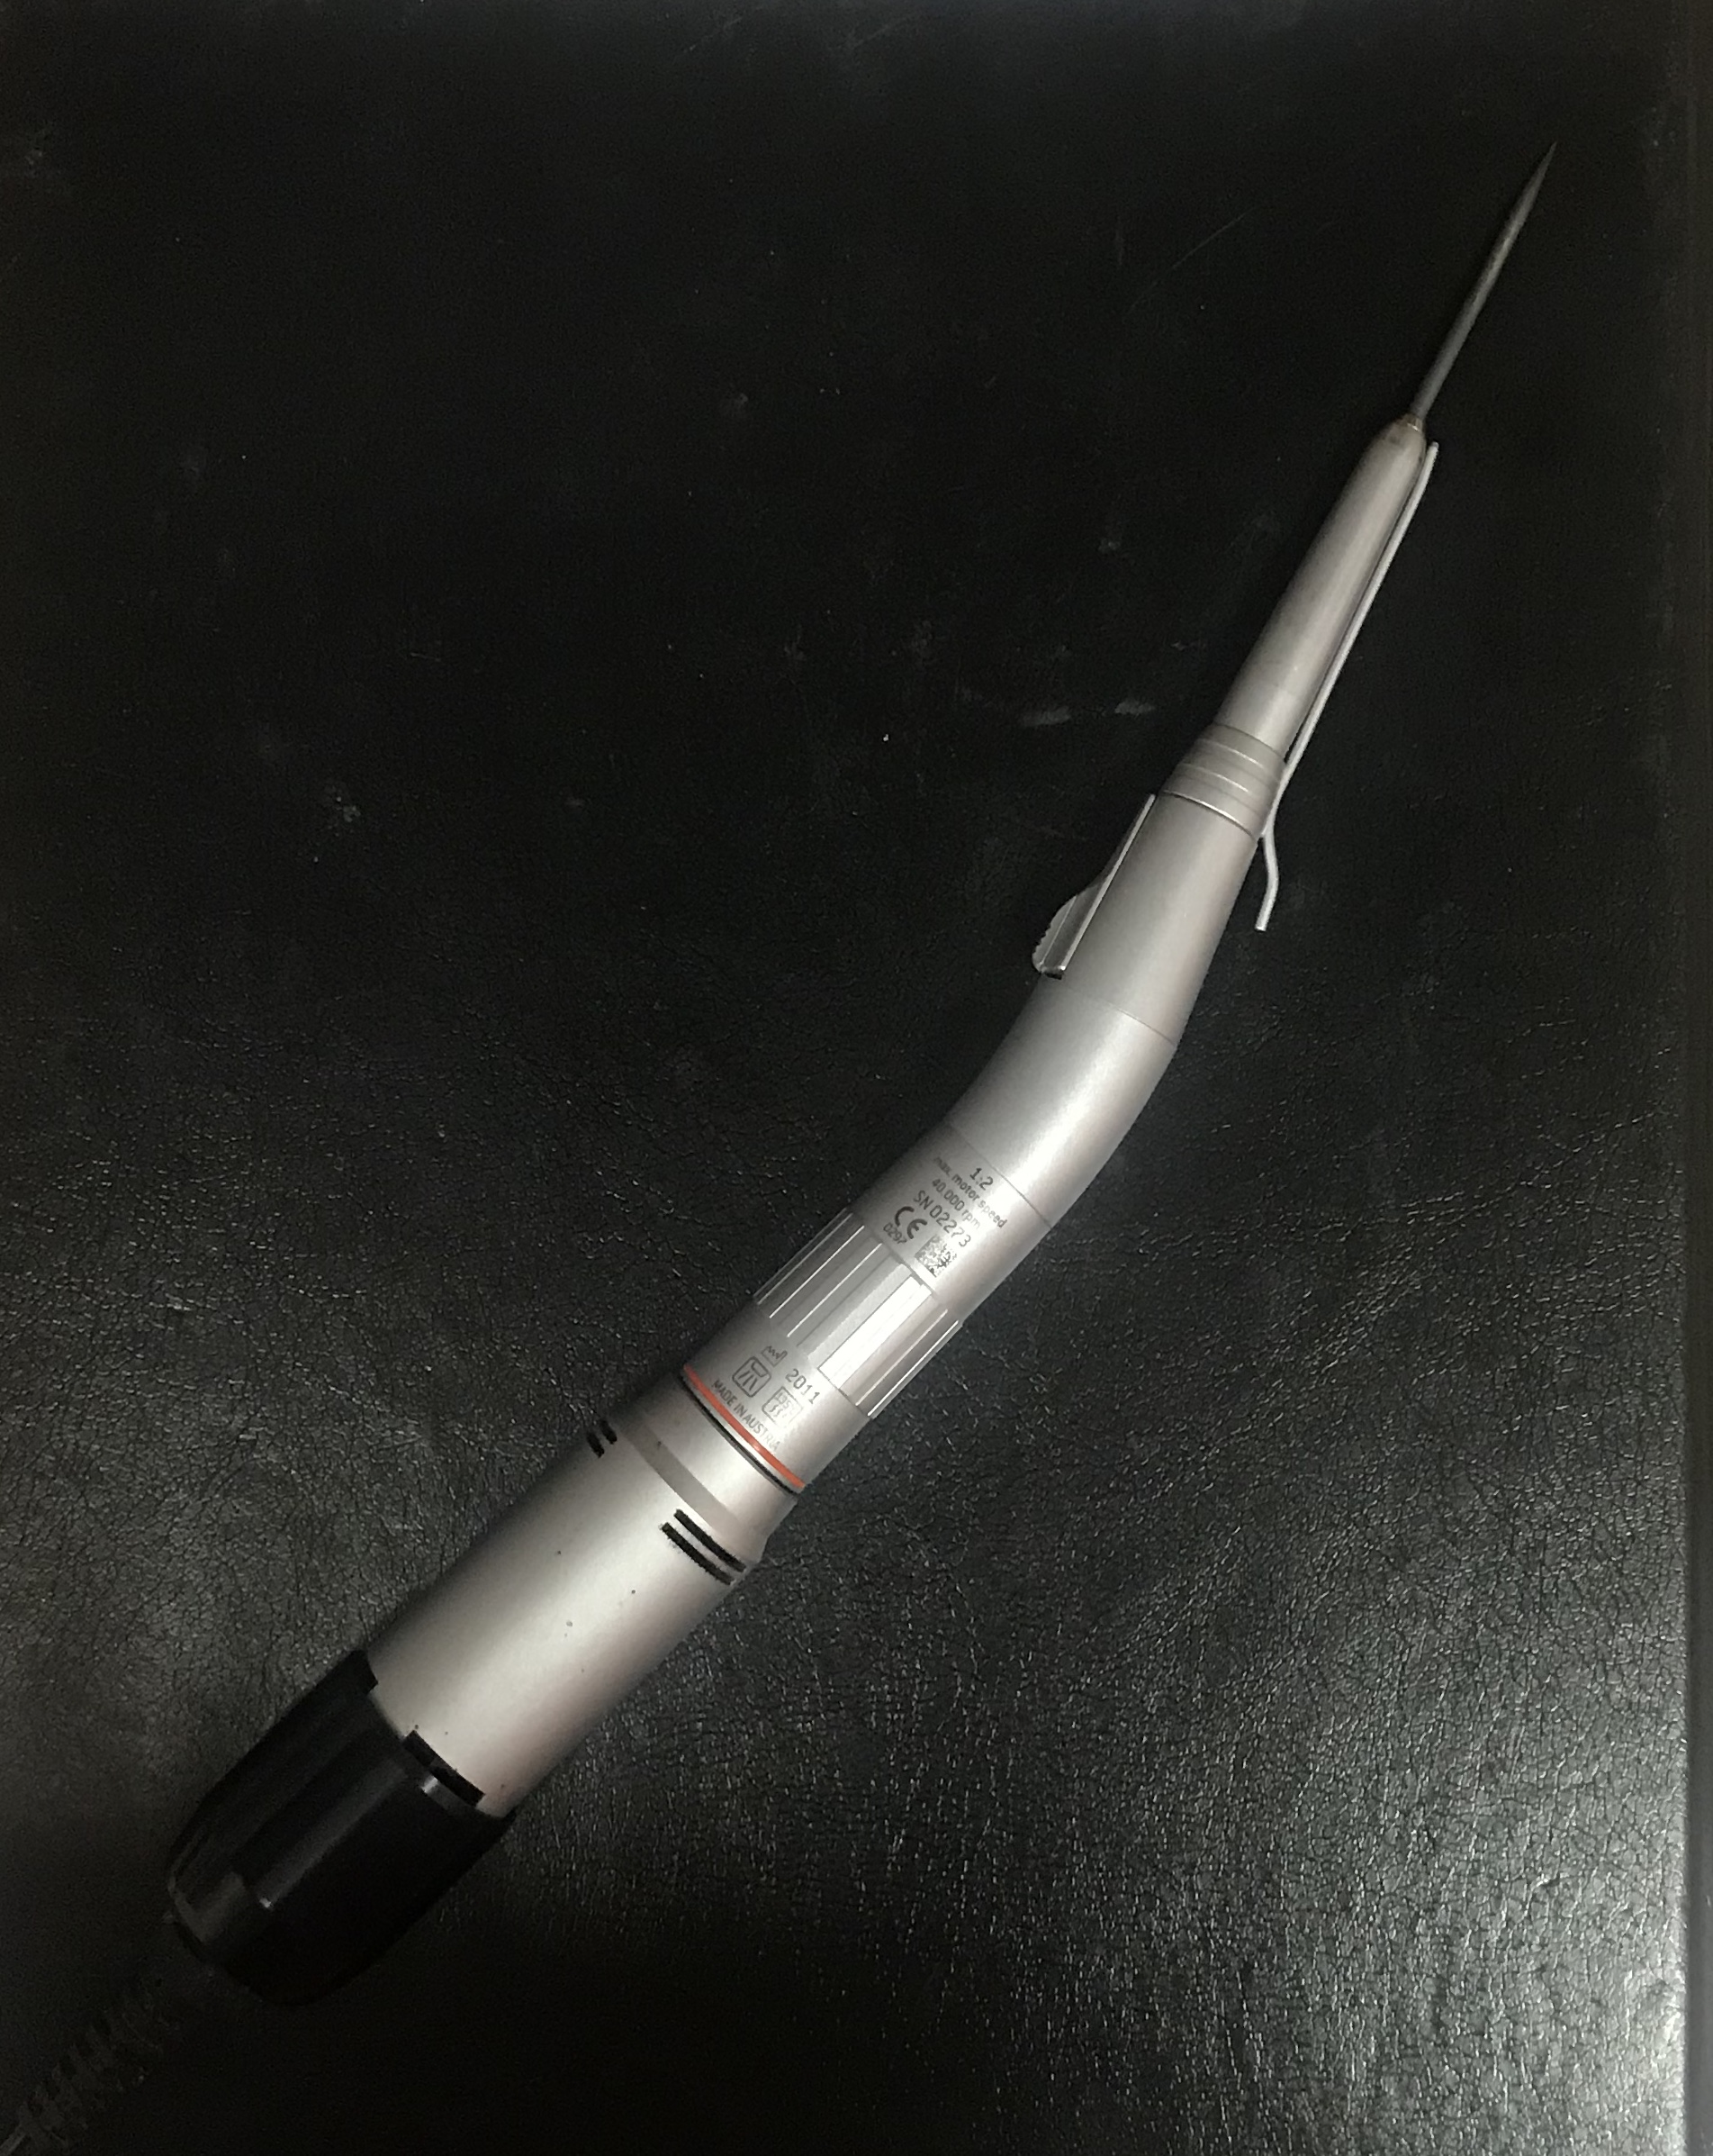
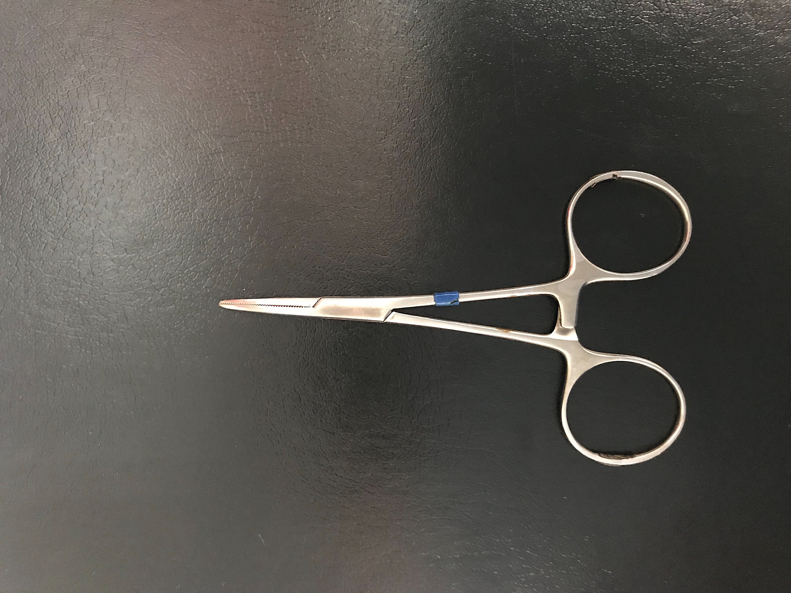
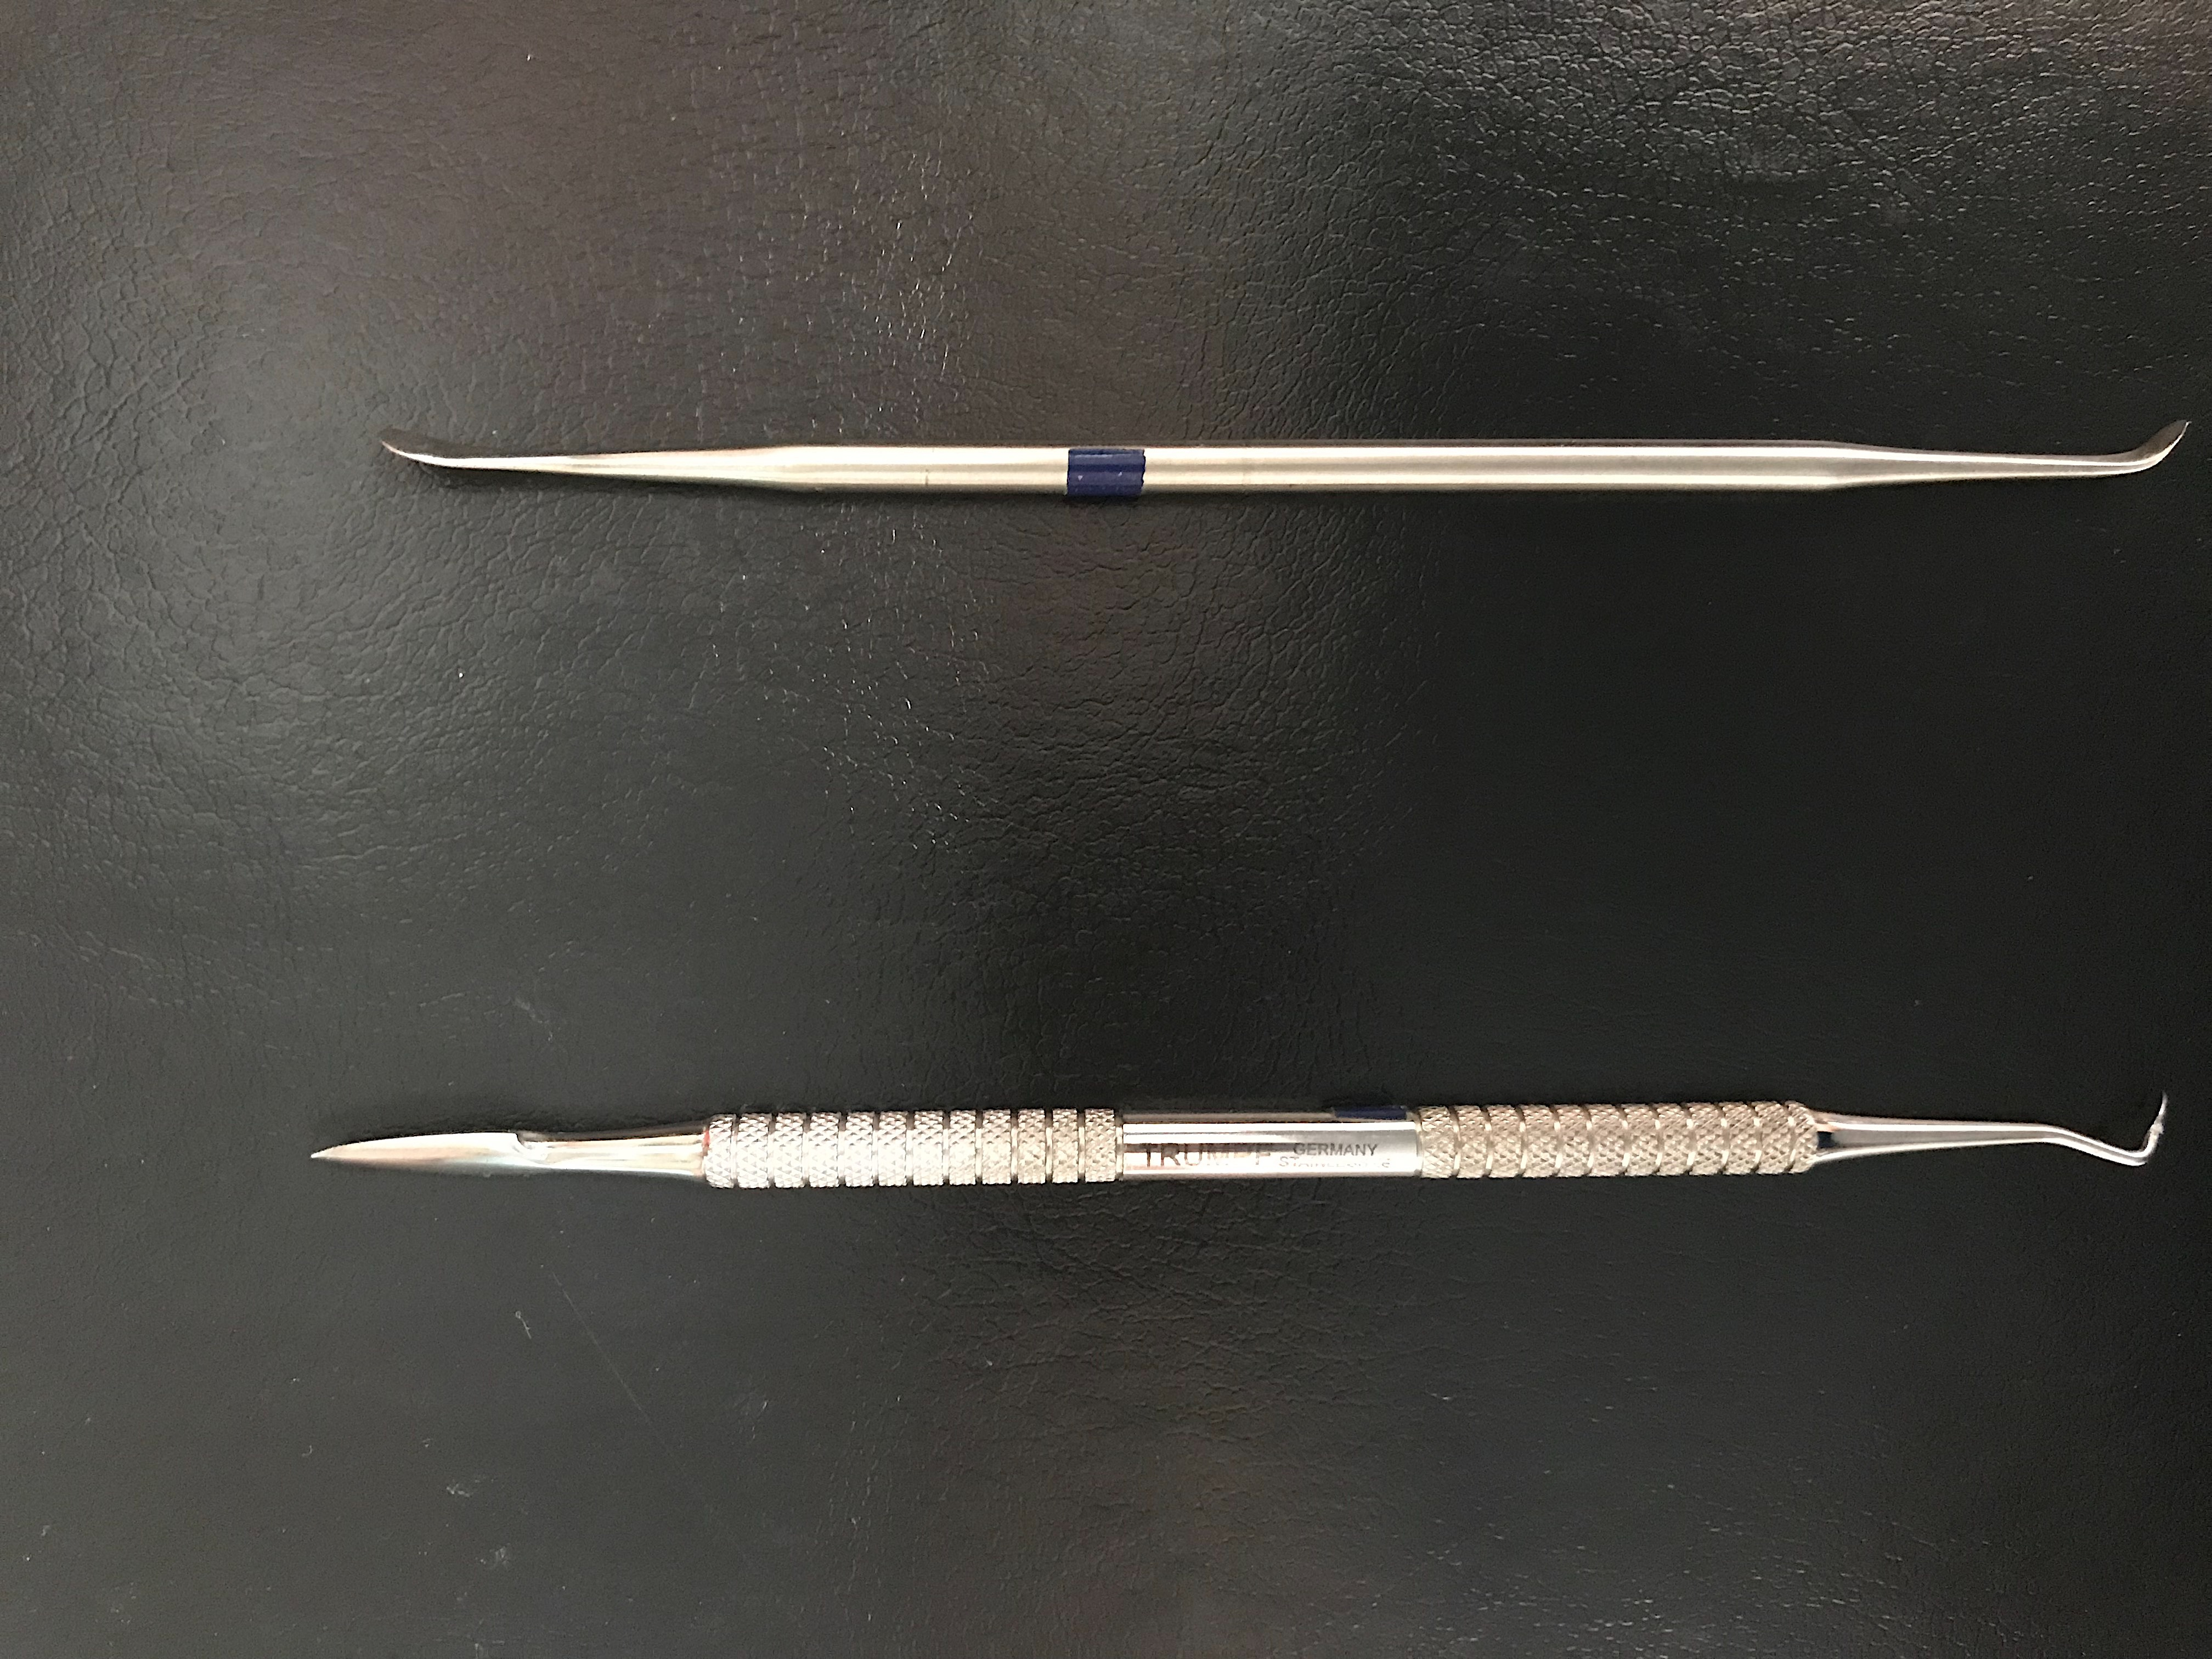
a.
b.
c.
d.
e.
f.
Figure 1. a) titanium mesh plate b) caliper c) titanium bender d) Thyroid cartilage spreader e)Handpiece drill f) thyroid cartilage elevator

Slide 2
Figure 2. Validated Filipino Voice Handicap Index

Slide 3

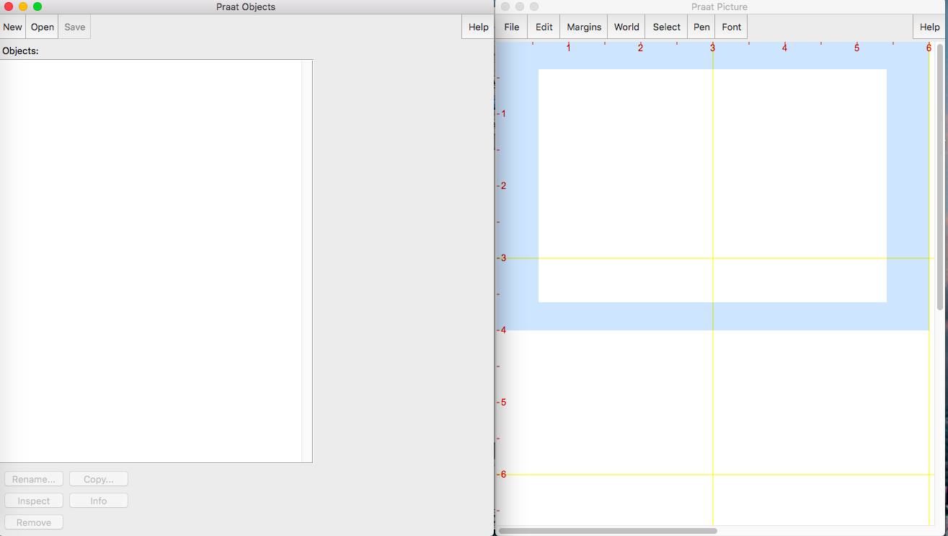
Figure 3. PRAAT Voice analysis software

Slide 4
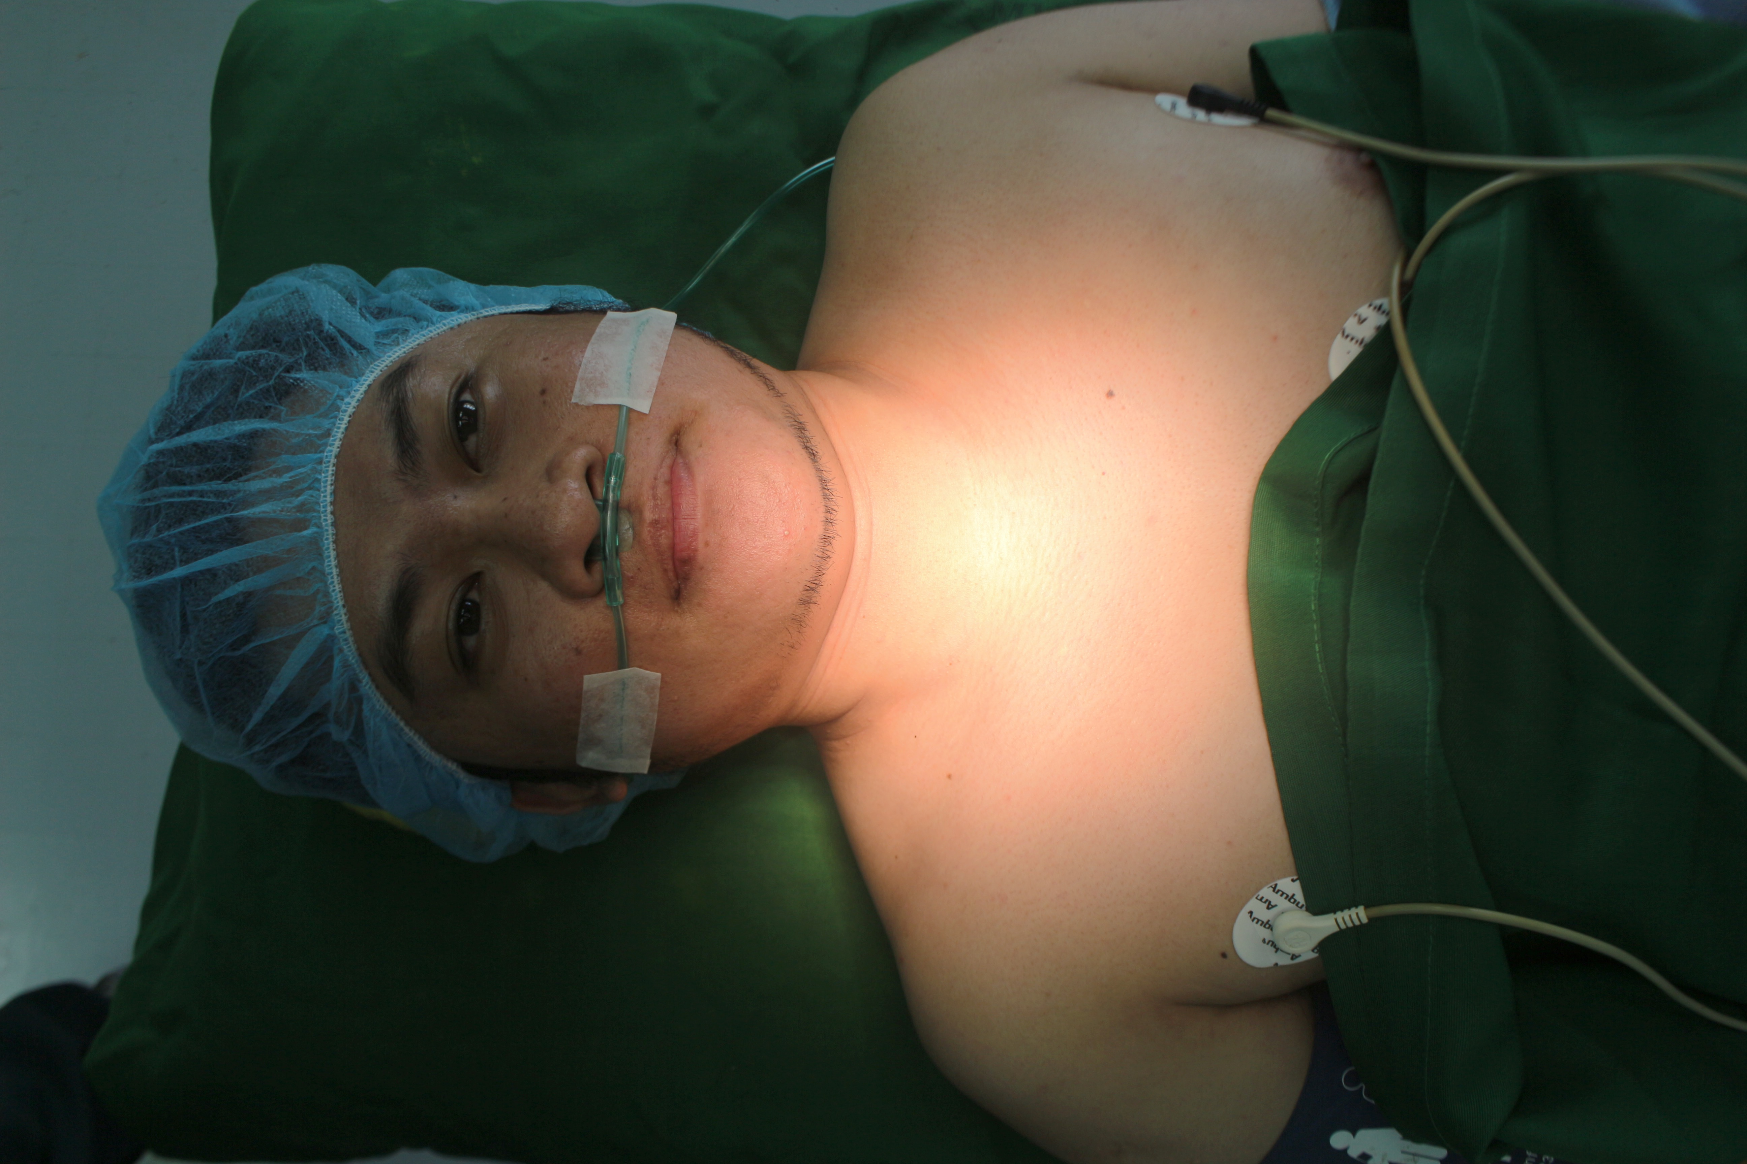
Figure 4. Patient placed in supine position

Slide 5
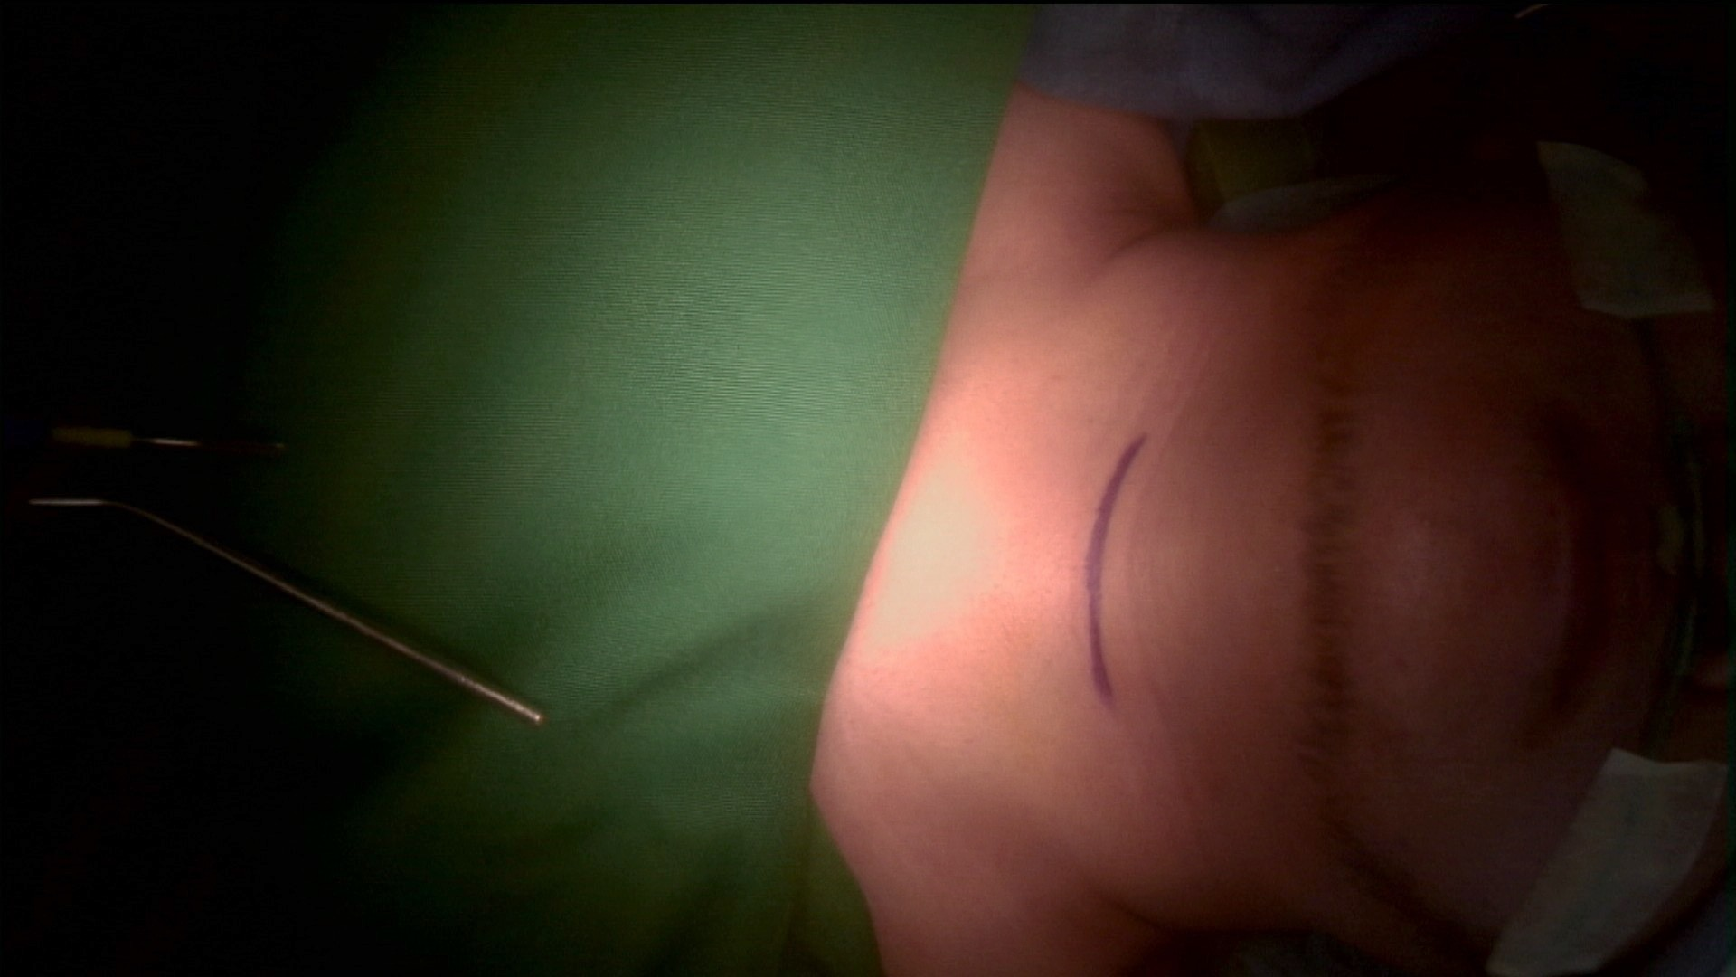
Figure 5. A 4 cm curvilinear incision marking at mid thyroid cartilage level

Slide 6
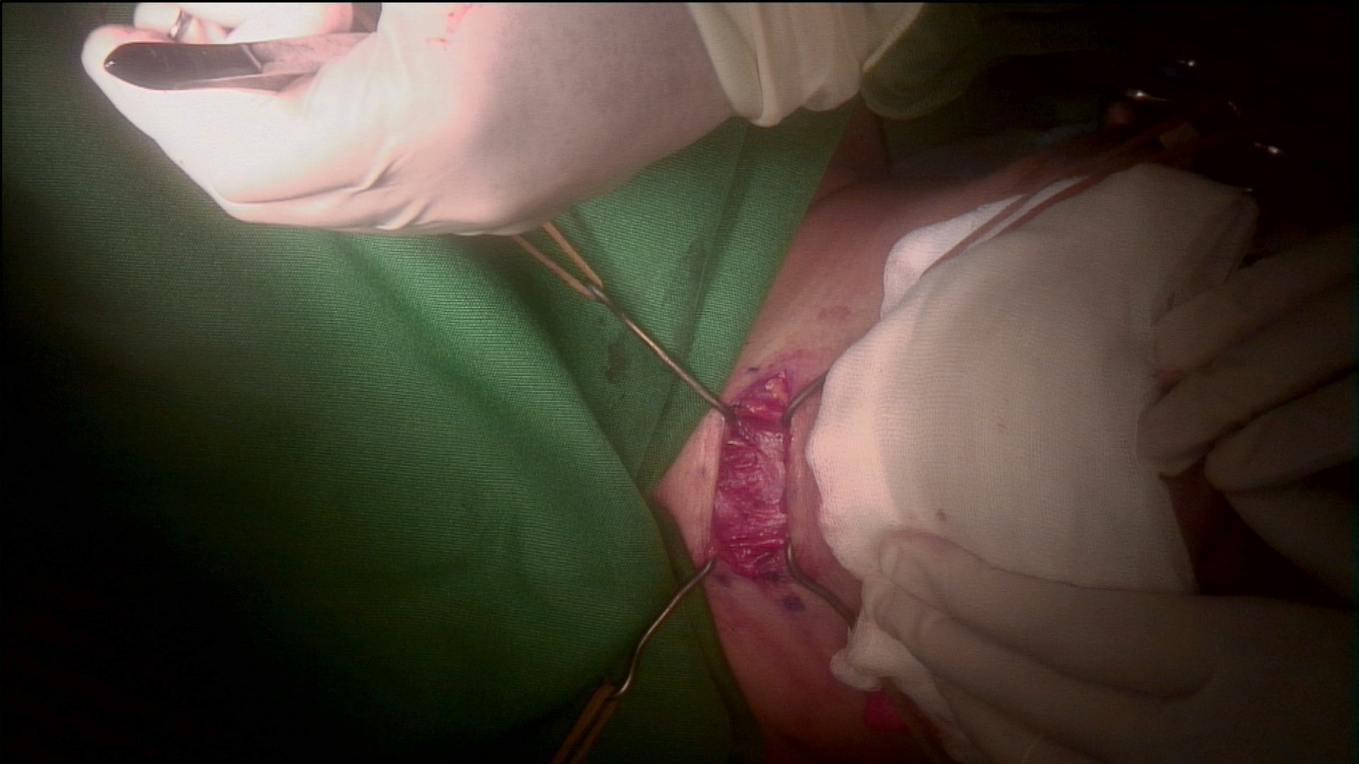
Figure 6. Elevation of skin flap

Slide 7
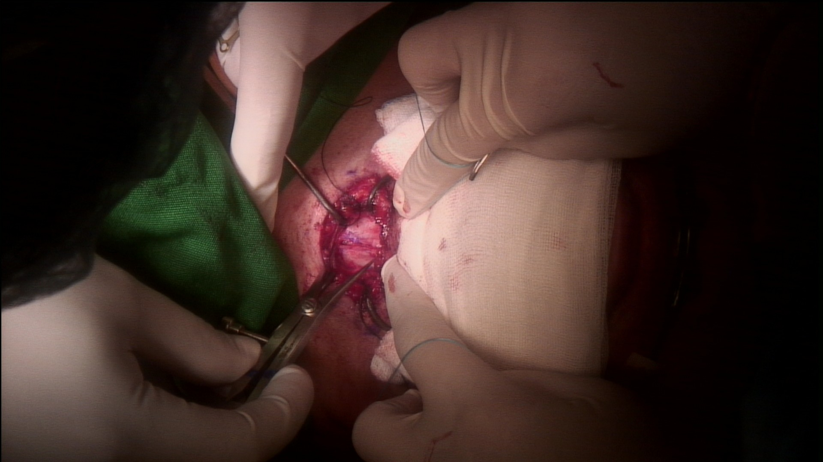
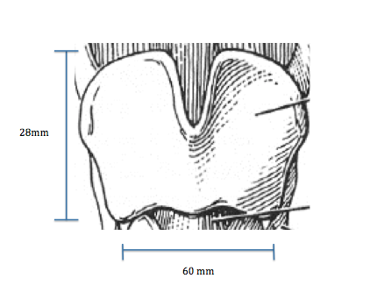
Figure 7. Thyroid cartilage was then exposed and dimensions were measured and recorded

Slide 8
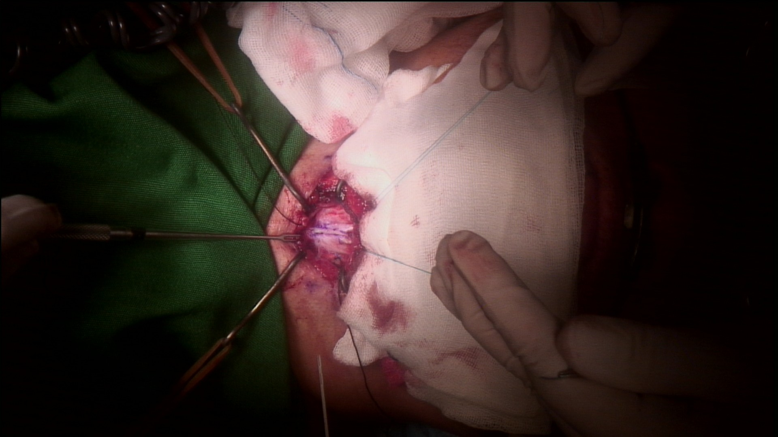
Figure 8. A vertical midline incision on the thyroid cartilage

Slide 9
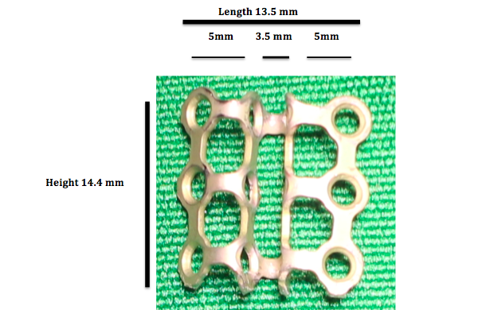
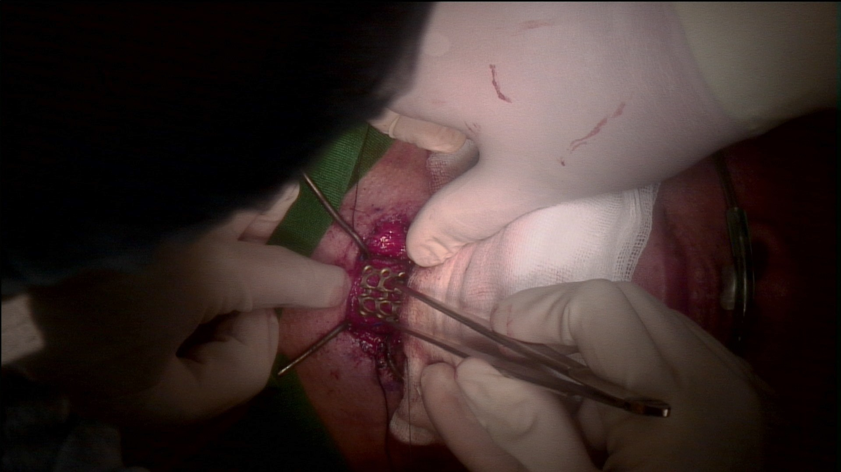
Figure 9. Titanium mesh plates carefully folded using hand bender pliers to fit the interthyroidal gap

Slide 10
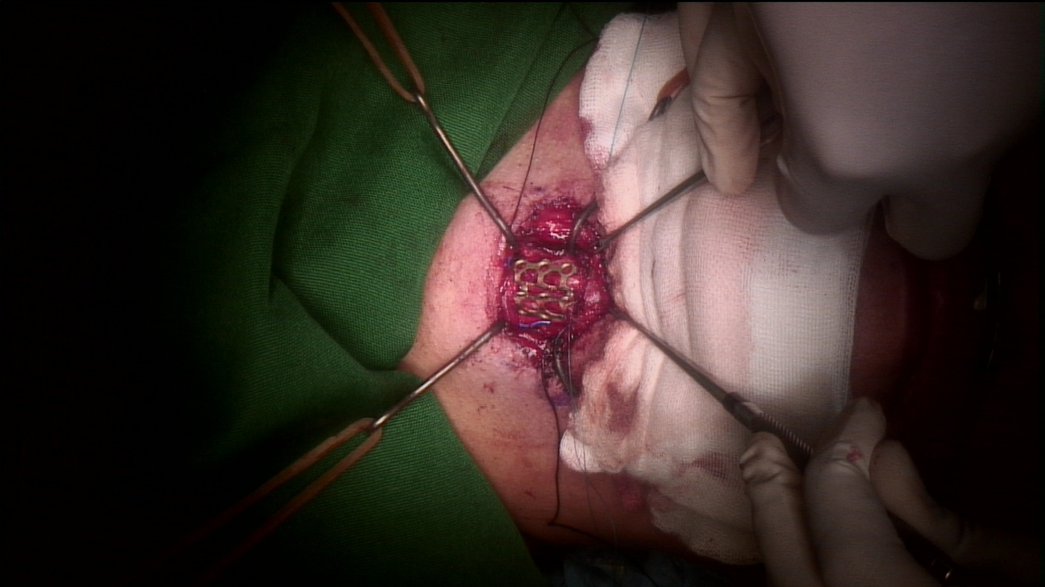
Figure 10. The customized titanium bridge was then anchored to the thyroid cartilage using a 2-O nylon suture placed on the superior and inferior edge of the plates

Slide 11
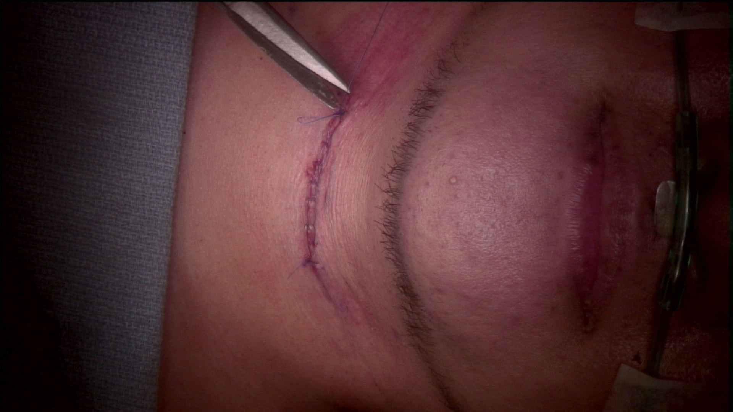
Figure 11. Subcutaneous layer was closed with Vicryl 3.O suture and the skin was closed with 3.O nylon suture

Slide 12
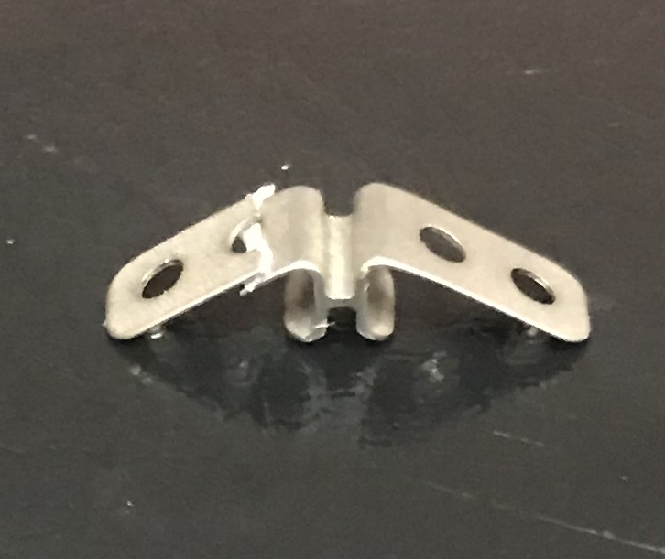
Figure 12. Isshiki Thyroplasty bridge

Slide 13
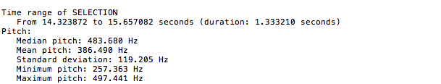
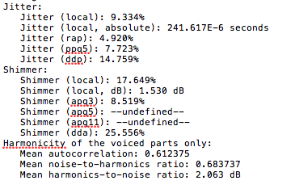
Figure 13. Preoperative PRAAT Voice Analysis

Slide 14
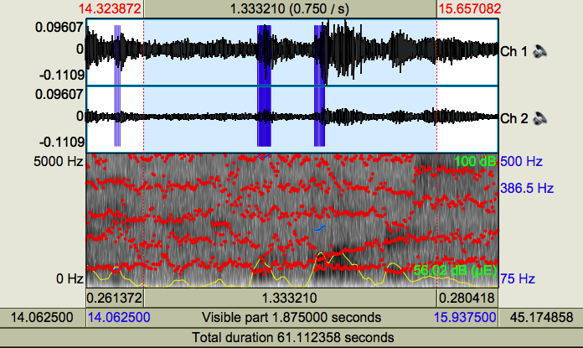
Figure 14. Preoperative PRAAT Voice Analysis

Slide 15
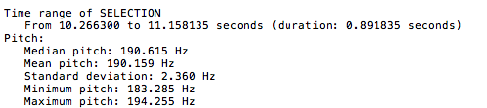
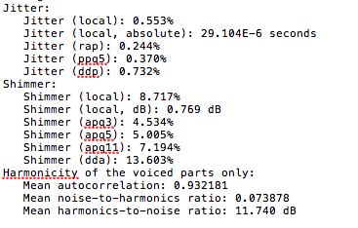
Figure 15. Postoperative PRAAT Voice Analysis

Slide 16
Figure 16. Postoperative PRAAT Voice Analysis

