Slide 1
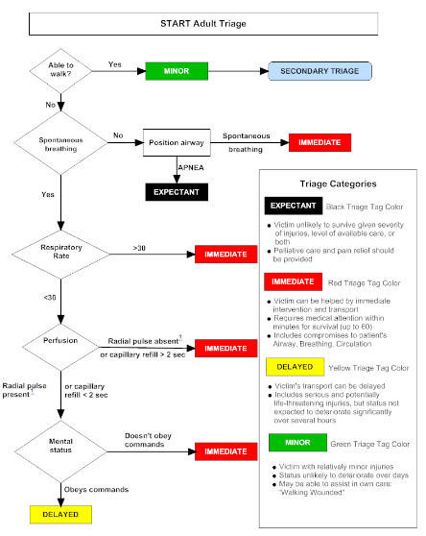
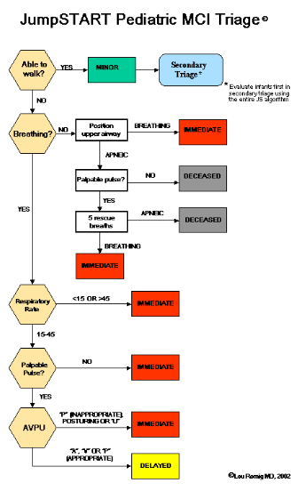

Slide 2
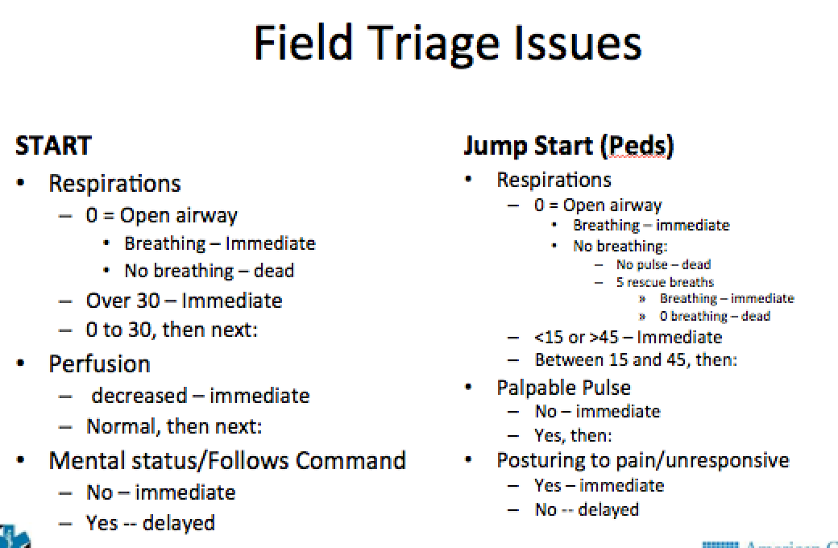

Slide 3
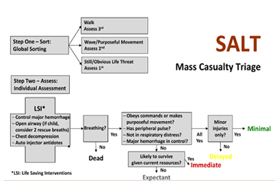

Slide 4
Pain
Pallor
Paresthesias
Pulseles
Paralysis
Poikelothermia

Slide 5
Pediatric Trauma Scale
-6 to +12
<9 high mortality
Size/Airway/CNS/Pulses/Wounds/Fx’s
+2/+1/-1

Slide 6
ISS
Three steps
Rank injury 1 – 6, with 6 being maximal
One of nine regions
Take the three worst
ISS = A² + B² + C², score from 1 – 75
Any 6’s is automatic 75

Slide 7
ESF’s
ESF 1 = Transportation (DOT)
ESF 2 = Communications (DHS/FEMA)
ESF 3 = Public Works & Engineering (DOD/FEMA)
ESF 4 = Firefighting (USDA)
ESF 5 = Emergency Management (DHS/FEMA)
ESF 6 = Mass Care (DHS/FEMA)
ESF 7 = Logistics & Resources (GSA/DHS/FEMA)
ESF 8 = Public Health (HHS)
ESF 9 = USAR (DHS/FEMA/DOD)
ESF 10 = Oil and Hazardous Mat (EPA)
ESF 11 = Agriculture and Nat Resources (USDA)
ESF 12 = Energy
ESF 13 = Public Safety
ESF 14 = Long Term Community Recovery
ESF 15 = External Affairs

Slide 8
USAR
28 federal teams
85 personnel
14 days self-sustaining
FEMA

Slide 9
NIMS Courses
IS – 100 = Intro to ICS
IS – 200 = ICS for Single Resources and Initial Action Incidents
IS – 700 = NIMS
IS – 800 = National Response Framework

Slide 10
NFPA
1221 = Call receipt to alert unit 90 sec / 90%
1500 = Health and Safety for Fire Service: Fireground Unit have transport capable unit standing by: EAP available
  1582 = Occupational Health
  1584 = Rehab standards “84 REHAB!!!”
1710 = Response Times, 1720 = Volunteer

Slide 11
OHSA
1904 = employers keep records on W/P related fatalities, injuries, illnesses
1910 = plan for BB pathogen exposure, masks, resources for TB risk prevention

Slide 12
Statistics
Parametric – bell curve
  Student’s T, ANOVA
Non-parametric – not normally distributed
  Wilcoxon, Chi Square
Enumerative – clinical studies, one effect
Analytical – CQI, provider performance
Special cause – Provider
Common cause – other factors (change blade)

Slide 13
Statistics
Numerical = parametric = StudT and ANOVA
Categorical = “categories”
  Categorical = Chi square
  Binary = Chi square
  Ordinal = Wilcoxon/Kraskall

Slide 14
APGAR
Appearance = Blue – Acro – Nl
Pulse = 0 - <100 - >100
Grimace = 0 – Grimace – Crying
Activity = 0 – Arms – Nl
Respiration = 0 – Slow - Nl

