Slide 1
HMLA Water Quality Highlights 2025

Slide 2
Conductivity has doubled (37 -> 75) since 1989 with a steady rise year/year. Conductivity is typically low in NH waters. Levels less than 100 are acceptable.
NH Median Value (42)
Conductivity in our lake indicates the concentration of dissolved salts and minerals. The lower the level the purer the water.

Slide 3
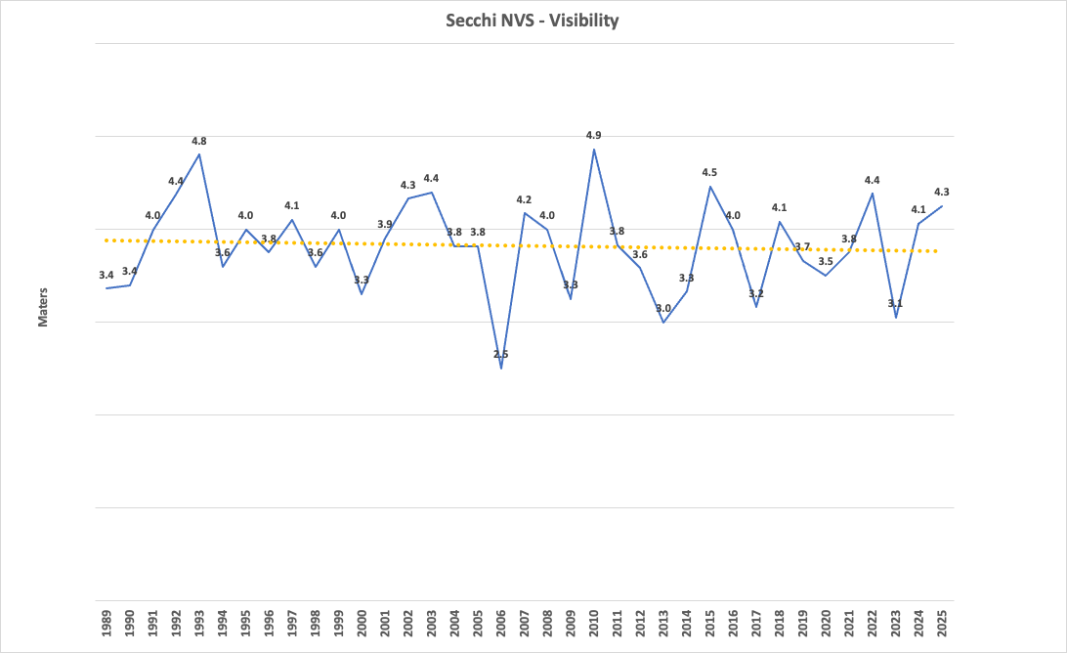
Visibiity has been stable and better than average for NH lakes. Levels between 2-2.5 are good, levels greater than 4.5 are exceptional.
NH Median Value (3.3)
Visibility within our lake is measured by how well light transmits through water, and is an indication of water quality.

Slide 4
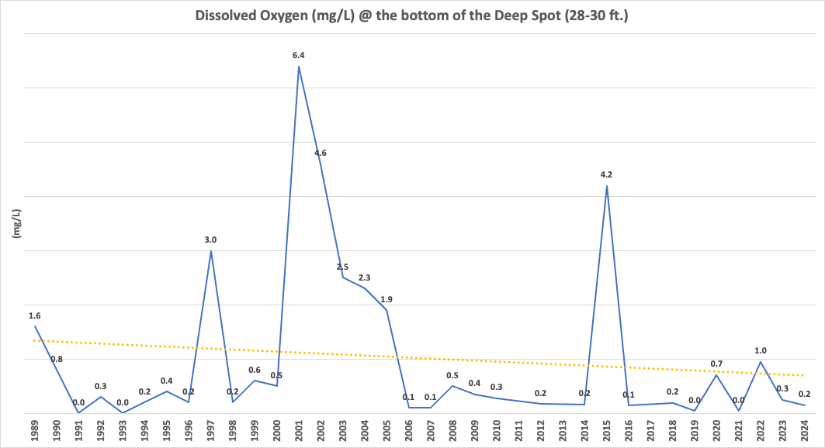
Dissolved oxygen at the bottom of the lake is extremely low (hypoxic) often at zero (anoxic) especially over the last 18 years. This poses a threat to aquatic life and contributes to rising phosphorous levels as seen on the next slide.
Dissolved Oxygen is a key water quality indicator. It is essential for aquatic life, as fish and other organisms need it for respiration.

Slide 5
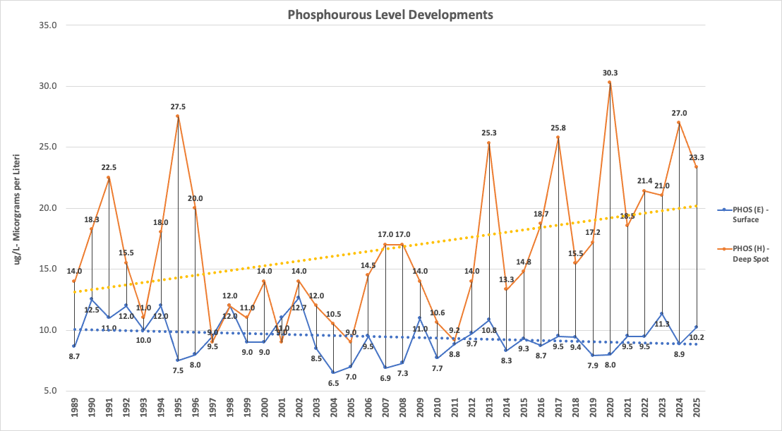


Bottom level phosphorous continues to rise year/year and is a concern. Increase is due at least partially to “internal loading” or leaching from the lake floor due to low and often zero dissolved oxygen levels.
Surface level phosphorous fluctuates slightly above and below acceptable levels year/year and are considered good and fairly stable.
NH Median Value (11)
Phosphorous is the most important water quality parameter in our lake. It is the nutrient that limits algae’s ability to grow and reproduce. Total phosphorous ranges for NH lakes are: (1-10 Low/Good), (11-20 Average), (21-40 High).

