Slide 1
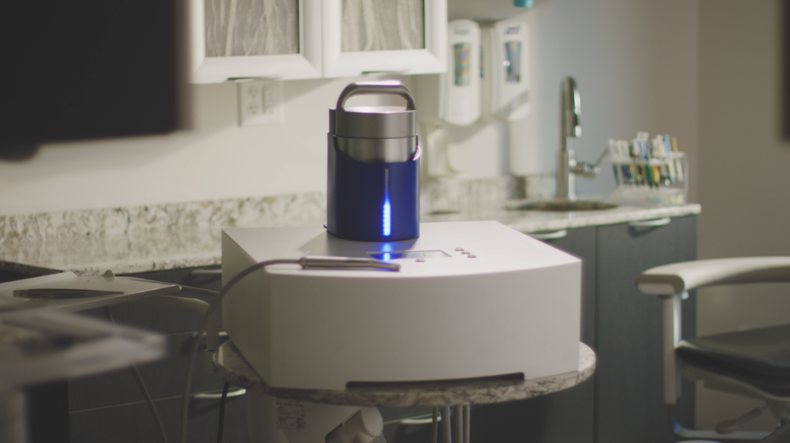
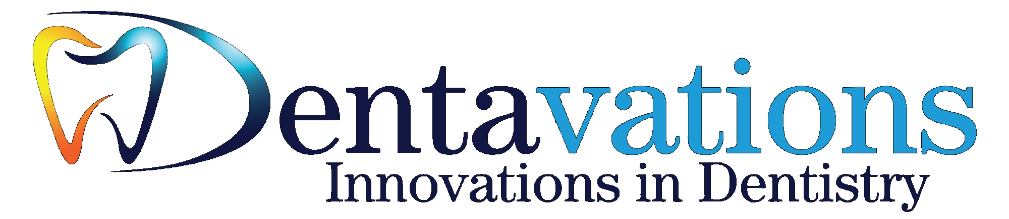
A Pain-Free Approach to
Tooth Restoration
Presented to [Acquirer Name] | May 2026

Slide 2
Today's Agenda
01
Introductions
Welcome
What would your team like to learn and accomplish today?
02
WaterJet Technology
A pain-free approach to tooth restoration
Dentavations, Inc.
03
WaterJet vs. Alternatives
Independent Midwestern University scorecard
04
The Acquirer Business Case
Unit economics, workflow integration, and revenue model
05
Live Demonstration
System walkthrough & video demonstration
06
Why Dentavations Reached Out
Actively marketing the sale of this technology

Slide 3
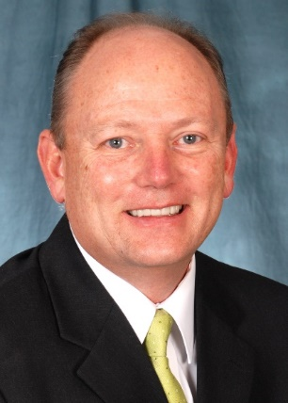
WaterJet Versus Alternatives
Independently Scored by Midwestern University
Criteria
Drill/Burr
Laser
Air Abrasion
WaterJet
8.50
Overall Rating
Lower Need for Anesthesia
3
8
4
8
Onlays
10
6
0
6
Inlays
10
10
7
9
Crown Preps
10
6
1
6
May Cause Tooth Cracking
3
7
4
9
"Wow, you have a product."
"This is the perfect cut for a composite restoration."
Brad Smith, DDS
Dean (Retired), Midwestern University, AZ
Noise Level
1
8
5
9
Bond Strength with Etch
10
10
10
10
Ease of Use
10
6
7
9
Lower Heat
3
7
9
9
Less Vibration
2
10
8
10
Speed of Cutting
10
8
4
8
Adjacent Tooth Safety
7
5
4
9
WaterJet scored highest across all 14 criteria
8.50 vs. Laser 7.21 vs.
Drill 6.57 vs. Air Abrasion 5.36
Patient Comfort
3
8
7
9
Equipment Price
10
2
5
8
Overall (10pt Scale)
6.57
7.21
5.36
8.50
7-10
4-6
1-3

Slide 4
WaterJet Technology
Business Model
Technology Validation
HW
System Acquisition
Midwestern University School of Dentistry
Hardware sale to dental practices — IP Protected
✓ Bonding Strength
✓ Cutting Precision
$$
Recurring Revenue
Top Five Global Dental Company
Patented abrasive mixture bottles — sold per use
✓ Removal Efficiency vs Dental Burr
✓ Temperature Study — zero heat transfer
TIP
Nozzle Replacement
✓ Use on Live Patients
Consumable nozzle tips — IP Protected
50+
SVC
Annual Maintenance
Service contracts — predictable revenue stream
Dentists Tested WaterJet on Actual Teeth
All showed interest in integrating into practice

Slide 5
The Acquirer
Business Case
Why WaterJet delivers a superior investment thesis vs. lasers
1
Larger Addressable Market
2
Patented Recurring Revenue
3
Faster Adoption Curve
Low price point unlocks 40-60% of dentists vs. 5-8% for lasers
Protected consumable margin on every cavity — grows with install base
<5 min transition time means faster market penetration and revenue ramp

Slide 6
Larger Market. Lower Barrier.
~8% adoption — low utility limits case breadth
~50% addressable — $7.5K price + 80% of procedures
~8% adoption — $100K barrier blocks 92% of dentists
WaterJet: 13x cheaper than lasers with 6x more addressable dentists
Of 200,000 active US dentists, WaterJet can reach 100K+. Lasers are structurally capped at ~16K by price.

Slide 7
5-Year Acquirer Revenue Model
Illustrative | US market
$756M total | 55% recurring (patent-protected) | 45K dentists
$963M total | 12% recurring (3rd-party competed) | 8.5K dentists
WaterJet annual revenue GROWS (consumable compounds) while laser revenue DECLINES (market saturates)

Slide 8
The Recurring Revenue Engine
Per-Dentist Unit Economics
WaterJet
Laser
Equipment
$7,500
$60K-$130K
Annual Consumable
$3,750
$0
Annual Service
$0
$3K-$8K
5yr Rev / Dentist
$26,250
$85K-$170K
Addressable (US)
~100,000
~16,000
Total Mkt Opportunity
$2.6B
$1.4-$2.7B
WaterJet consumable is PATENTED — laser service is not

Slide 9
Workflow Integration
WaterJet slots into existing practice flow — no disruption
A Typical Morning | 8 Patients
8:00
8:30
9:00
9:45
10:15
10:45
11:15
12:00
Pt 1
Pt 2
Pt 3
Pt 4
Pt 5
Pt 6
Pt 7
Pt 8
Class II composite
Sealant prep
Full crown prep
Class I composite
Class V restoration
MOD composite
Crown prep + buildup
Class III composite
WaterJet
WaterJet
Drill
WaterJet
WaterJet
WaterJet
Drill
WaterJet
WaterJet (6 of 8 patients)
Drill — same as always (2 of 8)
Why This Matters to an Acquirer
0
tools replaced
75%
of patients needle-free
<5
min to transition
Nothing Gets Removed
Anesthesia Wait Eliminated
< 5 Min Learning Curve
The drill stays in the operatory. WaterJet adds capability — it doesn't ask the dentist to abandon anything. Zero disruption to existing workflow.
For 6 of 8 morning patients, the 10-15 min numbing wait disappears entirely. That's 60-90 minutes of recovered chair time before lunch.
The WaterJet feels like a handpiece because it is one. Dentist's existing muscle memory transfers directly. No new modality to learn, unlike lasers.
No technology eliminates the drill — not even a $130K laser. WaterJet doesn't pretend otherwise. It just makes 80% of the day painless.

Slide 10
Legal & Regulatory
"
Almost 100% sure that this device will be cleared via the 510(k) process
— FDA Chief of Dental Device Branch
Intellectual Property
Regulatory
✓ Multiple Patents Issued — Domestic & International
✓ 510(k) Pathway confirmed
✓ Multiple Disclosures to File
✓ FDA Pre-Submission Meeting held
✓ Patented abrasive mixture = protected recurring margin
✓ Multiple Predicate Device Options identified

Slide 11
Outreach to Sell the Company
Our Process
Our Expectations
40+
of the world's largest dental manufacturing
and supply companies contacted
Multiple key players contacted in each
Multiple organizations have replied
Meetings scheduled — in-person and remote
1
LOI
Letter of Intent by end of Q1 2026
2
NDA
Executed between both parties
✓ Comparable introduction sent to top domestic and international dental companies
3
Data Room
✓ Multiple parties have responded and meetings are being scheduled
Full access to due diligence materials
✓ LOI expected by end of Q1 2026 from qualified party
4
Deep Dive
Deeper technology exploration and demo

Slide 12
Thank You for
Your Interest
Q & A
Your Next Steps
We welcome your questions about WaterJet
technology, market opportunity, and the
acquisition process.
Execute NDA to access full data room
Schedule in-person demonstration
Submit Letter of Intent (LOI)

