Slide 1
Planning and Executing A Successful Show
Walt Ogburn & Mark Bergland
Croix Chordsmen Chorus
Land O’ Lakes District Leadership Academy
January 5 & 6, 2024
Notes:
When we are ready to show the video clip it’s about 2:30 in and runs till about 5:15 which is Jon’s opening and Bill’s intro and the start of Till Then.

Slide 2
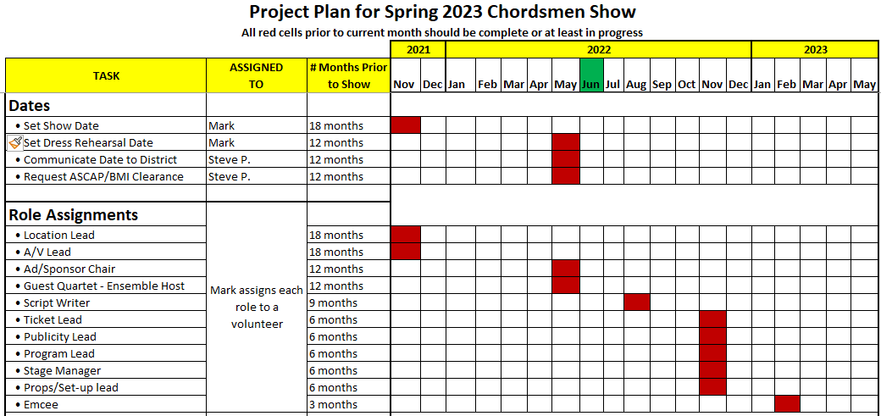
Planning and Organizing Work
A balance between delegating and doing
Organizing by time

Slide 3
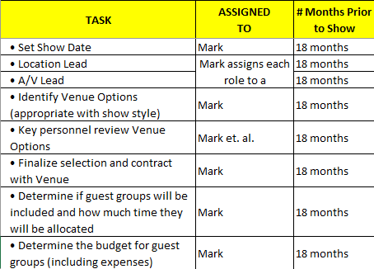
18 Months in Advance
Evaluate success and challenges with past venue
Capacity
Acoustics
Technology
Accessibility
Multiple venues
Multiple shows

Slide 4
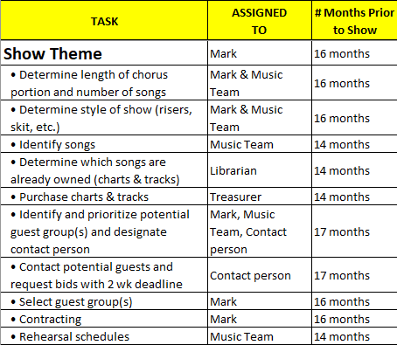
13 – 17 Months in Advance
Don’t dwell on every point equally
This section is when you evaluate the ability of your chorus to learn music

Slide 5
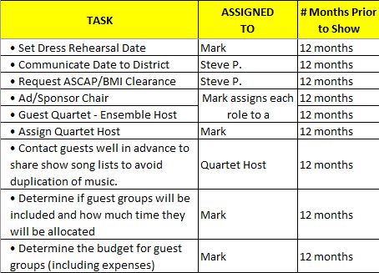
12 Months in Advance
Deciding and confirming logistics
Contracting

Slide 6
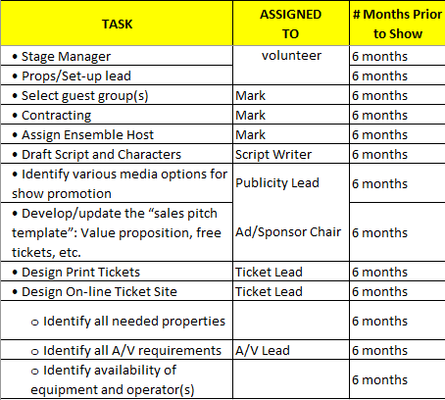
6 Months in Advance
Budgeting gets serious
Logistic planning starts turning into action

Slide 7
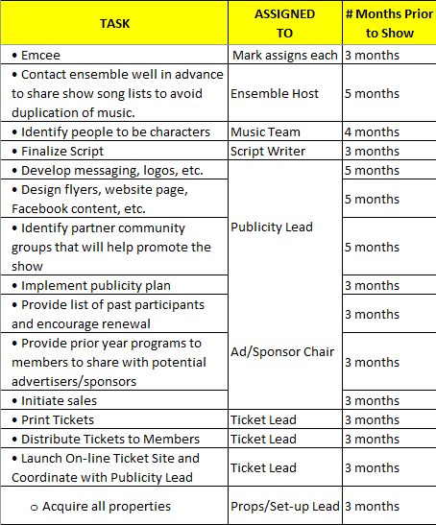
2 – 5 Months in Advance
The implementation phase
Communication with all involved parties
Chorus members get familiar with script – story line

Slide 8
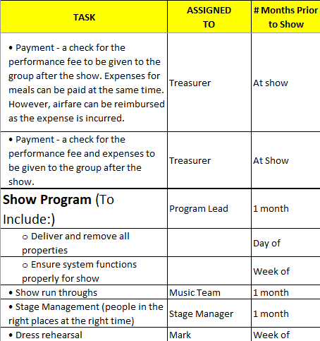
1 Month or less in Advance
Completing plans
Acknowledgement in program

Slide 9
Organizing By Topic

Slide 10
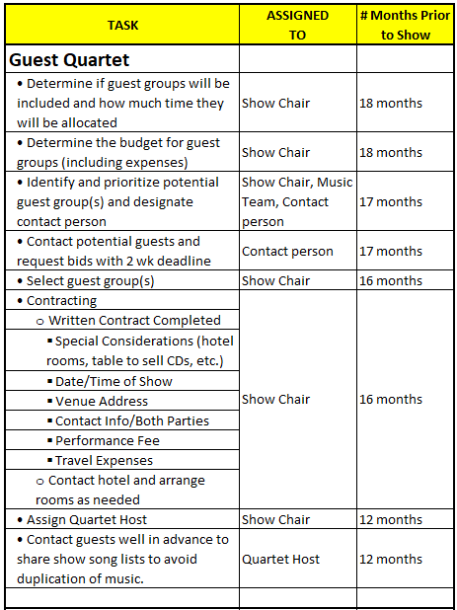
Guest Quartet

Slide 11
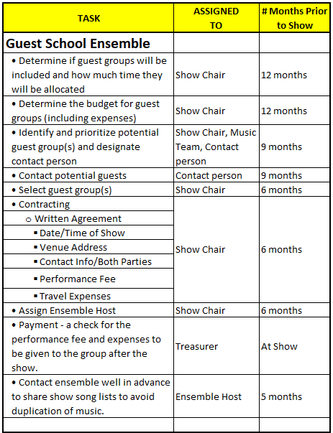
Guest School Ensemble

Slide 12
Example: Croix Chordsmen Spring Show

Slide 13
TIMELINE
Spring, 2019: Concept of Juke Box show developed, to use original arrangements by Jay Althof. Show was originally scheduled for Spring 2021, to follow our Disney Show in 2020.
2020-2021: COVID delayed Disney show, which was moved to April 2022. Section leaders created learning tracks for Jay’s arrangements, posted online.
May 2022: Began introducing chorus to songs for Juke Box show.
June, 2022: Committee began writing show script (show PDF).
August – December, 2022: Show songs were performed at Como Park, Red Wing, and District. Worked on show logistics (e.g. guest quartet contracts finalized, show set construction began, worked with sound and lighting technicians at Trinity Lutheran, video of actual juke box produced to be projected above stage when chorus ‘juke box’ sang, advertising graphics developed, cabaret show logistics worked out).

Slide 14
TIMELINE
January 2023: Chorus ‘actors’ read script and songs were rehearsed in show order, at each rehearsal.
February 2023: Online ticket sales system developed and implemented.
March 2023: Advertisements placed in publications in eastern Minnesota and western Wisconsin.
April 2023: Two dress rehearsals at Trinity Lutheran (one a week before show, the other the day before show).
April 15: Show day! (show selected portions of video)

Slide 16
LESSONS LEARNED
Advanced planning and implementation of the plan is essential, especially for a show involving script and sets, lighting, and sound. The delay due to COVID enabled us to have a much more elaborate show then originally envisioned.
Learning tracks need to be available and show songs performed in public well in advance of the show date. The script should be used during rehearsal as soon as it is available, so that the actors and chorus can become comfortable with reading and reacting to lines.
Venues and guest quartets need to be identified and formalized early in the planning process. Chapter and guest quartets must be informed of the show theme to give them enough time to work up songs that flow with the show script.
A detailed budget must be created and regularly updated (in our case, this was especially important because our main show was followed by a quartet ‘cabaret show’ that included food costs).

Slide 17
Key players in the chorus must be willing and available if the show is to go beyond a standard concert. In our case, this involved song arranging, script development, set construction, production of the ‘juke box’ video, and other key tasks. The chorus must include members who have the skillset and time to put that kind of effort into show planning and production.
Timing of the show is critical – will there be an intermission? If not, how long should the show be (85 minutes max, in our experience). Guest groups must be aware of the time allocated for their performances and not go over time, especially if no intermission. Emcee must perform duties efficiently. Show should begin with a bang, then brought down and gradually increased, ending with maximum impact. Order of groups that perform should reflect this.
Other thoughts on the planning process?

Slide 18
Table Topics
Think about the last couple of shows
What roles have been assigned?
How many people were on the “core team”?
How far in advance of the show was the show chair identified?
Discuss any of the points from the previous discussion that caught your attention.
Report back.

Slide 19
What do the comments have in common?

Slide 20
Planning and Executing A Successful Show
Walt Ogburn & Mark Bergland
Croix Chordsmen Chorus
Land O’ Lakes District Leadership Academy
January 5 & 6, 2024
Notes:
When we are ready to show the video clip it’s about 2:30 in and runs till about 5:15 which is Jon’s opening and Bill’s intro and the start of Till Then.

