Slide 1


Slide 2
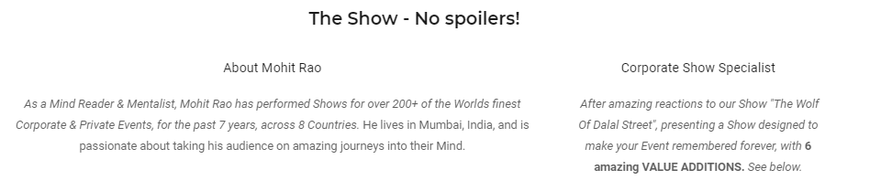

Slide 3
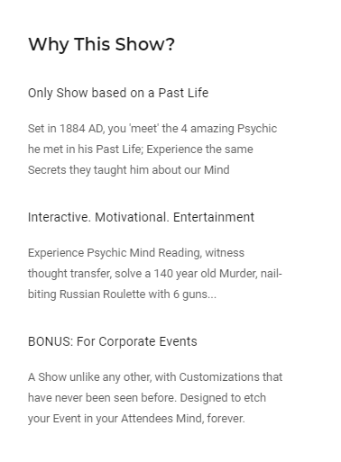
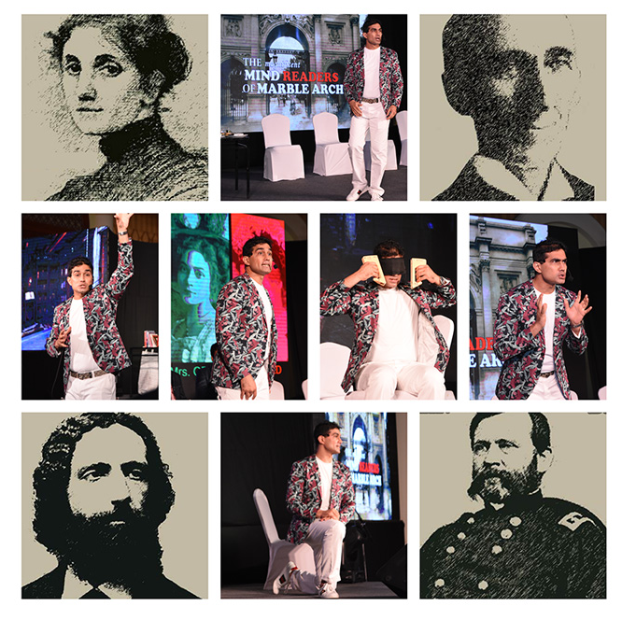

Slide 4
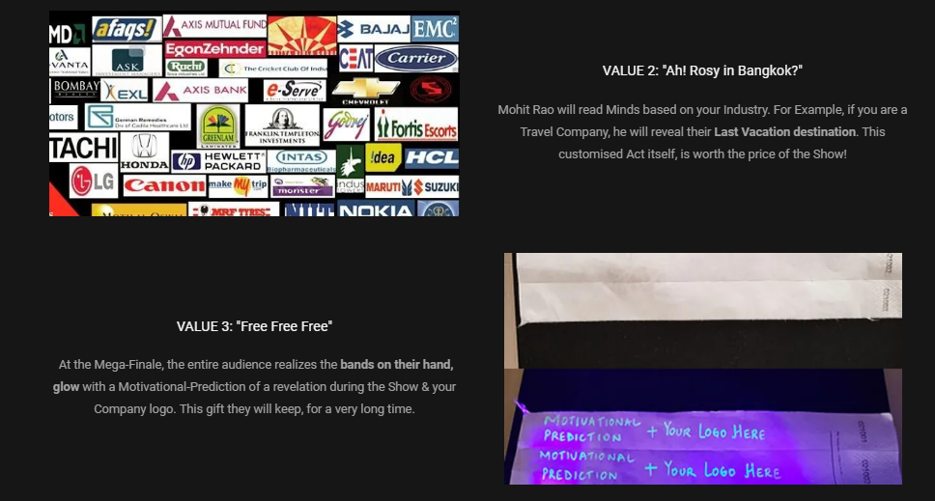

Slide 5







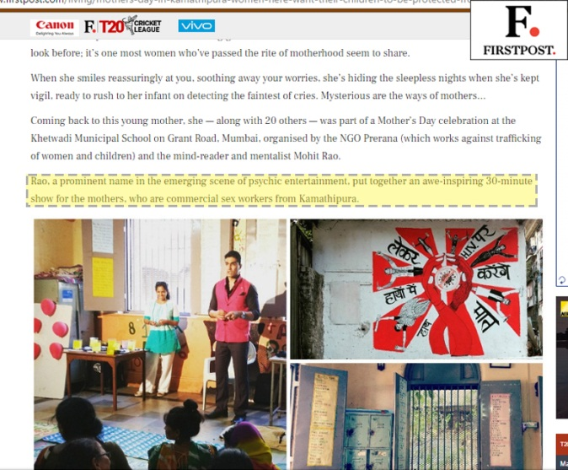
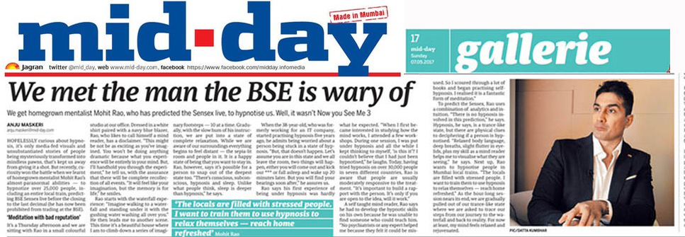
Endorsed by the Media

Slide 6
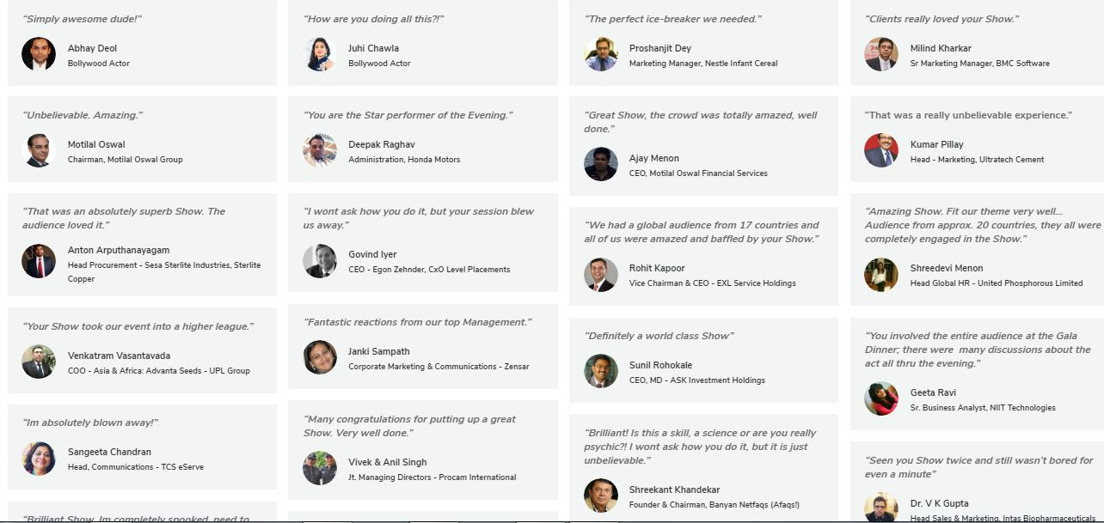
Endorsed by Corporate Czars (1/4)

Slide 7
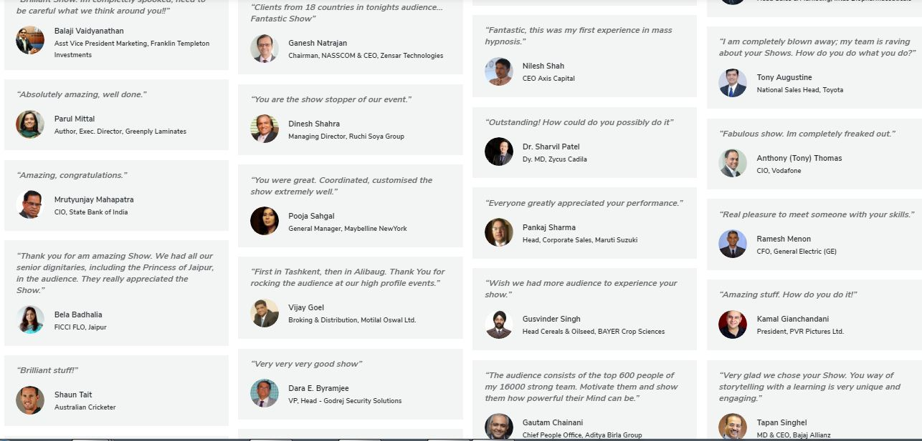
Endorsed by Corporate Czars (2/4)

Slide 8
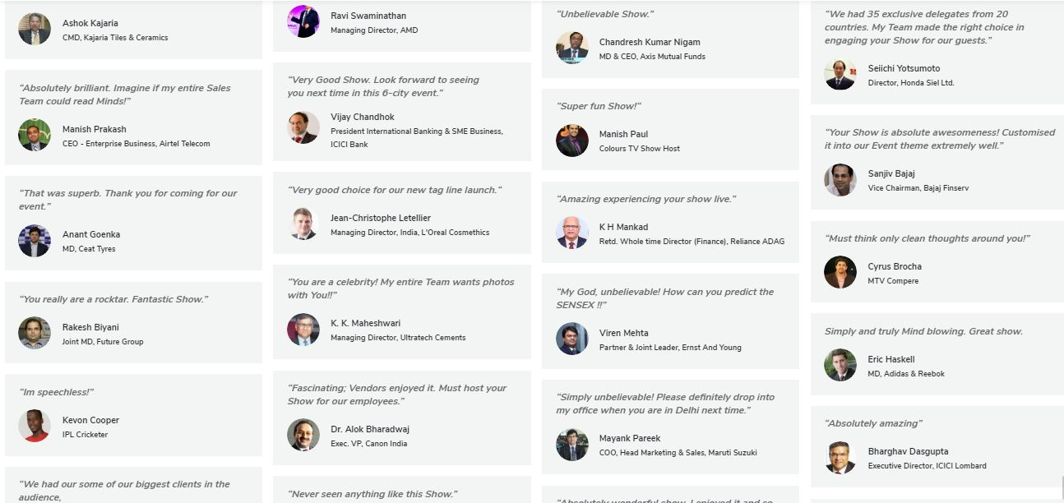
Endorsed by Corporate Czars (3/4)

Slide 9
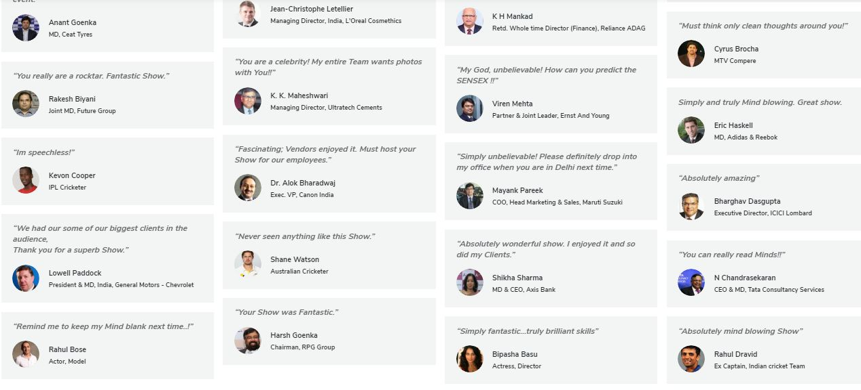
Endorsed by Corporate Czars (4/4)

Slide 10




Show for over 200 of the Worlds best Brands (1/3)

Slide 11




Show for over 200 of the Worlds best Brands (2/3)

Slide 12




Show for over 200 of the Worlds best Brands (3/3)

Slide 13

For more Show details:

