Slide 1
Atopic Dermatitis

Slide 2
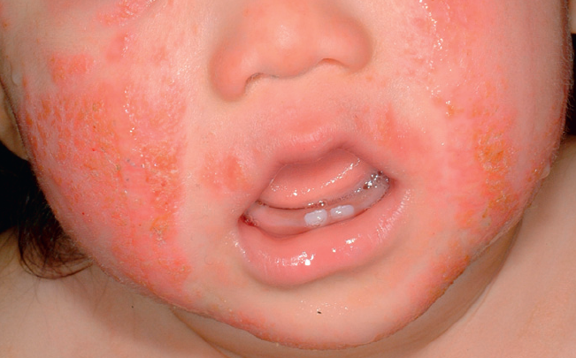
Which of the following is the most important aspect of treating a patient with atopic dermatitis?
Allergy testing
Diet
Moisturizers
Probiotics
Steroids
Hurwitz

Slide 3
Which of the following is the most important aspect of treating a patient with atopic dermatitis?
Allergy testing
Diet
Moisturizers
Probiotics
Steroids
Hurwitz

Slide 4
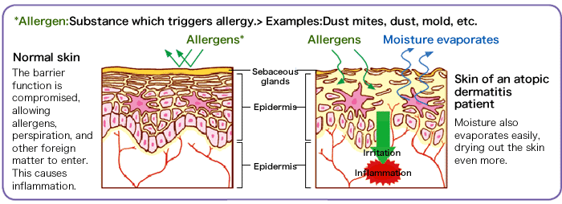
Atopic Dermatitis: A Skin Barrier Problem
www.fukushihoken.metro.tokyo.jp

Slide 5
What is a dermatologist’s favorite treatment?
HINT. It’s not…
Topical steroids
Doxycycline
Reassurance
It’s...

Slide 6
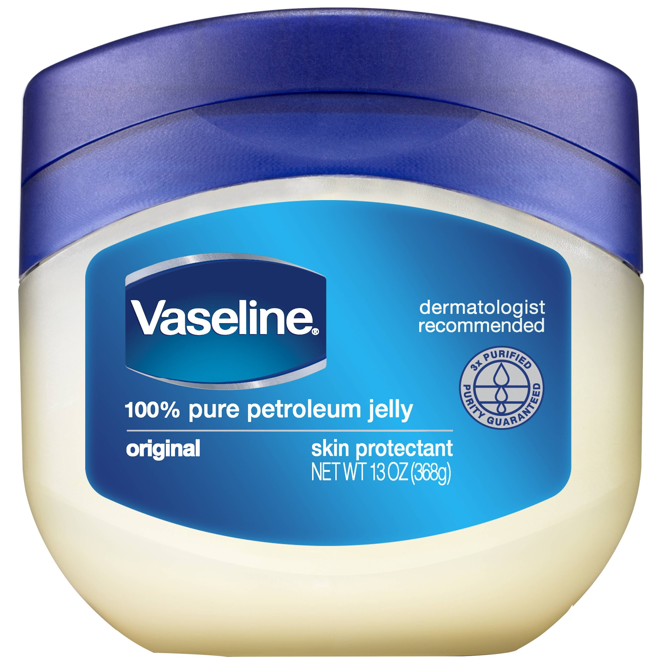
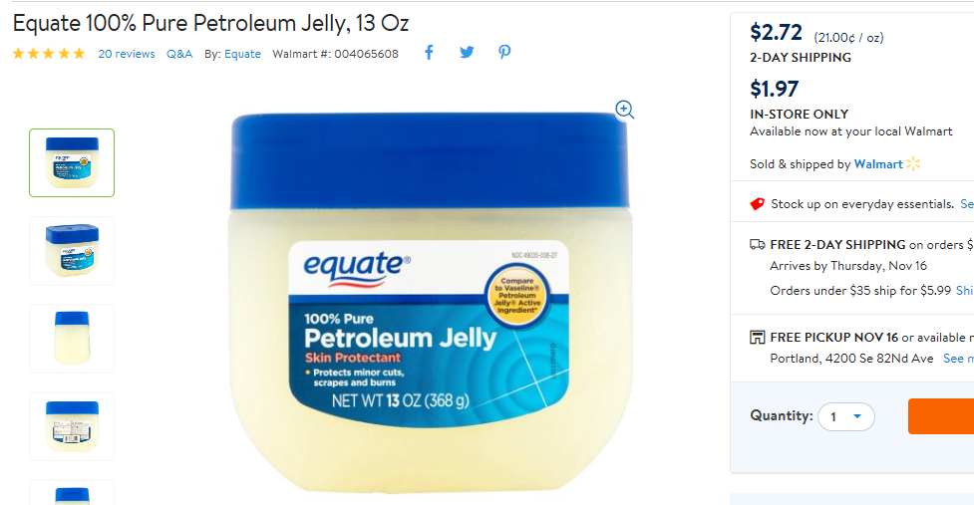
Petroleum Jelly!
Downsides:
Acne (?)
Miliaria
Greasy and messy
You can also call it petrolatum. Or Vaseline.
Uses include:
Moisturization
Atopic dermatitis
Wound care
Barrier functionality (e.g., diaper dermatitis, drooling, allergic or irritant contact dermatitis)
Other random rashes (e.g., psoriasis)

Slide 7
Vaseline

Slide 8
Vaseline
is

Slide 9
Vaseline
is the

Slide 10
Vaseline
is the
BALM!!!

Slide 11

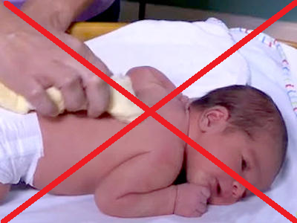
Bathing technique
Bathing: puts water in the skin
Then: it evaporates, and takes EVEN MORE water with it
Solution: Seal in the moisture!

Slide 12
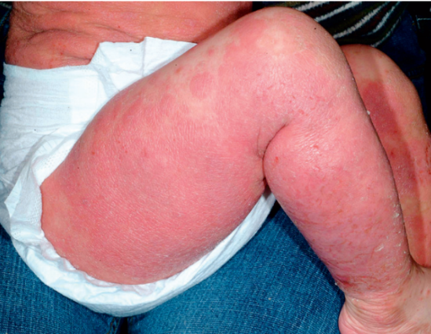
What would I recommend for this patient with eczema?
Hydrocortisone 2.5% ointment bid, 10 days on, 10 days off
Hydrocortisone 2.5% ointment bid until the skin is smooth
Triamcinolone 0.1% ointment, 10 days on, 10 days off
Triamcinolone 0.1% ointment bid until the skin is smooth
Something else
Hurwitz

Slide 13
What would I recommend for this patient with eczema?
Hydrocortisone 2.5% ointment bid, 10 days on, 10 days off
Hydrocortisone 2.5% ointment bid until the skin is smooth
Triamcinolone 0.1% ointment, 10 days on, 10 days off
Triamcinolone 0.1% ointment bid until the skin is smooth
Something else
Hurwitz

Slide 14


Slide 15
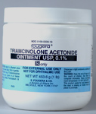
Anti-inflammatory meds
Use ointments
Give parents enough
My workhorse: Triamcinolone 0.1% ointment
Don’t use arbitrary cut-off times
Give parents something to do in ~2 weeks
Calcineurin inhibitors: Good
Crisaborole: Bad

Slide 16
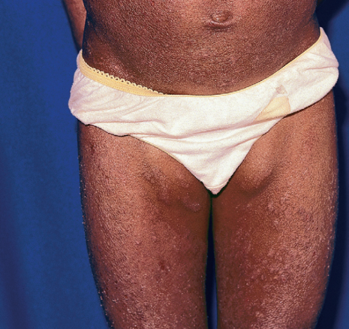
Severe Patients
Refer to Derm
Wet wraps in the meantime
No systemic steroids, please
Hurwitz

Slide 17
NO SYSTEMIC STEROIDS, PLEASE!!!

Slide 18
A Word on Diet
It doesn’t matter
“current evidence suggests that strict diet management is not effective in the treatment AD in the vast majority of patients.”
Lim NR, Lohman ME, Lio PA. The Role of Elimination Diets in Atopic Dermatitis-A Comprehensive Review. Pediatr Dermatol. 2017 Sep;34(5):516-527.

Slide 19
NIAID-sponsored Expert Panel (2010)
5.2.4. Testing in infants and children with persistent atopic dermatitis
Guideline 35: The EP suggests that children less than 5 years old with moderate to severe AD be considered for FA evaluation for milk, egg, peanut, wheat, and soy, if at least 1 of the following conditions is met:
  The child has persistent AD in spite of optimized management and topical therapy.
  The child has a reliable history of an immediate reaction after ingestion of a specific food.
Boyce JA, et al. Guidelines for the diagnosis and management of food allergy in the United States: summary of the NIAID-sponsored expert panel report. Nutr Res. 2011 Jan;31(1):61-75.

Slide 20
NIAID-sponsored Expert Panel (2010)
Because individuals can develop allergic sensitization (as evidenced by the presence of allergen-specific IgE (sIgE)) to food allergens without having clinical symptoms on exposure to those foods, an sIgE-mediated FA requires both the presence of sensitization and the development of specific signs and symptoms on exposure to that food. Sensitization [i.e., positive IgE] alone is not sufficient to define FA.
foods… that elicit reproducible adverse reactions but do not have established or likely immunologic mechanisms are not considered food allergens. Instead, these… are termed food intolerances.
The EP recommends that parent and patient reports of FA must be confirmed, because multiple studies demonstrate that 50% to 90% of presumed FAs are not allergies.
The EP recommends using oral food challenges for diagnosing FA. The double-blind placebo-controlled food challenge is the gold standard.

Slide 21


A Word on Allergies
Kids with atopic dermatitis have more allergies, but these generally aren’t responsible for flares of the eczema.
They don’t need to see an allergist.

Slide 22
A Word on Probiotics
Some mixed data leaning toward positive
But, there’s too much variation, so I don’t recommend them

