Slide 1
BRIDG Micro-Course Qualitative Research and Analysis
Brenna Bray, PhD
BRIDG T90/R90 Fellowship Postdoctoral Training Program
NCCIH, Grant AT008924
National University of Natural Medicine (NUNM) University of Washington (UW)
NourishED Research Foundation (Boulder, CO, USA | Wilmington, DE, USA)

Slide 2
BRIDG Micro-Course Module 4: Qualitative Data Analysis
Brenna Bray, PhD
BRIDG T90/R90 Fellowship Postdoctoral Training Program
NCCIH, Grant AT008924
National University of Natural Medicine (NUNM) University of Washington (UW)
NourishED Research Foundation (Boulder, CO, USA | Wilmington, DE, USA)

Slide 3
Content Overview
Overview of Qualitative Research
Classic Types of Qualitative Research Designs
Qualitative Evaluation Process
Qualitative Data Analysis
Reporting Findings
Guidelines
https://www.taylorfrancis.com/books/mono/10.4324/9781315108933/practical-approaches-applied-research-program-evaluation-helping-professionals-casey-barrio-minton-stephen-lenz
Notes:
Image from: https://www.taylorfrancis.com/books/mono/10.4324/9781315108933/practical-approaches-applied-research-program-evaluation-helping-professionals-casey-barrio-minton-stephen-lenz

Slide 4
Content Overview: Module 4
IV. Qualitative Data Analysis
Thematic Analysis
Braun & Clarke’s 6 Phases of Thematic Analysis (2006):
(1) Data Familiarization; (2) Initial Code Generation; (3) Searching for Themes; (4) Reviewing Themes; (5) Defining and Naming Themes; (6) Producing the Report.
Consensual Qualitative Research (CQR)
Hill et al.’s 3 Steps: (1) Divide responses into domains; (2) Construct core ideas within each domain; (3) Cross-Analysis. (2005, 2012).
Data Analysis Tools
NVIVO, Dedoose, Microsoft Office, Google Sheets
https://www.taylorfrancis.com/books/mono/10.4324/9781315108933/practical-approaches-applied-research-program-evaluation-helping-professionals-casey-barrio-minton-stephen-lenz
Notes:
Image from: https://www.taylorfrancis.com/books/mono/10.4324/9781315108933/practical-approaches-applied-research-program-evaluation-helping-professionals-casey-barrio-minton-stephen-lenz

Slide 5
Content Overview: Module 4
Module 4: Qualitative Data Analysis
Module Content | Readings | Course Objectives
Video//PowerPoint Lecture Thematic Analysis Braun & Clarke’s 6 Phases of Thematic Analysis (2006). Consensual Qualitative Research (CQR) Hill et al.’s 3 General Steps (2005). Data Analysis Tools NVIVO, Dedoose, Microsoft Excel, Google Sheets Module 4 Quiz 10 Questions, 20 Points, 20% Grade Module 4 Quiz 2: Coding Experience 6 Questions, 12 Points, 12% Grade | Barrio Minton & Lenz (2019). Ch. 7, Section 4 (Qualitative Data Analysis). Lim, (2024). Page 20 – 24 (scan). Page 26 – 30 (scan). | Design, plan, conduct, record, and analyze qualitative research Identify six key phases of thematic analysis Communicate benefits and strengths of consensual qualitative approaches Distill multi-step analytic processes to their essence. Identify common methods of analyzing qualitative data Critique studies using qualitative methodology of surveys for needs assessments, process evaluations, and satisfaction estimations

Slide 6
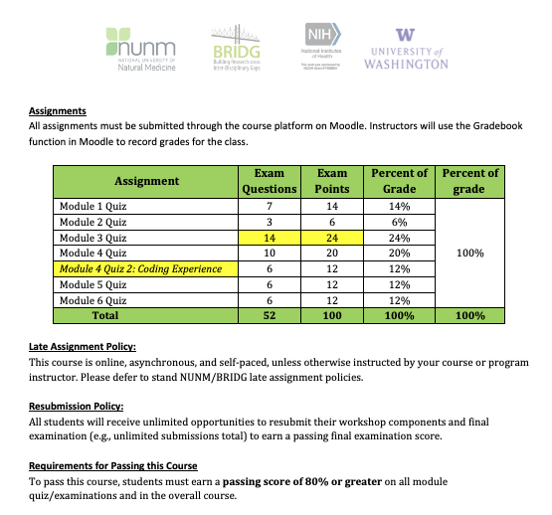
Content Overview: Module Examinations

Slide 7
IV. Qualitative Data Analysis
Thematic Analysis.
Consensual Qualitative Research (CQR).
Data Analysis Tools.
https://www.taylorfrancis.com/books/mono/10.4324/9781315108933/practical-approaches-applied-research-program-evaluation-helping-professionals-casey-barrio-minton-stephen-lenz
Notes:
Image from: https://www.taylorfrancis.com/books/mono/10.4324/9781315108933/practical-approaches-applied-research-program-evaluation-helping-professionals-casey-barrio-minton-stephen-lenz

Slide 8
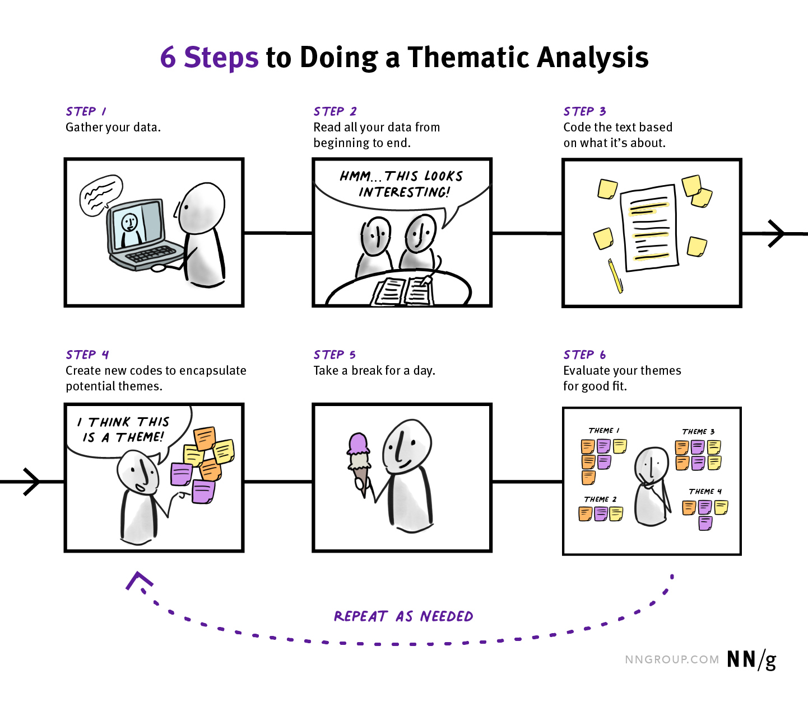
IV.1. Thematic Analysis
https://media.nngroup.com/media/editor/2022/08/17/6_steps_desktop.png
https://teleanalysis.com/wp-content/uploads/2023/11/Thematic-Analysis.pnghttps://teleanalysis.com/wp-content/uploads/2023/11/Thematic-Analysis.png
Notes:
Image from: https://www.taylorfrancis.com/books/mono/10.4324/9781315108933/practical-approaches-applied-research-program-evaluation-helping-professionals-casey-barrio-minton-stephen-lenz
Braun, V., & Clarke, V. (2006). Using thematic analysis in psychology. Research in Psychology, 3(2), 77–101.
https://doi.org/10.1191/1478088706qp063oa

Slide 9
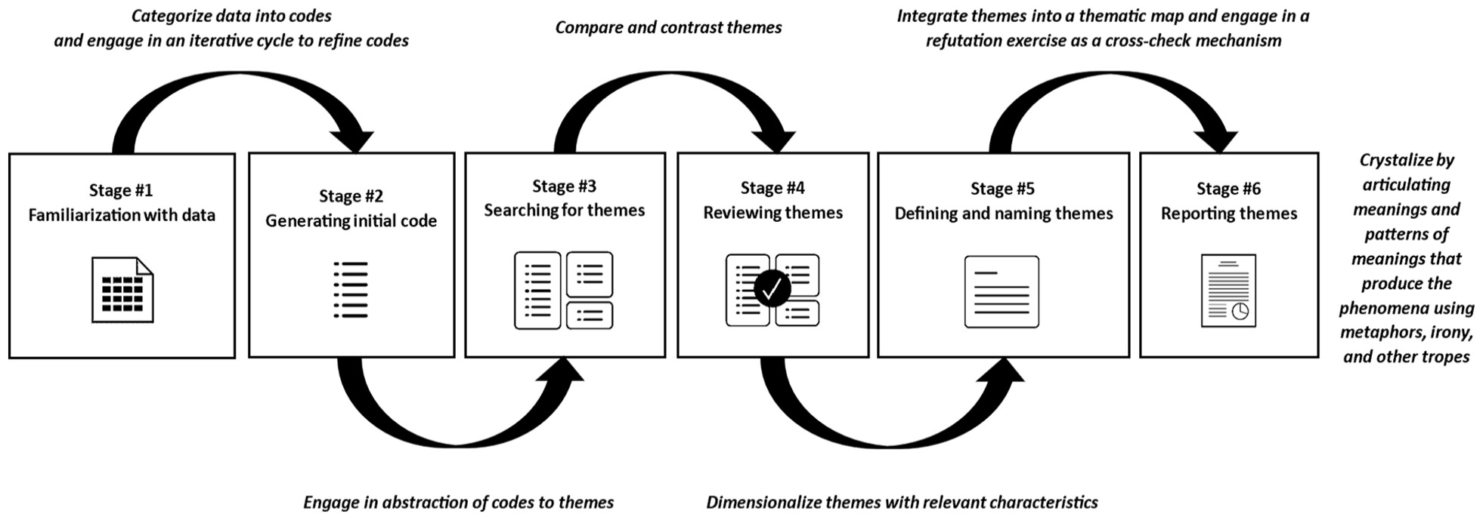
IV.1. Thematic Analysis
Figure 5. Thematic analysis inspired by Virginia Braun, Victoria Clarke, and Susan Spiggle. Note: The six stages of thematic analysis by Braun and Clarke (2006) are illustrated in regular font while the ideas or principles of analysis and interpretation by Spiggle (1994) are presented in italic font.
Figure from: Lim, W. M. (2024). What Is Qualitative Research? An Overview and Guidelines. Australasian Marketing Journal, 0(0), 14413582241264619. https://doi.org/10.1177/14413582241264619
Notes:
Image from: https://www.taylorfrancis.com/books/mono/10.4324/9781315108933/practical-approaches-applied-research-program-evaluation-helping-professionals-casey-barrio-minton-stephen-lenz
Braun, V., & Clarke, V. (2006). Using thematic analysis in psychology. Research in Psychology, 3(2), 77–101.
https://doi.org/10.1191/1478088706qp063oa

Slide 10
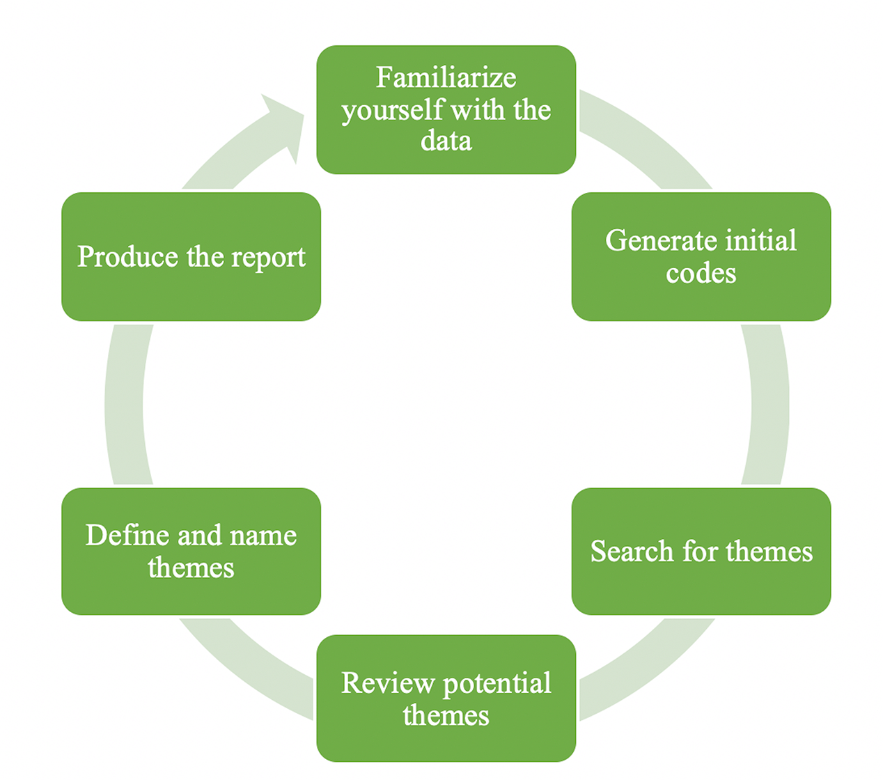
IV.1. Thematic Analysis
What is Thematic Analysis?
“Iterative process of connecting individual pieces of data within transcripts or documents to codes, connecting codes to themes, connecting themes to each other, and supporting overall analysis with use of specific pieces of data.”
- (Barrio Minton & Lenz, 2019).
Iterative:
Referring to a process that involves repeating a sequence of operations or procedures.
https://www.maxqda.com/wp/wp-content/uploads/sites/2/Figure-7-1.png
Notes:
Image from: https://www.taylorfrancis.com/books/mono/10.4324/9781315108933/practical-approaches-applied-research-program-evaluation-helping-professionals-casey-barrio-minton-stephen-lenz
Braun, V., & Clarke, V. (2006). Using thematic analysis in psychology. Research in Psychology, 3(2), 77–101.
https://doi.org/10.1191/1478088706qp063oa
(Iterative: referring to a process that involves repeating a sequence of operations or procedures)

Slide 11
IV.1. Thematic Analysis
What is Thematic Analysis?
“Foundational qualitative analysis method.”
Helps organize & describe data in detail.
Across broad range of methodological frameworks.
(Braun & Clarke, 2006).
https://www.maxqda.com/wp/wp-content/uploads/sites/2/Figure-7-1.png
Notes:
Image from: https://www.taylorfrancis.com/books/mono/10.4324/9781315108933/practical-approaches-applied-research-program-evaluation-helping-professionals-casey-barrio-minton-stephen-lenz
Braun, V., & Clarke, V. (2006). Using thematic analysis in psychology. Research in Psychology, 3(2), 77–101.
https://doi.org/10.1191/1478088706qp063oa
(Iterative: referring to a process that involves repeating a sequence of operations or procedures)

Slide 12
IV.1. Thematic Analysis
Six (6) Basic Steps of Thematic Analysis
Data Familiarization.
Code Generation.
Thematic Search/Identification.
Thematic Review.
Defining & Naming Themes.
Reporting (Publishing, Presenting).
https://www.maxqda.com/wp/wp-content/uploads/sites/2/Figure-7-1.png
Notes:
Image from: https://www.taylorfrancis.com/books/mono/10.4324/9781315108933/practical-approaches-applied-research-program-evaluation-helping-professionals-casey-barrio-minton-stephen-lenz
Braun, V., & Clarke, V. (2006). Using thematic analysis in psychology. Research in Psychology, 3(2), 77–101.
https://doi.org/10.1191/1478088706qp063oa
(Iterative: referring to a process that involves repeating a sequence of operations or procedures)

Slide 13
IV.1. Thematic Analysis
Six (6) Basic Steps of Thematic Analysis
Data Familiarization.
Code Generation.
Thematic Search/Identification.
Thematic Review.
Defining & Naming Themes.
Reporting (Publishing, Presenting).
https://media.nngroup.com/media/editor/2022/08/17/6_steps_desktop.png
Notes:
Image from: https://www.taylorfrancis.com/books/mono/10.4324/9781315108933/practical-approaches-applied-research-program-evaluation-helping-professionals-casey-barrio-minton-stephen-lenz
Braun, V., & Clarke, V. (2006). Using thematic analysis in psychology. Research in Psychology, 3(2), 77–101.
https://doi.org/10.1191/1478088706qp063oa
(Iterative: referring to a process that involves repeating a sequence of operations or procedures)

Slide 14
IV.1. Thematic Analysis
Phase | Process Description
1. Data Familiarization | Conduct interviews, transcribe data (if necessary), read and re-read data, note initial ideas.
2. Code Generation | Code interesting features of the data in a systematic fashion across the entire dataset, collating data relevant to each code.
3. Theme Search | Collate codes into potential themes, gathering all data relevant to each potential theme.
Steps 4 – 6 on next slide.
Braun & Clarke, 2006, p. 87 as cited in Barrio, Minton, & Lens, 2019 (Table 7.2 in Chapter 7).
Notes:
Image from: https://www.taylorfrancis.com/books/mono/10.4324/9781315108933/practical-approaches-applied-research-program-evaluation-helping-professionals-casey-barrio-minton-stephen-lenz

Slide 15
IV.1. Thematic Analysis
Phase | Process Description
4. Thematic Review | Test themes. Do they work in relation to the code extracts (Level 1) and the entire dataset (Level 2)? Map themes.
5. Define & Name Themes | Continue ongoing analysis. Refine specifics of each theme and overall ”story” generating clear definitions and names for each theme.
6. Produce Report | Final opportunity for analysis. Select vivid, compelling extract examples. Final analysis of selected extracts. Connect analysis to research questions and literature. Produce a scholarly report (manuscript) of the analysis.
Braun & Clarke, 2006, p. 87 as cited in Barrio, Minton, & Lens, 2019. (Table 7.2 in Chapter 7).
Notes:
Image from: https://www.taylorfrancis.com/books/mono/10.4324/9781315108933/practical-approaches-applied-research-program-evaluation-helping-professionals-casey-barrio-minton-stephen-lenz

Slide 16
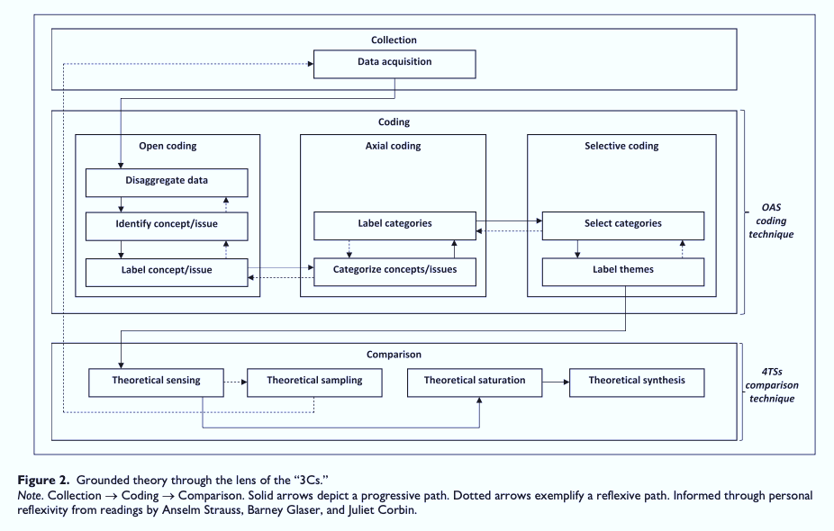
IV.1. Thematic Analysis
Want More? Grounded Theory
The “3 C’s” in Grounded Theory:
Collection.
Coding.
Comparison.
Figure from: Lim, W. M. (2024). What Is Qualitative Research? An Overview and Guidelines. Australasian Marketing Journal, 0(0), 14413582241264619. https://doi.org/10.1177/14413582241264619
Notes:
Image from: https://www.taylorfrancis.com/books/mono/10.4324/9781315108933/practical-approaches-applied-research-program-evaluation-helping-professionals-casey-barrio-minton-stephen-lenz
Braun, V., & Clarke, V. (2006). Using thematic analysis in psychology. Research in Psychology, 3(2), 77–101.
https://doi.org/10.1191/1478088706qp063oa
(Iterative: referring to a process that involves repeating a sequence of operations or procedures)

Slide 17
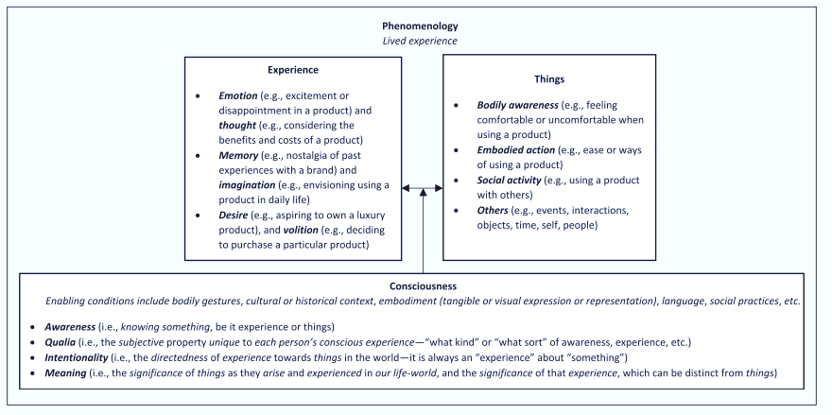
IV.1. Thematic Analysis
Want More? Phenomenology
Fig 3: Foundations of Phenomenology.
NOTE: Informed through personal reflexivity from readings by Husserl (1913) and Smith (2018).
Fig. 3 in Lim (2024).
Figure from: Lim, W. M. (2024). What Is Qualitative Research? An Overview and Guidelines. Australasian Marketing Journal, 0(0), 14413582241264619. https://doi.org/10.1177/14413582241264619
Notes:
Image from: https://www.taylorfrancis.com/books/mono/10.4324/9781315108933/practical-approaches-applied-research-program-evaluation-helping-professionals-casey-barrio-minton-stephen-lenz
Braun, V., & Clarke, V. (2006). Using thematic analysis in psychology. Research in Psychology, 3(2), 77–101.
https://doi.org/10.1191/1478088706qp063oa
(Iterative: referring to a process that involves repeating a sequence of operations or procedures)

Slide 18
IV.1. Thematic Analysis
Want More? Open, Axial, & Selective Coding
Figure 4. Open, axial, and selective coding inspired by Anselm Straus and Juliet Corbin.
Panel A. Iterative coding process.
Figure from: Lim, W. M. (2024). What Is Qualitative Research? An Overview and Guidelines. Australasian Marketing Journal, 0(0), 14413582241264619. https://doi.org/10.1177/14413582241264619
Notes:
Image from: https://www.taylorfrancis.com/books/mono/10.4324/9781315108933/practical-approaches-applied-research-program-evaluation-helping-professionals-casey-barrio-minton-stephen-lenz
Braun, V., & Clarke, V. (2006). Using thematic analysis in psychology. Research in Psychology, 3(2), 77–101.
https://doi.org/10.1191/1478088706qp063oa
(Iterative: referring to a process that involves repeating a sequence of operations or procedures)

Slide 19
IV.1. Thematic Analysis
Want More? Open, Axial, & Selective Coding
Figure 4. Open, axial, and selective coding inspired by Anselm Straus and Juliet Corbin.
Panel B. Example of coding expectations.
Figure from: Lim, W. M. (2024). What Is Qualitative Research? An Overview and Guidelines. Australasian Marketing Journal, 0(0), 14413582241264619. https://doi.org/10.1177/14413582241264619
Notes:
Image from: https://www.taylorfrancis.com/books/mono/10.4324/9781315108933/practical-approaches-applied-research-program-evaluation-helping-professionals-casey-barrio-minton-stephen-lenz
Braun, V., & Clarke, V. (2006). Using thematic analysis in psychology. Research in Psychology, 3(2), 77–101.
https://doi.org/10.1191/1478088706qp063oa
(Iterative: referring to a process that involves repeating a sequence of operations or procedures)

Slide 20
IV.1. Thematic Analysis
Figure 4. Open, axial, and selective coding inspired by Anselm Straus and Juliet Corbin.
Panel C. Surface mapping example of open, axial, and selective codes in healthy consumer lifestyle research.
Fig 4 in Lim, 2024.
Figure 4 from: Lim, W. M. (2024). What Is Qualitative Research? An Overview and Guidelines. Australasian Marketing Journal, 0(0), 14413582241264619. https://doi.org/10.1177/14413582241264619
Notes:
Image from: https://www.taylorfrancis.com/books/mono/10.4324/9781315108933/practical-approaches-applied-research-program-evaluation-helping-professionals-casey-barrio-minton-stephen-lenz
Braun, V., & Clarke, V. (2006). Using thematic analysis in psychology. Research in Psychology, 3(2), 77–101.
https://doi.org/10.1191/1478088706qp063oa
(Iterative: referring to a process that involves repeating a sequence of operations or procedures)

Slide 21
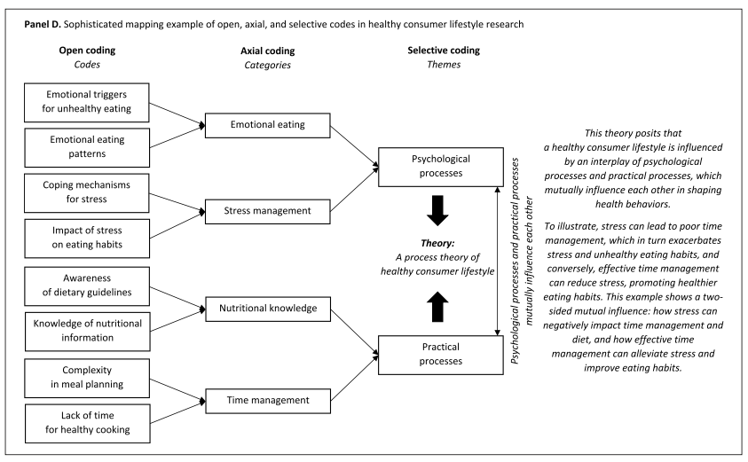
IV.1. Thematic Analysis (Coding)
Figure 4. Open, axial, and selective coding inspired by Anselm Straus and Juliet Corbin.
Panel D. Sophisticated mapping example of open, axial, and selective codes in healthy consumer lifestyle research.
Figure 4 from: Lim, W. M. (2024). What Is Qualitative Research? An Overview and Guidelines. Australasian Marketing Journal, 0(0), 14413582241264619. https://doi.org/10.1177/14413582241264619
Notes:
Image from: https://www.taylorfrancis.com/books/mono/10.4324/9781315108933/practical-approaches-applied-research-program-evaluation-helping-professionals-casey-barrio-minton-stephen-lenz
Braun, V., & Clarke, V. (2006). Using thematic analysis in psychology. Research in Psychology, 3(2), 77–101.
https://doi.org/10.1191/1478088706qp063oa
(Iterative: referring to a process that involves repeating a sequence of operations or procedures)

Slide 22
IV.2. Consensual Qualitative Research (CQR)
What is CQR?
Qualitative method focused on:
Multiple researchers.
Process of reaching consensus.
Systematic examination of representativeness of results across cases [e.g., face validity].
(Hill, Thomson, & Williams, 1997 in Barrio, Minton, & Lenz, 2019)
https://media.nngroup.com/media/editor/2022/08/17/6_steps_desktop.png
Notes:
Image from: https://www.taylorfrancis.com/books/mono/10.4324/9781315108933/practical-approaches-applied-research-program-evaluation-helping-professionals-casey-barrio-minton-stephen-lenz
Hill, C. B., Knox, S., Thompson, B. J., Williams, E. N., Hess, S. A., & Ladany, N. (2005). Consensual qualitative research: An update. Journal of Counseling Psychology, 52(2), 196–205. https://doi.org/10.1037/0022-0167.52.2.196
Hill, C. E. (2012). Introduction to consensual qualitative research. In C. E. Hill (Ed.), Consensual qualitative research: A practical resource for investigating social science phenomena (pp. 3–20, Chapter viii, 330 Pages). Washington, DC: American Psychological Association.
Hill, C. E., Thompson, B. J., & Williams, E. N. (1997). A guide to conducting consensual qualitative research. Counseling Psychologist, 25(4), 517–572.

Slide 23
IV.2. Consensual Qualitative Research (CQR)
Eight (8) Key Components of CQR
Open-ended questions avoid constraining responses.
Words used to describe phenomenon (vs. numbers).
Small number of cases are studied intensely.
Entire case used to understand specific parts of an experience.
Process is inductive; conclusions built from data (vs. imposing & testing a priori structure or theory).
https://media.nngroup.com/media/editor/2022/08/17/6_steps_desktop.png
Inductive: Forming general theories from specific observations. (Observing a repeated experience & concluding it will happen again).
Deductive: Forming specific conclusions from general premises. (“Everyone in Group X has feature Y; thus, pt N in group X has Y”).
Notes:
Image from: https://www.taylorfrancis.com/books/mono/10.4324/9781315108933/practical-approaches-applied-research-program-evaluation-helping-professionals-casey-barrio-minton-stephen-lenz
Hill, C. B., Knox, S., Thompson, B. J., Williams, E. N., Hess, S. A., & Ladany, N. (2005). Consensual qualitative research: An update. Journal of Counseling Psychology, 52(2), 196–205. https://doi.org/10.1037/0022-0167.52.2.196
Hill, C. E. (2012). Introduction to consensual qualitative research. In C. E. Hill (Ed.), Consensual qualitative research: A practical resource for investigating social science phenomena (pp. 3–20, Chapter viii, 330 Pages). Washington, DC: American Psychological Association.
Hill, C. E., Thompson, B. J., & Williams, E. N. (1997). A guide to conducting consensual qualitative research. Counseling Psychologist, 25(4), 517–572.

Slide 24
IV.2. Consensual Qualitative Research (CQR)
Eight (8) Key Components of CQR
Analytical decisions made by primary team of 3 – 5 researchers to ensure a variety of opinions are available.
Consensus enables best possible construct for all data.
One or two auditors used to check consensus judgements,
ensure primary team doesn’t overlooked important data.
Primary team continually engages in the raw data reflexively to ensure results and conclusions are accurate.
https://media.nngroup.com/media/editor/2022/08/17/6_steps_desktop.png
Hill, Thomson, & Williams, 1997 in Barrio, Minton, & Lenz, 2019
Notes:
Image from: https://www.taylorfrancis.com/books/mono/10.4324/9781315108933/practical-approaches-applied-research-program-evaluation-helping-professionals-casey-barrio-minton-stephen-lenz
Hill, C. B., Knox, S., Thompson, B. J., Williams, E. N., Hess, S. A., & Ladany, N. (2005). Consensual qualitative research: An update. Journal of Counseling Psychology, 52(2), 196–205. https://doi.org/10.1037/0022-0167.52.2.196
Hill, C. E. (2012). Introduction to consensual qualitative research. In C. E. Hill (Ed.), Consensual qualitative research: A practical resource for investigating social science phenomena (pp. 3–20, Chapter viii, 330 Pages). Washington, DC: American Psychological Association.
Hill, C. E., Thompson, B. J., & Williams, E. N. (1997). A guide to conducting consensual qualitative research. Counseling Psychologist, 25(4), 517–572.

Slide 25
IV.2. Consensual Qualitative Research (CQR)
Three (3) General Steps of CQR
Divide open-ended responses (from surveys, interviews) into domains (e.g., topic areas).
Construct core ideas (abstracts, brief summaries) for all material within each domain from each individual case.
Cross-analysis: Develop categories to describe consistencies in core ideas within domains across cases.
https://media.nngroup.com/media/editor/2022/08/17/6_steps_desktop.png
(Hill, Thomson, & Williams, 1997, as cited in Barrio, Minton, & Lenz, 2019).
Notes:
Image from: https://www.taylorfrancis.com/books/mono/10.4324/9781315108933/practical-approaches-applied-research-program-evaluation-helping-professionals-casey-barrio-minton-stephen-lenz
Hill, C. B., Knox, S., Thompson, B. J., Williams, E. N., Hess, S. A., & Ladany, N. (2005). Consensual qualitative research: An update. Journal of Counseling Psychology, 52(2), 196–205. https://doi.org/10.1037/0022-0167.52.2.196
Hill, C. E. (2012). Introduction to consensual qualitative research. In C. E. Hill (Ed.), Consensual qualitative research: A practical resource for investigating social science phenomena (pp. 3–20, Chapter viii, 330 Pages). Washington, DC: American Psychological Association.
Hill, C. E., Thompson, B. J., & Williams, E. N. (1997). A guide to conducting consensual qualitative research. Counseling Psychologist, 25(4), 517–572.

Slide 26
IV.2. Consensual Qualitative Research (CQR)
Indicators of a Good Qualitative Design (I)
Study purpose and focus are well defined & logically connected.
Logical connection of study purpose, research questions & analytic strategy.
Key informants & data sources are appropriate for study purpose and focus.
Data collection procedures clearly described, appropriate for study aims.
Trustworthiness protections are clearly described.
https://www.google.com/url?sa=i&url=https%3A%2F%2Fwww.whidbeyislandfilmfestival.org%2Fbest-in-show&psig=AOvVaw0_YKll3BCE0xQkOiYwlOzJ&ust=1743049015041000&source=images&cd=vfe&opi=89978449&ved=0CBQQjRxqFwoTCOjZjOTxpowDFQAAAAAdAAAAABAE
Notes:
Image from: https://www.taylorfrancis.com/books/mono/10.4324/9781315108933/practical-approaches-applied-research-program-evaluation-helping-professionals-casey-barrio-minton-stephen-lenz
Inductive: forming general theories from specific observations. Observing something happen repeatedly and concluding that it will happen again in the same way is an example of inductive reasoning. Deductivereasoning (also called deduction) involves forming specific conclusions from general premises,
Hill, C. B., Knox, S., Thompson, B. J., Williams, E. N., Hess, S. A., & Ladany, N. (2005). Consensual qualitative research: An update. Journal of Counseling Psychology, 52(2), 196–205. https://doi.org/10.1037/0022-0167.52.2.196
Hill, C. E. (2012). Introduction to consensual qualitative research. In C. E. Hill (Ed.), Consensual qualitative research: A practical resource for investigating social science phenomena (pp. 3–20, Chapter viii, 330 Pages). Washington, DC: American Psychological Association.
Hill, C. E., Thompson, B. J., & Williams, E. N. (1997). A guide to conducting consensual qualitative research. Counseling Psychologist, 25(4), 517–572.

Slide 27
IV.2. Consensual Qualitative Research (CQR)
Indicators of a Good Qualitative Design (II)
Ethical protections are clearly described.
Process for qualitative data analysis is clearly described.
Findings supported with direct quotations, illustrative stories.
Frequency, prevalence, & weight/intensity of findings reported.
Tables and visual depictions support reporting of findings.
https://www.google.com/url?sa=i&url=https%3A%2F%2Fwww.whidbeyislandfilmfestival.org%2Fbest-in-show&psig=AOvVaw0_YKll3BCE0xQkOiYwlOzJ&ust=1743049015041000&source=images&cd=vfe&opi=89978449&ved=0CBQQjRxqFwoTCOjZjOTxpowDFQAAAAAdAAAAABAE
Notes:
Image from: https://www.taylorfrancis.com/books/mono/10.4324/9781315108933/practical-approaches-applied-research-program-evaluation-helping-professionals-casey-barrio-minton-stephen-lenz
Inductive: forming general theories from specific observations. Observing something happen repeatedly and concluding that it will happen again in the same way is an example of inductive reasoning. Deductivereasoning (also called deduction) involves forming specific conclusions from general premises,
Hill, C. B., Knox, S., Thompson, B. J., Williams, E. N., Hess, S. A., & Ladany, N. (2005). Consensual qualitative research: An update. Journal of Counseling Psychology, 52(2), 196–205. https://doi.org/10.1037/0022-0167.52.2.196
Hill, C. E. (2012). Introduction to consensual qualitative research. In C. E. Hill (Ed.), Consensual qualitative research: A practical resource for investigating social science phenomena (pp. 3–20, Chapter viii, 330 Pages). Washington, DC: American Psychological Association.
Hill, C. E., Thompson, B. J., & Williams, E. N. (1997). A guide to conducting consensual qualitative research. Counseling Psychologist, 25(4), 517–572.

Slide 28
IV.3. Data Analysis Tools
Software systems (e.g., NVIVO) ($$)
Free or open-source software options.
Subscription-based software systems.
E.g., Dedoose (www.dedoose.com).
Enables individual and team analyses.
Subscription: $10.95/month
https://lumivero.com/products/nvivo/

Slide 29
IV.3. Data Analysis Tools
Software systems (e.g., NVIVO) ($$)
Free or open-source software options.
Subscription-based software systems.
E.g., Dedoose (www.dedoose.com).
Enables individual and team analyses.
Subscription: $10.95/month
www.dedoose.com

Slide 30
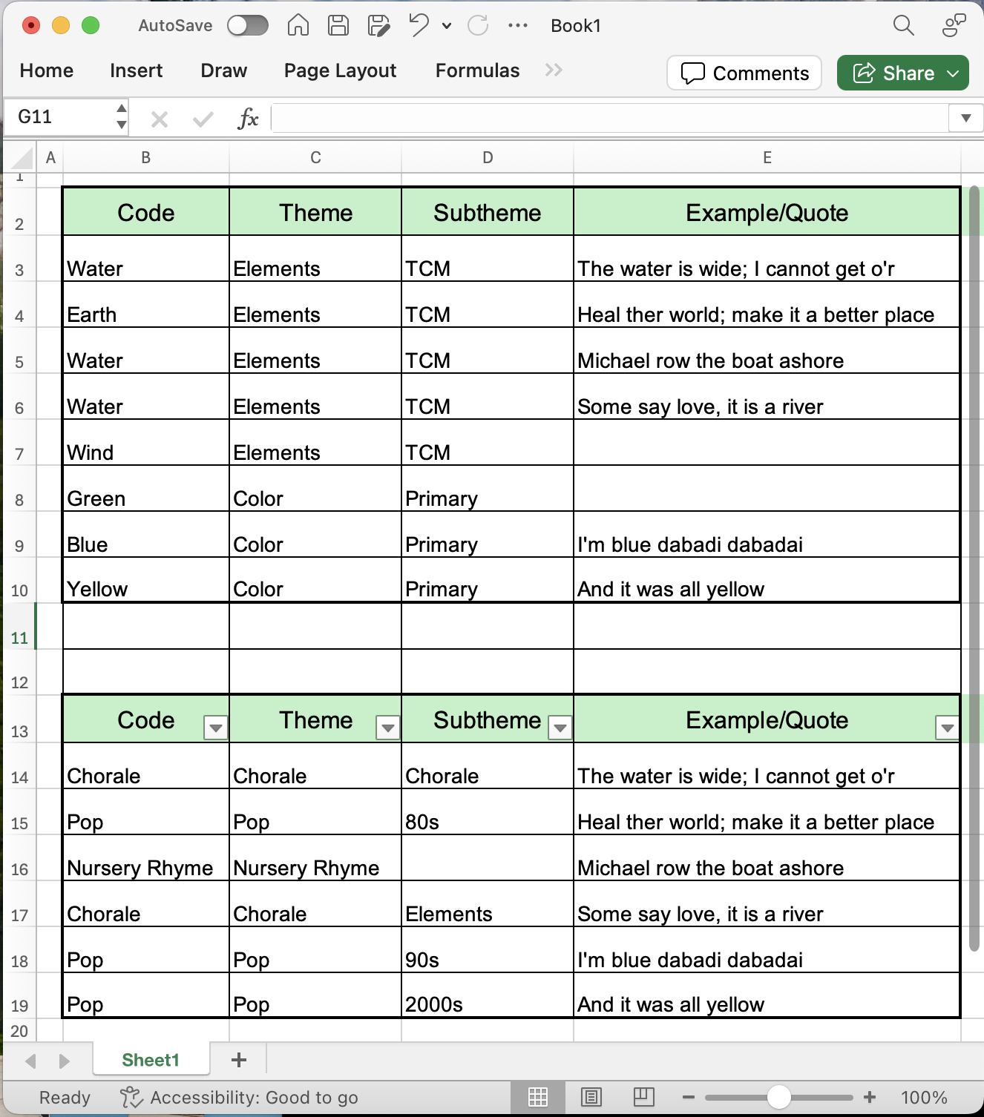
IV.3. Data Analysis Tools
Excel or Google Sheets Documents
Often used to manage coding process.
Naming codes.
Color-coding themes, categories, supporting data, quotes.
Organizing themes and categories.
Quantifying endorsement frequency rates.
Notes:
Image from: https://www.taylorfrancis.com/books/mono/10.4324/9781315108933/practical-approaches-applied-research-program-evaluation-helping-professionals-casey-barrio-minton-stephen-lenz
Inductive: forming general theories from specific observations. Observing something happen repeatedly and concluding that it will happen again in the same way is an example of inductive reasoning. Deductivereasoning (also called deduction) involves forming specific conclusions from general premises,
Hill, C. B., Knox, S., Thompson, B. J., Williams, E. N., Hess, S. A., & Ladany, N. (2005). Consensual qualitative research: An update. Journal of Counseling Psychology, 52(2), 196–205. https://doi.org/10.1037/0022-0167.52.2.196
Hill, C. E. (2012). Introduction to consensual qualitative research. In C. E. Hill (Ed.), Consensual qualitative research: A practical resource for investigating social science phenomena (pp. 3–20, Chapter viii, 330 Pages). Washington, DC: American Psychological Association.
Hill, C. E., Thompson, B. J., & Williams, E. N. (1997). A guide to conducting consensual qualitative research. Counseling Psychologist, 25(4), 517–572.

Slide 31
WE DID IT! ☺

Slide 32
BRIDG Micro-Course Qualitative Research and Analysis
Brenna Bray, PhD
BRIDG T90/R90 Fellowship Postdoctoral Training Program
NCCIH, Grant AT008924
National University of Natural Medicine (NUNM) University of Washington (UW)
NourishED Research Foundation (Boulder, CO, USA | Wilmington, DE, USA)

