Slide 1
Qualitative Research and Analysis BRIDG Micro-Course
Brenna Bray, PhD
BRIDG T90/R90 Fellowship Postdoctoral Training Program
NCCIH, Grant AT008924
National University of Natural Medicine (NUNM) University of Washington (UW)
NourishED Research Foundation (Boulder, CO, USA | Wilmington, DE, USA)

Slide 2
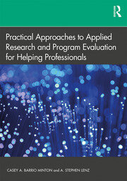
Suggested Textbooks & Readings
Textbook: Barrio Minton, C. A., & Lenz, A. S. (2019). Chapter 7: Understanding Lived Experiences. In Practical approaches to applied research and program evaluation for helping professionals. (1st Ed., pp 87 - 105). Routledge, Taylor & Francis Group. https://www.taylorfrancis.com/books/
Notes:
Image from: https://www.taylorfrancis.com/books/mono/10.4324/9781315108933/practical-approaches-applied-research-program-evaluation-helping-professionals-casey-barrio-minton-stephen-lenz
Companion Reading: Barrio Minton, C. A., & Lenz, A. S. (2019). Chapter 7: Understanding Lived Experiences. In Barrio Minton, C. A., & Lenz, A. S. (Eds.), Practical approaches to applied research and program evaluation for helping professionals. (1st Ed., pp 87 - 105). Routledge, Taylor & Francis Group.

Slide 3
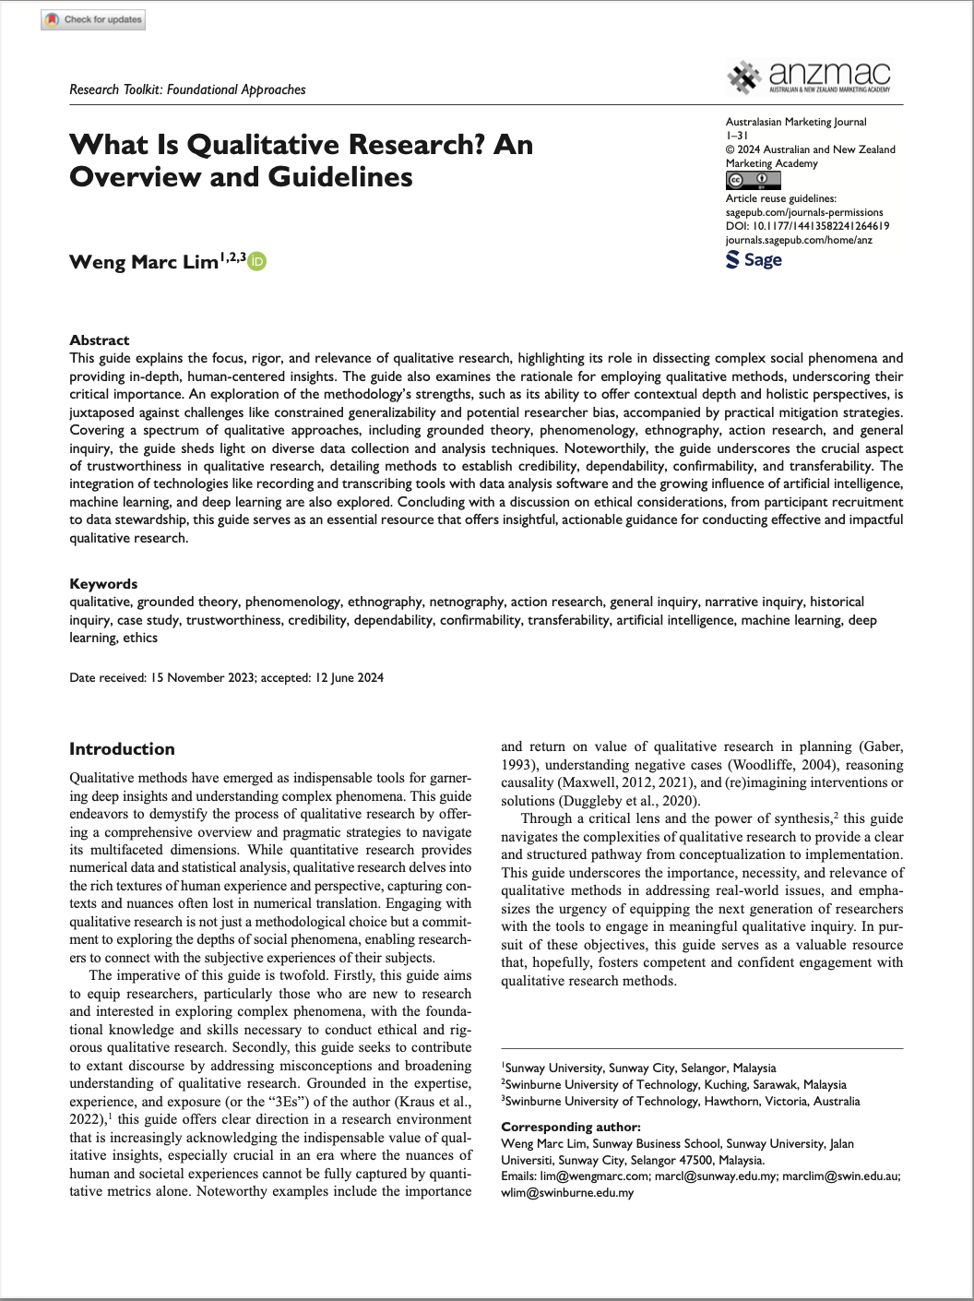
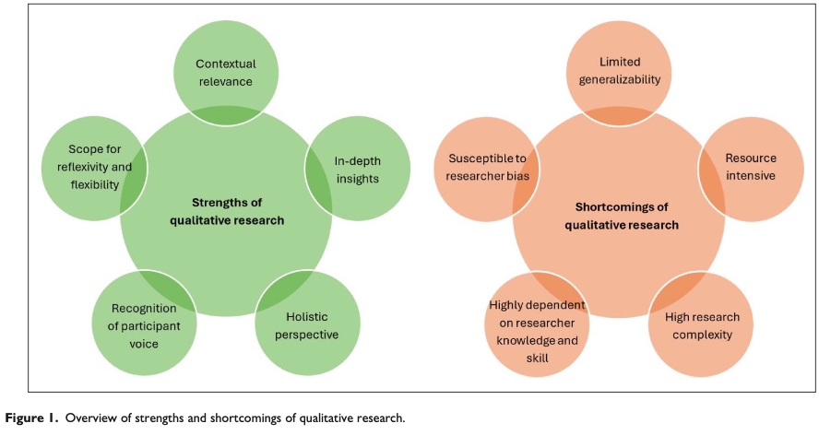
Suggested Textbooks & Readings
Textbook: Barrio Minton, C. A., & Lenz, A. S. (2019). Chapter 7: Understanding Lived Experiences. In Practical approaches to applied research and program evaluation for helping professionals. (1st Ed., pp 87 - 105). Routledge, Taylor & Francis Group. https://www.taylorfrancis.com/books/
Publication 1: Lim, W.M. (2024). What Is Qualitative Research? Overview & Guidelines. Australasian Marketing Journal, 0(0). https://doi.org/10.1177/14413582241264619.
https://doi.org/10.1177/14413582241264619

Slide 4
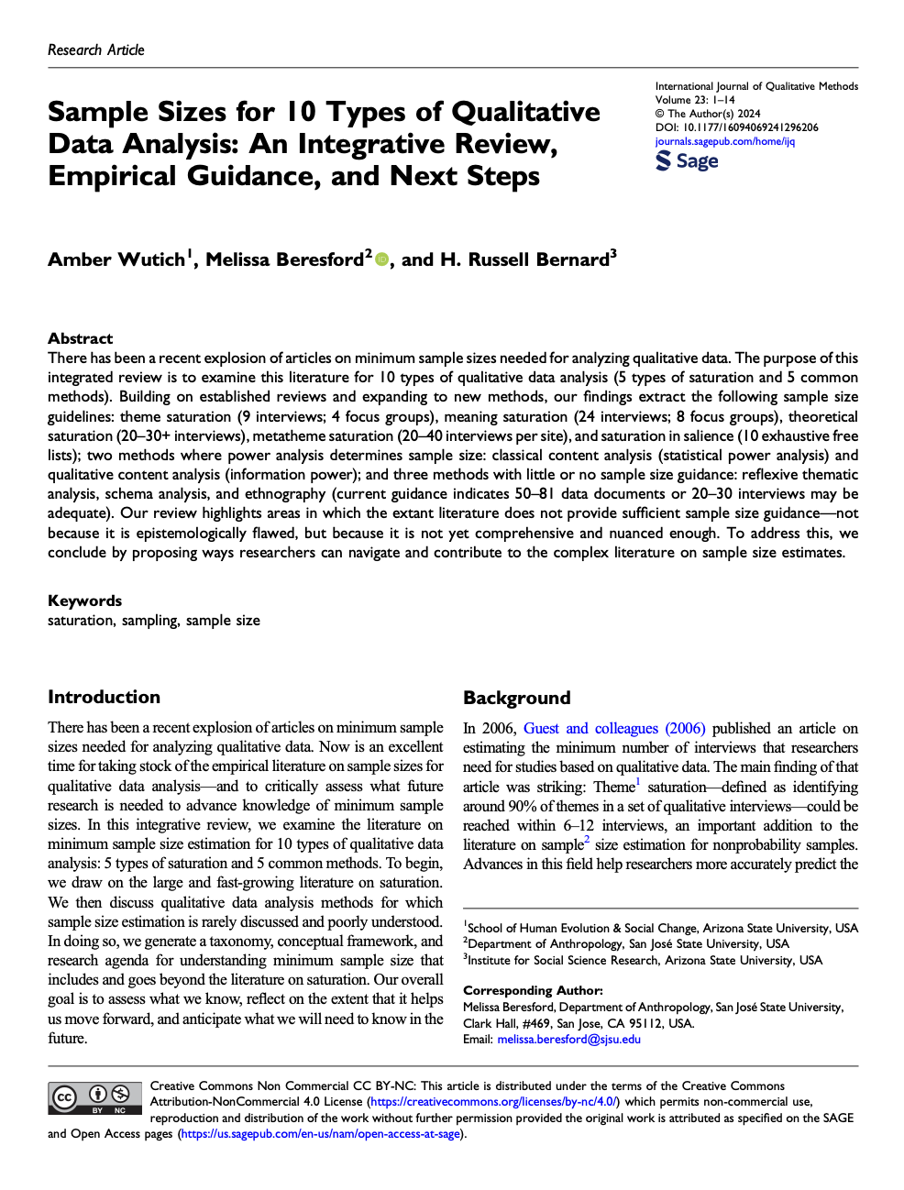
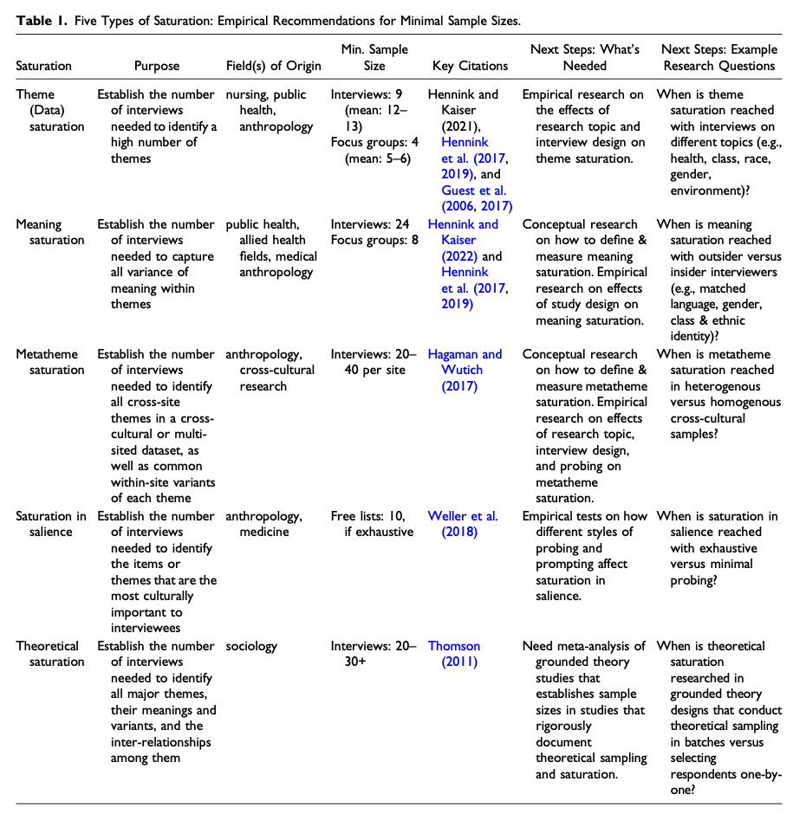
Suggested Textbooks & Readings
Textbook: Barrio Minton, C. A., & Lenz, A. S. (2019). Chapter 7: Understanding Lived Experiences. In Practical approaches to applied research and program evaluation for helping professionals. (1st Ed., pp 87 - 105). Routledge, Taylor & Francis Group. https://www.taylorfrancis.com/books/
Publication 1: Lim, W.M. (2024). What Is Qualitative Research? Overview & Guidelines. Australasian Marketing Journal, 0(0). https://doi.org/10.1177/14413582241264619.
Publication 2: Wutich, A., Beresford, M., & Bernard, H. R. (2024). Sample Sizes for 10 Types of Qualitative Data Analysis: An Integrative Review, Empirical Guidance, and Next Steps. International Journal of Qualitative Methods, 23, 16094069241296206. https://doi.org/10.1177/16094069241296206. (Module 3).
https://doi.org/10.1177/16094069241296206
Notes:
Image from: https://www.taylorfrancis.com/books/mono/10.4324/9781315108933/practical-approaches-applied-research-program-evaluation-helping-professionals-casey-barrio-minton-stephen-lenz
Companion Reading: Barrio Minton, C. A., & Lenz, A. S. (2019). Chapter 7: Understanding Lived Experiences. In Barrio Minton, C. A., & Lenz, A. S. (Eds.), Practical approaches to applied research and program evaluation for helping professionals. (1st Ed., pp 87 - 105). Routledge, Taylor & Francis Group.

Slide 5
Content Overview
Overview of Qualitative Research
Classic Types of Qualitative Research Designs
Qualitative Evaluation Process
Qualitative Data Analysis
Reporting Findings
Guidelines
https://www.taylorfrancis.com/books/mono/10.4324/9781315108933/practical-approaches-applied-research-program-evaluation-helping-professionals-casey-barrio-minton-stephen-lenz
Notes:
Image from: https://www.taylorfrancis.com/books/mono/10.4324/9781315108933/practical-approaches-applied-research-program-evaluation-helping-professionals-casey-barrio-minton-stephen-lenz
Companion Reading: Barrio Minton, C. A., & Lenz, A. S. (2019). Chapter 7: Understanding Lived Experiences. In Barrio Minton, C. A., & Lenz, A. S. (Eds.), Practical approaches to applied research and program evaluation for helping professionals. (1st Ed., pp 87 - 105). Routledge, Taylor & Francis Group.

Slide 6
Module 1 Overview
I. Overview of Qualitative Research
What is Qualitative Research?
When Are Qualitative Designs Indicated?
Understanding Lived Experiences
Development, Evaluation (Program, Intervention, Design)
Needs Assessment
Process Evaluation
Satisfaction Estimate
Giving Context to Quantitative Findings
Understanding “What,” “Why,” “How?”
Strengths & Limitations of Qualitative Research
https://www.taylorfrancis.com/books/mono/10.4324/9781315108933/practical-approaches-applied-research-program-evaluation-helping-professionals-casey-barrio-minton-stephen-lenz
Notes:
Image from: https://www.taylorfrancis.com/books/mono/10.4324/9781315108933/practical-approaches-applied-research-program-evaluation-helping-professionals-casey-barrio-minton-stephen-lenz
Companion Reading: Barrio Minton, C. A., & Lenz, A. S. (2019). Chapter 7: Understanding Lived Experiences. In Barrio Minton, C. A., & Lenz, A. S. (Eds.), Practical approaches to applied research and program evaluation for helping professionals. (1st Ed., pp 87 - 105). Routledge, Taylor & Francis Group.

Slide 7
Module 1 Overview
Module 1: Overview of Qualitative Research
Module Content | Readings | Course Objectives
Video//PowerPoint Lecture What is Qualitative Research? Qualitative vs. Quantitative Research When are Qualitative Designs Indicated? Understanding Lived Experiences Development & Evaluation Needs Assessment Process Evaluation Satisfaction Estimates Contextualizing Quantitative Data Exploring “What,” “Why,” “How?” Strengths & Limitations Exam 1 (7 Questions; 14 points, 14%) | Barrio Minton & Lenz (2019). Ch. 7, Section 1 (Overview of Qualitative Research Designs). Ch. 6, Section 3 (Types of Survey Designs). Lim, (2024). Pages 1 – 6 (column 1 on pg. 6). | Develop research questions consistent with use of qualitative methodology Understand when qualitative methods may be appropriate for use in applied research and program evaluation endeavors Articulate key features of needs assessments, process assessments, and satisfaction estimation Identify strengths and limitations of qualitative designs
https://doi.org/10.1177/14413582241264619
https://www.taylorfrancis.com/books/mono/10.4324/9781315108933/practical-approaches-applied-research-program-evaluation-helping-professionals-casey-barrio-minton-stephen-lenz
Notes:
Companion Reading: Barrio Minton, C. A., & Lenz, A. S. (2019). Chapter 7: Understanding Lived Experiences. In Barrio Minton, C. A., & Lenz, A. S. (Eds.), Practical approaches to applied research and program evaluation for helping professionals. (1st Ed., pp 87 - 105). Routledge, Taylor & Francis Group.

Slide 8
Module 2 Overview
II. Classic Types of Qualitative Research Designs
Phenomenology
Grounded Theory
Narrative Inquiry
Ethnography
Case Study
https://www.taylorfrancis.com/books/mono/10.4324/9781315108933/practical-approaches-applied-research-program-evaluation-helping-professionals-casey-barrio-minton-stephen-lenz
Notes:
Image from: https://www.taylorfrancis.com/books/mono/10.4324/9781315108933/practical-approaches-applied-research-program-evaluation-helping-professionals-casey-barrio-minton-stephen-lenz
Companion Reading: Barrio Minton, C. A., & Lenz, A. S. (2019). Chapter 7: Understanding Lived Experiences. In Barrio Minton, C. A., & Lenz, A. S. (Eds.), Practical approaches to applied research and program evaluation for helping professionals. (1st Ed., pp 87 - 105). Routledge, Taylor & Francis Group.

Slide 9
Module 2 Overview
Module 2: Classic Types of Qualitative Research Designs
Module Content | Readings | Course Objectives
Video//PowerPoint Lecture Phenomenology Grounded Theory Narrative Inquiry Ethnography Case Study Module 2 Quiz 3 Questions 6 Points 6% of Total Course Grade | Barrio Minton & Lenz (2019). Ch. 7, Section 2 (Classic Types of Qualitative Research Designs). Lim, (2024). Pages 6 – 16 (scan) Table 4. | Articulate key features, uses, strengths, limitations, and resource needs of different types of qualitative research designs
https://www.taylorfrancis.com/books/mono/10.4324/9781315108933/practical-approaches-applied-research-program-evaluation-helping-professionals-casey-barrio-minton-stephen-lenz
Notes:
Companion Reading: Barrio Minton, C. A., & Lenz, A. S. (2019). Chapter 7: Understanding Lived Experiences. In Barrio Minton, C. A., & Lenz, A. S. (Eds.), Practical approaches to applied research and program evaluation for helping professionals. (1st Ed., pp 87 - 105). Routledge, Taylor & Francis Group.

Slide 10
Module 3 Overview
III. Qualitative Evaluation Processes
Determining Inquiry Purpose and Focus
Identifying Key Informants and Data Sources
Data Collection Procedures
Semi-Structured Interviews
Focus Groups
Document Review
Sample Size Guidance for Analysis, Design, & Saturation Types
Data Management Strategies
Trustworthiness Protections
Responsible Conduct in Research
https://www.taylorfrancis.com/books/mono/10.4324/9781315108933/practical-approaches-applied-research-program-evaluation-helping-professionals-casey-barrio-minton-stephen-lenz
Notes:
Companion Reading: Barrio Minton, C. A., & Lenz, A. S. (2019). Chapter 7: Understanding Lived Experiences. In Barrio Minton, C. A., & Lenz, A. S. (Eds.), Practical approaches to applied research and program evaluation for helping professionals. (1st Ed., pp 87 - 105). Routledge, Taylor & Francis Group.

Slide 11
Module 3 Overview
Module 3: Qualitative Evaluation Processes
Module Content | Readings | Course Objectives
Video//PowerPoint Lecture Inquiry Purpose and Focus Key Informants & Data Sources Data Collection Procedures Semi-Structured Interviews Focus Groups Document Review Sample Size Guidance Data Management Strategies Trustworthiness Protections Responsible Conduct in Research Module 3 Quiz 14 Questions, 24 Points, 24% of Grade | Barrio Minton & Lenz (2019). Ch. 7, Section 3 (Qualitative Evaluation Process). Lim. (2024). Pgs. 6 – 16 (scan). Table 4. Wutich et al. (2024). SCAN. Note: Tables 1 – 2, Fig. 1. | Identify key sources of information and data collection that can be useful in qualitative analyses Develop procedures for conducting semi-structured interviews, focus groups, and document analysis Identify appropriate sample sizes for qualitative research studies based on analytic approach, design, and saturation preferences Develop strategies for data management Identify procedures for ensuring data trustworthiness Critique studies using qualitative methodology
Notes:
Companion Reading: Barrio Minton, C. A., & Lenz, A. S. (2019). Chapter 7: Understanding Lived Experiences. In Barrio Minton, C. A., & Lenz, A. S. (Eds.), Practical approaches to applied research and program evaluation for helping professionals. (1st Ed., pp 87 - 105). Routledge, Taylor & Francis Group.

Slide 12
Module 4 Overview
IV. Qualitative Data Analysis
Thematic Analysis
Braun & Clarke’s 6 Phases of Thematic Analysis (2006):
(1) Data Familiarization; (2) Initial Code Generation; (3) Searching for Themes; (4) Reviewing Themes; (5) Defining and Naming Themes; (6) Producing the Report.
Consensual Qualitative Research (CQR)
Hill et al.’s 3 Steps: (1) Divide responses into domains; (2) Construct core ideas within each domain; (3) Cross-Analysis. (2005, 2012).
Data Analysis Tools
NVIVO, Dedoose, Microsoft Office, Google Sheets
https://www.taylorfrancis.com/books/mono/10.4324/9781315108933/practical-approaches-applied-research-program-evaluation-helping-professionals-casey-barrio-minton-stephen-lenz
Notes:
Image from: https://www.taylorfrancis.com/books/mono/10.4324/9781315108933/practical-approaches-applied-research-program-evaluation-helping-professionals-casey-barrio-minton-stephen-lenz
Companion Reading: Barrio Minton, C. A., & Lenz, A. S. (2019). Chapter 7: Understanding Lived Experiences. In Barrio Minton, C. A., & Lenz, A. S. (Eds.), Practical approaches to applied research and program evaluation for helping professionals. (1st Ed., pp 87 - 105). Routledge, Taylor & Francis Group.

Slide 13
Module 4 Overview
Module 4: Qualitative Data Analysis
Module Content | Readings | Course Objectives
Video//PowerPoint Lecture Thematic Analysis Braun & Clarke’s 6 Phases of Thematic Analysis (2006). Consensual Qualitative Research (CQR) Hill et al.’s 3 General Steps (2005). Data Analysis Tools NVIVO, Dedoose, Microsoft Excel, Google Sheets Module 4 Quiz 10 Questions, 20 Points, 20% Grade Module 4 Quiz 2: Coding Experience 6 Questions, 12 Points, 12% Grade | Barrio Minton & Lenz (2019). Ch. 7, Section 4 (Qualitative Data Analysis). Lim, (2024). Page 20 – 24 (scan). Page 26 – 30 (scan). | Design, plan, conduct, record, and analyze qualitative research Identify six key phases of thematic analysis Communicate benefits and strengths of consensual qualitative approaches Distill multi-step analytic processes to their essence. Identify common methods of analyzing qualitative data Critique studies using qualitative methodology of surveys for needs assessments, process evaluations, and satisfaction estimations
https://www.taylorfrancis.com/books/mono/10.4324/9781315108933/practical-approaches-applied-research-program-evaluation-helping-professionals-casey-barrio-minton-stephen-lenz
Notes:
Companion Reading: Barrio Minton, C. A., & Lenz, A. S. (2019). Chapter 7: Understanding Lived Experiences. In Barrio Minton, C. A., & Lenz, A. S. (Eds.), Practical approaches to applied research and program evaluation for helping professionals. (1st Ed., pp 87 - 105). Routledge, Taylor & Francis Group.

Slide 14
Module 5 Overview
V. Reporting Findings
Reporting Priorities
Reporting Tips
Reporting Components
Applications
https://www.taylorfrancis.com/books/mono/10.4324/9781315108933/practical-approaches-applied-research-program-evaluation-helping-professionals-casey-barrio-minton-stephen-lenz
Notes:
Image from: https://www.taylorfrancis.com/books/mono/10.4324/9781315108933/practical-approaches-applied-research-program-evaluation-helping-professionals-casey-barrio-minton-stephen-lenz
Companion Reading: Barrio Minton, C. A., & Lenz, A. S. (2019). Chapter 7: Understanding Lived Experiences. In Barrio Minton, C. A., & Lenz, A. S. (Eds.), Practical approaches to applied research and program evaluation for helping professionals. (1st Ed., pp 87 - 105). Routledge, Taylor & Francis Group.

Slide 15
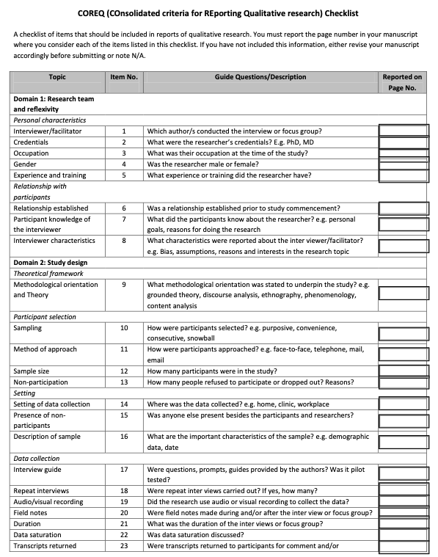
Module 5 Overview
Module 5: Reporting Findings
Module Content | Readings | Course Objectives
Video//PowerPoint Lecture Reporting Priorities Reporting Tips Reporting Components Applications Module 5 Quiz 6 Questions 12 Points 12 % of Course Grade | Barrio Minton & Lenz (2019). Ch. 7, Section 5 (Reporting Findings). See Reporting Guideline Documents in Module 6. | Develop research questions consistent with use of qualitative methodology Communicate findings from qualitative analyses
https://legacyfileshare.elsevier.com/promis_misc/ISSM_COREQ_Checklist.pdf
Notes:
Companion Reading: Barrio Minton, C. A., & Lenz, A. S. (2019). Chapter 7: Understanding Lived Experiences. In Barrio Minton, C. A., & Lenz, A. S. (Eds.), Practical approaches to applied research and program evaluation for helping professionals. (1st Ed., pp 87 - 105). Routledge, Taylor & Francis Group.

Slide 16
Module 6 Overview
VI. Qualitative Analysis Guidance Documents
Overall Quality Criteria
Determining Sample Sizes
Reporting Standards
Health & Healthcare (COREQ)
Psychology Research (JARS-Q)
Values-Based Reporting (Braun & Clarke, 2024)
https://www.taylorfrancis.com/books/mono/10.4324/9781315108933/practical-approaches-applied-research-program-evaluation-helping-professionals-casey-barrio-minton-stephen-lenz
Notes:
Image from: https://www.taylorfrancis.com/books/mono/10.4324/9781315108933/practical-approaches-applied-research-program-evaluation-helping-professionals-casey-barrio-minton-stephen-lenz
Companion Reading: Barrio Minton, C. A., & Lenz, A. S. (2019). Chapter 7: Understanding Lived Experiences. In Barrio Minton, C. A., & Lenz, A. S. (Eds.), Practical approaches to applied research and program evaluation for helping professionals. (1st Ed., pp 87 - 105). Routledge, Taylor & Francis Group.

Slide 17
Module 6 Overview
Module 6: Qualitative Analysis Guidance Documents
Module Content | Readings | Course Objectives
Video//PowerPoint Lecture Overall Quality Criteria Determining Sample Sizes Reporting Standards Health & Healthcare Research Psychology Research Values-Based Reporting Module 5 Quiz 6 Questions 12 Points 12 % of Course Grade | See Reporting Guideline Documents in the PowerPoint Lecture (and on the next two slides). | Engage with guidance documents on qualitative research conduct and reporting. Identify qualitative guidance documents that can support future qualitative research.
https://legacyfileshare.elsevier.com/promis_misc/ISSM_COREQ_Checklist.pdf
Notes:
Companion Reading: Barrio Minton, C. A., & Lenz, A. S. (2019). Chapter 7: Understanding Lived Experiences. In Barrio Minton, C. A., & Lenz, A. S. (Eds.), Practical approaches to applied research and program evaluation for helping professionals. (1st Ed., pp 87 - 105). Routledge, Taylor & Francis Group.

Slide 18
Module 6 Overview
Module 6: Qualitative Analysis Guidance Documents
Module Content & Readings (I)
Overall Quality Criteria Qualitative Research Overview and Guidelines (Lim, 2024) Criteria for Good Qualitative Research (Ydav & Drishti, 2022) General & Specific Guidelines for Quality Analysis in Psychology Research (Cena et al, 2024). The Oxford Handbook of Qualitative Research. (Leavy (Ed.), 2020). Practical Approaches to Applied Research & Program Evaluation for Helping Professionals (Barrio Minton & Lenz, 2019). Determining Sample Sizes Sample Sizes for 10 Types of Qualitative Data Analyses (Wutich et al., 2024) Sample Sizes for Saturation in Qualitative Research (Hennink & Kaiser, 2022)
Notes:
Companion Reading: Barrio Minton, C. A., & Lenz, A. S. (2019). Chapter 7: Understanding Lived Experiences. In Barrio Minton, C. A., & Lenz, A. S. (Eds.), Practical approaches to applied research and program evaluation for helping professionals. (1st Ed., pp 87 - 105). Routledge, Taylor & Francis Group.

Slide 19
Module 6 Overview
Module 6: Qualitative Analysis Guidance Documents
Module Content & Readings (II)
Reporting Standards Health & Healthcare Research COREQ (COnsolidated Criteria for Reporting Qualitative studies). In Guidelines for Reporting Health Research: A User's Manual. (Booth et al., 2014; Tong et al., 2007). Psychology Research JARS-Q (APA Style Journal Article Reporting Standards) (APA, 2020; Levitt et al., 2018) Values-Based Reporting Reporting Guidelines for Qualitative Research: Values-Based Approach (Braun & Clarke, 2024)
Notes:
Companion Reading: Barrio Minton, C. A., & Lenz, A. S. (2019). Chapter 7: Understanding Lived Experiences. In Barrio Minton, C. A., & Lenz, A. S. (Eds.), Practical approaches to applied research and program evaluation for helping professionals. (1st Ed., pp 87 - 105). Routledge, Taylor & Francis Group.

Slide 20
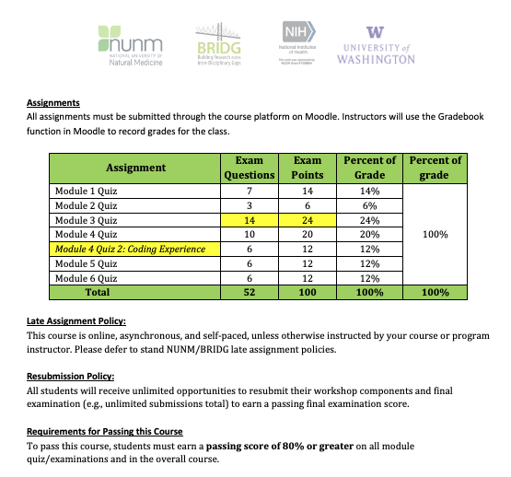
Content Overview: Module Examinations

Slide 21
Let’s Get Started! ☺

Slide 22
Qualitative Research and Analysis BRIDG Micro-Course
Brenna Bray, PhD
BRIDG T90/R90 Fellowship Postdoctoral Training Program
NCCIH, Grant AT008924
National University of Natural Medicine (NUNM) University of Washington (UW)
NourishED Research Foundation (Boulder, CO, USA | Wilmington, DE, USA)

