Slide 1
BRIDG Micro-Course Qualitative Research and Analysis
Brenna Bray, PhD
BRIDG T90/R90 Fellowship Postdoctoral Training Program
NCCIH, Grant AT008924
National University of Natural Medicine (NUNM) University of Washington (UW)
NourishED Research Foundation (Boulder, CO, USA | Wilmington, DE, USA)

Slide 2
BRIDG Micro-Course Module 3: Qualitative Evaluation Process
Brenna Bray, PhD
BRIDG T90/R90 Fellowship Postdoctoral Training Program
NCCIH, Grant AT008924
National University of Natural Medicine (NUNM) University of Washington (UW)
NourishED Research Foundation (Boulder, CO, USA | Wilmington, DE, USA)

Slide 3
Content Overview
Overview of Qualitative Research
Classic Types of Qualitative Research Designs
Qualitative Evaluation Process
Qualitative Data Analysis
Reporting Findings
Guidelines
https://www.taylorfrancis.com/books/mono/10.4324/9781315108933/practical-approaches-applied-research-program-evaluation-helping-professionals-casey-barrio-minton-stephen-lenz

Slide 4
Content Overview: Lesson 3
III. Qualitative Evaluation Processes
Determining Inquiry Purpose and Focus
Identifying Key Informants and Data Sources
Data Collection Procedures
Semi-Structured Interviews
Focus Groups
Document Review
Sample Size Guidance for Analysis, Design, & Saturation Types
Data Management Strategies
Trustworthiness Protections
Responsible Conduct in Research
https://www.taylorfrancis.com/books/mono/10.4324/9781315108933/practical-approaches-applied-research-program-evaluation-helping-professionals-casey-barrio-minton-stephen-lenz

Slide 5
Content Overview: Module 3
III. Qualitative Evaluation Processes
Determining Inquiry Purpose and Focus
Identifying Key Informants and Data Sources
Data Collection Procedures
Semi-Structured Interviews
Focus Groups
Document Review
Sample Size Guidance for Analysis, Design, & Saturation Types
Data Management Strategies
Trustworthiness Protections
Responsible Conduct in Research
https://www.taylorfrancis.com/books/mono/10.4324/9781315108933/practical-approaches-applied-research-program-evaluation-helping-professionals-casey-barrio-minton-stephen-lenz

Slide 6
Content Overview: Module 3
Module 3: Qualitative Evaluation Processes
Module Content | Readings | Course Objectives
Video//PowerPoint Lecture Inquiry Purpose and Focus Key Informants & Data Sources Data Collection Procedures Semi-Structured Interviews Focus Groups Document Review Sample Size Guidance Data Management Strategies Trustworthiness Protections Responsible Conduct in Research Module 3 Quiz 14 Questions, 24 Points, 24% of Grade | Barrio Minton & Lenz (2019). Ch. 7, Section 3 (Qualitative Evaluation Process). Lim. (2024). Pgs. 6 – 16 (scan). Table 4. Wutich et al. (2024). SCAN. Note: Tables 1 – 2, Fig. 1. | Identify key sources of information and data collection that can be useful in qualitative analyses Develop procedures for conducting semi-structured interviews, focus groups, and document analysis Identify appropriate sample sizes for qualitative research studies based on analytic approach, design, and saturation preferences Develop strategies for data management Identify procedures for ensuring data trustworthiness Critique studies using qualitative methodology

Slide 7
Content Overview: Module Examinations

Slide 8
III. Qualitative Evaluation Processes
Determining the Purpose and Focus of the Inquiry.
Identifying Key Informants and Data Sources.
Data Collection Procedures.
Data Management Strategy.
Ethical Protections.
Trustworthiness Protections.
Determining the Purpose and Focus of the Inquiry.
Identifying Key Informants and Data Sources.
Data Collection Procedures.
Observations, Records, Surveys.
Semi-Structured Interviews.
Focus Groups, Delphi Panels.

Slide 9
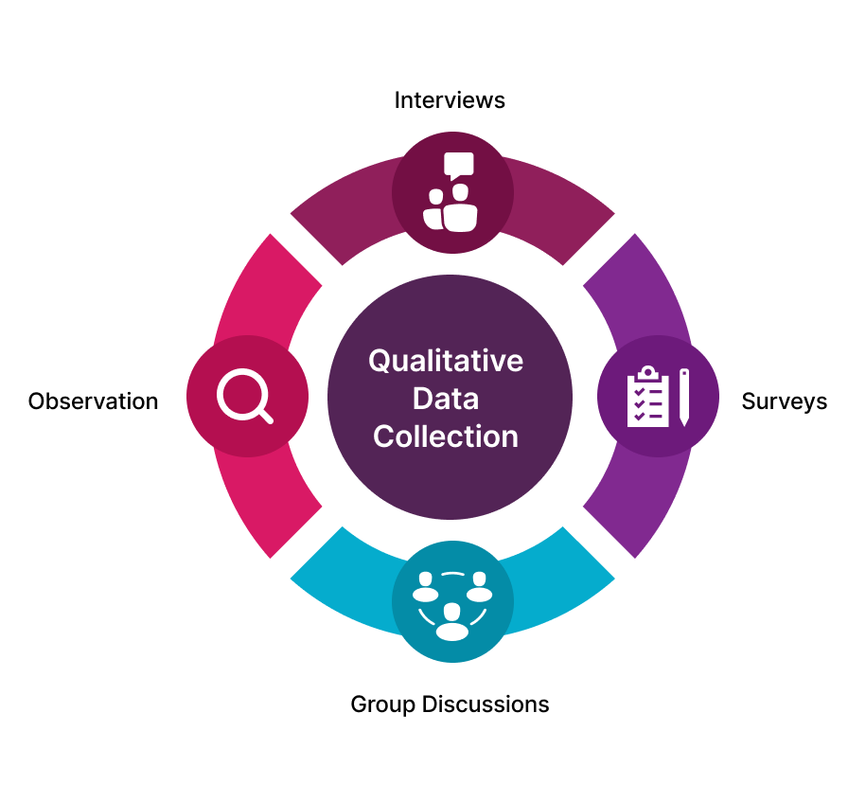
III. Qualitative Evaluation Processes
Determining the Purpose and Focus of the Inquiry.
Identifying Key Informants and Data Sources.
Data Collection Procedures.
Observations, Records, Surveys.
Semi-Structured Interviews.
Focus Groups, Delphi Panels.
https://cdn.brocoders.com/Qualitative_Data_Collection_Methods_49b867c159.png
Notes:
Image from: https://www.taylorfrancis.com/books/mono/10.4324/9781315108933/practical-approaches-applied-research-program-evaluation-helping-professionals-casey-barrio-minton-stephen-lenz

Slide 10
III. Qualitative Evaluation Processes
Determining the Purpose and Focus of the Inquiry.
Identifying Key Informants and Data Sources.
Data Collection Procedures.
Data Management Strategy.
Ethical Protections.
Trustworthiness Protections.
Determining the Purpose and Focus of the Inquiry.
Identifying Key Informants and Data Sources.
Data Collection Procedures.
Data Management Strategy.
Trustworthiness Protections.
Ethical Protections.
Notes:
Image from: https://www.taylorfrancis.com/books/mono/10.4324/9781315108933/practical-approaches-applied-research-program-evaluation-helping-professionals-casey-barrio-minton-stephen-lenz

Slide 11
III.1. Determine Inquiry Purpose and Focus
What do we want to understand?
Pathology, Population, Intervention, Program, Policy, Institution, Organization, Consumer Group?
Experience, Phenomenon?
Why do we want to answer these questions?
How will we use our responses/findings?
https://thumbs.dreamstime.com/b/what-do-i-need-to-know-person-thinking-d-words-letters-thinker-wondering-information-must-have-job-task-47570946.jpg

Slide 12
III.2. Identify Key Informants & Data Sources
How can we best access the type of information we need to answer our questions?
Through People? Patients, Providers, Experts?
Purposive Sampling (linked to inquiry purpose).
May include wide range of strategies:
Typical and atypical // deviant cases.
Maximum variation sampling (broad perspectives).
https://thumbs.dreamstime.com/b/thinker-person-asks-questions-who-what-where-24936629.jpg

Slide 13
III.2. Identify Key Informants & Data Sources
How can we best access the type of information we need to answer our questions?
Through People? (Who?)
Through Records? (Which Ones?)
Medical/Clinical Records, School/Agency Reports.
Review intake records vs. Interview new clients…
https://thumbs.dreamstime.com/b/thinker-person-asks-questions-who-what-where-24936629.jpg

Slide 14
III.2. Identify Key Informants and Data Sources
Who should be responsible for data collection?
Interview expertise.
Strong interpersonal skills.
Familiarity with focus phenomenon/population.
Caution against service providers.
(Given power differential, emotional ties with clients).
https://thumbs.dreamstime.com/b/thinker-person-asks-questions-who-what-where-24936629.jpg

Slide 15
III.3. Data Collection Procedures
What specific methods should be used to collect data?
Semi-Structured Interviews (Phone, Virtual, In-Person).
Focus Groups (Virtual or In-Person).
Observations.
Open-Ended Survey Responses.
Existing Documents (Client Files, Agency Records).
Guide/Script for Interviews and Focus Groups.
https://cdn.brocoders.com/Qualitative_Data_Collection_Methods_49b867c159.png

Slide 16
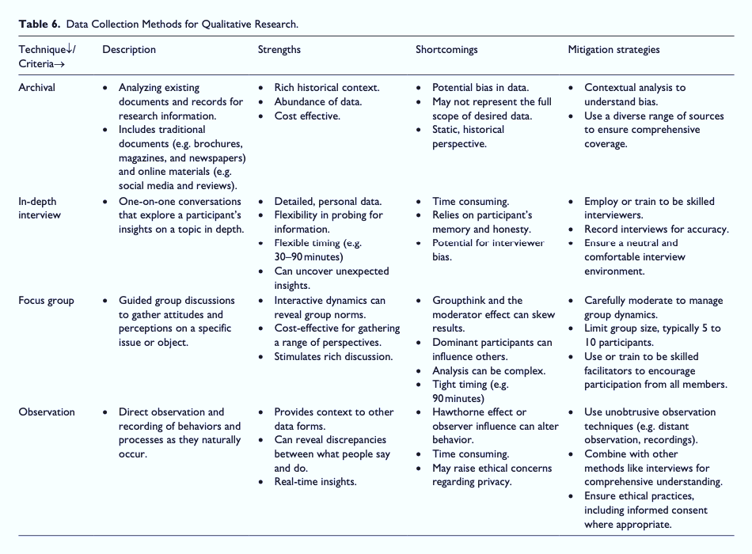
III.3. Data Collection Procedures
Table 6: Data Collection Methods for Qualitative Research
Figure from: Lim, W. M. (2024). What Is Qualitative Research? An Overview and Guidelines. Australasian Marketing Journal, 0(0), 14413582241264619. https://doi.org/10.1177/14413582241264619

Slide 17
III.4. Semi-Structured Interviews
What are Semi-Structured Interviews?
Individual (one-on-one) interviews.
Usually conversational tone.
Open- and closed-ended questions.
Follow-up probes to elicit deeper understanding.
(Adams, 2010 in Barrio, Minton, & Lenz, 2019)
https://www.telemedicine4you.com/call-a-doctor.html; https://www.leagueofwomeningovernment.org/2016/03/todays-how-to-post-how-to-ace-a-phone-interview/
https://www.taylorfrancis.com/books/mono/10.4324/9781315108933/practical-approaches-applied-research-program-evaluation-helping-professionals-casey-barrio-minton-stephen-lenz
Notes:
Image from: https://www.taylorfrancis.com/books/mono/10.4324/9781315108933/practical-approaches-applied-research-program-evaluation-helping-professionals-casey-barrio-minton-stephen-lenz
Adams, W. C. (2010). Conducting semi-structured interviews. In practical program evaluation (3rd ed., pp. 365–377). San Francisco, CA: John Wiley & Sons.

Slide 18
III.4. Semi-Structured Interviews
When are Semi-Structured Interviews Appropriate (I)?
Understand individuals’ independent thoughts.
Protect anonymity (and response authenticity).
One-on-one time with expert(s)/provider(s), etc.
Explore uncharted territory or “puzzles.”
(Adams, 2010 in Barrio, Minton, & Lenz, 2019)
https://www.telemedicine4you.com/call-a-doctor.html; https://www.leagueofwomeningovernment.org/2016/03/todays-how-to-post-how-to-ace-a-phone-interview/
https://www.taylorfrancis.com/books/mono/10.4324/9781315108933/practical-approaches-applied-research-program-evaluation-helping-professionals-casey-barrio-minton-stephen-lenz
Notes:
Image from: https://www.taylorfrancis.com/books/mono/10.4324/9781315108933/practical-approaches-applied-research-program-evaluation-helping-professionals-casey-barrio-minton-stephen-lenz
Adams, W. C. (2010). Conducting semi-structured interviews. In practical program evaluation (3rd ed., pp. 365–377). San Francisco, CA: John Wiley & Sons.

Slide 19
III.4. Semi-Structured Interviews
When are Semi-Structured Interviews Appropriate (II)?
Seek individual perspectives and narratives.
Seek personal and sensitive information.
Collect detailed, in-depth information.
Describe complex issues or processes.
Access geographically dispersed participants.
(Hennick, 2014 in Barrio, Minton, & Lenz, 2019).
https://www.telemedicine4you.com/call-a-doctor.html; https://www.leagueofwomeningovernment.org/2016/03/todays-how-to-post-how-to-ace-a-phone-interview/
Notes:
Image from: https://www.taylorfrancis.com/books/mono/10.4324/9781315108933/practical-approaches-applied-research-program-evaluation-helping-professionals-casey-barrio-minton-stephen-lenz
Hennick, M. M. (2014). Focus group discussions: Understanding qualitative research. New York, NY: Oxford University Press.

Slide 20
III.4. Semi-Structured Interviews
Designing Semi-Structured Interviews (“Dating 101”)
Optimal timing (<1 hour).
Careful topic selection.
Careful question ordering.
Most important questions first.
Ease into sensitive topics.
(Hennick, 2014 in Barrio, Minton, & Lenz, 2019).
https://www.telemedicine4you.com/call-a-doctor.html; https://www.leagueofwomeningovernment.org/2016/03/todays-how-to-post-how-to-ace-a-phone-interview/
Notes:
Image from: https://www.taylorfrancis.com/books/mono/10.4324/9781315108933/practical-approaches-applied-research-program-evaluation-helping-professionals-casey-barrio-minton-stephen-lenz
Hennick, M. M. (2014). Focus group discussions: Understanding qualitative research. New York, NY: Oxford University Press.

Slide 21
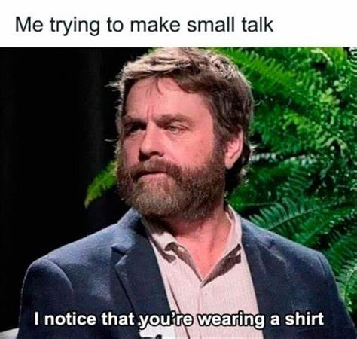
III.4. Semi-Structured Interviews
Designing Semi-Structured Interviews (“Dating 101”)
Optimal timing (<1 hour).
Careful topic selection.
Careful question ordering.
Most important questions first.
Ease into sensitive topics.
Just Like a First Date. ☺
https://www.telemedicine4you.com/call-a-doctor.html; https://www.leagueofwomeningovernment.org/2016/03/todays-how-to-post-how-to-ace-a-phone-interview/
https://th.bing.com/th/id/OIP.oUReLS79WpzDqNqZQ4Oc8QHaHC?rs=1&pid=ImgDetMain
Notes:
Image from: https://www.taylorfrancis.com/books/mono/10.4324/9781315108933/practical-approaches-applied-research-program-evaluation-helping-professionals-casey-barrio-minton-stephen-lenz
Adams, W. C. (2010). Conducting semi-structured interviews. In practical program evaluation (3rd ed., pp. 365–377). San Francisco, CA: John Wiley & Sons.

Slide 22
III.4. Semi-Structured Interviews
Designing Semi-Structured Interviews (“Dating 101”)
Open with pleasantries, close-ended questions.
F/up with questions designed to understand nuance.
Positive questions first, then explore limitations.
Progressively work up to greater depth & relevance.
Ease into more sensitive questions/topics (~last half).
Just Like a First Date. ☺
https://www.telemedicine4you.com/call-a-doctor.html; https://www.leagueofwomeningovernment.org/2016/03/todays-how-to-post-how-to-ace-a-phone-interview/
https://th.bing.com/th/id/OIP.oUReLS79WpzDqNqZQ4Oc8QHaHC?rs=1&pid=ImgDetMain
Notes:
Image from: https://www.taylorfrancis.com/books/mono/10.4324/9781315108933/practical-approaches-applied-research-program-evaluation-helping-professionals-casey-barrio-minton-stephen-lenz
Adams, W. C. (2010). Conducting semi-structured interviews. In practical program evaluation (3rd ed., pp. 365–377). San Francisco, CA: John Wiley & Sons.

Slide 23
III.4. Semi-Structured Interviews
Administering Informed Consent
Inform participants how and why they’ve been selected.
How you will use their information. (Standard).
How you will protect their privacy. (Standard).
Consider administering informed consent verbally.
Start recording after introductions (to protect anonymity).
Provide written informed consent in advance.
https://www.telemedicine4you.com/call-a-doctor.html; https://www.leagueofwomeningovernment.org/2016/03/todays-how-to-post-how-to-ace-a-phone-interview/
Notes:
Image from: https://www.taylorfrancis.com/books/mono/10.4324/9781315108933/practical-approaches-applied-research-program-evaluation-helping-professionals-casey-barrio-minton-stephen-lenz
Adams, W. C. (2010). Conducting semi-structured interviews. In practical program evaluation (3rd ed., pp. 365–377). San Francisco, CA: John Wiley & Sons.

Slide 24
III.4. Semi-Structured Interviews
Semi-Structured Interview Best Practices
Summarize informed consent (even if already provided).
Use nondirective language and listening skills.
Communicate acceptance of both person and message.
Reflect understanding, clarify unclear statements.
Discern when to probe and when to hold broad focus.
Summarize informed consent (even if already provided).
Use nondirective language and listening skills.
Communicate acceptance of both person and message.
Reflect understanding, clarify unclear statements.
Discern when to probe and when to hold broad focus.
Close: Sum: Key points; data use & protection, next steps.
https://www.telemedicine4you.com/call-a-doctor.html; https://www.leagueofwomeningovernment.org/2016/03/todays-how-to-post-how-to-ace-a-phone-interview/
Notes:
Image from: https://www.taylorfrancis.com/books/mono/10.4324/9781315108933/practical-approaches-applied-research-program-evaluation-helping-professionals-casey-barrio-minton-stephen-lenz
Adams, W. C. (2010). Conducting semi-structured interviews. In practical program evaluation (3rd ed., pp. 365–377). San Francisco, CA: John Wiley & Sons.

Slide 25
III.4. Semi-Structured Interviews
Sample Semi-Structured Interview Script
Will you tell me about your experience with this intervention?
What did you like best? What was most helpful? What are the biggest strengths? What should kept/retained, not changed?
Are there any changes you’ve noticed that you associate with the intervention? What changes are most important to you?
What did you like least? What was least helpful? What are the biggest weaknesses? What should be changed?
Is there anything else you’d like to share about this intervention?
https://www.telemedicine4you.com/call-a-doctor.html; https://www.leagueofwomeningovernment.org/2016/03/todays-how-to-post-how-to-ace-a-phone-interview/
Krueger & Casey (2010) as cited in Barrio Minton & Lenz (2019)
Notes:
Image from: https://www.taylorfrancis.com/books/mono/10.4324/9781315108933/practical-approaches-applied-research-program-evaluation-helping-professionals-casey-barrio-minton-stephen-lenz
Krueger, R. A., & Casey, M. A. (2010). Focus group interviewing. In Handbook ofpractical program evaluation (3rd ed.). San Francisco, CA: John Wiley & Sons.

Slide 26
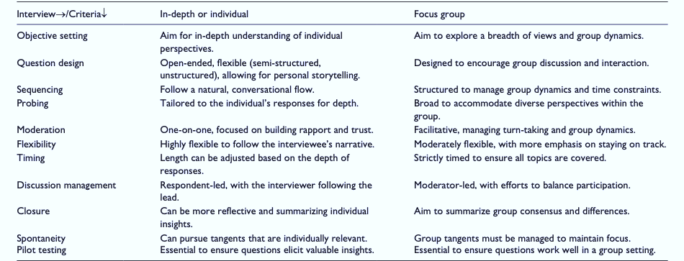
III.4. Semi-Structured Interviews
Table 7: Preparing & Managing Interviews (Lim, 2024).
Figure from: Lim, W. M. (2024). What Is Qualitative Research? An Overview and Guidelines. Australasian Marketing Journal, 0(0), 14413582241264619. https://doi.org/10.1177/14413582241264619
Notes:
Image from: https://www.taylorfrancis.com/books/mono/10.4324/9781315108933/practical-approaches-applied-research-program-evaluation-helping-professionals-casey-barrio-minton-stephen-lenz
Braun, V., & Clarke, V. (2006). Using thematic analysis in psychology. Research in Psychology, 3(2), 77–101.
https://doi.org/10.1191/1478088706qp063oa
(Iterative: referring to a process that involves repeating a sequence of operations or procedures)

Slide 27
III.4. Semi-Structured Interviews
Table 8: Toolbox of Probing Techniques (Lim, 2024).
Figure from: Lim, W. M. (2024). What Is Qualitative Research? An Overview and Guidelines. Australasian Marketing Journal, 0(0), 14413582241264619. https://doi.org/10.1177/14413582241264619
Notes:
Image from: https://www.taylorfrancis.com/books/mono/10.4324/9781315108933/practical-approaches-applied-research-program-evaluation-helping-professionals-casey-barrio-minton-stephen-lenz
Braun, V., & Clarke, V. (2006). Using thematic analysis in psychology. Research in Psychology, 3(2), 77–101.
https://doi.org/10.1191/1478088706qp063oa
(Iterative: referring to a process that involves repeating a sequence of operations or procedures)

Slide 28
III.5. Focus Groups
What Are Focus Groups?
Qualitative research method in which small, diverse groups discuss a specific topic, product, or idea.
Discussions typically guided by facilitator who encourages participants to share their opinions, experiences, & reactions.
https://cdn-images-1.medium.com/max/1600/1*dy2KnNN-jNBuvXvx_-8NMw.jpeg
Notes:
Image from: https://www.taylorfrancis.com/books/mono/10.4324/9781315108933/practical-approaches-applied-research-program-evaluation-helping-professionals-casey-barrio-minton-stephen-lenz

Slide 29
III.5. Focus Groups
What Are Focus Groups?
Widely used in research & media to explore group dynamics, gather feedback, and uncover insights through interactive small-group processes.
Focus on generating a range of options/ perspectives (expansive) vs. forcing consensus (reductive).
https://cdn-images-1.medium.com/max/1600/1*dy2KnNN-jNBuvXvx_-8NMw.jpeg
Notes:
Image from: https://www.taylorfrancis.com/books/mono/10.4324/9781315108933/practical-approaches-applied-research-program-evaluation-helping-professionals-casey-barrio-minton-stephen-lenz

Slide 30
III.5. Focus Groups
When are Focus Groups appropriate? (I)
Assess needs.
Design interventions.
Evaluate policy options.
Pilot-test data collection instruments.
Understand qualitative findings.
Monitor and evaluate agency options.
https://cdn-images-1.medium.com/max/1600/1*dy2KnNN-jNBuvXvx_-8NMw.jpeg
(Krueger & Casey, 2010 in Barrio, Minton, & Lenz, 2019)
Notes:
Image from: https://www.taylorfrancis.com/books/mono/10.4324/9781315108933/practical-approaches-applied-research-program-evaluation-helping-professionals-casey-barrio-minton-stephen-lenz
Krueger, R. A., & Casey, M. A. (2010). Focus group interviewing. In Handbook of practical program evaluation (3rd ed.). San Francisco, CA: John Wiley & Sons.

Slide 31
III.5. Focus Groups
When are Focus Groups appropriate? (II)
Capture a range of views and experiences.
Discuss or explain issues.
Explore new issues.
Identify social and community norms.
Seek broad community-level information.
Observe group interactions.
https://cdn-images-1.medium.com/max/1600/1*dy2KnNN-jNBuvXvx_-8NMw.jpeg
(Hennick, 2014 in Barrio, Minton, & Lenz, 2019)
Notes:
Image from: https://www.taylorfrancis.com/books/mono/10.4324/9781315108933/practical-approaches-applied-research-program-evaluation-helping-professionals-casey-barrio-minton-stephen-lenz
Hennick, M. M. (2014). Focus group discussions: Understanding qualitative research. New York, NY: Oxford University Press.

Slide 32
III.5. Focus Groups
Focus Groups Guidelines (I)
Start with sampling plan.
Prioritize homogeneity in participant role (e.g., all patients/providers with similar power).
Ideal size: 6–8 (range: 5–10; Wutich et al., 2024).
Develop semi-structured script (60–90 min).
Consider question order, timing, progression.
https://cdn-images-1.medium.com/max/1600/1*dy2KnNN-jNBuvXvx_-8NMw.jpeg
(Hennick, 2014 in Barrio, Minton, & Lenz, 2019)
Notes:
Image from: https://www.taylorfrancis.com/books/mono/10.4324/9781315108933/practical-approaches-applied-research-program-evaluation-helping-professionals-casey-barrio-minton-stephen-lenz
Wutich, A., et al. (2024). "Sample Sizes for 10 Types of Qualitative Data Analysis: An Integrative Review, Empirical Guidance, and Next Steps." International Journal of Qualitative Methods 23: 16094069241296206.
Hennick, M. M. (2014). Focus group discussions: Understanding qualitative research. New York, NY: Oxford University Press.

Slide 33
III.5. Focus Groups
Focus Groups Guidelines (II)
Attend to the process (and process skills) while facilitating focus groups.
Draw out equal participation. Invite contrasting opinions. Remain supportively neutral.
Manage group dynamics. Facilitate discussion (vs. question/answer).
https://cdn-images-1.medium.com/max/1600/1*dy2KnNN-jNBuvXvx_-8NMw.jpeg
(Hennick, 2014 in Barrio, Minton, & Lenz, 2019)
Notes:
Image from: https://www.taylorfrancis.com/books/mono/10.4324/9781315108933/practical-approaches-applied-research-program-evaluation-helping-professionals-casey-barrio-minton-stephen-lenz
Wutich, A., et al. (2024). "Sample Sizes for 10 Types of Qualitative Data Analysis: An Integrative Review, Empirical Guidance, and Next Steps." International Journal of Qualitative Methods 23: 16094069241296206.
Hennick, M. M. (2014). Focus group discussions: Understanding qualitative research. New York, NY: Oxford University Press.

Slide 34
III.5. Focus Groups
Focus Groups Guidelines (III)
Close with summary of major points, how findings will be used and data protected, and next steps.
https://cdn-images-1.medium.com/max/1600/1*dy2KnNN-jNBuvXvx_-8NMw.jpeg
(Hennick, 2014 in Barrio, Minton, & Lenz, 2019)
Notes:
Image from: https://www.taylorfrancis.com/books/mono/10.4324/9781315108933/practical-approaches-applied-research-program-evaluation-helping-professionals-casey-barrio-minton-stephen-lenz
Wutich, A., et al. (2024). "Sample Sizes for 10 Types of Qualitative Data Analysis: An Integrative Review, Empirical Guidance, and Next Steps." International Journal of Qualitative Methods 23: 16094069241296206.
Hennick, M. M. (2014). Focus group discussions: Understanding qualitative research. New York, NY: Oxford University Press.

Slide 35
III.5. Focus Groups
Focus Group Interview Script
Will you tell me about your experience with this intervention?
What did you like best? What was most helpful? What are the biggest strengths? What should kept/retained, not changed?
Are there any changes you’ve noticed that you associate with the intervention? What changes are most important to you?
What did you like least? What was least helpful? What are the biggest weaknesses? What should be changed?
Is there anything else you’d like to share about this intervention?
https://cdn-images-1.medium.com/max/1600/1*dy2KnNN-jNBuvXvx_-8NMw.jpeg
Krueger & Casey (2010) as cited in Barrio Minton & Lenz (2019)
Notes:
Image from: https://www.taylorfrancis.com/books/mono/10.4324/9781315108933/practical-approaches-applied-research-program-evaluation-helping-professionals-casey-barrio-minton-stephen-lenz
Krueger, R. A., & Casey, M. A. (2010). Focus group interviewing. In Handbook ofpractical program evaluation (3rd ed.). San Francisco, CA: John Wiley & Sons.

Slide 36
III.6. Document Review
What Does Document Review Entail?
Systematic review and interpretation of written or visual materials to uncover insights, patterns, and themes related to a research question or topic.
https://img.freepik.com/premium-photo/business-document-paper-icon-document-management-system-dms_336744-1421.jpg
Notes:
Image from: https://www.taylorfrancis.com/books/mono/10.4324/9781315108933/practical-approaches-applied-research-program-evaluation-helping-professionals-casey-barrio-minton-stephen-lenz
Microsoft Copilot AI Communication, 3-25-25.

Slide 37
III.6. Document Review
What Types of Documents Can Be Reviewed?
Texts: Books, articles, reports, letters, diaries.
Visuals: Photographs, illustrations, advertisements.
Records: Meeting minutes, official documents,
transcripts.
Media: Social media posts, news articles, recordings.
https://img.freepik.com/premium-photo/business-document-paper-icon-document-management-system-dms_336744-1421.jpg
Notes:
Image from: https://www.taylorfrancis.com/books/mono/10.4324/9781315108933/practical-approaches-applied-research-program-evaluation-helping-professionals-casey-barrio-minton-stephen-lenz
Microsoft Copilot AI Communication, 3-25-25.

Slide 38
III.6. Document Review
What Types of Documents Can Be Reviewed?
Texts: Books, articles, reports, letters, diaries.
Visuals: Photographs, illustrations, advertisements.
Records: Meeting minutes, official documents, transcripts.
Media: Social media posts, news articles, recordings.
Notes:
Image from: https://www.taylorfrancis.com/books/mono/10.4324/9781315108933/practical-approaches-applied-research-program-evaluation-helping-professionals-casey-barrio-minton-stephen-lenz
Nutley, S. K., Falise, A. M., Henderson, R., Apostolou, V., Mathews, C. A., & Striley, C. W. (2021). Impact of the COVID-19 Pandemic on Disordered Eating Behavior: Qualitative Analysis of Social Media Posts. JMIR mental health, 8(1), e26011. https://doi.org/10.2196/26011

Slide 39
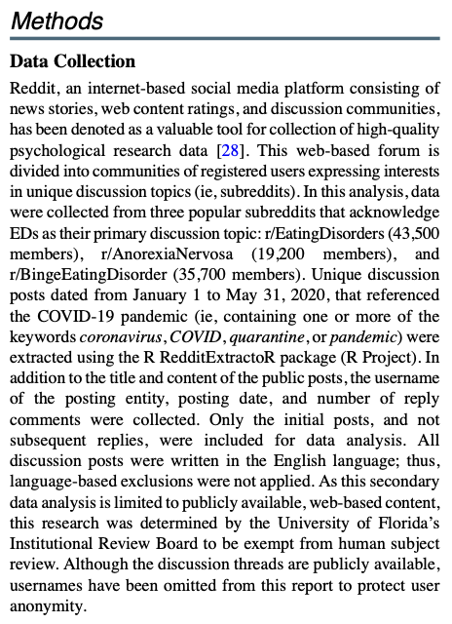
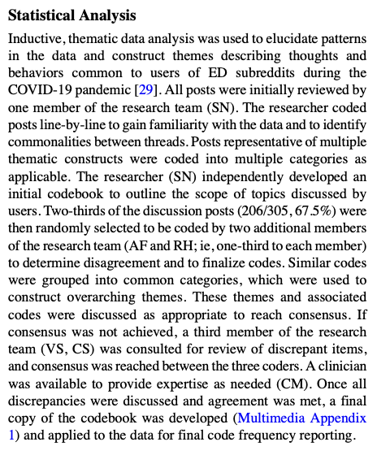
III.6. Document Review
Notes:
Image from: https://www.taylorfrancis.com/books/mono/10.4324/9781315108933/practical-approaches-applied-research-program-evaluation-helping-professionals-casey-barrio-minton-stephen-lenz
Nutley, S. K., Falise, A. M., Henderson, R., Apostolou, V., Mathews, C. A., & Striley, C. W. (2021). Impact of the COVID-19 Pandemic on Disordered Eating Behavior: Qualitative Analysis of Social Media Posts. JMIR mental health, 8(1), e26011. https://doi.org/10.2196/26011

Slide 40
III.6. Document Review
Notes:
Image from: https://www.taylorfrancis.com/books/mono/10.4324/9781315108933/practical-approaches-applied-research-program-evaluation-helping-professionals-casey-barrio-minton-stephen-lenz
Nutley, S. K., Falise, A. M., Henderson, R., Apostolou, V., Mathews, C. A., & Striley, C. W. (2021). Impact of the COVID-19 Pandemic on Disordered Eating Behavior: Qualitative Analysis of Social Media Posts. JMIR mental health, 8(1), e26011. https://doi.org/10.2196/26011

Slide 41
III.6. Document Review
Notes:
Image from: https://www.taylorfrancis.com/books/mono/10.4324/9781315108933/practical-approaches-applied-research-program-evaluation-helping-professionals-casey-barrio-minton-stephen-lenz
Nutley, S. K., Falise, A. M., Henderson, R., Apostolou, V., Mathews, C. A., & Striley, C. W. (2021). Impact of the COVID-19 Pandemic on Disordered Eating Behavior: Qualitative Analysis of Social Media Posts. JMIR mental health, 8(1), e26011. https://doi.org/10.2196/26011

Slide 42
III.6. Document Review
What Types of Documents Can Be Reviewed?
Client Records: Intake reports, case notes, etc.
Weekly Group Session Reflection Forms.
Group Meeting Notes, Recordings, Transcripts.
Supervision Notes for staff members.
Incident Reports (e.g., group home, residential, etc.).
https://img.freepik.com/premium-photo/business-document-paper-icon-document-management-system-dms_336744-1421.jpg
Notes:
Image from: https://www.taylorfrancis.com/books/mono/10.4324/9781315108933/practical-approaches-applied-research-program-evaluation-helping-professionals-casey-barrio-minton-stephen-lenz
Microsoft Copilot AI Communication, 3-25-25.

Slide 43
III.6. Document Review
Why Include Document Reviews?
Enable greater understanding of context, meaning, & significance (of doc contents).
Integration with other qualitative methods (e.g., interviews or observations).
Trace historical developments, explore cultural narratives, or gather perspectives on a particular event or phenomenon.
https://img.freepik.com/premium-photo/business-document-paper-icon-document-management-system-dms_336744-1421.jpg
Notes:
Image from: https://www.taylorfrancis.com/books/mono/10.4324/9781315108933/practical-approaches-applied-research-program-evaluation-helping-professionals-casey-barrio-minton-stephen-lenz
Microsoft Copilot AI Communication, 3-25-25.

Slide 44
III.6. Document Review
Guidelines for Document Review
IRB Approval, Informed Consent, Permission.
Identify how to access the information we seek:
All records entered during specific time-period.
Only records w specific outcome (dx, referral).
Random selection.
https://img.freepik.com/premium-photo/business-document-paper-icon-document-management-system-dms_336744-1421.jpg
Notes:
Image from: https://www.taylorfrancis.com/books/mono/10.4324/9781315108933/practical-approaches-applied-research-program-evaluation-helping-professionals-casey-barrio-minton-stephen-lenz
Microsoft Copilot AI Communication, 3-25-25.

Slide 45
III.3. Data Collection Procedures
Table 6: Data Collection Methods for Qualitative Research
Figure from: Lim, W. M. (2024). What Is Qualitative Research? An Overview and Guidelines. Australasian Marketing Journal, 0(0), 14413582241264619. https://doi.org/10.1177/14413582241264619
Notes:
Image from: https://www.taylorfrancis.com/books/mono/10.4324/9781315108933/practical-approaches-applied-research-program-evaluation-helping-professionals-casey-barrio-minton-stephen-lenz
Braun, V., & Clarke, V. (2006). Using thematic analysis in psychology. Research in Psychology, 3(2), 77–101.
https://doi.org/10.1191/1478088706qp063oa
(Iterative: referring to a process that involves repeating a sequence of operations or procedures)

Slide 46
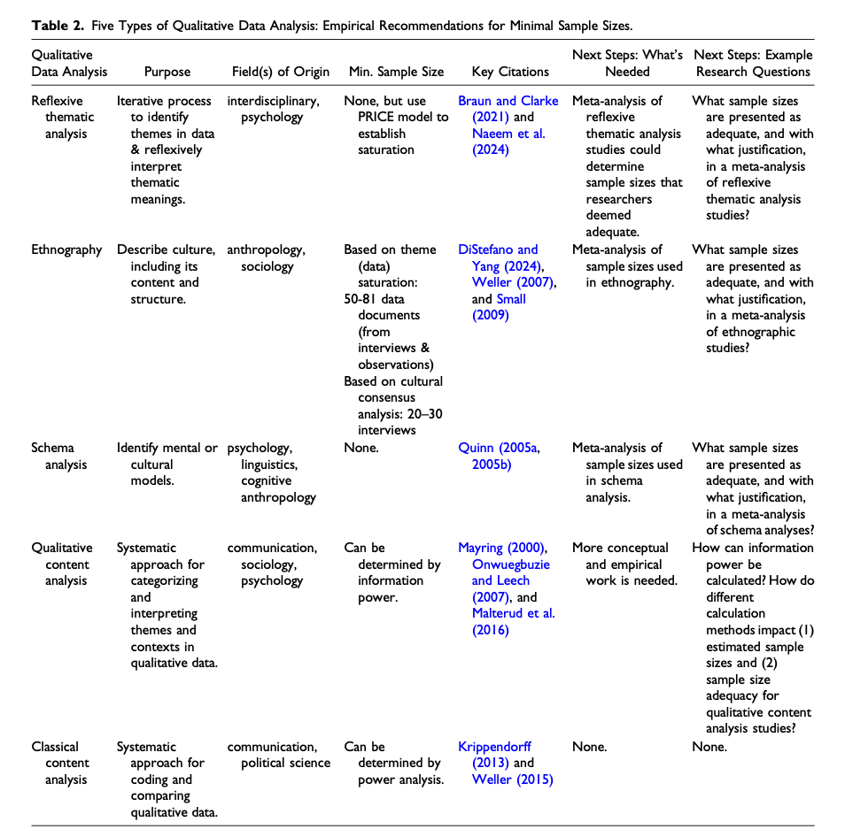
Table 2: Five Types of Qualitative Data Analysis: Empirical Recommendations for Minimal Sample Sizes.
Wutich, A., Beresford, M., & Bernard, H. R. (2024). Sample Sizes for 10 Types of Qualitative Data Analysis: An Integrative Review, Empirical Guidance, and Next Steps. International Journal of Qualitative Methods, 23, 16094069241296206. https://doi.org/10.1177/16094069241296206.

Slide 47
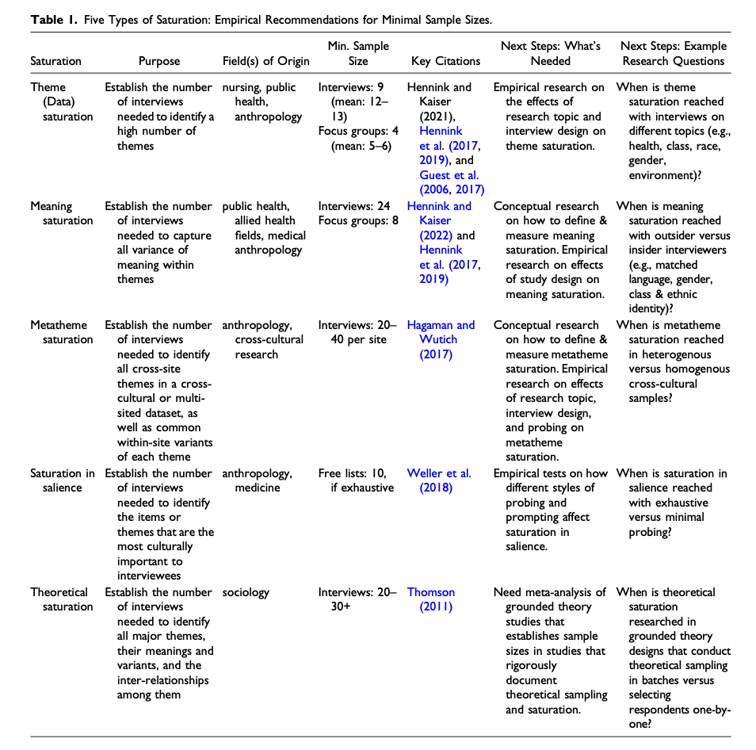
Table 1: Five Types of Saturation: Empirical Recommendations for Minimal Sample Sizes
Wutich, A., Beresford, M., & Bernard, H. R. (2024). Sample Sizes for 10 Types of Qualitative Data Analysis: An Integrative Review, Empirical Guidance, and Next Steps. International Journal of Qualitative Methods, 23, 16094069241296206. https://doi.org/10.1177/16094069241296206.
Notes:
Wutich, A., Beresford, M., & Bernard, H. R. (2024). Sample Sizes for 10 Types of Qualitative Data Analysis: An Integrative Review, Empirical Guidance, and Next Steps. International Journal of Qualitative Methods, 23, 16094069241296206. https://doi.org/10.1177/16094069241296206.

Slide 48
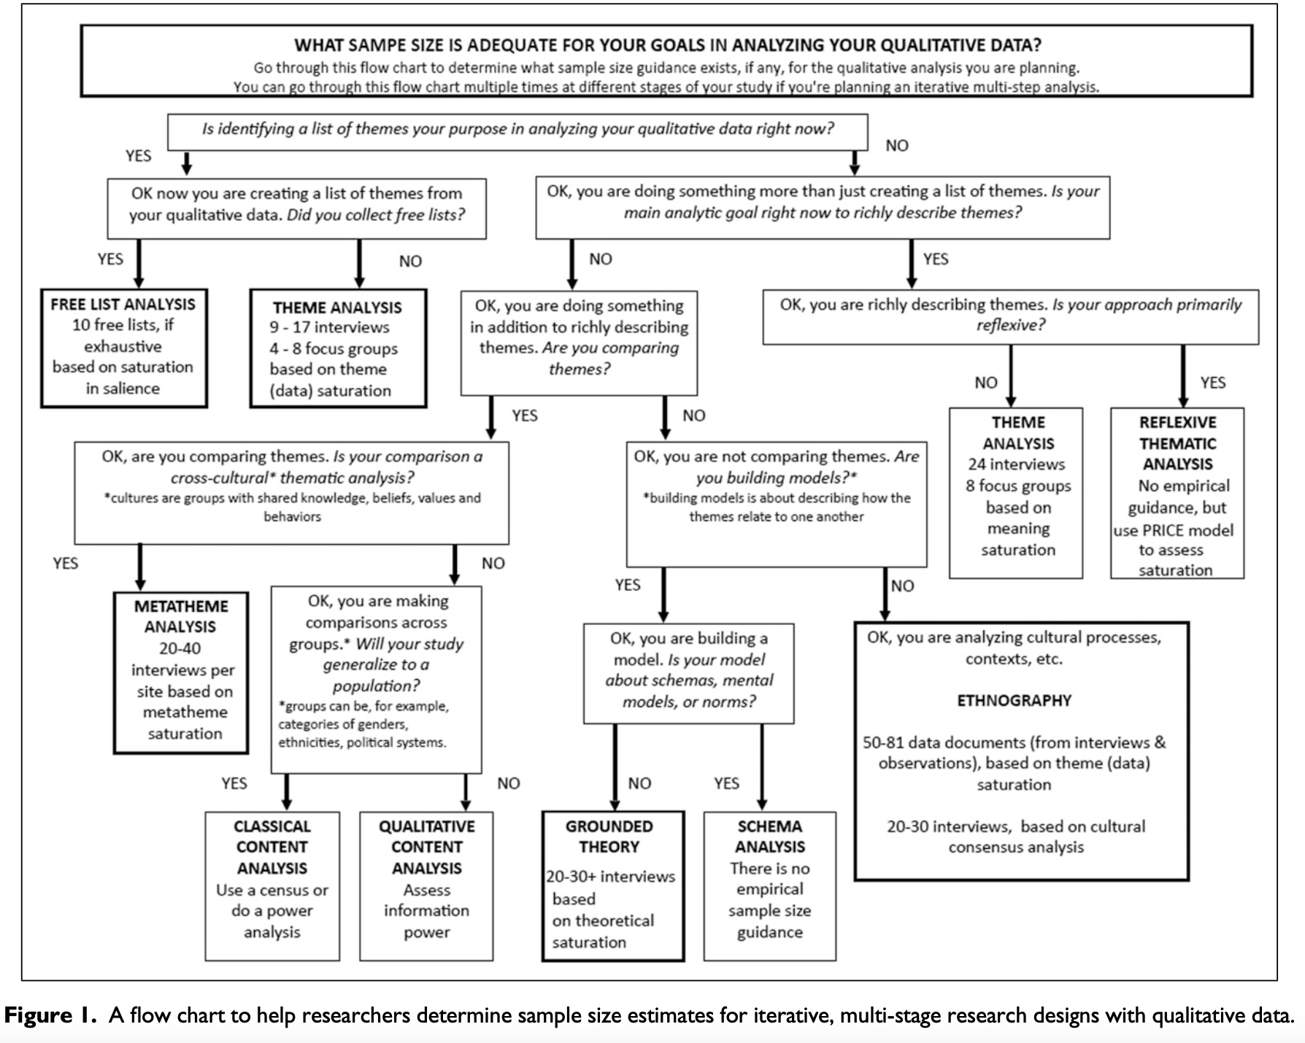
Figure 1: Flow Chart to help researchers determine sample size estimates for iterative, multi-stage research designs w/ qualitative data.
Wutich, A., Beresford, M., & Bernard, H. R. (2024). Sample Sizes for 10 Types of Qualitative Data Analysis: An Integrative Review, Empirical Guidance, and Next Steps. International Journal of Qualitative Methods, 23, 16094069241296206. https://doi.org/10.1177/16094069241296206.

Slide 49
III.3. Data Collection Procedures
Sample Sizes for 10 Types of Qualitative Data Analysis: An Integrative Review, Empirical Guidance, & Next Steps (Wutich et al., 2024).
Wutich, A., Beresford, M., & Bernard, H. R. (2024). Sample Sizes for 10 Types of Qualitative Data Analysis: An Integrative Review, Empirical Guidance, and Next Steps. International Journal of Qualitative Methods, 23, 16094069241296206. https://doi.org/10.1177/16094069241296206.

Slide 50
III.7. Data Management Strategy
Qualitative data are rich, complex, & MESSY!
Active data management strategy is critical.
Recording and Transcription tend to be Central.
For anonymity, start recording after introductions.
Note-taking can be used as supplement. Should be planned in advance.
Use interview script to organize, structure notes.
https://dfifnluhfzgk8.cloudfront.net/wp-content/uploads/2024/04/how-to-build-a-data-management-strategy.svg
Notes:
Image from: https://www.taylorfrancis.com/books/mono/10.4324/9781315108933/practical-approaches-applied-research-program-evaluation-helping-professionals-casey-barrio-minton-stephen-lenz
Wutich, A., et al. (2024). "Sample Sizes for 10 Types of Qualitative Data Analysis: An Integrative Review, Empirical Guidance, and Next Steps." International Journal of Qualitative Methods 23: 16094069241296206.
Hennick, M. M. (2014). Focus group discussions: Understanding qualitative research. New York, NY: Oxford University Press.

Slide 51
III.7. Data Management Strategy
For Semi-Structured Interviews:
Use interview script to organize, structure notes.
For Focus Groups:
Ask participants to generate notes on a white board, document with photographs.
Include a co-facilitating note-taker to record responses (if not recorded formally).
https://dfifnluhfzgk8.cloudfront.net/wp-content/uploads/2024/04/how-to-build-a-data-management-strategy.svg
Notes:
Image from: https://www.taylorfrancis.com/books/mono/10.4324/9781315108933/practical-approaches-applied-research-program-evaluation-helping-professionals-casey-barrio-minton-stephen-lenz
Wutich, A., et al. (2024). "Sample Sizes for 10 Types of Qualitative Data Analysis: An Integrative Review, Empirical Guidance, and Next Steps." International Journal of Qualitative Methods 23: 16094069241296206.
Hennick, M. M. (2014). Focus group discussions: Understanding qualitative research. New York, NY: Oxford University Press.

Slide 52
III.7. Data Management Strategy
For Document Review:
Decide whether to analyze records as whole or use short-hand note-taking strategy.
E.g., Complete ½ – 2pg worksheet for each document reviewed, then work from those notes.
https://dfifnluhfzgk8.cloudfront.net/wp-content/uploads/2024/04/how-to-build-a-data-management-strategy.svg
Notes:
Image from: https://www.taylorfrancis.com/books/mono/10.4324/9781315108933/practical-approaches-applied-research-program-evaluation-helping-professionals-casey-barrio-minton-stephen-lenz
Wutich, A., et al. (2024). "Sample Sizes for 10 Types of Qualitative Data Analysis: An Integrative Review, Empirical Guidance, and Next Steps." International Journal of Qualitative Methods 23: 16094069241296206.
Hennick, M. M. (2014). Focus group discussions: Understanding qualitative research. New York, NY: Oxford University Press.

Slide 53
III.8. Trustworthiness Protections
Provide evidence that:
Findings accurately capture participants’ experiences.
Conclusions were generated with rigor and credibility.
https://www.marketing91.com/wp-content/uploads/2020/03/trustworthiness.jpg
Notes:
Image from: https://www.taylorfrancis.com/books/mono/10.4324/9781315108933/practical-approaches-applied-research-program-evaluation-helping-professionals-casey-barrio-minton-stephen-lenz
Levitt, Motulsky, Wertz, Morrow, & Ponterotto. (2017). Recommendations for designing and reviewing qualitative research in psychology: Promoting methodological integrity. Qualitative Psychology, 4(1), 2–22. http://dx.doi.org.proxy.lib.utk.edu:90/10.1037/qup0000082.

Slide 54
III.8. Trustworthiness Protections
Levitt, Motulsky, Wertz, Morrow, & Ponterotto. (2017). Recommendations for designing and reviewing qualitative research in psychology: Promoting methodological integrity. Qualitative Psychology, 4(1), 2–22. http://dx.doi.org.proxy.lib.utk.edu:90/10.1037/qup0000082.
https://www.marketing91.com/wp-content/uploads/2020/03/trustworthiness.jpg
Notes:
Image from: https://www.taylorfrancis.com/books/mono/10.4324/9781315108933/practical-approaches-applied-research-program-evaluation-helping-professionals-casey-barrio-minton-stephen-lenz
Levitt, Motulsky, Wertz, Morrow, & Ponterotto. (2017). Recommendations for designing and reviewing qualitative research in psychology: Promoting methodological integrity. Qualitative Psychology, 4(1), 2–22. http://dx.doi.org.proxy.lib.utk.edu:90/10.1037/qup0000082.

Slide 55
III.8. Trustworthiness Protections
Qualitative Strategies for Fidelity & Utility:
Prolonged engagement.
Negative case analysis.
Triangulation of data sources.
Audit trails.
Peer debriefing.
Member checks.
https://www.marketing91.com/wp-content/uploads/2020/03/trustworthiness.jpg
Levitt et al. (2017). http://dx.doi.org.proxy.lib.utk.edu:90/10.1037/qup0000082.
Notes:
Image from: https://www.taylorfrancis.com/books/mono/10.4324/9781315108933/practical-approaches-applied-research-program-evaluation-helping-professionals-casey-barrio-minton-stephen-lenz
Levitt, Motulsky, Wertz, Morrow, & Ponterotto. (2017). Recommendations for designing and reviewing qualitative research in psychology: Promoting methodological integrity. Qualitative Psychology, 4(1), 2–22. http://dx.doi.org.proxy.lib.utk.edu:90/10.1037/qup0000082.

Slide 56
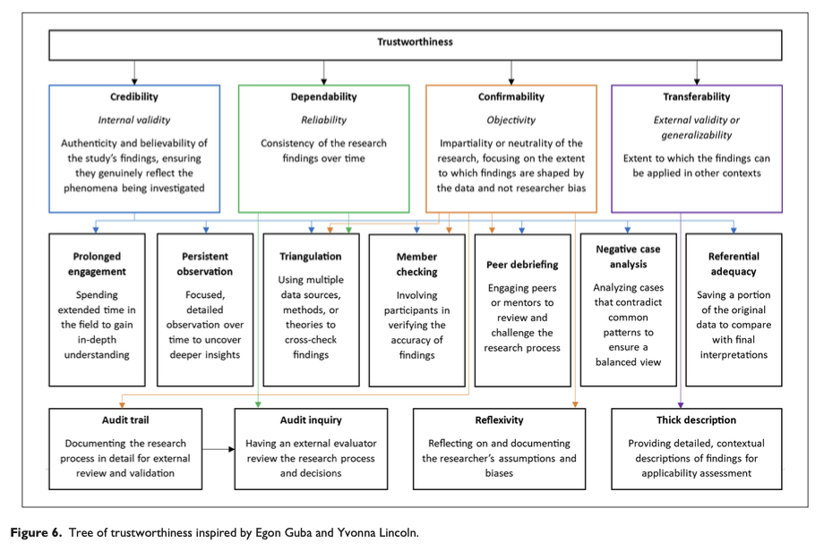
IV.1. Trustworthiness
Fig 6: Tree of Trustworthiness. Trustworthiness includes the following components:
Credibility (prolonged engagement, persistent observation, triangulation, member checking, peer debriefing, negative case analysis, & referential adequacy).
Dependability (triangulation and audit inquiry).
Confirmability (triangulation, member checking, audit trail, peer debriefing, reflexivity).
Transferability (thick description).
Figure from: Lim, W. M. (2024). What Is Qualitative Research? An Overview and Guidelines. Australasian Marketing Journal, 0(0), 14413582241264619. https://doi.org/10.1177/14413582241264619
Notes:
Image from: https://www.taylorfrancis.com/books/mono/10.4324/9781315108933/practical-approaches-applied-research-program-evaluation-helping-professionals-casey-barrio-minton-stephen-lenz
Braun, V., & Clarke, V. (2006). Using thematic analysis in psychology. Research in Psychology, 3(2), 77–101.
https://doi.org/10.1191/1478088706qp063oa
(Iterative: referring to a process that involves repeating a sequence of operations or procedures)

Slide 57
III.8. Trustworthiness Safeguards
Reflect on your experiences and expectations related to your topic before data collection to identify potential biases.
Consider outsourcing for topics with strong biases. (E.g., do not lead an analysis of your intervention).
Collaborate with 1 – 2 colleagues on data analysis.
Consider Coding.
Ensure common consensus regarding overall findings.
Consider peer-auditing (review original documents).
https://www.marketing91.com/wp-content/uploads/2020/03/trustworthiness.jpg
Barrio Minton & Lenz, 2019.
Notes:
Image from: https://www.taylorfrancis.com/books/mono/10.4324/9781315108933/practical-approaches-applied-research-program-evaluation-helping-professionals-casey-barrio-minton-stephen-lenz
Levitt, Motulsky, Wertz, Morrow, & Ponterotto. (2017). Recommendations for designing and reviewing qualitative research in psychology: Promoting methodological integrity. Qualitative Psychology, 4(1), 2–22. http://dx.doi.org.proxy.lib.utk.edu:90/10.1037/qup0000082.

Slide 58
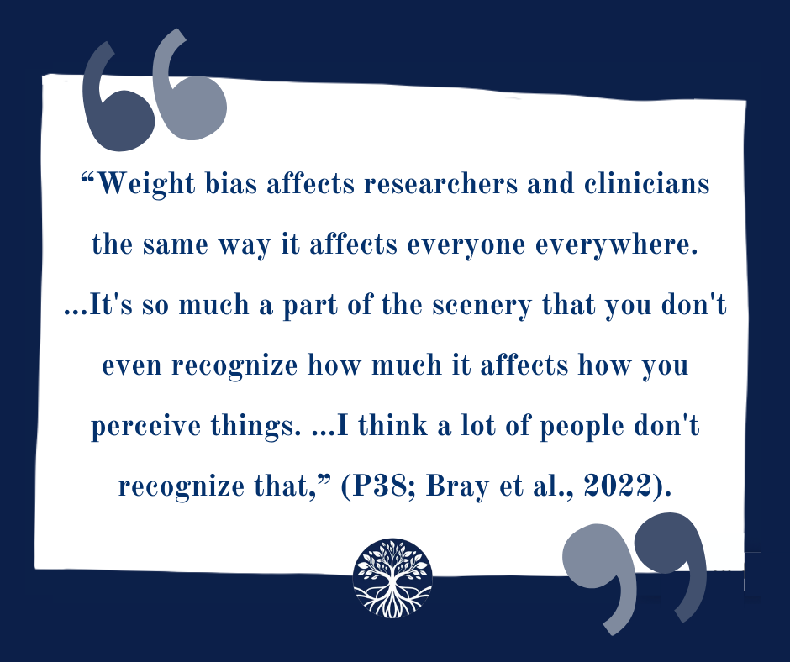
III.8. Trustworthiness Safeguards
“Weight bias affects researchers and clinicians in the field of eating disorders the same way it affects everyone, everywhere.
. . . I thought I was not weight-biased, but somebody [who focuses on weight bias professionally] said, to me, . . . ‘well, of course, you have weight bias; everyone has weight bias.’
So . . . I’ve thought about it and [I] realized . . . I do [have weight bias] . . . it’s so much [a] part of the scenery . . . that you don’t even . . . recognize how much it affects how you perceive things. . . . I think there’s a lot of people who don’t recognize that.” _{(P38, Bray et a., 2022)}
https://www.marketing91.com/wp-content/uploads/2020/03/trustworthiness.jpg
Barrio Minton & Lenz, 2019.
Bray, B., Bray, C., Bradley, R., & Zwickey, H. (2022). Binge Eating Disorder Is a Social Justice Issue: A Cross-Sectional Mixed-Methods Study of Binge Eating Disorder Experts' Opinions. International journal of environmental research and public health, 19(10), 6243. https://doi.org/10.3390/ijerph19106243
Notes:
Image from: https://www.taylorfrancis.com/books/mono/10.4324/9781315108933/practical-approaches-applied-research-program-evaluation-helping-professionals-casey-barrio-minton-stephen-lenz
Levitt, Motulsky, Wertz, Morrow, & Ponterotto. (2017). Recommendations for designing and reviewing qualitative research in psychology: Promoting methodological integrity. Qualitative Psychology, 4(1), 2–22. http://dx.doi.org.proxy.lib.utk.edu:90/10.1037/qup0000082.

Slide 59
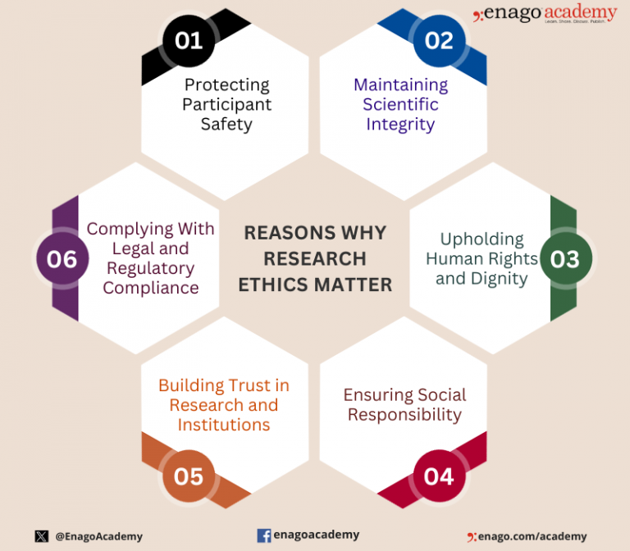
III.9. Ethical Protections
Notes:
Image from: https://www.taylorfrancis.com/books/mono/10.4324/9781315108933/practical-approaches-applied-research-program-evaluation-helping-professionals-casey-barrio-minton-stephen-lenz
Wutich, A., et al. (2024). "Sample Sizes for 10 Types of Qualitative Data Analysis: An Integrative Review, Empirical Guidance, and Next Steps." International Journal of Qualitative Methods 23: 16094069241296206.
Hennick, M. M. (2014). Focus group discussions: Understanding qualitative research. New York, NY: Oxford University Press.

Slide 60
III.9. Ethical Protections
Preview All Proposed Procedures for Ethics
Non-Coercion.
Non-retaliation or loss of esteem.
Adequate Privacy Protections.
Mask specific stories or examples.
Anonymous interviews vs. focus groups for sensitive topics.
https://www.enago.com/academy/wp-content/uploads/2023/12/WhyResearchEthicsMatter-768x672.png
Notes:
Image from: https://www.taylorfrancis.com/books/mono/10.4324/9781315108933/practical-approaches-applied-research-program-evaluation-helping-professionals-casey-barrio-minton-stephen-lenz
Microsoft Copilot AI Communication, 3-25-25.

Slide 61
WE DID IT! ☺

Slide 62
BRIDG Micro-Course Qualitative Research and Analysis
Brenna Bray, PhD
BRIDG T90/R90 Fellowship Postdoctoral Training Program
NCCIH, Grant AT008924
National University of Natural Medicine (NUNM) University of Washington (UW)
NourishED Research Foundation (Boulder, CO, USA | Wilmington, DE, USA)

