Slide 1
Qualitative Research and Analysis BRIDG Micro-Course
Brenna Bray, PhD
BRIDG T90/R90 Fellowship Postdoctoral Training Program
NCCIH, Grant AT008924
National University of Natural Medicine (NUNM) University of Washington (UW)
NourishED Research Foundation (Boulder, CO, USA | Wilmington, DE, USA)

Slide 2
BRIDG Micro-Course Module 5: Reporting Findings
Brenna Bray, PhD
BRIDG T90/R90 Fellowship Postdoctoral Training Program
NCCIH, Grant AT008924
National University of Natural Medicine (NUNM) University of Washington (UW)
NourishED Research Foundation (Boulder, CO, USA | Wilmington, DE, USA)

Slide 3
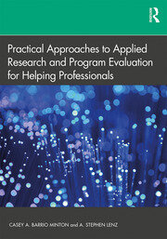
Content Overview
Overview of Qualitative Research
Classic Types of Qualitative Research Designs
Qualitative Evaluation Process
Qualitative Data Analysis
Reporting Findings
Guidelines
https://www.taylorfrancis.com/books/mono/10.4324/9781315108933/practical-approaches-applied-research-program-evaluation-helping-professionals-casey-barrio-minton-stephen-lenz

Slide 4
Content Overview: Module 5
V. Reporting Findings
Reporting Priorities
Reporting Tips
Reporting Components
Applications
https://www.taylorfrancis.com/books/mono/10.4324/9781315108933/practical-approaches-applied-research-program-evaluation-helping-professionals-casey-barrio-minton-stephen-lenz

Slide 5
Content Overview: Module 5
Module 5: Reporting Findings
Module Content | Readings | Course Objectives
Video//PowerPoint Lecture Reporting Priorities Reporting Tips Reporting Components Applications Module 5 Quiz 6 Questions 12 Points 12 % of Course Grade | Barrio Minton & Lenz (2019). Ch. 7, Section 5 (Reporting Findings). See Reporting Guideline Documents in Module 6. | Develop research questions consistent with use of qualitative methodology Communicate findings from qualitative analyses
https://www.taylorfrancis.com/books/mono/10.4324/9781315108933/practical-approaches-applied-research-program-evaluation-helping-professionals-casey-barrio-minton-stephen-lenz

Slide 6
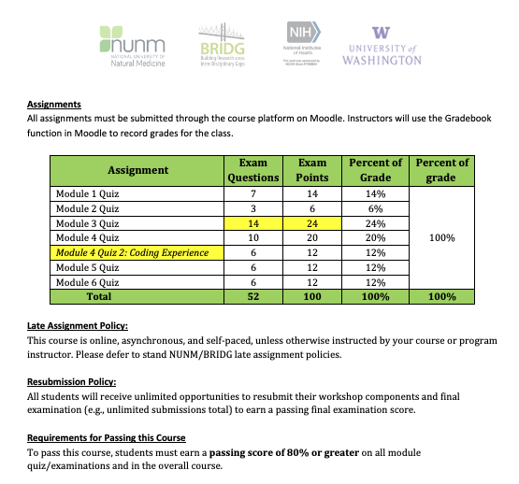
Content Overview: Module Examinations

Slide 7
V. Reporting Findings
Impact of work tied to how findings are reported.
Key Considerations:
Transparency in methodology.
Clarity of themes and categories.
Data used to support assertions.
https://img.freepik.com/premium-vector/software-development-company-coding-programming_187411-397.jpg?w=2000
https://www.taylorfrancis.com/books/mono/10.4324/9781315108933/practical-approaches-applied-research-program-evaluation-helping-professionals-casey-barrio-minton-stephen-lenz

Slide 8
V. Reporting Findings
Provide Clear Description of:
Purpose & focus of inquiry.
Data collection & analysis methodology.
Recruitment or selection processes.
Participant roles and demographic characteristics.
Individuals involved in the process.
Data collection & analysis methods.
Safeguards to ensure trustworthiness & ethics.
https://img.freepik.com/premium-vector/software-development-company-coding-programming_187411-397.jpg?w=2000
Notes:
Image from: https://www.taylorfrancis.com/books/mono/10.4324/9781315108933/practical-approaches-applied-research-program-evaluation-helping-professionals-casey-barrio-minton-stephen-lenz
Inductive: forming general theories from specific observations. Observing something happen repeatedly and concluding that it will happen again in the same way is an example of inductive reasoning. Deductivereasoning (also called deduction) involves forming specific conclusions from general premises,
Hill, C. B., Knox, S., Thompson, B. J., Williams, E. N., Hess, S. A., & Ladany, N. (2005). Consensual qualitative research: An update. Journal of Counseling Psychology, 52(2), 196–205. https://doi.org/10.1037/0022-0167.52.2.196
Hill, C. E. (2012). Introduction to consensual qualitative research. In C. E. Hill (Ed.), Consensual qualitative research: A practical resource for investigating social science phenomena (pp. 3–20, Chapter viii, 330 Pages). Washington, DC: American Psychological Association.
Hill, C. E., Thompson, B. J., & Williams, E. N. (1997). A guide to conducting consensual qualitative research. Counseling Psychologist, 25(4), 517–572.

Slide 9
V. Reporting Findings
Provide Clear Description of:
Inquiry purpose and focus.
Data collection & analysis methodology.
Themes and categories derived from the data.
Consider tables to name & describe themes and categories.
Use 2 – 3 quotes or statements to support & lift each theme.
Consider figures to show thematic relationships (network maps)
https://img.freepik.com/premium-vector/software-development-company-coding-programming_187411-397.jpg?w=2000
Notes:
Image from: https://www.taylorfrancis.com/books/mono/10.4324/9781315108933/practical-approaches-applied-research-program-evaluation-helping-professionals-casey-barrio-minton-stephen-lenz
Inductive: forming general theories from specific observations. Observing something happen repeatedly and concluding that it will happen again in the same way is an example of inductive reasoning. Deductivereasoning (also called deduction) involves forming specific conclusions from general premises,
Hill, C. B., Knox, S., Thompson, B. J., Williams, E. N., Hess, S. A., & Ladany, N. (2005). Consensual qualitative research: An update. Journal of Counseling Psychology, 52(2), 196–205. https://doi.org/10.1037/0022-0167.52.2.196
Hill, C. E. (2012). Introduction to consensual qualitative research. In C. E. Hill (Ed.), Consensual qualitative research: A practical resource for investigating social science phenomena (pp. 3–20, Chapter viii, 330 Pages). Washington, DC: American Psychological Association.
Hill, C. E., Thompson, B. J., & Williams, E. N. (1997). A guide to conducting consensual qualitative research. Counseling Psychologist, 25(4), 517–572.

Slide 10
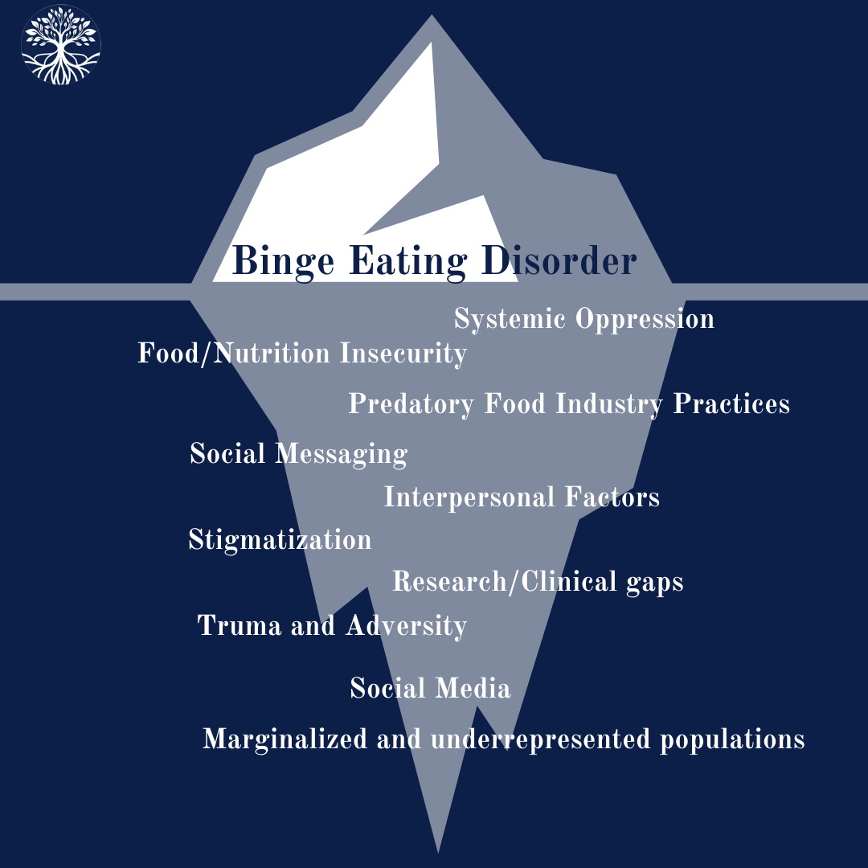
Environmental Factors Experts Associate with BED
Invalidating Environments & Experiences (100%)
Systemic Issues (100%).
Marginalized Populations (100%).
Economic Precarity (93%).
Stigmatization & Discrimination (93%).
Trauma & Adversity (79%).
Food Insecurity (64%).
Interpersonal Factors (64%).
Social Messaging & Social Media (50%).
Nutrition Scarcity (43%).
Predatory Food Industry Practices/Env (29%).
Research Gaps & Future Directions (100%).
Bray, B., Bray, C., Bradley, R., & Zwickey, H. (2022). Binge Eating Disorder Is a Social Justice Issue: A Cross-Sectional Mixed-Methods Study of Binge Eating Disorder Experts' Opinions. International journal of environmental research and public health, 19(10), 6243. https://doi.org/10.3390/ijerph19106243
Notes:
Bray, B., Bray, C., Bradley, R., & Zwickey, H. (2022). Binge Eating Disorder Is a Social Justice Issue: A Cross-Sectional Mixed-Methods Study of Binge Eating Disorder Experts' Opinions. International journal of environmental research and public health, 19(10), 6243. https://doi.org/10.3390/ijerph19106243
"Binge Eating Disorder is a Social Justice Issue: A Cross-Sectional Mixed-Methods Study of Binge Eating Disorder Experts' Opinion" (Bray et al., 2022; https://www.ncbi.nlm.nih.gov/pmc/articles/PMC9141064/).
Brenna Bray, PhD
Abstract: Binge eating disorder is an autonomous DSM-V diagnosis characterized by recurrent episodes of rapid and excessive food intake accompanied by loss of control and distress, without compensatory behaviors. The role of environmental factors in binge eating disorder continues to evolve. Here, we used a mixed-methods cross-sectional design to explore the views of experts in the field on environmental factors that influence adult binge eating disorder. Fourteen international experts in binge eating disorder research, treatment, and policy were selected based on federal funding, peer-reviewed publications, active involvement in the field, leadership in relevant societies, and/or popular media distinction. Semi-structured interviews were conducted anonymously and analyzed by ≥2 researchers using reflexive thematic analysis and quantification. The main themes that emerged were: (1) systemic issues and systems of oppression (100% spontaneous endorsement); (2) marginalized and under-represented populations (100%); (3) economic, food, and nutrition insecurity and insufficiency (93%); (4) stigmatization and its psychological consequences (93%); (5) trauma and adversity (79%); (6) interpersonal factors (64%); (7) social messages and social media (50%); (8) predatory food industry practices (29%); and (9) research/clinical gaps and directives (100%). Overall, these findings align with experts’ calls for policy changes to address the systemic factors that facilitate binge eating and for more public awareness about the diversity of people who can have binge eating disorder. Findings and experts also emphasize the importance of listening to and learning from the narratives and lived experiences of individuals with binge eating disorder to improve our current understanding of the diagnosis and the environmental factors that shape it. 5R90AT008924-07.

Slide 11
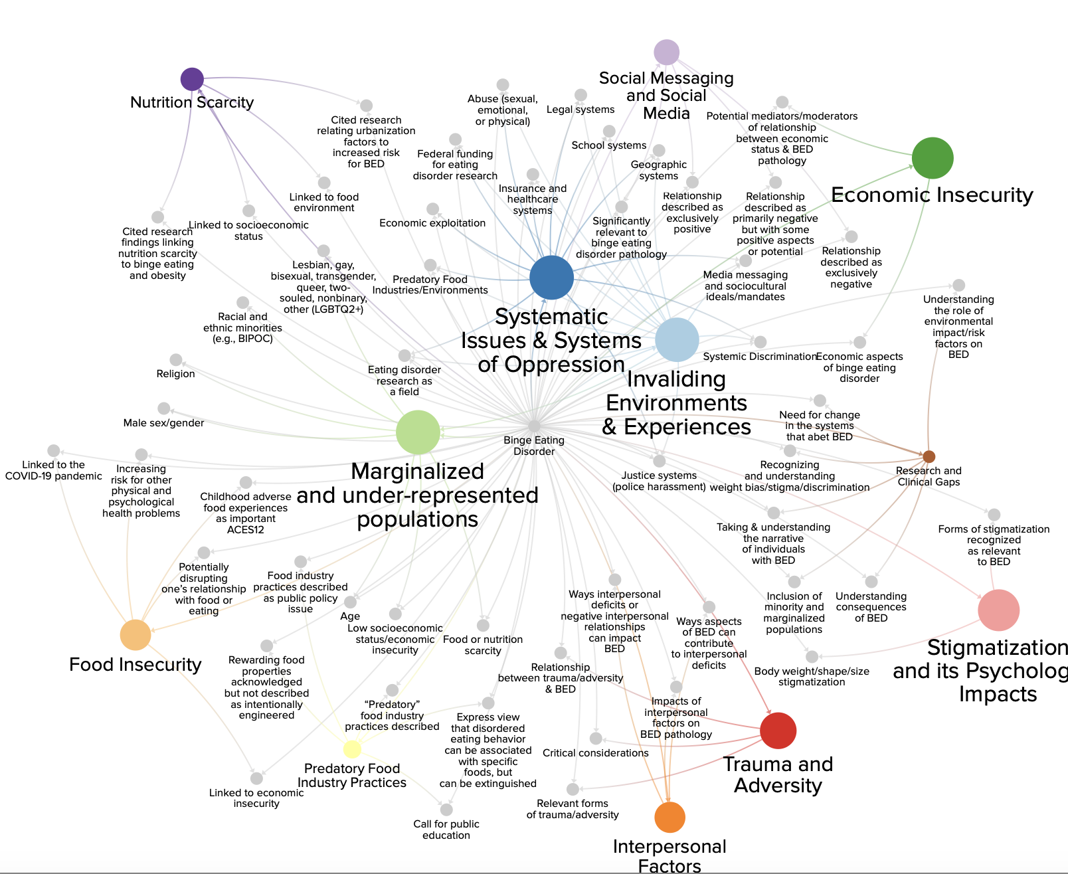
Environmental Factors Experts Associate with BED
Invalidating Environments & Experiences (100%)
Systemic Issues (100%).
Marginalized Populations (100%).
Economic Precarity (93%).
Stigmatization & Discrimination (93%).
Trauma & Adversity (79%).
Food Insecurity (64%).
Interpersonal Factors (64%).
Social Messaging & Social Media (50%).
Nutrition Scarcity (43%).
Predatory Food Industry Practices/Env (29%).
Research Gaps & Future Directions (100%).
Lamichhane, H., Tesha, R., Zwickey, H., Bradley, R., Bray, C., Bray, B. (2025; in prep). Network Mapping Methods for Qualitative Data: Application & Comparison of Two Social Network Mapping Protocols. Primary Data obtained from Bray et al. (2022). Binge Eating Disorder Is a Social Justice Issue: A Cross-Sectional Mixed-Methods Study of Binge Eating Disorder Experts' Opinions. IJERPH. https://doi.org/10.3390/ijerph19106243.
Notes:
Lamichhane, H., Tesha, R., Zwickey, H., Bradley, R., Bray, C., Bray, B. (2025; Under Review). Network Mapping Methods for Qualitative Data: Application & Comparison of Two Social Network Mapping Protocols. Behavioral Science.
Primary Data obtained from
Bray, B., Bray, C., Bradley, R., & Zwickey, H. (2022). Binge Eating Disorder Is a Social Justice Issue: A Cross-Sectional Mixed-Methods Study of Binge Eating Disorder Experts' Opinions. International journal of environmental research and public health, 19(10), 6243. https://doi.org/10.3390/ijerph19106243
"Binge Eating Disorder is a Social Justice Issue: A Cross-Sectional Mixed-Methods Study of Binge Eating Disorder Experts' Opinion" (Bray et al., 2022; https://www.ncbi.nlm.nih.gov/pmc/articles/PMC9141064/).
Brenna Bray, PhD
Abstract: Binge eating disorder is an autonomous DSM-V diagnosis characterized by recurrent episodes of rapid and excessive food intake accompanied by loss of control and distress, without compensatory behaviors. The role of environmental factors in binge eating disorder continues to evolve. Here, we used a mixed-methods cross-sectional design to explore the views of experts in the field on environmental factors that influence adult binge eating disorder. Fourteen international experts in binge eating disorder research, treatment, and policy were selected based on federal funding, peer-reviewed publications, active involvement in the field, leadership in relevant societies, and/or popular media distinction. Semi-structured interviews were conducted anonymously and analyzed by ≥2 researchers using reflexive thematic analysis and quantification. The main themes that emerged were: (1) systemic issues and systems of oppression (100% spontaneous endorsement); (2) marginalized and under-represented populations (100%); (3) economic, food, and nutrition insecurity and insufficiency (93%); (4) stigmatization and its psychological consequences (93%); (5) trauma and adversity (79%); (6) interpersonal factors (64%); (7) social messages and social media (50%); (8) predatory food industry practices (29%); and (9) research/clinical gaps and directives (100%). Overall, these findings align with experts’ calls for policy changes to address the systemic factors that facilitate binge eating and for more public awareness about the diversity of people who can have binge eating disorder. Findings and experts also emphasize the importance of listening to and learning from the narratives and lived experiences of individuals with binge eating disorder to improve our current understanding of the diagnosis and the environmental factors that shape it. 5R90AT008924-07.

Slide 12
V. Reporting Findings
Provide Clear Description of:
Inquiry purpose and focus.
Data collection & analysis methodology.
Themes and categories derived from the data.
Note frequency, prevalence, weight // intensity.
https://img.freepik.com/premium-vector/software-development-company-coding-programming_187411-397.jpg?w=2000
Notes:
Image from: https://www.taylorfrancis.com/books/mono/10.4324/9781315108933/practical-approaches-applied-research-program-evaluation-helping-professionals-casey-barrio-minton-stephen-lenz
Inductive: forming general theories from specific observations. Observing something happen repeatedly and concluding that it will happen again in the same way is an example of inductive reasoning. Deductivereasoning (also called deduction) involves forming specific conclusions from general premises,
Hill, C. B., Knox, S., Thompson, B. J., Williams, E. N., Hess, S. A., & Ladany, N. (2005). Consensual qualitative research: An update. Journal of Counseling Psychology, 52(2), 196–205. https://doi.org/10.1037/0022-0167.52.2.196
Hill, C. E. (2012). Introduction to consensual qualitative research. In C. E. Hill (Ed.), Consensual qualitative research: A practical resource for investigating social science phenomena (pp. 3–20, Chapter viii, 330 Pages). Washington, DC: American Psychological Association.
Hill, C. E., Thompson, B. J., & Williams, E. N. (1997). A guide to conducting consensual qualitative research. Counseling Psychologist, 25(4), 517–572.

Slide 13
V. Reporting Findings
Provide Clear Description of:
Note frequency, prevalence, weight/ intensity.
Frequency: Number of mentions.
Prevalence: Number of participant endorsements.
Weight/intensity: Energy around an idea.
https://img.freepik.com/premium-vector/software-development-company-coding-programming_187411-397.jpg?w=2000
Notes:
Image from: https://www.taylorfrancis.com/books/mono/10.4324/9781315108933/practical-approaches-applied-research-program-evaluation-helping-professionals-casey-barrio-minton-stephen-lenz
Inductive: forming general theories from specific observations. Observing something happen repeatedly and concluding that it will happen again in the same way is an example of inductive reasoning. Deductivereasoning (also called deduction) involves forming specific conclusions from general premises,
Hill, C. B., Knox, S., Thompson, B. J., Williams, E. N., Hess, S. A., & Ladany, N. (2005). Consensual qualitative research: An update. Journal of Counseling Psychology, 52(2), 196–205. https://doi.org/10.1037/0022-0167.52.2.196
Hill, C. E. (2012). Introduction to consensual qualitative research. In C. E. Hill (Ed.), Consensual qualitative research: A practical resource for investigating social science phenomena (pp. 3–20, Chapter viii, 330 Pages). Washington, DC: American Psychological Association.
Hill, C. E., Thompson, B. J., & Williams, E. N. (1997). A guide to conducting consensual qualitative research. Counseling Psychologist, 25(4), 517–572.

Slide 14
V. Reporting Findings
Provide Clear Description of:
Inquiry purpose and focus.
Data collection & analysis methodology.
Themes and categories derived from the data.
Note frequency, prevalence, weight // intensity.
Additional Tips: Barrio Minton & Lenz, 2019, Ch. 17 “Reporting to Stakeholders.”
https://img.freepik.com/premium-vector/software-development-company-coding-programming_187411-397.jpg?w=2000
Notes:
Image from: https://www.taylorfrancis.com/books/mono/10.4324/9781315108933/practical-approaches-applied-research-program-evaluation-helping-professionals-casey-barrio-minton-stephen-lenz
Inductive: forming general theories from specific observations. Observing something happen repeatedly and concluding that it will happen again in the same way is an example of inductive reasoning. Deductivereasoning (also called deduction) involves forming specific conclusions from general premises,
Hill, C. B., Knox, S., Thompson, B. J., Williams, E. N., Hess, S. A., & Ladany, N. (2005). Consensual qualitative research: An update. Journal of Counseling Psychology, 52(2), 196–205. https://doi.org/10.1037/0022-0167.52.2.196
Hill, C. E. (2012). Introduction to consensual qualitative research. In C. E. Hill (Ed.), Consensual qualitative research: A practical resource for investigating social science phenomena (pp. 3–20, Chapter viii, 330 Pages). Washington, DC: American Psychological Association.
Hill, C. E., Thompson, B. J., & Williams, E. N. (1997). A guide to conducting consensual qualitative research. Counseling Psychologist, 25(4), 517–572.

Slide 15
V. Reporting Findings
Tips for High-Quality Reporting (BM & L, 2019; Ch 17)
Report in Accurate, Even-Handed Ways.
Account for Your Audience.
Use Pluralistic Communication Strategies.
Time Your Reports.
Prioritize Documents and Materials.
Emphasize Practical Effects & Social Implications.
https://img.freepik.com/premium-vector/software-development-company-coding-programming_187411-397.jpg?w=2000
Notes:
Image from: https://www.taylorfrancis.com/books/mono/10.4324/9781315108933/practical-approaches-applied-research-program-evaluation-helping-professionals-casey-barrio-minton-stephen-lenz
Inductive: forming general theories from specific observations. Observing something happen repeatedly and concluding that it will happen again in the same way is an example of inductive reasoning. Deductivereasoning (also called deduction) involves forming specific conclusions from general premises,
Hill, C. B., Knox, S., Thompson, B. J., Williams, E. N., Hess, S. A., & Ladany, N. (2005). Consensual qualitative research: An update. Journal of Counseling Psychology, 52(2), 196–205. https://doi.org/10.1037/0022-0167.52.2.196
Hill, C. E. (2012). Introduction to consensual qualitative research. In C. E. Hill (Ed.), Consensual qualitative research: A practical resource for investigating social science phenomena (pp. 3–20, Chapter viii, 330 Pages). Washington, DC: American Psychological Association.
Hill, C. E., Thompson, B. J., & Williams, E. N. (1997). A guide to conducting consensual qualitative research. Counseling Psychologist, 25(4), 517–572.

Slide 16
V. Reporting Findings
Fundamental Reporting Components (BM & L, 2019; Ch 17)
Cover Page (Title, Front Matter)
Executive Summary (Abstract)
Overview of Program & Role of Evaluation (Intro)
Evaluation of Methodology (Methods)
Findings & Impact (Results, Discussion)
Conclusions & Recommendations (Discussion)
Appendices
https://img.freepik.com/premium-vector/software-development-company-coding-programming_187411-397.jpg?w=2000
Notes:
Image from: https://www.taylorfrancis.com/books/mono/10.4324/9781315108933/practical-approaches-applied-research-program-evaluation-helping-professionals-casey-barrio-minton-stephen-lenz
Inductive: forming general theories from specific observations. Observing something happen repeatedly and concluding that it will happen again in the same way is an example of inductive reasoning. Deductivereasoning (also called deduction) involves forming specific conclusions from general premises,
Hill, C. B., Knox, S., Thompson, B. J., Williams, E. N., Hess, S. A., & Ladany, N. (2005). Consensual qualitative research: An update. Journal of Counseling Psychology, 52(2), 196–205. https://doi.org/10.1037/0022-0167.52.2.196
Hill, C. E. (2012). Introduction to consensual qualitative research. In C. E. Hill (Ed.), Consensual qualitative research: A practical resource for investigating social science phenomena (pp. 3–20, Chapter viii, 330 Pages). Washington, DC: American Psychological Association.
Hill, C. E., Thompson, B. J., & Williams, E. N. (1997). A guide to conducting consensual qualitative research. Counseling Psychologist, 25(4), 517–572.

Slide 17
V. Reporting Findings
Application. Reporting on:
Purpose of Needs Assessment.
Related Questions Guiding the Evaluation.
Overview of Data Sources.
Putting Findings into Context.
https://img.freepik.com/premium-vector/software-development-company-coding-programming_187411-397.jpg?w=2000
https://www.taylorfrancis.com/books/mono/10.4324/9781315108933/practical-approaches-applied-research-program-evaluation-helping-professionals-casey-barrio-minton-stephen-lenz

Slide 18
Application: Binge Eating Disorder (BED)
National Surveys (Quantitative), Find That 50–95% of Individuals with BED:
Lack awareness of their condition (50 – 67%).^{1-3,7-9}
Lack formal diagnosis (95%). ^{1-3,7-9}
Never access standard treatment (56-87%).^{1,3,7-9}
Lack access to healthcare (85%).^{1,3,7-9}
Lack representation in research (95%).⁷⁻⁹
Don’t respond to conventional treatment (~60%).⁴⁻⁹
Image obtained from: https://www.brennabray.com/brenna-bray-phd-about/research/, www.nourishedrfi.com/research
¹Sonneville & Lipson, 2018; ²Hudson et al., 2007; ³Cossrow et al., 2016 ⁴ Hudson et al., 2007; ⁵ Kessler et al., 2013; ⁶ Grilo et al., 2011; as cited in ⁷Bray et al., 2022, ⁸2023, ⁹2025)

Slide 19
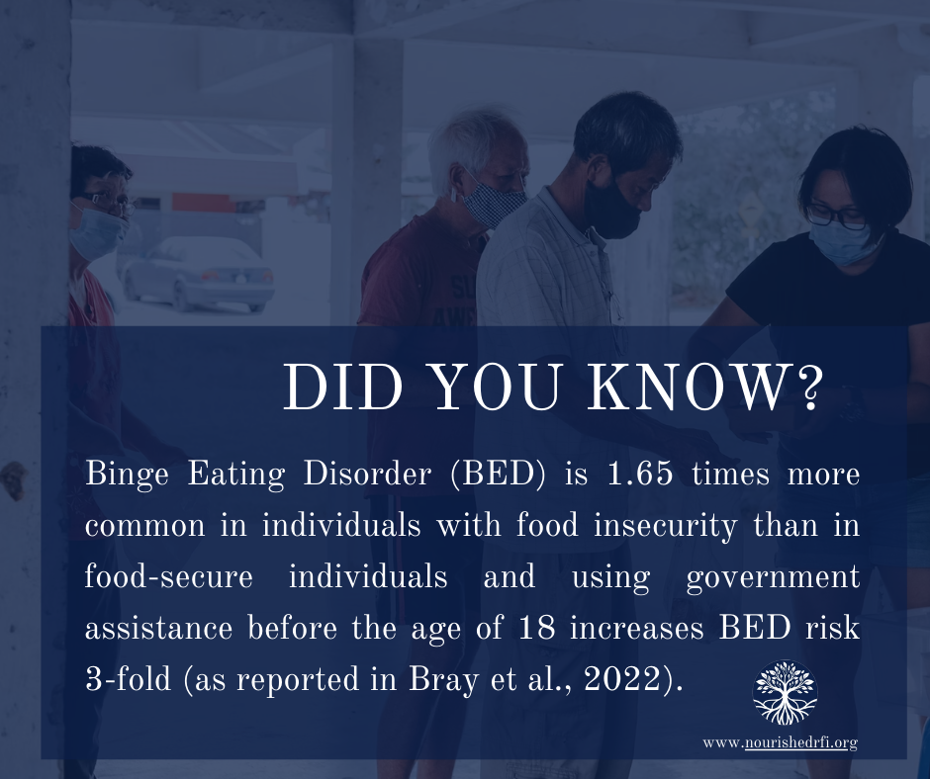
Application: Binge Eating Disorder (BED)
Food Insecurity & Binge Eating Disorder:
• Food insecurity increases BED risk 1.65-fold (165%).
• Govt. assistance increases BED risk 3-fold (300%).
Need for Greater Understanding:
Relationship between food insecurity and BED
Experience of individuals w/ food insecurity & BED
Hazzard et al., 2020

Slide 20
Application: Binge Eating Disorder (BED)
Purpose of Needs Assessment
Understand experience of individuals who use food pantries AND have an eating disorder.
Understand relationship btwn food insecurity & BED.
Utilize findings to develop programs that can support these individuals biological and psychological needs.
(Hazzard et al., 2020, Middlemass et al., 2021, cited in Bray et al., 2022).
Image obtained from: https://www.brennabray.com/brenna-bray-phd-about/research/, www.nourishedrfi.com/research

Slide 21
Application: Binge Eating Disorder (BED)
Related Questions Guiding the Evaluation
Understand if food pantry users deliberately try to limit the amount of food they eat (for any reason) and WHY.
Understand if food pantry users go for 8 waking hours or more without eating anything at all and WHY.
Understand if food pantry users try to exclude from their diet any foods they like and WHY.
Middlemass et al., 2021
Image obtained from: https://www.brennabray.com/brenna-bray-phd-about/research/, www.nourishedrfi.com/research

Slide 22
Application: Binge Eating Disorder (BED)
Overview of Data Sources
On IRB approval, researchers (RAs) contacted food pantries to ask if they would allow data collection.
If agency agreed, Ras met with staff to discuss food distribution patterns and best recruitment tactics.
RAs made contacts with clients, used recruit script.
Paper survey administered after informed consent.
RA available for questions, survey collection, resources.
Image obtained from: https://www.brennabray.com/brenna-bray-phd-about/research/, www.nourishedrfi.com/research

Slide 23
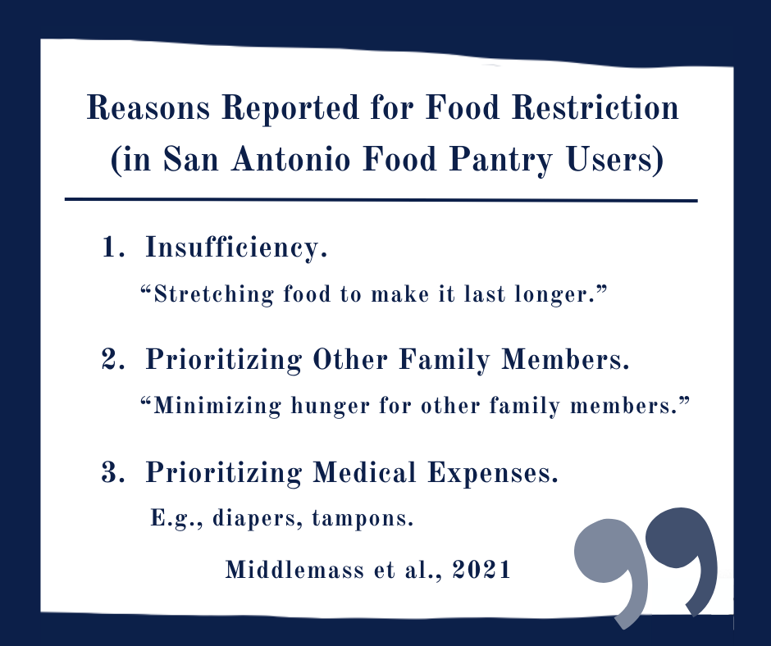
Application: Binge Eating Disorder (BED)
Putting Findings Into Context
52% of San Antonio TX food pantry users report restricting food/eating or fasting >8 hrs (2015-6).
Significant correlation with increased weight/BMI and increased ED pathology (r=0.25, p=0.0001).
Middlemass et al., 2021
Notes:
Middlemass, K. M., Cruz, J., Gamboa, A., Johnson, C., Taylor, B., Gomez, F., & Becker, C. B. (2021). Food insecurity & dietary restraint in a diverse urban population. Eating disorders, 29(6), 616–629. https://doi.org/10.1080/10640266.2020.1723343
Keesha M Middlemass ¹, Jessica Cruz ², Alexandra Gamboa ³, Clara Johnson ³, Brigitte Taylor ³, Francesca Gomez ³, Carolyn Black Becker ³
Affiliations
¹Department of Political Science, Howard University, Washington, District of Columbia, USA.
²Departments of Political Science & Psychology, Trinity University, San Antonio, Texas, USA.
³Department of Psychology, Trinity University, San Antonio, Texas, USA.

Slide 24
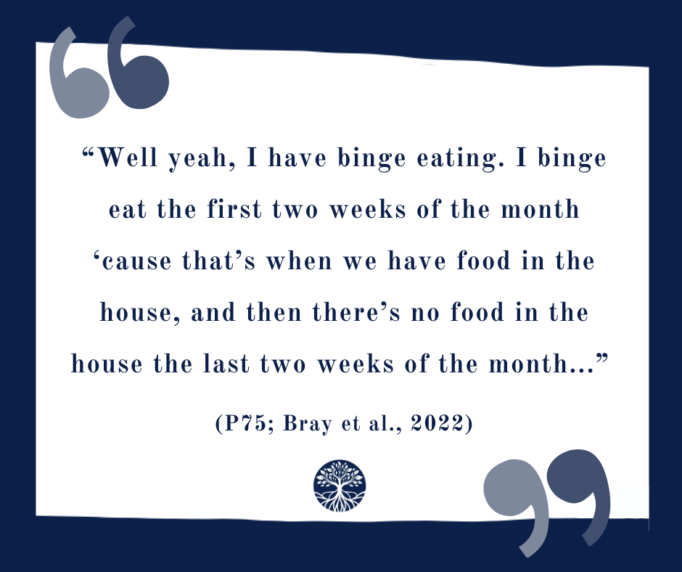
Application: Binge Eating Disorder (BED)
Putting Findings Into Context
52% of San Antonio TX food pantry users report restricting food/eating or fasting >8 hrs (2015-6).
Significant correlation with increased weight/BMI and increased ED pathology (r=0.25, p=0.0001).
(Middlemass et al., 2021; Bray et al., 2022).
Notes:
Middlemass, K. M., Cruz, J., Gamboa, A., Johnson, C., Taylor, B., Gomez, F., & Becker, C. B. (2021). Food insecurity & dietary restraint in a diverse urban population. Eating disorders, 29(6), 616–629. https://doi.org/10.1080/10640266.2020.1723343
Keesha M Middlemass ¹, Jessica Cruz ², Alexandra Gamboa ³, Clara Johnson ³, Brigitte Taylor ³, Francesca Gomez ³, Carolyn Black Becker ³
Affiliations
¹Department of Political Science, Howard University, Washington, District of Columbia, USA.
²Departments of Political Science & Psychology, Trinity University, San Antonio, Texas, USA.
³Department of Psychology, Trinity University, San Antonio, Texas, USA.

Slide 25
Application: Binge Eating Disorder (BED)
Putting Findings Into Context
Food insecure adults deliberately restrict food for reasons other than weight and shape concerns.
Existing dietary restraint measures fail to assess non-weight and shape dietary restraint.
Dietary restraint for other reasons is still correlated with increased eating disorder pathology.
Clinicians should assess dietary restraint for any reasons.
Middlemass et al., 2021
Notes:
Middlemass, K. M., Cruz, J., Gamboa, A., Johnson, C., Taylor, B., Gomez, F., & Becker, C. B. (2021). Food insecurity & dietary restraint in a diverse urban population. Eating disorders, 29(6), 616–629. https://doi.org/10.1080/10640266.2020.1723343
Keesha M Middlemass ¹, Jessica Cruz ², Alexandra Gamboa ³, Clara Johnson ³, Brigitte Taylor ³, Francesca Gomez ³, Carolyn Black Becker ³
Affiliations
¹Department of Political Science, Howard University, Washington, District of Columbia, USA.
²Departments of Political Science & Psychology, Trinity University, San Antonio, Texas, USA.
³Department of Psychology, Trinity University, San Antonio, Texas, USA.

Slide 26
Application: Binge Eating Disorder (BED)
Middlemass, K. M., Cruz, J., Gamboa, A., Johnson, C., Taylor, B., Gomez, F., & Becker, C. B. (2021). Food insecurity & dietary restraint in a diverse urban population. Eating disorders, 29(6), 616–629. https://doi.org/10.1080/10640266.2020.1723343
Notes:
Middlemass, K. M., Cruz, J., Gamboa, A., Johnson, C., Taylor, B., Gomez, F., & Becker, C. B. (2021). Food insecurity & dietary restraint in a diverse urban population. Eating disorders, 29(6), 616–629. https://doi.org/10.1080/10640266.2020.1723343
Keesha M Middlemass ¹, Jessica Cruz ², Alexandra Gamboa ³, Clara Johnson ³, Brigitte Taylor ³, Francesca Gomez ³, Carolyn Black Becker ³
Affiliations
¹Department of Political Science, Howard University, Washington, District of Columbia, USA.
²Departments of Political Science & Psychology, Trinity University, San Antonio, Texas, USA.
³Department of Psychology, Trinity University, San Antonio, Texas, USA.

Slide 27
WE DID IT! ☺

Slide 28
Qualitative Research and Analysis BRIDG Micro-Course
Brenna Bray, PhD
BRIDG T90/R90 Fellowship Postdoctoral Training Program
NCCIH, Grant AT008924
National University of Natural Medicine (NUNM) University of Washington (UW)
NourishED Research Foundation (Boulder, CO, USA | Wilmington, DE, USA)

