Slide 1
BRIDG Micro-Course Qualitative Research and Analysis
Brenna Bray, PhD
BRIDG T90/R90 Fellowship Postdoctoral Training Program
NCCIH, Grant AT008924
National University of Natural Medicine (NUNM) University of Washington (UW)
NourishED Research Foundation (Boulder, CO, USA | Wilmington, DE, USA)

Slide 2
BRIDG Micro-Course Module 6: Guidelines
Brenna Bray, PhD
BRIDG T90/R90 Fellowship Postdoctoral Training Program
NCCIH, Grant AT008924
National University of Natural Medicine (NUNM) University of Washington (UW)
NourishED Research Foundation (Boulder, CO, USA | Wilmington, DE, USA)

Slide 3
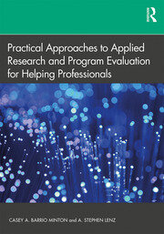
Content Overview
Overview of Qualitative Research
Classic Types of Qualitative Research Designs
Qualitative Evaluation Process
Qualitative Data Analysis
Reporting Findings
Guidelines
https://www.taylorfrancis.com/books/mono/10.4324/9781315108933/practical-approaches-applied-research-program-evaluation-helping-professionals-casey-barrio-minton-stephen-lenz
Notes:
Image from: https://www.taylorfrancis.com/books/mono/10.4324/9781315108933/practical-approaches-applied-research-program-evaluation-helping-professionals-casey-barrio-minton-stephen-lenz

Slide 4
Content Overview: Module 6
VI. Qualitative Analysis Guidance Documents
Overall Quality Criteria
Determining Sample Sizes
Reporting Standards
JARS
COREQ
SQRS
Values-Based Approach
Psychology Research
https://www.taylorfrancis.com/books/mono/10.4324/9781315108933/practical-approaches-applied-research-program-evaluation-helping-professionals-casey-barrio-minton-stephen-lenz

Slide 5
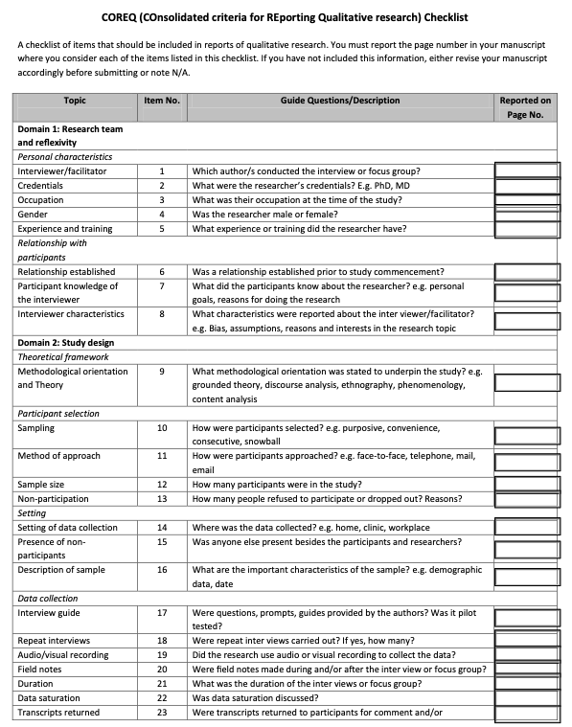
Content Overview: Module 6
Module 6: Qualitative Analysis Guidance Documents
Module Content | Readings | Course Objectives
Video//PowerPoint Lecture Overall Quality Criteria Determining Sample Sizes Reporting Standards Health & Healthcare Research Psychology Research Values-Based Reporting Module 6 Quiz 6 Questions 12 Points 12 % of Course Grade | See Reporting Guideline Documents in the PowerPoint Lecture (and on the next two slides). | Engage with guidance documents on qualitative research conduct and reporting. Identify qualitative guidance documents that can support future qualitative research.
https://legacyfileshare.elsevier.com/promis_misc/ISSM_COREQ_Checklist.pdf

Slide 6
Content Overview: Module 6
Module 6: Qualitative Analysis Guidance Documents
Module Content & Readings (I)
Overall Quality Criteria Qualitative Research Overview and Guidelines (Lim, 2024) Criteria for Good Qualitative Research (Ydav & Drishti, 2022) General & Specific Guidelines for Quality Analysis in Psychology Research (Cena et al, 2024). The Oxford Handbook of Qualitative Research. (Leavy (Ed.), 2020). Practical Approaches to Applied Research & Program Evaluation for Helping Professionals (Barrio Minton & Lenz, 2019). Determining Sample Sizes Sample Sizes for 10 Types of Qualitative Data Analyses (Wutich et al., 2024) Sample Sizes for Saturation in Qualitative Research (Hennink & Kaiser, 2022)

Slide 7
Content Overview: Module 6
Module 6: Qualitative Analysis Guidance Documents
Module Content & Readings (II)
Reporting Standards Health & Healthcare Research COREQ (COnsolidated Criteria for Reporting Qualitative studies). In Guidelines for Reporting Health Research: A User's Manual. (Booth et al., 2014; Tong et al., 2007). Psychology Research JARS-Q (APA Style Journal Article Reporting Standards) (APA, 2020; Levitt et al., 2018) Values-Based Reporting Reporting Guidelines for Qualitative Research: Values-Based Approach (Braun & Clarke, 2024)

Slide 8
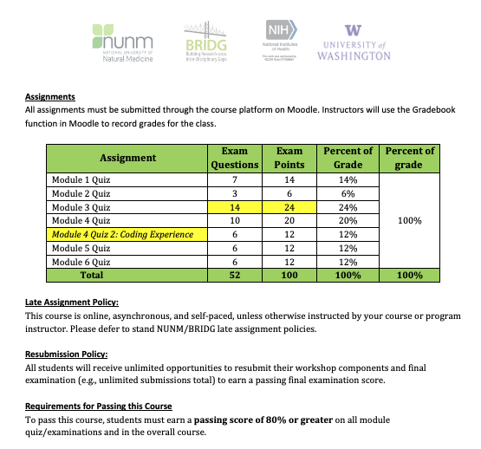
Content Overview: Module Examinations

Slide 9
VI. Guidelines
COnsolidated criteria for REporting Qualitative Research (COREQ)
Tong, A., Sainsbury, P., & Craig, J. (2007). Consolidated criteria for reporting qualitative research (COREQ): a 32-item checklist for interviews and focus groups. International Journal for Quality in Health Care, 19(6), 349-357.
Booth, A., Hannes, K., Harden, A., Noyes, J., Harris, J., & Tong, A. (2014). COREQ (Consolidated Criteria for Reporting Qualitative Studies). In Guidelines for Reporting Health Research: A User's Manual (pp. 214-226).
Developed from: Tong A, Sainsbury P, Craig J. Consolidated criteria for reporting qualitative research (COREQ): a 32-item checklist for interviews and focus groups. International Journal for Quality in Health Care. 2007. Volume 19, Number 6: pp. 349 – 357. https://legacyfileshare.elsevier.com/promis_misc/ISSM_COREQ_Checklist.pdf
Notes:
Image from: https://www.taylorfrancis.com/books/mono/10.4324/9781315108933/practical-approaches-applied-research-program-evaluation-helping-professionals-casey-barrio-minton-stephen-lenz

Slide 10
COnsolidated criteria for REporting Qualitative research (COREQ) Checklist
Developed from: Tong A, Sainsbury P, Craig J. Consolidated criteria for reporting qualitative research (COREQ): a 32-item checklist for interviews and focus groups. International Journal for Quality in Health Care. 2007. Volume 19, Number 6: pp. 349 – 357. https://legacyfileshare.elsevier.com/promis_misc/ISSM_COREQ_Checklist.pdf
Notes:
Image from: https://www.taylorfrancis.com/books/mono/10.4324/9781315108933/practical-approaches-applied-research-program-evaluation-helping-professionals-casey-barrio-minton-stephen-lenz

Slide 11
VI. Guidelines
COnsolidated criteria for REporting Qualitative Research (COREQ).
Standards for Reporting Qualitative Research (SRQR).
O'Brien, B. C., Harris, I. B., Beckman, T. J., Reed, D. A., & Cook, D. A. (2014). Standards for reporting qualitative research: a synthesis of recommendations. Acad Med, 89(9), 1245-1251. https://doi.org/10.1097/acm.0000000000000388

Slide 12
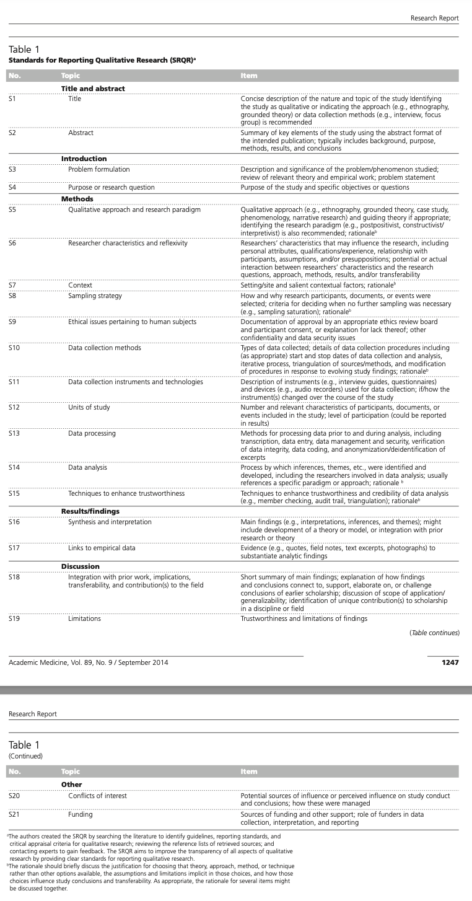
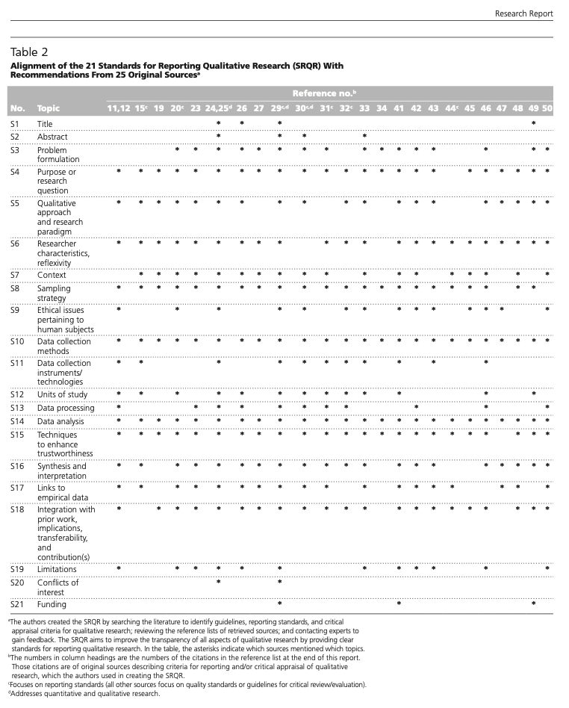
Standards for Reporting Qualitative Research (SRQR)
O'Brien, B. C., Harris, I. B., Beckman, T. J., Reed, D. A., & Cook, D. A. (2014). Standards for reporting qualitative research: a synthesis of recommendations. Acad Med, 89(9), 1245-1251. https://doi.org/10.1097/acm.0000000000000388

Slide 13
VI. Guidelines
COnsolidated criteria for REporting Qualitative Research (COREQ).
Standards for Reporting Qualitative Research (SRQR).
APA’s Journal Article Reporting Standards (JARS) for qualitative … and mixed-methods research in psychology.
Levitt, H. M., … & Suárez-Orozco, C. (2018). Journal article reporting standards for qualitative primary, qualitative meta-analytic, and mixed methods research in psychology: The APA Publications and Communications Board task force report. Am Psychol, 73(1), 26-46. https://doi.org/10.1037/amp0000151

Slide 14
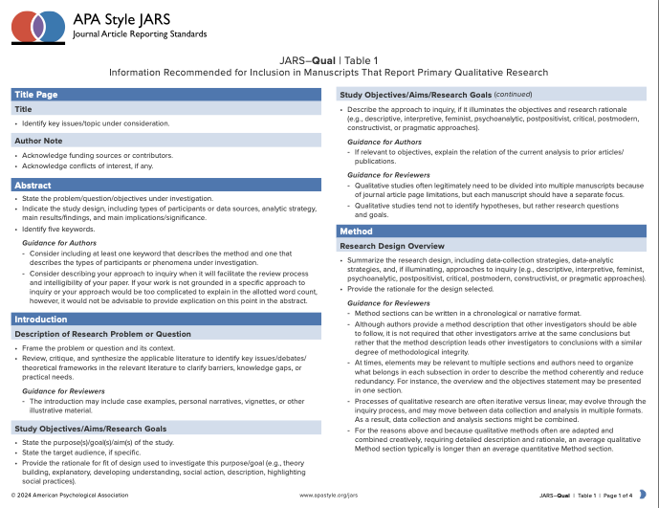
VI. Guidelines
COnsolidated criteria for REporting Qualitative Research (COREQ).
Standards for Reporting Qualitative Research (SRQR).
APA Style Journal Article Reporting Standards (JARS).
American Psychological Association. (2020). APA Style Journal Article Reporting Standards (JARS). APA. https://apastyle.apa.org/jars/qual-table-1.pdf
https://apastyle.apa.org/jars/qual-table-1.pdf

Slide 15
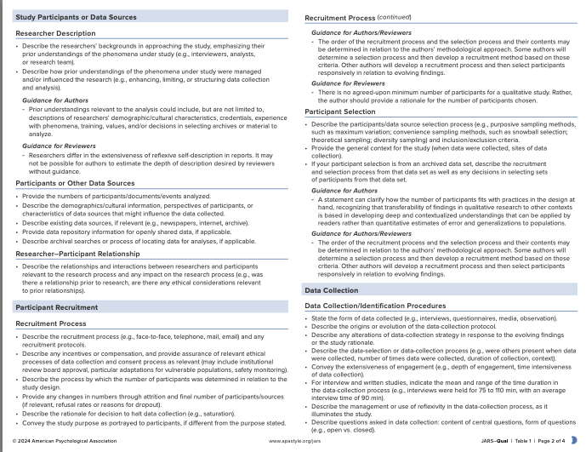
APA Style Journal Article Reporting Standards (JARS)
https://apastyle.apa.org/jars/qual-table-1.pdf

Slide 16
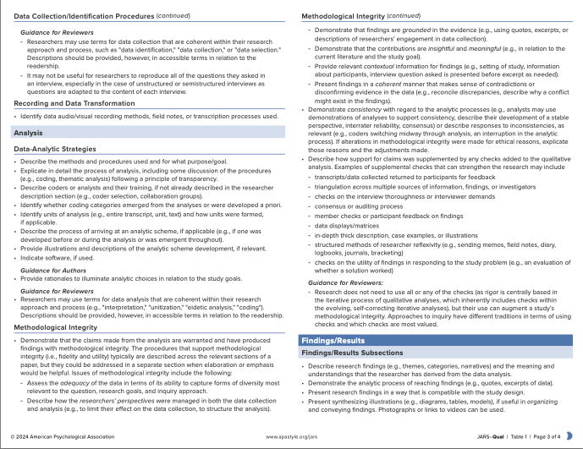
APA Style Journal Article Reporting Standards (JARS)
https://apastyle.apa.org/jars/qual-table-1.pdf

Slide 17
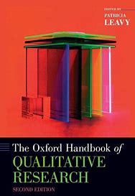
VI. Guidelines
COnsolidated criteria for REporting Qualitative Research (COREQ).
Standards for Reporting Qualitative Research (SRQR).
APA Style Journal Article Reporting Standards (JARS).
Oxford Handbook of Qualitative Research, 2/e
Leavy, Patricia (ed.), The Oxford Handbook of Qualitative Research, 2nd edn, Oxford Handbooks (2020; online edn, Oxford Academic, 2 Sept. 2020), https://doi.org/10.1093/oxfordhb/9780190847388.001.0001.

Slide 18
VI. Guidelines
COnsolidated criteria for REporting Qualitative Research (COREQ).
Standards for Reporting Qualitative Research (SRQR).
APA Style Journal Article Reporting Standards (JARS).
Oxford Handbook of Qualitative Research, 2/e.
Yadav, D. (2022). Criteria for Good Qualitative Research: A Comprehensive Review. The Asia-Pacific Education Researcher, 31(6), 679-689. https://doi.org/10.1007/s40299-021-00619-0.

Slide 19
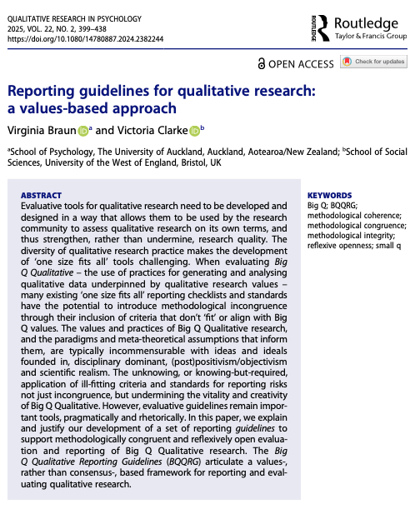
VI. Guidelines
COnsolidated criteria for REporting Qualitative Research (COREQ).
Standards for Reporting Qualitative Research (SRQR).
APA Style Journal Article Reporting Standards (JARS).
Oxford Handbook of Qualitative Research, 2/e.
Criteria for Good Qualitative Research: Comprehensive Review.
Reporting Guidelines for Values-Based Qualitative Research.
Braun, V., & Clarke, V. (2024). Reporting guidelines for qualitative research: a values-based approach. Qualitative Research in Psych, 1-40. https://doi.org/10.1080/14780887.2024.2382244.

Slide 20
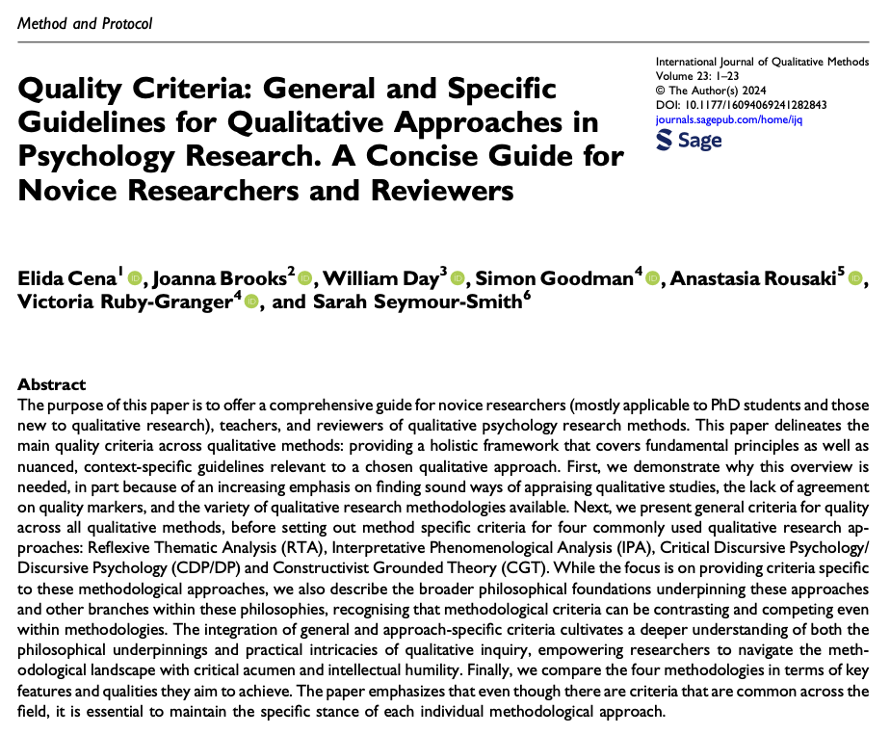
VI. Guidelines
Quality Criteria Guidelines for Qualitative Psychology Research.
Cena et al. (2024). Quality Criteria: General and Specific Guidelines for Qualitative Approaches in Psychology Research. A Concise Guide for Novice Researchers and Reviewers. International Journal of Qualitative Methods, 23, 16094069241282843. https://doi.org/10.1177/16094069241282843

Slide 21
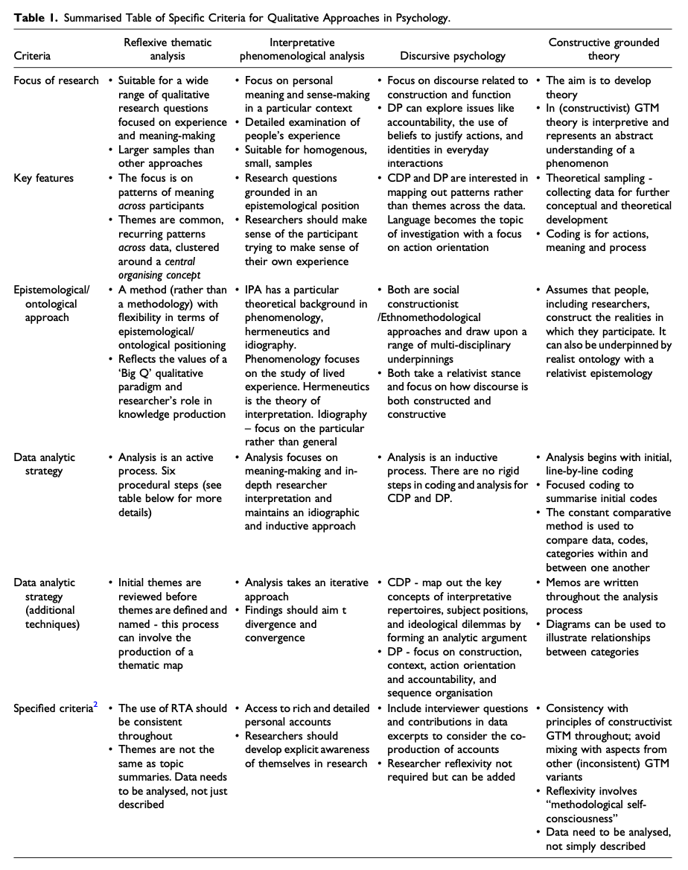
Guidelines for Quality Qualitative Psychology Research
Cena et al. (2024). Quality Criteria: General and Specific Guidelines for Qualitative Approaches in Psychology Research. A Concise Guide for Novice Researchers and Reviewers. International Journal of Qualitative Methods, 23, 16094069241282843. https://doi.org/10.1177/16094069241282843

Slide 22
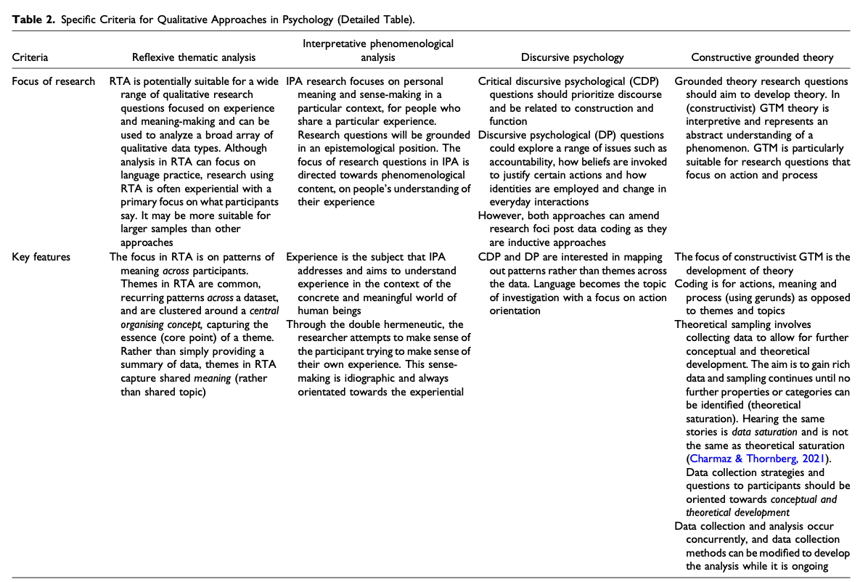
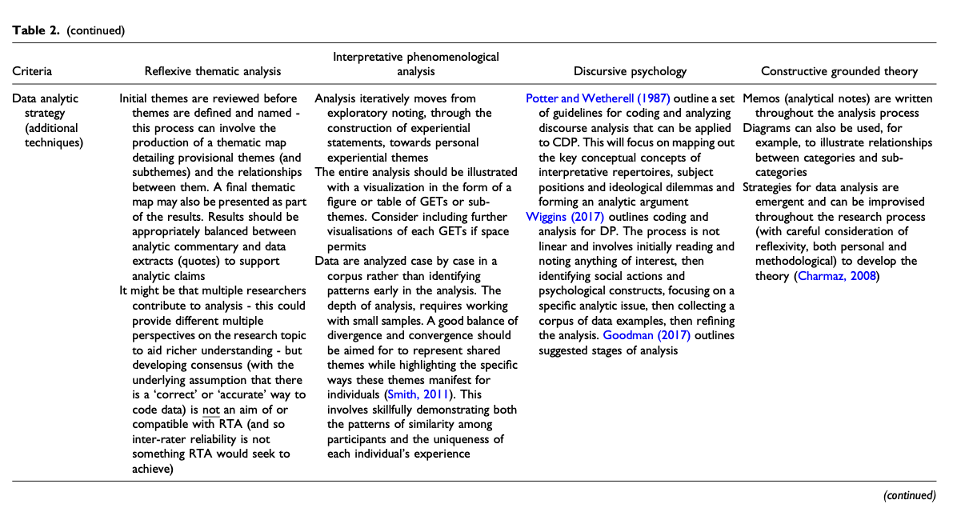
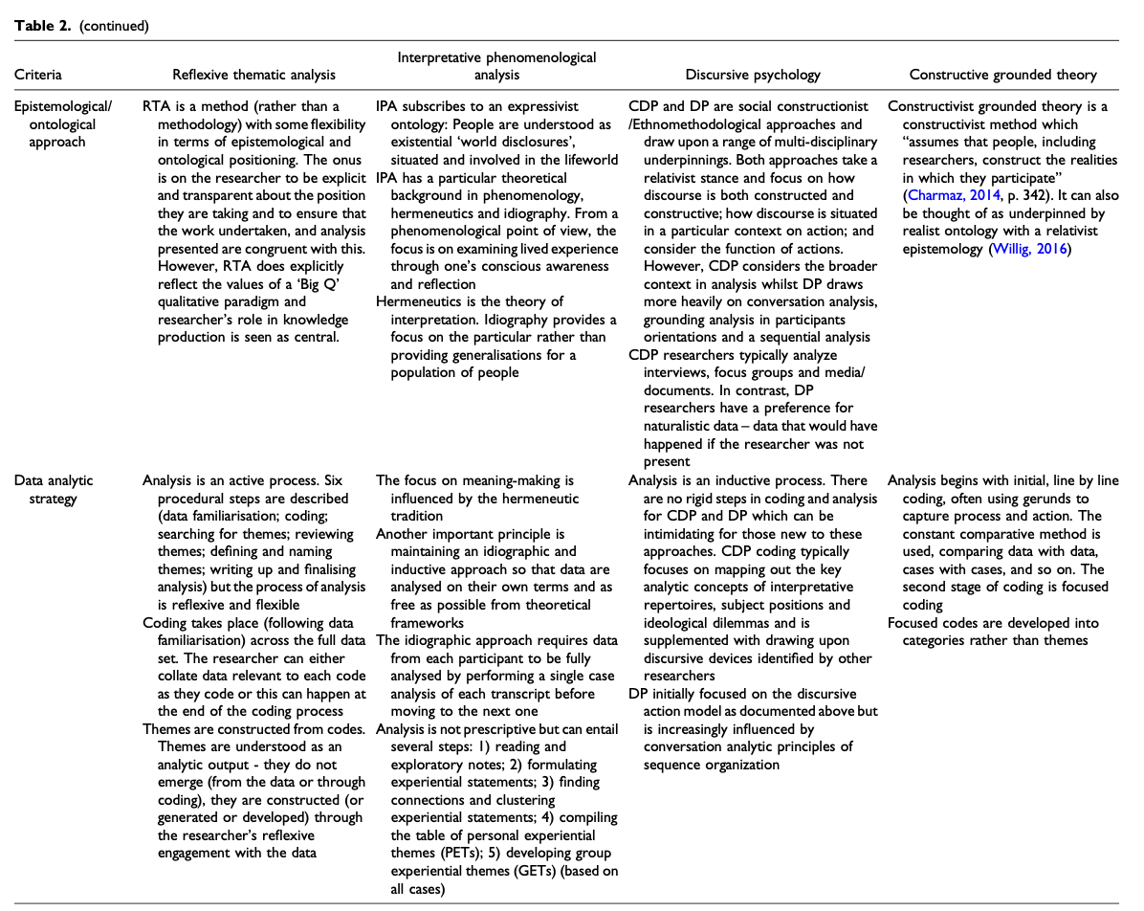
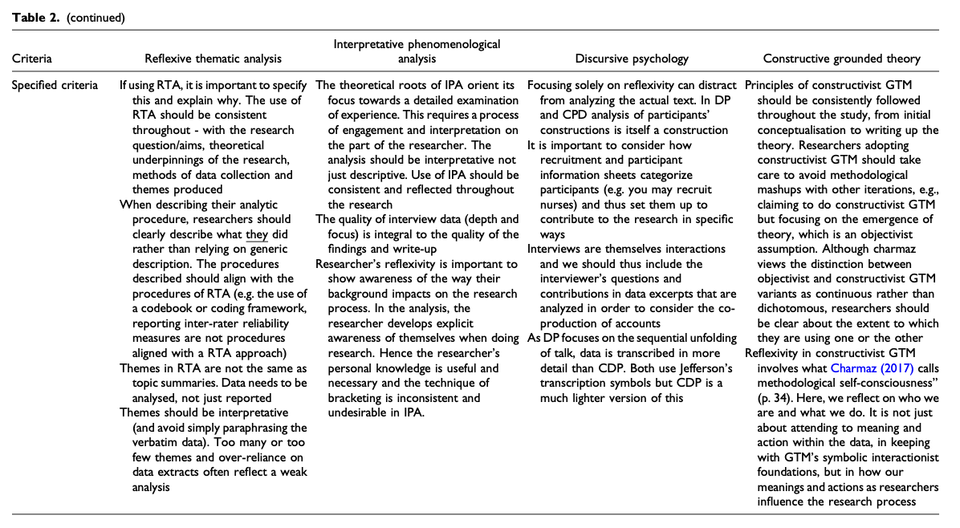
Guidelines for Quality Qualitative Psychology Research
Cena et al. (2024). Quality Criteria: General and Specific Guidelines for Qualitative Approaches in Psychology Research. A Concise Guide for Novice Researchers and Reviewers. International Journal of Qualitative Methods, 23, 16094069241282843. https://doi.org/10.1177/16094069241282843

Slide 23
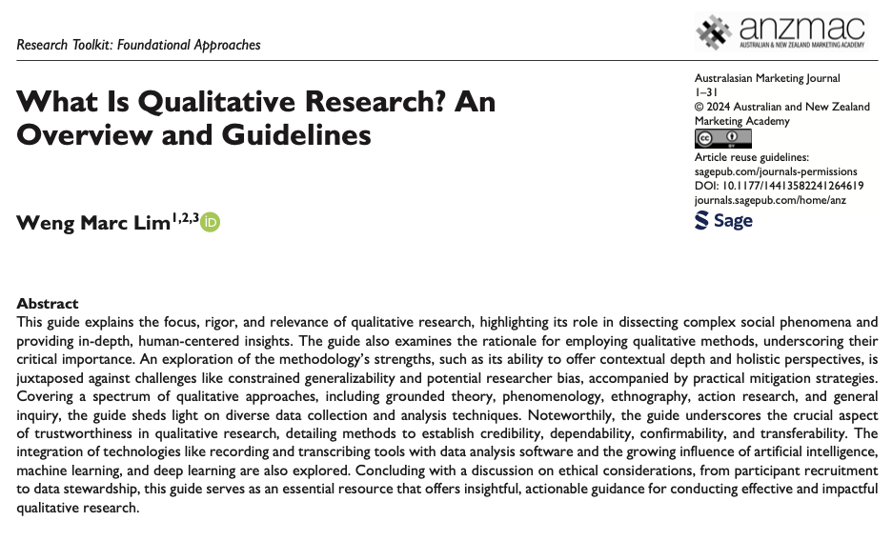
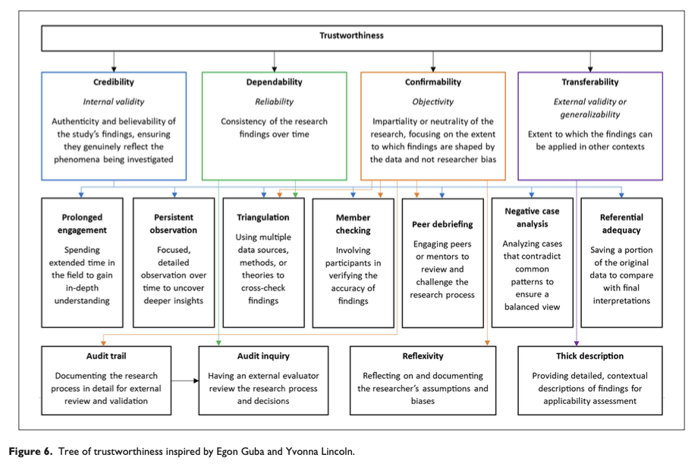
VI. Guidelines & Resources
Quality Criteria Guidelines for Qualitative Psychology Research.
Lim, W. M. (2024). What Is Qualitative Research? An Overview and Guidelines. Australasian Marketing Journal, 0(0), 14413582241264619. https://doi.org/10.1177/14413582241264619.

Slide 24
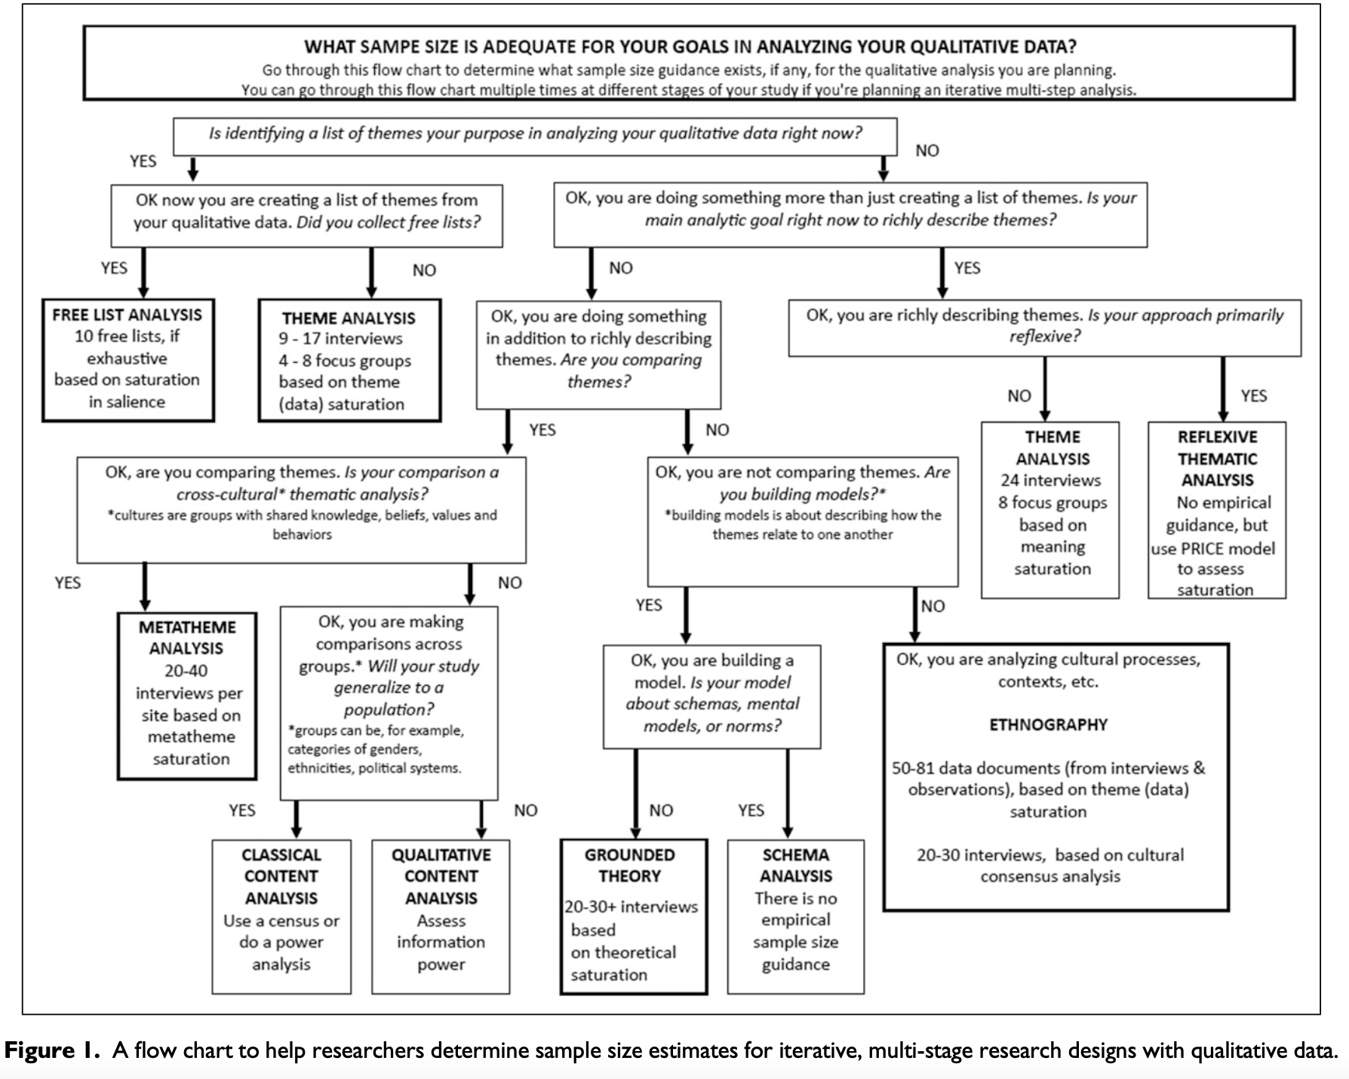
VI. Guidelines & Resources
Quality Criteria Guidelines for Qualitative Psychology Research.
Lim, W. M. (2024). What Is Qualitative Research? An Overview and Guidelines. https://doi.org/10.1177/14413582241264619.
Sample Sizes for 10 Types of Qualitative Data Analysis: An Integrative Review, Empirical Guidance, & Next Steps (Wutich et al., 2024).
Wutich, A., Beresford, M., & Bernard, H. R. (2024). Sample Sizes for 10 Types of Qualitative Data Analysis: An Integrative Review, Empirical Guidance, and Next Steps. International Journal of Qualitative Methods, 23, 16094069241296206. https://doi.org/10.1177/16094069241296206.

Slide 25
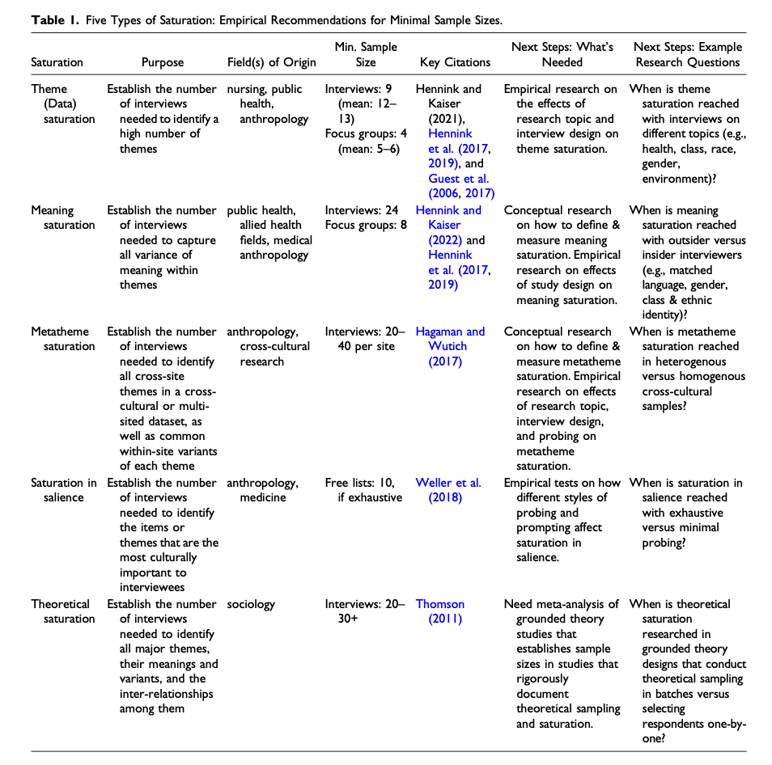
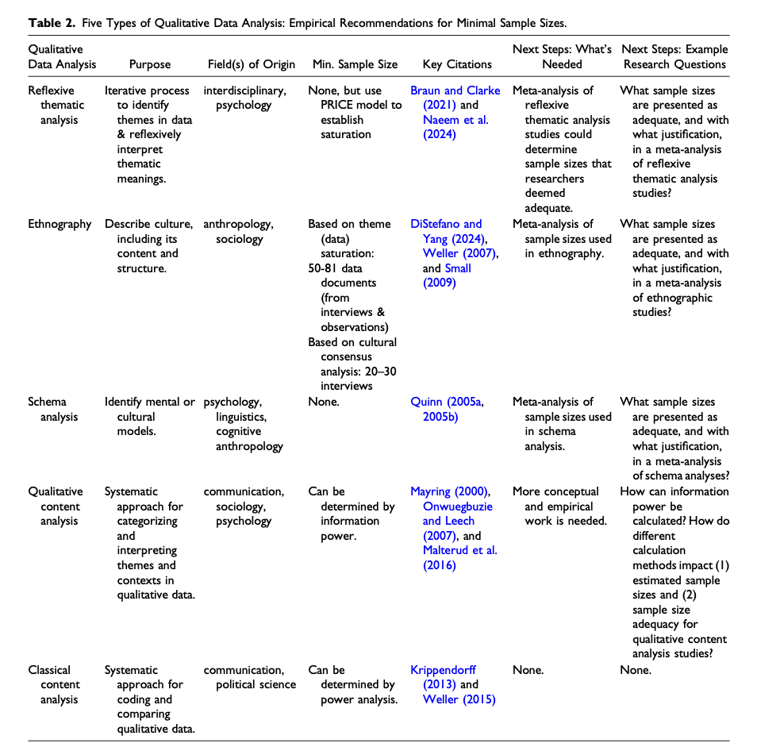
Sample Sizes for 10 Types of Qualitative Data Analysis: An Integrative Review, Empirical Guidance, & Next Steps (Wutich et al., 2024)
Notes:
Wutich, A., Beresford, M., & Bernard, H. R. (2024). Sample Sizes for 10 Types of Qualitative Data Analysis: An Integrative Review, Empirical Guidance, and Next Steps. International Journal of Qualitative Methods, 23, 16094069241296206. https://doi.org/10.1177/16094069241296206.

Slide 26
VI. Guidelines & Resources
Quality Criteria Guidelines for Qualitative Psychology Research.
Lim, W. M. (2024). What Is Qualitative Research? An Overview and Guidelines. https://doi.org/10.1177/14413582241264619.
Sample Sizes for 10 Types of Qualitative Data Analysis: An Integrative Review, Empirical Guidance, & Next Steps (Wutich et al., 2024).
Barrio Minton, C. A., & Lenz, A. S. (2019). Chapter 7: Understanding Lived Experiences. In Barrio Minton, C. A., & Lenz, A. S. (Eds.), Practical approaches to applied research and program evaluation for helping professionals. (1st Ed., pp 87 - 105). Routledge, Taylor & Francis Group.

Slide 27
WE DID IT! ☺

Slide 28
BRIDG Micro-Course Qualitative Research and Analysis
Brenna Bray, PhD
BRIDG T90/R90 Fellowship Postdoctoral Training Program
NCCIH, Grant AT008924
National University of Natural Medicine (NUNM) University of Washington (UW)
NourishED Research Foundation (Boulder, CO, USA | Wilmington, DE, USA)

