Slide 1




BRIDG Micro-Course Qualitative Research and Analysis
Brenna Bray, PhD
BRIDG T90/R90 Fellowship Postdoctoral Training Program
NCCIH, Grant AT008924
National University of Natural Medicine (NUNM) University of Washington (UW)
NourishED Research Foundation (Boulder, CO, USA | Wilmington, DE, USA)

Slide 2
BRIDG Micro-Course Module 2: Classic Types of Qualitative Designs
Brenna Bray, PhD
BRIDG T90/R90 Fellowship Postdoctoral Training Program
NCCIH, Grant AT008924
National University of Natural Medicine (NUNM) University of Washington (UW)
NourishED Research Foundation (Boulder, CO, USA | Wilmington, DE, USA)

Slide 3
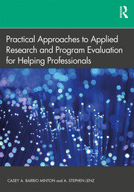
Module 2 Overview
Overview of Qualitative Research
Classic Types of Qualitative Research Designs
Qualitative Evaluation Process
Qualitative Data Analysis
Reporting Findings
Guidelines
https://www.taylorfrancis.com/books/mono/10.4324/9781315108933/practical-approaches-applied-research-program-evaluation-helping-professionals-casey-barrio-minton-stephen-lenz

Slide 4
Module 2 Overview
II. Classic Types of Qualitative Research Designs
Phenomenology
Grounded Theory
Narrative Inquiry
Ethnography
Case Study
https://www.taylorfrancis.com/books/mono/10.4324/9781315108933/practical-approaches-applied-research-program-evaluation-helping-professionals-casey-barrio-minton-stephen-lenz

Slide 5
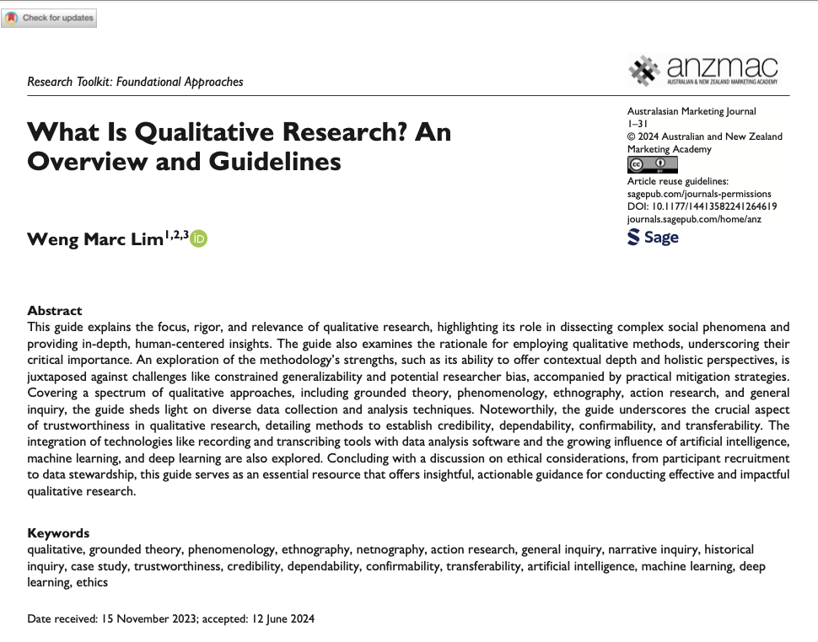
Content Overview: Module 2
Module 2: Classic Types of Qualitative Research Designs
Module Content | Readings | Course Objectives
Video//PowerPoint Lecture Phenomenology Grounded Theory Narrative Inquiry Ethnography Case Study Module 2 Quiz 3 Questions 6 Points 6% of Total Course Grade | Barrio Minton & Lenz (2019). Ch. 7, Section 2 (Classic Types of Qualitative Research Designs). Lim, (2024). Pages 6 – 16 (scan) Table 4. | Articulate key features, uses, strengths, limitations, and resource needs of different types of qualitative research designs
https://www.taylorfrancis.com/books/mono/10.4324/9781315108933/practical-approaches-applied-research-program-evaluation-helping-professionals-casey-barrio-minton-stephen-lenz

Slide 6

Content Overview: Module Examinations

Slide 7
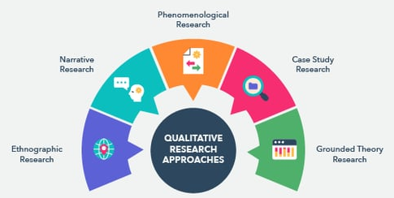
II. Classic Types of Qualitative Research
Frameworks for Designing and Implementing Qualitative Research
Notes:
Image from: https://www.taylorfrancis.com/books/mono/10.4324/9781315108933/practical-approaches-applied-research-program-evaluation-helping-professionals-casey-barrio-minton-stephen-lenz

Slide 8
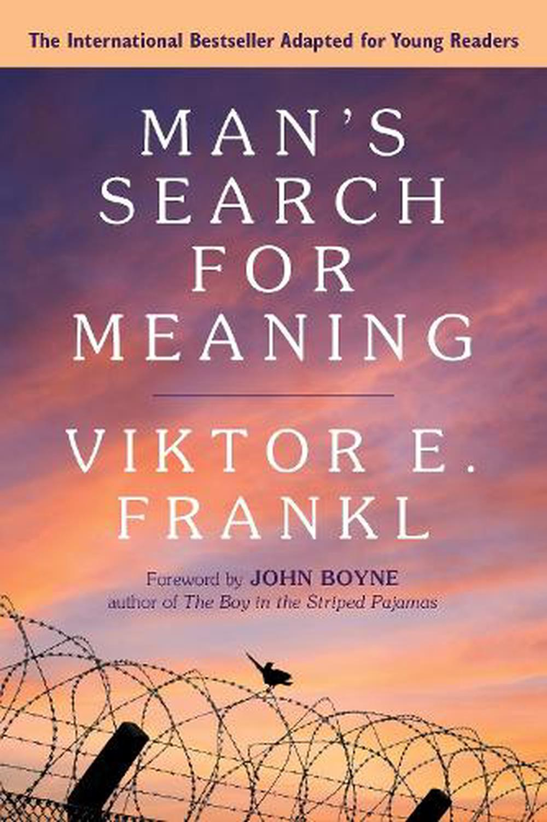
II.1. Phenomenology
Emphasis: Meaning-making related to lived experiences, distilling experiences to “essence.”
Primary Data Source: In-depth interviews
Participants: Shared experience of common events or phenomena.
E.g.₁: Man’s Search for Meaning: Describes shared lived experience of life in a concentration camp.
https://www.thenile.com.au/books/viktor-e-frankl/mans-search-for-meaning-young-adult-edition/9780807067994
Notes:
“Phenomenology focuses on understanding lived experiences from the perspective of those who live them. One example that may resonate with many is Viktor Frankl's seminal work Man's Search for Meaning. While it's more philosophical and memoir-like, Frankl captures the phenomenological essence by describing his and others' lived experiences in concentration camps during the Holocaust. He explores how individuals find meaning in suffering, a deeply subjective and universal human experience,” (Microsoft Copilot Communication, March 24, 2025).

Slide 9
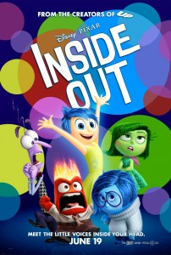
II.1. Phenomenology
Emphasis: Meaning-making related to lived experiences, distilling experiences to “essence.”
Primary Data Source: In-depth interviews
Participants: Shared experience of common events or phenomena.
E.g.₂: Inside Out: Explores Riley’s lived internal emotional experience of change, growth, & emotion.
http://www.my-sf.com/2015/07/03/inside-out-animated-film-review/
Notes:
“Another example, drawn from media, could be the movie Inside Out. While it's animated, the film delves into the internal, emotional world of a young girl named Riley. It explores her lived experience of dealing with change, growth, and emotion. The movie beautifully captures subjective emotional experiences in a way that's accessible and relatable to all ages,” (Microsoft Copilot Communication, March 24, 2025).

Slide 10
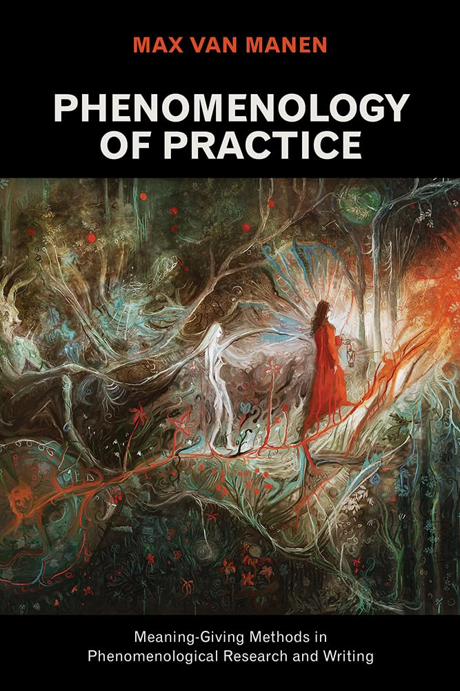
II.1. Phenomenology
Emphasis: Meaning-making related to lived experiences, distilling experiences to “essence.”
Primary Data Source: In-depth interviews
Participants: Shared experience of common events or phenomena.
E.g.₃: Phenomenology of Practice: Explores lived experiences, including healthcare & education settings
https://a.co/d/6kADkR3
Notes:
Max van Manen's research in Phenomenology of Practice
“A well-known example of phenomenology using in-depth interviews is Max van Manen's research in Phenomenology of Practice. His work explores lived experiences through deep and reflective interviews, particularly with individuals in healthcare and education settings. By engaging participants in sharing their firsthand experiences, he aims to uncover the essence of what it feels like to be in particular situations—like being a patient or a caregiver.” (Microsoft Copilot Communication, March 24, 2025).

Slide 11
II.1. Phenomenology
In-depth interviews with participants who have experienced common events or phenomena.
Uncover individual experiences and meaning-making processes in-depth.
Work across cases to uncover shared elements of these experiences.
Phenomenology of Practice: “Meaning Giving Methods”
https://a.co/d/6kADkR3

Slide 12
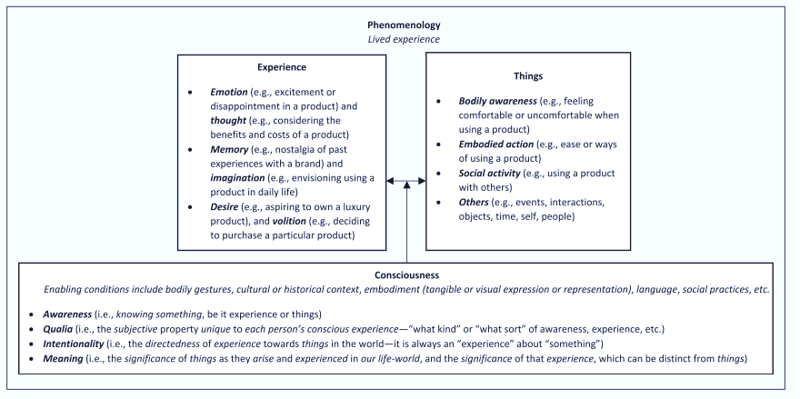
II.1 Phenomenology (Deep Dive)
Fig 3: Foundations of Phenomenology. Informed through personal reflexivity from readings by Husserl (1913) and Smith (2018).
Fig. 3 in Lim (2024).
Figure from: Lim, W. M. (2024). What Is Qualitative Research? An Overview and Guidelines. Australasian Marketing Journal, 0(0), 14413582241264619. https://doi.org/10.1177/14413582241264619
Notes:
Image from: https://www.taylorfrancis.com/books/mono/10.4324/9781315108933/practical-approaches-applied-research-program-evaluation-helping-professionals-casey-barrio-minton-stephen-lenz
Braun, V., & Clarke, V. (2006). Using thematic analysis in psychology. Research in Psychology, 3(2), 77–101.
https://doi.org/10.1191/1478088706qp063oa
(Iterative: referring to a process that involves repeating a sequence of operations or procedures)

Slide 13

II.2. Grounded Theory
Focus: Developing a theory directly from data through iterative process of coding, analysis, & comparison.
Emphasis: Using data to build a substantive theory about a process or phenomenon.
Primary Data Source: Semi-structured interviews.
May Also Include: Observations, document reviews.
https://artworks.thetvdb.com/banners/posters/140141-3.jpg
Notes:
“Grounded theory focuses on developing a theory directly from data through an iterative process of coding, analysis, and comparison. … For a media-related example, consider the TV show Undercover Boss. In each episode, a high-level executive works incognito within their company, experiencing daily operations from an employee's perspective. While the show isn't formal research, it loosely follows grounded theory principles: the executive gathers firsthand observations, identifies recurring patterns in employee experiences, and develops changes or policies based on these insights.” (Microsoft Copilot Communication, March 24, 2025).

Slide 14
II.2. Grounded Theory
E.g.1: Undercover Boss. (Loose GT Principles) Exec works incognito in their company, experiencing daily operations from an employees’ perspective.
Loosely follows GT Principles: Executive:
Gathers firsthand observations,
Identifies patterns in employee experiences,
Develops policies or changes based on insights.
https://artworks.thetvdb.com/banners/posters/140141-3.jpg
Notes:
“Grounded theory focuses on developing a theory directly from data through an iterative process of coding, analysis, and comparison. … For a media-related example, consider the TV show Undercover Boss. In each episode, a high-level executive works incognito within their company, experiencing daily operations from an employee's perspective. While the show isn't formal research, it loosely follows grounded theory principles: the executive gathers firsthand observations, identifies recurring patterns in employee experiences, and develops changes or policies based on these insights.” (Microsoft Copilot Communication, March 24, 2025).

Slide 15
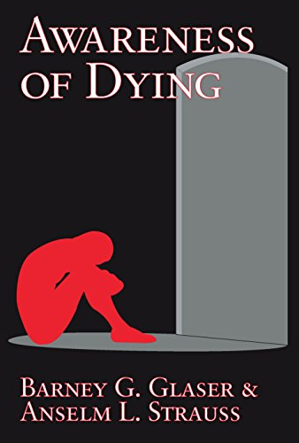
II.2. Grounded Theory
E.g.2: Glaser & Strauss’ Awareness of Dying.
Uses grounded theory to develop framework about how medical staff manage and communicate with terminally ill patients.
Insights emerge directly from observing and interviewing patients, nurses, and doctors.
Captures the reality of their interactions.
https://amzn.eu/d/7hILS2r
Notes:
“Grounded theory focuses on developing a theory directly from data through an iterative process of coding, analysis, and comparison. A well-known research example is Barney Glaser and Anselm Strauss's original study in their book Awareness of Dying. They used grounded theory to develop a framework about how medical staff manage and communicate with terminally ill patients. The insights emerged directly from observing and interviewing patients, nurses, and doctors, capturing the reality of their interactions.” (Microsoft Copilot Communication, March 24, 2025).

Slide 16
II.2. Grounded Theory
Semi-structured interviews used to build a substantive theory about a process or phenomenon.
Constant comparative analysis to understand units of meaning within and across cases.
Categories/Themes (groups of units) are identified to create theories that explain relationships & processing among categories/themes.
https://amzn.eu/d/7hILS2r
Notes:
“Grounded theory focuses on developing a theory directly from data through an iterative process of coding, analysis, and comparison. A well-known research example is Barney Glaser and Anselm Strauss's original study in their book Awareness of Dying. They used grounded theory to develop a framework about how medical staff manage and communicate with terminally ill patients. The insights emerged directly from observing and interviewing patients, nurses, and doctors, capturing the reality of their interactions.” (Microsoft Copilot Communication, March 24, 2025).

Slide 17
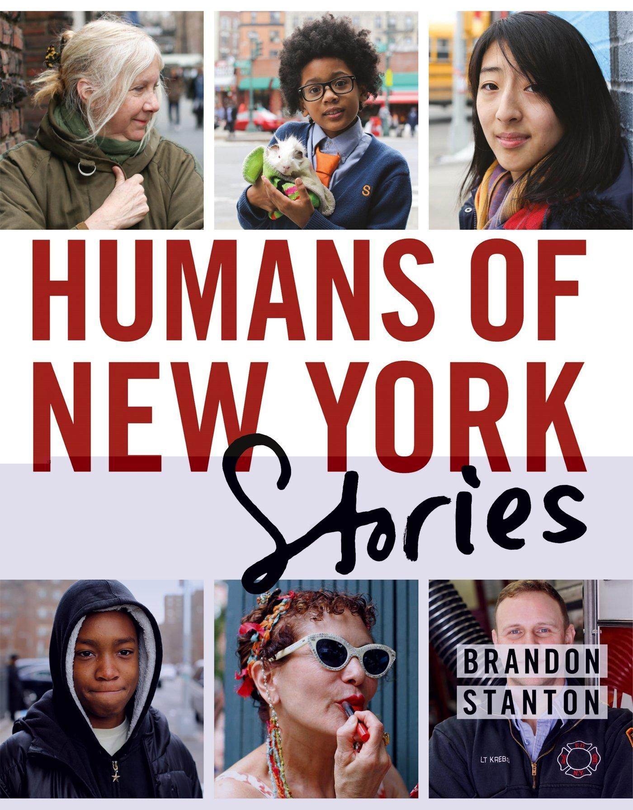
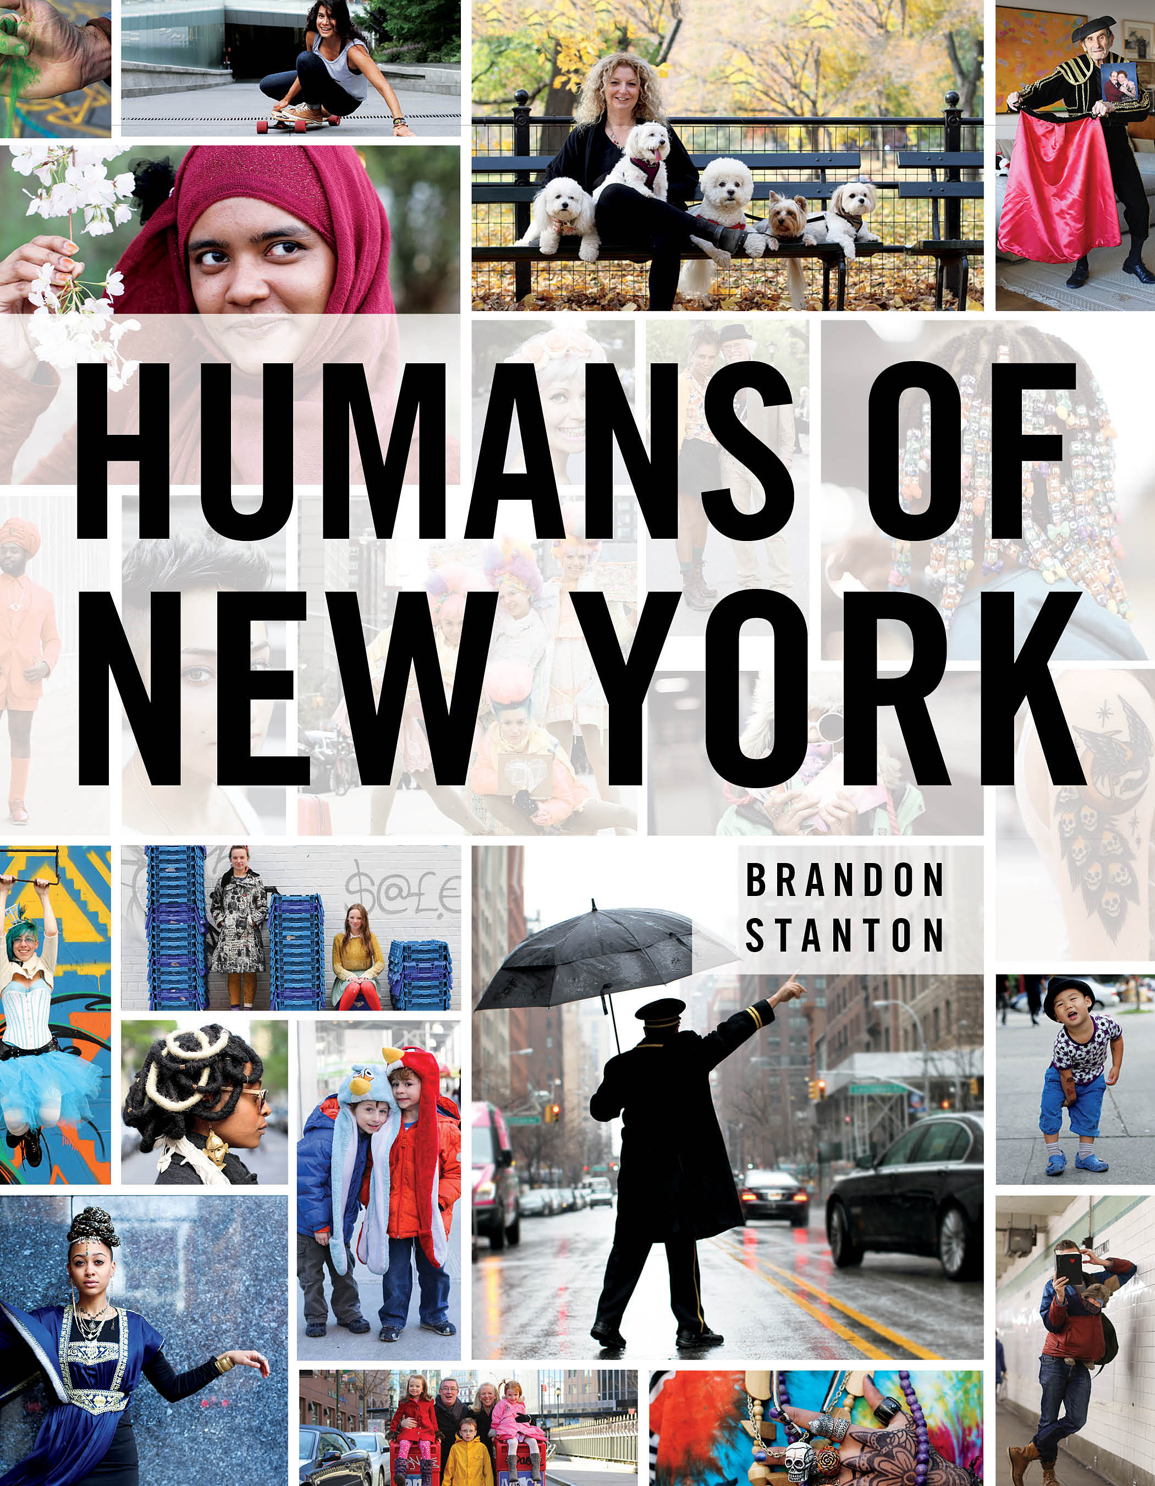
II.3. Narrative Inquiry
Emphasis: Using story to illustrate meaning and experience.
Primary Data Source: Oral and written word.
Primarily semi-structured interviews.
May incorporate experiences conveyed in autobiographical writings and other documents.
https://images.huffingtonpost.com/2014-01-25-humansofnewyork.jpg
https://d30a6s96kk7rhm.cloudfront.net/original/readings/978/125/005/9781250058904.jpg
Notes:
“Narrative inquiry centers on the exploration of individuals’ life stories to understand their experiences and the meaning they derive from them,” (Microsoft Copilot Communication, March 24, 2025).
“… Humans of New York (Brandon Stanton) … is a widely known project where everyday individuals share their personal stories through interviews and photographs. It embodies narrative inquiry principles by focusing on people's lived experiences, revealing universal themes of humanity, resilience, and connection. Stanton's work resonates with audiences precisely because it unearths the profound meaning within ordinary lives.
[HNY] reflect the power of narrative to connect us and deepen understanding. If you'd like to integrate this into your class, I can help you brainstorm activities or discussion prompts! Just say the word,” (Microsoft Copilot Communication, March 24, 2025).

Slide 18
II.3. Narrative Inquiry
E.g.: Brandon Stanton’s Humans of New York. Widely known project: Everyday individuals share personal stories through interviews & photographs.
Embodies Narrative Inquiry Principles:
Focus on Lived Experiences.
Reveals Universal Themes
(Re: Humanity, Resilience, Connection).
https://d30a6s96kk7rhm.cloudfront.net/original/readings/978/125/005/9781250058904.jpg
Notes:
“Narrative inquiry centers on the exploration of individuals’ life stories to understand their experiences and the meaning they derive from them,” (Microsoft Copilot Communication, March 24, 2025).
“… Humans of New York (Brandon Stanton) … is a widely known project where everyday individuals share their personal stories through interviews and photographs. It embodies narrative inquiry principles by focusing on people's lived experiences, revealing universal themes of humanity, resilience, and connection. Stanton's work resonates with audiences precisely because it unearths the profound meaning within ordinary lives.
[HNY] reflect the power of narrative to connect us and deepen understanding. If you'd like to integrate this into your class, I can help you brainstorm activities or discussion prompts! Just say the word,” (Microsoft Copilot Communication, March 24, 2025).

Slide 19
II.3. Narrative Inquiry
Narrative Inquiry: Semi-structured interviews used to illustrate meaning and experience.
Process:
Collecting stories and experiences.
Analyzing for themes.
Constructing a common shared story.
https://d30a6s96kk7rhm.cloudfront.net/original/readings/978/125/005/9781250058904.jpg
Notes:
“Narrative inquiry centers on the exploration of individuals’ life stories to understand their experiences and the meaning they derive from them,” (Microsoft Copilot Communication, March 24, 2025).
“… Humans of New York (Brandon Stanton) … is a widely known project where everyday individuals share their personal stories through interviews and photographs. It embodies narrative inquiry principles by focusing on people's lived experiences, revealing universal themes of humanity, resilience, and connection. Stanton's work resonates with audiences precisely because it unearths the profound meaning within ordinary lives.
[HNY] reflect the power of narrative to connect us and deepen understanding. If you'd like to integrate this into your class, I can help you brainstorm activities or discussion prompts! Just say the word,” (Microsoft Copilot Communication, March 24, 2025).

Slide 20
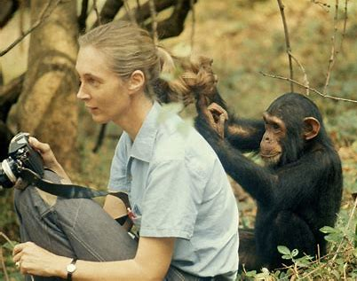
II.4. Ethnography
Focus:
Understanding cultural groups or phenomenon.
Uncover greater cultural meaning.
Prolonged immersion, observation, & engagement in a site (e.g., mos. to yrs).
https://spyscape.com/article/jane-goodall-from-champion-of-chimpanzees-to-environmental-superhero
https://www.taylorfrancis.com/books/mono/10.4324/9781315108933/practical-approaches-applied-research-program-evaluation-helping-professionals-casey-barrio-minton-stephen-lenz
Notes:
(Microsoft Copilot Communication, March 24, 2025).

Slide 21
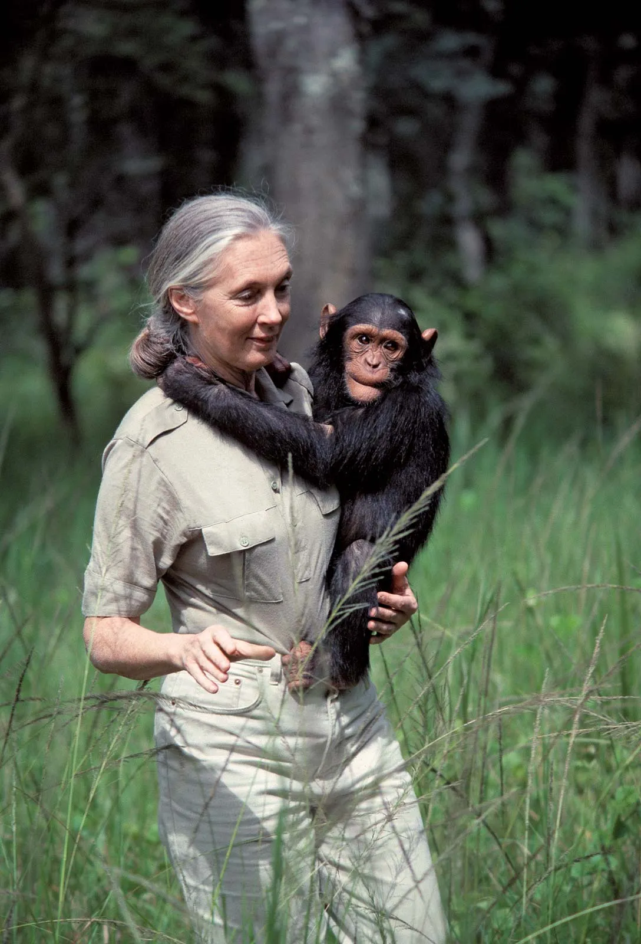
II.4. Ethnography
Focus: Understanding cultural groups, phenomenon.
Primary Data Source:
Observations of Individuals & Interactions.
Artifact Notes: Photos, Documents, Everyday Items
Interviews with Community Members.
https://www.britannica.com/biography/Jane-Goodall
Notes:
(Microsoft Copilot Communication, March 24, 2025).

Slide 22
II.4. Ethnography
E.g.: Jane Goodall’s Primatological Ethnography. Decades-long immersion with chimpanzees in Tanzania.
Key Ethnographic Principles:
Prolonged Engagement.
Deep Observation.
Ability to Interpret Behaviors within Cultural and Social Contexts
https://www.britannica.com/biography/Jane-Goodall
Notes:
“Ethnography focuses on immersing oneself in a cultural or social environment to understand behaviors, practices, and perspectives.
…Jane Goodall's work is an exemplary model of ethnographic research—though more specifically, primatological ethnography. Her decades-long immersion with chimpanzees in Gombe Stream National Park in Tanzania demonstrates key ethnographic principles: prolonged engagement, deep observation, and the ability to interpret behaviors within a cultural and social context.
Goodall didn’t just study chimpanzees from a distance; she integrated herself into their environment, documenting their social structures, emotions, and relationships. Her findings challenged long-standing assumptions about primates and humans, such as her discovery that chimpanzees use tools—a behavior previously thought to be uniquely human.
While her primary focus was on animals, her method of observing and understanding the lived realities of a distinct community aligns closely with ethnographic principles, making her work both iconic and transformative.
(Microsoft Copilot Communication, March 24, 2025).

Slide 23
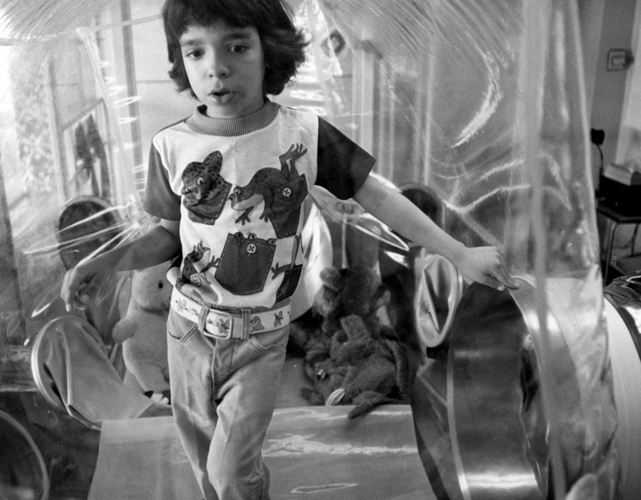
II.5. Case Study
Emphasis: Understanding one [thing] well, often from multiple perspectives [e.g., one phenomenon, pathology, program, unit].
Unit of analysis: “Bounded system” (e.g., individual, program, organization) in its own context.
https://cdn.houstonpublicmedia.org/wp-content/uploads/2016/05/13154629/David-Vetter-the-Bubble-Boy-at-5-years-old-Dec.-1976--1200x800.jpg
E.g., David Vetter, Case of (SCID)
Notes:
"The Boy in the Bubble" could be considered a compelling example of a case study in science, as it focuses on the real-life experiences of David Vetter, a boy born with severe combined immunodeficiency (SCID). This rare genetic disorder left him without an effective immune system, requiring him to live in a sterile environment ("the bubble") to avoid life-threatening infections.
David's story has been extensively documented and analyzed, providing valuable insights into the medical, psychological, and ethical dimensions of living with SCID. The case also contributed significantly to advancements in medical science, including bone marrow transplants and gene therapy, which are now standard treatments for SCID. At the same time, it raises important ethical questions about experimental treatments, quality of life, and the limits of medical intervention.
Because it is such a personal and widely discussed example, David's story resonates with people emotionally while also offering a concrete example of how case studies can drive medical progress. It’s an excellent choice for discussing the intersection of science, ethics, and human experience. “

Slide 24
II.5. Case Study
David Vetter, “Boy in the Bubble”
Case Study in Science: Focuses on real-life experiences of Severe Combined Immunodeficiency Disorder (SCID).
SCID: Rare genetic disorder resulting in no effective immune system, requiring sterile living environment (“bubble”).
https://cdn.houstonpublicmedia.org/wp-content/uploads/2016/05/13154629/David-Vetter-the-Bubble-Boy-at-5-years-old-Dec.-1976--1200x800.jpg
Notes:
"The Boy in the Bubble" could be considered a compelling example of a case study in science, as it focuses on the real-life experiences of David Vetter, a boy born with severe combined immunodeficiency (SCID). This rare genetic disorder left him without an effective immune system, requiring him to live in a sterile environment ("the bubble") to avoid life-threatening infections.
David's story has been extensively documented and analyzed, providing valuable insights into the medical, psychological, and ethical dimensions of living with SCID. The case also contributed significantly to advancements in medical science, including bone marrow transplants and gene therapy, which are now standard treatments for SCID. At the same time, it raises important ethical questions about experimental treatments, quality of life, and the limits of medical intervention.
Because it is such a personal and widely discussed example, David's story resonates with people emotionally while also offering a concrete example of how case studies can drive medical progress. It’s an excellent choice for discussing the intersection of science, ethics, and human experience. “

Slide 25
II.5. Case Study
David Vetter, Case Study of SCID:
Insights into medical, psychological, & ethical aspects of living with SCID.
Medical advancements in SCID SoC (bone marrow transplant, gene therapy).
Ethical Questions: Experimental tx, QoL, & Limits of Ethical Medical Intervention.
https://cdn.houstonpublicmedia.org/wp-content/uploads/2016/05/13154629/David-Vetter-the-Bubble-Boy-at-5-years-old-Dec.-1976--1200x800.jpg
Notes:
"The Boy in the Bubble" could be considered a compelling example of a case study in science, as it focuses on the real-life experiences of David Vetter, a boy born with severe combined immunodeficiency (SCID). This rare genetic disorder left him without an effective immune system, requiring him to live in a sterile environment ("the bubble") to avoid life-threatening infections.
David's story has been extensively documented and analyzed, providing valuable insights into the medical, psychological, and ethical dimensions of living with SCID. The case also contributed significantly to advancements in medical science, including bone marrow transplants and gene therapy, which are now standard treatments for SCID. At the same time, it raises important ethical questions about experimental treatments, quality of life, and the limits of medical intervention.
Because it is such a personal and widely discussed example, David's story resonates with people emotionally while also offering a concrete example of how case studies can drive medical progress. It’s an excellent choice for discussing the intersection of science, ethics, and human experience. “

Slide 26
II.5. Case Study
Primary Data Source: N/A.
Multiple data sources triangulated within the bounded case.
E.g., case study of SCID may conduct observations, review of medical records, interview patient, parents, experts in ethics, science, medicine, psychology.
https://cdn.houstonpublicmedia.org/wp-content/uploads/2016/05/13154629/David-Vetter-the-Bubble-Boy-at-5-years-old-Dec.-1976--1200x800.jpg
Notes:
"The Boy in the Bubble" could be considered a compelling example of a case study in science, as it focuses on the real-life experiences of David Vetter, a boy born with severe combined immunodeficiency (SCID). This rare genetic disorder left him without an effective immune system, requiring him to live in a sterile environment ("the bubble") to avoid life-threatening infections.
David's story has been extensively documented and analyzed, providing valuable insights into the medical, psychological, and ethical dimensions of living with SCID. The case also contributed significantly to advancements in medical science, including bone marrow transplants and gene therapy, which are now standard treatments for SCID. At the same time, it raises important ethical questions about experimental treatments, quality of life, and the limits of medical intervention.
Because it is such a personal and widely discussed example, David's story resonates with people emotionally while also offering a concrete example of how case studies can drive medical progress. It’s an excellent choice for discussing the intersection of science, ethics, and human experience. “

Slide 27
II.5. Case Study
Primary Data Source: N/A.
Multiple data sources triangulated within the bounded case.
May incorporate quantitative data.
Focus: Using multiple data sources to describe a case and central themes.
https://cdn.houstonpublicmedia.org/wp-content/uploads/2016/05/13154629/David-Vetter-the-Bubble-Boy-at-5-years-old-Dec.-1976--1200x800.jpg
Notes:
"The Boy in the Bubble" could be considered a compelling example of a case study in science, as it focuses on the real-life experiences of David Vetter, a boy born with severe combined immunodeficiency (SCID). This rare genetic disorder left him without an effective immune system, requiring him to live in a sterile environment ("the bubble") to avoid life-threatening infections.
David's story has been extensively documented and analyzed, providing valuable insights into the medical, psychological, and ethical dimensions of living with SCID. The case also contributed significantly to advancements in medical science, including bone marrow transplants and gene therapy, which are now standard treatments for SCID. At the same time, it raises important ethical questions about experimental treatments, quality of life, and the limits of medical intervention.
Because it is such a personal and widely discussed example, David's story resonates with people emotionally while also offering a concrete example of how case studies can drive medical progress. It’s an excellent choice for discussing the intersection of science, ethics, and human experience. “

Slide 28
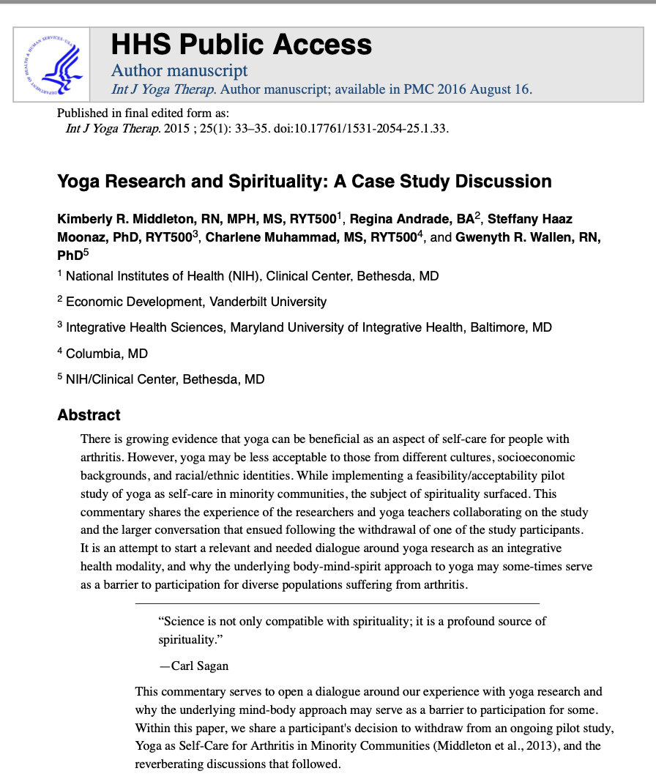
II.5. Case Study
Notes:
"The Boy in the Bubble" could be considered a compelling example of a case study in science, as it focuses on the real-life experiences of David Vetter, a boy born with severe combined immunodeficiency (SCID). This rare genetic disorder left him without an effective immune system, requiring him to live in a sterile environment ("the bubble") to avoid life-threatening infections.
David's story has been extensively documented and analyzed, providing valuable insights into the medical, psychological, and ethical dimensions of living with SCID. The case also contributed significantly to advancements in medical science, including bone marrow transplants and gene therapy, which are now standard treatments for SCID. At the same time, it raises important ethical questions about experimental treatments, quality of life, and the limits of medical intervention.
Because it is such a personal and widely discussed example, David's story resonates with people emotionally while also offering a concrete example of how case studies can drive medical progress. It’s an excellent choice for discussing the intersection of science, ethics, and human experience. “

Slide 29
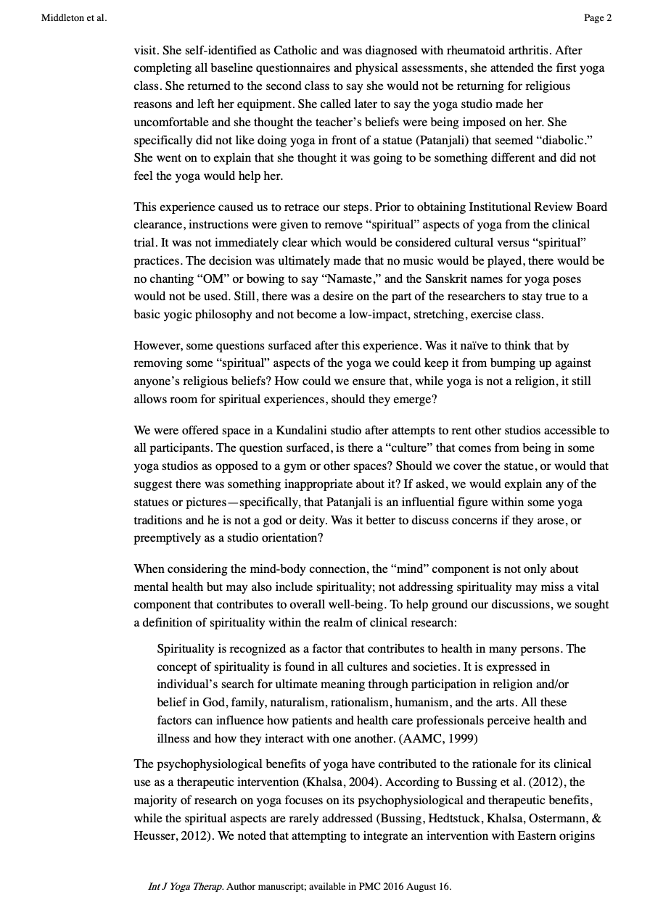
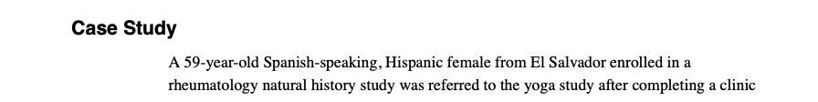
Notes:
"The Boy in the Bubble" could be considered a compelling example of a case study in science, as it focuses on the real-life experiences of David Vetter, a boy born with severe combined immunodeficiency (SCID). This rare genetic disorder left him without an effective immune system, requiring him to live in a sterile environment ("the bubble") to avoid life-threatening infections.
David's story has been extensively documented and analyzed, providing valuable insights into the medical, psychological, and ethical dimensions of living with SCID. The case also contributed significantly to advancements in medical science, including bone marrow transplants and gene therapy, which are now standard treatments for SCID. At the same time, it raises important ethical questions about experimental treatments, quality of life, and the limits of medical intervention.
Because it is such a personal and widely discussed example, David's story resonates with people emotionally while also offering a concrete example of how case studies can drive medical progress. It’s an excellent choice for discussing the intersection of science, ethics, and human experience. “

Slide 30

WE DID IT! ☺

Slide 31
BRIDG Micro-Course Qualitative Research and Analysis
Brenna Bray, PhD
BRIDG T90/R90 Fellowship Postdoctoral Training Program
NCCIH, Grant AT008924
National University of Natural Medicine (NUNM) University of Washington (UW)
NourishED Research Foundation (Boulder, CO, USA | Wilmington, DE, USA)

