Slide 1
BRIDG Micro-Course Qualitative Research and Analysis
Brenna Bray, PhD
BRIDG T90/R90 Fellowship Postdoctoral Training Program
NCCIH, Grant AT008924
National University of Natural Medicine (NUNM) University of Washington (UW)
NourishED Research Foundation (Boulder, CO, USA | Wilmington, DE, USA)

Slide 2
BRIDG Micro-Course Module 1: Overview of Qualitative Research
Brenna Bray, PhD
BRIDG T90/R90 Fellowship Postdoctoral Training Program
NCCIH, Grant AT008924
National University of Natural Medicine (NUNM) University of Washington (UW)
NourishED Research Foundation (Boulder, CO, USA | Wilmington, DE, USA)

Slide 3
Content Overview
Overview of Qualitative Research
Classic Types of Qualitative Research Designs
Qualitative Evaluation Process
Qualitative Data Analysis
Reporting Findings
Guidelines
https://www.taylorfrancis.com/books/mono/10.4324/9781315108933/practical-approaches-applied-research-program-evaluation-helping-professionals-casey-barrio-minton-stephen-lenz

Slide 4
Content Overview: Module 1
I. Overview of Qualitative Research
What is Qualitative Research?
When Are Qualitative Designs Indicated?
Understanding Lived Experiences
Development, Evaluation (Program, Intervention, Design)
Needs Assessment
Process Evaluation
Satisfaction Estimate
Giving Context to Quantitative Findings
Understanding “What,” “Why,” “How?”
https://www.taylorfrancis.com/books/mono/10.4324/9781315108933/practical-approaches-applied-research-program-evaluation-helping-professionals-casey-barrio-minton-stephen-lenz
https://www.taylorfrancis.com/books/mono/10.4324/9781315108933/practical-approaches-applied-research-program-evaluation-helping-professionals-casey-barrio-minton-stephen-lenz

Slide 5
Content Overview: Module 1
Module 1: Overview of Qualitative Research
Module Content | Readings | Course Objectives
Video//PowerPoint Lecture What is Qualitative Research? Qualitative vs. Quantitative Research When are Qualitative Designs Indicated? Understanding Lived Experiences Development & Evaluation Needs Assessment Process Evaluation Satisfaction Estimates Contextualizing Quantitative Data Exploring “What,” “Why,” “How?” Strengths & Limitations Exam 1 (7 Questions; 14 points, 14%) | Barrio Minton & Lenz (2019). Ch. 7, Section 1 (Overview of Qualitative Research Designs). Ch. 6, Section 3 (Types of Survey Designs). Lim, (2024). Pages 1 – 6 (column 1 on pg. 6). | Develop research questions consistent with use of qualitative methodology Understand when qualitative methods may be appropriate for use in applied research and program evaluation endeavors Articulate key features of needs assessments, process assessments, and satisfaction estimation Identify strengths and limitations of qualitative designs
https://www.taylorfrancis.com/books/mono/10.4324/9781315108933/practical-approaches-applied-research-program-evaluation-helping-professionals-casey-barrio-minton-stephen-lenz

Slide 6
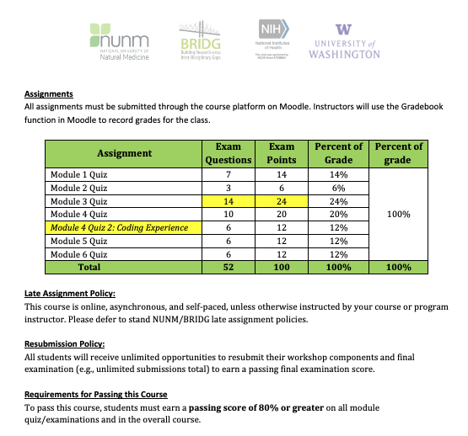
Content Overview: Module Examinations

Slide 7
I. Overview of Qualitative Research
What is Qualitative Research?
When are Qualitative Designs Indicated?
Understanding Lived Experiences
Needs, Process, & Satisfaction Evaluations
Giving Context to Quantitative Findings
https://www.taylorfrancis.com/books/mono/10.4324/9781315108933/practical-approaches-applied-research-program-evaluation-helping-professionals-casey-barrio-minton-stephen-lenz

Slide 8
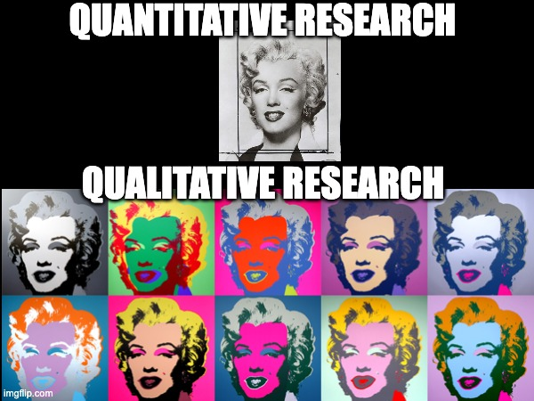
I.1. What is Qualitative Research?
Quantitative Methods:
Understanding through numbers (numerical or categorical data).
Qualitative Research: Understanding experience & meaning through words, contextual content.
https://imgflip.com/i/83e6tt
https://www.taylorfrancis.com/books/mono/10.4324/9781315108933/practical-approaches-applied-research-program-evaluation-helping-professionals-casey-barrio-minton-stephen-lenz

Slide 9
I.2 Qualitative Research: Core Characteristics
Focus: Understanding meaning of and from participants’ perspectives.
Researcher(s): Primary instrument for data collection and analysis.
(Merriam & Tisdell, 2015; Barrio Minton & Lenz, 2019).
https://imgflip.com/i/83e6tt

Slide 10
I.2 Qualitative Research: Core Characteristics
Inductive vs Deductive: Focused on building and expanding understanding & frameworks (vs. deducing data to test hypotheses).
Depth: Rich description of context, participants, data.
https://imgflip.com/i/83e6tt

Slide 11
I.2. Qualitative vs. Quantitative Research
Feature | Qualitative Research | Quantitative Research
Research Focus | Quality (nature, essence) | Quantity (how much/many)
Philosophical Roots | Phenomenology, symbolic interactionism, constructivism. | Positivism, logical empiricism, realism.
Associated Elements | Fieldwork, ethnographic, naturalistic, grounded, constructivist. | Experimental, empirical, statistical.
Methodological Goals | Understanding, describing, discovery, meaning-making, hypothesis generating. | Describing, predicting, mapping, confirming, hypothesis testing.
Merriam & Tisdell, 2015; p. 20 as cited in Barrio, Minton, & Lens, 2019.

Slide 12
I.2. Qualitative vs. Quantitative Research
Feature | Qualitative Research | Quantitative Research
Design | Flexible, evolving, emergent. | Predetermined, structured.
Sample | Small, nonrandom, purposeful, theoretical. | Large, random, representative.
Data Collection | Researcher as primary instrument. Interviews, observations, documents. | Inanimate instruments (scales, tests, surveys, questionnaires, computers).
Analysis | Inductive, constant, comparative methods. | Deductive, statistical.
Findings | Comprehensive, holistic, expansive, descriptive (rich). | Precise, numerical.
Merriam & Tisdell, 2015; p. 20 as cited in Barrio, Minton, & Lens, 2019.
Notes:
Image from: https://www.taylorfrancis.com/books/mono/10.4324/9781315108933/practical-approaches-applied-research-program-evaluation-helping-professionals-casey-barrio-minton-stephen-lenz

Slide 13
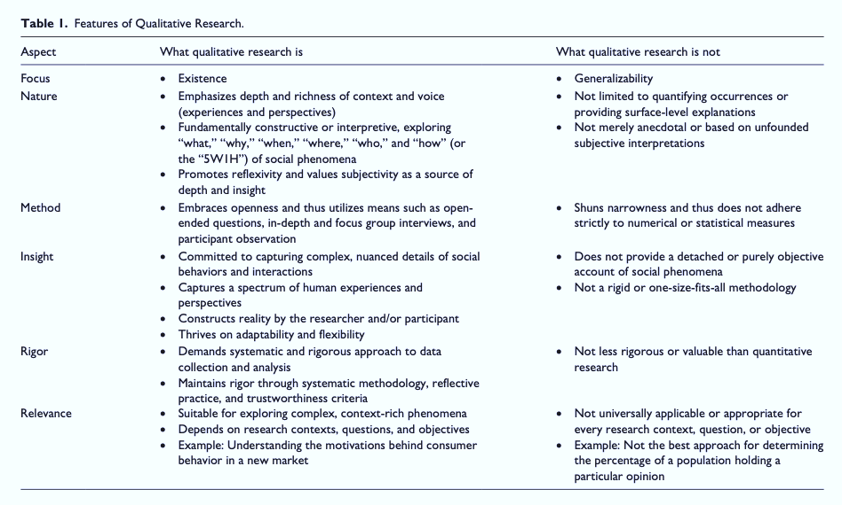
I.2. What Qualitative Analysis Is & Is Not
Lim, W. M. (2024). What Is Research? An Overview and Guidelines. Australasian Marketing Journal, 0(0), 14413582241264619. https://doi.org/10.1177/14413582241264619
Notes:
Image from: https://www.taylorfrancis.com/books/mono/10.4324/9781315108933/practical-approaches-applied-research-program-evaluation-helping-professionals-casey-barrio-minton-stephen-lenz

Slide 14
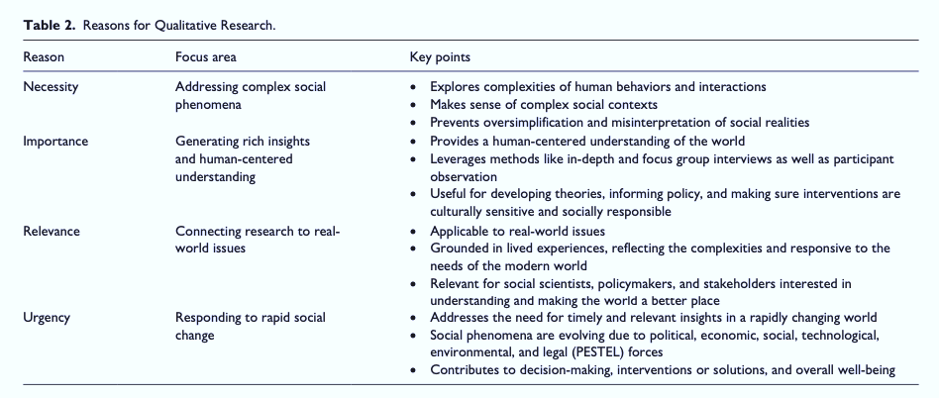
I.2. Reasons for Qualitative Analysis
Lim, W. M. (2024). What Is Research? An Overview and Guidelines. Australasian Marketing Journal, 0(0), 14413582241264619. https://doi.org/10.1177/14413582241264619
Notes:
Image from: https://www.taylorfrancis.com/books/mono/10.4324/9781315108933/practical-approaches-applied-research-program-evaluation-helping-professionals-casey-barrio-minton-stephen-lenz

Slide 15
I.3. When are Qualitative Designs Indicated?
Understanding Experiences, Processes, Meaning-Making.
Development, Evaluation (Program, Intervention, Design).
Needs Assessments.
Process Evaluations.
Satisfaction Estimates.
Contextualizing quantitative findings.
Understanding Meaning
Notes:
Image from: https://www.taylorfrancis.com/books/mono/10.4324/9781315108933/practical-approaches-applied-research-program-evaluation-helping-professionals-casey-barrio-minton-stephen-lenz

Slide 16
I.3. When are Qualitative Designs Indicated?
Understanding Experiences, Processes, Meaning-Making.
Development, Evaluation (Program, Intervention, Design).
Evaluating Needs, Processes, Satisfaction.
Contextualizing quantitative findings.
Answering questions about “What,” “why,” and “How?”
Understanding Meaning
Notes:
Image from: https://www.taylorfrancis.com/books/mono/10.4324/9781315108933/practical-approaches-applied-research-program-evaluation-helping-professionals-casey-barrio-minton-stephen-lenz

Slide 17
I.4. Types of Assessments
Three Main Types of Assessments
Needs Assessments.
Process Evaluations.
Satisfaction Estimates.
Understanding Meaning
Notes:
Image from: https://www.taylorfrancis.com/books/mono/10.4324/9781315108933/practical-approaches-applied-research-program-evaluation-helping-professionals-casey-barrio-minton-stephen-lenz

Slide 18
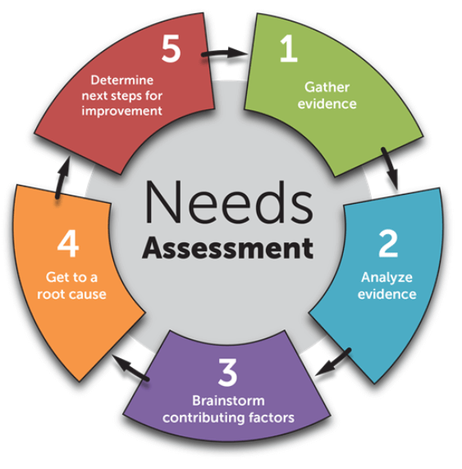
I.5. Needs Assessments
Identify & Understand Gaps (in research, knowledge, clinical care, resources, outcomes).
Determining (a) what the important needs are and (b) how to address them.
Important when starting point is uncertain.
Enables understanding of key needs or barriers.
https://www.teamly.com/blog/what-is-a-needs-assessment/
https://i.pinimg.com/736x/32/91/e1/3291e111f7e764be62193825c992a297.jpg
Notes:
Image from: https://www.taylorfrancis.com/books/mono/10.4324/9781315108933/practical-approaches-applied-research-program-evaluation-helping-professionals-casey-barrio-minton-stephen-lenz

Slide 19
I.5. Needs Assessments
Include input from a variety of sources & stakeholders
Patients, Consumers, Users.
Specific Subpopulations (e.g., children, elderly).
Community Members.
Providers, Clinical & Organizational Staff & Admin.
Health Issuers, Policy Makers, Donors/Funders.
https://www.teamly.com/blog/what-is-a-needs-assessment/
Notes:
Image from: https://www.taylorfrancis.com/books/mono/10.4324/9781315108933/practical-approaches-applied-research-program-evaluation-helping-professionals-casey-barrio-minton-stephen-lenz

Slide 20
I.5. Needs Assessments
Include input from variety of sources.
Consider what data sources best align with target audience and intended use.
May include data from surveys, records, focus groups, interviews, Delphi Panels…
Identify key SH perceptions of needs
https://www.teamly.com/blog/what-is-a-needs-assessment/

Slide 21
I.5. Needs Assessments
Four Primary Uses:
Secure or Advocate for Resources.
Modify Policy or Advocate for Policy Change.
Improve Services.
Establish or Strengthen Partnerships.
https://www.teamly.com/blog/what-is-a-needs-assessment/
Notes:
Image from: https://www.taylorfrancis.com/books/mono/10.4324/9781315108933/practical-approaches-applied-research-program-evaluation-helping-professionals-casey-barrio-minton-stephen-lenz

Slide 22
I.5. Needs Assessments
Four Types of Needs:
Normative (Determined by experts).
Expressed (Noted in consumer requests for services and engagement in services).
Felt (Expressed by consumers).
Comparative (Seen when comparing population info to services within an agency).
https://www.teamly.com/blog/what-is-a-needs-assessment/
Notes:
Image from: https://www.taylorfrancis.com/books/mono/10.4324/9781315108933/practical-approaches-applied-research-program-evaluation-helping-professionals-casey-barrio-minton-stephen-lenz

Slide 23
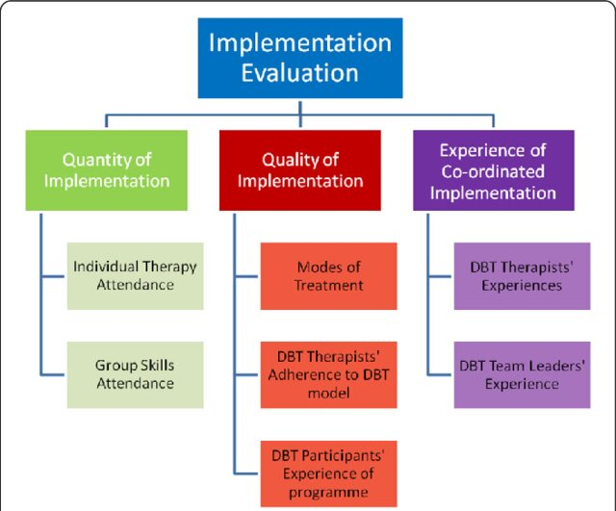
I.6. Process or Implementation Evaluations
Flynn et al. (2018). DBT for treating adults and adolescents with emotional and behavioural dysregulation: Study protocol of a coordinated implementation in a publicly funded health service. BMC Psychiatry, 18. https://doi.org/10.1186/s12888-018-1627-9
Notes:
Flynn, D., Kells, M., Joyce, M., Suarez, C., & Gillespie, C. (2018, 02/26). Dialectical behaviour therapy for treating adults and adolescents with emotional and behavioural dysregulation: Study protocol of a coordinated implementation in a publicly funded health service. BMC Psychiatry, 18. https://doi.org/10.1186/s12888-018-1627-9

Slide 24
I.6. Process or Implementation Evaluations
Assess if implementation occurs as planned
Formative: Assess implementation fidelity, program activities, timelines, number reached.
Occurs during Rollout: Enables troubleshooting, adjustments, & responsivity for long-term success.
Gives context to outcome data.
https://www.slideserve.com/kendall/preventative-actions-strategic-planning-and-evaluation-powerpoint-ppt-presentation#google_vignette

Slide 25
I.6. Process or Implementation Evaluations
https://youtu.be/LQc8NDKcnpM?si=-OwMiZzfaY7-hAeN&t=58

Slide 26
I.6. Process Evaluations (User-Focused)
Assess How & Why a Program Works (or Doesn’t).
Understand what keeps users engaged.
Identify meaningful program/intervention aspects.
Identify confusing or frustrating aspects.
Identify how are users’ lives are impacted.
https://www.slideserve.com/kendall/preventative-actions-strategic-planning-and-evaluation-powerpoint-ppt-presentation#google_vignette

Slide 27
I.6. Process Evaluations (Provider-Focused)
Understand what is and is not working.
Observations about participant response.
Obstacles or barriers to implementing programs as intended.
Flynn et al. (2018). DBT for treating adults and adolescents with emotional and behavioural dysregulation: Study protocol of a coordinated implementation in a publicly funded health service. BMC Psychiatry, 18. https://doi.org/10.1186/s12888-018-1627-9

Slide 28
I.6. Process or Implementation Considerations
Service/program location (e.g., rural, urban, online).
Number & sociodemographic background of folks served.
Quality of services.
Actual events that occur while the services are delivered.
Amount of money the project is using.
Direct and in-kind funding for services.
Staffing for services or programs.
Number of activities and meetings.
Number of training sessions conducted.
CDC, as cited in Barrio Minton & Lenz, 2020

Slide 29
I.7. Satisfaction Estimations
https://www.questionpro.com/blog/surveys/
Notes:
Image from: https://www.taylorfrancis.com/books/mono/10.4324/9781315108933/practical-approaches-applied-research-program-evaluation-helping-professionals-casey-barrio-minton-stephen-lenz

Slide 30
I.7. Satisfaction Estimations
Satisfaction Data Complements Outcome Data …(but does not replace outcome data).
Enables Patient/Consumer-Driven Responses & Care (validates consumer experiences).
Patient quality assessments (QA): Federally mandated (in some cases).
https://www.questionpro.com/blog/surveys/
Notes:
Image from: https://www.taylorfrancis.com/books/mono/10.4324/9781315108933/practical-approaches-applied-research-program-evaluation-helping-professionals-casey-barrio-minton-stephen-lenz

Slide 31
I.7. Satisfaction Estimations
Factors to Include in Satisfaction Estimates:
Interpersonal Satisfaction: E.g., with relational quality between patient & provider.
Administrative Satisfaction: E.g., with scheduling, wait times, registration, etc.
Technical/Clinical Satisfaction: E.g., with clinical experience & progress toward outcome.
https://www.questionpro.com/blog/surveys/
Notes:
Image from: https://www.taylorfrancis.com/books/mono/10.4324/9781315108933/practical-approaches-applied-research-program-evaluation-helping-professionals-casey-barrio-minton-stephen-lenz

Slide 32
I.7. Satisfaction Estimation Factors
https://www.nccih.nih.gov/research/blog/exploring-patient-provider-relationships-to-improve-treatment-outcomes
Exploring Patient-Provider Relationships To Improve Treatment Outcomes | NCCIH (nih.gov)

Slide 33
I.3. When are Qualitative Designs Indicated?
Understanding Experiences, Processes, Meaning-Making.
Development, Evaluation (Program, Intervention, Design).
Needs Assessments.
Process Evaluations.
Satisfaction Estimates.
Contextualizing quantitative findings.
Understanding Meaning

Slide 34
I.8. Contextualizing Quantitative Data
Complement/supplement quantitative data.
(Support, contrast, illuminate, understand)
Add context and richness.
Illuminate specific takeaway.
Add human touch, enable connection to data.

Slide 35
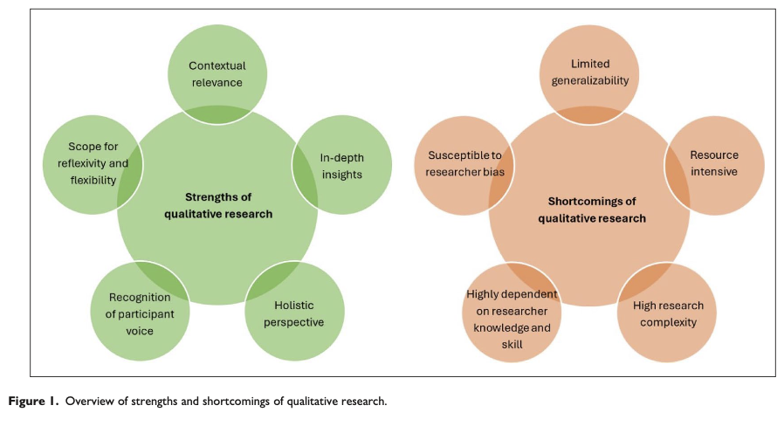
I. 9. Strengths & Limitations of Qualitative Research
Lim, W. M. (2024). What Is Research? An Overview and Guidelines. Australasian Marketing Journal, 0(0), 14413582241264619. https://doi.org/10.1177/14413582241264619

Slide 36
WE DID IT! ☺

Slide 37
BRIDG Micro-Course Qualitative Research and Analysis
Brenna Bray, PhD
BRIDG T90/R90 Fellowship Postdoctoral Training Program
NCCIH, Grant AT008924
National University of Natural Medicine (NUNM) University of Washington (UW)
NourishED Research Foundation (Boulder, CO, USA | Wilmington, DE, USA)

