Slide 1

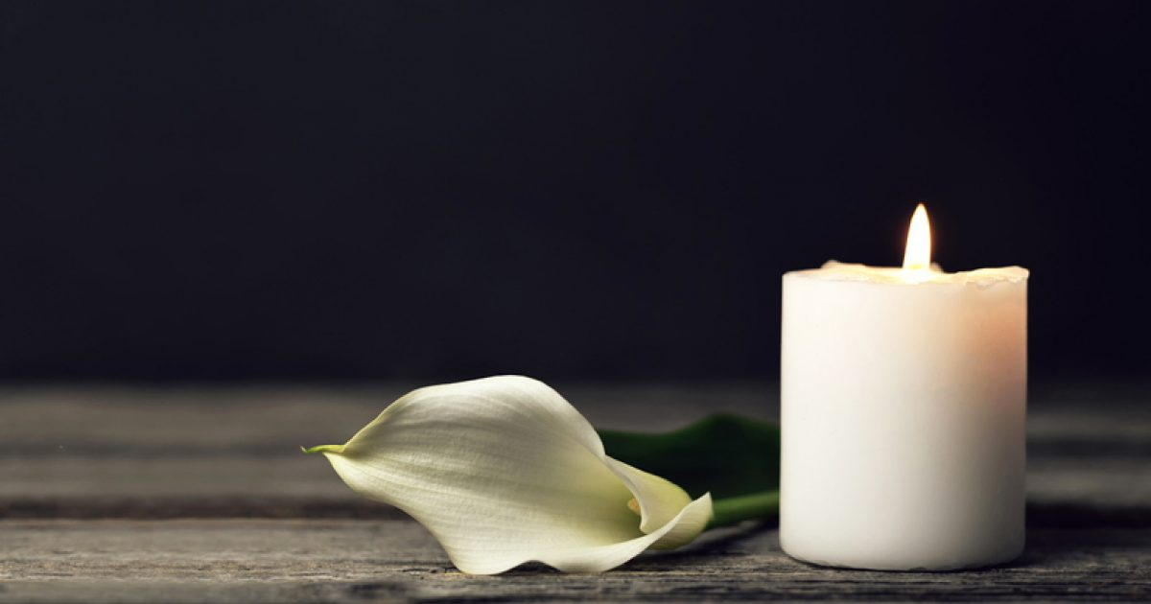

Threshold technologies: Ritualizing Death and Dignity in Hospice caregiving
By Alyssa Alvarado
Dr. Casteneda
ANT4462
University Of South Floridia

Slide 2

Introduction
Caregiving and Ritual :
Death and dying can be perceived and practiced as a rite of passage that historically has been shaped by societal, environmental and cultural belief systems.
There are many different practices, rituals and customs that aid in this process; it often involves community and specific people who are the gate keepers, healers or ceremonial leaders for the processes surrounding death.
Hospice nurses are modern medical gate keepers that provide both holistic and clinical caregiving in the dying process.
Investigation goals:
How these specialized nurses experience Death and dying
Navigating technology in end-of-life stages
Medicalization and desensitization within the hospice environment
What barriers were implemented and experienced?
How Hospice and caregivers experience physical and emotional burnout
Why Ritual is essential to maintaining ethical human-centered healthcare within modern medicine environments and technologies.

Slide 3
Theoretical framework:
Research Focus:
Science and technology studies and symbolic anthropology to explore hospice care as a technoscientific system and symbolic system and focus on how these specialized caregivers ritualize protocols and integrate emerging technologies to maintain compassionate care and patients' dignity during the dying process.
What are technoscientific and symbolic systems?
Technoscientific systems in hospice focus on how caregivers utilize emerging technologies while maintaining compassionate care. Such as telemedicine or procedures such as pain management, or washing, dressing and preparation of the body after death. These are procedural systems that provide respect, dignity and symbolic meaning.
Symbolic systems in hospice explore how caregivers ritualize the protocols and practices to create meaning in their work that is often emotionally and physically draining.

Slide 4
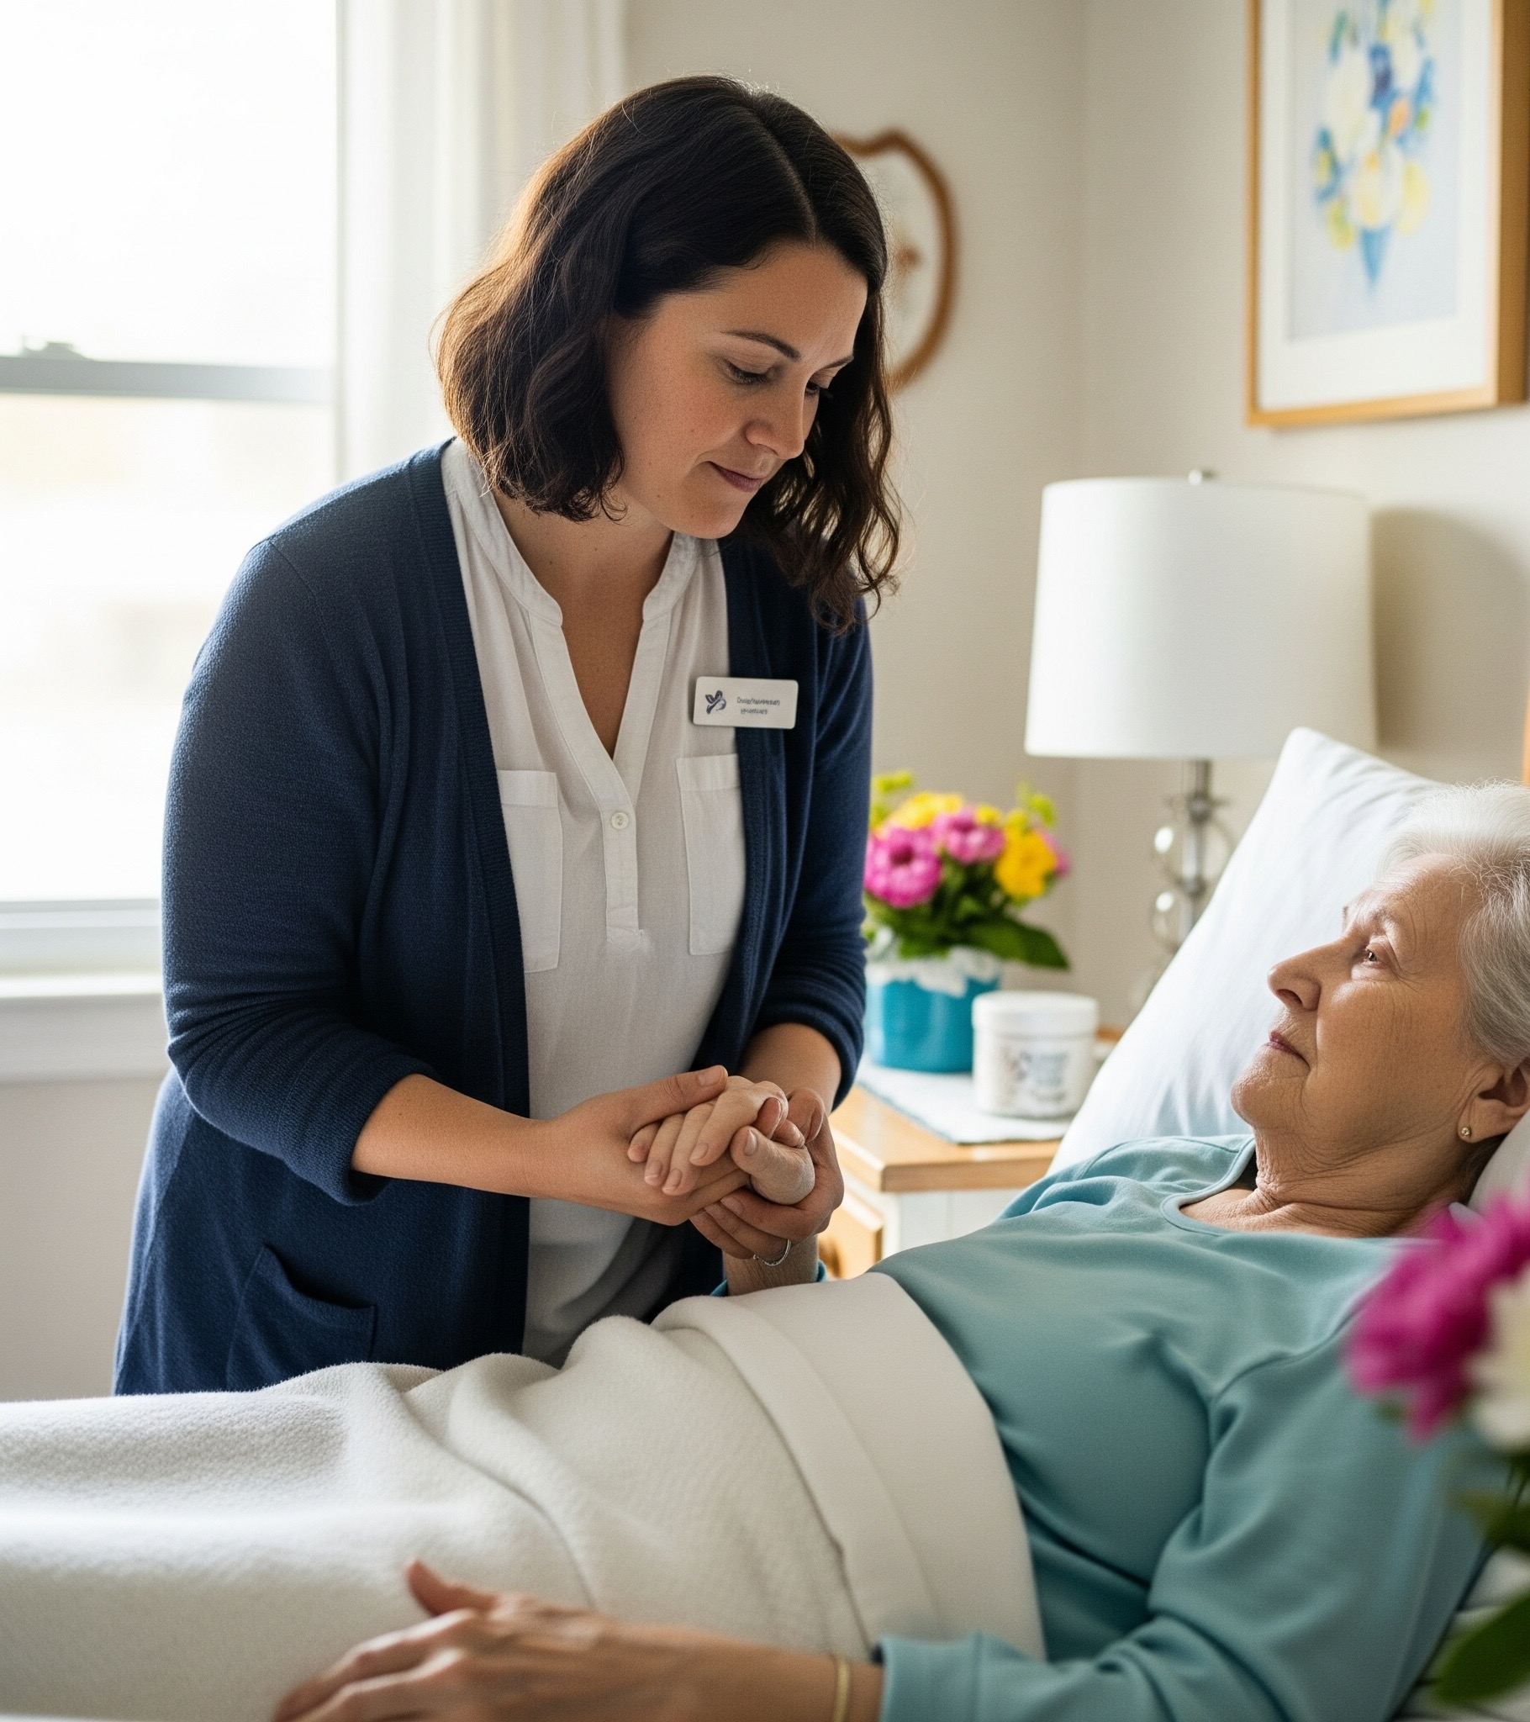
Insights from Hospice Nurses
Methods:
Interviewed four nurses who had diverse backgrounds within the health care field in a semi-structured interviews utilizing Zoom Virtual Meeting and one in person interview with the consent to video record.
Criteria:
Participants worked in hospice or have experienced hospice personally
Interviewee 1: BA in history / RN/worked in med-surg in hospitals, in oncology, and two years in hospice. Retired two years ago.
Interviewee 2:. Advanced practice RN, CRNA (home hospice experience during first Covid-19 outbreak)
Interviewee 3: LPN/Death Doula
Interviewee 4: Hospice Nurse
Notes:
Hospice nurse interviews reveal deep compassion and dedication to patient comfort. Nurses discuss the importance of communication with both patients and families during end-of-life care. They also share how building trust helps them provide emotional support, manage pain, and ensure dignity in their patients’ final days.

Slide 5
What is Hospice?
Hospice Care: supports patients primarily at the end-of life, prioritizing comfort and dignity.
Environments: Include Home/Residential hospice and Clinical institutions catered to the dying often called Hospice Houses
Knowledge required: end-of-life nutrition, pain management, wound care and holistic caregiving practices such as riki (energy healing/regulation) and massage.
Provide 24hr availability because death is often unpredictable. Assigned to patients and families; in cases such as home hospice most of the caregiving is left to the family, with stand by hospice assistance.
Hospice Nurses and caregivers are the central figures in the End-of-Life process. Providing clinical, emotional, social and spiritual guidance for patients and families.
“Hospice care is ideally patient-led, so we would do whatever we could to accommodate the patient’s wishes setting, music, food, tv, medications, some wanted their pets. If the patient couldn’t make certain decisions, then the family would make some of them” (Jordana, RN).

Slide 6
Existing Research on ritual in Hospice
Death Ritual among nurses was abundant; it was often considered a nursing tradition to pass down rituals that were important to honor death within the clinical setting. Such as a silent pause, body preparation for the family and funeral homes, lighting of a candle at the end of the bed are rituals done within the hospice setting. This was confirmed in many of my interviews, yet it was not seen or practiced as ritual but as procedural or routine tasks that needed to be done.
Research Barriers presented: System pressures, workload and the desensitization and medicalization of death in the medical setting.
There was gaps in Ritual and how hospice nurses identified with new technologies as ritual in their daily work.
Notes:
In a society where religion and spirituality and state are separated leads one to question how beliefs and practices are incorporated and handled within the medical field especially in palliative and hospice care where there is an innate form of behavior when death and dying are present. Due to the barriers and the complexity of use of religion and spirtuality in such environments creating and using ritual can provide connection to the environment, patient and can be utilized as protocol and a resourceful in end-of-life care.

Slide 7
Results And suggestions
Results:
Upon my investigation of hospice nurses there were signs of burnout with the schedule, shortage of people who want to do the hospice caregiving work. But due to the patient care aspect of the job, they felt the work they provided was essential and intimate because it was doing something for others.
There was a mixed awareness of ritual within the work that hospice nurses do surrounding the dying process and after death has occurred, it was seen as more of routine protocol caring that was expected or needed at the time of death.
Suggestions:
Bringing more awareness of how the procedural and routine tasks in home hospice can aid in the physical, emotional and mental burnout.
Encouragement for people to work within the hospice field, will aid in nurse burnout and increase quality of care and compassion for the work.
A solution would be implementing more volunteers in hospice setting. Communicating with people and community that there is a need for end-of-life care.
Implementing community workers such as a death doula who can implement their time and skills in holistic death care and aid in nurse and family burnout. Death doulas can also implement a death centered on agency of autonomy.

Slide 8
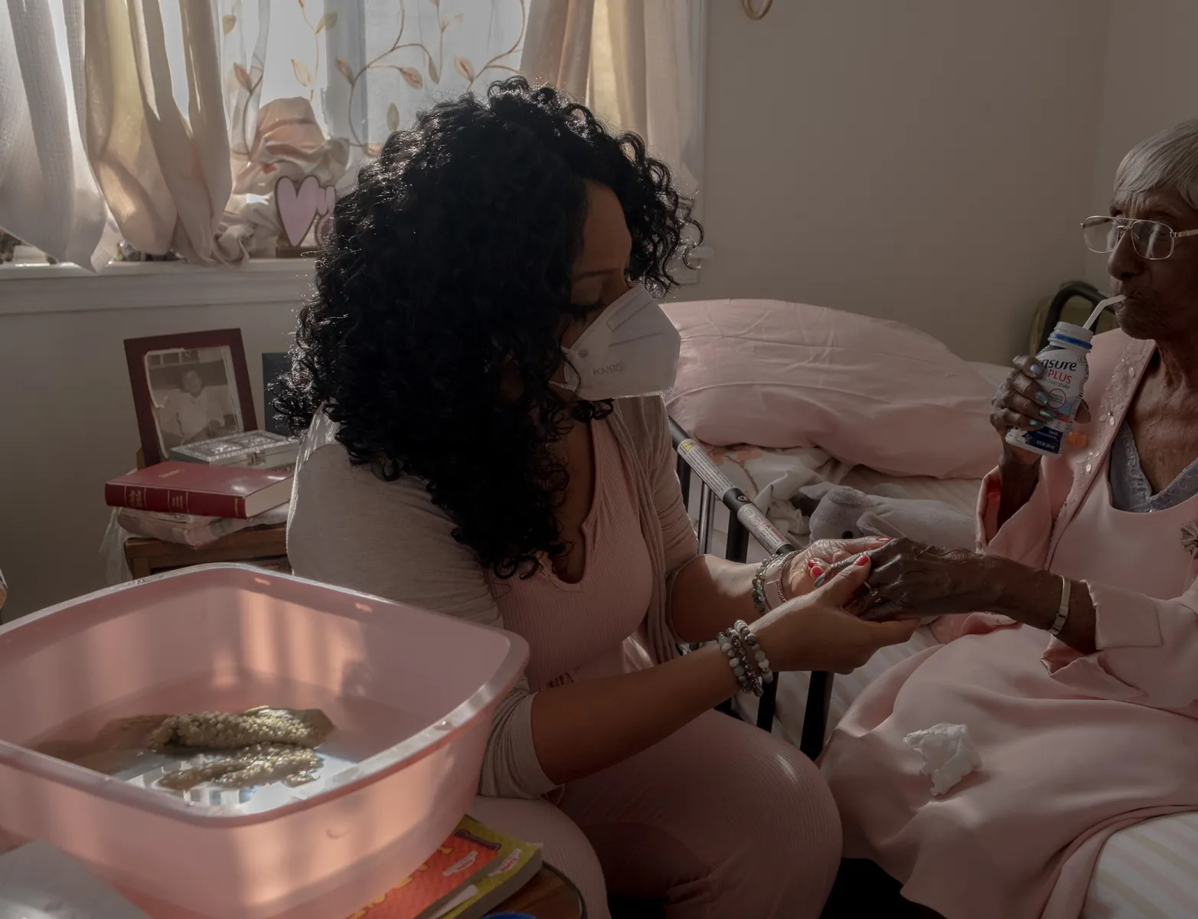
Medical Anthropology in Hospice caregiving:
Medical anthropology can look beyond the clinical setting and see the interconnectedness of how death is experienced among end-of-life caregivers and how this influences how they navigate their environment, their patients and personal life .
  Medical Anthropology can enhance how we perceive technologies beyond modern appliances but as intimate cognitive behaviors that can be utilized as ritual protocols within our daily lives.
  In environments like Hospice death is normal. Death is apart of their cultural workforce that extends beyond protocol and clinical barriers. Understanding the function of ritual and how it enhances and aids in the healing process is essential for the construction of reflection and social cohesion within the clinical environment.
  Picture (https://time.com/6128469/death-doulas-covid-19-pandemic).

Slide 9
References:
Buster, L., Croucher, K., Green, L., & Faull, C. (2023, January). Mediating worlds: The rold of nurses as ritual specialist for caring for the dead and dying. Tandfonline; UK Limited. https://www.tandfonline.com/doi/pdf/10.1080/13576275.2023.2198694
DiTullio, EdD, M., & MacDonald, CSW, D. (1999, October 1). The struggle for the soul of hospice: Stress, coping and change amount hospice workers. American Journal of Hospice and Palliative Medicine; Sage Journals. https://journals.sagepub.com/doi/epdf/10.1177/104990919901600505
Gordon, L. (2017, July 1). The transformation of ritual in end-of-life: How does medicalization influence the dying process? ScholarWorks; California State University. https://scholarworks.calstate.edu/downloads/js956g99b
Greenwald, D. E. (1973). Durkheim on Society, Thought and Ritual. Sociological Analysis, 34(3), 157–168. https://doi.org/10.2307/3709771
Martin Varisco, PhD, D. (2011, January 1). The end of life, the ends of life: An Anthropological View. Https://Pmc.ncbi.nlm.nih.gov/Articles/PMC3516113/Pdf/Jima-43-3-7037.Pdf; JIMA:Volume 43. https://
Mayr, K., Barth, N., Walker, A., & Gigou, S. (2022, July 19). Organized rituals- ritualized reflection. on mourning culture in palliative care units and hospice. Tandfonline; Routledge Taylor and Francis Group.
Montross-Thomas, L. P., Scheiber, C., Meier, E. A., & Irwin, S. A. (2016, October 1). Personally meaningful rituals: A way to increase compassion and decrease burnout among hospice staff and volunteers. National Library of Medicine; PubMed Central. https://pmc.ncbi.nlm.nih.gov/articles/PMC6453491/
Vandersman, P., & Tieman, J. (2024, January 1). Technology in the end-of-life care is very important: The view of nurses regarding technology and end of life care. Springer Nature Iink; BMC Nursing. https://link.springer.com/article/10.1186/s12912-024-02475-x

