Slide 1
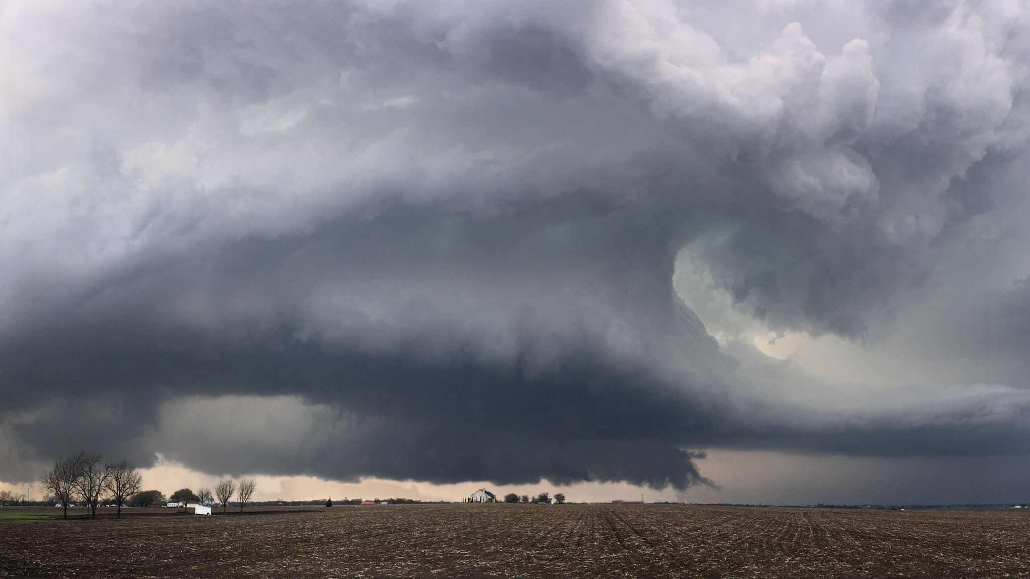
Spring & Storm Season Safety Guide
Helpful Tips from Interstate Helicopters, Inc.

Slide 2
Welcome!
At Interstate Helicopters, safety is at the heart of everything we do – whether you’re flying with us or navigating Oklahoma’s unpredictable weather on the ground.
This guide includes helpful tips to stay prepared for severe weather this spring and beyond.

Slide 3
Tornado Safety Tips
Know the Signs:
Dark, greenish sky
Large, low-lying clouds
Loud roar (like a freight train)
What to Do:
Go to a storm shelter or interior room
Avoid windows
Cover your head

Slide 4
Emergency Kit Checklist
Battery powered weather radio
Flashlights and extra batteries
Water and non-perishable food
First aid kit
Phone charger/power bank

Slide 5
Thunderstorm & Lightning Safety
Get inside immediately
Avoid open areas and tall structures
Stay away from windows
Postpone flights or outdoor activities if storms are nearby
Fact: Lightning can strike from up to 10 miles away!

Slide 6
Hail & Wind Preparedness
Protect Yourself & Your Property
Move vehicles and aircraft into garages or hangars
Stay away from windows
If you’re outdoors, seek shelter immediately
Watch for flying debris during high winds

Slide 7
Travel Safety During Storm Season
Smart Travel Tips
Always check weather forecasts before trips
Delay travel if severe weather is predicted
Plan alternate routes in case of road closures
Understand flight delays – they’re in place for your safety
At Interstate Helicopters, we adjust all flights for safety first.

Slide 8
Helpful Resources
Apps and Alerts
NOAA Weather Radio
Storm Shield App
Local news for Oklahoma alerts
Contact Interstate Helicopters, Inc.
405.440.1053
Interstatehelicopters.com
@interheli

Slide 9
Thank You!
Thank you for trusting Interstate Helicopters, Inc.
Fly safe. Travel smart. Stay weather aware.
Book your flight today (weather permitting!)
Follow us for updates on Instagram & Facebook

