Slide 1
Chinese Faith Baptist Church
Security Cameras Project January 10, 2026
Prepared by: Tenny Chan
P&F Committee

Slide 2
Contents
Purposes of the project
Require equipment & supply
Coverage areas & constraints
Coverage areas drawings
Project cost & timeline
Fund sources

Slide 3
Purposes of the project
Use security cameras system to monitor the entrance doors activities of the building.
Videos by the system would be used as records when unexpected & unusual issues was happened in the church, for example: safety, burglary.
Monitor road condition around the building remotely in case of incremental weather, instead of asking member of the congregation to evaluate road condition in person.

Slide 4
Equipment & Supply
Camera system with speaker capacity (Reolink 4TB NVR security camera system)
Ethernet Cat 6 cable (plenum-rated)
Cameras’ mounting supply
Cable wiring & cameras mounting services by licenser contractor (highly recommended by serval church families)

Slide 5
Coverage Areas & Constraints
All entrance doors, lobby & hallway of the building
North & south sides main entrances
Entrance doors from outside to library, toddlers room & office
Lower-level entrance door
Lobby area on main floor, facing both entrance doors
Hallway in the lower-lever, facing the entrance door
Main parking lot & parking spot in the south side
Driveways towards building from Greentree Road & Greentree Circle
Avoid giving an impression for capturing houses of surrounding neighbors

Slide 6
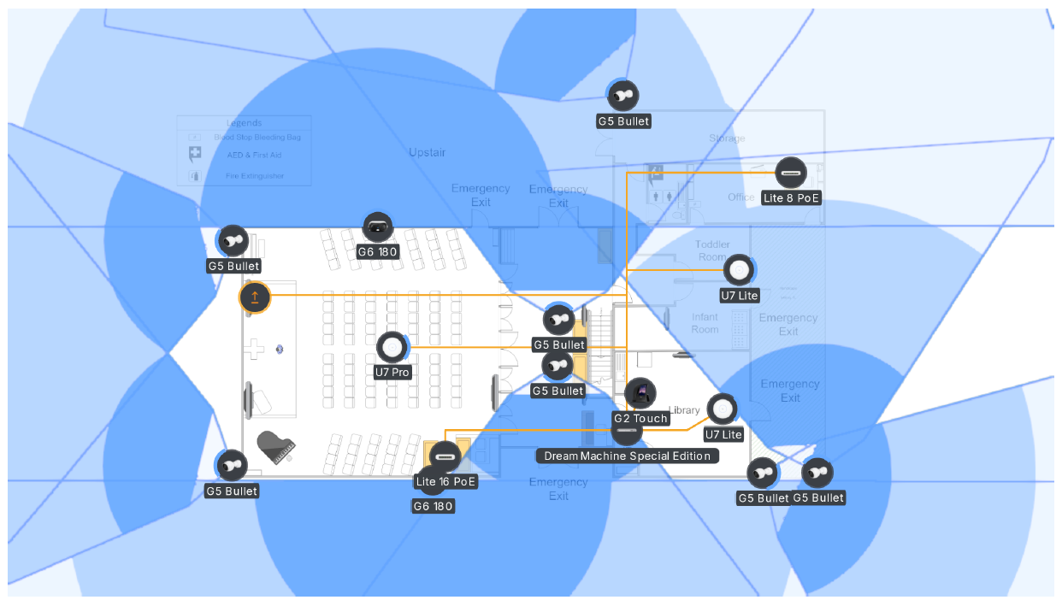
Capture Areas Drawing (main floor)
Notes:
Major works were done by April, fine touch works were applied gradually

Slide 7
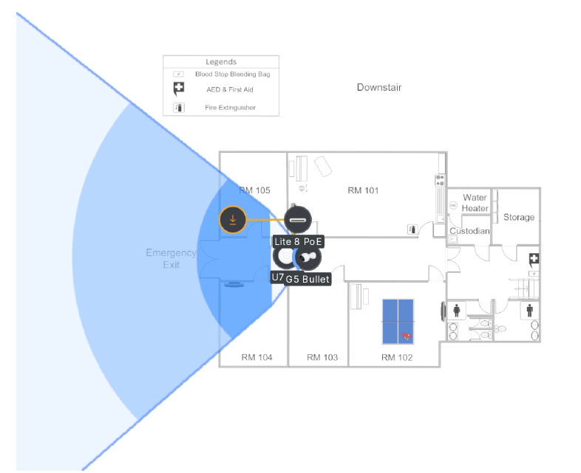
Capture Areas Drawing (lower level)
Notes:
Major works were done by April, fine touch works were applied gradually

Slide 8
Cost of the project & installation timeline
Cost estimation of the project:
Reolink Secure Camera NVR system $600 come with 10 cameras
180-degree angle camera @$200, requires 2 units $400
Cat 6a Plenum Rated Cable (1000’) & accessories $300
Labor cost for installation & upgrade existing Ethernet cables $1,600 (4 days @400)
Estimated total: $2,900
System installation timeline (subject to final decision)
End of February or early March 2026 for 3-4 days

Slide 9
Sources of funding
P&F committee current year budget
Building reserve fund (designated fund)

Slide 10
Please feel free to reach out the committee or email to PF.CFBC@gmail.com
Thanks for your attention!

