Slide 1

Database & Research Metrics

Slide 2

Database And Research Metrics
A database is a collection of information that is organized so that it can be easily accessed, managed and updated. Computer databases typically contain aggregations of data records or files, containing information about sales transactions or interactions with specific customers.

Slide 3
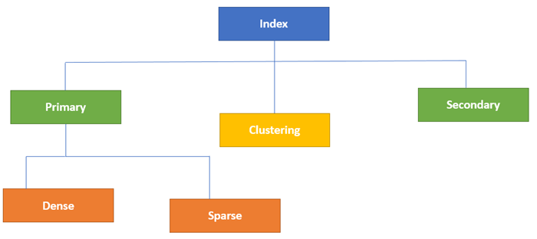
Indexing Databases
Database index. ... Indexes are used to quickly locate data without having to search every row in a database table every time a database table is accessed. Indexes can be created using one or more columns of a database table, providing the basis for both rapid random lookups and efficient access of ordered records.

Slide 4
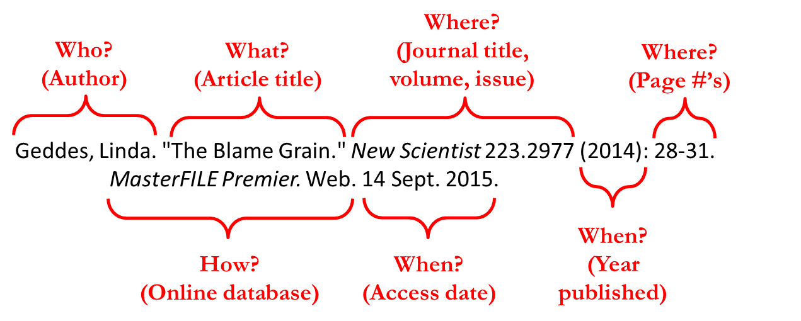
Citation Databases
Citation databases are databases that have been developed for evaluating publications. The citation databases enable you to count citations and check, for example, which articles or journals are the most cited ones.

Slide 5
Abstraction and Indexing
Why use Abstraction and Indexing?
  What is an Abstraction and Indexing database?
  Comparison with other resources
  When and how to use them in the research process
Use cases
  Basic searching and refining
  Constructing advanced searches and using the thesaurus
  Saving and repeating searches
How the content is indexed
Notes:
RN
What do I mean by A&I – make sure we’re talking about the same thing
Why you should use them, what uniquely useful features they have, in comparison to other online tools?
Specifically how and when to use them in the research process

Slide 6
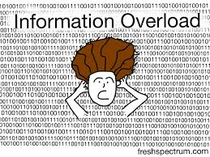
Why Abstraction and Indexing?
Notes:
now it’s navigating the morass of information

Slide 7
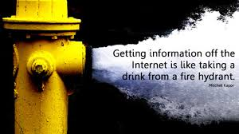
Why use Abstraction and Indexing?

Slide 8






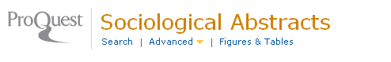
What are Abstraction and Indexing databases?
Abstracting + Indexing
“An indexing service is a service that assigns descriptors and other kinds of access points to documents”
Bibliographic databases, Citation Indexes… organized digital collections of references to published literature
Used by academic (or other) researchers, for literature searching

Slide 9
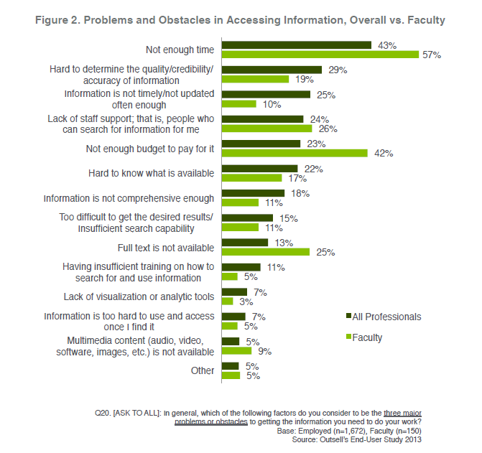
Why use Abstraction and Indexing?
Addresses key problems and obstacles as identified in end user surveys
Saves you time
Only includes quality, credible information sources

Slide 10
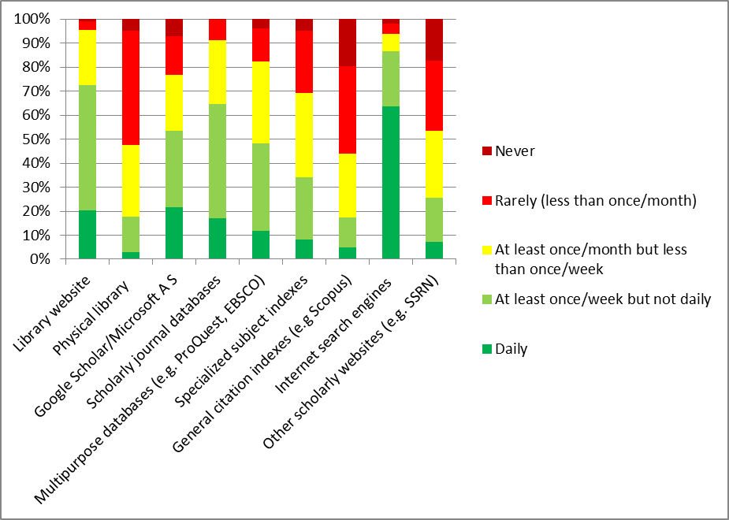
Social Science Faculty Resource Use
ProQuest survey May 2014. n=235
Notes:
34% use at least once a week, 69% at least once a month

Slide 11
Relevance & comprehensiveness
Relevance of results
Comprehensiveness of results
Specialized subject indexes are rated well, but below scholarly journal databases, with only a minority ranking as excellent.

Slide 12
Quality & ease of use
Quality of information (trustworthy / authoritative):
Convenience / time saving
Specialized subject indexes score very well on quality of information, but less well on convenience.

Slide 13
Experience of online research
How strongly do these statements correspond to your experience of online research?
Most respondents don’t want to construct complex searches, but also don’t want to miss any relevant records. They find it fairly easy to identify the relevant material, but tend to return a lot of irrelevant results.

Slide 14
Comparison – controlled for frequent use
% of respondents using resource once a week or more ranking as excellent
There is no statistically significant difference in the way subject indexes, multipurpose databases and scholarly journal databases were ranked when controlled for frequency of use. Google Scholar has a different profile, favoured for time saving rather than relevance or quality.

Slide 15
Using Abstraction and Indexing in your research
  Broad scan of research in a field
  New research topic – what’s out there?
  Quantity of material
  Research trends - changes over time
  Literature review
  Construct detailed searches to find highly relevant material
  Identify subject terms, key authors & journals
  Current awareness
  Save searches to re-run at set intervals
Notes:
RN
Broad scan:
e.g. how does search on women’s role compare with search on masculinity?
When do we start seeing research on Islamic fundamentalism?
Systematic literature review:
Most common/obvious use of A&I. Can construct highly elaborate searches (will show you how)
Current awareness – possible because of regular updates.

Slide 16
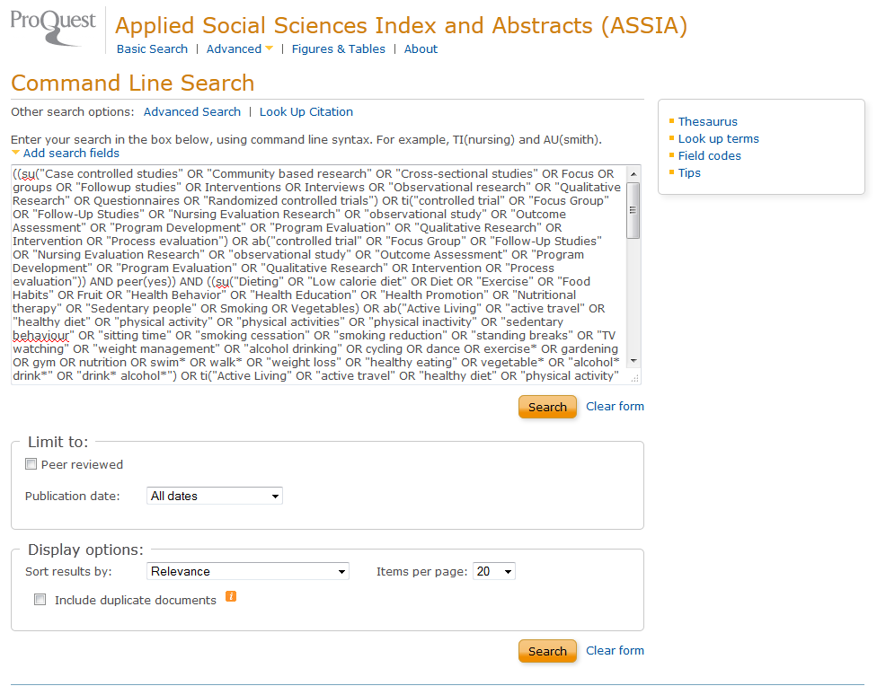
Myth: A&I databases are only for expert searchers constructing queries like this!
Notes:
RN

Slide 17
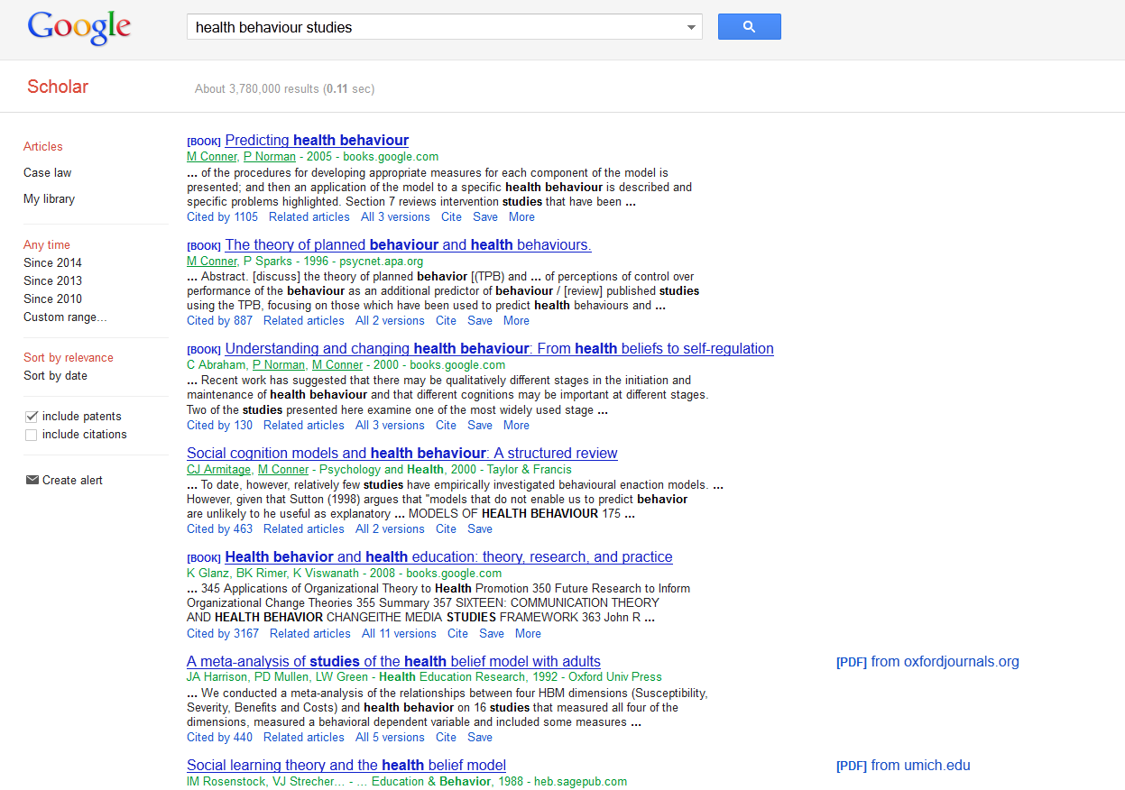
Notes:
RN
What about the kind of simple searching that is the attraction of just using Google?

Slide 18
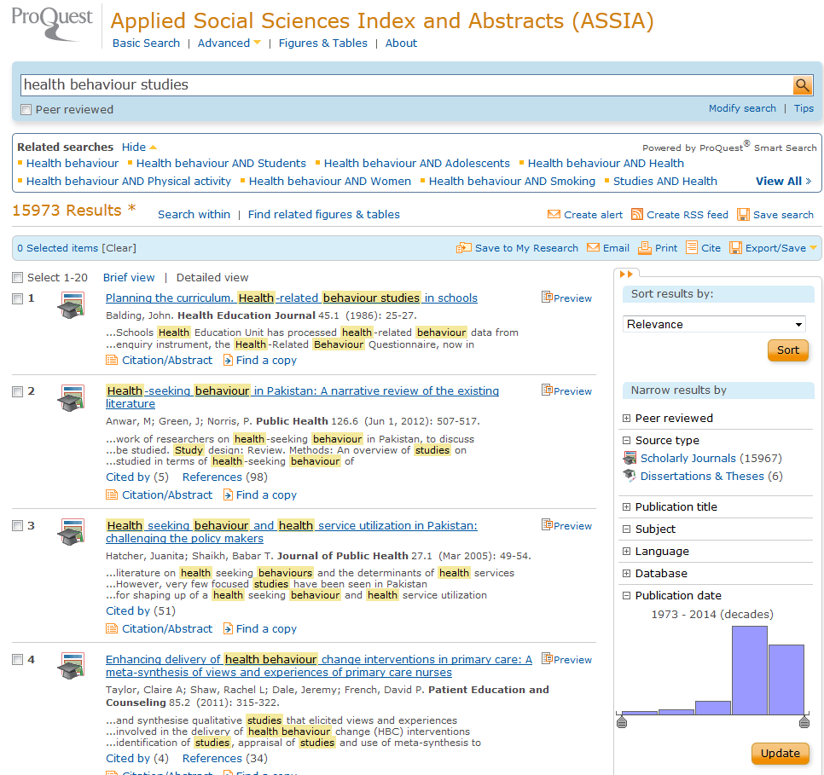
Notes:
RN
Using an A&I database to do exactly the same very basic search we ran in GS gets more relevant results which are easier to narrow (or expand using related searches), saving you time.

Slide 19
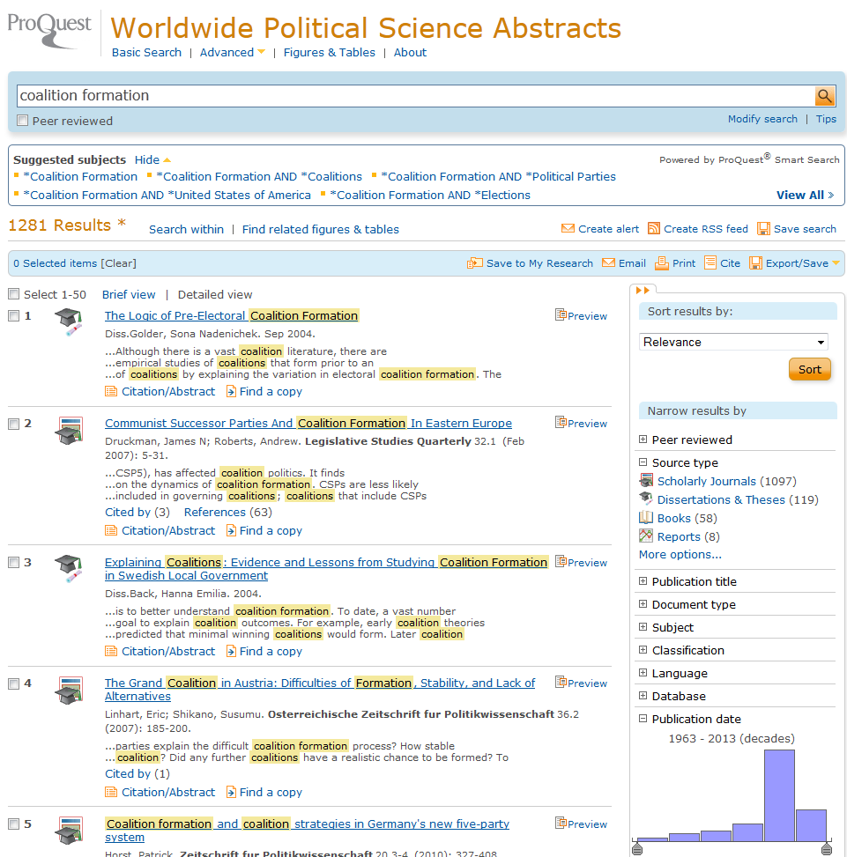
Notes:
RN
Example use case: looking for relevant empirical research on the formation of political coalitions. Simple search in WPSA gets you to very good relevant results straight away.

Slide 20
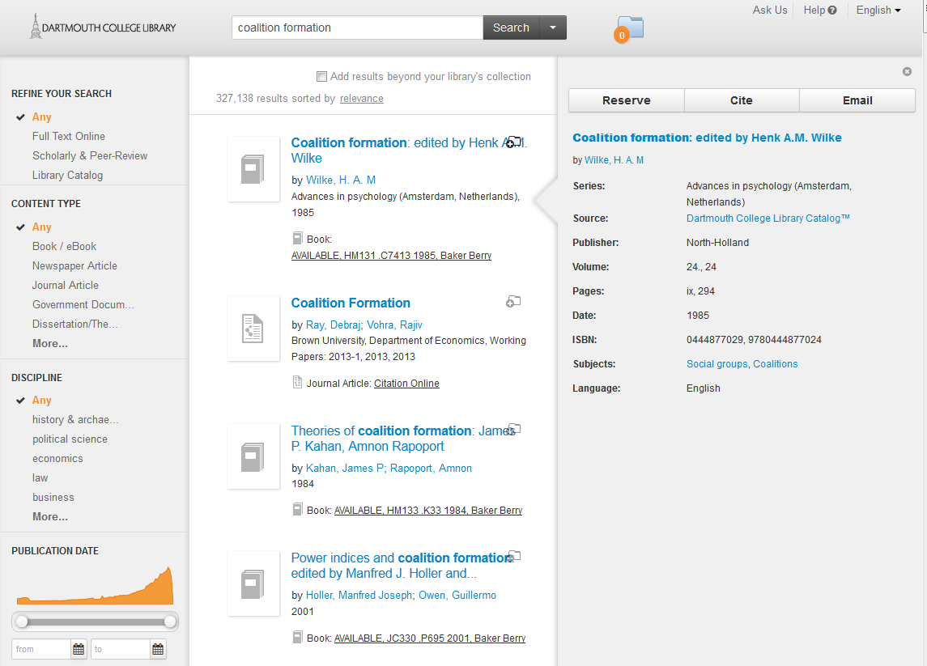
Notes:
RN
Summon is great for when you want to search across the library’s entire holdings, particularly if you know exactly what you are looking for and want to get to the full text item wherever it is. But for this kind of search you would have to wade through a lot of irrelevant results.

Slide 21
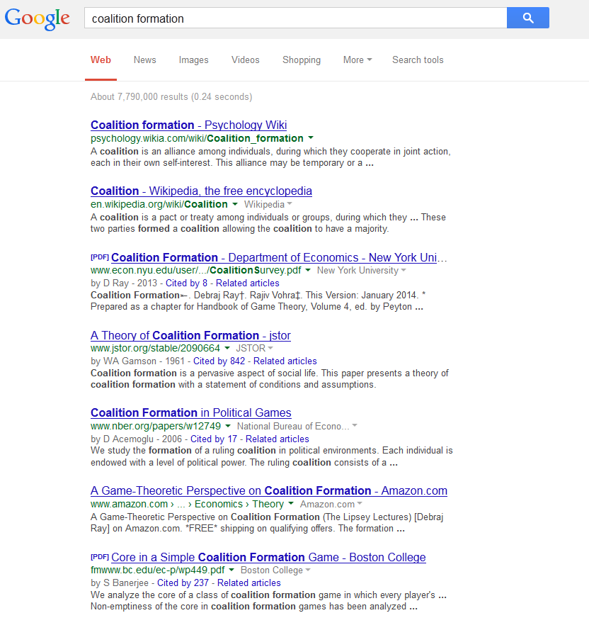
A general Google search will return some scholarly articles, alongside Wikipedia, Amazon links etc. None of this first page are empirical political science studies.
Notes:
RN

Slide 22
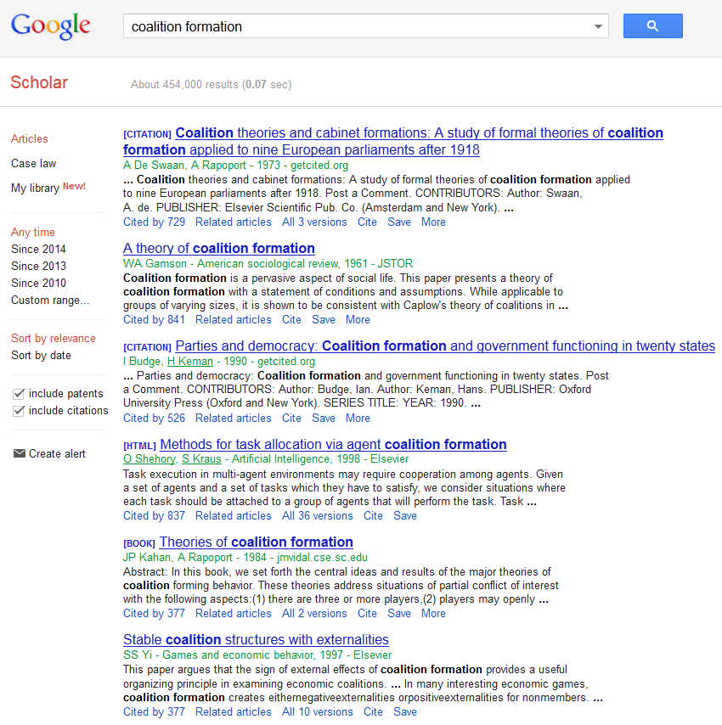
Google Scholar returns scholarly papers, but the initial results page is mostly the older articles which have been extensively cited over many years. There are no recent political science articles on the first results page.
Notes:
RN

Slide 23
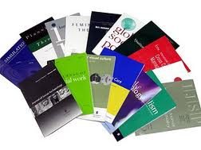
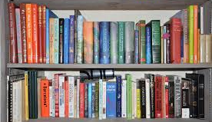

Why use Abstraction and Indexing for literature review?
Selection
Discipline-specific content: across a range of content types: scholarly journal articles, books, reviews, dissertations, grey literature, newspapers & magazines
  editorial selection gives reassurance of quality material
  allows researchers to search a subject-specific relevant data set
  aims to include all important material within a discipline
Notes:
RU
I am going to highlight for you some features of A&I databases that make them particularly well suited to literature review.
First thing: this is a dataset that has been put together editorially.
Discipline- narrower (Sociological Abstracts) or broader (IBSS – International Bibliography of the Social Sciences)
Aims:
Only relevant material is included (Eliminates ‘noise’)
All material important to discipline is included
Selection at journal title level and, for databases of a very specific focus, at article level. E.g. socAbst will scan broad social sciences journals for their sociology content.

Slide 24
Why use Abstraction and Indexing for literature review?
  Historical perspective
  Many A&I databases have a long history (started in print)
  Indexes an entire discipline over time
  Access to non-digital material
  There is still a significant amount of research not available in electronic format which will not be picked up by internet search engines
  Transparency of content
  Title lists available
Notes:
RU
Many indexes have a long history – began in print, in an era with challenges already highlighted by Rob.
IBSS < 1951 (aims of overcoming scholarly divide emerging due to political divide of cold war);
PAIS International < 1914 : for the purpose of chronicling the world's public affairs, public and social policies, international relations, and world politics. PAIS was formed to prepare and disseminate information, primarily bibliographic in nature, for the use of scholars, researchers, librarians, legislators, government officials, the business and financial community, policy researchers, students, and others seeking to locate published information in the realm of public policy.
Most open web searching will throw up only material that has a digital presence.
A&I databases are a really valuable source of information for those journals, articles, papers from before the digital era, that have not been – and may never be – digitized.
Transparency. – it is generally possible to see fairly precisely how these indexes are put together. List of journals, whether they are actively indexed or were indexed in the past, and whether inclusion is cover-to-cover, or selective.

Slide 25
Why use Abstraction and Indexing for literature review?
Indexing & metadata
  Editorial input to aid users in search, navigation, and retrieval
    indexing
    abstracting
    classification
    translation
  Metadata in the language of the discipline
  Only key terms are included (improves precision & relevance)
  Indexing key for filtering through large data aggregates

Slide 26
Subject searching: Thesaurus & controlled vocabulary
List of accepted terms, usually in hierarchical thesaurus structure
Subject specific
May have other ‘authority lists’ e.g. for company names, personal names, works of art or literature
Advantages of controlled vocabulary
Controls synonyms and near synonyms
Standardizes different vocabulary used by different authors
Allows cross searching of multilingual material
Transparency of terms & use
Notes:
RU
A&I databases use a controlled vocabulary
Some also have the option for uncontrolled terms
Most also have controlled geographic indexing
Mainly we use thesaurus-type structure (broader/narrower term hierarchy)
Each PQ A&I database has its own vocabulary, specific to the field – e.g. SocAbst vocab deeper level of sociology terms than IBSS – broader range of social science terms

Slide 27
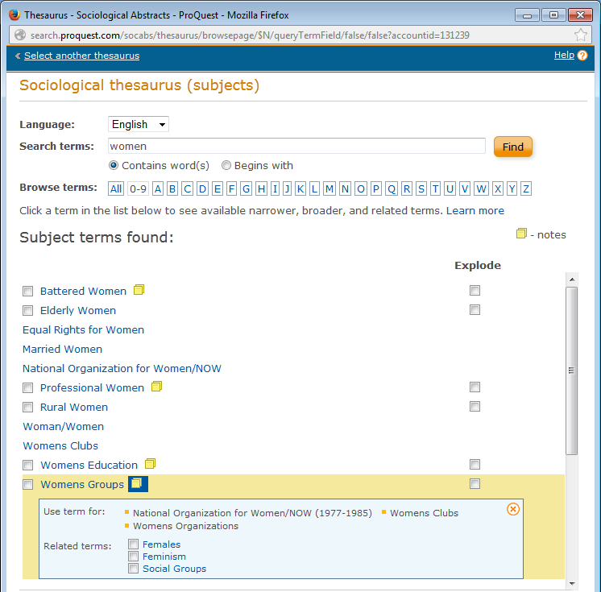
Controlled vocabulary
Browseable
‘Use for’ terms shown
Notes:
RU
Sociological Abstracts thesaurus
Statistics
Preferred terms: 3315
Non-Preferred (USE) terms: 2658
Scope Notes: 918
Once identify area of research, a BROWSABLE thesaurus helps you to narrow down. So you can start with ‘women’ and then get a good sense of all associated terms. Related will suggest other terms to look at.

Slide 28
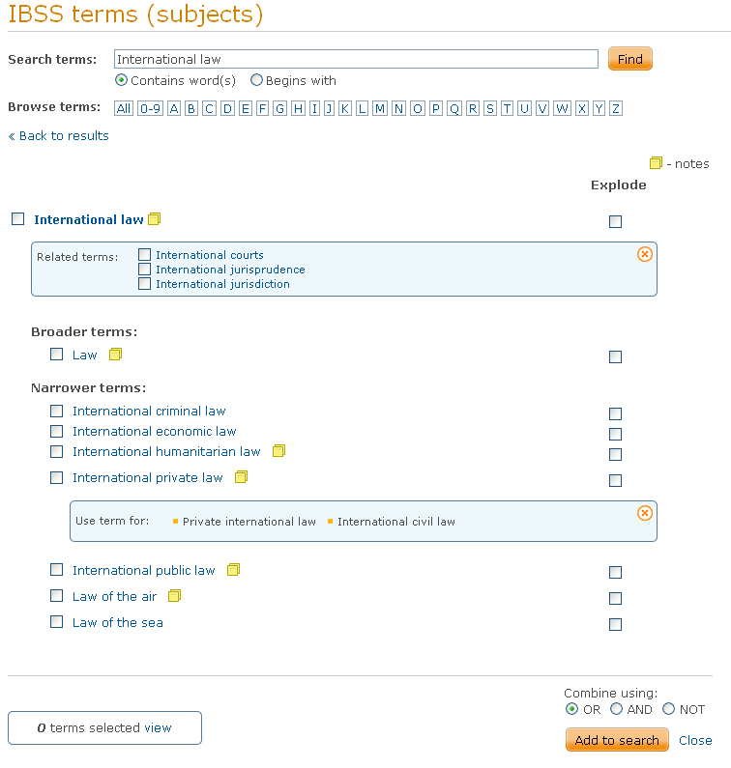
Subject searching: Thesaurus search
Hierarchy: broader, narrower, related terms
‘Explode’ function
Combine using AND, OR, NOT
Notes:
RU
IBSS thesaurus (social sciences)
8,000 terms
Hierarchical, lateral and ‘use-for’ relationships
Essentially a ‘Keyword’ list
What does this mean for a researcher?
EXPLODE function allows you easily to drill down
Combine using AND OR NOT allows you to include or exclude terms / research areas to make your search highly specific. - AND – narrows a search (v. specific)
OR – widens a search

Slide 29
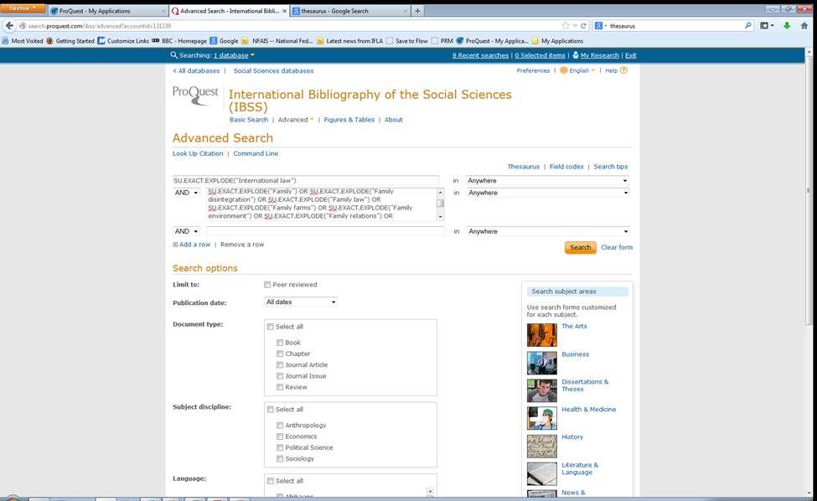
Thesaurus search
Explode “International law”
AND
Explode “Family”
Notes:
RU
This screen shows you a search constructed using the thesaurus option.
You don’t need to type in a complex Boolean string (though you can).
In this, we are including as many international law terms as we can, but then excluding economic law
AND – narrows a search (v. specific)
OR – widens a search

Slide 30
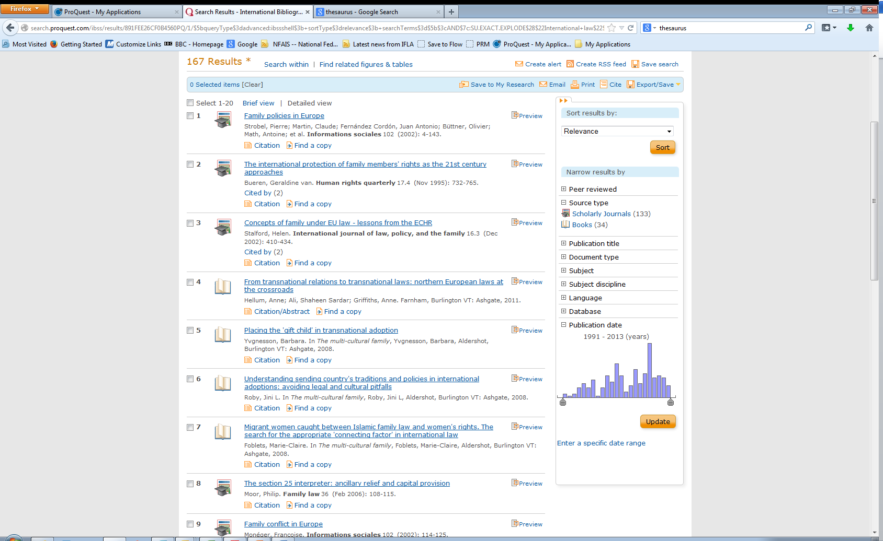
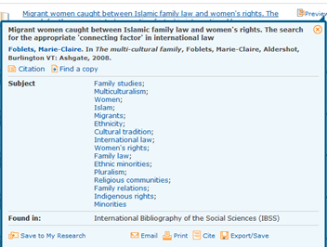
Thesaurus search
Notes:
RU
This screen shows you a search constructed using the thesaurus option.
You don’t need to type in a complex Boolean string (though you can).
In this, we are including as many international law terms as we can, but then excluding economic law
AND – narrows a search (v. specific)
OR – widens a search

Slide 31
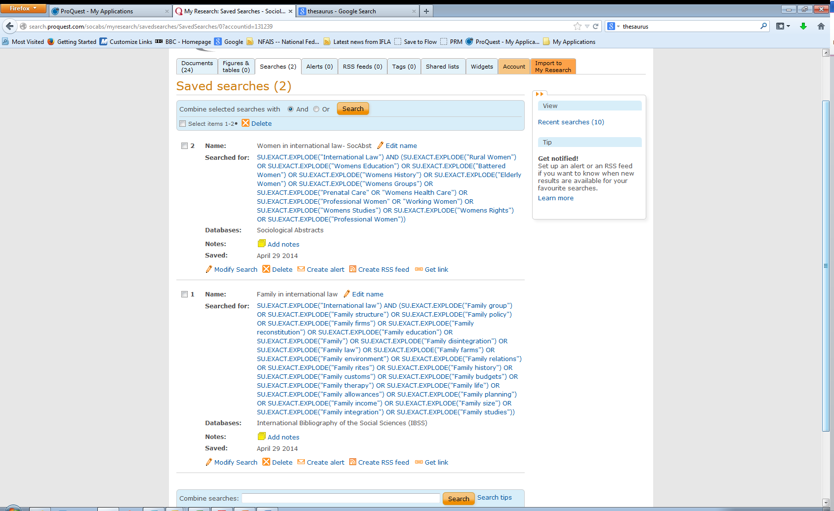
Saved searches & alerts
Notes:
RU
This screen shows you a search constructed using the thesaurus option.
You don’t need to type in a complex Boolean string (though you can).
e.g apply wildcards, Boolean terms
Run equivalent searches across multiple subject-specific databases (e.g. ASSIA, Medline, PsycINFO, Sociological Abstracts)
Save and record results

Slide 32
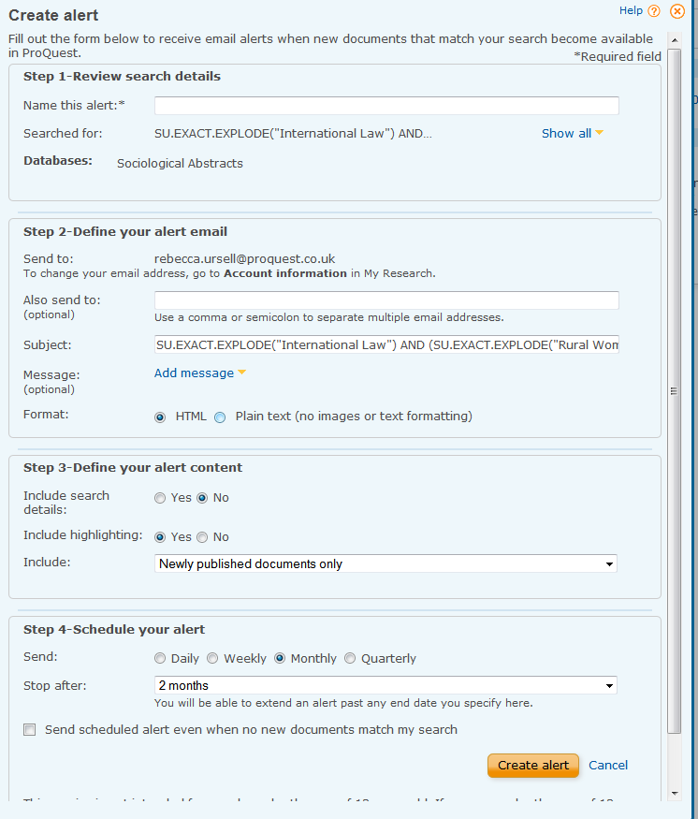
Saved searches & alerts Current awareness
Save searches and repeat as needed
Set up an alert to run at regular intervals with any new documents matching your search
Keep abreast of what is being published on a topic
Ensure you do not miss any new and relevant articles when finalizing a paper for publication
Notes:
RU
So, you can save your searches and set them up to automatically deliver new results to you.
A&I databases are updated according to a regular schedule – weekly, fortnightly, monthly - so you can set an alert to run according to this schedule and to deliver you any records newly added to the database with that updated, which match your field of interest.
This will ensure that you can keep abreast of research in your field, and that you don’t miss any new and relevant articles as you’re finalizing your research.

Slide 33
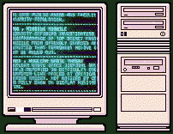

Human vs machine indexing
Advantages of human indexers
  Lateral thinking
  Diverse skills - abstracting, translating, classifying
  Understand user needs
Advantages of machine indexing
  Speed!
  ongoing improvement and consistency
  greater insight into the vocabulary

Slide 34
Indexing steps
Determine what document is about
Special attention is paid to titles, headings, introduction, conclusion, abstracts and keywords (if available)
Select concepts that would be of interest to users
Consider subject area of database, e.g. for a social sciences database, social sciences concepts will be of more interest than others
Translate concepts into controlled vocabulary terms
The concepts selected should be as specific and precise as possible
What aspects of the documents will our users be interested in? Why would any one of our users be interested in this document?
What a document is about is more important than words used by author

Slide 35
Management of controlled vocabularies
A&I databases generally index a discipline over an extended period
term use changes over time – through culture, fashion, or knowledge development
  Terminology around mental disability
Mental retardation > learning disability > intellectual disability

Slide 36
One final survey finding – experience of online research
% of respondents agreeing or strongly agreeing, by frequency of use of specialist subject indexes
Those frequently using specialist indexes are much more likely to find it easy to identify relevant material.
Notes:
Little difference for three questions, and a predictable increase for use of citations/abstracts. The interesting result is that those frequently using specialist indexes are much more likely to find it easy to identify relevant material.

Slide 37
Summary
Abstraction and Indexing gives you….
A relevant dataset
Scholarly material only
Indexing in the language of the discipline
Known search parameters
A view of pre-digital material
Transparent search construction
Regular updates
Consistency of search results over time

Slide 38
CITATION DATABASE

Slide 39
Concept of Citations
Citations symbolize the conceptual association of scientific ideas as recognized by publishing research authors.
By the references they cite in their papers, authors make explicit linkages between their current research and prior work in the archive of scientific literature.

Slide 40
Distinction between "citation" and "reference"
If Paper R contains a bibliographic footnote using and describing Paper C, then
  R contains a reference to C,
  C has a citation from R.
The number of references a paper has is measured by the number of items in its bibliography as endnotes, footnotes, etc.,
The number of citations a paper has is found by looking it up [in a] citation index and seeing how many others papers mention it."

Slide 41
Paper R
…..To start, it is important to clarify the terminological distinction between "citation“[6] and "reference". In his classic book Little Science, Big Science, Derek Price gave a clear definition of both terms. He said: "It seems to me a great pity to waste a good technical term by using the words citation and reference interchangeably. I therefore propose and adopt the convention that if Paper R contains a bibliographic footnote using and describing Paper C, then R contains…
  R contains a reference to C,
[6] The concept of citation indexing: A unique and innovative tool for navigating the research literature. Current Contents, January 3, 1994.
Paper C
Little science, big science...and beyond.
This is my first Current Contents® (CC®) essay under the rubric of Citation Comments. As discussed in last week's CC, this new monthly feature will focus on the applications of the Institute for Scientific Information's (ISI's) databases. 1 An appropriate topic to launch this new series is perhaps the most rudimentary -- the basic concept of citation indexing.
To start, it is important to clarify the terminological distinction between "citation" and "reference". In his classic book Little Science, Big Science, Derek Price gave a clear definition of both terms. He said: "It seems to me a great pity to waste a good technical term by using the words citation and reference interchangeably. I therefore propose and adopt the convention that if Paper R contains a bibliographic footnote using and describing Paper C, then R contains a.
C has a citation from R.

Slide 42
Paper C
Citation Index
Paper X
Paper Y
Paper R
Paper Q

Slide 43
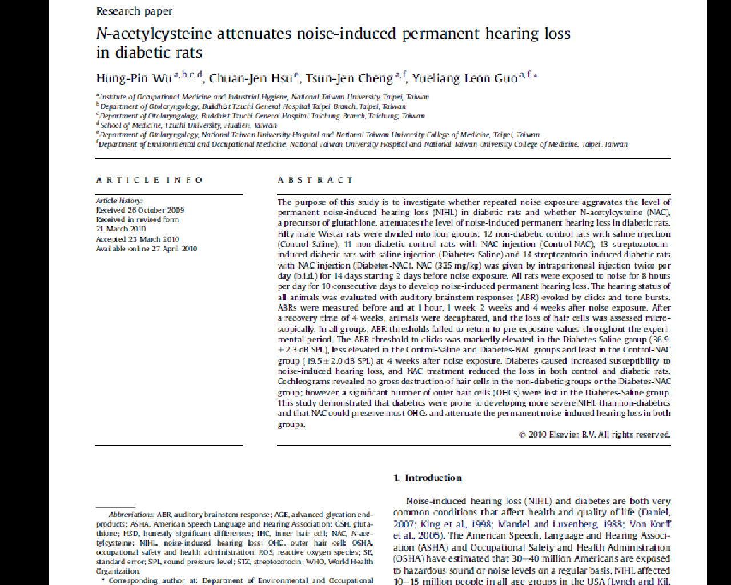
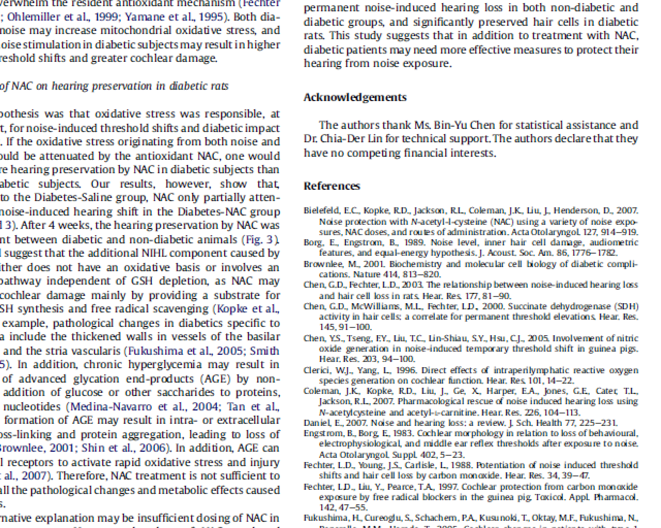
Sample of a journal publication
Citing publication
Cited publications

Slide 44
CITATION has two meanings in library usage:
a bibliographic item of a work, e.g. journal article, which includes the title of the publication, the authors’ names, data of sources (source title, volume, issue, pages, publication year)
a quotation, which an author has received in a paper published by other researcher

Slide 45
What is Web of Science?
A research platform from Thomson Reuters (formerly ISI Web of Knowledge)
Different databases are available on the platform depends on subscriptions
Semmelweis University has access to:
  Web of Science Core Collection
  Chinese Science Citation Database
  KCI-Korean Journal Database
  Scielo Citation Index

Slide 46
What is Web of Science Core Collection?
Multidisciplinary bibliographic database (formerly Web of Science)
Includes full bibliographic information and citation searching
Updated weekly
Contains 5 indexes (at Semmelweis University):
  Science Citation Index Expanded
  Social Sciences Citation Index
  Arts & Humanities Citation Index
  Conference Proceedings Citation Index- Science
  Conference Proceedings Citation Index- Social Science & Humanities
Timespan (in Hungary):
  1975 to present
  1990 to present (at Conference Proceedings Citation Indexes)

Slide 47
Value-added services – My tools
(required registration)
  Create a private user profile
  Save searches and create search alerts (eg. RSS feeds)
  Citation Alerts
  It allow you to monitor citation activity for any WoS article.
  EndNote Basic/Online:
  web-based reference organizer
  ResearcherID:
  heightens communication among researchers in all disciplines, increasing their visibility and making their work more accessible

Slide 48
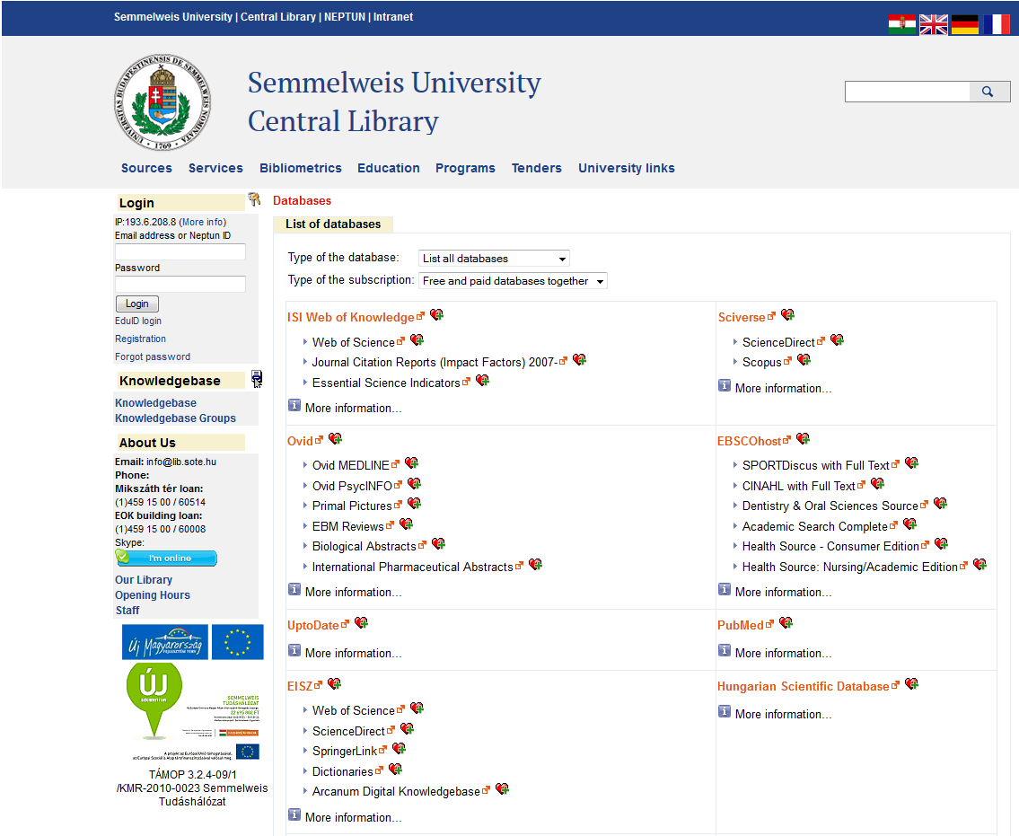
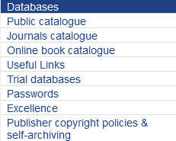
Access
On the website of Central Library of Semmelweis University : Sources - Databases:
Web of Science link

Slide 49
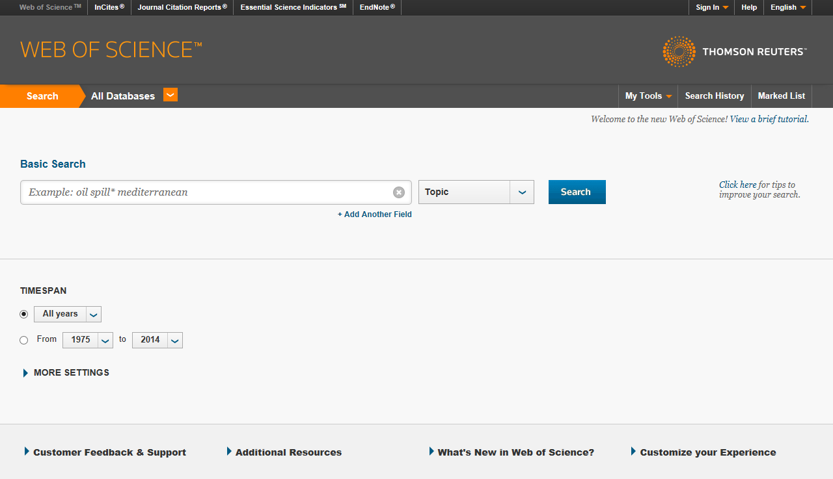
Web of Science platform
Other access:
http://isiknowledge.com

Slide 50
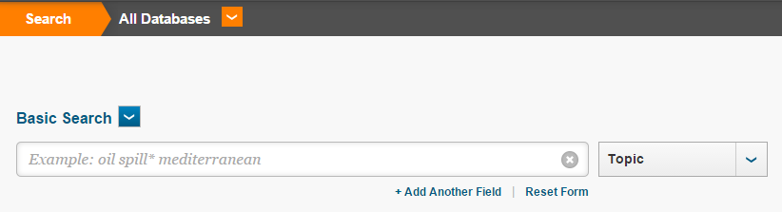
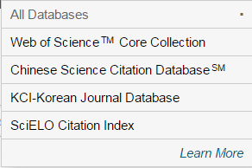
Select Web of Science Core Collection database

Slide 51
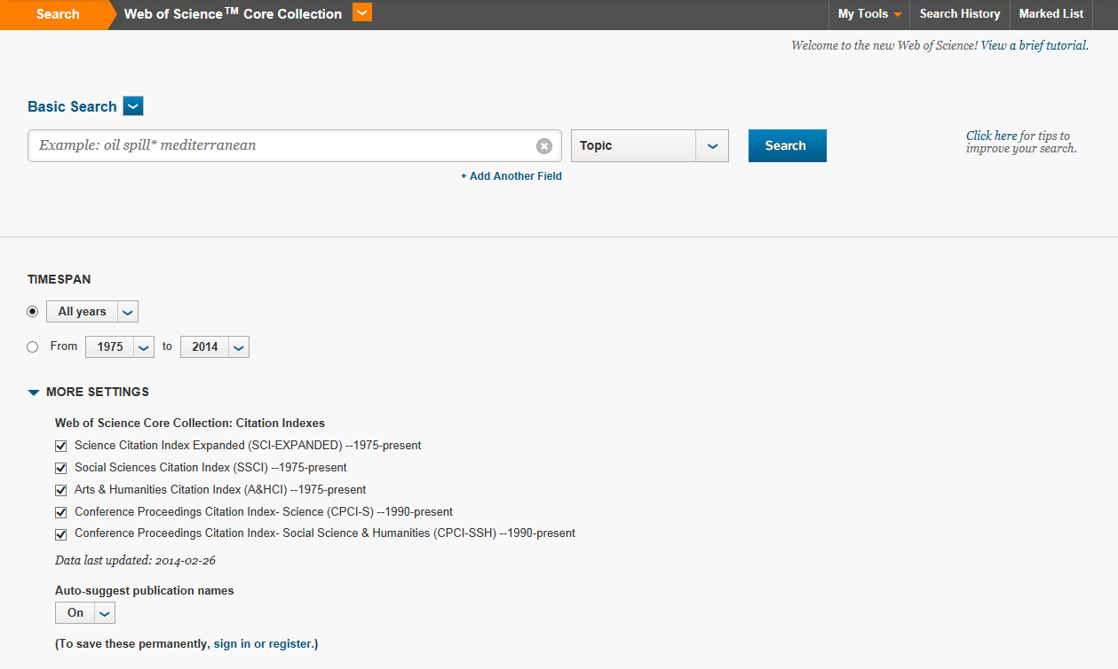
Web of Science Core Collection – with 5 indexes

Slide 52
Search options
Basic Search:
general search by topic, author, DOI, publication year, address, etc.
Cited Reference Search
Advanced Search

Slide 53
Basic search – detailed search fields
Topic: search the following fields within a record: title, abstract, author keywords, keywords plus®
Title: search for the title of a publication
Author: search for an author name of a publication (include group author too)
Author Identifiers: search for unique identifier (ResearcherID or ORCID) of an author
Group Author: search for corporate author name
Editor: search for name of an editor
Publication Name: search the source title (a.k.a. journal name) within a record
DOI: search for digital object identifier (DOI®), which identifies the digital content on the web

Slide 54
Year Published: search for publication year(s)
Address: search for the full or partial name of an institution and/or location from an author's address
Organizations-Enhanced: search for preferred organization names and/or their name variants from the Preferred Organization Index
Conference: search for conference title or location or date or sponsor
Language: you can select one or more languages from a list
Document Type: you can select one or more documents from the document list
Funding Agency: search for a funding agency
Grant Number: search for a grant number
Accession Number: search for a unique identifying number associated with each record in Web of Science
PubMed ID: search a unique identifier assigned to each MEDLINE record

Slide 55
Search tips
Truncation symbols / wildcard characters
* | Zero or more characters | Eg.: hydroxy*= hydroxylase, hydroxydopamine, hydroxyethyl, etc.
? | One character | Eg.: en?oblast = entoblast, emndoblast
$ (cannot be used within quotation marks) | Zero or one character | Eg.: col$r = color, colour
Operators
AND | The AND operator finds all terms entered. | Eg.: allergy AND stress
OR | When using OR, at least one term must occur. Your search will retrieve articles that contain any one of these terms. | Eg.: saccharine OR sweetener
NOT | The NOT operator excludes terms from your search. | Eg.: aids NOT hearing => will retrieve records about the disease AIDS, not hearing aids
„…” | If you would like to search for an exact phrase, enter it in quotation marks. | Eg.: „eating disorder”, „hearing loss”
NEAR/x | NEAR finds terms within the same field, and allows you to specify how far apart terms should be. If no number is specified, the default is 15 words. | Eg.: osmium near/3 hydroxy* => where osmium term must be within a maximum of 3 words from the terms beginning with hydroxy*
SAME | The SAME operator is used only in the Address field and retrieves terms that all occur within the same address. | Eg.: yale SAME hospital
Source: https://www.brainshark.com/thomsonscientific/searchtipswok5_v2

Slide 56
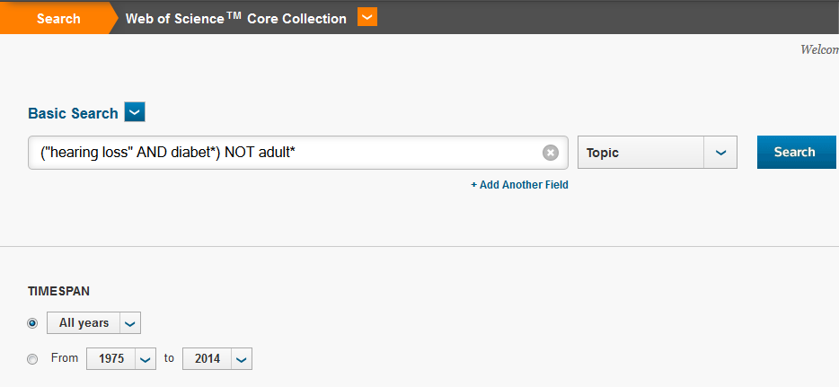
Search for keywords (in Topic)
Use truncation symbols (*, ?, $) and operators (NEAR/x, SAME, NOT, AND, OR)!

Slide 57
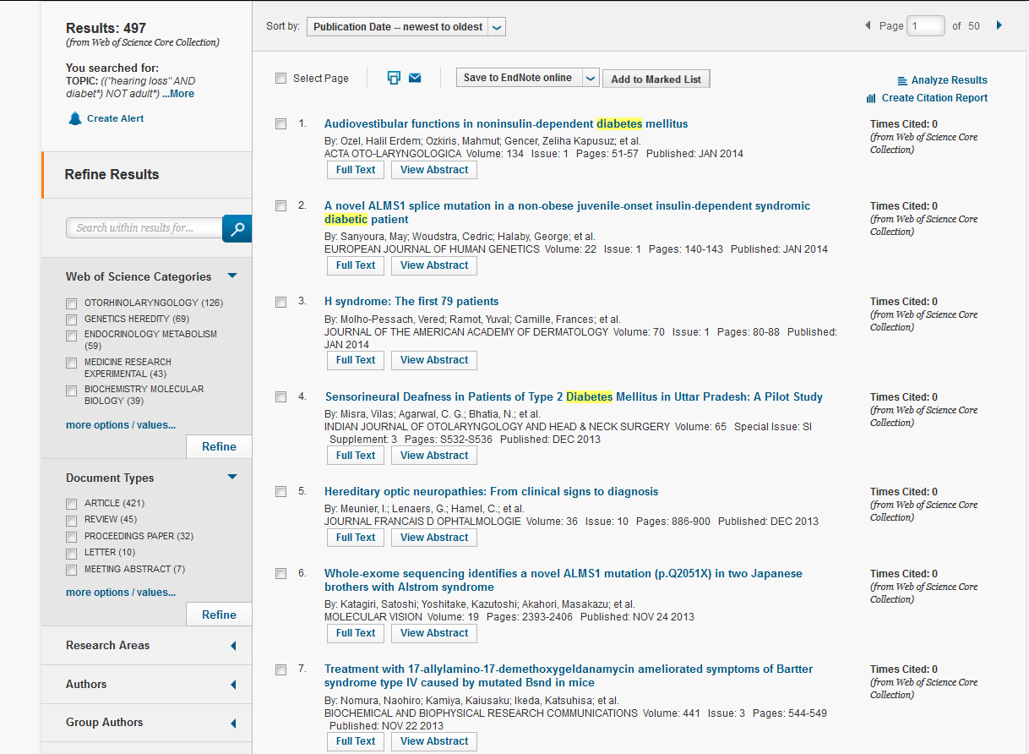
Results list

Slide 58
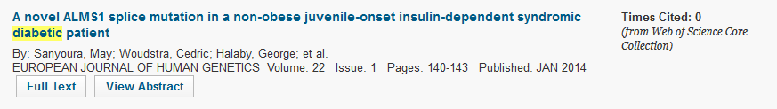

A bibliographic item
Extra information:
-Times Cited: how many papers cited this publication in Web of Science Core Collection database
-Full Text: sometimes the paper has a full text button: if our institution's has subscription, you can read the full text of the publication at the publisher’s site
-View abstract: you can read the brief summary (abstract) of the paper

Slide 59
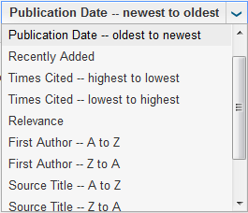
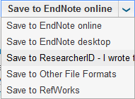
Results list – refine, process, analyze
3.
4.
2.
1.
Refine Results:
Results may be refined by e.g. categories, document types, subject areas, authors, source titles, publication years, institutions, languageas, or countries/territories.
Processing Records:
You can choose to print, e-mail, add to marked marked list, add to ResearcherID or export to bibliographic manage software the records that you have checked off.
Sort by:
The default sort is Publication Date (newest to oldest). You can change the sort order of your results by e.g. times cited, relevance, first author, source title, publication year, conference title.
Analyze Results by different options or Create Citation Report to see aggregate citation statistics for a set of search results.

Slide 60
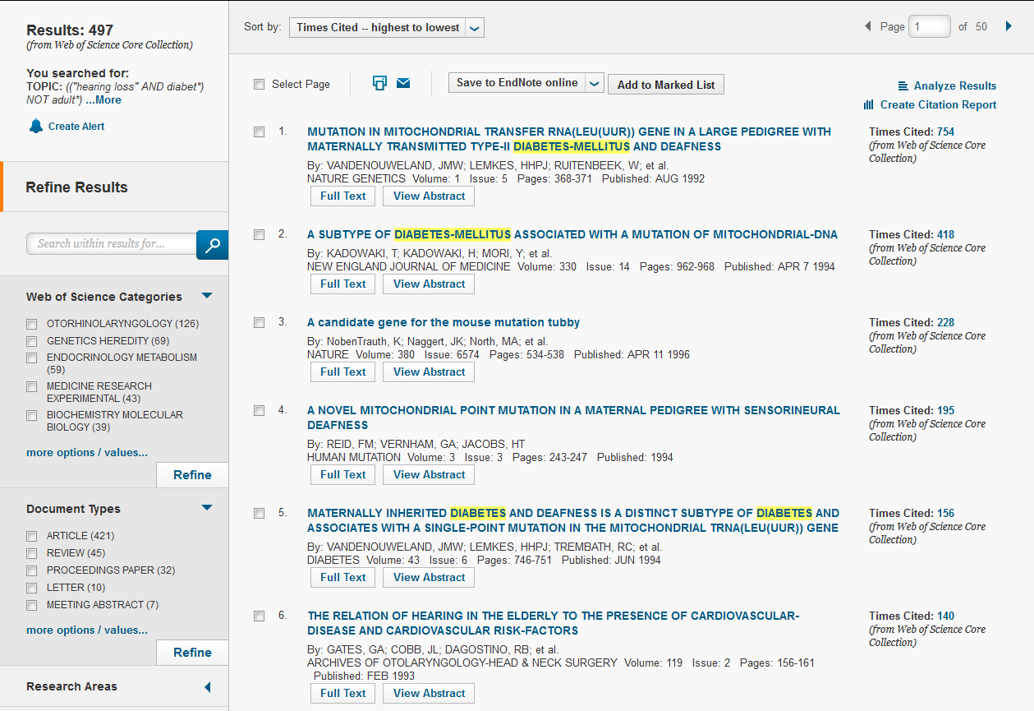
Results list

Slide 61
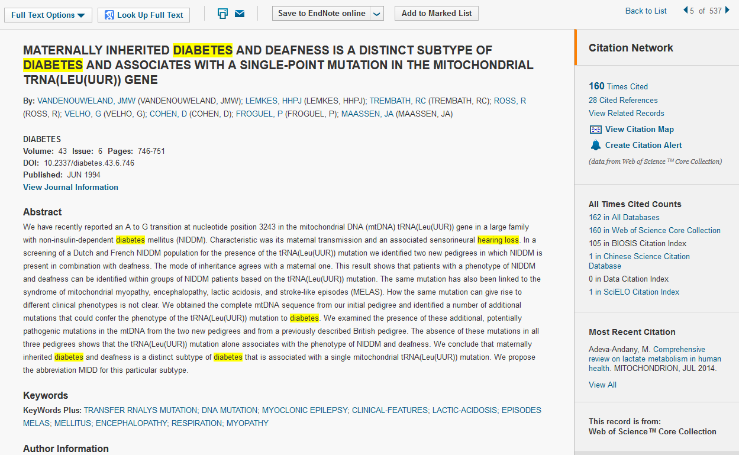
Full record (1)
Access to full text depends on the institution’s subscription!
Look Up Full Text takes you to Google Scholar database.
Click Times Cited to find out who cited this paper in Web of Science Core Collection database.
Click Cited References to move to this paper’s bibliography.
Click view related records to view records that share cited references with this paper. (The more cited references two articles share, the close the subject relationship.)
All Times Cited shows who cited this paper in all citation indexes of Web of Science database (Access to records is limited to the institution’s entitlements subscription).

Slide 62
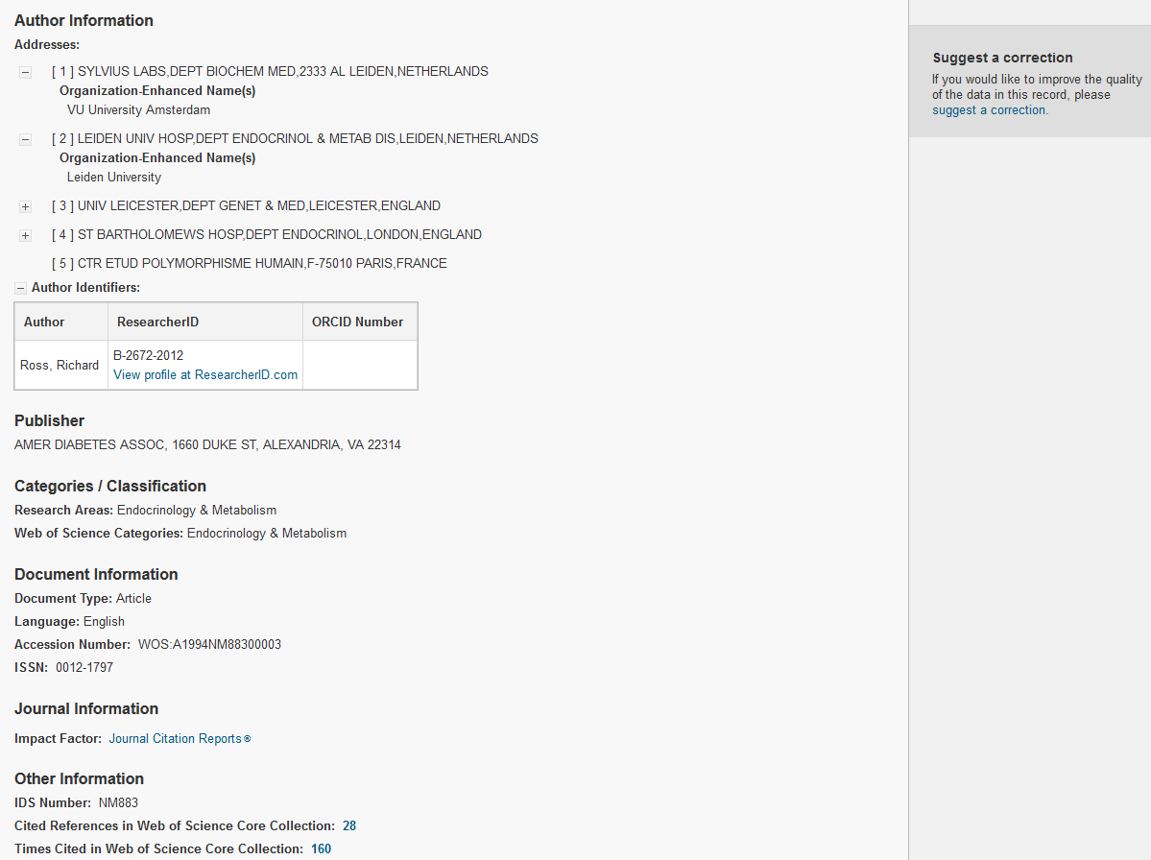
Full record (2)
Address of the authors: name, city, country of the institutions, etc.
Author Identifiers, if at least one of the authors has ResearcherID and/or ORCID.
Plus information about the journal and its publication.

Slide 63
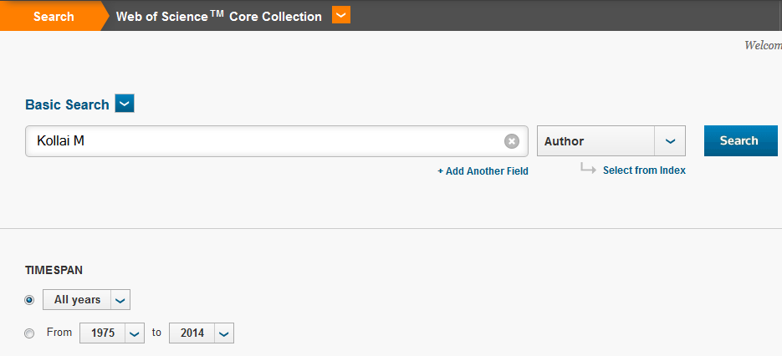
Search for author

Slide 64
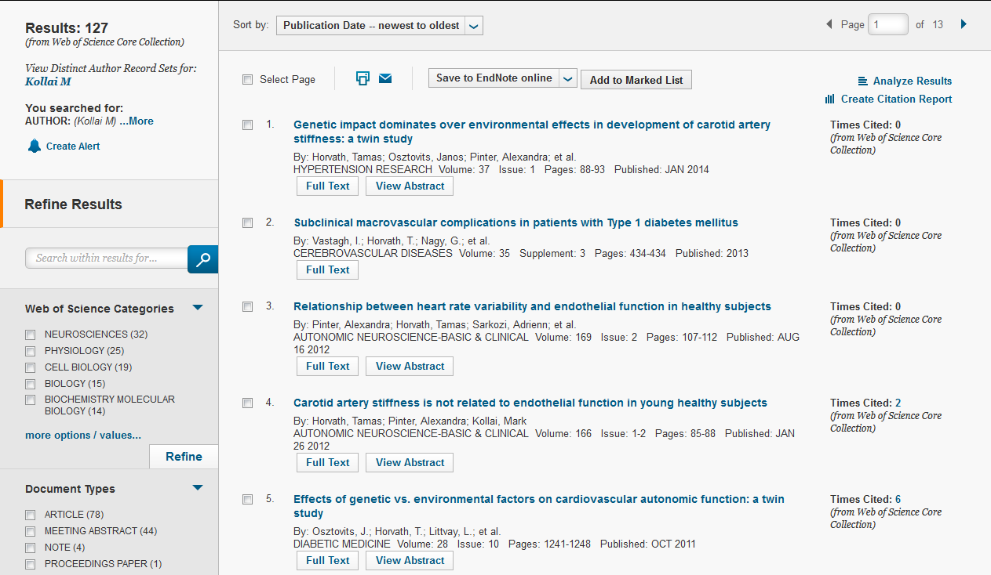
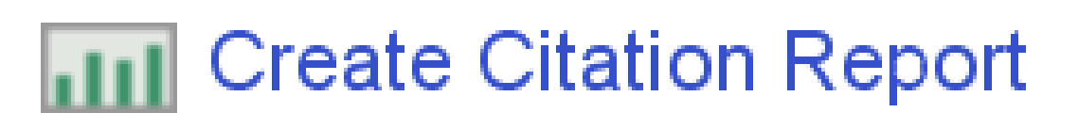
Results list – documents of the author

Slide 65
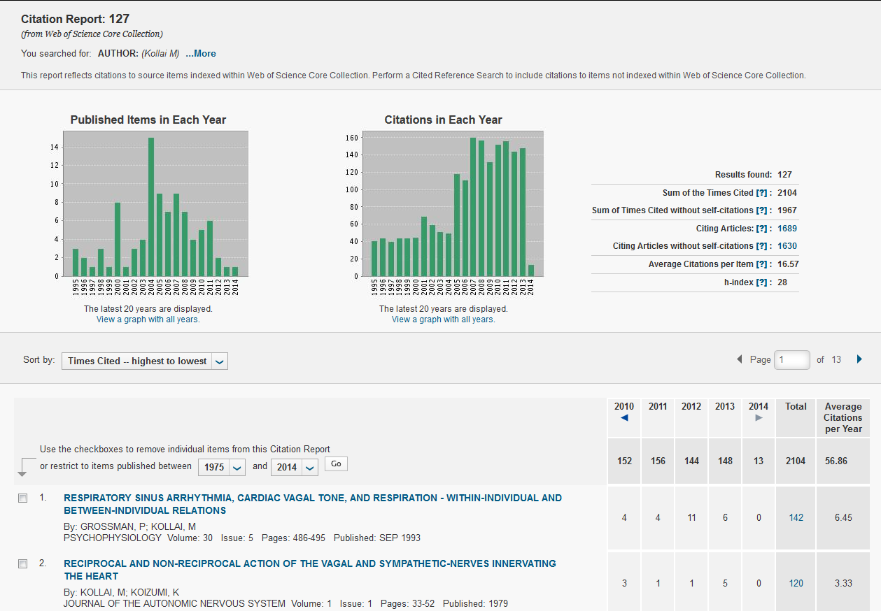
Citation report of the author

Slide 66
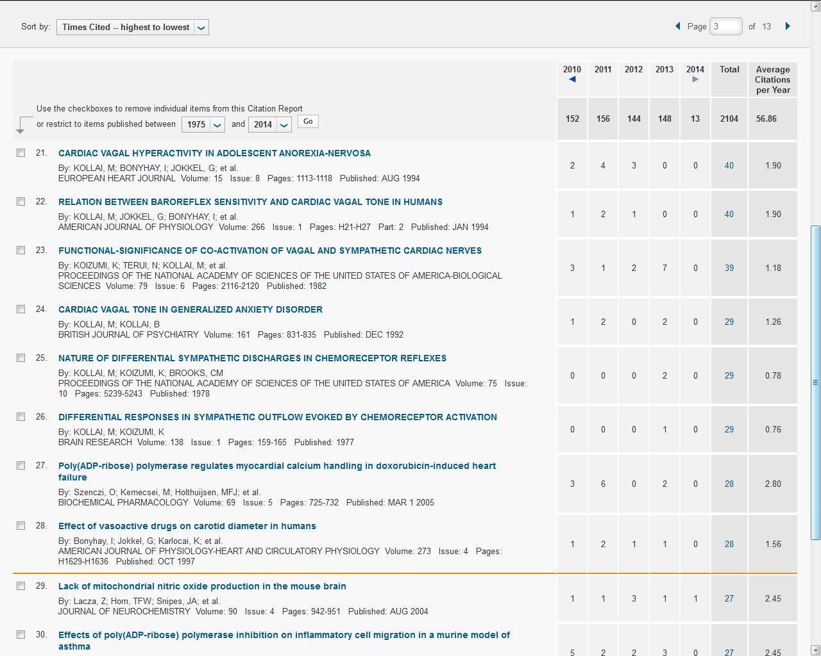
H-index
The h-index is a bibliometric indicator based on the set of a researcher’s most cited papers and the number of citations (quotations). It is indicated by an orange horizontal line at Citation Report in Web of Science. The number of items above this line, which is h, have at least h citations. For this example, the h-index of 28 means that there are 28 published papers that have 28 citation or more.

Slide 67
Search options
Basic Search
Cited Reference Search:
search for the articles that have cited a previously published work
Advanced Search

Slide 68
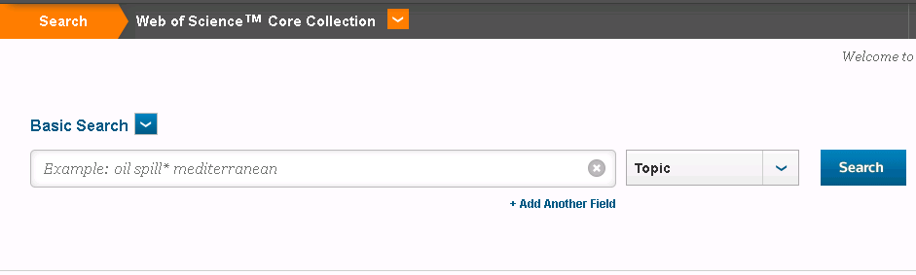
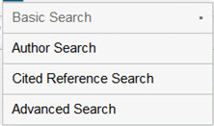
C ited reference search – settings

Slide 69
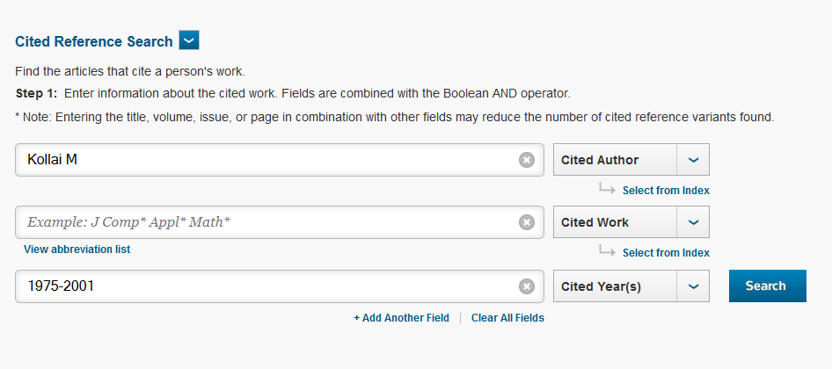
Cited reference search – first step

Slide 70
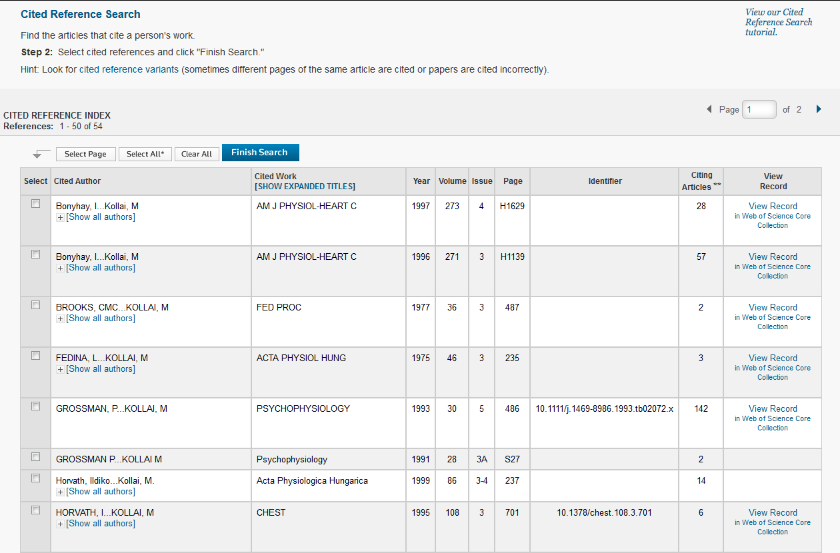
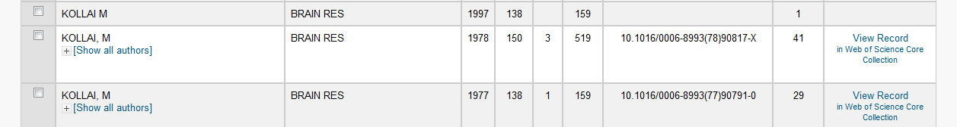
Cited reference search – second step (a)
Citations retrieving:
-View Record
- Mark the checkbox(es), Finish Search

Slide 71

Full record – number of the citing documents
Number of the quotations in Web of Science Core Collection database
Number of the quotations in all citation indexes of Web of Science database (what we can see depends on the subscription)

Slide 72


Let see the number of the citations!

Slide 73

Cited reference search – second step (b)
Look for variants. Papers are sometimes cited incorrectly.

Slide 74
Search options
Basic Search
Cited Reference Search
Advanced Search:
create complex queries using two-character field tags and Boolean operators (AND, OR, NOT, SAME, NEAR)

Slide 75
Advanced search – settings

Slide 76


Advanced search
Search box

Slide 77

Advanced search
– number of the records in the Search history

Slide 78

Results list – sort by Times Cited -- highest to lowest
The most cited publication of the results list

Slide 79


Combine the results
Advanced Search / Search History

Slide 80

New results list after combining

Slide 81
What is Scopus?
One of the largest abstract and citation database of research literature from Elsevier Publisher
Multidisciplinary bibliographic database
Updated daily
Approximately 70% of titles are not from North America
About 21% of the indexed journals are bilinguals and/or not English
~100% Medline coverage
Timespan:
  70% of all Scopus records, back to 1823, have an abstract
  References go back to 1970
  (Scopus is in progress of updating pre-1996 cited references going back to 1970.)

Slide 82
Value-added service (requireS r egistration)
Set up alerts
  Search alerts send new results from a previous search directly to your mailbox.
  Document citation alerts notify you when an article you specify is cited by another article.
Personalize
  You can edit your searches, save them for a future session or set up an alert to receive new results by email.
Access to another Elsevier product
  If you have subscriptions to more than one Elsevier product, you only need to log in to one product. For example, if you log in to Scopus and have a subscription to ScienceDirect, you will not need to log in again when you use ScienceDirect.

Slide 83
Access
On the website of Central Library of Semmelweis University:
Sources - Databases:
Scopus link

Slide 84

Scopus database

Slide 85
Search options
Document Search:
search by article title, abstract, keyword, author, affiliation, language, ISSN, DOI, references, etc.
Author Search
Affiliation Search
Advanced Search

Slide 86
Document search – detailed search fields
Article Title, Abstract, Keywords: a combined field that searches abstracts, keywords, and article titles
Authors: search for an author name of a publication (Note: Use a comma to separate last name and first name.)
First Author: search for the first author listed for a document.
Source Title: search for the title of a journal, book, conference proceeding, or report in which the document was published.
Article Title: search for the title of a publication
Abstract: search in the summary of a document
Keywords: a combined field that searches the author keywords, indexterms, tradename, and chemname fields

Slide 87
Affilitiation: search for the full or partial name of an institution and/or location from an author's address
Language: search for the language in which the original document was written
ISSN: search for International Standard Serial Number: a unique identification number assigned to all serial publications
CODEN: search for a unique code that identifies serial and nonserial publications
DOI: search for digital object identifier (DOI®), which identifies the digital content on the web
References: search in reference lists of documents
Conference: search for conference name or sponsor or location
Article Title, Abstract, Keywords, Authors: a combined field that searches abstracts, article titles, keywords, and author names
Chemical Name: search for chemical names
CAS Number: search for Chemical Abstracts Service (CAS) registry number
Limit to: Date Range: search for publication year(s)
Document Type: search for a document type

Slide 88


Document search – document types

Slide 89
Search tips
Truncation symbols / wildcard characters
? | Only one character | Eg.: AFFIL(nure?berg) = Nuremberg, Nurenberg
* | Any number of characters | Eg.: toxi* = toxin, toxic, toxicity, toxicology, etc.
Operators
AND | Searches for publications containing both words. | Eg.: food AND poison
OR | Searches for publications containing either or both words. | Eg.: weather OR climate
AND NOT | Searches for publications that do not contain the following word (after AND NOT). | Eg.: tumor AND NOT malignant
„…” | To search as a phrase, use quote marks, it will also search for both singular and plurals. | Eg.: „heart-attack” = heart-attack, heart attack, heart attacks
{…} | With curly brackets you can search for the exact phrase. | Eg.: {heart-attack} = heart-attack
PRE/n | Restricts to n words between the two words. The word order is as set. | Eg.: newborn PRE/2 screening => where newborn term precedes with a maximum of 2 words screening term
W/n | Restricts to n words between the two words. The word order is not set. | Eg.: pain W/5 morphine => where pain term must be within a maximum of 5 words from morphine term
Source: SciVerse Scopus. Quick Reference Guide. ©2011, Elsevier B.V.

Slide 90

Search for keywords 1.
(at Document search platform)
Use operators:
OR, (W/n, PRE/n), AND, AND NOT

Slide 91

Results list

Slide 92
A bibliographic item*
* The bibliographic item is full – with the volume, issue and page numbers – when we hover over the record.
Extra information:
-number of the last column (Cited by): shows how many papers cited this publication
-View at publisher: if you see this button, you can read the full text of the document at the publisher’s site depends on our institution’s subscription
-Show abstract: you can read the brief summary (abstract) of the paper
-Related documents: you can view a list of related documents based on shared references

Slide 93

Results list – refine, process
3.
4.
Some further options:
View secondary documents: Results from reference lists.
Patents: Results from 5 patent offices.
2.
1.
The default sort is latest Date. You can change the sort order of your results by date (newest or oldest), cited by, relevance, first author (A-Z or Z-A), or source title (A-Z).

Slide 94

Full record (1)
If you click the icon, you can email the author(s).
If you click the icon, you can see the correspondence information (author, address) for this document.
Cited by shows who cited this paper.

Slide 95


Full record (2)
References shows this paper’s bibliography.
Information about the correspondence author.

Slide 96

Search for keywords 2.
(at Document search platform)

Slide 97

Results list – edit, save, alerts; analyze results

Slide 98

Analyze results – by different options

Slide 99

Results list – View citation overview

Slide 100

Citation overview

Slide 101

Search for author
(at Document Search platform)

Slide 102

Results list – documents of the author

Slide 103
Search options
Document Search
Author Search:
locate a particular author easily
Affiliation Search
Advanced Search

Slide 104

Author search – first step

Slide 105

Author search – second step

Slide 106


Author – „information sheet”(search for name variants)

Slide 107

Author – „information sheet”
(with the grouped author name variants)

Slide 108

Author – publications and citations data

Slide 109

Author - h-index
Option to look the h-index of the given author.
The h-index of 18 means that there are 18 published papers that have 18 citations or more.

Slide 110
Search options
Document Search
Author Search
Affiliation Search:
search for institutes
Advanced Search

Slide 111

Affiliation search – first step

Slide 112

Affiliation search – second step

Slide 113

Affiliation – „information sheet”

Slide 114
Search options
Document Search
Author Search
Affiliation Search
Advanced Search:
create complex queries using operators (e.g. AND, OR, AND NOT) and codes

Slide 115

Advanced search
Search box

Slide 116

Results list – sort by: Cited by (times cited)
The most cited publication of the results list

Slide 117

Search history: Combine the results

Slide 118

New results list after combining

Slide 119
What is Google Scholar ?
Free database from Google
You can search across many disciplines and sources: articles, theses, books, abstracts and court opinions, from academic publishers, professional societies, online repositories, universities and other web sites
You can find out what publications have cited other publications
At „Advanced Search” platform you can combine your queries, such as terms, authors, publication years
There are duplicate, false, etc. citations, so need to double-check the records – the procedure is time-consuming
Access to full text depends on subscription, because the links go to sites of different publishers, vendors, etc.

Slide 120


http://scholar.google.com/

Slide 121

Google Scholar – results list

Slide 122


Search for keywords/topic
"irritable bowel syndrome"

Slide 123
SUMMARY
Characteristics | Web of Science* | Scopus | Google Scholar
Indexing | Journals, proceeding publications in mostly English and with impact factor | Journals, books, book chapters, coference publications in many languages | Journals, dissertations, books, book chapters, etc. in different languages
Document types | Article, review, note, proceedings paper , meeting abstract, letter, editorial material, journal series as book chapters, etc. | Article, review, short survey, book, book chapter, conference paper, letter, etc. | Articles, theses, books, abstracts and court opinions, from academic publishers, professional societies, online repositories, universities, etc.
Years covered-documents | From 1975 (Proc. Cit. Ind: from 1990) | From 1960 (depends on the indexing, you can find bibliographic information back to 1823) | Not revealed / undefinable
Years covered-citations | From 1975 | From 1970 (Scopus is in progress of updating pre-1996 cited references going back to 1970.) | Not revealed / undefinable
Updates | Weekly | Daily | Weekly/6-9 Monthly/Yearly
* Regarding to Semmelweis University

Slide 124
Number of the citations: compare the results from Web of Science, Scopus és Google Scholar databases – an example
Sample:
Tuller T., Atar S., Ruppin E., Gurevich M., Achiron A.
Common and specific signatures of gene expression and protein-protein interactions in autoimmune diseases. Genes and Immunity 2013; 14(2): 67-82.
(Date of the citation search: 23.03.2015.)
Groups | Number of the citations
Overlapping citations (WoS, Scopus, GS) | 11
Overlapping citations (WoS, Scopus) | 0
Overlapping citations (WoS, GS) | 1
Overlapping citations (Scopus, GS) | 2
Unique citations in GS | 6*
* Records from GS:
2 journal articles (one of them cites incorrectly), 3 dissertations, 1 Chinese publication

Slide 125
Scientometrics & Altmetrics
Why Metrics?

Slide 126
“One of the diseases of this age is the multiplicity of books; they doth so overcharge the world that it is not able to digest the abundance of idle matter that is every day hatched and brought forth into the world.“
3

Slide 127



Information Overload in Science
Information overload is NOT a contemporary problem in science
Science has been growing exponentially for the last 400 years (Price 1961, 1963)
Number of papers (Larsen/von Ins 2010) Number of researchers (NSB 2010)
Instruments to deal with the overload
Journals and conferences Peer review
Quantitative analysis →→ Scientometrics
4

Slide 128


Pathways through Science
Science Citation Index (Garfield 1955)
 Web of Science
An index of incoming citations
Purpose
Relational scientometrics
Discovery of literature that is not linked thematically
Increased collaboration between researchers
Evaluation of science
Evaluative scientometrics
5
Garfield et al. (1964)

Slide 129
Relational Scientometrics
Example: Genetics research (Garfield et al. 1964)
From the beginnings in the 1800s to the dis- covery of DNA
Relationships given by history of science (red), citations (yellow),
and both (blue)
6
Garfield et al. (1964)

Slide 130


Map of Information Science
7
Van Eck and Waltman (2019)

Slide 131

Knowledge Domain Visualization
Selection of an appropriate data source
Definition of unit of analysis
▪▪ Words, articles, authors, journals, categories…
Determination of measures & calculation of similarities
▪▪ Linkages, co-occurrences, Vector Space Model…
Ordination and/or detection of sub-areas
▪▪ Dimensionality reduction (e.g. multidimensional scaling), cluster analysis, spatial configuration (e.g. force-directed placement)
5. Visualization and interaction design

Slide 132

Citations in Retrieval: Google Scholar
9

Slide 133

Citation-based Metrics: h-Index
A metric to quantify the scientific output of an individual scientist
“A scientist has index h if h of his or her N_{p} papers have at least h citations each and the other (N_{p} – h) papers
have ≤h citations each.” (Hirsch 2005)

Slide 134

Citation-based Metrics: h-Index
Paper | Citations
Paper 1 | 33
Paper 2 | 20
Paper 3 | 10
Paper 4 | 9
Paper 5 | 9
Paper 6 | 9
Paper 7 | 8
Paper 8 | 8
Paper 9 | 7
Paper 10 | 7
Paper 11 | 6
Paper 12 | 6
Paper 13 | 6
Paper 14 | 5
… | …
Paper 86 | 0
11
Source: Scopus

Slide 135

Citation-based Metrics: Impact Factor
A measure to quantify the relative importance of a scientific journal
The average number of citations in a given year y to papers of a journal in the years y-1 and y-2

Slide 136

Citation-based Metrics: Impact Factor
Source: Thomson Reuters

Slide 137
Criticisms of the Impact Factor
The IF is volatile as it uses the arithmetic mean, even though citation distributions usually follow a power law
„Blockbuster“ papers can skew the IF
A change in the number of „citable“ papers can influence the IF considerably
The IF is field dependent – publication and citation behavior varies wildly between fields

Slide 138

Criticisms of Citation-based Metrics
Citations take very long to appear in meaningful quantities
Source: Amin & Mabe (2019)

Slide 139
Criticisms of Citation-based Metrics
Citations take very long to appear in meaningful quantities
Citation metrics are dependent on the corpus that is used for calculation
A single indicator is not sufficient to assess impact

Slide 140
Measuring a journal’s impact
Metrics have become a fact of life in many - if not all - fields of research and scholarship. In an age of information abundance (often termed ‘information overload’), having a shorthand for the signals for where in the ocean of published literature to focus our limited attention has become increasingly important.
Research metrics are sometimes controversial, especially when in popular usage they become proxies for multidimensional concepts such as research quality or impact. Each metric may offer a different emphasis based on its underlying data source, method of calculation, or context of use.

Slide 141
Elsevier promotes the responsible use of research metrics encapsulated in two “golden rules”. Those are:
Always use both qualitative and quantitative input for decisions (i.e. expert opinion alongside metrics)
Always use more than one research metric as the quantitative input.
Using multiple complementary metrics can help to provide a more complete picture and reflect different aspects of research productivity and impact in the final assessment.

Slide 142
Cite Score metrics
CiteScore metrics are a suite of indicators calculated from data in Scopus, the world’s leading abstract and citation database of peer-reviewed literature.
CiteScore itself is an average of the sum of the citations received in a given year to publications published in the previous three years divided by the sum of publications in the same previous three years.
CiteScore is calculated for the current year on a monthly basis until it is fixed as a permanent value in May the following year, permitting a real-time view on how the metric builds as citations accrue.

Slide 143
BENEFITS
Current: A monthly CiteScore Tracker keeps you up-to-date about latest progression towards the next annual value, which makes next CiteScore more predictable.
Comprehensive: Based on Scopus, the leading scientific citation database.
Clear: Values are transparent and reproducible to individual articles in Scopus.
The scores and underlying data for more than 25,000 active journals, book series and conference proceedings are freely available at www.scopus.com/sources or via a widget (available on each source page on Scopus.com) or the Scopus API.

Slide 144


Slide 145
SCImago Journal Rank (SJR)
SCImago Journal Rank (SJR) is based on the concept of a transfer of prestige between journals via their citation links. Drawing on a similar approach to the Google PageRank algorithm - which assumes that important websites are linked to from other important websites .
SJR weights each incoming citation to a journal by the SJR of the citing journal, with a citation from a high-SJR source counting for more than a citation from a low-SJR source. Like CiteScore, SJR accounts for journal size by averaging across recent publications and is calculated annually.
SJR is also powered by Scopus data and is freely available alongside CiteScore at www.scopus.com/sources

Slide 146
Source Normalized Impact per Paper (SNIP)
Source Normalized Impact per Paper (SNIP) is a sophisticated metric that intrinsically accounts for field-specific differences in citation practices. It does so by comparing each journal’s citations per publication with the citation potential of its field, defined as the set of publications citing that journal.
SNIP therefore measures contextual citation impact and enables direct comparison of journals in different subject fields, since the value of a single citation is greater for journals in fields where citations are less likely, and vice versa.
SNIP is calculated annually from Scopus data and is freely available alongside CiteScore and SJR at www.scopus.com/sources.

Slide 147


Slide 148


Slide 149
Journal Impact Factor (JIF)
Journal Impact Factor (JIF) is calculated by Clarivate Analytics as the average of the sum of the citations received in a given year to a journal’s previous two years of publications (linked to the journal, but not necessarily to specific publications) divided by the sum of “citable” publications in the previous two years.
Owing to the way in which citations are counted in the numerator and the subjectivity of what constitutes a “citable item” in the denominator, JIF has received sustained criticism for many years for its lack of transparency and reproducibility and the potential for manipulation of the metric.
Available for only 11,785 journals (Science Citation Index Expanded plus Social Sciences Citation Index, per December 2019), JIF is based on an extract of Clarivate’s Web of Science database, and includes citations that could not be linked to specific articles in the journal, so-called unlinked citations.

Slide 150
g -index
The g-index is an index for quantifying productivity in science, based on publication record . It was suggested in 2006 by Leo Egghe.
The index is calculated based on the distribution of citations received by a given researcher's publications, such that given a set of articles ranked in decreasing order of the number of citations that they received, the g-index is the unique largest number such that the top g articles received together at least g² citations.

Slide 151

It can be equivalently defined as the largest number n of highly cited articles for which the average number of citations is at least n. This is in fact a rewriting of the definition

Slide 152
The g-index is an alternative for the older h-index, which does not average the numbers of citations. The h-index only requires a minimum of n citations for the least-cited article in the set and thus ignores the citation count of very highly cited papers.
Roughly, the effect is that h is the number of papers of a quality threshold that rises as h rises; g allows citations from higher-cited papers to be used to bolster lower-cited papers in meeting this threshold. Therefore, in all cases g is at least h, and is in most cases higher.However, unlike the h-index, the g-index saturates whenever the average number of citations for all published papers exceeds the total number of published papers; the way it is defined, the g-index is not adapted to this situation.

Slide 153


Slide 154
Advantages of the G-Index
Accounts for the performance of author's top articles.
g-index looks at overall record.
g-index allows highly-cited papers to bolster low-cited papers.
Helps to make more apparent the difference between authors' respective impacts. The inflated values of the G-Index help to give credit to lowly-cited or non-cited papers while giving credit for highly-cited papers.

Slide 155
i-10 Index
I10-Index is a sole metrics design and develop by Google Scholar and used in Google’s My Citations feature. It can be defined as follows:
i10-Index = The number of publications with at least 10 citations
I10-Index will give you a number of your online published articles citations and how much of it was cited by other authors with more than 10 times. If your article has been referred by more than 10 authors and citation in their research articles means your article is having a separate core value as far as the quality article metrics concern.

Slide 156
The highest citation which was reported on google scholar is Charles Robert Darwin scientist. He is the man of revolution done in a various subject like naturalist, geologist & biologist.
The I10-Index is a sole metrics by google scholar and not shown or put in metrics to another renowned publishing firm. The google scholar only creates it and use it to show quality metrics to the respective author and yes that is the credit given by the google scholar to that author.

Slide 157





Setting the Stage for Alternative Metrics
Increased use of online services in the scientific community
E-Journals and pre-print/data archives Collaborative reference management systems
(Micro-)blogs & social networks
Seeing academic literature through the eyes of the readers (Rowlands & Nicholas 2007)
Usage data (downloads, readership) Links, likes and shares

Slide 158

Altmetrics
Altmetrics: alternative metrics based on data generated in online systems
Promises of altmetrics
Assess publications quicker and on a broader scale Consider all outputs of research, not just papers
The altmetrics manifesto: http://altmetrics.org
20

Slide 159




Example: PLOS Article-Level Metrics (ALM)
Source: http://www.plosone.org/ article/metrics/info%3Adoi
%2F10.1371%2Fjournal.pon e.0047523#close
21

Slide 160

Examples: Altmetric.com
22
Source: http://www.altmetric.com/details.php?domain=www.altmetric.com&citation_id=843656

Slide 161

Example: ImpactStory
Source: https://
impactstory.org/
23

Slide 162
Relational Altmetrics and KDViz
Based on implicit and explicit links created in altmetrics sources
Example: Bollen et al. (2009)
Based on user clickstreams in digital libraries and bibliographic databases
Co-occurrence matrix of journals in clickstreams
Force-directed placement applied to the matrix Produces an overview map of all of science

Slide 163

Relational Altmetrics
Example: Head Start (Kraker 2013)
Based on Mendeley readership
Co-readership as a measure of subject similarity Matrix of document co-occurrences in user
libraries
Multidimensional scaling and hierarchical clustering applied to the matrix;
force-directed placement applied to the resulting map; naming heuristic for labels
Produces an overview map of a research field
26

Slide 164

http://labs.mendeley.com/headstart http://github.com/pkraker/headstart

Slide 165
Popular Altmetrics Data Sources
APIs
Name | Type | Indicators | License | Open Data | URL
Mendeley | Reference Management | Readership | CC-BY 3.0 | Yes | http://dev.mendeley.com/
figshare | Repository | Views/ Downloads | CC0 | Yes | http://api.figshare.com
PLOS ALM | Publisher | Various | CC0 | Yes | http://api.plos.org
Altmetric.com | Meta- Provider | Various | Propriet ary | No | http://api.altmetric.com/
SDKs
Name | Language | License | Data sources | URL
rAltmetric | R | CC0 | Altmetric.com | http://ropensci.org/packages
alm | R | MIT | PLOS ALM | http://ropensci.org/packages
Mendeley SDK | Python/JS | Apache | Mendeley | http://dev.mendeley.com/ code/sdks.html

Slide 166


Relationship between different indicators
JoSIS
r=0.73, n=150
r=0.77, n=150
Source: Schlögl et al. (2014)
r=0.51, n=150
I&M
r=0.66, n=528
r=0.76, n=528
r=0.59, n=528

Slide 167
Problems of Altmetrics
Intention unknown: What does it mean to download/save/tweet a paper?
What does it mean to aggregate these numbers?
Reliability and validity of altmetrics
Altmetrics are prone to sample biases (Bollen & van de Sompel 2008, Kraker et al. 2014)
Gaming is a potential threat
 There is a need for a better understanding of altmetrics
 Altmetrics data needs to be open and reproducible

Slide 168



THANK YOU FOR LISTENING!
Ph: +91 989 327 0311
Email: imtiazexplores@gmail.com

Slide 169

Any Questions Please?
Comments!
THANK YOU

