Slide 1
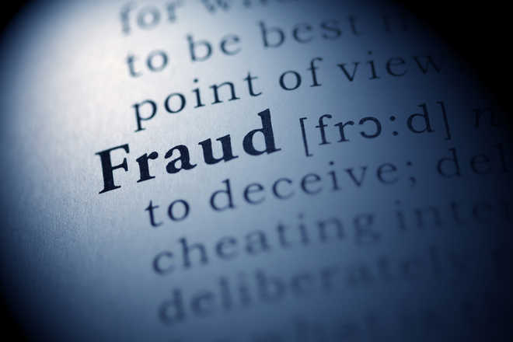
Publication Misconduct

Slide 2
Authorship
There is no universally agreed definition of authorship, although attempts have been made .As a minimum, authors should take responsibility for a particular section of the study.
(1) The award of authorship should balance intellectual contributions to the conception, design, analysis and writing of the study against the collection of data and other routine work. If there is no task that can reasonably be attributed to a particular individual, then that individual should not be credited with authorship.
(2) To avoid disputes over attribution of academic credit, it is helpful to decide early on in the planning of a research project who will be credited as authors, as contributors, and who will be acknowledged.
(3) All authors must take public responsibility for the content of their paper. The multidisciplinary nature of much research can make this difficult, but this can be resolved by the disclosure of individual contributions.

Slide 3
Peer Review
Peer reviewers are external experts chosen by editors to provide written opinions, with the aim of improving the study. Working methods vary from journal to journal, but some use open procedures in which the name of the reviewer is disclosed, together with the full or “edited” report
(1) Suggestions from authors as to who might act as reviewers are often useful, but there should be no obligation on editors to use those suggested.
(2) The duty of confidentiality in the assessment of a manuscript must be maintained by expert reviewers, and this extends to reviewers’ colleagues who may be asked (with the editor’s permission) to give opinions on specific sections.
(3) The submitted manuscript should not be retained or copied.
(4) Reviewers and editors should not make any use of the data, arguments, or interpretations, unless they have the authors’ permission.
(5) Reviewers should provide speedy, accurate, courteous, unbiased and justifiable reports.
(6) If reviewers suspect misconduct, they should write in confidence to the editor.
(7) Journals should publish accurate descriptions of their peer review, selection, and appeals processes.
(8) Journals should also provide regular audits of their acceptance rates and publication times.

Slide 4
The impact factor (IF) is a measure of the frequency with which the average article in a journal has been cited in a particular year. It is used to measure the importance or rank of a journal by calculating the times it's articles are cited.
Calculation of 2010 IF of a journal:
A = the number of times articles published in 2008 and 2009 were cited by indexed journals during 2010.
B = the total number of "citable items" published in 2008 and 2009.
A/B = 2010 impact factor
A citation index is a kind of bibliographic index, an index of citations between publications, allowing the user to easily establish which later documents cite which earlier documents. A form of citation index is first found in 12th-century Hebrew religious literature.
The index is based on a list of publications ranked in descending order by the number of citations these publications received. The value of h is equal to the number of papers (N) in the list that have N or more citations. Before you can calculate your h-index, you will need a complete publication list

Slide 5
The h-index is calculated by counting the number of publications for which an author has been cited by other authors at least that same number of times. For instance, an h-index of 17 means that the scientist has published at least 17 papers that have each been cited at least 17 times.
The advantage of the h-index is that it combines productivity (i.e., number of papers produced) and impact (number of citations) in a single number
Scopus-Abstaract and citation Database,Research Gate-European Social Networking Site,Google Scholar-Web search Engine

Slide 6
Ethical Issues/considerations in Research
The major ethical issues in conducting research are
Informed consent.
Voluntary participation.
Do no harm.
Confidentiality.
Anonymity.
Only assess relevant components.
Maintain Integrity of Research
Importance of Research and Publication Ethics
To treat all papers fairly and without bias during the review process.
To investigate any allegations made about articles, whether under peer review or already published, in line with industry standards.
A sign of trust.

Slide 7
Publication misconduct includes plagiarism, fabrication, falsification, inappropriate authorship, duplicate submission/multiple submissions, overlapping publication, and salami publication.
Scientific misconduct or Research Misconduct is the violation of the standard codes of scholarly conduct and ethical behavior in the publication of professional scientific research.
Research misconduct -The U.S. National Science Foundation defines three types of research misconduct: fabrication, falsification, and plagiarism.

Slide 8
Scientific Misconduct
It is the violation of the standard codes of Scholarly conduct and ethical behavior in the publication of professional scientific research.
Reasons of Scientific misconduct
According to David Goodstein of Caltech, there are motivators for scientists to commit misconduct, which are :-
Career pressure
Ease of fabrication

Slide 9
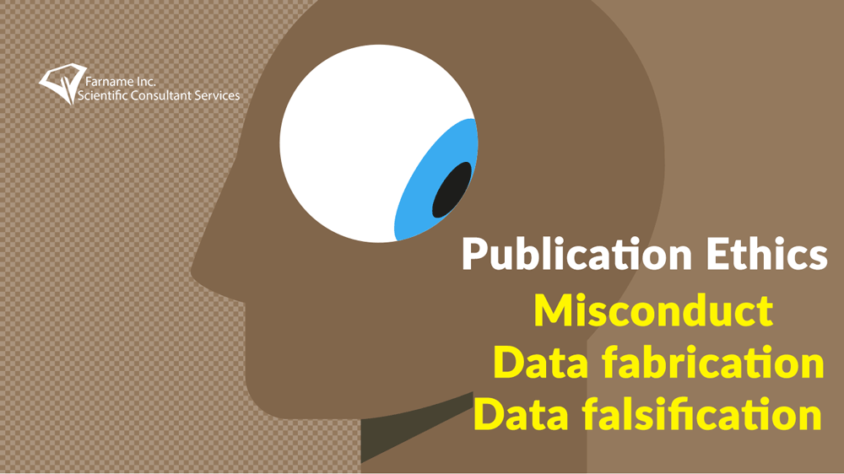
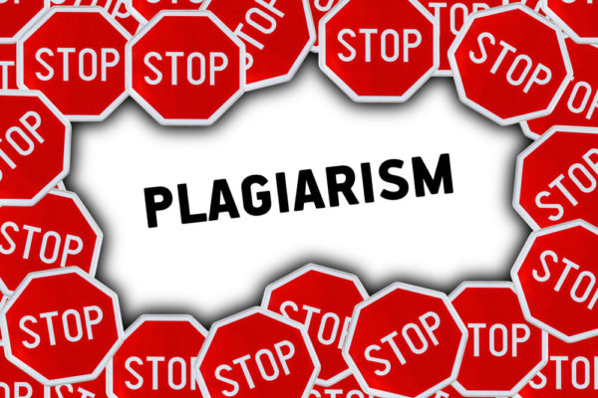
The U.S. National Science Foundationdefines three types of research misconduct: FFP (The Unholy Trinity of Scientific Writing)
Fabrication- छलरचना Making up results and recording or reporting them. This is sometimes referred to as "drylabbing
Falsification -फर्जीवाड़ा manipulating research materials, equipment, or processes or changing or omitting data or results such that the research is not accurately represented in the research record.
Plagiarism- साहित्यिक चोरी the appropriation of another person's ideas, processes, results, or words without giving appropriate credit. Plagiarism ranges from the unreferenced use of others’ published and unpublished ideas, including research grant applications to submission under “new” authorship of a complete paper, sometimes in a different language. It may occur at any stage of planning, research, writing, or publication: it applies to print and electronic versions.

Slide 10
TYPES OF SCIENTIFIC MISCONDUCT
1.Misappropriation of Ideas – / Fabrication -taking the intellectual property of others, perhaps as a result of reviewing someone else’s article or manuscript, or grant application and proceeding with the idea as your own.
Plagiarism – utilizing someone else’s words, published work, research processes, or results without giving appropriate credit via full citation.
Self-plagiarism – recycling or re-using your own work without appropriate disclosure and/or citation.
Impropriety of Authorship – claiming undeserved authorship on your own behalf, excluding material contributors from co-authorship, including non-contributors as authors, or submitting multi-author papers to journals without the consensus of all named authors.
Failure to Comply with Legislative and Regulatory Requirements – willful violations of rules concerning the safe use of chemicals, care of human and animal test subjects, inappropriate use of investigative drugs or equipment, and inappropriate use of research funds.

Slide 11
Violation of Generally Accepted Research Practices – this can include the proposal of the research study, manipulation of experiments to generate preferred results, deceptive statistical or analytical practices to generate preferred results, or improper reporting of results to present a misleading outcome.
Falsification of Data – rather than manipulate the experiments or the data to generate preferred results, this transgression simply fabricates the data entirely.
Failure to Support Validation of Your Research – by refusing to supply complete datasets or research material needed to facilitate validation of your results through a replication study.
Failure to Respond to Known Cases of Unsuccessful Validation Attempts – published research that is found to be flawed should be retracted from the journal that published it.
Inappropriate Behavior in Relation to Suspected Misconduct – failure to cooperate with any claims of misconduct made against you, failure to report known or suspected misconduct, destruction of any evidence related to any claim of misconduct, retaliation against any persons involved in a claim of misconduct, knowingly making false claims of misconduct.

Slide 12
Photo manipulation-it can frequently be detected by external parties.
splicing together different images to represent a single experiment
changing brightness and contrast of only a part of the image
any change that conceals information, even when it is considered to be aspecific, which includes:
changing brightness and contrast to leave only the most intense signal
using clone tools to hide information
showing only a very small part of the photograph so that additional information is not visible

Slide 13
Responsibility of journals
journal editors should consider retracting a publication if they have clear evidence that the findings are unreliable, either as a result of misconduct (e.g. data fabrication) or honest error (e.g. miscalculation or experimental error). Retraction is also appropriate in cases of redundant publication, plagiarism and unethical research.(COPE Guideline)
issuing an expression of concern if they receive inconclusive evidence of research or publication misconduct by the authors
Journal editors should consider issuing a correction if a small portion of an otherwise reliable publication proves to be misleading (especially because of honest error), or the author / contributor list is incorrect (i.e. a deserving author has been omitted or somebody who does not meet authorship criteria has been included).

Slide 14
Responsibility of Authors and of Co Authors
To check findings submitted to academic journals for publication.
Simultaneous submission of scientific findings to more than one journal or duplicate publication of findings is usually regarded as misconduct, under what is known as the Ingelfinger rule, named after the editor of the New England Journal of Medicine 1967-1977, Franz Ingelfinger.
Guest Authorship (where there is stated authorship in the absence of involvement, also known as gift authorship) and Ghost authorship (where the real author is not listed as an author) are commonly regarded as forms of research misconduct.
Authors are expected to keep all study data for later examination even after publication
Responsibilities of research institutions-In general, defining whether an individual is guilty of misconduct requires a detailed investigation by the individual's employing academic institution.
Responsibilities of uninvolved scientific colleagues-Some academics believe that scientific colleagues who suspect scientific misconduct should consider taking informal action themselves, or reporting their concerns.

Slide 15
Ethical guidelines for Journal Editors
We ask all journal editors to make every reasonable effort to adhere to the following ethical guidelines for articles submitted for peer review in journals:
Journal editors should give unbiased consideration to each manuscript submitted for publication. They should judge each on its merits, without regard to race, religion, nationality, sex, seniority, or institutional affiliation of the author(s).
Journal editors must keep the peer-review process confidential. They must not share information about a manuscript with anyone outside of the peer-review process.
If a journal editor receives a credible allegation of misconduct by an author, reviewer, or journal editor, then they have a duty to investigate the matter .
Journal editors may reject a submitted manuscript without formal peer review if they consider it to be inappropriate for the journal and outside its scope.

Slide 16
Journal editors should make all reasonable effort to process submissions on time.
Journal editors should delegate the peer review of any original self-authored research article to a member of the editorial or advisory board as appropriate.
If a journal editor receives convincing evidence that the main substance or conclusions of an article published in the journal are incorrect, then, the journal editor should ensure the publication of an appropriate notice of correction.
Any data or analysis presented in a submitted manuscript should not be used in a journal editor’s own research without the consent of the author.

Slide 17
International Ethics for Editors
"Editors are accountable and should take responsibility for everything they publish"
"Editors should guard the integrity of the published record by issuing corrections and retractions when needed and pursuing suspected or alleged research and publication misconduct"
"Editors should pursue reviewer and editorial misconduct "
"Editors should have appropriate policies in place for handling editorial conflicts of interest"
Guidelines developed at the 2nd World Conference on Research Integrity in Singapore, July 2010,

Slide 18
PUBLIATION MISCONDUCT
The US Office of Research Integrity defines Misconduct quite narrowly as:
"...fabrication, falsification, or plagiarism in proposing, performing or reviewing research, or in reporting research results"
Source: http://ori.hhs.gov/ misconduct/definition_misconduct.shtml

Slide 19
Types of Publication Misconduct
To respect the intellectual property rights of others and uphold the standards for academic publishing Publication Misconduct should not be tolerated.
1 Plagiarism: Plagiarism is the appropriation of another person's thoughts, ideas, data, figures, research methods, or words without giving appropriate credit, or the over-citation of another person's published work.
2 Fabrication: Fabrication is the practice of making up data or results without having performed relevant research.
3 Falsification: Falsification is the practice of changing data or results intentionally such that misleading conclusion is drawn.
4 Inappropriate authorship: Authorship is not appropriately assigned based on the author's contributions.

Slide 20
5 Duplicate submission/multiple submissions: Duplicate submission/multiple submissions refers to practice of submitting the same manuscript or several manuscripts with minor differences (e.g., differences only in title, keywords, abstract, author order, author affiliations, or a small amount of text) to two or more journals at the same time, or submitting to another journal within an agreed or stipulated period.
6 Overlapping publication: Overlapping publication refers to the practice of publishing a paper overlaps substantially with one already published.
7 Salami publication: Salami publication refers to the practice of slicing data from a large study,could have been reported in a single paper, into different pieces and publishing them in two or more articles, all of which cover the same population, methods, and question.
8 Inappropriate authorship: Authorship is not appropriately assigned based on the author's contributions.

Slide 21
Dealing with Misconduct
Principles
(1) The general principle confirming misconduct is intention to cause others to regard as true that which is not true.
(2) The examination of misconduct must therefore focus, not only on the particular act or omission, but also on the intention of the researcher, author, editor, reviewer or publisher involved.
(3) Deception may be by intention, by reckless disregard of possible consequences, or by negligence. It is implicit, therefore, that “best practice” requires complete honesty, with full disclosure.
(4) Codes of practice may raise awareness, but can never be exhaustive.

Slide 22
Investigating misconduct
(1) Editors should not simply reject papers that raise questions of misconduct.They are ethically obliged to pursue the case. However, knowing how to investigate and respond to possible cases of misconduct is difficult.
(2) COPE is always willing to advise, but for legal reasons, can only advise on anonymised cases.
(3) It is for the editor to decide what action to take.

Slide 23
Serious misconduct
(1) Editors must take all allegations and suspicions of misconduct seriously, but they must recognise that they do not usually have either the legal legitimacy or the means to conduct investigations into serious cases.
2) The editor must decide when to alert the employers of the accused author(s).
(3) Some evidence is required, but if employers have a process for investigating accusations—as they are increasingly required to do—then editors do not need to assemble a complete case. Indeed, it may be ethically unsound for editors to do so, because such action usually means consulting experts, so spreading abroad serious questions about the author(s).
4) If editors are presented with convincing evidence—perhaps by reviewers—of serious misconduct, they should immediately pass this on to the employers, notifying the author(s) that they are doing so.
(5) If accusations of serious misconduct are not accompanied by convincing evidence, then editors should confidentially seek expert advice.
(6) If the experts raise serious questions about the research, then editors should notify the employers.

Slide 24
(7) If the experts find no evidence of misconduct, the editorial processes should proceed in the normal way.
(8) If presented with convincing evidence of serious misconduct, where there is no employer to whom this can be referred, and the author(s) are registered doctors, cases can be referred to the General Medical Council.
(9) If, however, there is no organisation with the legitimacy and the means to conduct an investigation, then the editor may decide that the case is sufficiently important to warrant publishing something in the journal. Legal advice will then be essential.
(10) If editors are convinced that an employer has not conducted an adequate investigation of a serious accusation, they may feel that publication of a notice in the journal is warranted. Legal advice will be essential. (11) Authors should be given the opportunity to respond to accusations of serious misconduct

Slide 25
Less serious Misconduct
(1) Editors may judge that it is not necessary to involve employers in less serious cases of misconduct, such as redundant publication, deception over authorship, or failure to declare conflict of interest. Sometimes the evidence may speak for itself, although it may be wise to appoint an independent expert. (2) Editors should remember that accusations of even minor misconduct may have serious implications for the author(s), and it may then be necessary to ask the employers to investigate. (3) Authors should be given the opportunity to respond to any charge of minor misconduct. (4) If convinced of wrongdoing, editors may wish to adopt some of the sanctions decided upon by the authorities.

Slide 26
Consequences for those who expose misconduct
Persons who expose such cases, commonly called whistleblowers, find themselves open to retaliation by a number of different means.
Loneliness,Uncertainity for career,Get the reputation of troublemaker.No International body to protect their Rights

Slide 27
C.O.P.E (Committee on Publication Ethics )
COPE was founded in 1997 to address breaches of research and publication ethics. A voluntary body providing a discussion forum and advice for scientific editors, it aims to find practical ways of dealing with the issues, and to develop good practice.COPE is a charity registered in the United Kingdom (Registered Charity No 1123023, Registered in England and Wales, Company No 6389120). COPE is a member organisation which exists to educate and support editors, publishers and those involved in publication ethics with the aim of moving the culture of publishing towards one where ethical practices becomes the norm.
These guidelines should be useful for authors, editors, editorial board members, readers, owners of journals, and publishers for encouraging Intellectual honesty .
The guidelines were developed from a preliminary version drafted by individual members of the committee, which was then submitted to extensive consultation.
They address: study design and ethical approval, data analysis, authorship, conflict of interests, the peer review process, redundant publication, plagiarism, duties of editors, media relations, advertising, and how to deal with misconduct.

Slide 28
Conflict of Interest एक ऐसी स्थिति जिसमें अधिकारी का निर्णय उसकी व्यक्तिगत रूचि से प्रभावित हो
A situation in which the concerns or aims of two different parties are incompatible. Eg "the conflict of interest between elected officials and corporate lobbyists"
A situation in which a person is in a position to derive personal benefit from actions or decisions made in their official capacity.
A conflict of interest can occur when you (or your employer or sponsor) have a financial, commercial, legal, or professional relationship with other organizations, or with the people working with them, that could influence your research.
Conflicts of interest comprise those which may not be fully apparent and which may influence the judgment of author, reviewers, and editors. They have been described as those which, when revealed later, would make a reasonable reader feel misled or deceived. They may be personal, commercial, political, academic or financial.

Slide 29
"A conflict of interest is a set of circumstances that creates a risk that professional judgement or actions regarding a primary interest will be unduly influenced by a secondary interest.“
Primary interest refers to the principal goals of the profession or activity, such as the protection of clients, the health of patients, the integrity of research, and the duties of public Officer . Secondary interest includes personal benefit and is not limited to only financial gain but also such motives as the desire for professional advancement, or the wish to do favours for family and friends. These secondary interests are not treated as wrong in and of themselves, but become objectionable when they are believed to have greater weight than the primary interests. Conflict of interest mainly focus on financial relationships since they are relatively more objective, fungible, and quantifiable, and usually involve the political, legal, and medical fields.

Slide 30
Types of COI
Self-dealing
Nepotism
Gifts from friends who also do business with the person receiving the gifts or from individuals or corporations who do business with the organization in which the gift recipient is employed. Such gifts may include non-tangible things of value such as transportation and lodging.
Pump and dump, in which a stock broker who owns a security artificially inflates the price by "upgrading" it or spreading rumors, sells the security and adds short position, then "downgrades" the security or spreads negative rumors to push the price down.
Other improper acts that are sometimes classified as conflicts of interests may have better classification. For example, accepting bribes can be classified as corruption, use of government or corporate property or assets for personal use is fraud, and unauthorized distribution of confidential information is a security breach. For these improper acts, there is no inherent conflict.

Slide 31
COIs by Agent
COIs of journals -Journals are often not transparent about their institutional COIs, Journals often fail to provide information about the proportion of their income that derived from advertisements, reprints, and industry-supported supplements, citing policies on non-disclosure of financial information.
Owners and governing bodies -The owner of an academic journal has ultimate power over the hiring and firing of editorial staff;editors' interests in pleasing their employers conflict with some of their other editorial interests.Journals are also more likely to accept papers by authors who work for the journals' hosting institutions.

Slide 32
Some journals are owned by publishers. When journals print reviews of books published by their own publishers, they rarely add COI disclosures.The publishers' interest in maximizing profit will often conflict with academic interests or ethical standards. In the case of closed-access publications, publishers' desire for high subscription income may conflict with an editorial desire for broader access and readership.
Some journals are owned by academic societies and professional organisations. Leading journals can be very profitable and there is often friction about revenue between the journal and the member society that owns it.Some academic societies and professional organisations are themselves funded by membership fees and/or donations. If the owners benefit financially from donations, the journal has a conflict between its financial interest in satisfying the donors—and therefore the owners—and its journalistic interests.

Slide 33
Reprints
A reprint is a copy of an individual article that is printed and sold as a separate product by the journal or its publisher or agent.Reprints are often used in pharmaceutical marketing and other medical marketing of products to doctors. This gives journals an incentive to produce good marketing material. Journals sell reprints at very high profit margins, often around 70%, as of 2010. A journal may sell a million dollars worth of reprints of a single article if, for example, it is a large industry-funded clinical trial .The selling of reprints can bring in over 40% of a journal's income.
Impact factors, reputation, and subscriptions
If a journal is accused of managing COIs badly, its reputation is harmed. Some journals engage in coercive citation, in which an editor forces an author to add extraneous citations to an article to inflate the impact factor of the journal in which the extraneous papers were published.

Slide 34
Advertising-An interest in increasing advertising revenue can conflict with interests in journalistic independence and truthfulness.
Sponsored supplements-some journals publish supplements that often either cover an industry-funded conference or are "symposia" on a given topic. These supplements are often subsidized by an external sponsor with a financial interest in the outcome of research in that field; for instance, a drug manufacturer or food industry group. These Supplements are often not peer-reviewed to the same standard as the journal itself, and are more likely to use promotional language.
Publishers may not be strongly motivated to ensure the quality of their journals

Slide 35
COIs of journal staff
Personal conflicts of interest faced by journal staff are individual. If a person leaves the journal—unlike the COIs of journals as institutions—their personal COIs will go with them. Many journals have policies limiting COIs staff can enter into; for instance, accepting gifts of travel, accommodation, or hospitality may be prohibited.
COIs of Peer Reviewers
If a peer reviewer fails to disclose a conflict of interest, the paper will generally not be withdrawn, corrected, or re-reviewed; the reviews, however, may be reassessed. If peer reviewers are anonymous, their COIs cannot be published. Some experiments with publishing the names of reviewers have been undertaken; in others, the identities of reviewers were disclosed to authors, allowing authors to identify COIs.

Slide 36
Some journals now have an open review process in which everything, including the peer reviews and the names of the reviewers, and editor and author comment, is published transparently online.The duties of peer review may conflict with social interests or institutional loyalties; to avoid such COIs, reviewers may be excluded if they have some forms of COI, such as having collaborated with the author
COIs of Article Authors
Authors of individual papers may face conflicts with their duty to report truthfully and impartially. Financial, career, political, and social interests are all sources of conflict. Many journals require authors to self-declare their conflicts of interest when submitting a paper; they also ask specific questions about conflicts of interest. The questions vary substantially between journals

Slide 37
Complaints and Appeals
Journals should have a clearly described process for handling complaints against the journal, its staff, editorial board or publisher.
1) Who complains or makes an appeal? Submitters, authors, reviewers, and readers may register complaints and appeals in a variety of cases as follows: falsification, fabrication, plagiarism, duplicate publication, authorship dispute, conflict of interest, ethical treatment of animals, informed consent, bias or unfair inappropriate competitive acts, copyright, stolen data, defamation, and legal problem. If any individuals or institutions want to inform the cases, they can send a letter to editor. For the complaints or appeals, concrete data with answers to all factual questions (who, when, where, what, how, why) should be provided.
2) Who is responsible to resolve and handle complaints and appeals? The Editor, Editorial Board, or Editorial Office is responsible for them.
3) What may be the consequence of remedy? It depends on the type or degree of misconduct. The consequence of resolution will follow the guidelines of the Committee of Publication Ethics.

Slide 38
Authorship dispute during the Review process Case text (Anonymised):
During the review process for a manuscript submitted to our journal, one of the reviewers alerted us that the manuscript appeared to be the work of a collaborator (Dr X) who was not listed as an author on the paper. It became clear that the manuscript’s corresponding author (Dr Y, affiliation A) was a postdoctoral researcher supervised by Dr X (previously at affiliation A, recently moved to affiliation B). A third researcher, Dr Z, was an author on the manuscript and at an institution in a different country.
We asked Dr X whether they were aware of the manuscript from their postdoctoral researcher, Dr Y. Dr X was not aware and stated that Dr Y was funded solely by Dr X’s grant, and that they were working on a similar manuscript for submission elsewhere. Dr X requested that we withdraw the paper.
We asked Dr Y to confirm whether the author list on the paper was complete and to provide us with funding details. Dr Y replied that there were no other authors, and that the work was completely self-funded.
Question(s) for the COPE Forum
Should the journal contact the author's institution (and/or the supervisor's institution) to investigate?
Should the journal withdraw the manuscript from consideration at this stage, or wait for the results of an investigation?

Slide 39
Advice:
The editor updated the Forum that the journal had contacted the author's institution. It seems that the supervisor, Dr X, is in the process of moving to a new institution but is still at the same institution as the first author. The department chair said that they will look into the matter. The journal told Dr Y that they had contacted the institution and Dr Y asked to withdraw the paper. The journal withdrew the paper as requested but let the institution and author's postdoctoral advisor know that the paper had been withdrawn. The institution is continuing their investigation.
Author Y is stating that this work is under their own funding even though they put their affiliation as the institution where they are employed and supervised by Dr X. How should institutional affiliations be reported correctly or what constitutes a misrepresentation of an institutional affiliation? Perhaps there is some form of misrepresentation here. Editors should be able to validate whether affiliations that are reported by authors are real. They should be publicly verifiable.According to the American Psychological Association (APA), institutional affiliations should be included to the extent that the institutions have contributed substantially to the research being done or to the paper that is being produced from that research.
As Dr X stated they were working on a similar manuscript for submission elsewhere, withdrawal of the article seems a reasonable response by the journal.

Slide 40
Follow up:
The paper was withdrawn. The editor contacted the institution and they said that they are conducting their own investigation.
Resolution:
On-going
Year:
2019
Core practices:
Authorship and contributorship
Clear policies (that allow for transparency around who contributed to the work and in what capacity) should be in place for requirements for authorship and contributorship as well as processes for managing potential disputes
Post-publication discussions and corrections
Journals must allow debate post publication either on their site, through letters to the editor, or on an external moderated site, such as PubPeer. They must have mechanisms for correcting, revising or retracting articles after publication

Slide 41
Examples of Scientific Fraud Image Manipulation in a Published Article
Relates only to cases where concerns related to digital photographic images are raised (eg, duplication of parts within an image, or use of identical images to show different things.The Image manipulation flowchart offers guidance in steps to take when there is a suspicion of image manipulation, including who to contact and when to consider a retraction or correction.
A research group at the Department of Chemistry, Bose Institute, Kolkata, has 14 papers with suspected image manipulation and/or duplication. Two papers have been retracted and two more have been corrected for image manipulation
Core practices:
Journal management
A well-described and implemented infrastructure is essential, including the business model, policies, processes and software for efficient running of an editorially independent journal, as well as the efficient management and training of editorial boards and editorial and publishing staff

Slide 42
Post-publication discussions and corrections
Journals must allow debate post publication either on their site, through letters to the editor, or on an external moderated site, such as PubPeer. They must have mechanisms for correcting, revising or retracting articles after publication

Slide 43
IIM Ahmedabad
On 17 August 1992, a student complained to the Director IIM "While doing my summer project, I had to do some modelling and data analysis. I had carried my copies of Levin (Statistics for Management), and Baumol (Economic Theory and Operations Analysis) along. From the organisation I was in, I borrowed copies of Wagner (Principles of Operations Research) and Quantitative Techniques for Managerial Decisions by U. K. Srivastava (a CMA Prof. at IIMA), G. V. Shenoy, and S. C. Sharma. As I was browsing through the books, I came across a most interesting thing. At several places, the Srivastava, Shenoy, Sharma book had simply lifted stuff from the other three books (Baumol, Levin, and Wagner) and no references anywhere in the book". Upon enquiry a Committee, based on a report by a student, found that the book Quantitative Techniques for Managerial Decisions by U. K. Srivastava, G. V. Shenoy, and S. C. Sharma had copied without acknowledgment of the source at least at 10 different places including 5 foreign books and some other Indian books, such as Baumol, Levin and Wagner (all books were published prior to the publication of the book)

Slide 44
Prof. B.S. Rajput controversy
The most high-profile and widely publicised controversy in India has been that of Prof. B. S. Rajput and colleagues in the field of Theoretical Physics.
Prof. B.S. Rajput was the vice-chancellor of Kumaon University, India in 2002 when various physicists in India started a website alleging that some of his papers claimed authorship of work, reported earlier by other researchers.The principal allegation was that a paper published by S.C. Joshi and B.S. Rajput entitled "Axion-dilaton black holes with SL(2,Z) symmetry through APT-FGP model" in Europhysics Letters, Vol. 57, No. 5, was entirely copied from a six-year-old paper by Renata Kallosh of Stanford in Physical Review D,, Vol 54, No. 8. However, the campaign very soon included three other papers by Prof. Rajput and colleagues as plagiarised papers.

Slide 45
On publication of the site, Prof. Rajput threatened to take legal action against the website, maintaining that the paper was written by Mr. Joshi, one of his students, without prior approval from him.However, the site was endorsed by over 40 Indian physicists. In addition, seven physicists wrote to the president of India, APJ Abdul Kalam requesting an investigation in this matter. The situation became murkier when Prof Kavita Pandey, head of the Physics department at Kumaon University claimed that she was suspended by the university as she brought this issue to the public.
In midst of all this blame game, the president of India asked the Governor of Uttaranchal who was also the chancellor of the Kumaon University to institute an enquiry to investigate the case. The committee led by a retired judge of Allahabad high court Justice S.R. Singh consisted of Prof K.B. Powar, former chief of the Association of Indian Universities , New Delhi, Prof Indira Nath, former secretary of the Society of Scientific Values and AIIMS faculty member and physicist Prof R. Rajaraman of JNU. The committee presented its report in February 2003 upholding the plagiarism charges.Prof. Rajput maintained that he has personally done no harm and it was his student's fault. However, he resigned from Vice-chancellorship immediately after the report.

Slide 46
Prof. P. Chiranjeevi controversy
Chemistry professor of Sri Venkateswara University (SVU) is accused of plagiarising more than 70 research papers published between 2004 and 2007. University Executive Council has banned him from undertaking examination work and research guidance. He has been debarred from securing further promotions and appointments to administrative positions.
Dr. Sanjeeb Kumar Sahoo controversy
Dr. S.K. Sahoo is a scientist in the field of nanotechnology (cancer drug delivery) at the Institute of Life Sciences (an autonomous institute of the Department of Biotechnology, Govt. of India) located in Bhubaneswar, India.There have been serious concerns related to the accuracy of the data presented in many articles published by him. According to a notice published in the June 2013 issue of the journal Acta Biomaterialia, five research articles published by Dr. S.K. Sahoo have been retracted following highly unethical practices such as serial self plagiarism, data manipulation and falsification of results

Slide 47
Take Away
Unlike ORI, India lacks an effective statutory body to deal with research misconduct in the academia and the cases are often dealt in ad-hoc fashion. The Society for Scientific Values (SSV) is an independent body of scientists with the goal of upholding ethics in the Indian Scientific community and is India's only watchdog group against research misconduct. The SSV does not have legal powers and cannot go ahead until the university acknowledges it or the scientist accepts misconduct.
It is important to create awareness among the scientific writers toward what constitutes academic misconduct and plagiarism. Universities, journal editors and academia must educate the young researchers to follow the ethos and values of academic honesty and integrity.Lack of awareness about research ethics and lack of language skills lead to indulgence in plagiarism.
. Database of all cases of plagiarism is required to be maintained with disclosure of all blacklisted plagiarists to name and shame them

Slide 48
Increasing pressure to publish, deficient training in ethical scientific writing, ignorance, oversight and lack of statutory controls and clear policies to deal with scientific misconduct in academics has led to the rise of research misconduct which can severely impact growth of India's higher education system
Linking publications to individual's professional growth, academic promotions, and pay cheques have resulted in unethical publishing and indulgence in plagiarism
It is important to create awareness among the scientific writers toward what constitutes academic misconduct and plagiarism. Universities, journal editors and academia must educate the young researchers to follow the ethos and values of academic honesty and integrity
Young Scholars should rely on the tenets of ethical education, scientific self-confidence, sound knowledge and scientific curiosity

Slide 49
Acknowledgements and Courtsey
Wikipedia
https://en.wikipedia.org/wiki/Scientific_plagiarism_in_India#:~:text=India%20does%20not%20have%20a,being%20followed%20in%20different%20cases
https://en.wikipedia.org/wiki/Conflicts_of_interest_in_academic_publishing
Telegraph 13.6.2020 (Electronic)
Tribune 19.6.19 (Electronic)
https://www.ndpublisher.in/publicationconduct.php

Slide 51
Group Discussion

Slide 52
Group A

Slide 53
Group B

Slide 54
Group C

Slide 55
Group D

Slide 56
Questions
Q.1 How can the Academia detect Balloon Professors who use their scholars as Ladders and credit without any contribution?
Q.2 Why should we declare COI in Publication?
Q.3 Is there any statutory body to regulate Scientific and Publication Misconduct in India? Why do we need it ?
Q.4 How do u think that the problem of Publication and Research Misconduct be solved?

