Slide 1
PUBLICATION ETHICS

Slide 5
WHY PUBLISH RESEARCH PAPER?
WITHOUT PUBLICATIONS RESEARCH WORK DOES NOT PROGRESS
WITHOUT PUBLICATION YOU MAY NOT GET PROMOTION OR PLACEMENT.
YOU MAY NOT GET YOUR PROJECT SANCTIONED , IF YOU HAVE NO PUBLICATIONS.
PUBLICATIONS KEEP YOU AHEAD FROM YOUR COLLEAGUES.

Slide 6
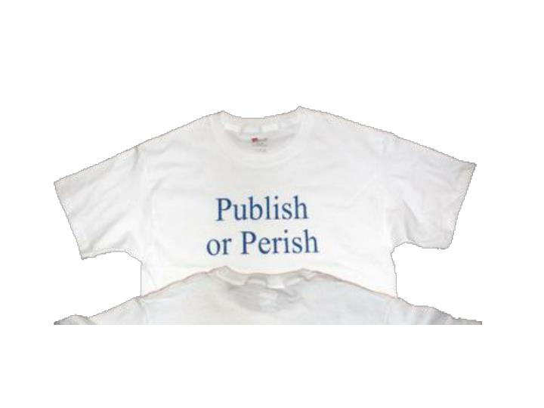

Slide 9
REASONS FOR DIFFICULTY IN WRITING RESEARCH PAPER
LIMITED AWARENESS REGARDING THE IMPORTANCE OF RESEARCH PAPER
NO TRAINING IS GIVEN TO SCHOLARS FOR SCIENTIFIC WRITING OF RESEARCH PAPER
DIFFERENCES BETWEEN THE MAGAZINES , BOOKS, JOURNALS AND NEWSLETTERS ARE NOT KNOWN TO STUDENTS.
NOT AWARE OF THE IMPORTANT GUIDELINES OF PARTICULAR JOURNAL

Slide 12
WHAT IS GOOD JOURNAL?
MUST BE AVAILABLE ONLINE
SEARCHABLE, EASY TO LOCATE, SHARE
MUST BE PEER REVIEWED ( REFEREED)
MUST BE INDEXED WITH SOME WIDELY CONSULTED DATABASE LIKE UGC, WEB OF SCIENCE, SCOPUS ETC
GOOGLE SCHOLAR IS NOT A INDEXING DATABASE

Slide 13
BETTER JOURNALS
HAS A GOOD IMPACT FACTOR
NATIONAL/ INTERNATIONAL
MUST BE OPEN ACCESS JOURNAL
TAKES MINIUM TIME FOR EDITORIAL DECISION
PROVIDES EASY ONLINE SUBMISSION PROCESS
NO ARTICLE PROCESSING FEE, COLOR PRINTING CHARGES, REPRINT CHARGES, SUBMISSION FEE ETC.

Slide 14
BE CAREFUL ABOUT……….
FAKE IMPACT FACTOR JOURNALS
AUTHOR HAVE TO PAY FEES FOR RESEARCH PAPER PRINTING
FAKE PEER REVIEW PROCESS
DON’T BELIEVE ON “ CALL FOR PAPERS”
CLAIMS AS INDEXED IN “ ELSEVIER”

Slide 15
BOGUS JOURNALS …….
GLOBAL IMPACT FACTOR
UNIVERSAL IMPACT FACTOR
INTERNATIONAL IMPACT FACTOR
INTERNATIONAL SCINTIFIC INDEXING
DIRECTORY OF JOURNAL QUALITY FACTOR

Slide 16
AT WHICH STAGE YOU CAN PUBLISH RESEARCH PAPER?
YOU HAVE COMPLETED YOUR STUDY METHODICALLY, DATA ANALYSIS IS OVER AND YOU HAVE ORIGINAL RESULTS WITH YOU.
YOU HAVE MADE SOME OBSERVATIONS THAT ADDS SIGNIFICANTLY TO THE EXISTING KNOWLEDGE
YOU HAVE SOME UNIQUE AND DIFFERENT EXPLANATION TO SOME IMPORTANT TOPIC

Slide 17
IMPORTANT THINGS FOR WRITING MANUSCRIPT
YOU HAVE TO FOLLOW ALL THE STANDARD GUIDELINES
YOU HAVE ETHICAL CLEARENCE/ ALL THE ORIGINAL DATA / PHOTOGRAPHS/ SLIDES/ QUESTIONIRE WITH YOU
YOU HAVE EXECUTED STUDY AS PER PROTOCOLS

Slide 18
IMPORTANT THINGS FOR WRITING MANUSCRIPT
YOU HAVE LICENCE OR PERMISSION FOR REPRODUCING PICTURES AND FIGURES
YOU HAVE NO CONFLICT OF INTEREST FOR PUBLISHING RESULTS
YOU HAVE SELECTED THE JOURNAL IN WHICH YOU WANT TO PUBLISH YOUR PAPER

Slide 19
AUTHORSHIP NEEDS…….
ORIGINALITY MEANS NO PLAGIARISM
INTEGRITY, HONESTY, OBJECTIVITY
TRANSPARENCY
IPR
DECLARING NO CONFLICT OF INTEREST
COPYRIGHT AGREEMENT
RESPONSIBILITY FOR CORRECTIONS/ WITHDRAWING / RETRACING ETC.

Slide 20
DUTIES OF DIFFERENT COAUTHORS
FIRST AUTHOR- THE ONE , WHO HAS CARRIED OUT ACTUAL WORK AND HAS WRITTEN THE MANUSCRIPT
CORRESPONDING AUTHOR- HE IS SENIOR MOST OR LAST AUTHOR , WHO ORIGINALLY CONCIVED THE STUDY, PLANNED IT AND APPROVED THE FINAL MANUSCRIPT TO BE PUBLISHED

Slide 21
DUTIES OF DIFFERENT COAUTHORS
SECOND/ THIRD AUTHORS- WHO HELPED IN CARRYING OUT THE WORK AND ALSO IN MANUSCRIPT PREPARATION
THOSE WHO CONTRIBUTED TO YOUR STUDY , BUT DID NOT HELP YOU IN WRITING THE MANUSCRIPT. YOU INCLUDE THEIR NAMES IN ACKNOWLEDGEMENT.

Slide 22
IF YOUR MANUSCRIPT IS REVISED
EDITOR OF THE JOURNAL WILL COMMUNICATE YOU ABOUT REFEREES COMMENT
READ CAREFULLY ALL THE COMMENTS
DON’T BE IN A HURY TO RE SUBMIT THE PAPER
REVISE MANUSCRIPT AS PER THE COMMENTS OF REVIEWER
HIGHLIGHT THE CHANGES IN THE MANUSCRIPT WITH YELLOW COLOUR

Slide 23
VIOLATION OF RESEARCH PAPER PUBLICATION ETHICS
GERMAN RESEARCH FUNDING AGENCY 1998 CASE
BRITISH JOURNAL CASE 1996
US NATIONAL SCIENCE FOUNDATION CASE
GEOLOGY INDIA CASE

Slide 24
BEST PRACTICES FOR AUTHORSHIP
DISCUSS THE ORDER OF AUTHORSHIP IN BEGINNING
REVISIT DECISIONS OF AUTHORSHIP .IF RESPONSIBILITIES CHANGES.
DISCLOSE IF ANY WRITING DONE BY PROFESSIONAL WRITERS.
DOCUMENT EVERYTHING IN WRITING.
ALL AUTHORS TAKE RESPONSIBILITY FOR CONTENT.

Slide 25
ITHNENTICATE POLICY
15% SIMILARITY ALLOWED
16-30% AUTHOR INVITED TO REVISE
31-50% PAPER REJECTED
OVER 50% - PAPER REJECTED AND AUTHOR ASKED FOR EXPLANATION

Slide 26
WHAT IS CONFLICT OF INTEREST?
A SET OF CONDITIONS IN WHICH PROFESSIONAL JUDGEMENT CONCERNING A PRIMARY INTEREST
( SUCH AS THE VALIDITY OF RESEARCH STUDY) TENDS TO BE UNDULY INFLUENCED BY SECONDARY INTEREST ( SUCH AS FINANCIAL GAIN)
THEY MAY BE COMMERCIAL, PERSONAL, ACADEMIC, POLITICAL OR FINANCIAL.

Slide 27
MISCONDUCT
FAILURE TO SUBMIT CONFLICT OF INTEREST
MULTIPLE SUBMISSIONS
DUPLICATE PUBLICATION
BOGUS REVIEWERS
GUEST AUTHORSHIP FOR EARLY PUBLICATION
GHOST AUTHORSHIP
ANONYMOUS AUTHORSHIP
SURROGATE AUTHORSHIP
GIFT AUTHORSHIP

Slide 28
SALAMI SLICING
PUBLISHING THE SAME DATA IN DIFFERENT FORMS
EDITORS RESPONSIBILITIES
JOURNAL OWNER RESPONSIBILITIES
PUBLISHERS RESPONSIBILITIES
REVIEWERS RESPONSIBILITIES

