Slide 1



Apple Creek School
Community Survey Report
March 9, 2026

Slide 2





Contents
Background Info
Survey/Respondent Information
Results & Analysis
Wrap-up/Questions

Slide 3

Our mission is to help educational leaders gather, organize, and use data to make strategic decisions.
Founded in 2002 to provide independent research
Conducted over 3 million staff, parent, and student, and community surveys for school improvement
Helped more than 1,400 school districts navigate the strategic planning and referendum planning process

Slide 4
Survey Information
February 23rd, 2026 survey deadline
161 respondents
43.4% response rate

Slide 5
What is your age?
Notes:
65+:
55-64:
45-54:
35-44:
25-34:
18-24:

Slide 6
Is your primary residence in the
Apple Creek School District?

Slide 7
Respondent Information
Are you an employee of
Apple Creek School?
Do you have children attending Apple Creek School?

Slide 8
How would you like to receive information from us?

Slide 9
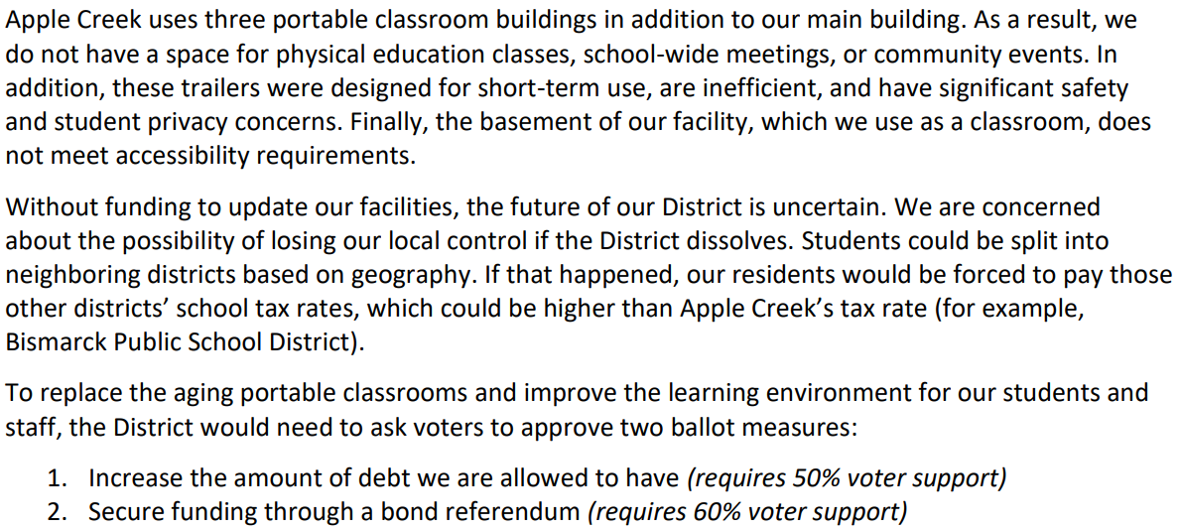
Facility Challenges

Slide 10
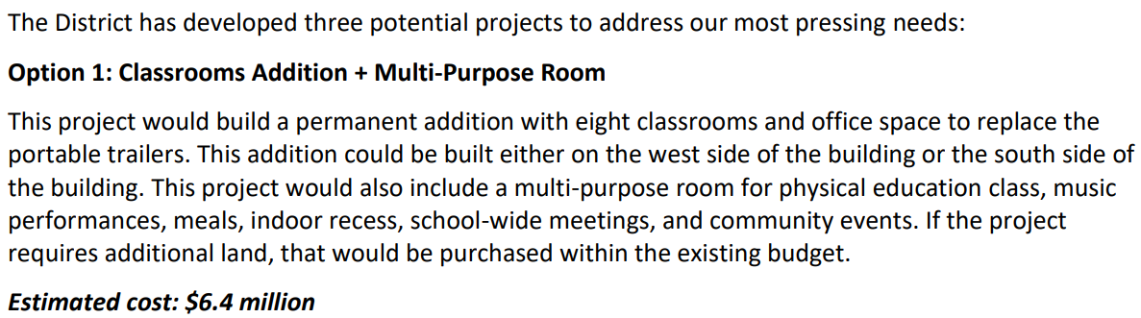
Potential Projects

Slide 11
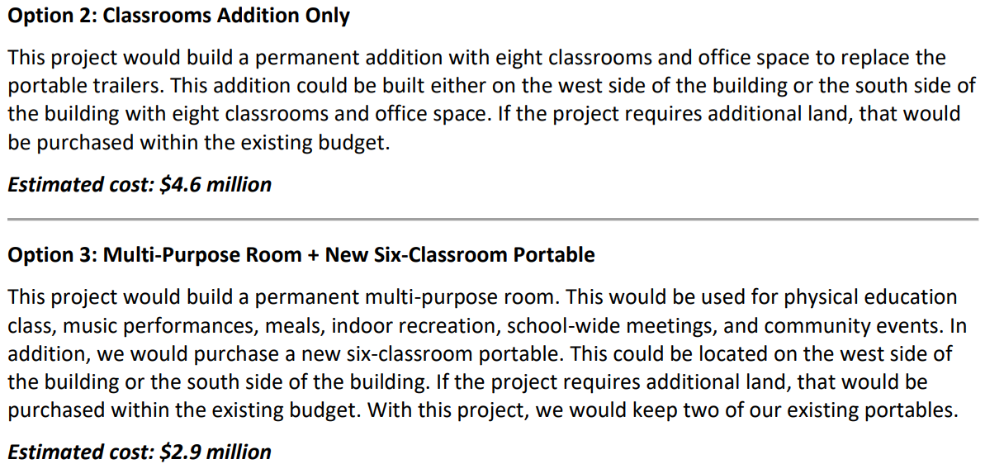
Potential Projects

Slide 12
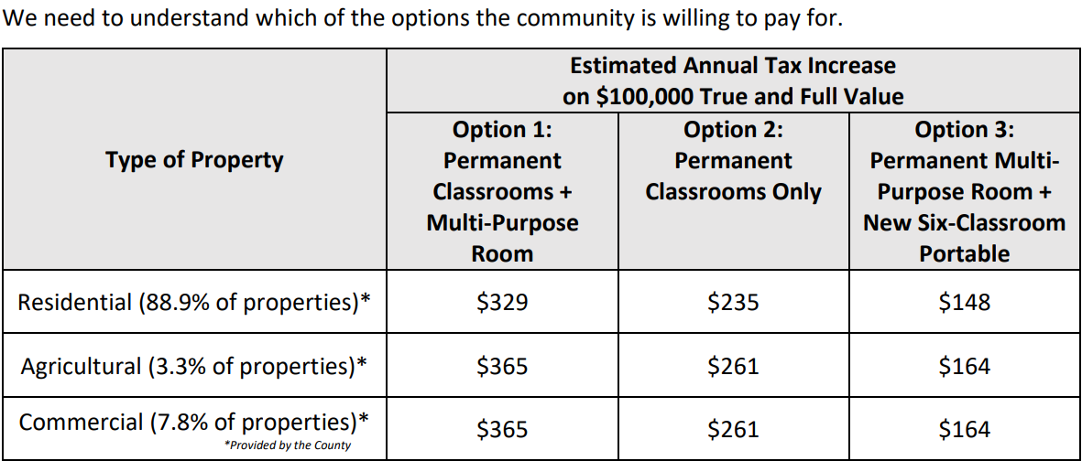
Funding Support

Slide 13
Which option(s) would you support through a bond referendum?

Slide 14
Additional Analysis: Bond referendum options
Weighted support for Definitely yes and Probably yes:
Option 1: 0.30 (53%) + 0.70 (15%) = 26.4%
Option 2: 0.30 (20%) + 0.70 (4%) = 8.8%
Option 3: 0.30 (27%) + 0.70 (30%) = 29.1%

Slide 15
How is the District doing in each of the following areas? Great = 4, Good = 3, Fair = 2, Poor = 1
Item | Staff | Parents | Non-Parents/ Non-Staff
Delivering a high-quality education | 3.67 | 3.50 | 3.07
Keeping the public informed | 3.33 | 2.88 | 2.11
Managing funds appropriately | 3.60 | 3.21 | 2.72
Building pride in the community | 3.33 | 3.19 | 2.47

Slide 16
How is the District doing in each of the following areas? Great = 4, Good = 3, Fair = 2, Poor = 1
Item | Percent “Great” or “Good” | Average
Delivering a high-quality education | 87% | 3.32
Keeping the public informed | 49% | 2.46
Managing funds appropriately | 71% | 3.01
Building pride in the community | 66% | 2.79

Slide 17
On a scale of 0 – 10, how likely would you be to recommend the District to a friend or family member?
Apple Creek Score: 6.13

Slide 18


