Slide 1
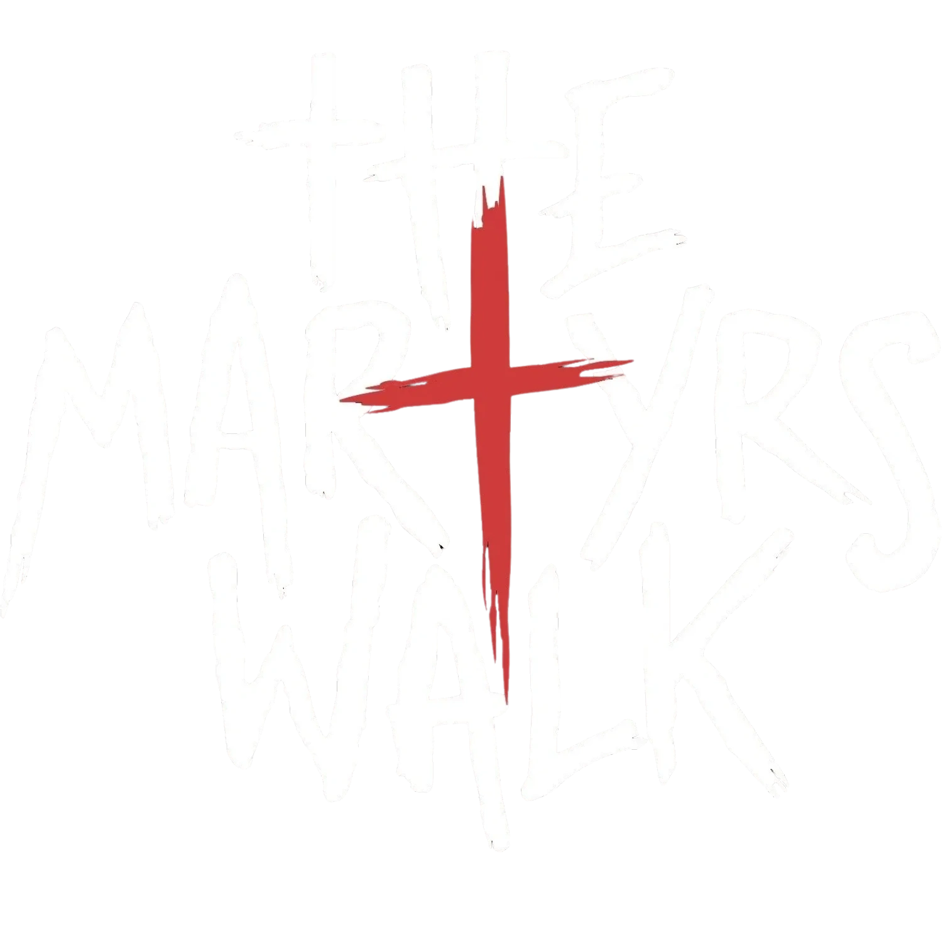
Reclaiming Christian
Masculinity
Die to Sin.
Die to Self.
Live For God.
01
Notes:
Welcome and introduce the mission. Establish the challenging motto immediately. Explain that the Walk is an intensive experience for men seeking profound change. The full presentation title is The Martyrs’ Walk: Reclaiming Christian Masculinity.
Content: user-provided presentation outline. Official program reference and logo: https://themartyrswalk.com/ . Image source: official website.

Slide 2
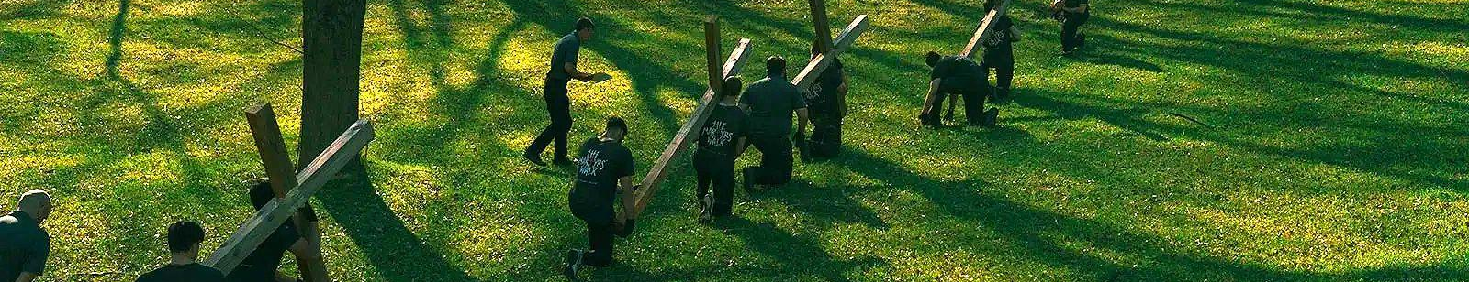
What is The Martyrs’ Walk?
THE MARTYRS' WALK is an intensive bootcamp styled retreat experience for men that will include mental, physical, and spiritual exercises that will push you beyond your perceived abilities.
In Brotherhood
In Christ
For Life
Lifelong bonds with men who challenge you and pray for you.
Suffering and prayer deepen your relationship with God.
Lead, protect, and provide for your family and community.
02
Notes:
The purpose is to help men tap into their God-given potential and develop discipline for authentic leadership. In Brotherhood: lifelong bonds with action-oriented men who challenge and pray for one another. In Christ: a deeper relationship with the Creator, connecting suffering and prayer for sanctification. For Life: lead, protect, and provide for families and communities. Photo: official website, blob-53e0c27.png.
Content: user-provided presentation outline. Official program reference and logo: https://themartyrswalk.com/ . Image source: official website.

Slide 3
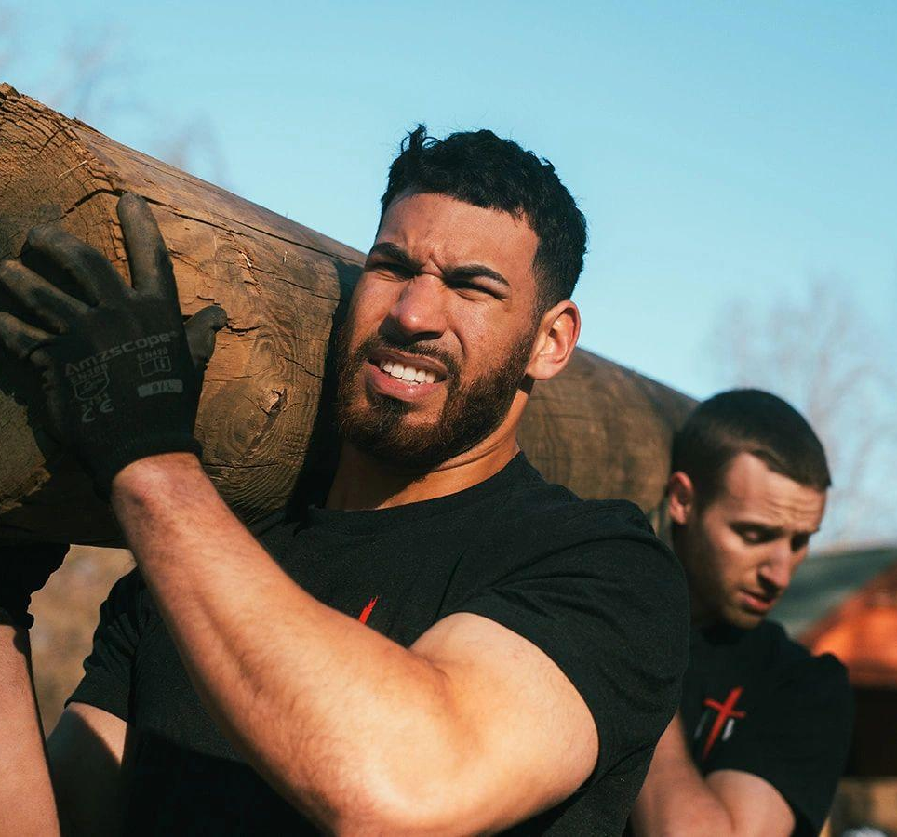
The Challenge: Why Men Need the Walk
Complacency & mediocrity
Settling for “good enough” in faith, family, and personal life.
Vices & isolation
Battles with lust, pornography, alcohol, and pride without accountable brothers.
Lack of presence
Work and technology crowd out attention to God and family.
03
Notes:
The struggle is real. Men face difficult barriers in faith, family, and personal life. Discuss complacency, mediocrity, being tired of routine, lust, pornography, alcohol, pride, and isolation. Noise from work and technology can prevent emotional and spiritual presence at home. The Walk addresses these struggles through faith and accountable brotherhood. Photo: https://themartyrswalk.com/ (themartyrswalk-221.jpg).
Content: user-provided presentation outline. Official program reference and logo: https://themartyrswalk.com/ . Image source: official website.

Slide 4
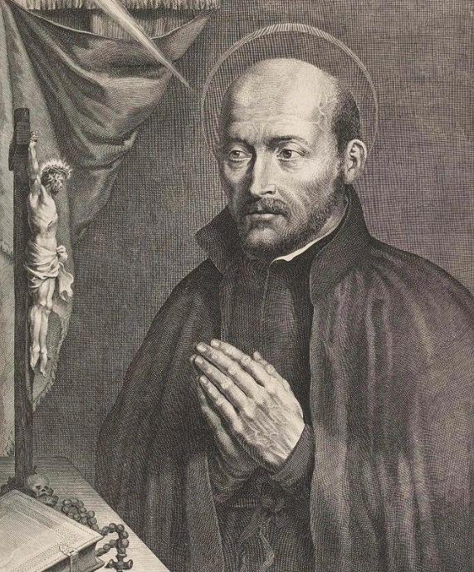
The Formula: Ignatian Retreat
Meets Military Boot Camp
DEATH - JUDGEMENT - HEAVEN - HELL
Military discipline
Physical rigor and mental trials push you beyond perceived limits. The vehicle to engage the body.
Ignatian spirituality
Prayer, discernment, and spiritual exercises confront sin. The vehicle to engage the soul.
The only competition is yourself.
04
Notes:
The Martyrs’ Walk is a three-day experience of virtual martyrdom, an in-person journey of mental, physical, and spiritual challenges. Military discipline includes extreme fitness and mental trials adapted to perceived limitations. Ignatian spiritual exercises focus on discernment, prayer, and confronting sin. The only competition is yourself. The journey confronts barriers placed by the world, the flesh, and the devil. Reference: https://themartyrswalk.com/the-walk . Photo: official website, St I.jpg.
Content: user-provided presentation outline. Official program reference and logo: https://themartyrswalk.com/ . Image source: official website.

Slide 5
The Method: Prayer, Discipline, Brotherhood
01
02
03
Prayer
Discipline
Brotherhood
Life of the soul
Mind & Body
Accountability & Support
You will learn to create a structured prayer life by intentional, ordered, and personal prayer which is designed to help you draw closer to Christ to gain confidence as a son of God according to your state in life.
The maxim grace builds upon nature is fostered by an environment of discipline which will help you master your appetites, vices, and complacency through physical training and acts of mortification.
Leave this retreat with a stronger bond alongside like-minded men who will support and pray for you. Giving you virtuous friendships that will hold you accountable on your journey to sainthood.
05
Notes:
Pillar 1, Discipline (Mind & Body): a structured and ordered prayer life. Master appetites and vices through physical acts of mortification. Grace builds upon nature. Pillar 2, Brotherhood (Accountability & Support): move beyond group chats and memes to real camaraderie, accountability, and men who literally have your back. Pillar 3, Spiritual Focus (The Weight of Sin): encounter death, judgment, and the weight of sin, opening the eyes to the role of a Christian man. The official website names its pillars Prayer, Brotherhood, and Discipline. This slide follows the requested thematic organization.
Content: user-provided presentation outline. Official program reference and logo: https://themartyrswalk.com/ . Image source: official website.

Slide 6
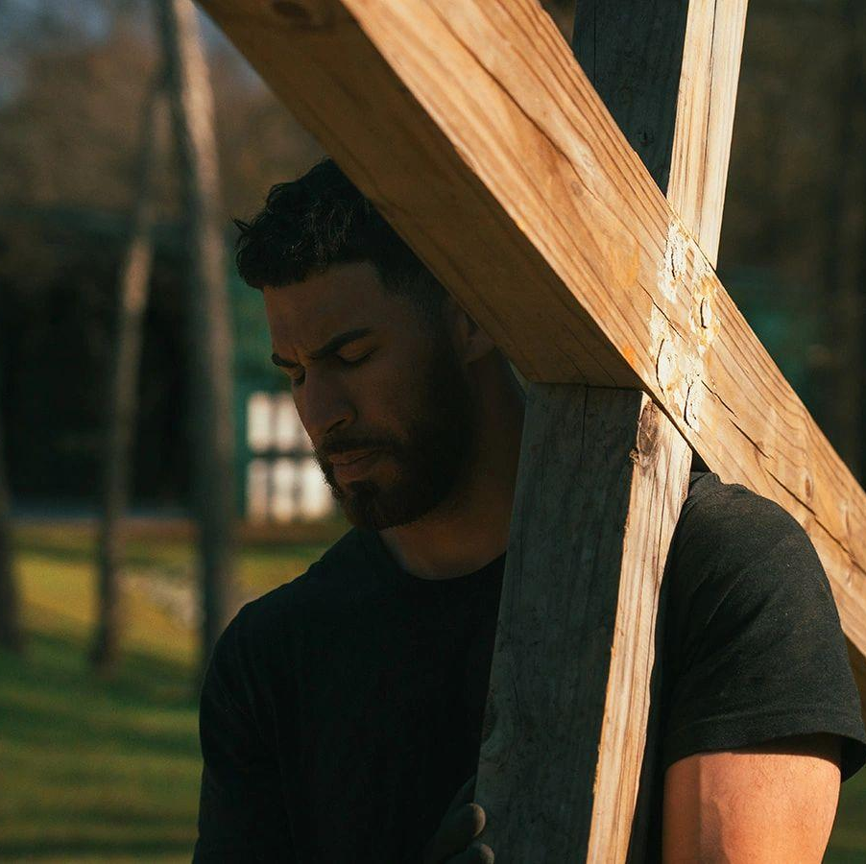
Carry Your Cross Daily and Follow Me
“If any man will come after Me,
let him deny himself, and take up
his cross daily, and follow Me.”
Luke 9:23
Deny thyself
Offer suffering as prayer for others and for your own growth.
Surrender to God beyond your own strength.
06
Notes:
Root the Walk in Luke 9:23. Read the verse on the slide. Deny thyself: turn suffering and physical pain into intentional prayer for others and personal sanctification. Surrender: physical and mental exhaustion reveals the need to rely on God instead of self-will or physical strength alone. The language of virtual martyrdom is a retreat metaphor for dying to sin and self. Photo: official website, themartyrswalk-25.jpg.
Content: user-provided presentation outline. Official program reference and logo: https://themartyrswalk.com/ . Image source: official website.

Slide 7
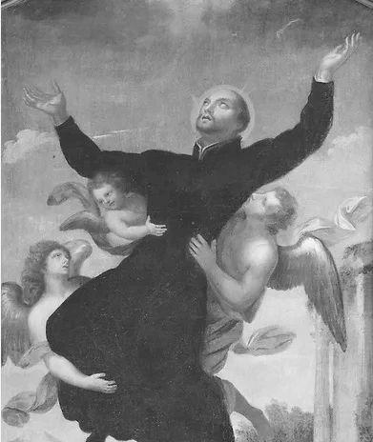
The Origin: From Brokenness to Purpose
JASON MURPHY, FOUNDER
Brokenness
Childhood hardship, abuse, addiction, and suicidal thoughts. Lead to isolation and brokenness.
Conversion
A return to Catholic faith through reverence, tradition, and beauty. Introduced to Ignatian Retreat.
Discipleship
As Faith increased became active in service, leadership, and men’s ministries. K of C & Catholic Men’s Conference.
PURPOSE
February 2023: The Martyrs’ Walk begins
07
Notes:
Jason Murphy’s story: a difficult childhood marked by divorced parents and abuse led to addiction, depression, and suicidal thoughts. A friend helped him through this crisis and invited him back to church. He encountered reverence, tradition, and beauty, beginning a reversion to the Catholic faith. His discernment later included religious formation, marriage, family, and a real estate development career. He served in the Knights of Columbus and hosted The Obligation radio show. Though busy and professionally successful, he sensed God calling him to more purposeful work. After prayer and discernment, The Martyrs’ Walk began in February 2023. Reference: https://themartyrswalk.com/the-walk . Symbolic artwork, not a founder portrait: official website, blob-3cbaf39.png.
Content: user-provided presentation outline. Official program reference and logo: https://themartyrswalk.com/ . Image source: official website.

Slide 8
The Proof: What Men Gain from the Walk
Found brotherhood
“I knew that on the other side of it was a brotherhood that I so desperately seek.”
Spiritual awakening
“The Walk really opened up my eyes about my role as a Catholic man and what God wants us to do.”
Relying on God
“I found that I was relying on myself too much.”
Deeper faith, conviction, and conversion.
08
Notes:
The following quotations are supplied by the user’s outline. Speaker identities and exact source recordings were not supplied, so do not attribute these quotations to specific participants. Found Brotherhood: “I knew that on the other side of it was a brotherhood that I so desperately seek.” Spiritual Awakening: “The Walk really opened up my eyes about my role as a Catholic man and what God wants us to do.” Relying on God: “You realize you have to surrender to God. He’s with you in your prayer... I found that I was relying on myself too much.” Conviction: stronger faith, including for non-Catholics in RCIA/OCIA. Official testimonial videos are available at https://themartyrswalk.com/ .
Content: user-provided presentation outline. Official program reference and logo: https://themartyrswalk.com/ . Image source: official website.

Slide 9
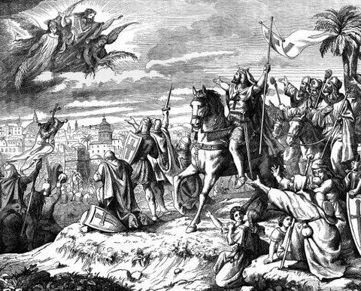
Be Ready: The Courage the Church Demands
No more excuses.
Prepare for the daily “white martyrdoms”:
small acts of virtue and dying to self.
The world needs God-fearing men
with discipline and confidence.
YOUR CHURCH, THE WORLD,
& YOUR FAMILY DESERVE IT.
09
Notes:
The retreat calls serious Christian men to stop making excuses and take a leap of faith. Explain white martyrdom as daily self-denial and acts of virtue, preparing the heart for greater sacrifice. The Church and family deserve faithful men with discipline, courage, and confidence. The strong call to responsibility is the message. Photo: official website, Crusaders-0b77dbb.jpg, historical spiritual warfare imagery.
Content: user-provided presentation outline. Official program reference and logo: https://themartyrswalk.com/ . Image source: official website.

Slide 10

Will you be ready?
Die to Sin. Die to Self. Live For God.
TheMartyrsWalk.com
Apply online. Begin discernment. Follow upcoming dates.
info@themartyrswalk.com
10
Notes:
Repeat the motto: Die to Sin. Die to Self. Live For God. Invite men to visit TheMartyrsWalk.com for details and resources. Complete the online application or registration to begin the discernment process. Follow the official website for upcoming Walk dates. The outline describes the Walk as highly selective, but the official website emphasizes access for every serious Christian man, including scholarships, so the slide avoids an unsupported exclusivity claim. General email verified on the official Fund contact page: https://themartyrswalkfund.org/contact .
Content: user-provided presentation outline. Official program reference and logo: https://themartyrswalk.com/ . Image source: official website.

