Slide 1
Saul, Paul and Acts
Exploring who, where and when in ACTS

Slide 2
Saul, Paul and Acts
Place events in History
  Fulfilled prophecy becomes human history
Be familiar with the Geography
  Events take place on the earth at specific points in time
Explore the human element mainly in the book of Acts as events unfold
  Relate them to when Paul’s epistles were written
  Relate to: with whom Paul travelled, interacted and make it personal
Doing all this as we study Paul’s ministry in Acts (chapters 9-28)
  Forming and asking questions

Slide 3
Saul, Paul and Acts
2Tim 2:2 And the things that thou hast heard of me among many witnesses, the same commit thou to faithful men, who shall be able to teach others also.

Slide 4
Saul, Paul and Acts
2 Tim 2:2 And the things that thou hast heard of me among many witnesses, the same commit thou to faithful men, who shall be able to teach others also.
2 Tim 2:2 …. On Paul’s heart : pass it on
It is all about Paul’s message, his gospel of grace but much, much more:
Specifically, what Timothy had heard of Paul among many witnesses
So when reading Acts and Paul’s epistles: let’s see what Paul said and wrote among many witnesses

Slide 5
Saul, Paul and Acts
ACTS- Book of Transitions
  2nd Book of Luke / The Acts of the Apostles / Acts of the Holy Ghost
    Continuity with 1 Luke
    Personal and real (use of “certain”, “no small”)
    The kingdom question “at this time” (Acts 1:6) is answered
  Fall of Israel
    Kingdom offered to the government of Israel and their answer
    Jerusalem to Antioch
    Jesus to Peter to Paul
  Prophecy to Mystery
  Transition from one dispensation to another
  Much to glean in Acts but no clear doctrines of grace or of the kingdom, except maybe in the sermons but they are not focused like the Book of Romans is

Slide 7
Saul, Paul and Acts
Rulers of The Land
Transitions in the New Testament
Saul – Paul
Acts 9+

Slide 8
Saul, Paul and Acts
Rulers of The Land
Transitions in the New Testament
Saul – Paul
Acts 9+

Slide 9
Rulers in the Land
[Luke 3:1 Now in the fifteenth year of the reign of Tiberius Caesar, Pontius Pilate being governor of Judaea, and Herod being tetrarch of Galilee, and his brother Philip tetrarch of Ituraea and of the region of Trachonitis, and Lysanias the tetrarch of Abilene,

Slide 10
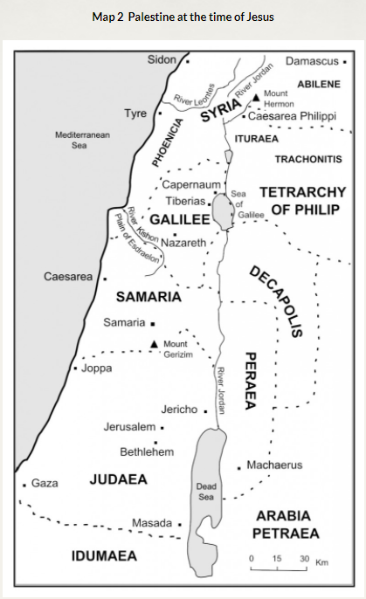
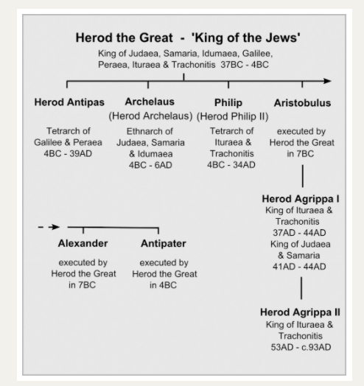
Luke 3:1 Now in the fifteenth year of the reign of Tiberius Caesar, Pontius Pilate being governor of Judaea, and Herod being tetrarch of Galilee, and his brother Philip tetrarch of Ituraea and of the region of Trachonitis, and Lysanias the tetrarch of Abilene,
Luke 3:1-3

Slide 11
ROMAN Emperors
Augustus 31 BC to 14 AD
Tiberius 14 AD to 37 AD
Caligula 37-41
Claudius 41-54
Nero 54-68
Vespasian 68-79
Titus 79-81

Slide 12
Approximate Dates (mine)
Jesus born (3 years off) (4 BC ? ) 1 AD
Jesus’ ministry 31-33 AD
Stoning of Stephen 34 AD
Conversion of Saul 34 AD
Saul in Damascus/Arabia 35-37 AD
Saul to Jerusalem 38 AD
Saul to Tarsus 38 AD
Saul fetched to Antioch
by Barnabas 41 AD
S& B to Jerusalem (Acts 12) 43/44 AD
1st Journey (Acts 13:3-14:26) 44AD
Paul to Jerusalem Council 52 AD
2nd Journey (Acts 15:40-18:22) 53-54 AD
3rd Journey (Acts 18:23-21:17) 55-60 AD
Paul to Rome (Acts 23:23-28:16) 60-63 AD
ROMAN Emperors
Augustus 31 BC to 14 AD
Tiberius 14 AD to 37 AD
Caligula 37-41
Claudius 41-54
Nero 54-68
Vespasian 68-79
Titus 79-81
Luke 3:1 Now in the fifteenth year of the reign of Tiberius Caesar, ….. is 29AD

Slide 13
John the Baptist placed into history and geography
Luke 3:1-3
1 Now in the fifteenth year of the reign of Tiberius Caesar, Pontius Pilate being governor of Judaea, and Herod being tetrarch of Galilee, and his brother Philip tetrarch of Ituraea and of the region of Trachonitis, and Lysanias the tetrarch of Abilene,
2 Annas and Caiaphas being the high priests, the word of God came unto John the son of Zacharias in the wilderness.
3 And he came into all the country about Jordan, preaching the baptism of repentance for the remission of sins;

Slide 14
Acts 2: Jews going to Jerusalem at Pentecost
The Age of Pentecost
Acts 2:1-7 ¹ And when the day of Pentecost was fully come, they were all with one accord in one place. ² And suddenly there came a sound from heaven as of a rushing mighty wind, and it filled all the house where they were sitting.
³ And there appeared unto them cloven tongues like as of fire, and it sat upon each of them.⁴ And they were all filled with the Holy Ghost, and began to speak with other tongues, as the Spirit gave them utterance. ⁵ And there were dwelling at Jerusalem Jews, devout men, out of every nation under heaven. ⁶ Now when this was noised abroad, the multitude came together, and were confounded, because that every man heard them speak in his own language.⁷ And they were all amazed and marvelled, saying one to another, Behold, are not all these which speak Galilaeans?

Slide 15
Acts 2: Jews going to Jerusalem at Pentecost
Acts 2: 8-12
⁸ And how hear we every man in our own tongue, wherein we were born?
⁹ Parthians, and Medes, and Elamites, and the dwellers in Mesopotamia, and in Judaea, and Cappadocia, in Pontus, and Asia,
¹⁰ Phrygia, and Pamphylia, in Egypt, and in the parts of Libya about Cyrene, and strangers of Rome, Jews and proselytes,
¹¹ Cretes and Arabians, we do hear them speak in our tongues the wonderful works of God.
¹² And they were all amazed, and were in doubt, saying one to another, What meaneth this

Slide 16
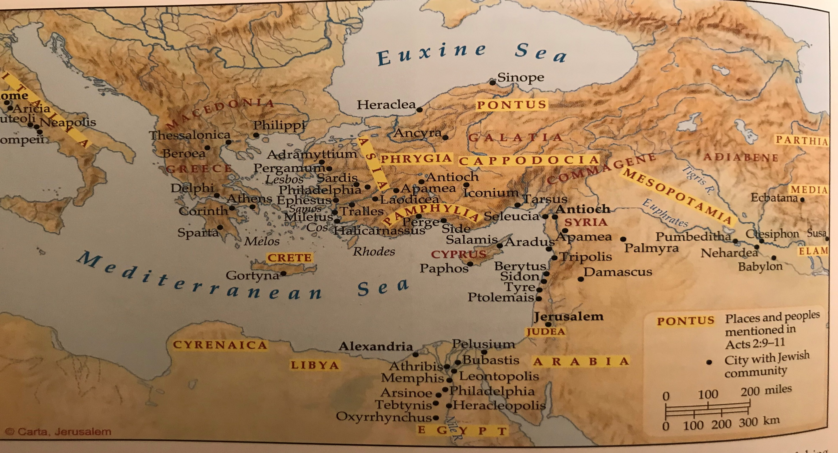
A Map of Mediterranean

