Slide 1

Army Rugby Advisory Committee (ARAC)
Leadership Call: 191115-001

Slide 2


Agenda
Roll call, by class (Dean)
Quick review of ARAC organizing document (purpose, objectives, structure) (lew)
Achievements to date (lew)
Review of Army Rugby vision + update on 2019 Fall season (Coach Sherman)
Areas of Emphasis & Immediate Focus (lew or Brian)
Alumni Brotherhood Legacy Weekend; March 20-22, 2019 (Coach, Dean, Jonathan, HR, Brian, lew)
Brothers Legacy Award
Communications Committee (Al & Pete)
Commitment Committee (lew)
  Description of Army Rugby alumni database efforts, and marketing tools available to AOG (Jonathan)
Call to Action (everyone)
Q&A/Discussion/Closing (everyone)

Slide 3
Roll Call: Kickoff Roster - Army Rugby Advisory Committee:
ARAC members:
  Chairman – Lew Boore
  Chairmen Emeritus – Coach Mike Mahan, Jerry Williams
  3 Co-chairs – Dean Dorman, Brian Mennes, HR MacMaster
  3 from 70’s – Dave Lemcoe, Frank Kearney, Jim Melesky
  2 from 80’s – Bill Coyle, John Oliver
  2 from 90’s – Chip Colbert, Jon Petrucelli
  3 from 00’s – Nate Conkey, Andy Locke, Tim Lawton
  2 from 10’s – Dave Geib , Andrew Borer
  Head Coach -- Coach Sherman
  1 Player Parent – Adam Smith
  2 Cadet Ruggers – Chris Berger <christopher.berger@westpoint.edu>, Jacob Ericksen <jacob.ericksen@westpoint.edu>
  Cadet / Officer Mentorship Program- Tim Lawton, Frank Kearney, Nate Conkey, Billy Marshall, Andrew Borer
  Legacy Award Committee- Coach, Bill Coyle, Frank Kearney, Nate Conkey
  Communications Directors- Al Hogue, Pete Patacsil
  Auction/gifts Committee - Dave Averett, Bill Marshall

Slide 4
Purpose
Purpose: The purpose of the Army Rugby Advisory Committee (ARAC) is to ensure the continuation of the honored traditions of Army West Point Rugby while providing the essential support necessary for a successful Top 1 D1A Rugby Program.
Committee Member Qualities:
  Strong Leader with passion for rugby and Army Rugby
  Willingness to commit time and effort to grow the Army West Point Rugby program support efforts
  Commitment to network actively among the Alumni within their respective decade
  Ability to meet the “Committee Member Commitments”
Term: 5 years (Fall-’18 thru Fall-’23); will rotate off smoothly over time
Committee Member Commitments:
  Approximately 2 calls/ year
  One 2+ hour face : face session at yearly Old Grey weekend
  Minimum $1K/ year donation standard (Coaches, Active Duty & Cadets exempt) – set example
  Attend Army Rugby Legacy Weekend: ARLW; (not necessary to play)
  Attend as many events as possible to support Coach’s vision
  Chairman and co-chairs + Coach on point for all coordination with AOG/ODIA representatives

Slide 5
Achievements to Date
Active Communications via the Legacy Ledger is successfully informing & mobilizing the Army Rugby community
Cadet/ Officer Mentorship Program underway ensuring proactive support & guidance
Attendance for “Old Gray”/ ARLW the highest ever
Established the “Brothers Legacy Award”, recognizing the accomplishment of Army Ruggers, Coaches and Contributors who have been instrumental in the success of USMA & Army Rugby
1st year Brothers Legacy Event a huge success (273 attendees) topping USNA Rugby “Hall of Fame” dinners and USMA Football banquets
Over $178,000 raised since the inception of ARAC! ($114k for Endowment/ $64k for “Friends of”)
However our work is not yet done. . .

Slide 6
Coaches Update:
2020 Update
Army West Point Rugby
Army West Point Rugby’s greatest need

Slide 7
Areas of Emphasis:
Communications: Inspiring the USCC, current Rugby Squad and Alumni alike, using new avenues of communications and social media
Fundraising: Within the guidelines provided by the ODIA and Head Coach
  Support Coach’s agenda
  Support Cadet development, major events, and trips
  Support needy kids to attend Army’s summer rugby camp
Non-Financial Support:
  Supporting the Coaching Staff & Admin Support whenever and wherever possible
  Supporting the team at home and away (“mini-reunions”)
Ensuring the Vision & Mission of the Coach is fully supported by Alumni
Army Rugby “Brothers Legacy Award”: Recognizing the achievements of the Trailblazers
Cadet Mentorship Program – Ensuring proactive support & guidance

Slide 8
Immediate ARAC Focus
Brothers Legacy Weekend & Banquet
Communications
Commitment
#1 Priority-> Drive Attendance
“Save the Date”
“Build the Buzz”
Hearts, Minds, Financial

Slide 9
Army Rugby Legacy Weekend & Event Overview
SAVE THE DATE: Saturday 21 March 2020 “Beat Penn State Weekend”
Friday, 20 March 2020
  Traditional informal practice attendance and reception within the guidelines provided by the ODIA and Head Coach
Saturday, 21 March 2020
  1000: Old Gray Match
  Beat Penn State!
  1800 2nd Annual Brother’s Legacy Event @ Kimsey Center
Sunday Morning: Traditional informal breakfast

Slide 10
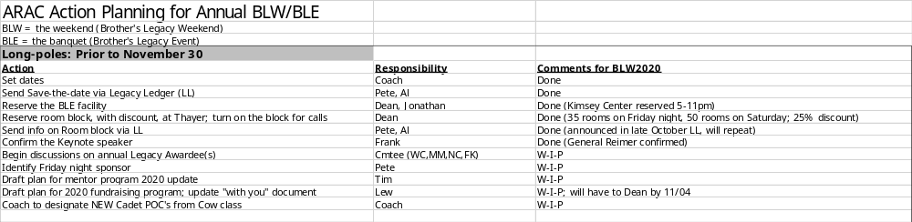
Army Rugby Legacy Weekend & Event Planning: Long Poles

Slide 11
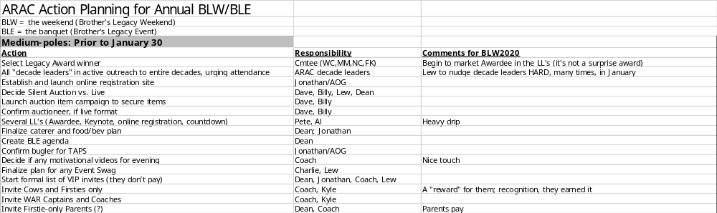
Army Rugby Legacy Weekend & Event Planning: Medium Poles

Slide 12
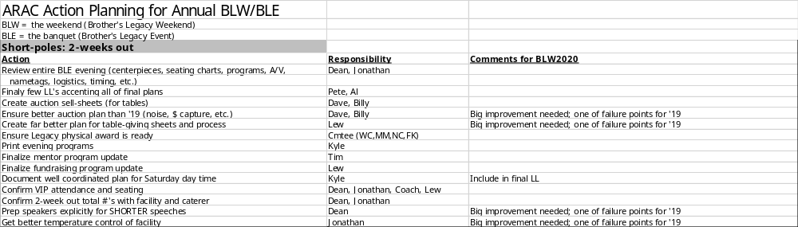
Army Rugby Legacy Weekend & Event Planning: Short Poles

Slide 13


Brothers Legacy: Army Rugby Legacy Award
Coach, Frank, Nate & Bill
Legacy Ledger & Historian:
Al & Pete

Slide 14
Commitment Committee
Structure: 1 Chair (lew), Jonathan and “Decade Leaders”
  Volunteers come from within your Decades
Description of Army Rugby alumni database efforts, and marketing tools available to AOG (Jonathan)
Objectives:
  Non-Financial Support:
    Promoting & motivating Alumni (w/in your decades) to attend Legacy Weekend & Banquet
    Supporting the Coaching Staff & Admin Support whenever and wherever possible
    Supporting the team at home and away (“mini-reunions”)
  Fundraising
    Support Coach’s agenda
    Support Cadet development, major events, and trips
    Support needy kids to attend Army’s summer rugby camp
    Working w/ AOG & within your decades to garner financial commitment
      Focus is motivating & getting commitment; NOT collecting
US: “Setting the Standard” – by giving
  Minimum $1K/ year donation standard (Coaches, Active Duty & Cadets exempt) – set example

Slide 15
Our Opportunity to Fund the Endowment
Army Rugby $250k Matching Gift Challenge
  Anonymous Rugby alum has pledged $250k to the endowment
December 3, 2019: Army West Point Giving Day
  Kick off campaign
  Live donor and dollar tracker competing with all other sports
Communications
  Email: Legacy Ledger, ODIA emails promoting Giving Day/MG Challenge
  Social: M. Rugby social channels to promote Giving Day/MG Challenge
  Phone: From A Club staff to Rugby alum asking them to support
Goal: Raise $250k from Rugby alums, friends and parents between 12/3/19-3/19/20
Announce we’ve hit the initial $1 mil endowment goal at BLE ‘20
  Introduce long-term endowment fundraising plan*

Slide 16

Call to ACTION
ARAC planning starts NOW!
The support starts NOW!
  Volunteers come from within your Decades
This is a TEAM effort!
What do YOU need for US to be successful?

Slide 17
APPENDIX

Slide 18
DRAFT Agenda: Brothers Legacy Event; 21 March 2020
Venue: Reception & Dinner @ Kimsey Center
Reception: 1700-1800
Dinner: 1800;
Dress: Coat & tie
Banquet Chair: Dean Dorman
DRAFT Agenda
  Welcome and remarks
  Additional opening remarks by 1 or 2 co-chairs (Mennes and/or McMaster)
  Welcome and update on Army Rugby by Coach Sherman
  Captain’s update
  KEYNOTE speaker (TBD) – GEN Reimer
  2nd “Army West Point Rugby Legacy Award” recipients
      Nominating Process SOP
      Recommendations for Award individuals to ARAC
      Plaque for A.R.C.
      10-15 minutes speech
  “CONTINUE to Raise the Bar”- The importance of involvement & the future of Army West Point Rugby- lew
  Decade Leaders showcasing 2019 commitments thus far (Decade Leaders)
  Quick update from Cadet Mentor Program Leader Tim Lawton
  Live Auction (items to be show-cased at the reception) (Dave A)
  Closing remarks by Dean
Additional:
  Fundraising:
    Need to brainstorm; examples
      Could we get a sponsor of the reception, and dinner? (Corporate/ Individual)
      Commemorative Rugby balls for "donations“
      Challenge Coins
      Weekend summer homes, trips, etc.
      Class competition for donations (platinum, gold, silver, etc.) -- expecting the ARAC “decade leaders” to work their respective decade
Other Topics
  Website – lew ( & Charlie M)

