Slide 1
Invertors Prospectus

Slide 2
Investor Prospectus
General Procedures
A project will be researched and proposed.
Investors will be identified.
The project budget and timelines will be generated.
Promissory Notes are executed.
The project gets funded and moneys is put into an account.
The project begins within 15 days of funding.
Project is completed.
Home is sold.
Promissory note is paid off.

Slide 3
Promissory Note
A promissory Note will be drafted and executed by the investor and Therma-Star, with the following terms:
Each note will be for a term of 4 months.
Annual interest is 12% plus a 1% origination fee.
Total payed back to the investor in 120 days is the total principal plus $7,500.
The note will be secured with the property involved with the project.
Should the project exceed the 4 months then there is a 1% penalty as well as the ongoing interest.
The note will be administered with a well-known financial instruction such as Quest Trust Company.

Slide 4
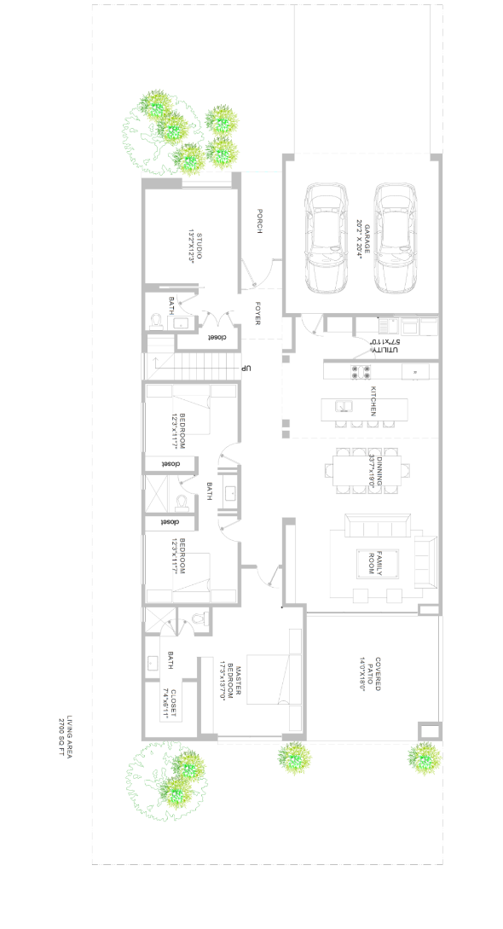
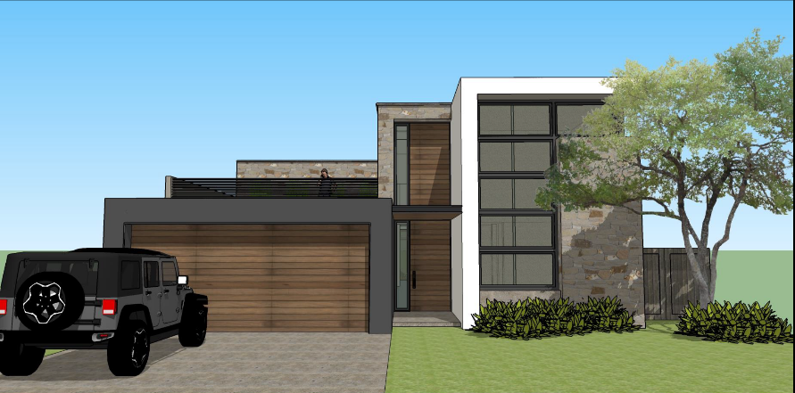
A Sample Project
An example of a home project. This is only an example and actual projects will vary.
An Affordable home.
Open floorplan.
Stucco and stamped brick.
Modern design.

Slide 5
2901 W. Parker Rd
P.O. Box 863241
Plano, TX 75086
Https://therma-star.com
+1-817-846-7900
“Do Good by Doing Good”

