Slide 1
General Meeting #2
August 6, 2023
2023-2024 Season

Slide 2
AGENDA
- Welcome
Secretary and District 14 Representative Reports
Financial Report
President’s Report
Vice President’s Report
Assignor’s Report
Members-At-Large Report
Door Prizes
Notes:
Welcome everyone to the 2023 season. There is always A LOT of information to cover in our first meeting so let’s get started.

Slide 3
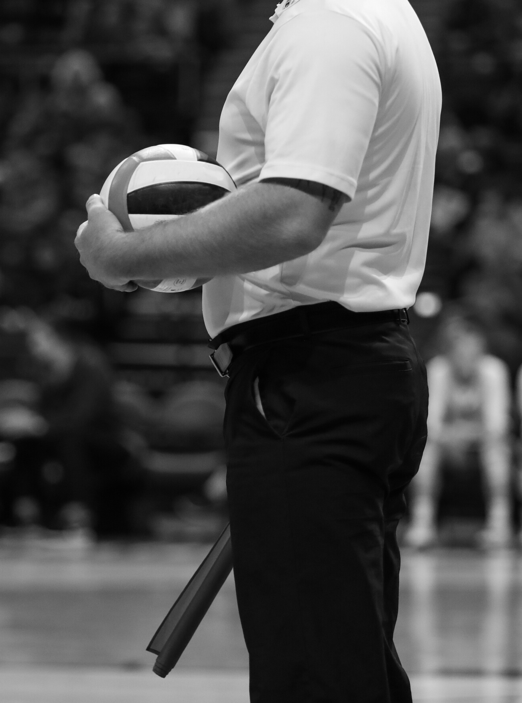
BVTASO Minutes
TASO Executive Board Recap
Karen Mitchell
- BVTASO Secretary
- TASO District 14 Representative

Slide 4
BVTASO Financial Report
Dorothy Nevill
- BVTASO Treasurer

Slide 5
BVTASO President’s Report
Wally Simpson
- BVTASO President

Slide 6
State Meeting Highlights
Getting the Season Started
BVTASO Officials Spotlight
Looking forward
Notes:
Thomas and Steve have a lot of information to cover so I want to get through this ASAP.

Slide 7
TASO Annual Meeting Recap
Emphasis on Sportsmanship
- State Law passed banning anyone who is charged with assaulting a referee for no less than 1 year (up to 5 years) from attending ALL athletic activities of their respective school.
- UIL, TAPPS and TASO are still wanting to monitor abusive behavior, but Incident Reports will NOT have to be completed for Yellow Cards issued for Unsporting Conduct Warnings. Red Cards and Ejections will still need to be reported through the TASO website. Continue to notify me or Thomas of ALL incidents of unsporting behavior that you feel needs to be addressed.

Slide 8
TASO Annual Meeting Recap
10-Year Pay Plan in effect
All match rates have increased $5 for all levels.
Portal-to-Portal mileage rates have been updated to abide by State of Texas mileage reimbursement rates. This is ONLY for Portal-to-Portal and does NOT impact the Travel Rings.

Slide 9
TASO Annual Meeting Recap
Rule Changes and Points of Emphasis
Steve will address in the Vice President’s Report.

Slide 10
TASO Service Award Winners
Five Year Service Awards
Debra Abbott Shonecra James
Breanne Brown Omar Joglar
Paul Brown Tomeka Johnson
Yarbarnette Brown Jerry Jones
Rodney Cheshire Alma Malcolm
Jelani El-Rahim Lana Maurer
Kim Fox Michelle Prejean
Donna Hull Bay Trojacek

Slide 11
TASO Service Award Winners
Ten Year Service Awards
Harold Cano
Germariyea Mott
Jerry Paceley
Kelsey Robinson
Steven Wohlschlaeger
Jean Morgan (13)

Slide 12
TASO Service Award Winners
Fifteen Year Service Awards
Elias Hernandez
Russell James
Al Schipplein
Dietrich Shepard

Slide 13
TASO Service Award Winners
Twenty Year Service Awards
Ross Skillman

Slide 14
TASO Service Award Winners
Thirty Year Service Awards
Bill Buller
JoAnn Gibson
Charles Bennett (33)

Slide 15
Getting the Season Started
Registration and Dues
EXPIRED
Must register or renew, pay TASO (State) dues, and
successfully complete a Background Check.
Go to www.taso.org.
TASO new official registration and membership renewal must be completed by midnight, August 1.

Slide 16
Getting the Season Started
Local – Brazos Valley Chapter TASO (BVTASO)
Pay BVTASO Local Chapter Dues and Assigner Fee
Online www.bvtaso.org “Resources” Tab, or
Directly to Treasurer at Chapter Meeting
Register on Arbiter and Setup Arbiter Pay
Local Dues, Assigner Fee and Arbiter set up must be completed before you can be scheduled to ref.

Slide 17
Getting the Season Started
Complete educational component
First-year and second-year officials must complete both BVTASO online training sessions AND on-court training.
All officials must have either attended the Annual State Meeting, a Regional Clinic or complete the online TASO training modules.
All training must be completed before midnight, August 13.

Slide 18
Getting the Season Started
Complete educational component
First-year and second-year officials must complete both BVTASO online training sessions AND on-court training.
All officials must have either attended the Annual State Meeting, a Regional Clinic or complete the online TASO training modules.
If you haven’t already, be sure to pick up your Rule Book and Case Book. More books are on the way…
All training must be completed before midnight, August 13.

Slide 19
Getting the Season Started
Successfully complete and pass the
TASO Volleyball Exam
Must score a MINIMUM of 70 to be able to be eligible to be scheduled as an official (R1, R2 or LJ).
To be eligible to officiate Playoff Matches (R1, R2 or LJ), you MUST score at minimum of 90 on the exam. NO EXCEPTIONS. This is now a State-wide TASO mandate.
Online Test was available July 12.
Test must be taken and passed before midnight, August 13.

Slide 20
Getting the Season Started
Other Deadlines
August 15 – 15% BVTASO discount on all apparel and officiating equipment expires. Use code BVTASOVB23 at www.UmpJunkSA.com.
ALL criteria must be taken care of before you can be scheduled for any matches.

Slide 21
Getting the Season Started
Purchase necessary uniforms and equipment
Uniforms
Black dress pants (warm up pants not acceptable)
Black belt, black shoes, black socks
White or grey TASO polo. White is the default, but grey can be worn WHEN BOTH OFFICIALS AGREE. R1 & R2 must wear the same color polo. Paid line judges must match, too. 4-person crew could all be one color or R1 & R2 can match and LJs can match.
White TASO sweatshirt or zipper jacket can be worn. If zipper jacket, it must be zipped up.
Undershirt, if worn, must be white.

Slide 22
Getting the Season Started
Purchase necessary uniforms and equipment
Equipment
Black whistle (Fox 40 HIGHLY recommended), with solid black lanyard (pink whistle and lanyard allowed during October in honor of Breast Cancer Awareness Month)
line judge flags
net height chain
yellow/red cards
air pressure gauge, pump, needles
pens, lineup cards

Slide 23
Getting the Season Started
Additional items…
Paperwork
Match paysheet (keep extra copies with you just in case)
W-9 form (keep extra copies with you just in case)
Travel Fees List
Match Fees/Tracker sheet
Scoresheets
Libero tracker sheets
Better to have it and not need it than need it and not have it.
Notes:
Where can find all of this???

Slide 24
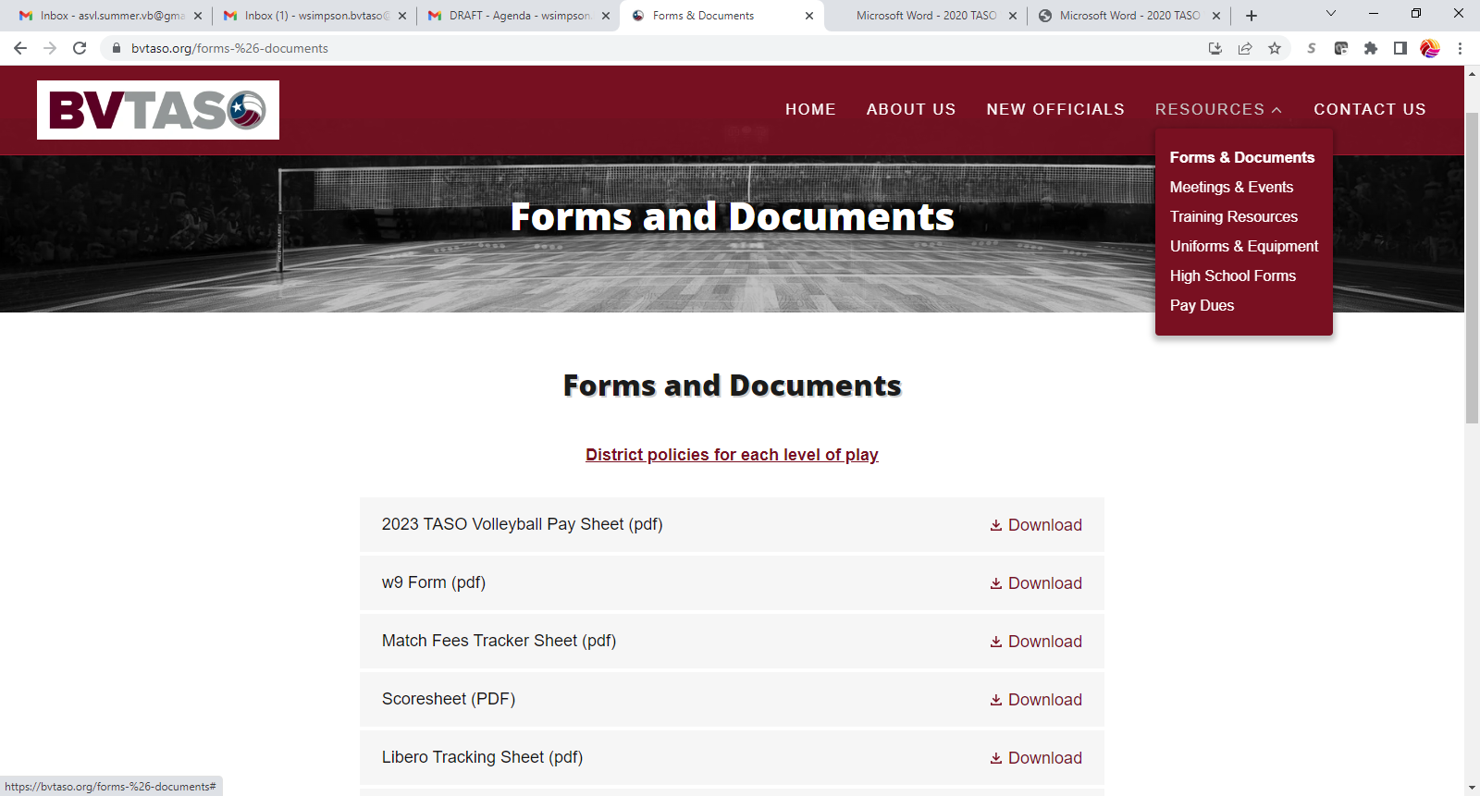
Getting the Season Started
Additional items…

Slide 25
Getting the Season Started
TASO Policies - All policies are found on the TASO website. Download and follow these policies. Failure to do so can result in disciplinary action.
Code of Conduct Policy - Details the principles and standards by which officials must operate.

Slide 26
Getting the Season Started
TASO Policies
Social Media Policy – Provides guidelines and parameters whereby officials are to refrain from posting anything that could embarrass or tarnish the reputation or image of TASO, the BVTASO chapter, any TASO member or the schools and programs we cover.
Officials are to refrain from making any comments online regarding their assignments or TASO duties, the results of their matches, performance of any other official, coach, player, fans, etc.

Slide 27
Getting the Season Started
TASO Policies
Social Media Policy (cont.) - Social Media connections with coaches, athletic directors, players, sports media or any other participants should be avoided.
Violation of the Social Media Policy may result in disciplinary action ranging from private reprimand to expulsion and may include fine, probation, suspension, or combination of punishment as deemed appropriate by the Chapter Executive Board.

Slide 28
Getting the Season Started
TASO Policies
Conflict of Interest Policy – Officials cannot accept any assignment if any of the following exist:
the assignment did not come from the Assigning Secretary.
You are a student at the school, or you or your spouse attended or worked at a school in the last 5 years.
You are your spouse are employed by the school district.
You are related by blood or marriage to a person affiliated with a team involved in a contest.
Had a child that attended the school in the last 2 years.
And more.
Check the policy on the TASO website.
Notify Thomas of any teams you will not be able to officiate due to a conflict of interest listed in this policy.
Notes:
Again, you ask…where can I find these policies because I know I must read them and abide by them???

Slide 29
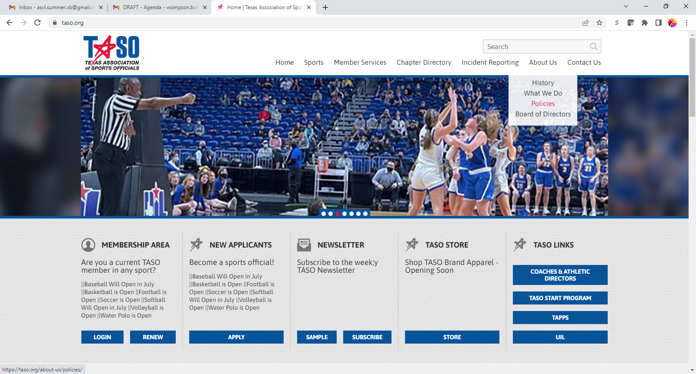
Getting the Season Started
TASO Policies

Slide 30
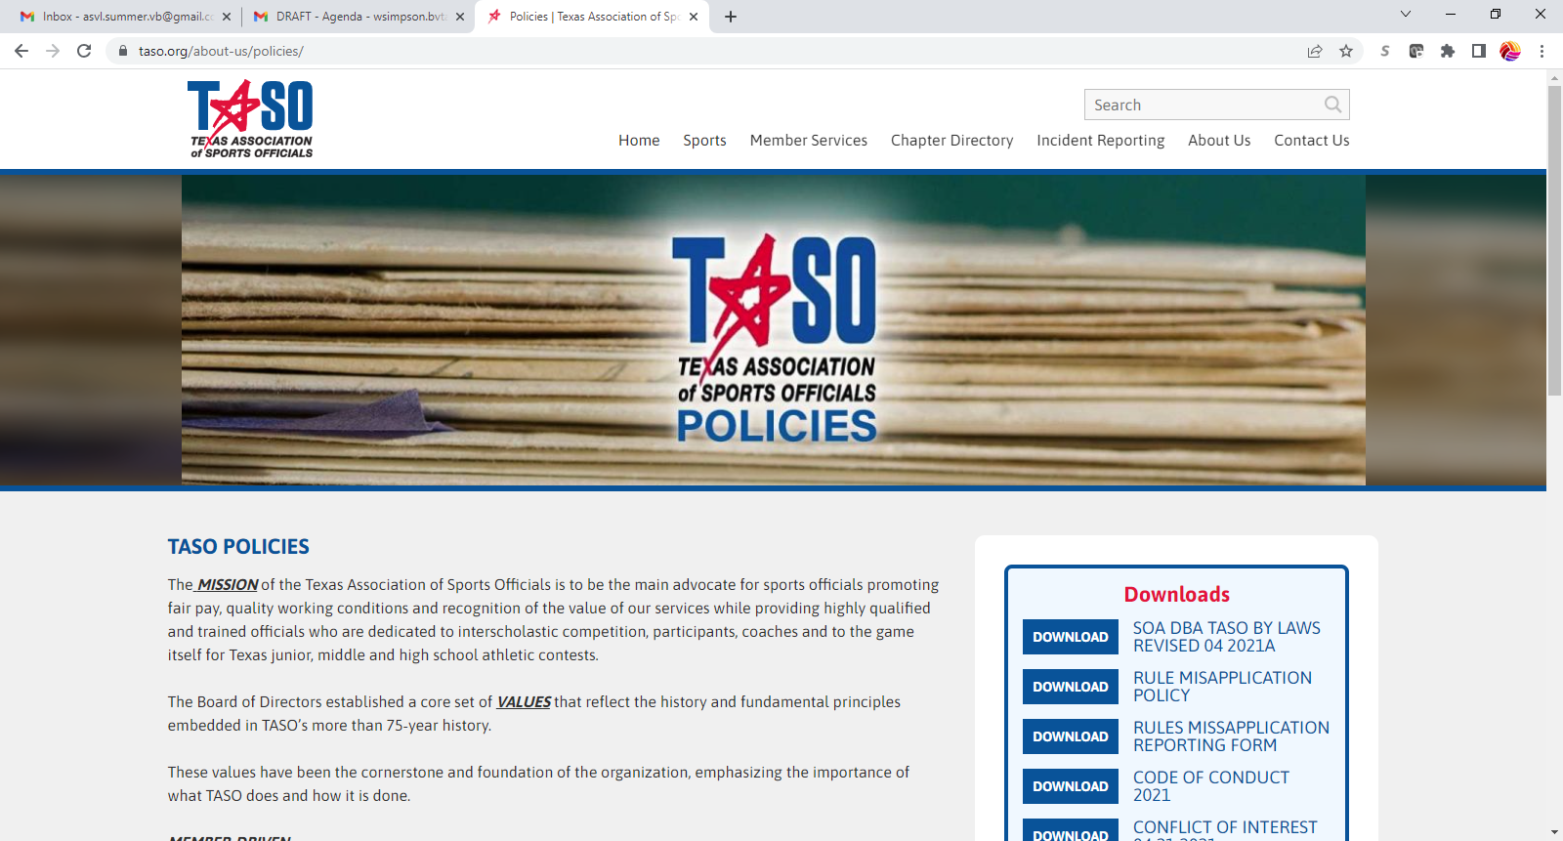
Getting the Season Started
TASO Policies

Slide 31
BVTASO Officials
Doing Great Things!!!
Notes:
With the new policies adopted by UIL on coaches being allowed to negotiate for their own officials through more levels of the playoffs, many more officials earned the chance to officiate at higher level matches. The Brazos Valley Chapter is very highly regarded as one of the chapters that goes very deep in quality officials. I want to take this opportunity to let you know about the job that many did.

Slide 32
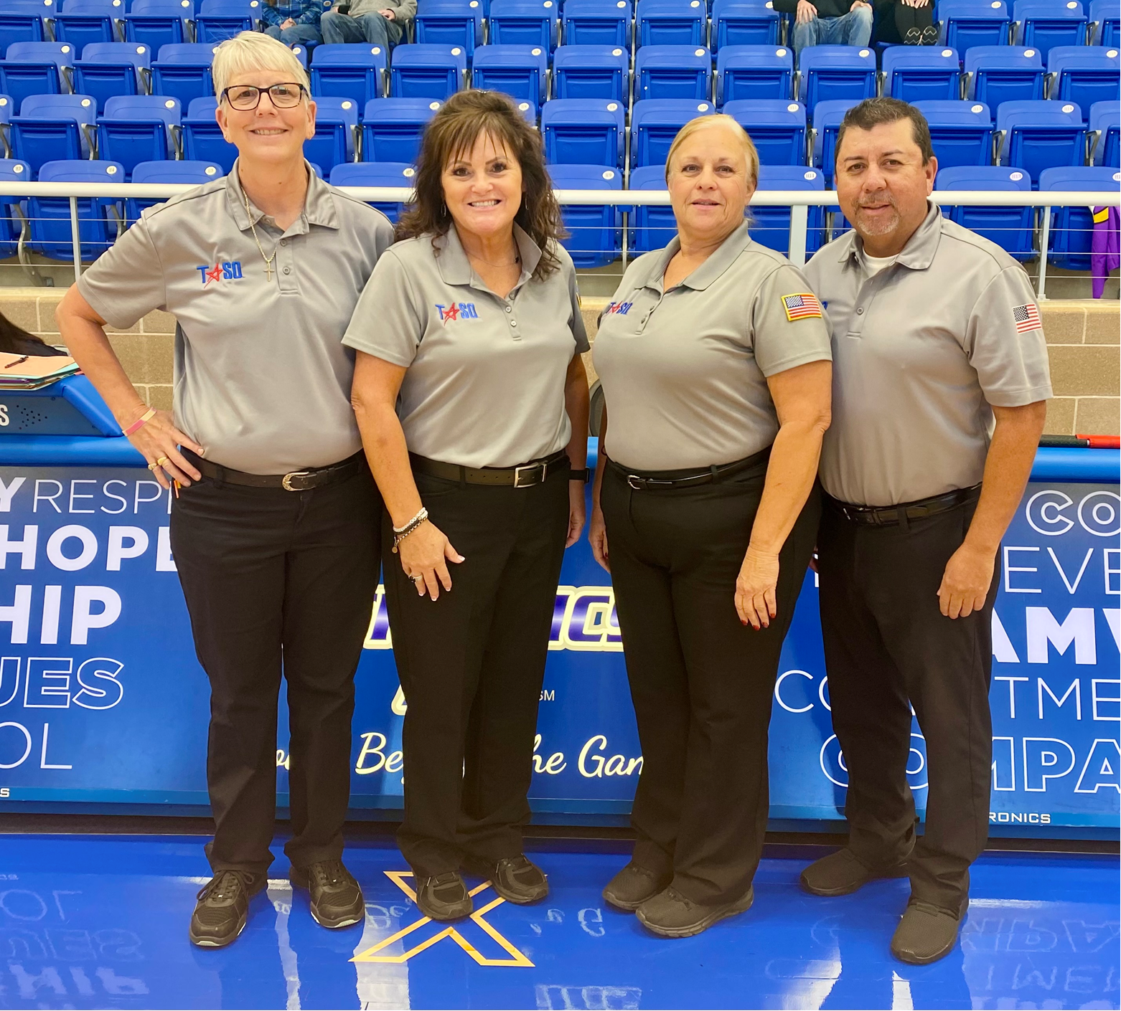
CONGRATULATIONS !!!
Exceptional BVTASO Officials at work
Caroline Simpson (R1)
Judi Delesandri (R2)
Sallie Bennett (L J)
Harold Cano (L J)
- - - - - - - -
5A – Region IV Championship
- - - - - - - -
Leander Rouse vs Liberty Hill

Slide 33
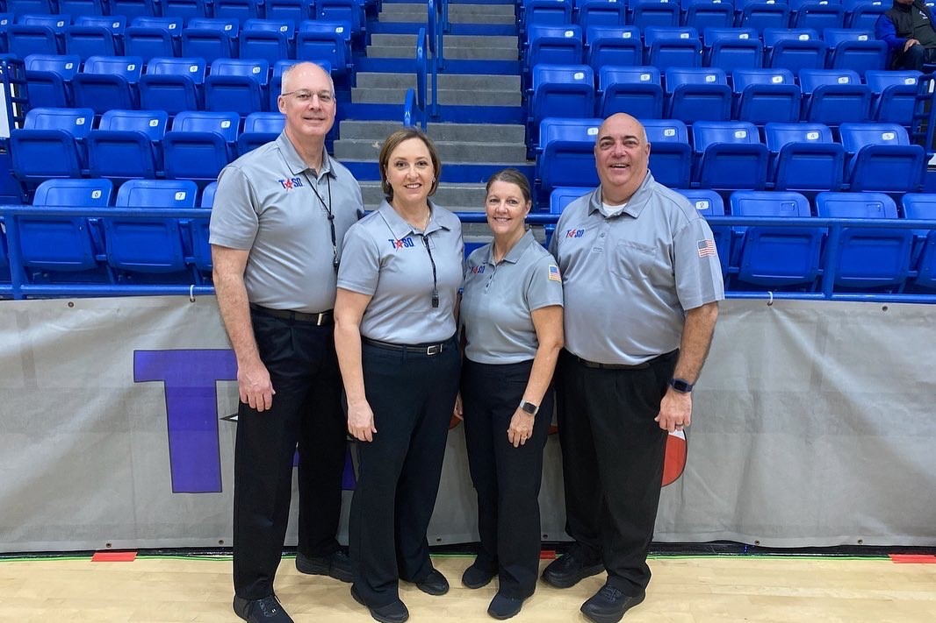
CONGRATULATIONS !!!
Exceptional BVTASO Officials at work
Steve Wohlschlaeger
Melissa Fadler
Karen Mitchell
Wally Simpson
- - - - - - - -
2A TAPPS State Championship
- - - - - - -
6A TAPPS State Semifinals

Slide 34
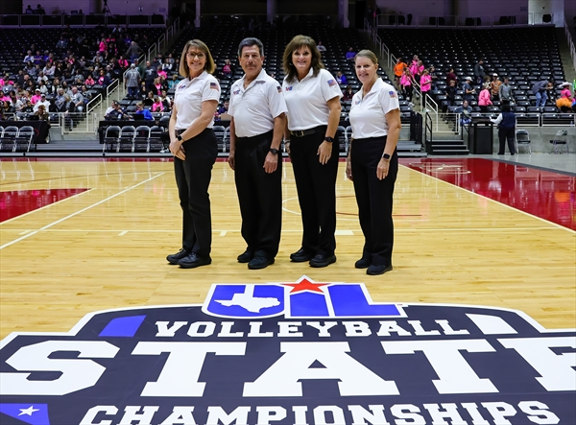
CONGRATULATIONS !!!
Exceptional BVTASO Officials at work
Judi Delesandri (R1) Karen Mitchell (L J)
- - - - - - - -
2A State Semifinal
- - - - - - - -
Jewett Leon vs Lindsay

Slide 35
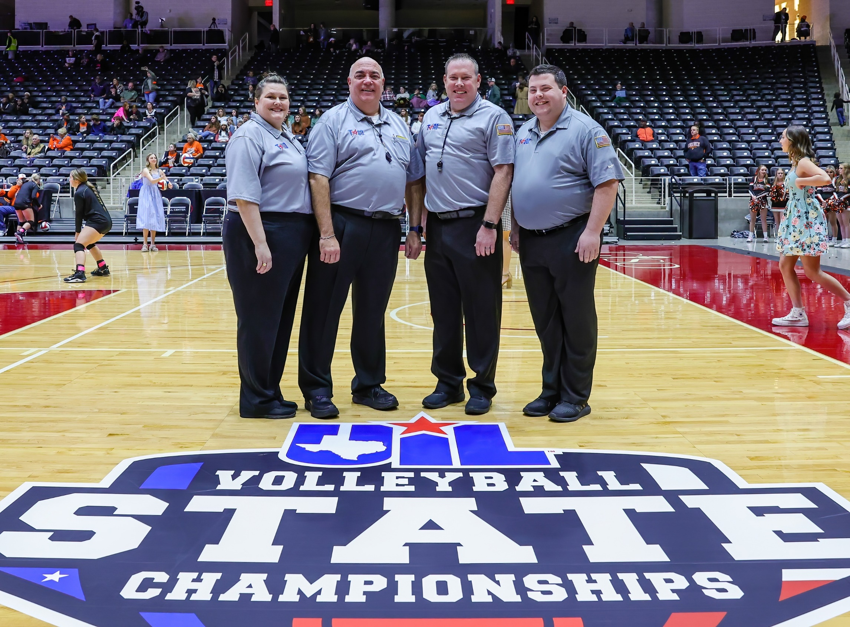
CONGRATULATIONS !!!
Exceptional BVTASO Officials at work
Wally Simpson (R1)
Kim Fox (L J)
- - - - - - - -
2A State Semifinal
- - - - - - - -
Windthorst vs Schulenburg

Slide 36
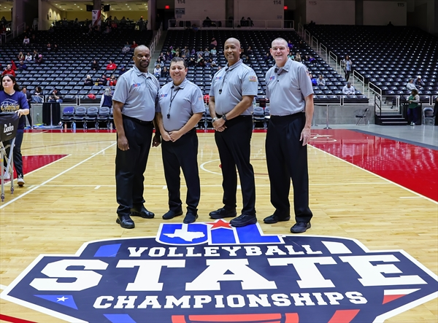
CONGRATULATIONS !!!
Exceptional BVTASO Officials at work
Harold Cano (R2)
Billy Ross (L J)
- - - - - - - -
5A State Semifinal
- - - - - - - -
Colleyville Heritage
vs
Montgomery Lake Creek

Slide 37
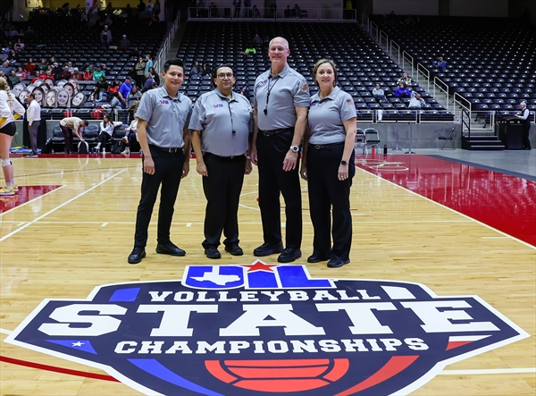
CONGRATULATIONS !!!
Exceptional BVTASO Officials at work
Steve Wohlschaeger (R1)
Melissa Fadler (L J)
- - - - - - - -
6A State Semifinal
- - - - - - - -
The Woodlands
vs
Dripping Springs

Slide 38
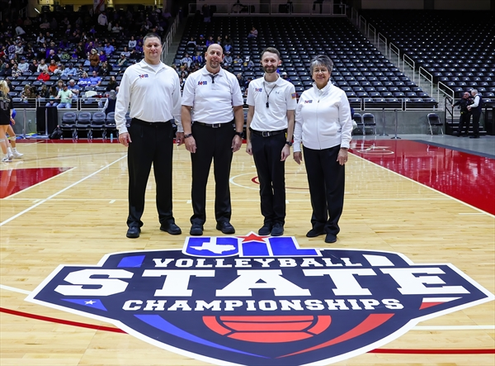
CONGRATULATIONS !!!
Exceptional BVTASO Officials at work
Thomas Walkoviak
- - - - - - - -
3A State Championship (L J)
Gunter vs Bushland
- - - - - - - -
4A State Championship (R1)
Aubrey vs Canyon Randall

Slide 39
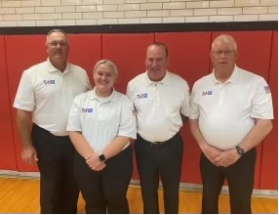
CONGRATULATIONS !!!
Exceptional BVTASO Officials at work
Charles Bennett (R1)
Jerry Paceley (L J)
- - - - - - -
Texas Girls Coaches Association
1A – 4A All Star Game

Slide 40
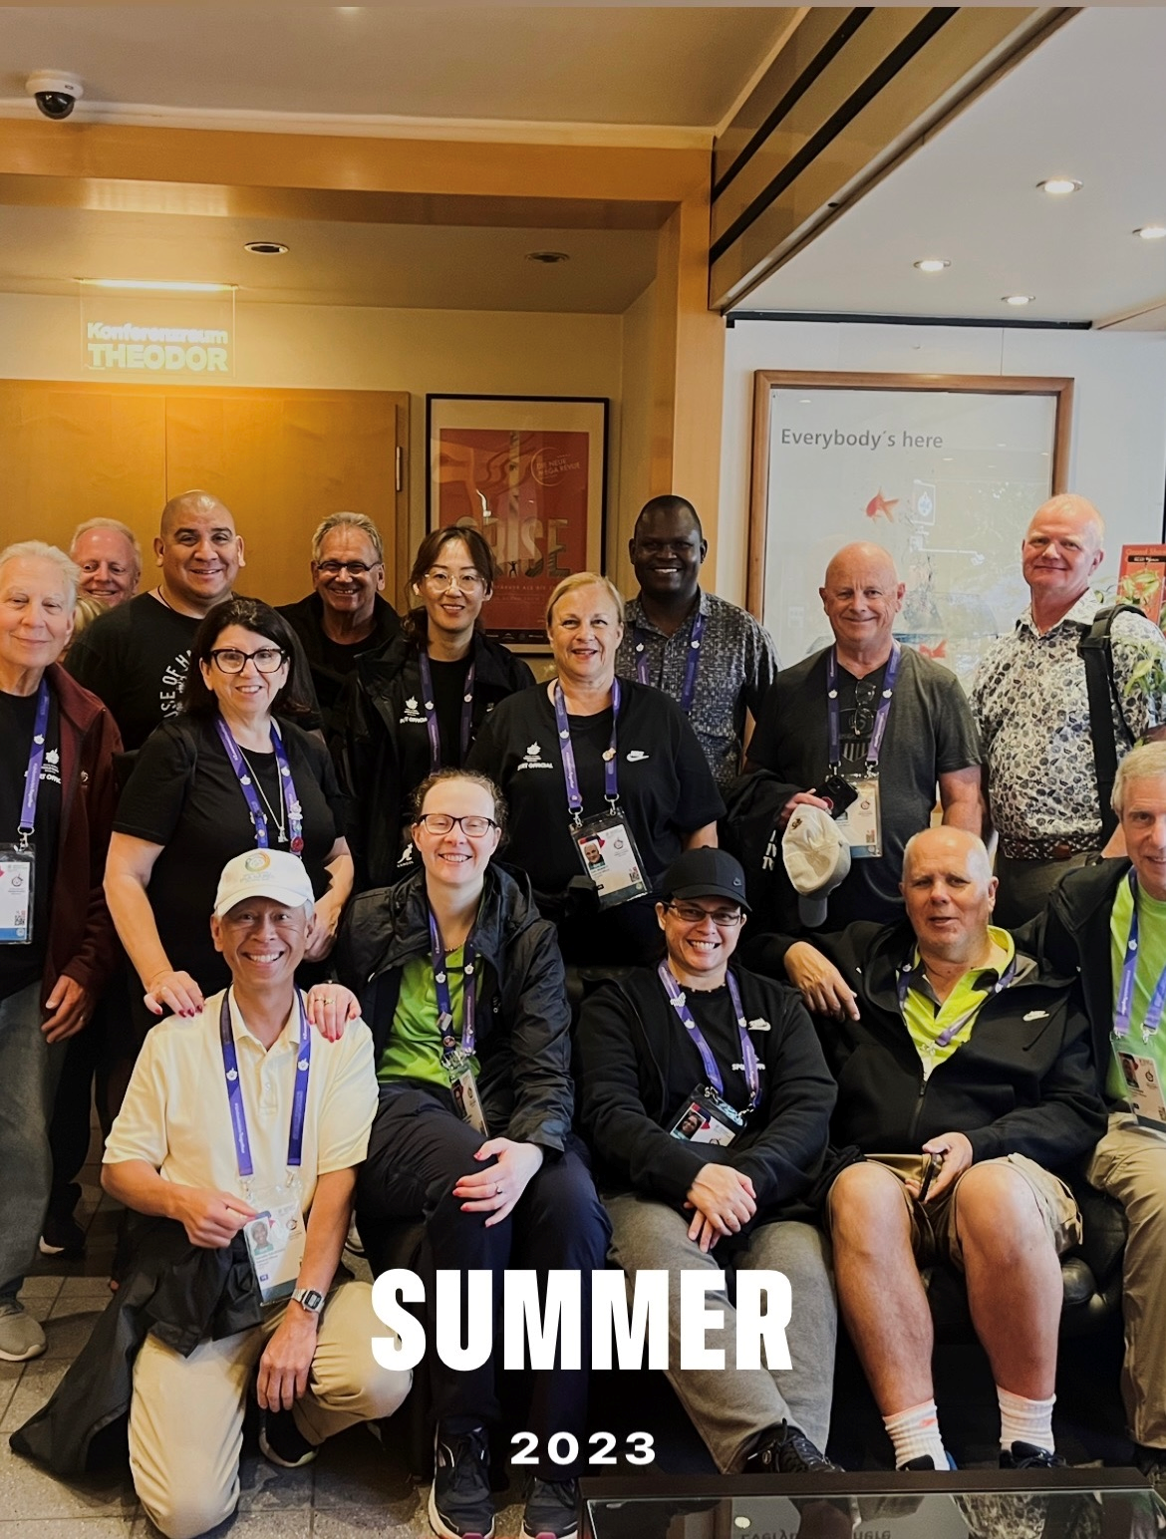
CONGRATULATIONS !!!
Exceptional BVTASO Officials at work
Sallie Bennett
- - - - - - -
Special Olympics World Games
Notes:
This is a HUGE accomplishment as it represents her exceptional officiating at the international level with a very rewarding experience working with special atheltes.

Slide 41
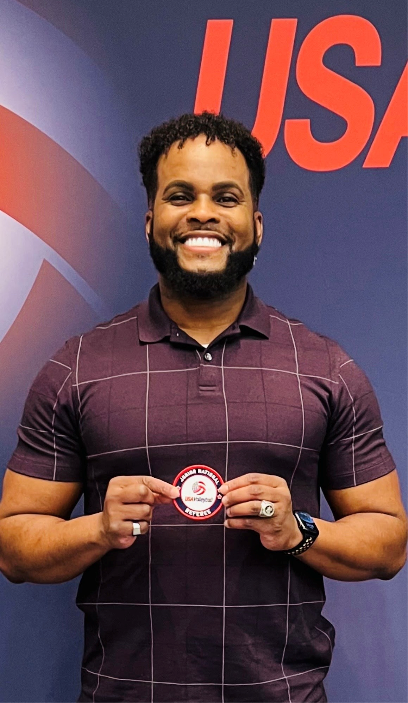
CONGRATULATIONS !!!
Exceptional BVTASO Officials at work
Wil Jefferson
(Dual member with HAVOC)
- - - - - - -
USAV Junior National
Official

Slide 42
CONGRATULATIONS !!!
Exceptional BVTASO Officials at work
Kudos go out to ALL the BVTASO officials worked not only throughout
the Lone Star Region,
but all over the country for
USAV and AAU tournaments.
GREAT JOB!!!

Slide 43
Update
Mark Giles
Adar Healthcare and Wellness
600 Bacon Street
Madisonville, TX 77864

Slide 44
Looking forward – What’s Next?
#1 – Take care of your business.
#2 – Accept your assignments.
#3 – Keep attending the meetings.
#4 – HAVE FUN!!!
Future business…
Notes:
#1 – Take care of what is needed to be eligible to officiate.
#2 – Assignments. First up – scrimmages. Opportunity to blow the dust out of your whistle or get back to the school-ball way of doing things. Lead officials will be giving feedback as well.
#3 – Not only is this the best way to stay informed of what’s going on in the chapter, but we need your participation. Expect upcoming changes recommended to our Constitution and Bylaws. This Chapter extends from Schulenburg/Flatonia to Lufkin. I want to increase the number of Executive Board members to include representation from the far west and far east areas to get them involved more and keep our efforts connected throughout the entire chapter.
#4 – And most importantly, HAVE FUN THIS SEASON.

Slide 45
BVTASO
Vice President’s Report
Steve Wohlschlaeger
- BVTASO Vice President

Slide 46
BVTASO
Assigning Secretary’s Report
Thomas Walkoviak
- BVTASO Assigning Secretary

Slide 47
BVTASO
Members At Large Report
Harold Cano, Melissa Fadler, Kim Fox, Billy Ross
- BVTASO Members at Large

Slide 48
Lucky Number Time!!!
Thank you to UmpJunk for providing the door prizes
this season.

